Slide 1
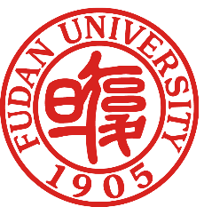

^{p-process chaser detector}
The Workshop on Photonuclear Science in 2025 Shanghai
Reporter: Yifan Liu
Team Members: Hiroaki Utsunomiya (Team Leader), Yugang Ma (Advisor), Gongtao Fan, Xiangai Deng , Yifan Liu , Hao Zirui,
Liyong Zhang, Baohua Sun, Jianjun He, Hongwei Wang, Dan Filipescu,
Ioana Gheorghe, Taka Kajino,
Stéphane Goriely, Y-W. Lui

Slide 2
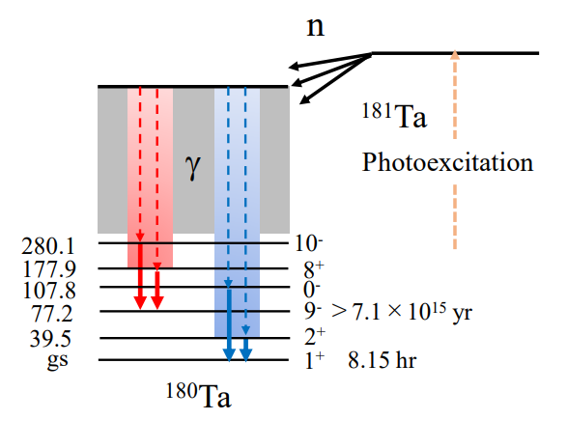




We perform n-γ₁-γ₂ triple coincidence measurements by chasing the p-process.
s-wave
¹⁸¹Ta(γ, n)¹⁸⁰Ta
9/2-, 7/2-, 5/2-
15
5-, 4-, 3-, 2-
$$Ex [MeV]$$
10
$$2ℏ$$
$$5ℏ$$
Cross talks
E1
5
S_{n}=7576 keV
1
1⁺
9⁻
181Ta
7/2+
0
5
10
15
$$J [ℏ]$$
2
30

Slide 3
1. Detector Geometry
2. Detection Efficiency Simulation and Optimization
3. The Influence of the Self-Absorption Effect
3

Slide 4
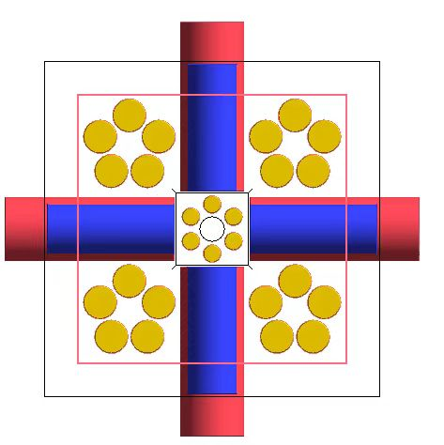
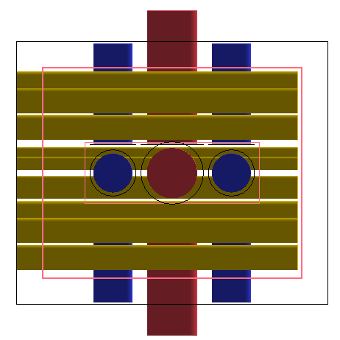
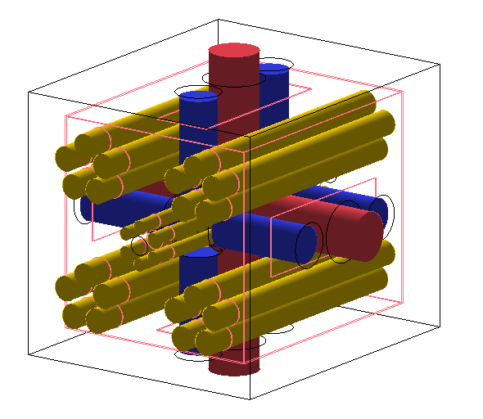
Geant4 - Detector Geometry
Yellow cylinders: He-3 neutron counters for detecting neutrons (20 × 2-inches + 6 × 1-inch)
Pink cylinders: HPGe detectors for detecting γ-rays (2 × 80mm × 70mm + 2 × 73mm × 73mm)
Blue cylinders: LaBr₃ detectors for detecting γ-rays (8 × 76.2mm × 101.6mm)
Inside the Pink wireframe: HDPE (High-Density Polyethylene) — Neutron moderator
Between the Pink and Black frame: to shield background neutrons from outside
4

Slide 5
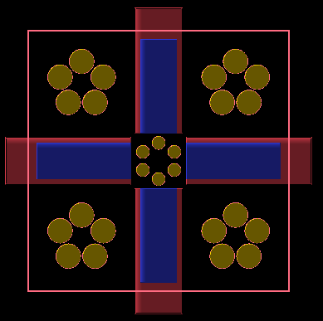
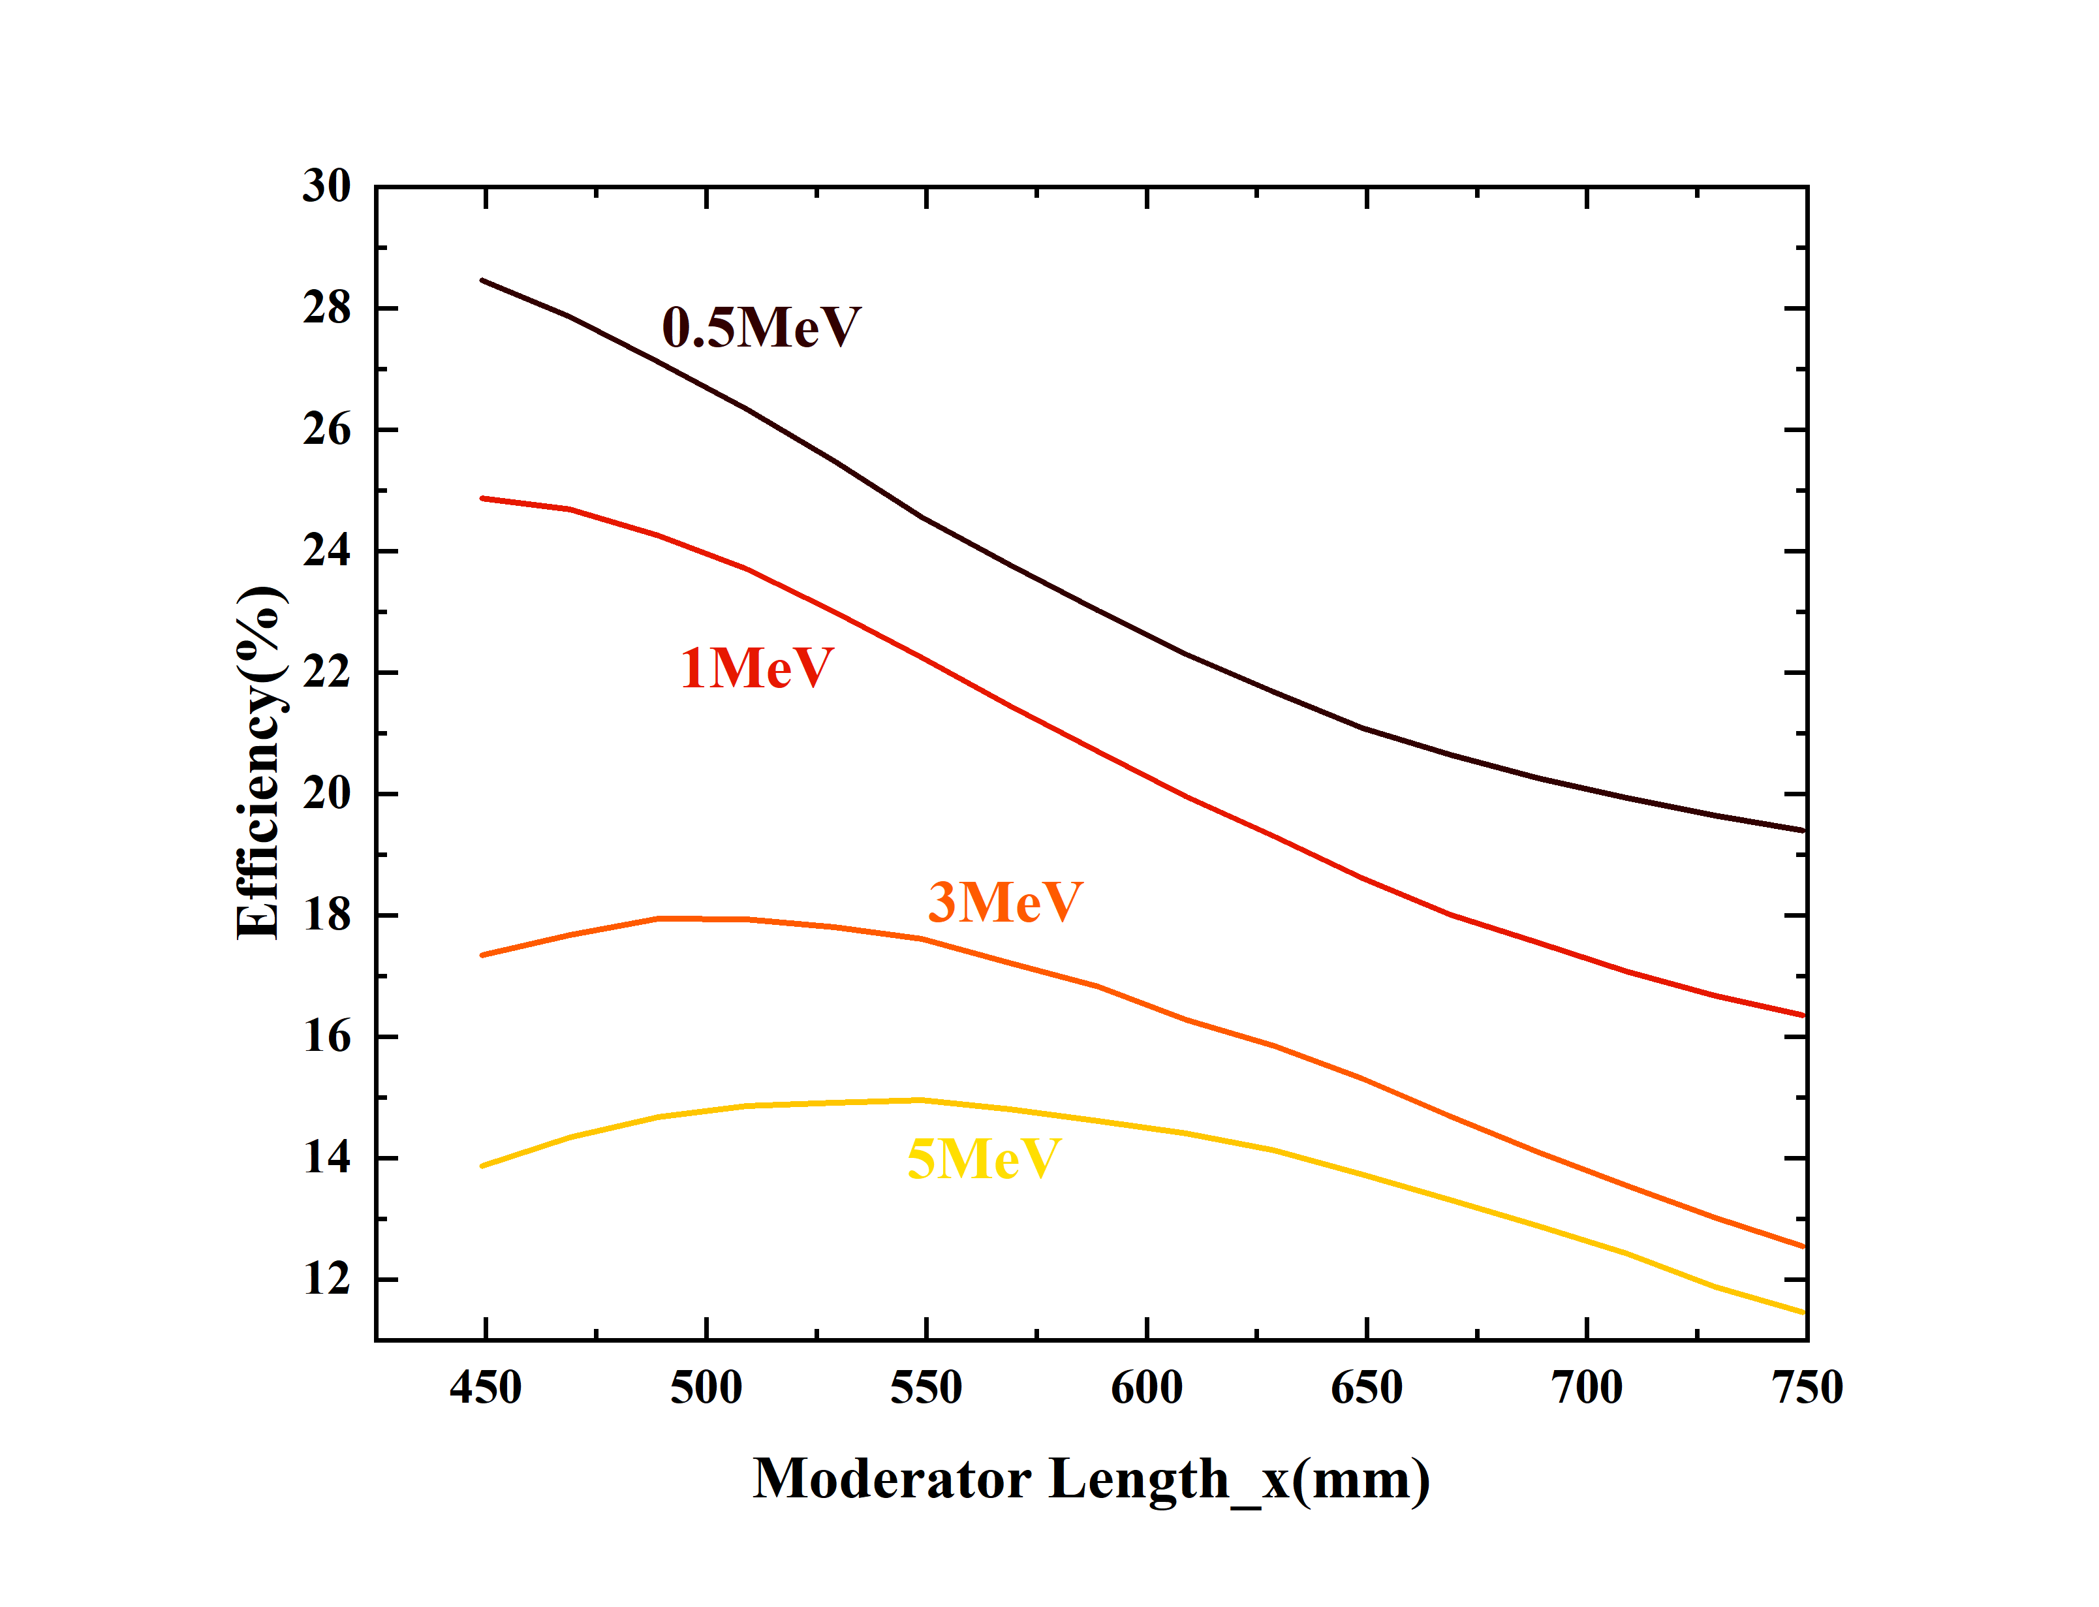
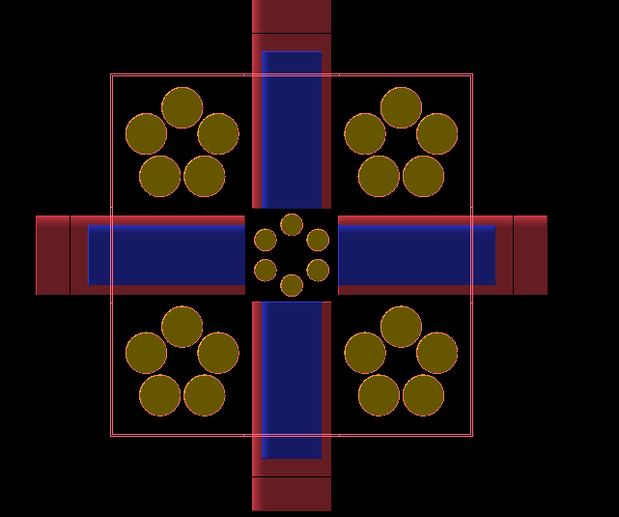
Detection Efficiency Simulation and Optimization (neutron)
Plan A:
  Keep the center of the pentagon formed by the ³He counters aligned with the center of the moderator in that area;
  The side length of the pentagon remains fixed.
To cover the broad neutron energy range→Moderator Length_x=479mm
5

Slide 6
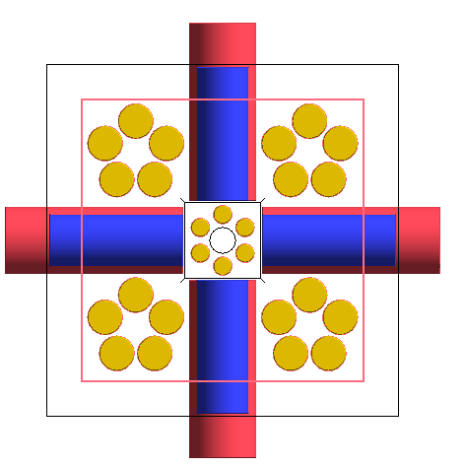
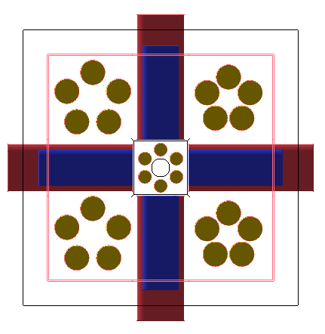
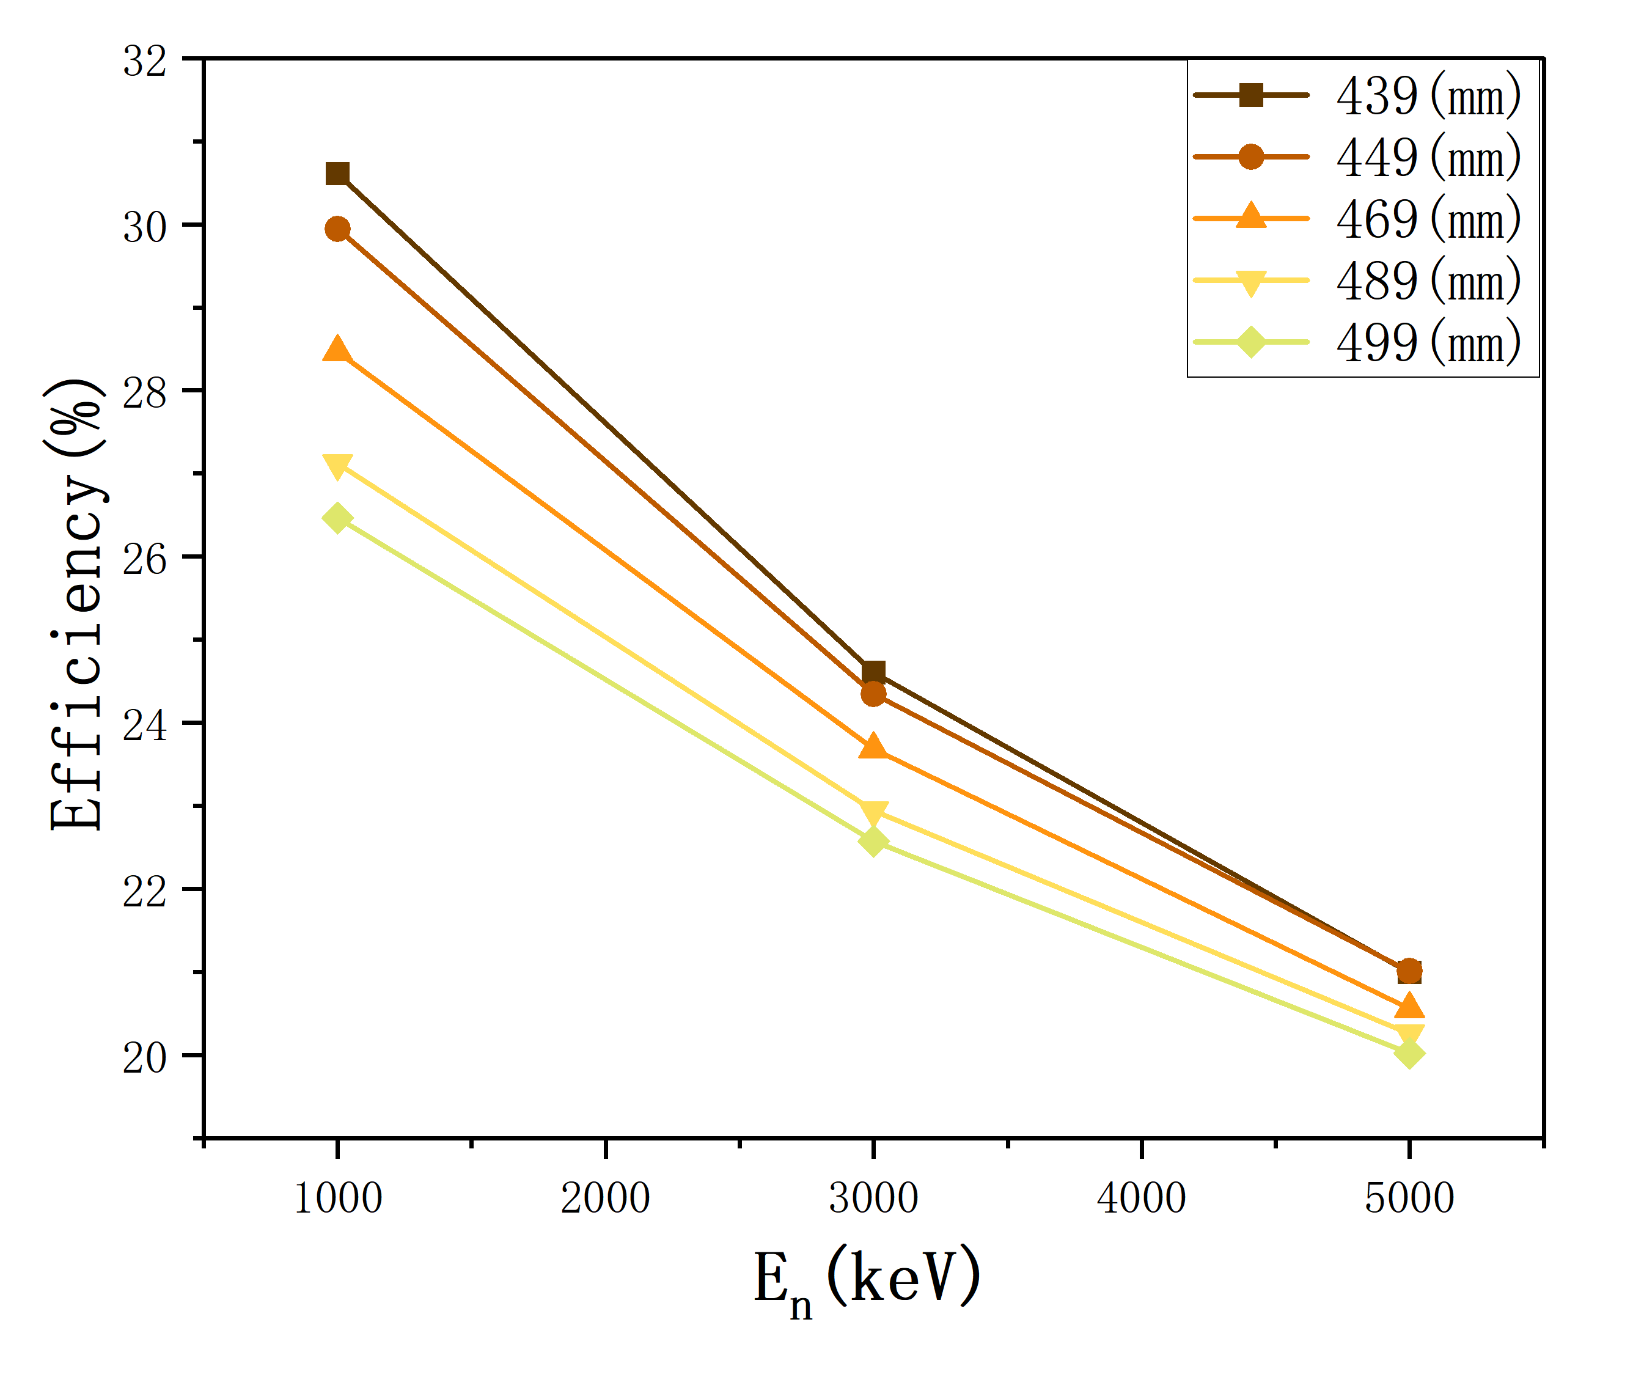
Detection Efficiency Simulation and Optimization （neutron）
Plan B:
  Keep the same center
  Change the side length of the pentagon— making it as large as possible to fill the area
Neutron detection efficiency improves slightly with reduced moderator length.
Detection efficiency improves with greater dispersion of ³He tubes.
6

Slide 7
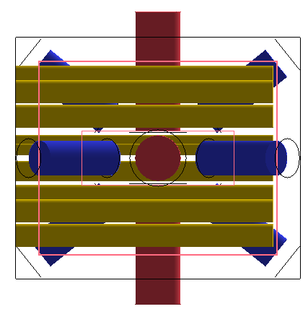
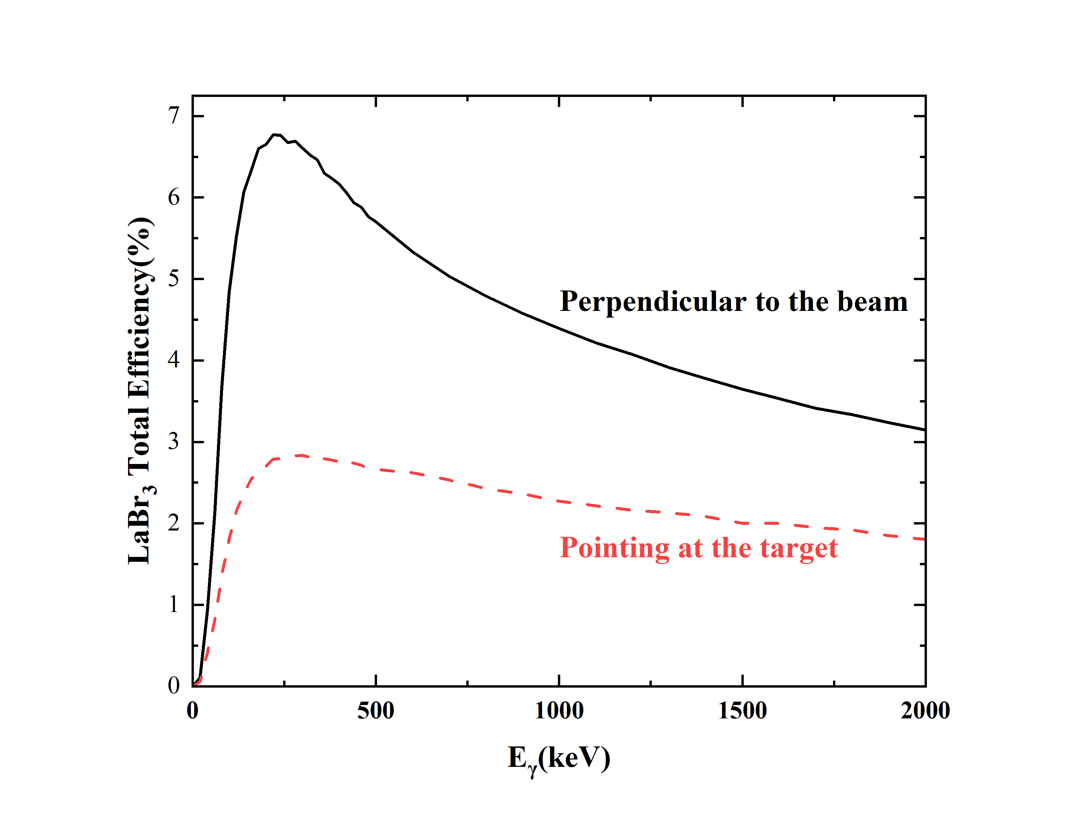
Optimization of LaBr₃ Detection Efficiency (gamma)
vs
Perpendicular to the beam
Pointing at the target
Perpendicular to the beam gives better performance.
7

Slide 8
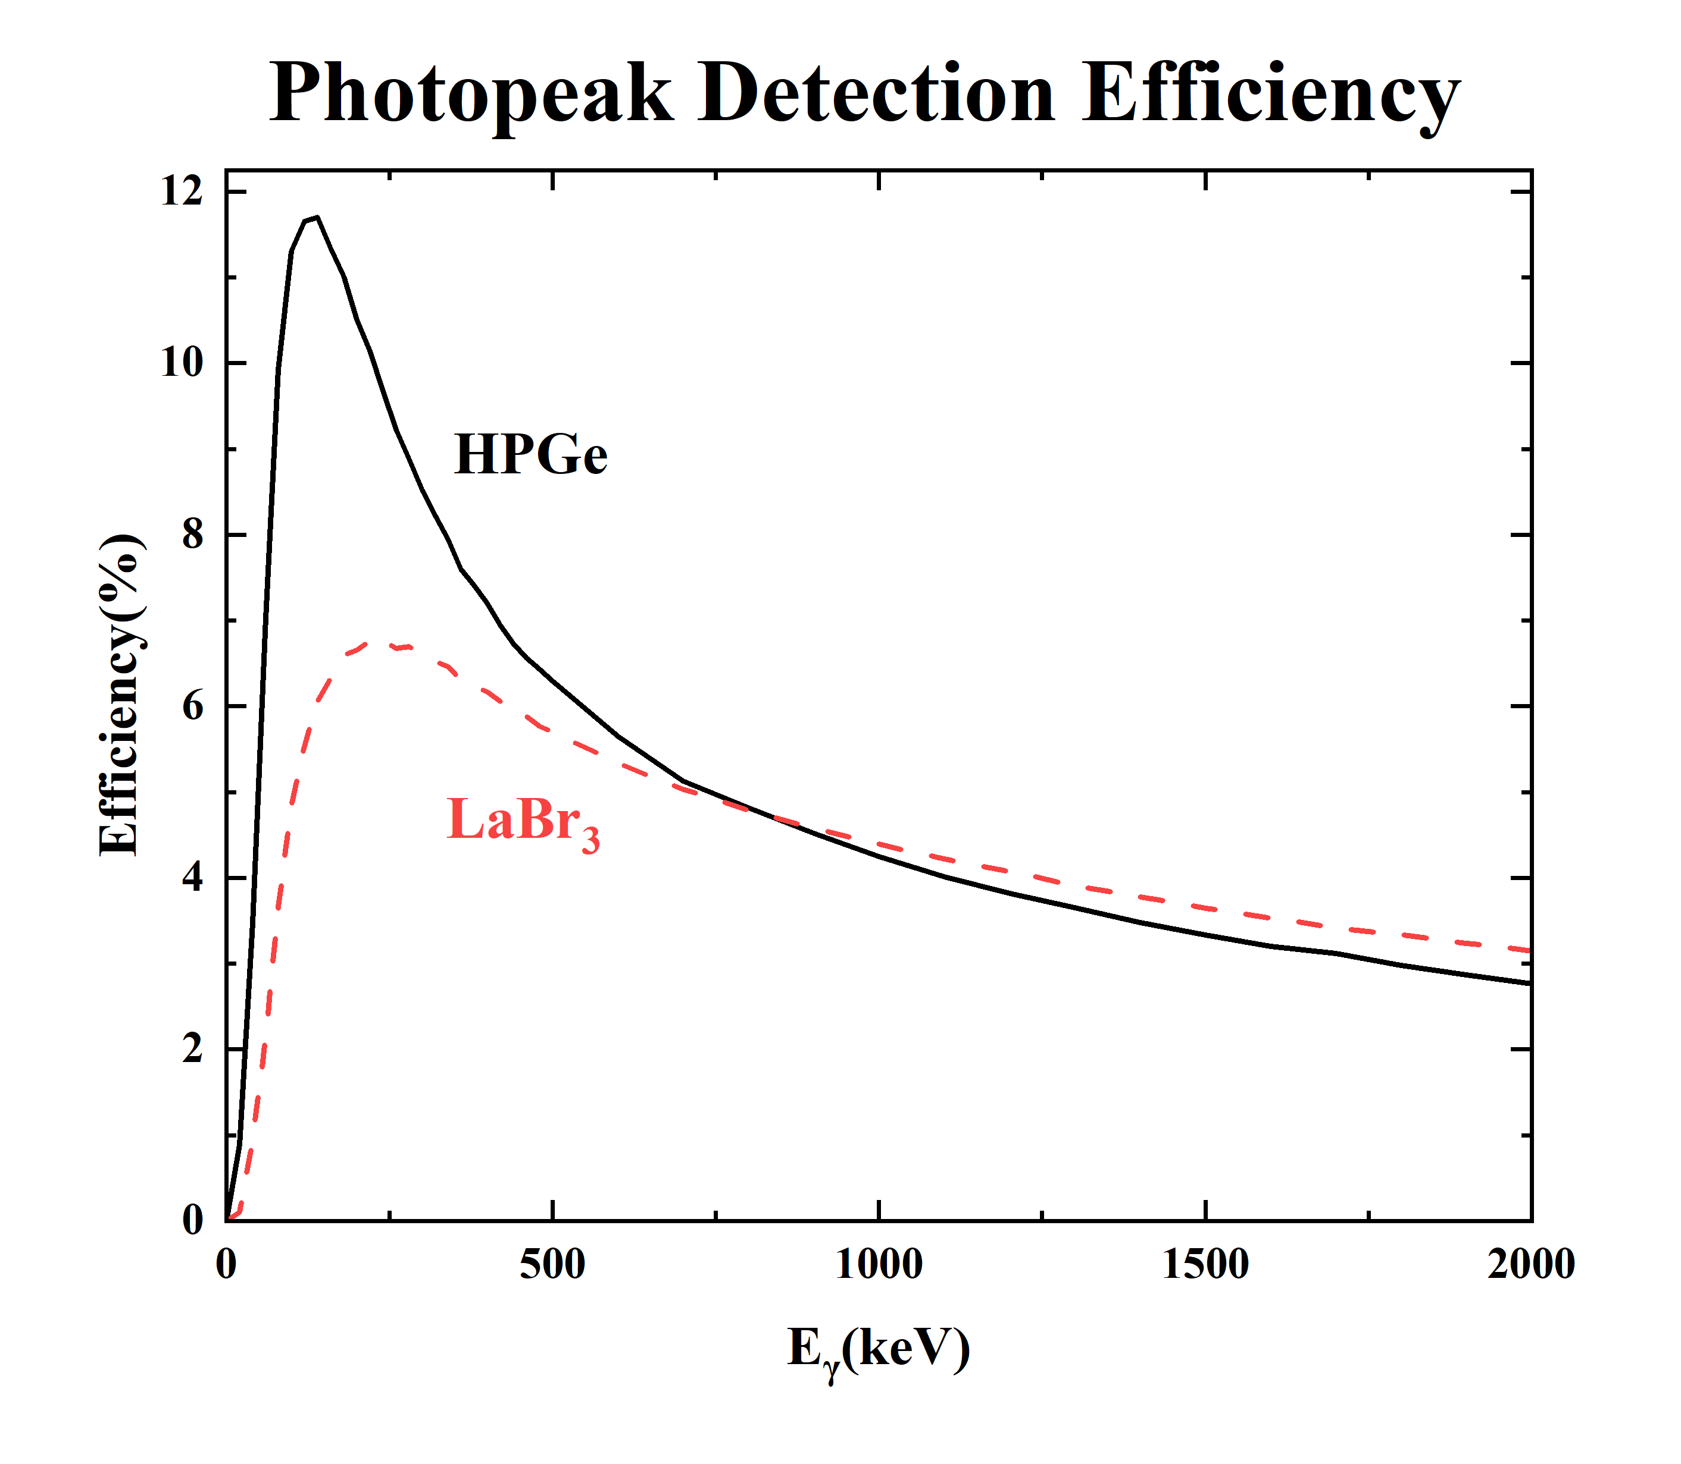
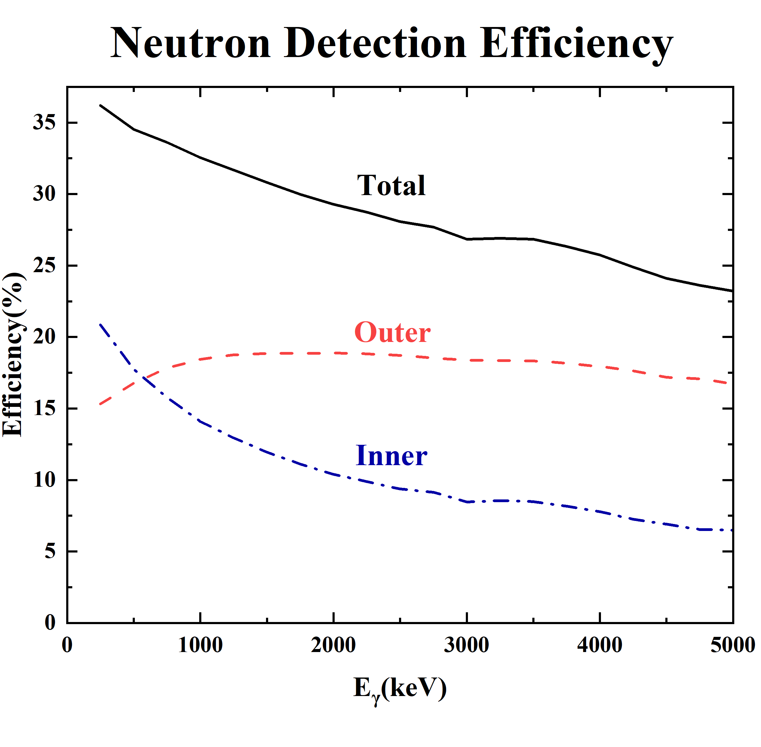
Final Structure and Detection Efficiency Simulation
Moderator Length_x
=Moderator Length_y = 479 mm
³He detectors as widely as possible
Moderator Length_z = 568 mm
Perpendicular to beam direction
Total neutron detection efficiency: 23%~37%
8

Slide 9
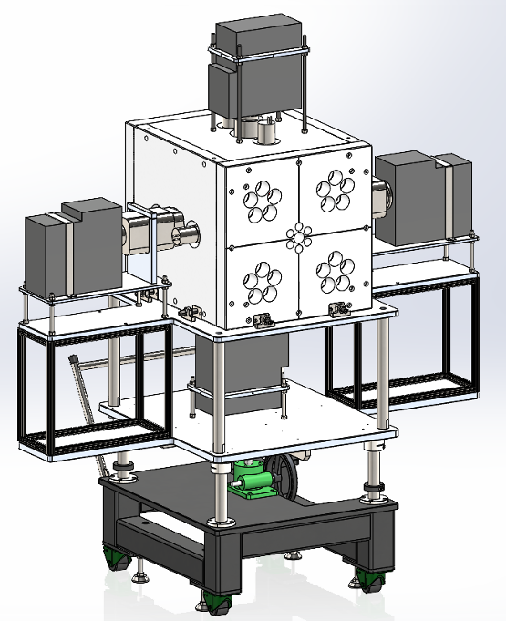
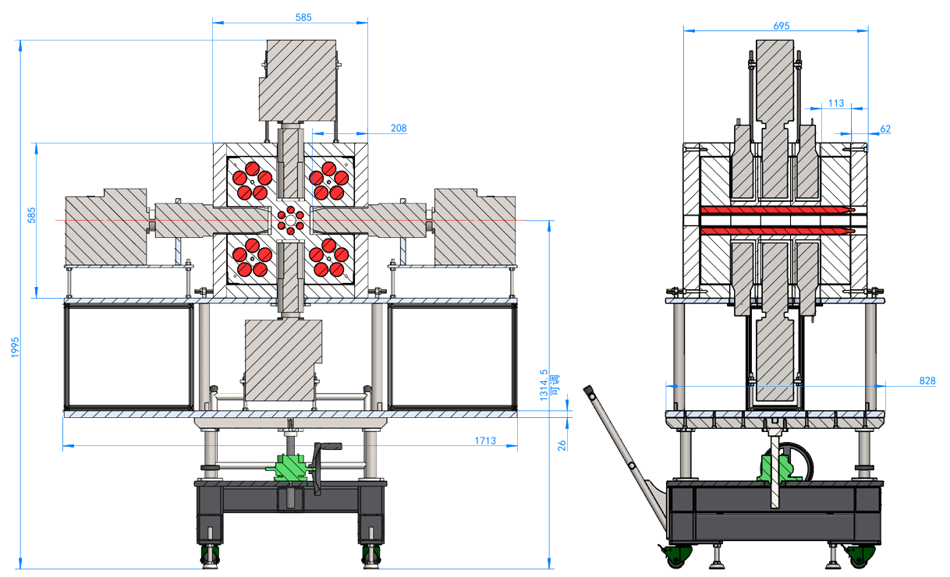
Design of the Detector Support Frame Based on Simulation Optimization
Designed the support frame according to the detector’s requirements
9

Slide 10
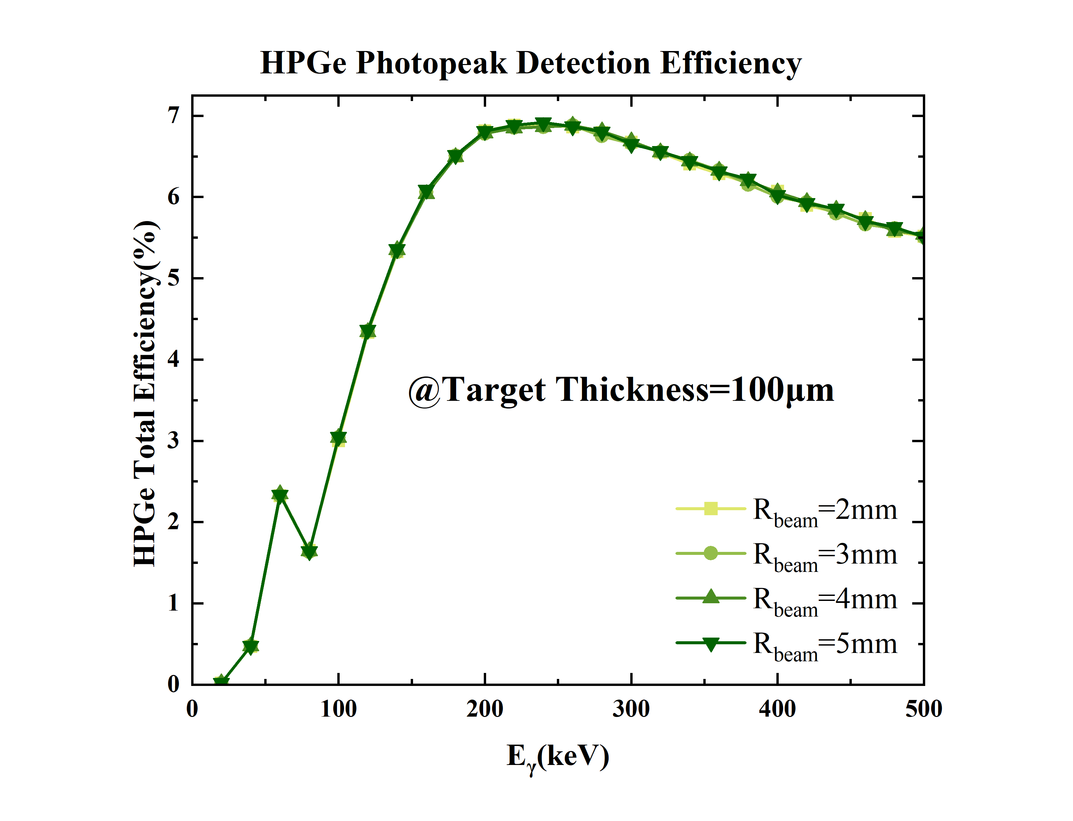
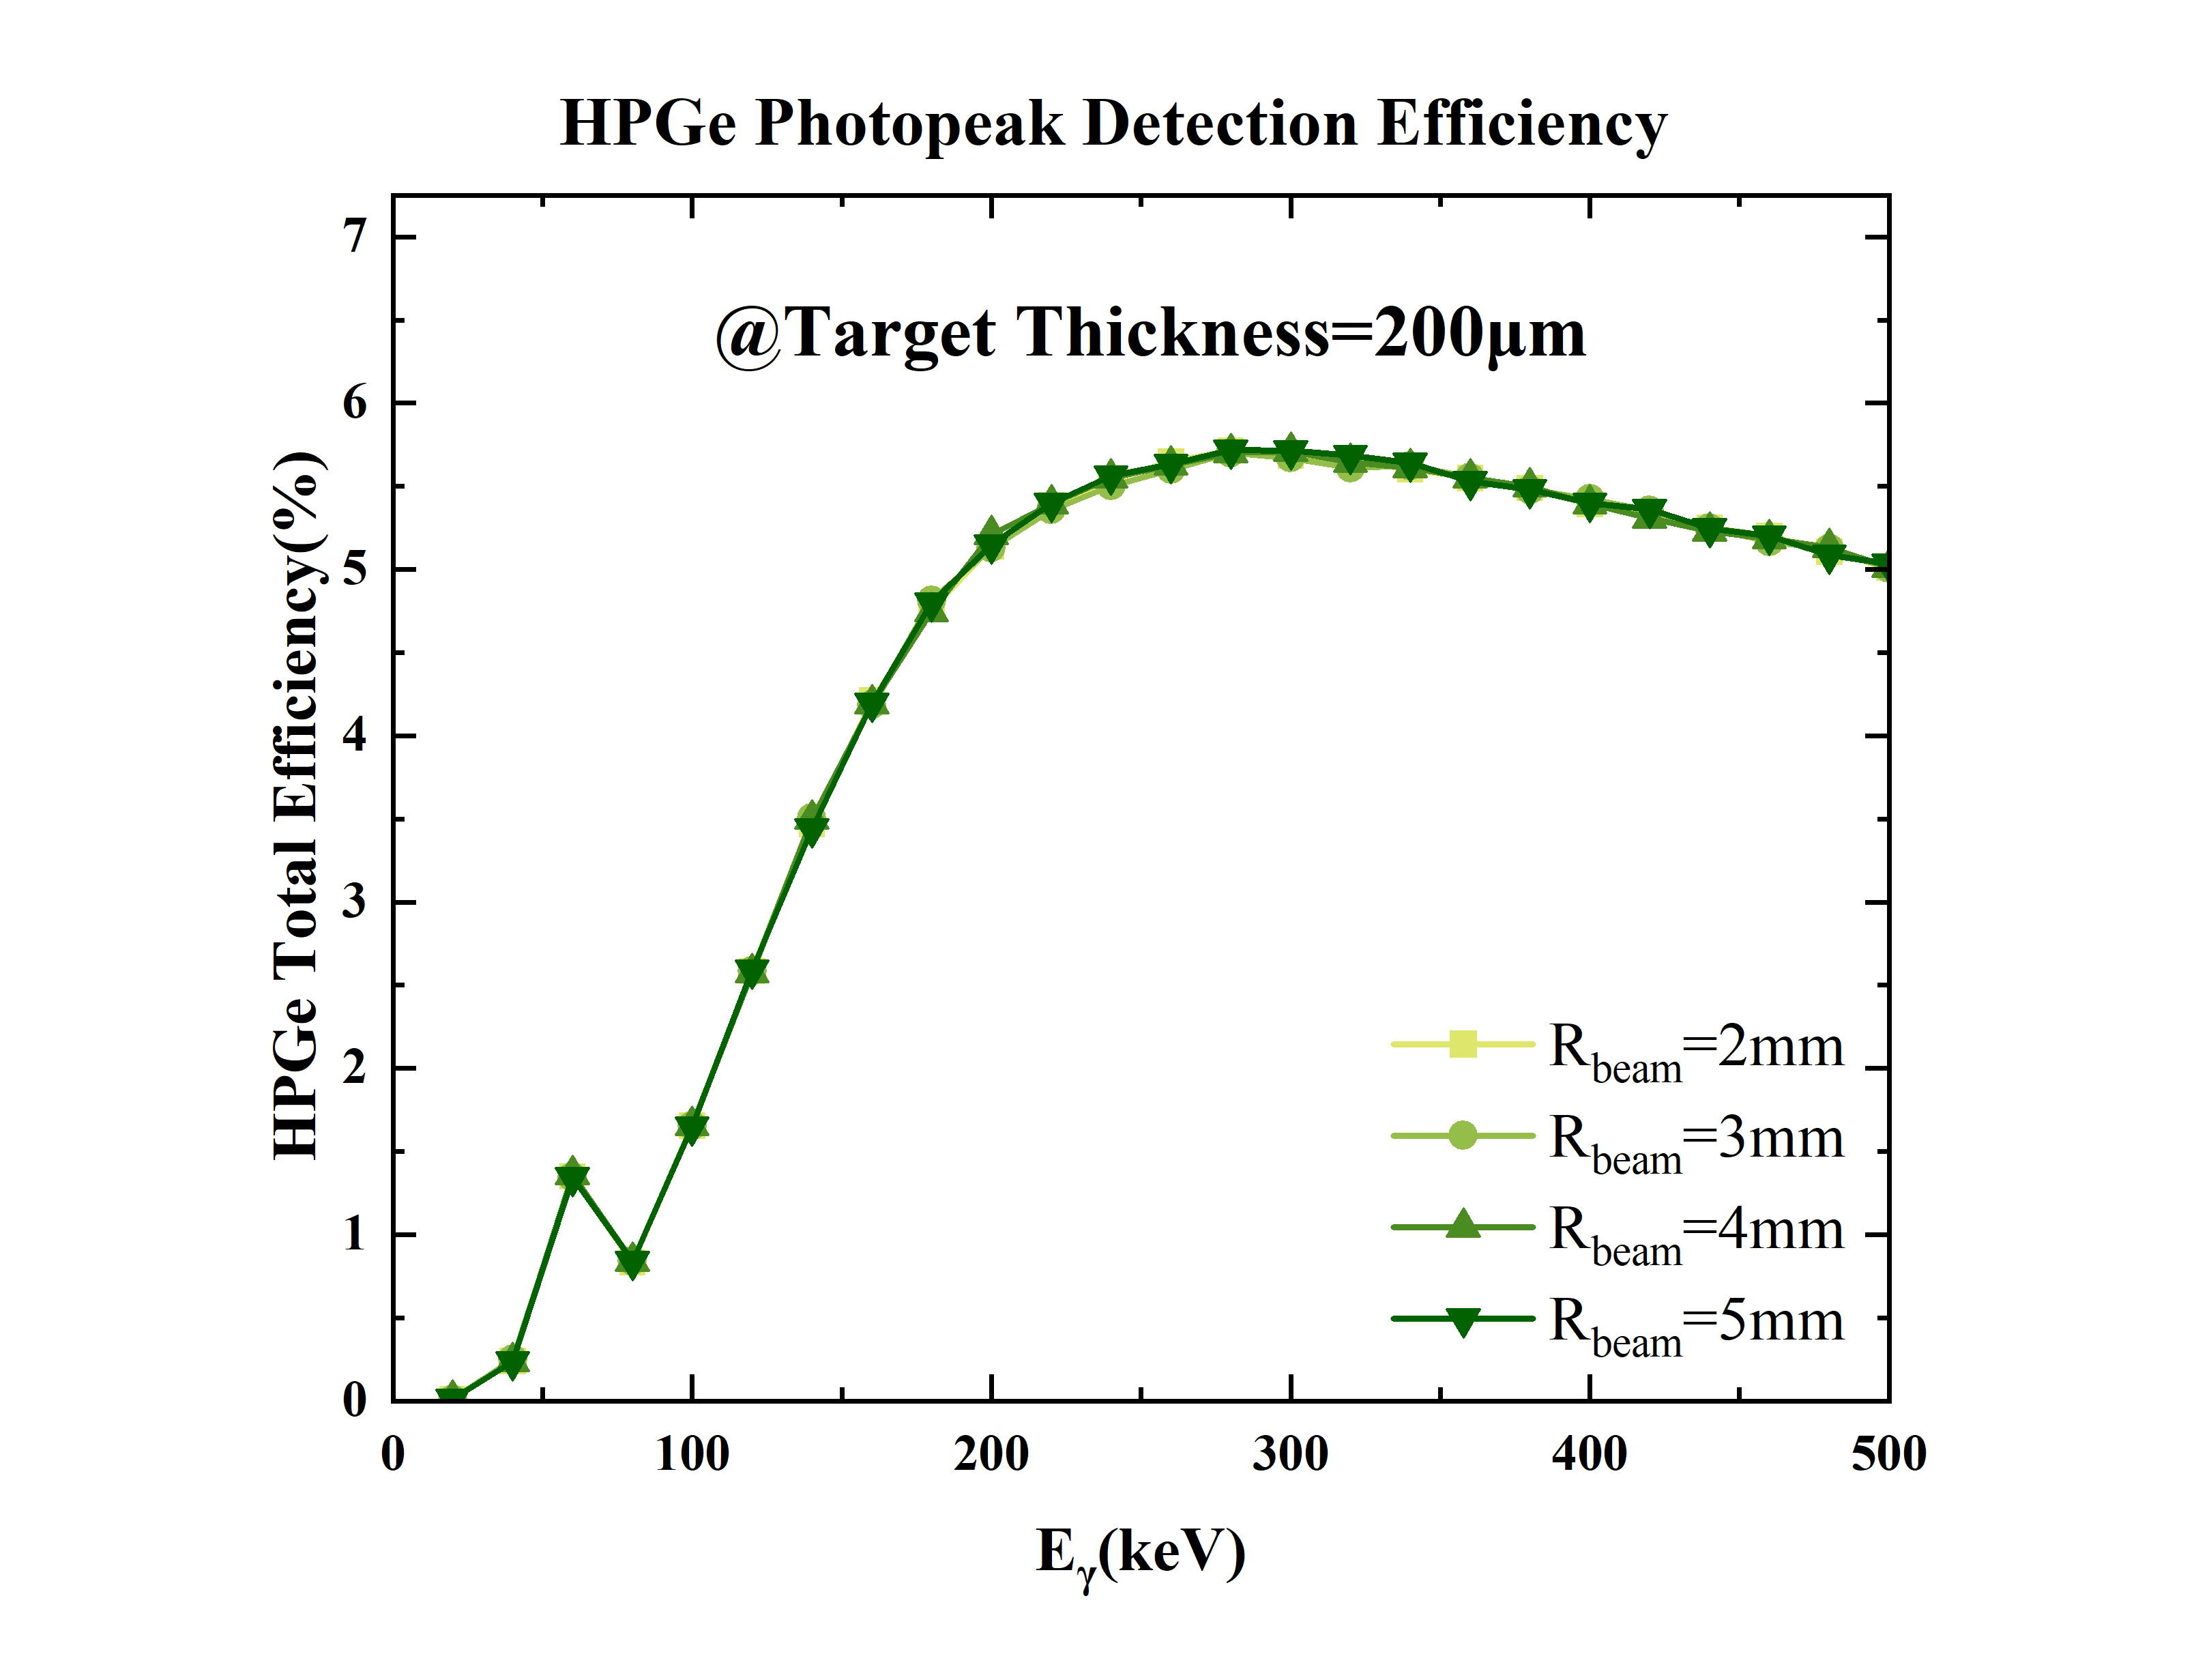
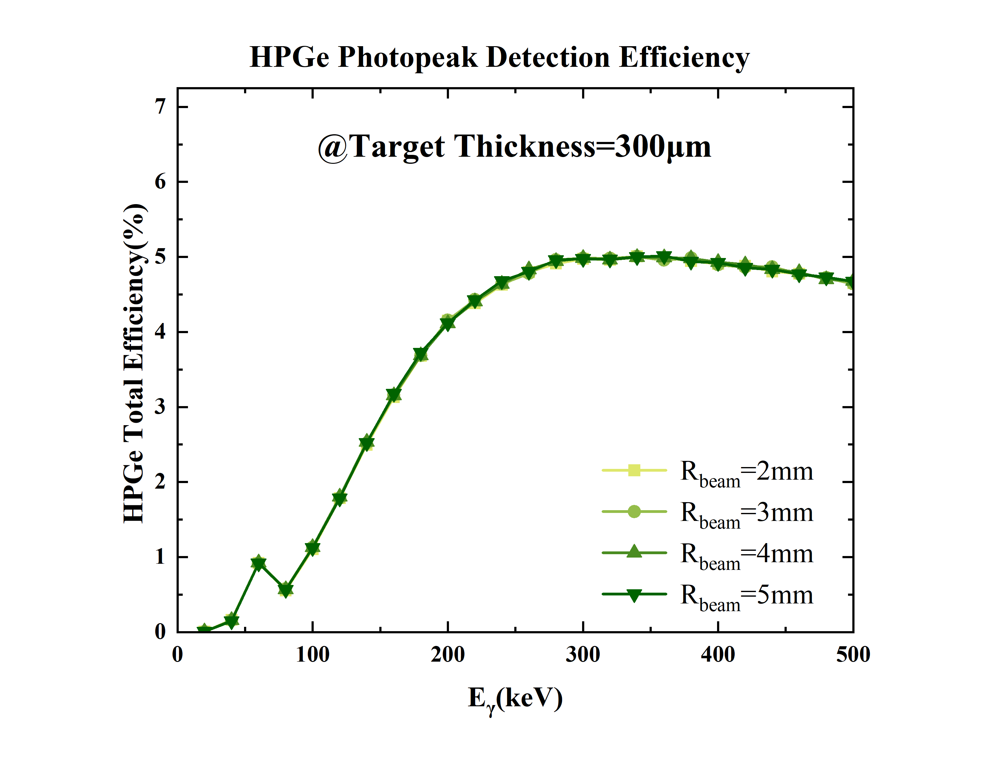
The Influence of Beam Spot Size on Self-Absorption
Beam spot size has almost no effect on self-absorption.
Target thickness significantly affects self-absorption effects.
10

Slide 11
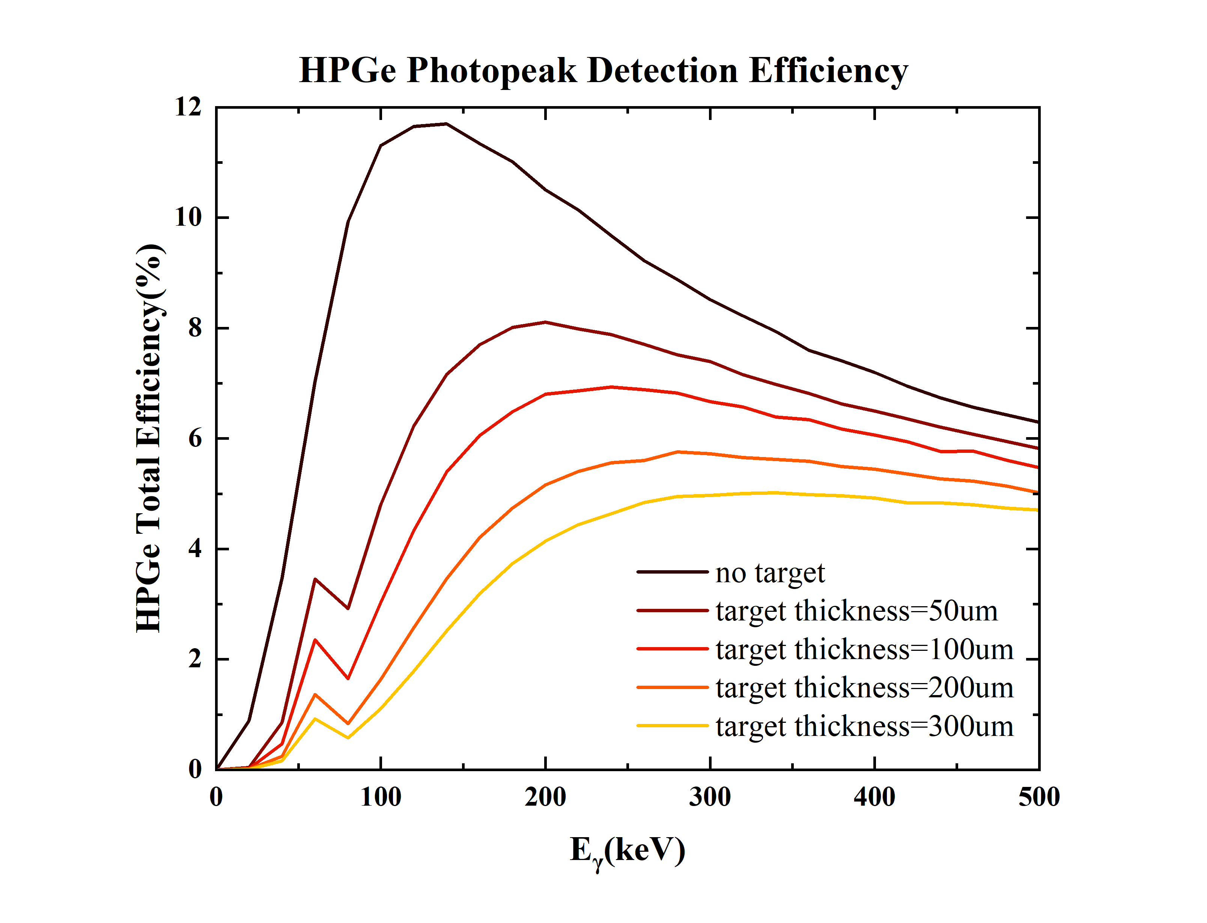
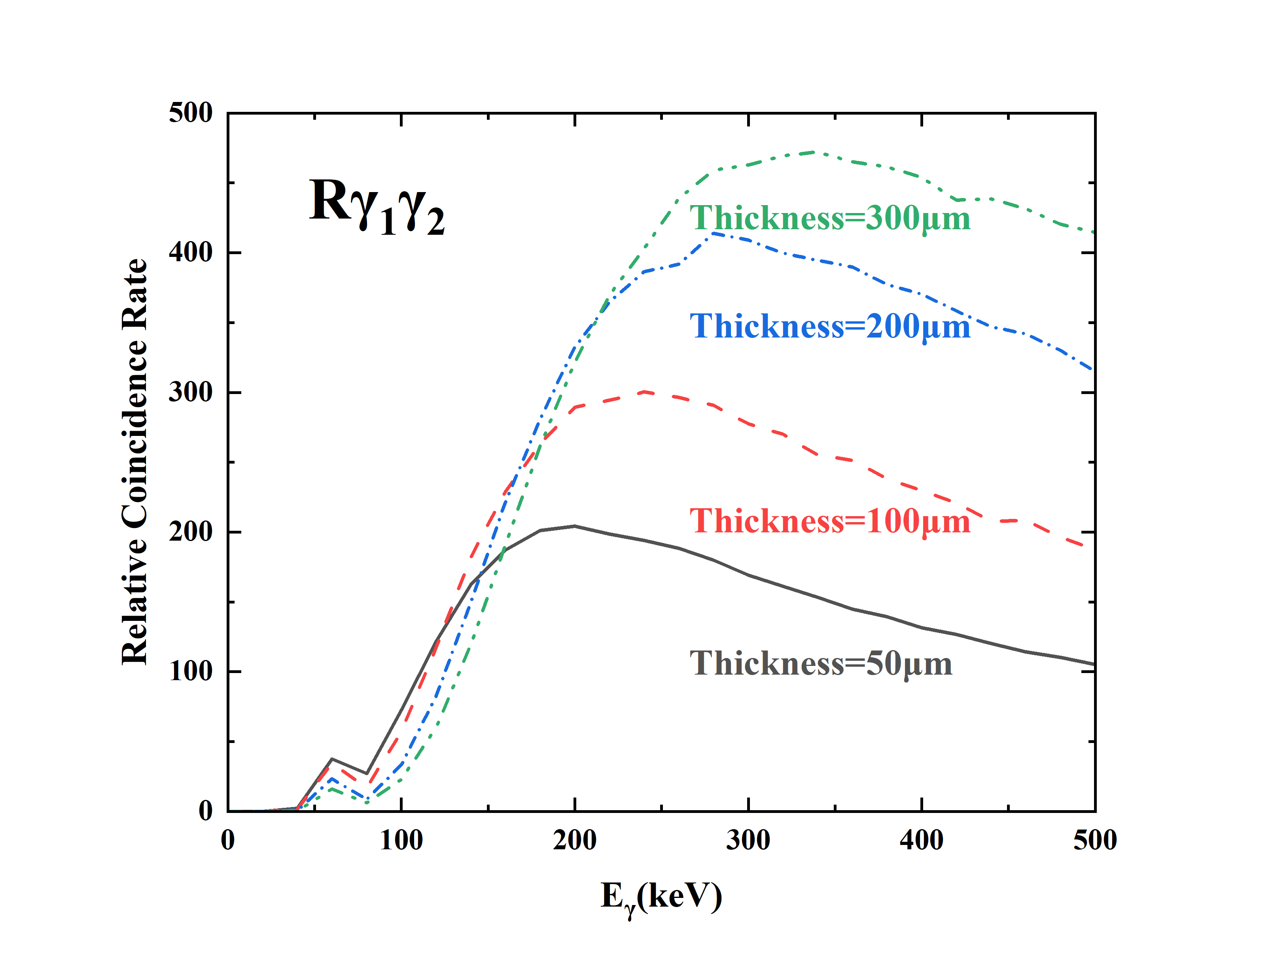
The Influence of Target Thickness on Self-Absorption
lower-energy gamma rays→ 50 μm
higher-energy gamma rays → 300 μm
Rγ₁γ₂ ∝N_{t}ε₁ε₂
Use multiple target thicknesses (50 μm + 300 μm) to cover the full energy range.
11

Slide 12
The Influence of Target Rotation on Self-Absorption
HPGe
HPGe
HPGe
HPGe
Angle between target and beam: 90°
Mean free path of γ-rays in target: Long
Self-absorption effect: Significant
Angle between target and beam: 45°
Mean free path of γ-rays in target: Short
self-absorption effect: Minor
12

Slide 13
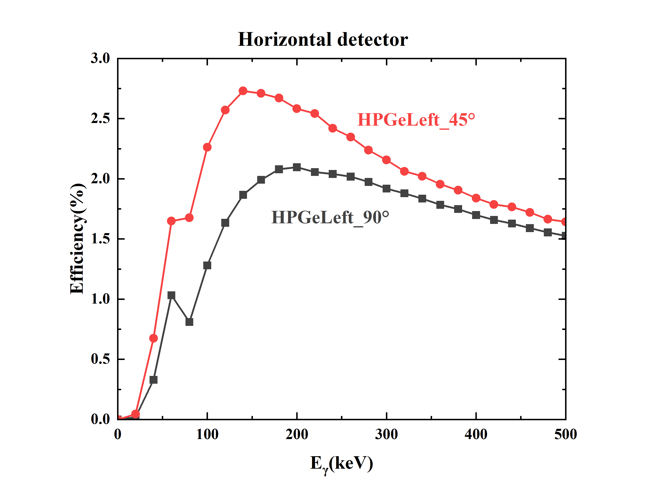
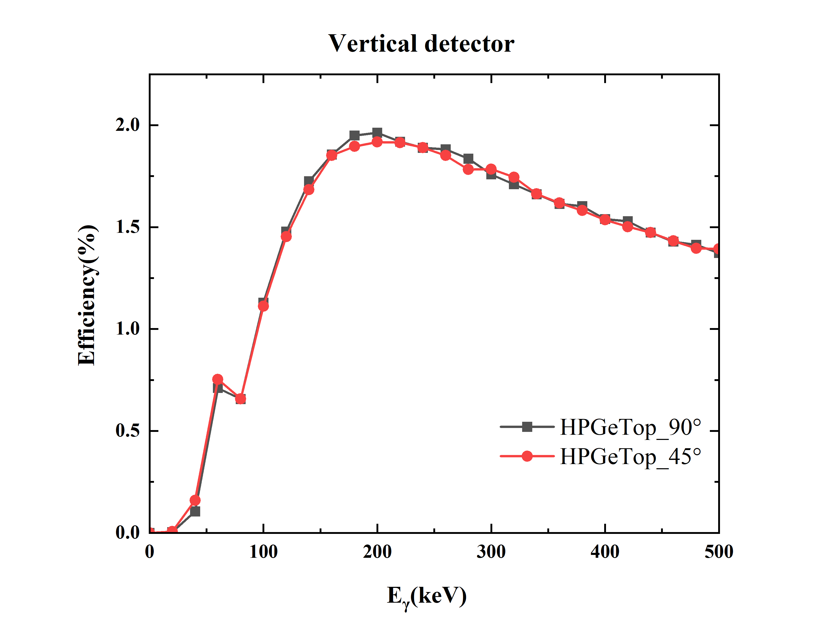
The Influence of Target Rotation on Self-Absorption
E_{γ} = 100 keV: Horizontal detectors: ε₄₅° ≈ 2ε₉₀°
Vertical detectors: ε₄₅° ≈ ε₉₀°
adopt the 45-degree rotated target placement
13

Slide 14
Summary
Optimization of ³He Tube Efficiency
  Enhanced neutron detection efficiency by adjusting moderator length and maximizing ³He tube dispersion
2. Optimization of HPGe Detector Efficiency
  Positioning HPGe detectors closest to the beam for optimal gamma-ray efficiency
3. Optimization of LaBr₃ Detector Efficiency
  Placing LaBr₃ Perpendicular to beam for improved gamma detection
4. Minimizing Self-Absorption Effects
  The target thickness was optimized to minimize self-absorption effects, thereby enhancing the γ-γ coincidence detection efficiency.
  The target was positioned at a 45°angle to reduce self-absorption effects.
14

