Slide 1
A new-type of γ-ray spectroscopy in search of mediating states in ¹⁸⁰Ta
H. Utsunomiya Fudan/Konan
Content
1．180Ta project
2．Timeline
3. Summary

Slide 2
Project Team
Hiroaki Utsunomiya (Fudan/Konan) Leader
Gongtao Fan (SARI) Sub-leader
Xiangai Deng (Fudan) Sub-leader
Yifan Liu (Shanghai Tech) PhD student
Zirui Hao (SARI)
Liyong Zhang (BNU)
Baohua Sun (BUAA)
Jianjun He (Fudan)
Hongwei Wang (SARI)
Yugang Ma (Fudan)
Dan Filipescu (IFIN-HH, Romania)
Ioana Gheorghe (IFIN-HH, Romania)
Taka Kajino (BUAA) Theorist
Stephane Goriely (ULB, Belgium) Theorist
Y.-W. Lui (Texas A&M)

Slide 3
¹⁸⁰Ta
Naturally occurring isomer
Rarest element
Nucleosynthesis of ¹⁸⁰Ta
s-process : Yokoi and Takahashi, Nature (London) 305, 198 (1983).
ν-process : Woosley et al., Astrophys. J. 356, 272 (1990).
p-process : Prantzos et al., Astron. Astrophys. 238, 455 (1990).
Mediating excited states are unidentified – an unveiled mystery
Mediating excited states
77.2 keV
9⁻
¹⁸⁰Ta^{m}
> 7.1 x 10¹⁵ ys
1⁺
¹⁸⁰Ta^{gs}
8.15ｈｒ

Slide 4
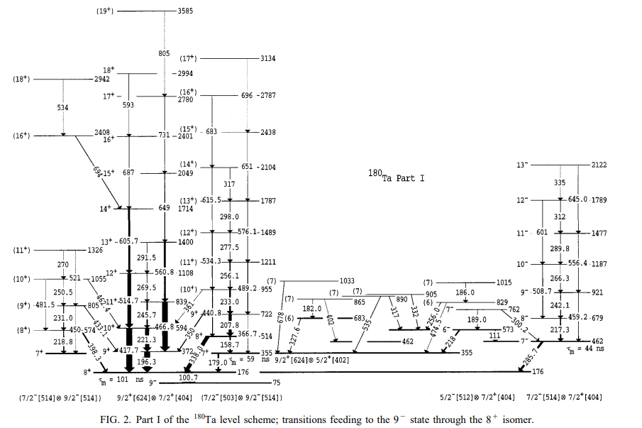
Search for mediating states in γ-ray spectroscopy
Dracoulis et al., PRC58, 1444 (1998)
Saitoh et al., NPA660, 121 (1999).
176Yb(11B,α3n)180Ta
Conventional γ-spectroscopy failed to identify the mediating states !

Slide 5
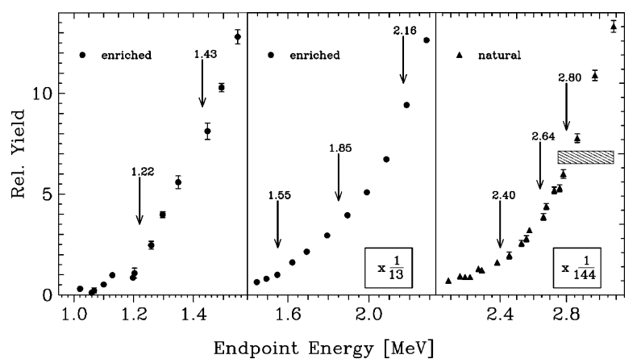
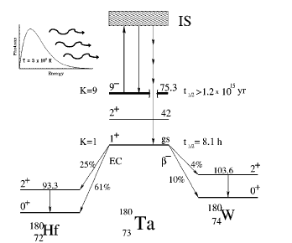
Photodestruction experiment of ¹⁸⁰Ta^{m} with bremsstrahlung
Beric et al., PRL83, 5242 (1999); PRC 65, 035801 (2002).
¹⁸⁰Ta target enriched to 5.45%. (Natural abundance: 0.012%)
Mediating states

Slide 6
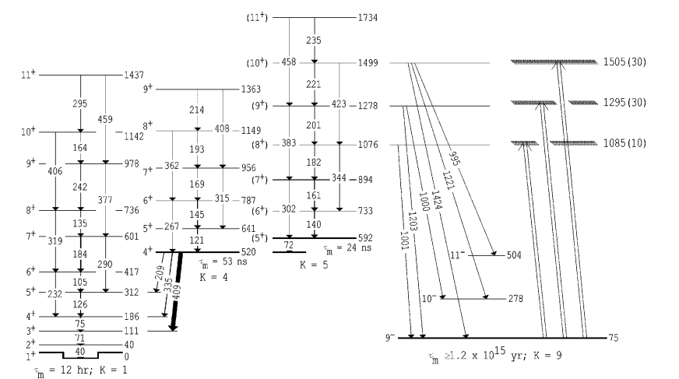
γ-spectroscopic interpretation of the photodestruction data
Walker et al., PRC 64, 061302(R) (2001).
Observed in
photodestruction
K=5⁺
Parity was reassigned
to + from -.
K=9⁻

Slide 7





Dracoulis et al.
PRC58 (1998)
¹⁷⁶Yb(¹¹B, α3n)¹⁸⁰Ta
15
¹⁸⁰Ta
$$16ℏ$$
$$25ℏ$$
$$13 MeV$$
$$Ex [MeV]$$
10
Most of the observed
transitions are
irrelevant to
nucleosynthesis
5
1
1⁺
9⁻
213 discrete γ
0
5
10
15
20
25
30
$$J [ℏ]$$

Slide 8
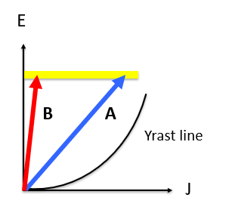
Photoreaction vs Heavy-ion reaction
B: photoreaction
A: heavy-ion reaction
E1 excitation
ΔJ=1
Large J transfer is emphasized
with degeneracy 2J+1

Slide 9
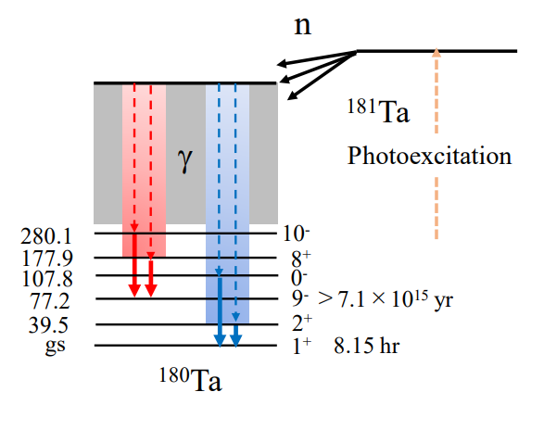
Let’s chase the p-process nucleosynthesis
¹⁸¹Ta(γ,n)¹⁸⁰Ta
s-wave
9/2-, 7/2-, 5/2-
5-, 4-, 3-, 2-
E1
E1 photoexcitation
S_{n}=7576 keV
181Ta 7/2+

Slide 10







Utsunomiya et al.
NIMA (2022)
Dracoulis et al.
PRC58 (1998)
¹⁸¹Ta(γ, n)¹⁸⁰Ta
¹⁷⁶Yb(¹¹B, α3n)¹⁸⁰Ta
¹⁸⁰Ta
15
$$16ℏ$$
$$25ℏ$$
$$13 MeV$$
Previously inaccessible
$$Ex [MeV]$$
10
$$2ℏ$$
$$5ℏ$$
Most of the observed
γ transitions are irrelevant
to nucleosynthesis
5
1
1⁺
9⁻
213 discrete γ
0
5
10
15
20
25
30
$$J [ℏ]$$

Slide 11
p-process nucleosynthesis
Total cross sections
s-wave
9/2-, 7/2-, 5/2-
¹⁸¹Ta(γ,n)¹⁸⁰Ta
5-, 4-, 3-, 2-
Partial cross sections
E1
¹⁸¹Ta(γ,n)¹⁸⁰Ta^{gs}
E1 photoexcitation
¹⁸¹Ta(γ,n)¹⁸⁰Ta^{m}
S_{n}=7576 keV
181Ta 7/2+

Slide 12
Partial cross sections
Goko et al. Phys. Rev. Lett. 96, 192501 (2006)
σ_{m}/σ_{total}
~1/10 @ E_{γ}=12 MeV
~1/20 @ E_{γ}=10 MeV
HFB combinatorial NLD
Hilaire & Goriely, NPA779 (2006)
Statistical NLD
Demetriou & Goriely, NPA695 (2001)

Slide 13




We perform n-γ₁-γ₂ triple coincidence measurements by chasing the p-process.
H. Utsunomiya et al., NIMA 1034 (2022) 166819
s-wave
9/2-, 7/2-, 5/2-
¹⁸¹Ta(γ, n)¹⁸⁰Ta
5-, 4-, 3-, 2-
15
Cross talks
$$Ex [MeV]$$
E1
10
$$2ℏ$$
$$5ℏ$$
5
S_{n}=7576 keV
181Ta
7/2+
1
1⁺
9⁻
0
5
10
15
$$J [ℏ]$$
30

Slide 14
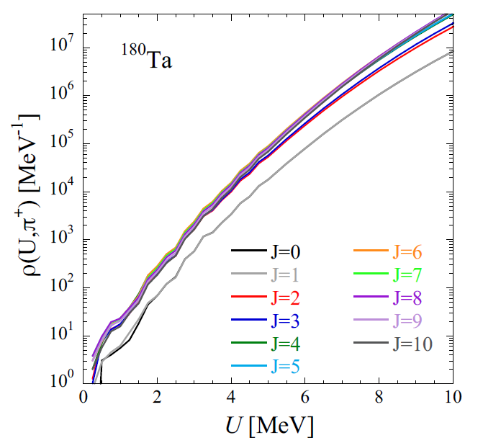
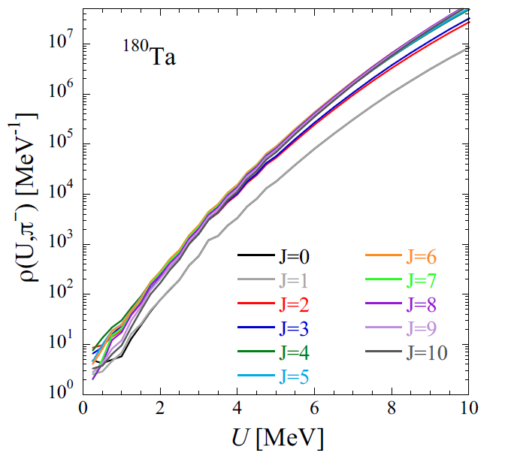
Unresolved states in ¹⁸⁰Ta
S. Goriely HFB Combinatorial NLD, Phys. Rev. C78 (2008) 064307
+ parity
- parity

Slide 15




Unresolved states
γ transitions can occur through unresolved states.
¹⁸¹Ta(γ, n)¹⁸⁰Ta
15
$$Ex [MeV]$$
10
$$2ℏ$$
$$5ℏ$$
5
1
1⁺
9⁻
0
5
10
15
$$J [ℏ]$$

Slide 16

How do we single out γ transitions through unresolved states?
Concept of methodology: One discrete case
3” × 4” LaBr spectrum
Discrete state
we unfold γ-transitions through unresolved states in
the experimental spectrum folded with many discrete states.
Response function to
discrete state
E_{γ}
Extra
Component : γ transitions through unresolved states

Slide 17
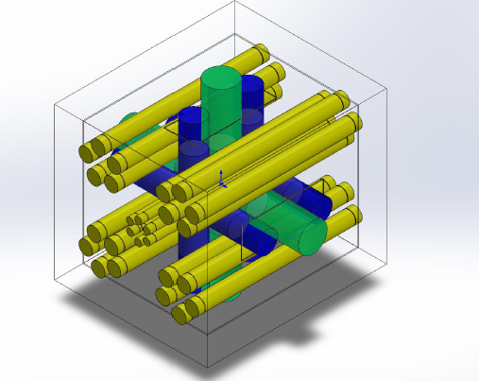
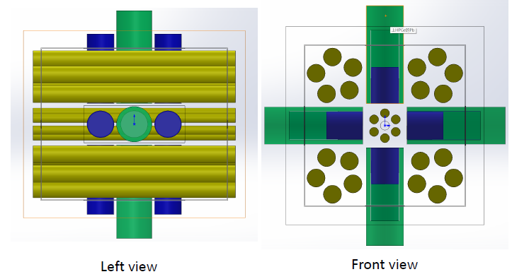
Upgraded p-process chaser detector Type-I
Next talk
Yifan Liu
26 ³He counters
4 HPGe
8 LaBr₃(Ce)

Slide 18
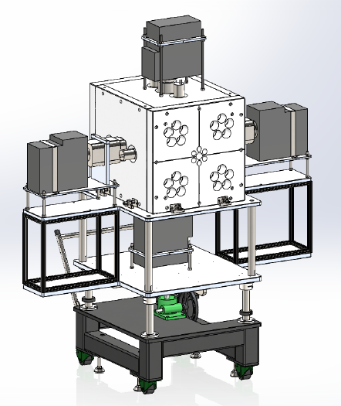
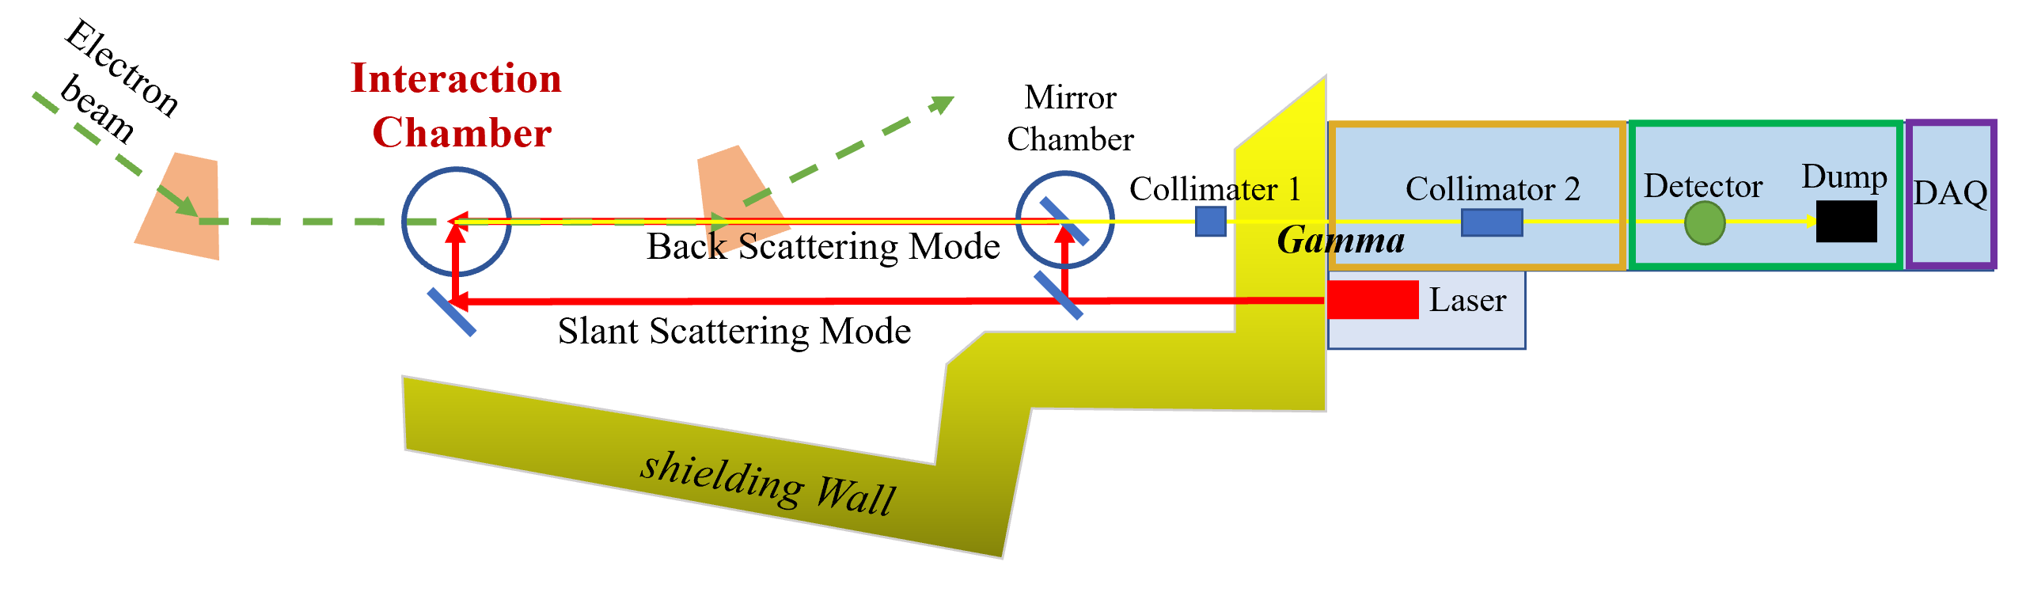
Timeline
Polyethylene moderator and mechanical support
August 2025
Assembly of the detector system and offline tuning
with the standard neutron and gamma sources
January 2026
Online test measurements with gamma-ray beams
February-March 2026
4. Experiment at SLEGS
March-April 2026

Slide 19
Summary
We are preparing for a new γ-spectroscopy experiment to identify mediating excited states between ¹⁸⁰Ta^{m} and ¹⁸⁰Ta^{gs}.
The p-process chaser detector is sensitive not only to resolved states but also, in principle, to unresolved states.
The γ-spectroscopy with photonuclear reactions plays a complementary role to that with heavy-ion reactions.
Applications!

Slide 20
¹⁸⁰Ta^{gs} → ¹⁸⁰Hf : Electron Capture
Hf characteristic X rays
Life time measurement
λ_{exp} =0.084
λ_{nominal}=0.085
K_{α1}
K_{α2}
K_{β}

