Slide 1
Nuclear reactions for nuclear astrophysics and EFTs
Shung-Ichi Ando
Daegu University,
PhNS2025@Fudan U., Shanghai, China, August 9-10, 2025

Slide 2
Contents
Introduction
Nuclear reactions for nuclear astrophysics (review)
Theories and EFTs
Radiative neutron capture on a proton in pionless EFT
Summary

Slide 3
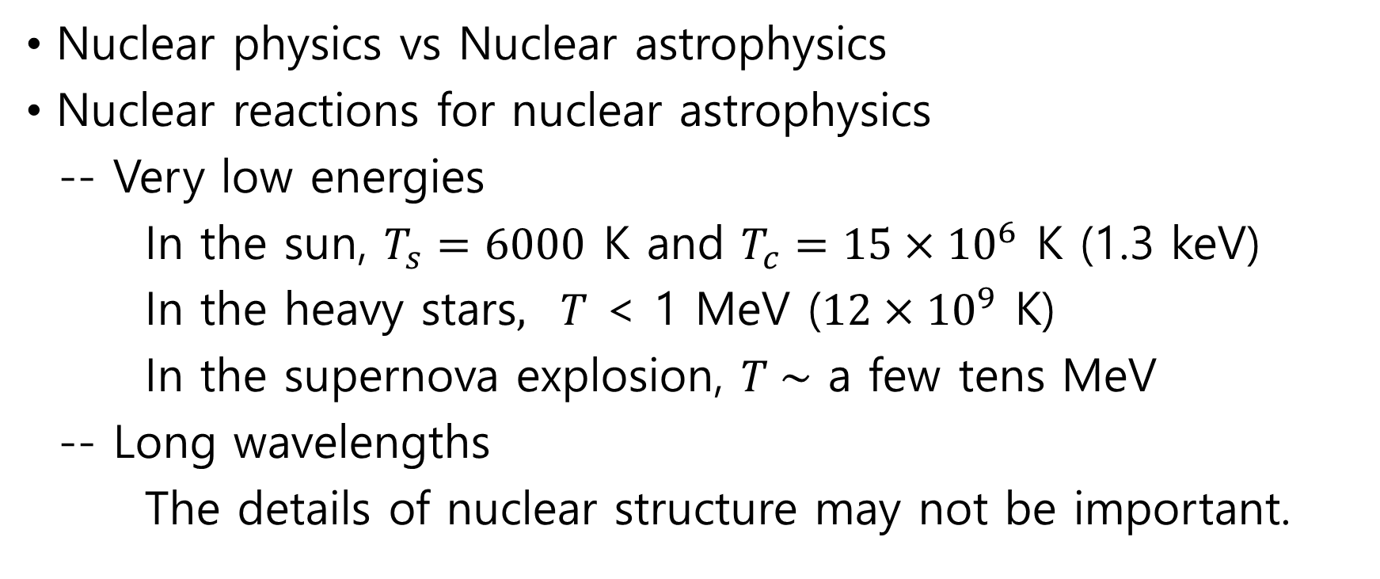
Introduction
Nuclear physics vs Nuclear astrophysics
Nuclear reactions for nuclear astrophysics
-- Very low energies
In the sun, $T_{s}=6000$ K and $T_{c}=15×{10}^{6}$ K (1.3 keV)
In the heavy stars$, T$ < 1 MeV ($12×{10}^{9}$ K)
In the supernova explosion, $T \sim$ a few tens MeV
-- Long wavelengths
The details of nuclear structure may not be important.

Slide 4
Nuclear reactions for nuclear astrophysics
Nuclear astrophysics (Wikipedia) studies the origin of the chemical elements and isotopes, and the role of nuclear energy generation, in cosmic sources such as stars, supernovae, novae, and violent binary-star interactions.
Nuclear reactions for nuclear astrophysics are studied well;
-- BBN, hydrogen burning process (p-p chains), CNO cycles, helium burning process, carbon burning process, etc.
-- While, significant uncertainties in the cross sections.

Slide 5
Theories
All theories may have a theoretical limit (or a starting point)
-- ChPT, shell model, mean field theories, potential models
-- Departure from the limit leads to difficulties to apply the theory to the study.
Theories for nuclear astrophysics
-- Field theoretical (diagram) approach,
potential models, R-matrix analysis
-- Blatt and Weisskopf, Theoretical Nuclear Physics (1952)
``Phenomena involving energies below 50 MeV called
classical nuclear physics.’’

Slide 6
Effective field theories
In quantum field theory, to construct a perturbation theory,
1) unitarity and 2) renormalizability of the loop diagrams are important. (George Sterman’s textbook)
Effective field theory provides us with a perturbative expansion scheme, and is constructed by introducing a separation scale to separate relevant degrees of freedom at low energies and irrelevant degrees of freedom at high energy.

Slide 7
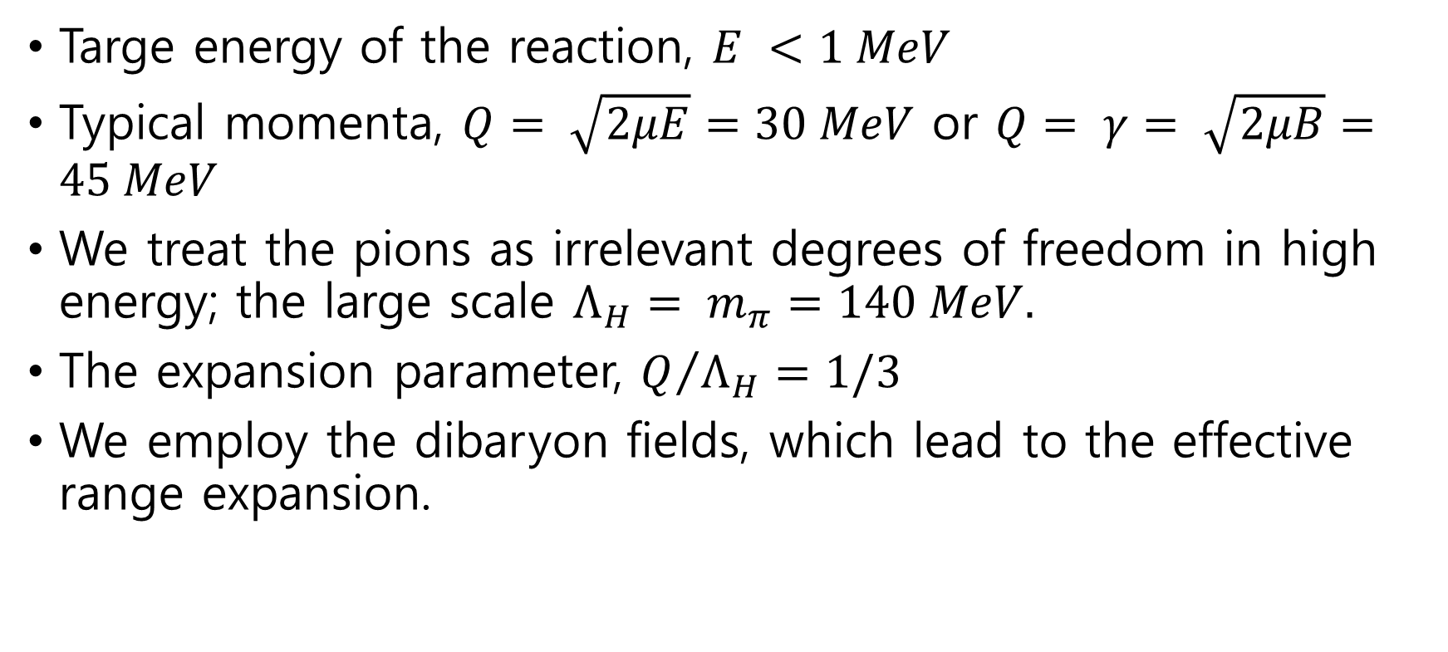
Radiative neutron capture on a proton for BBN
Targe energy of the reaction, $E <1 MeV$
Typical momenta, $Q= \sqrt{2μE}=30 MeV$ or $Q= γ= \sqrt{2μB}=45 MeV$
We treat the pions as irrelevant degrees of freedom in high energy; the large scale $Λ_{H}= m_{π}=140 MeV.$
The expansion parameter, $Q/{Λ_{H}}=1/3$
We employ the dibaryon fields, which lead to the effective range expansion.

Slide 8
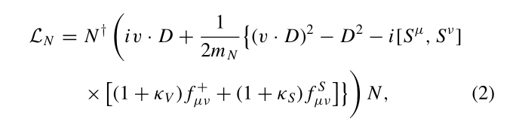
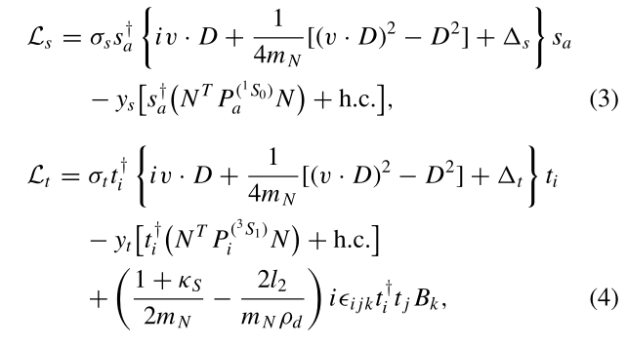
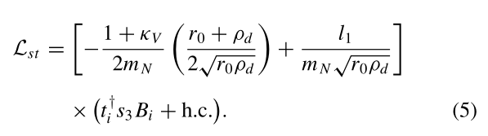
Effective Lagrangian

Slide 9
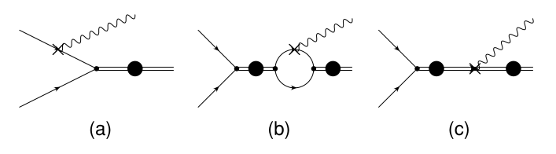

Feynman diagrams

Slide 10
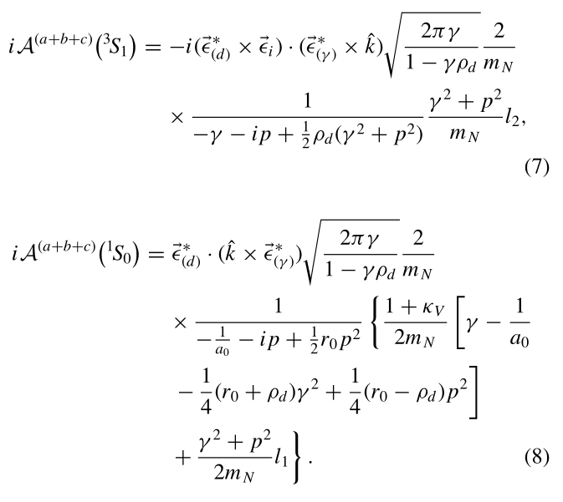
Reaction amplitudes for s-waves

Slide 11
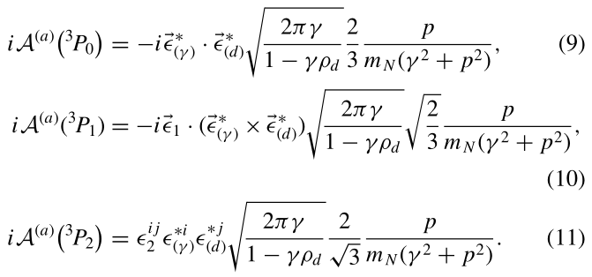
Reaction amplitudes for p-waves

Slide 12
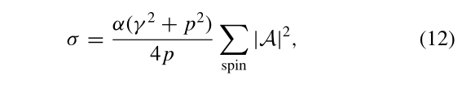


Cross sections

Slide 13
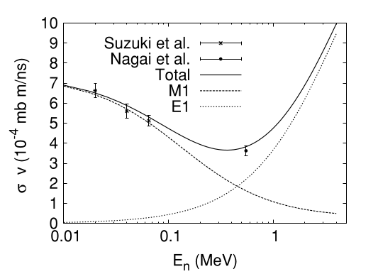
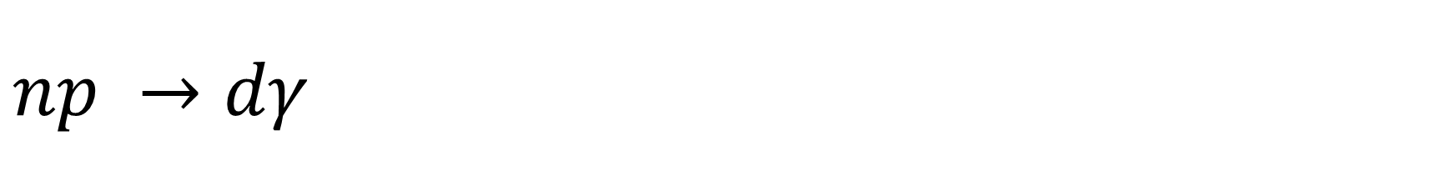
$$np →dγ$$

Slide 14
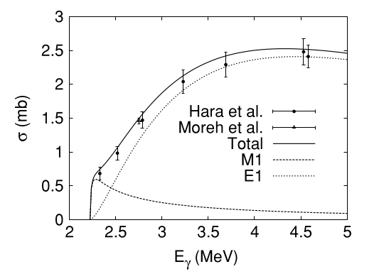
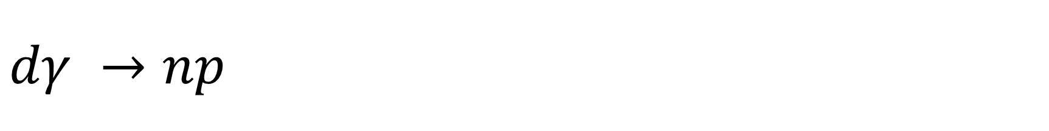
$$dγ →np$$

Slide 15
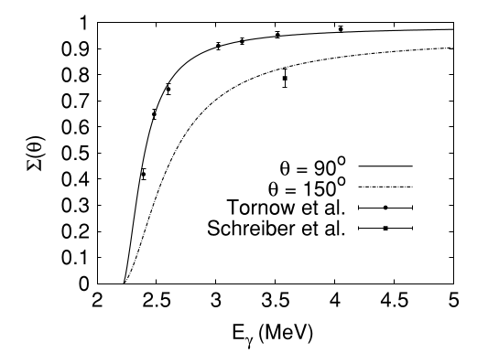
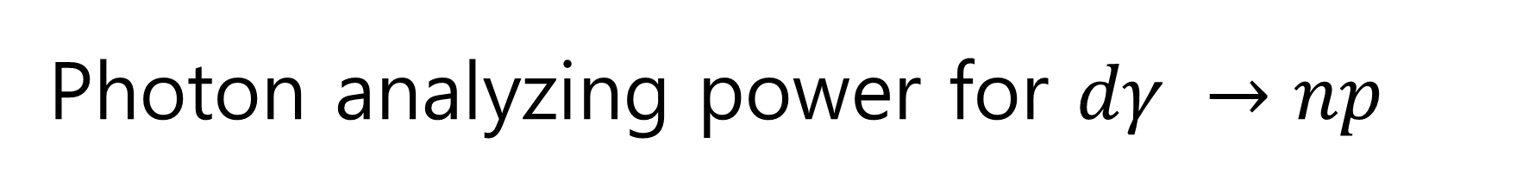
Photon analyzing power for $dγ →np$

Slide 16
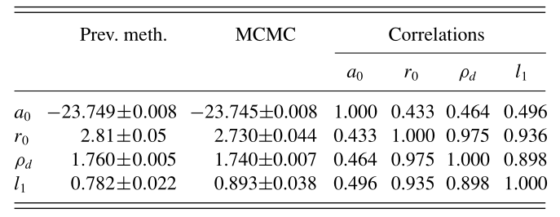
Fixing parameters

Slide 17
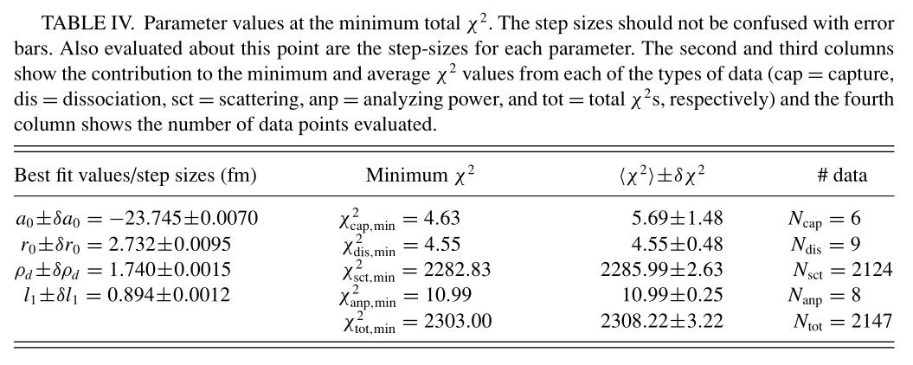
Fitted parameters

Slide 18
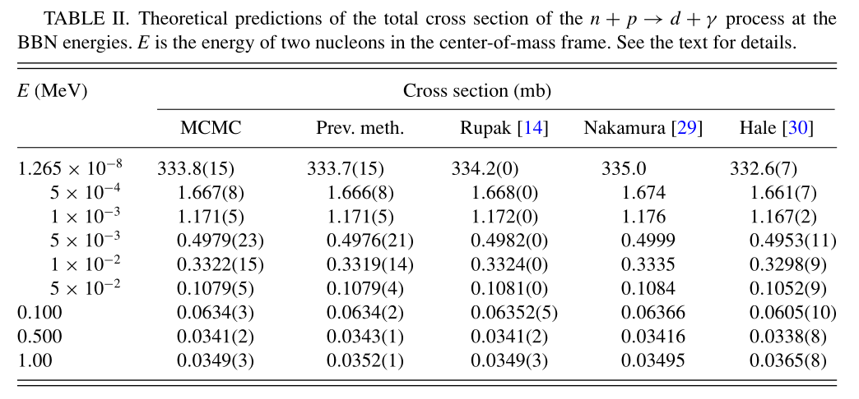
Total cross section

Slide 19
Summary
The present situation of the studies of nuclear reactions at low energies for nuclear astrophysics was briefly reviewed.
We discussed the constructions of EFTs for the studies of nuclear reactions at low energies.
The study of radiative neutron capture on a proton in pionless EFT was reviewed.
In conclusion, an EFT can provide us with a unique and useful method to study the nuclear reactions at low energies.

Slide 22
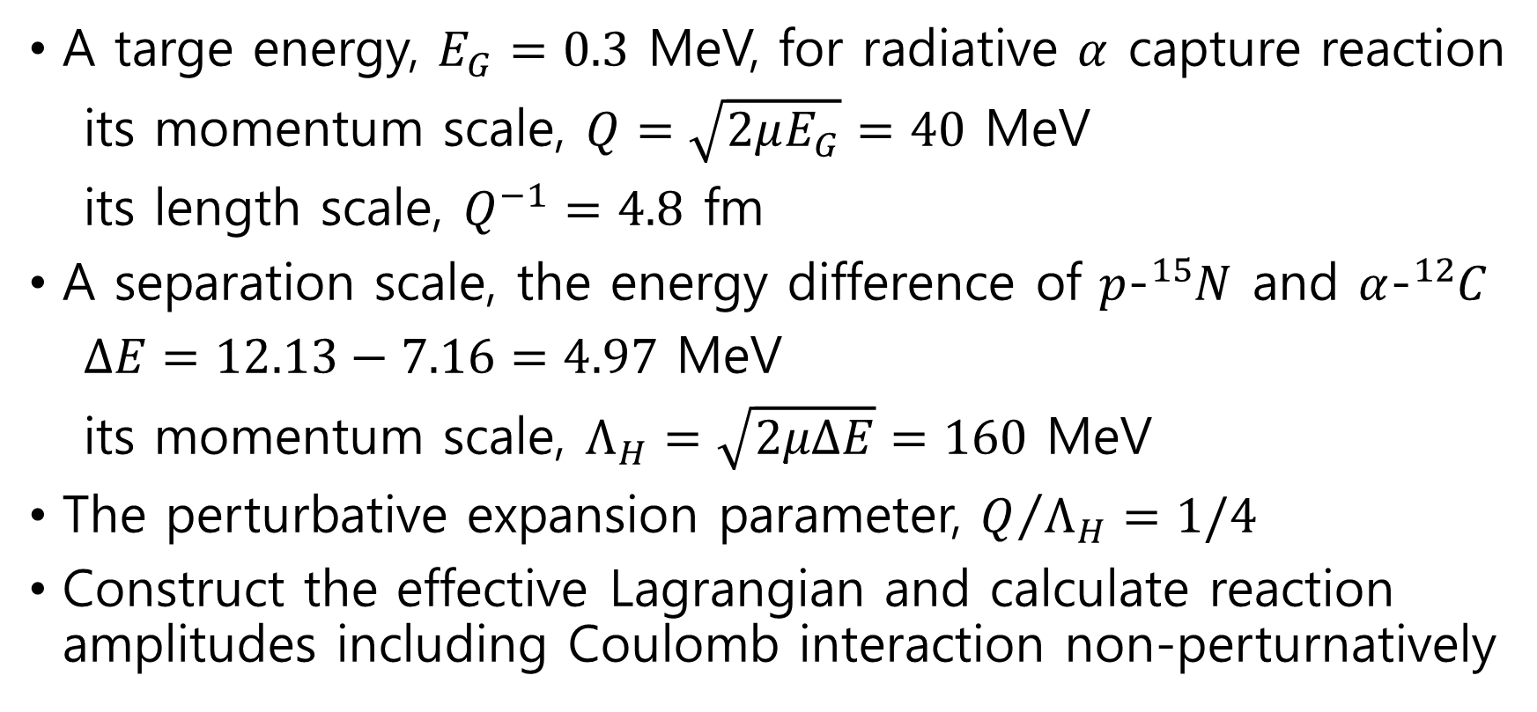

A cluster EFT for the $α$-${}_{ }^{12}C$ system
A targe energy, $E_{G}=0.3$ MeV, for radiative $α$ capture reaction
its momentum scale, $Q=\sqrt{2μE_{G}}=40$ MeV
its length scale, $Q^{−1}=4.8$ fm
A separation scale, the energy difference of $p$-${}_{ }^{15}N$ and $α$-${}_{ }^{12}C$
$∆E=12.13−7.16=4.97$ MeV
its momentum scale, $Λ_{H}=\sqrt{2μΔE}=160$ MeV
The perturbative expansion parameter, $Q/{Λ_{H}}=1/4$
Construct the effective Lagrangian and calculate reaction amplitudes including Coulomb interaction non-perturnatively

Slide 23
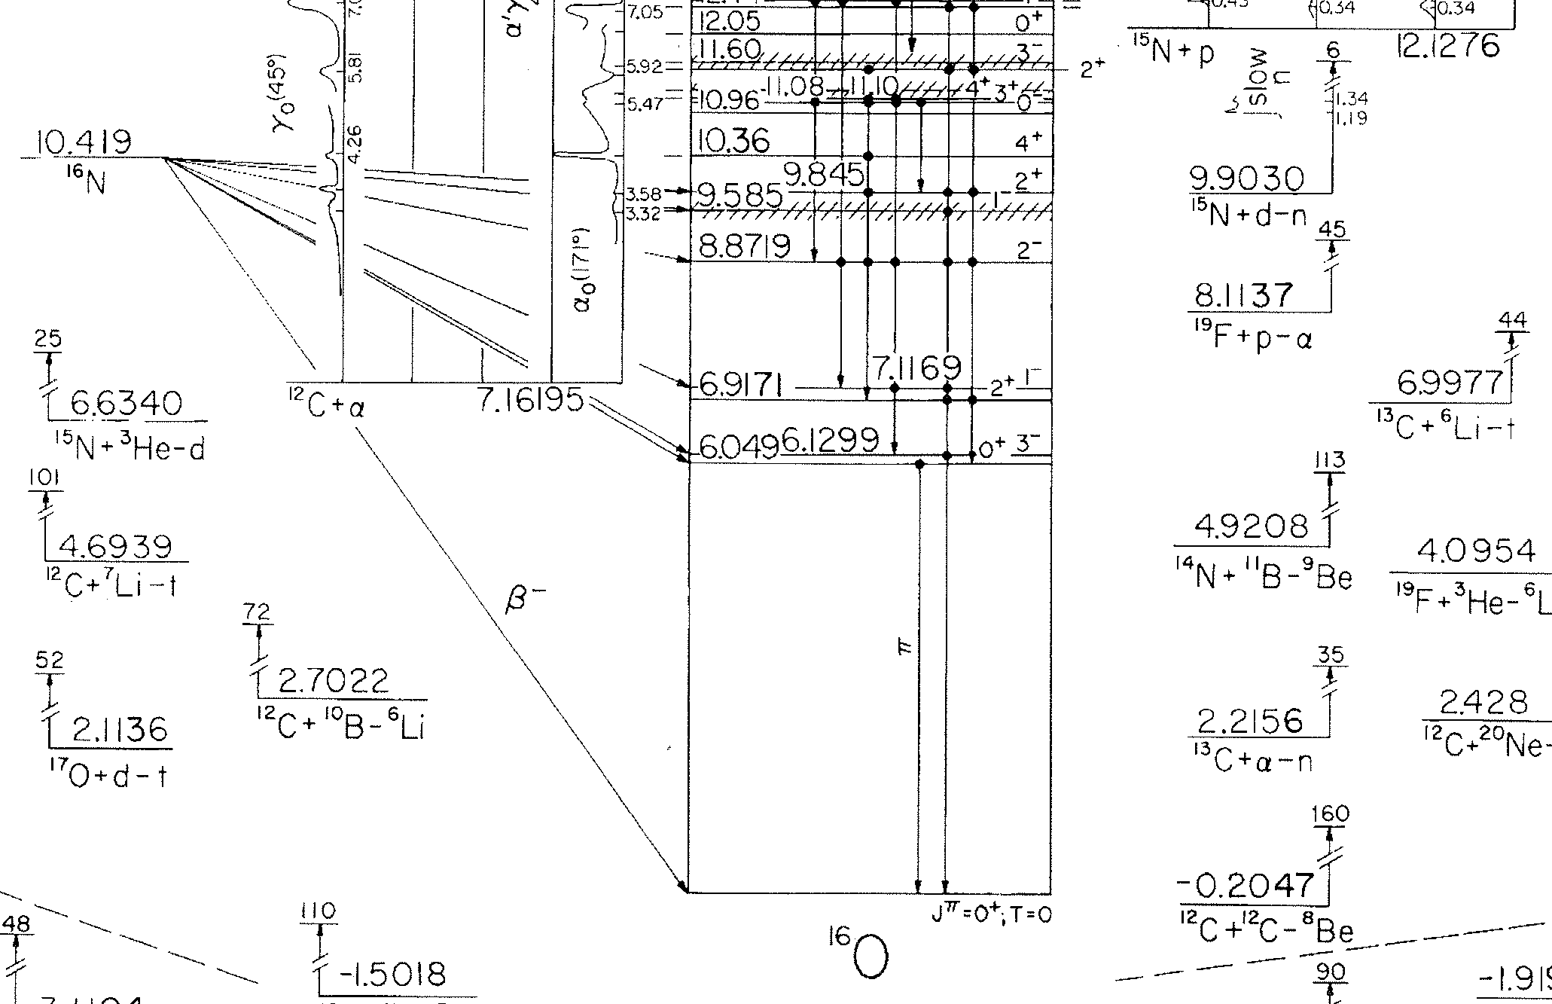

Slide 24
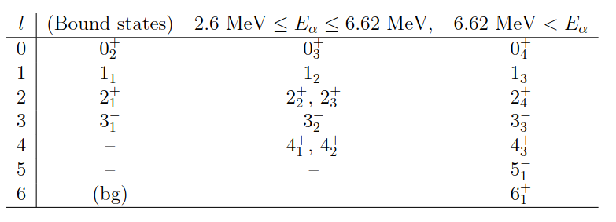
Phase shifts for partial waves
Phase shift data for partial waves, l = 0,1,2,3,4,5,6
Resonant energy and widths, 7 resonant states

Slide 25
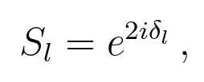
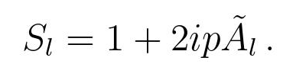
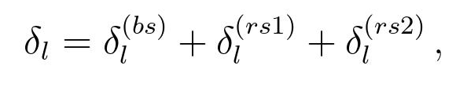
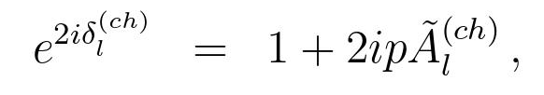
S matrices of the elastic scattering
S matrix

Slide 26
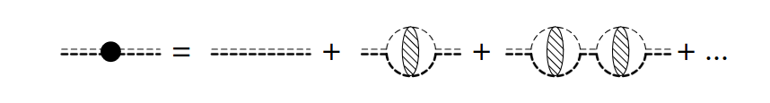
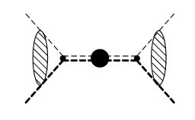
Elastic $α$-${}_{ }^{12}C$ scattering at low energies
Effective Lagrangian
Feynman diagrams
-- Dressed ${}_{ }^{16}O$ propagators
-- Elastic scattering amplitudes

Slide 27
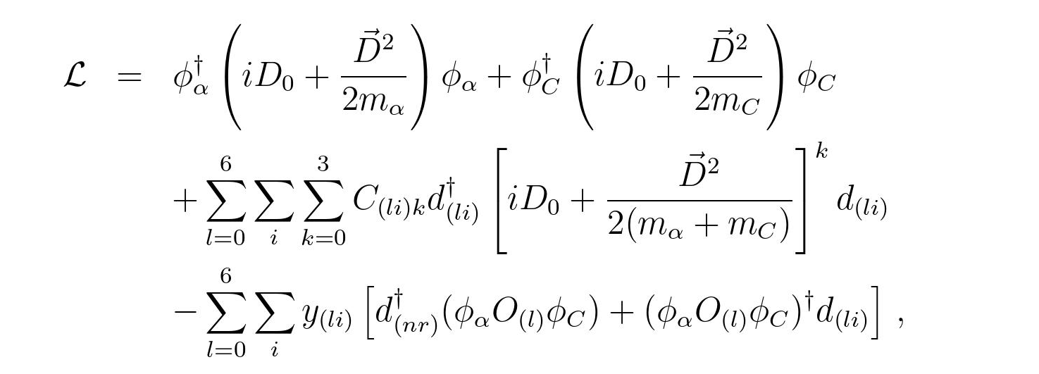
Effective Lagrangian

Slide 28
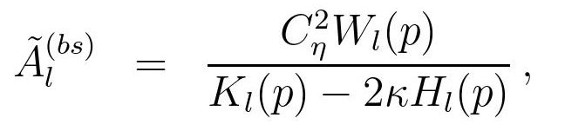
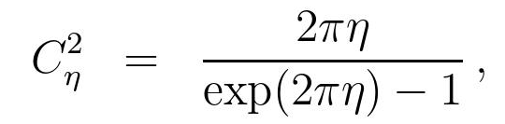
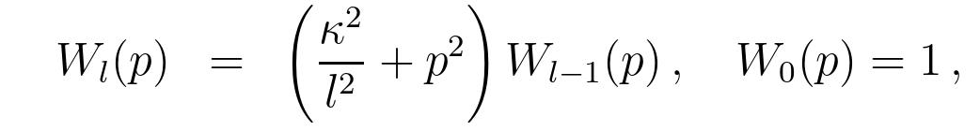
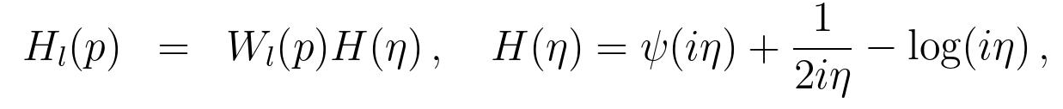
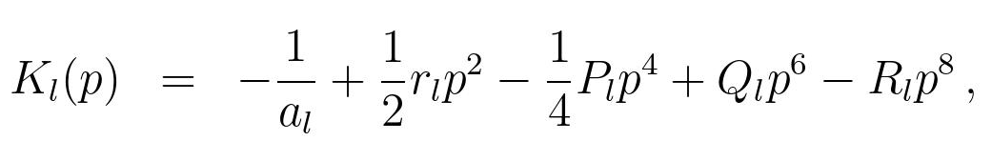
Amplitude for bound states

Slide 29
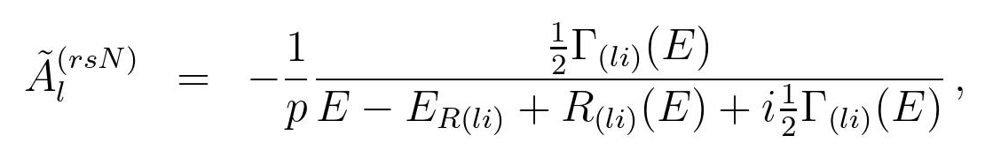
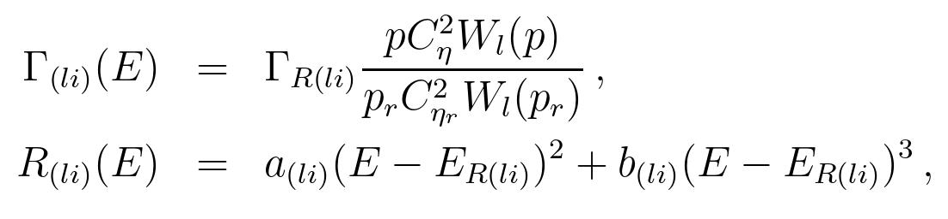
Amplitudes for resonant states

Slide 30
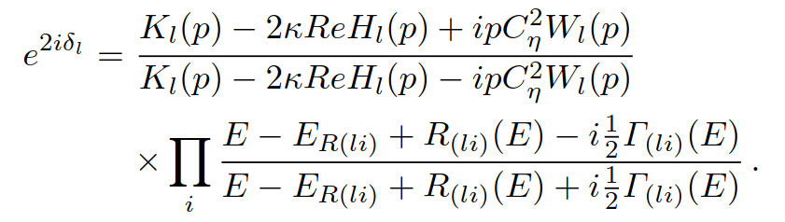
S matrices

Slide 31
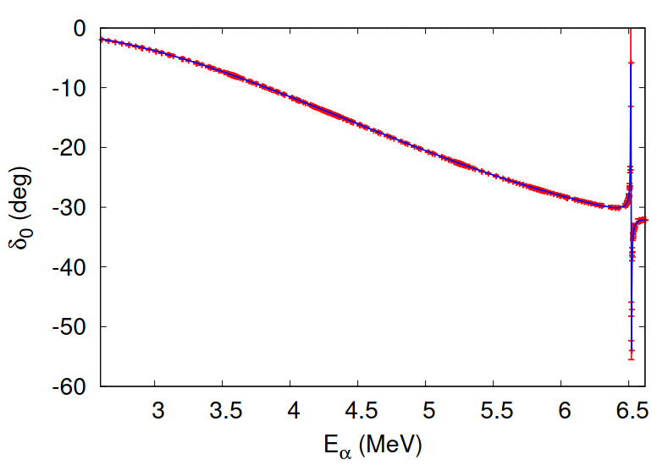
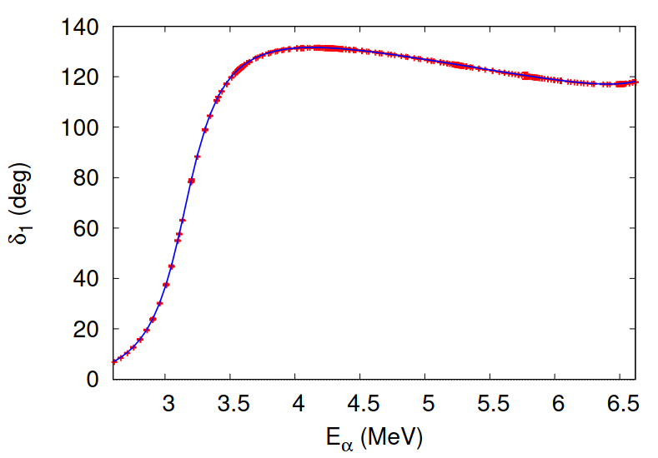
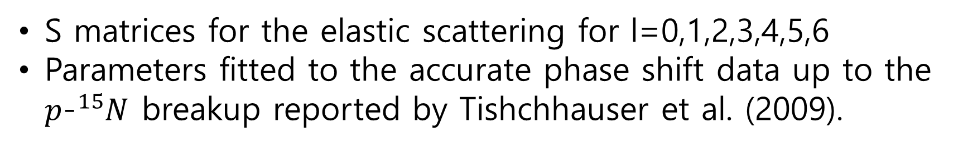
Phase shifts data
S matrices for the elastic scattering for l=0,1,2,3,4,5,6
Parameters fitted to the accurate phase shift data up to the $p$-${}_{ }^{15}N$ breakup reported by Tishchhauser et al. (2009).

Slide 32
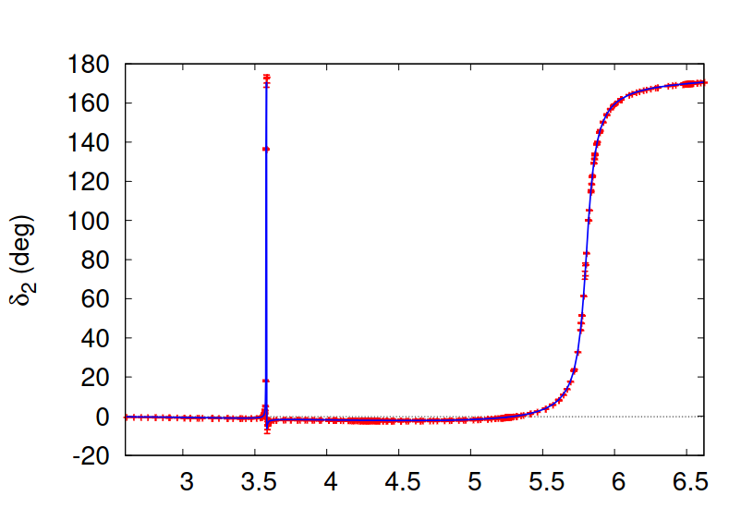
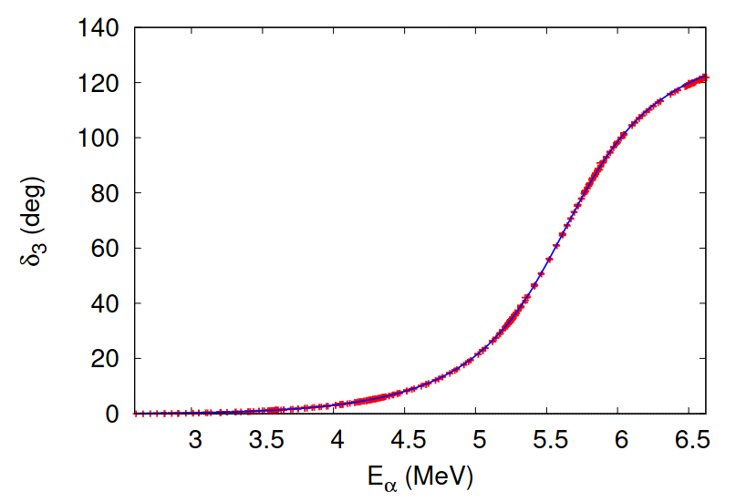
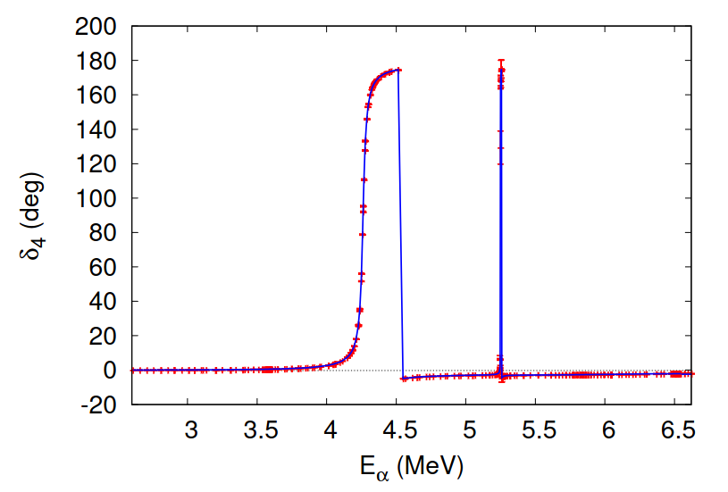
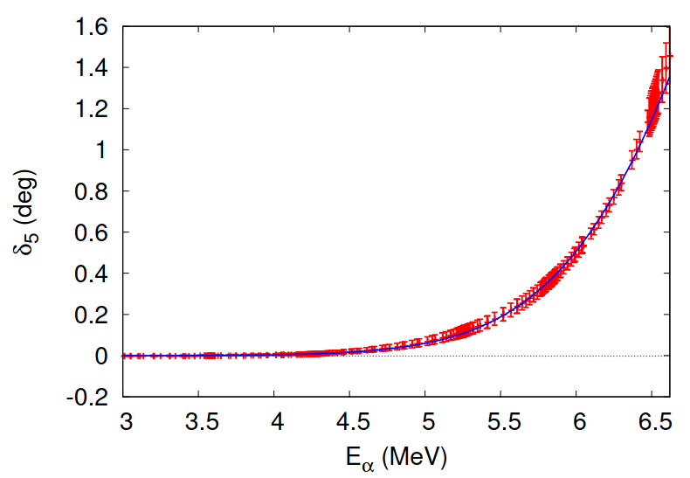

Slide 33
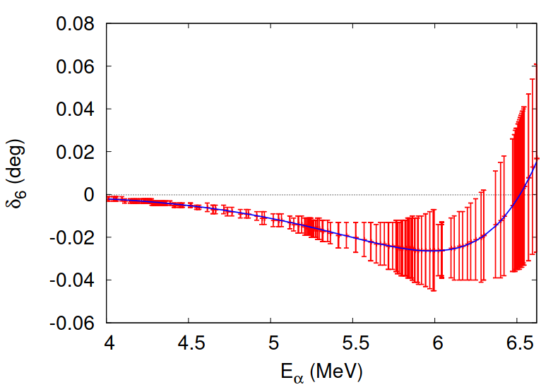

Slide 34
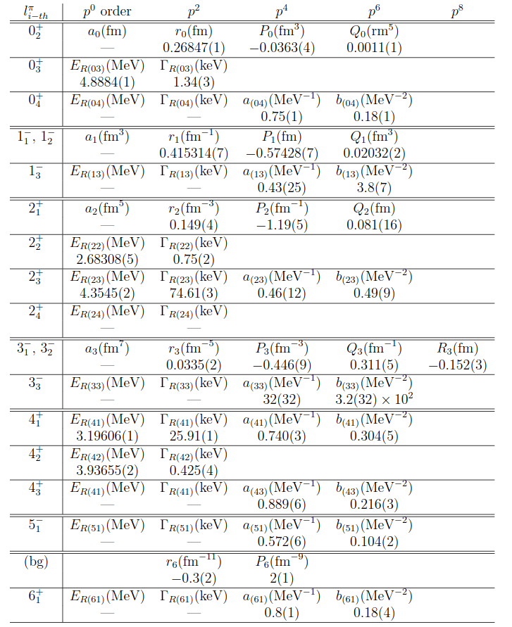
L=0, 7 parameters,
L=1, 5,
L=2, 9,
L=3, 6,
L=4, 8,
L=5, 2,
L=6, 4,
41 parameters in total

Slide 35

Differential cross section of elastic $α$-${}_{ }^{12}C$ scattering
Phase shifts are deduced by using the R-matrix analysis, while the cluster EFT reproduced the phase shifts very well.
Question: is there a model dependence in the phase shift analysis?
We fit the parameters of EFT directly to experimental data of the differential cross section.

Slide 36
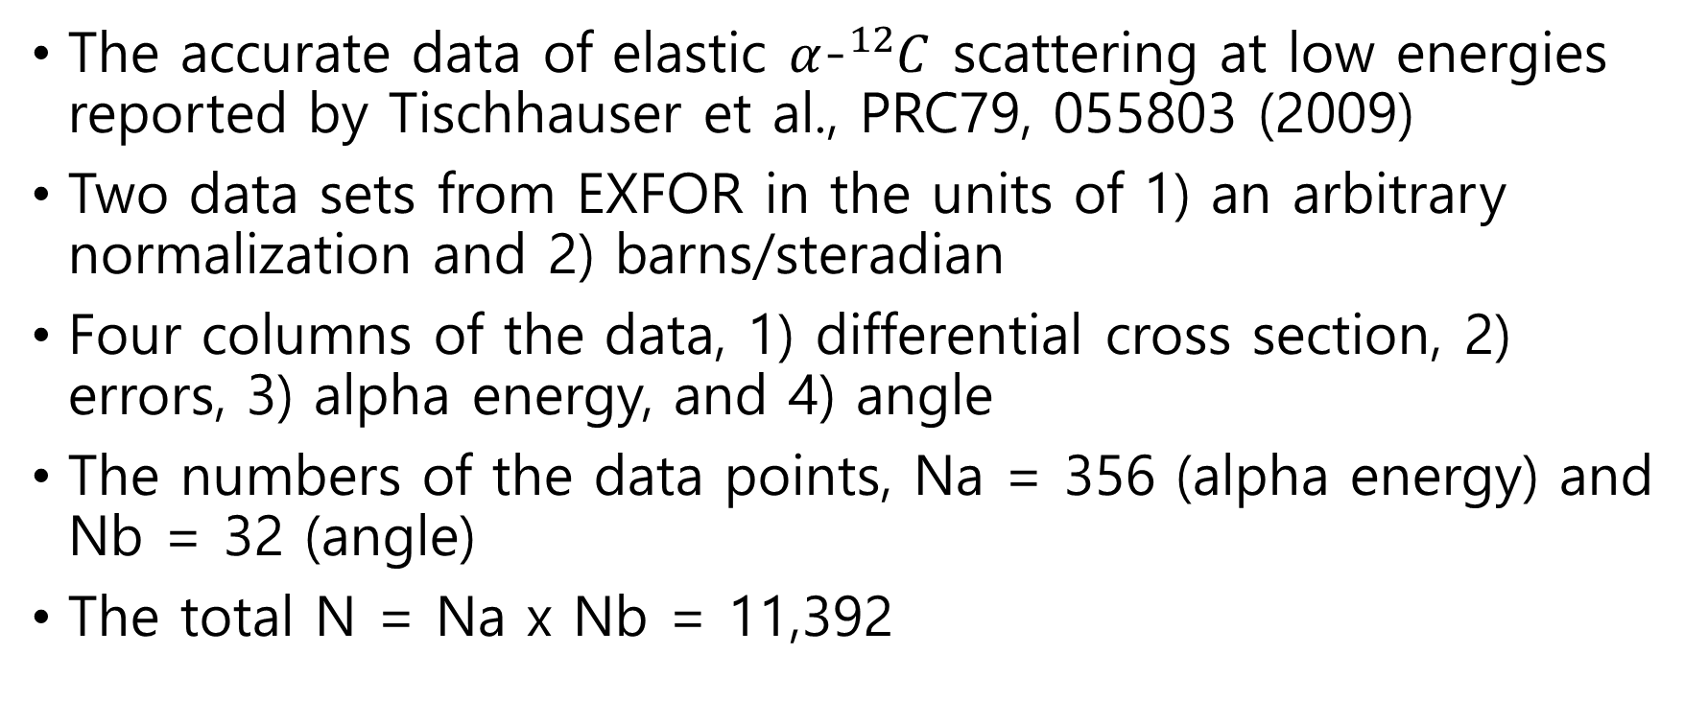
Differential cross section data
The accurate data of elastic $α$-${}_{ }^{12}C$ scattering at low energies reported by Tischhauser et al., PRC79, 055803 (2009)
Two data sets from EXFOR in the units of 1) an arbitrary normalization and 2) barns/steradian
Four columns of the data, 1) differential cross section, 2) errors, 3) alpha energy, and 4) angle
The numbers of the data points, Na = 356 (alpha energy) and Nb = 32 (angle)
The total N = Na x Nb = 11,392

Slide 37
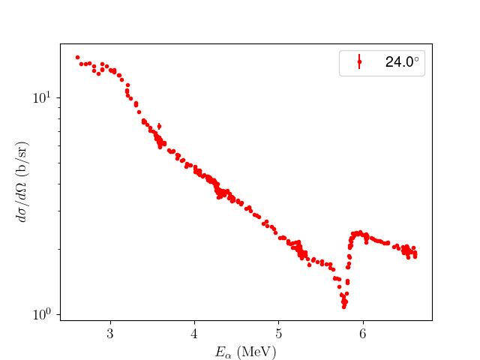
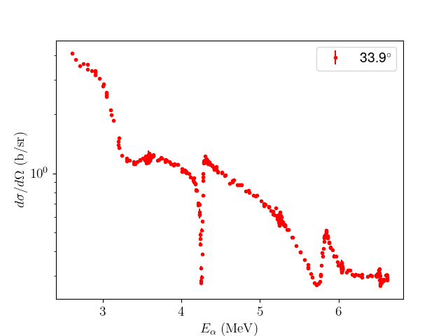
DC_data, Nb = 32 angles

Slide 38
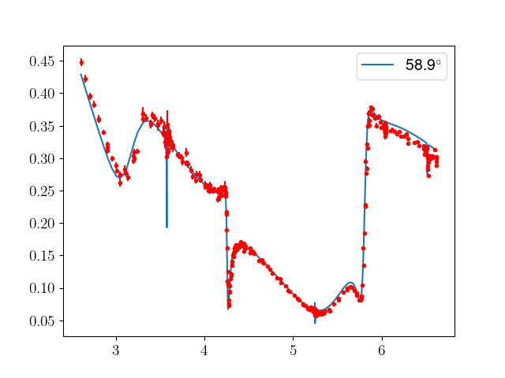
Before the parameter fit

Slide 39
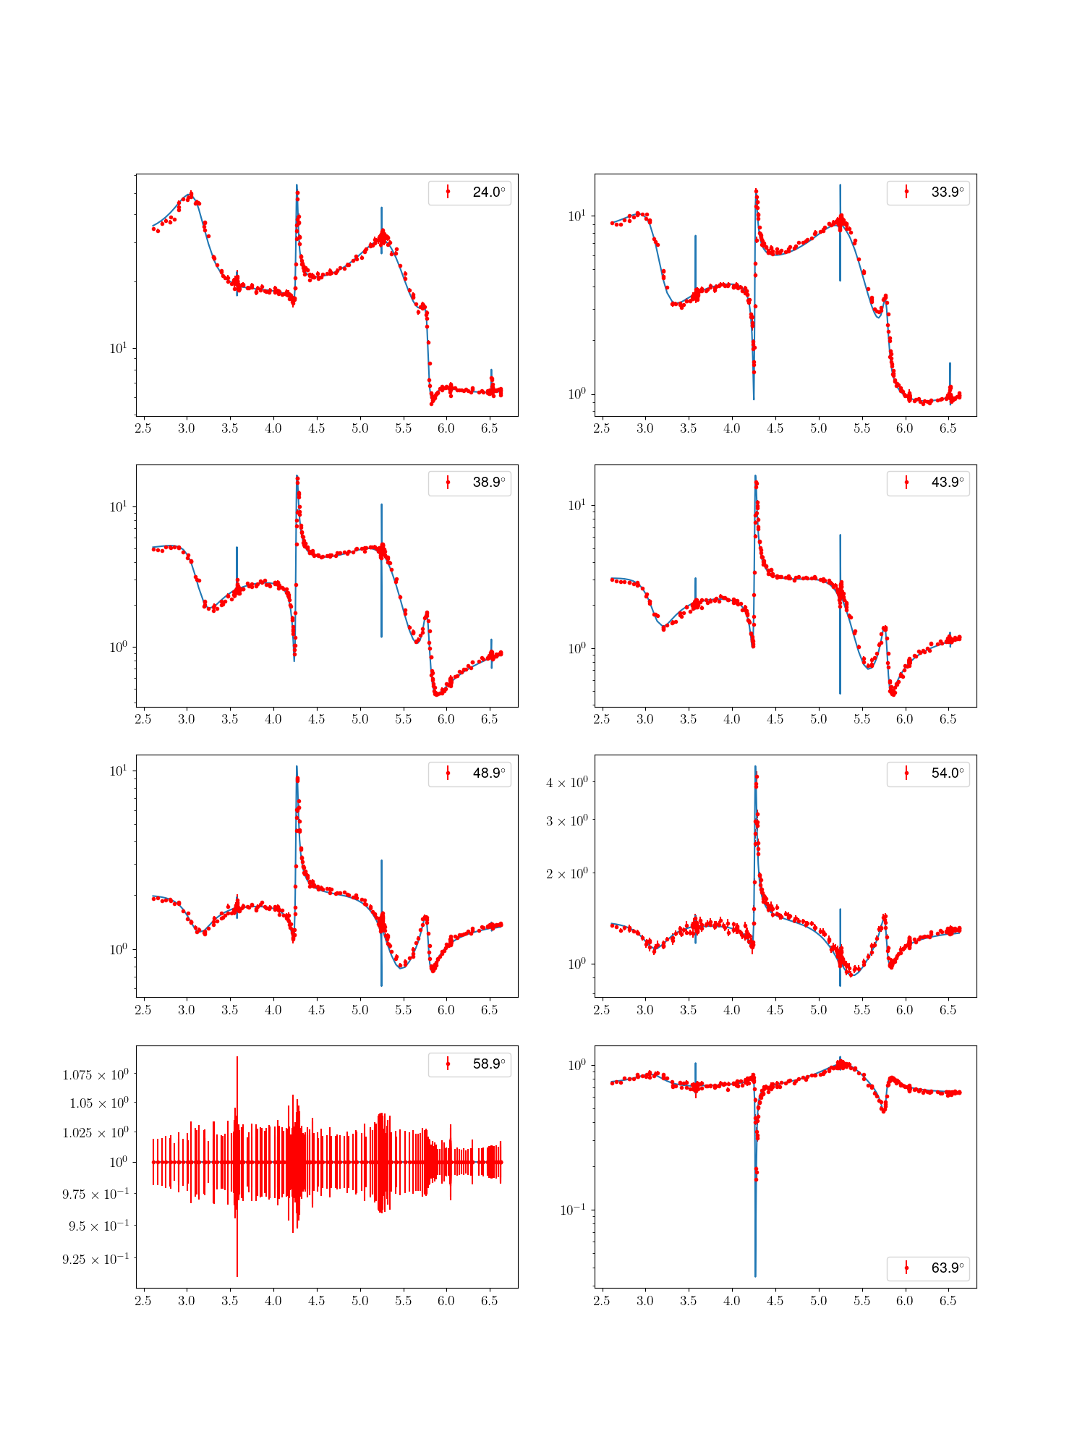


Slide 40



Slide 41
A plan
1) Make sure whether the data of the differential cross section can be reproduced well by the results of the cluster EFT. (The chi2 of the initial values of parameters is chi2/N = 29.9.)
2) How the phase shifts and their uncertainties of the elastic scattering are altered by fitting the 41 parameters of the cluster EFT to the differential cross section data.
3) To study the raw data by ML.

Slide 42
Preliminary numerical results
Perform the standard chi2 fit in an MCMC analysis
The number of parameter is reduced from 41 to 35.
N(step) = 100,000, averaged autocollimation time, tau =
Using a home PC with an Intel i5 processer (about 10 hours)

Slide 43

35 parameters
N(steps) = 100,000
Mean autocorrelation steps = 1070
Chi2/N = 6.559

Slide 44


Slide 45



Slide 46



Slide 47


Slide 48

Preliminary results
A value of the chi2/N of the differential cross section data is improved from 30 to 6.6
Differences observed in the phase shift data in the sharp resonant $0_{3}^{+}$, $2_{2}^{+}$, $4_{2}^{+ }$ states of ${}_{ }^{16}O$ and the shape of the high energy part, $E_{α}$ > 5 MeV, for l = 5 and 6.
Error estimate of cross section and phase shifts is now in progress

Slide 49

Summary and remarks
EFTs are a new method for the study of nuclear reactions for nuclear astrophysics.
Phase shift data the elastic scattering are well reproduced by the fitted vales of the parameters of cluster EFT.
We employed an MCMC analysis to fit the parameters of cluster EFT to the differential cross section data to study the scheme dependence in phase shifts and their uncertainties.
Another application of EFTs for nuclear astrophysics, ${}_{ }^{13}{C(α,n){}_{ }^{16}O}$ reaction, is under discussion with colleagues.

Slide 51



