Slide 1




FUDAN UNIVERSITY
Direct Measurement of the D(γ,n) on SLEGS and Its Impact on BBN
Yinji Chen, FDU
August 9, 2025
Notes:
Good morning, everyone. My name is Yinji Chen. Currently I‘m a postdoc under Professor Jianjun He at fudan university. I’m very happy to be here to share our recent work conducted at the SLEGS of SSRF.
Using the gamma-ray beam of SLEGS, we performed a direct measurement of the D(γ,n) reaction and investigate its impact on Big bang Nu…. In this presentation, I will show the background of this experiment, the method, key results, and some astrophysical implications. Ok ,lt’s start!
. It’s the inverse reaction of H(n,γ)D. Proton capture of a neutron to produce D is a important process in Big Bang Nucleosynthesis (BBN). In this presentation, I will show the background of this experiment, the method, key results, and some astrophysical implications.

Slide 2

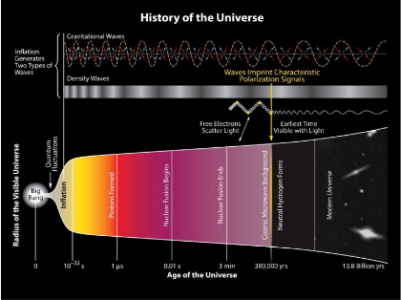
Background and significance
1. The Big Bang and Primordial Nuclear Synthesis
Primordial Nucleosynthesis: 3min ~ 0.5h after the Big Bang;
A unique probe for understanding the early universe;
Light elements (H, He, Li, ...) were produced.
2. Recheck to the standard Big Bang model
Prediction of the primordial light elements and comparing them with observation is a key check.
The observation accuracy of D has significantly improved (~1.19%). Similar accuracy is required for related nuclear reaction inputs (cross-section, rate, …).
So, accurate measurement of the relevant reaction must be carried out in BBN energies!
Schematic diagram of cosmic evolution
1
Notes:
the first slide describes the background and significance of this research. the left picture shows the brief evolution of our universe.
we all know our universe originated from the Big Bang about 13.8 billion years ago, After the Big Bang, the universe experienced rapid expansion and cooling. In about three minutes, the primordial nucleosynthesis of the universe began, it lasted for about twenty minutes. So , BBN is a unique probe for understanding the early universe. During this period, light elements such as hydrogen, helium, and lithium were produced. In these light elements, Deuterium is the first one produced by the BBN and it’s a raw material for subsequent nucleosynthesis. So, the study of deuterium abundance in the early universe is very important. It’s also the focus of my report today.
In addition, predicting the abundance of light elements such as D, 3He, 4He, and 7Li, as well as comparing them with observation, can help us recheck the standard Big Bang model.
Recently, the observation accuracy of deuterium has significantly improved, reaching 1.19%. So, the related nuclear reaction inputs used for calculation also needs to achieve similar accuracy. At present, the uncertainty mainly comes from such as cross-sections, rates and so on. So accurate measurement of the relevant reaction must be carried out in BBN energies!

Slide 3
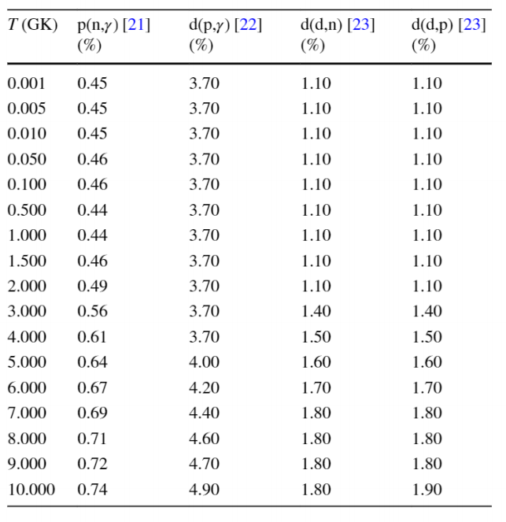

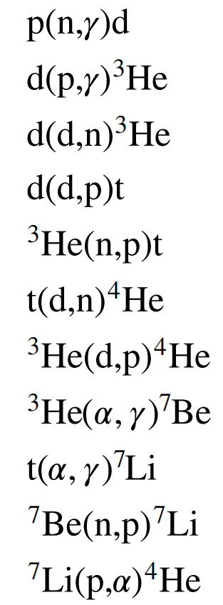
Reaction related to Y_{D}
important reaction in BBN Network
PRIMAT default rate uncertainty
key starting point
D abundance related
uncertainty:
calculation~ 1.83%
observation~1.19%
Z. L. Shen, J. J. He, Nucl. Sci. Tech. 35:63 (2024)
2
Notes:
On the left, we list 11 important nuclear reactions in the BBN network. Among these, the four reactions in the red box are most related to the deuterium abundance.
In the right table, we can see the uncertainties of this four reactions. These values correspond to the input of the PRIMAT BBN code. Based on these uncertainties, we can calculate the error of deuterium abundance is about 1.83%. Compared with the observation (1.19%), there still remains a significant gap.
Among these four reactions, the pn capture reaction (p(n,γ)D) is the key starting point of BBN. It can significantly affect the deuterium abundance and subsequent nucleosynthesis. So, we planned to perform a high-precision measurement to help reduce uncertainties.

Slide 4
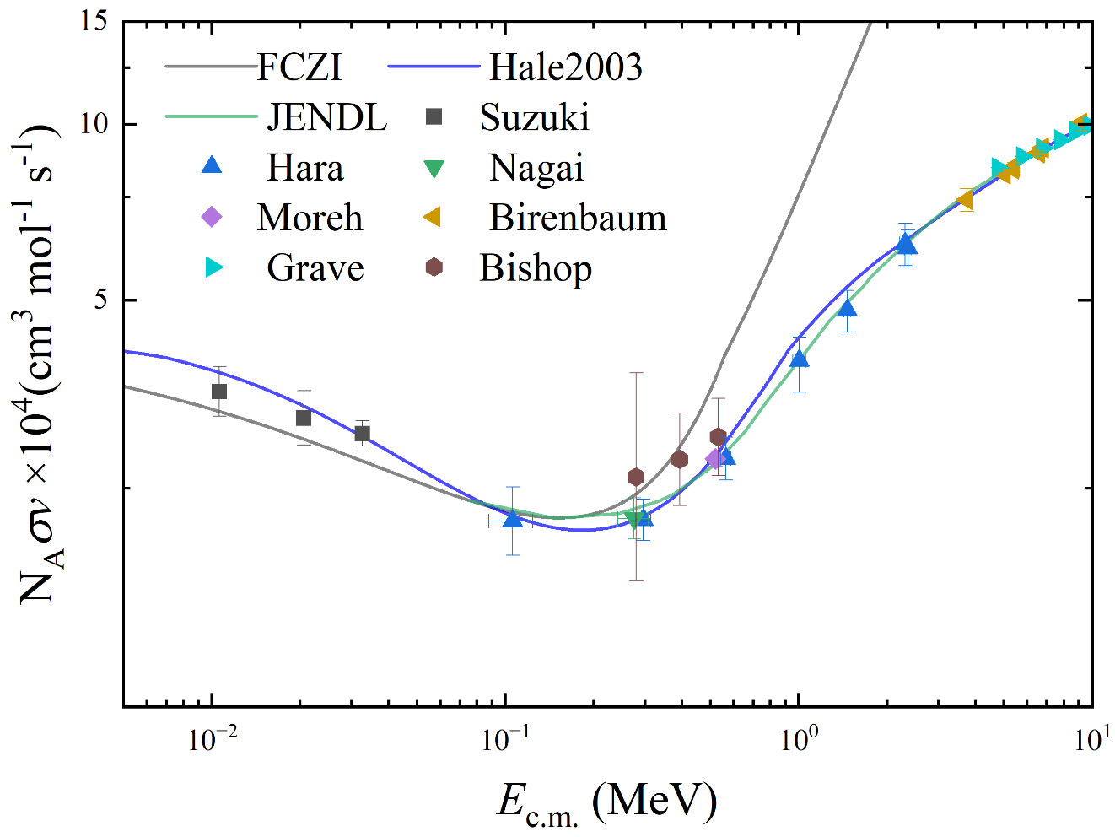
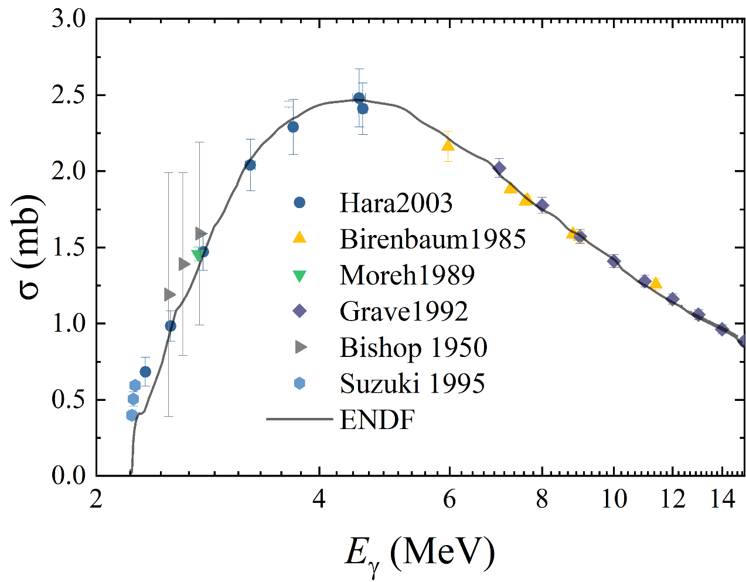
Previous research data
¹H(n, γ)D
D(γ, n)¹H
(1) Lack of data and large errors
(2) Some differences between different datasets, lack of continuous datasets in BBN energies.
Significant errors existing in the rate and abundance evaluation!
Goal：Conduct continuous and consistent precise measurement in the BBN energy to constrain rates and abundances.
3
Notes:
Ok, these two pictures show the previous research data of the pn capture reaction and its inverse reaction D(g,n). The lines represent theories or calculations.
We can see in the energy region we interest, there are few data and large errors. If we use these data to make subsequent astrophysical calculations，Significant errors will be introduced.
So Our goal was determined to conduct continuous and consistent precise measurement in the BBN energy to constrain the uncertainties of rates and abundances.

Slide 5
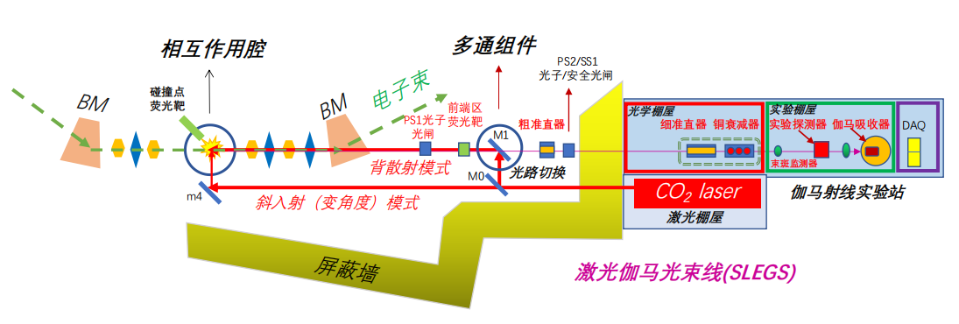
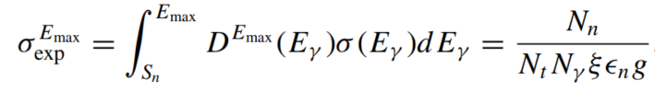
Experimental method
SLEGS built in 2021
provide a stable and high intensity gamma beam
Experiment Setup
³He detector
γ beam
target(D₂O)
LaBr₃
³He detector
0.4~21MeV@20°~180°；10^{6~8} phs/s；resolution: 2~15%
Direct measurement of the inverse reaction D(γ, n)¹H
γ-beam hits the high-purity D₂O target
³He array for neutrons detection
LaBr₃ as gamma beam monitor
4
Notes:
about the SSRF and laser electron gamma source，many talks before have introduced the details of the facility, so we don’t need to introduce them again. The SLEGS was built in 2021, it can provide a stable and high intensity gamma beam for us to make some photonuclear studies. the energy ranges from 0.4 to 21 MeV, and the intensity can reach 10 to the 6 to 8. and the resolution varies with the energy from 2%~15%.
In our measurement, we use this gamma beam hit the high purity D target, and use the He-3 array to detect the photoneutrons produced by the reaction, and set a LaBr3 detector at the end of the beamline as a monitor of the gamma beam, and eventually we can calculate the preliminary cross-section using this formula.
yeah, this is a brief summary of the direct measurement method, sounds very easy, is it?

Slide 6
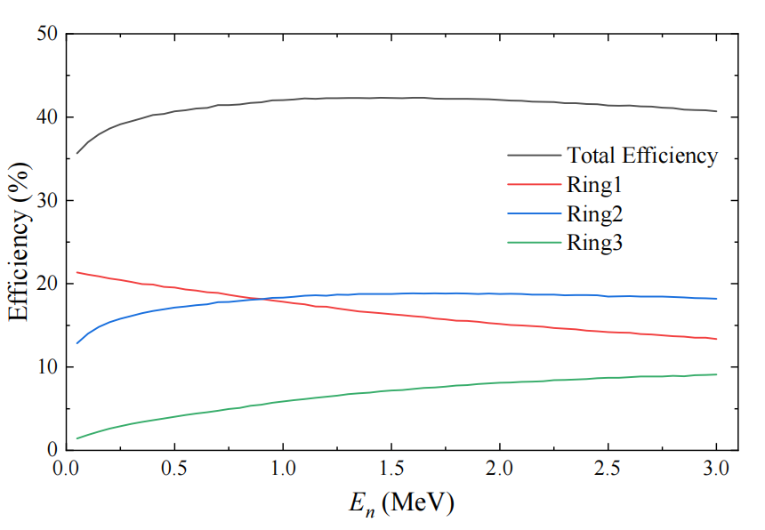
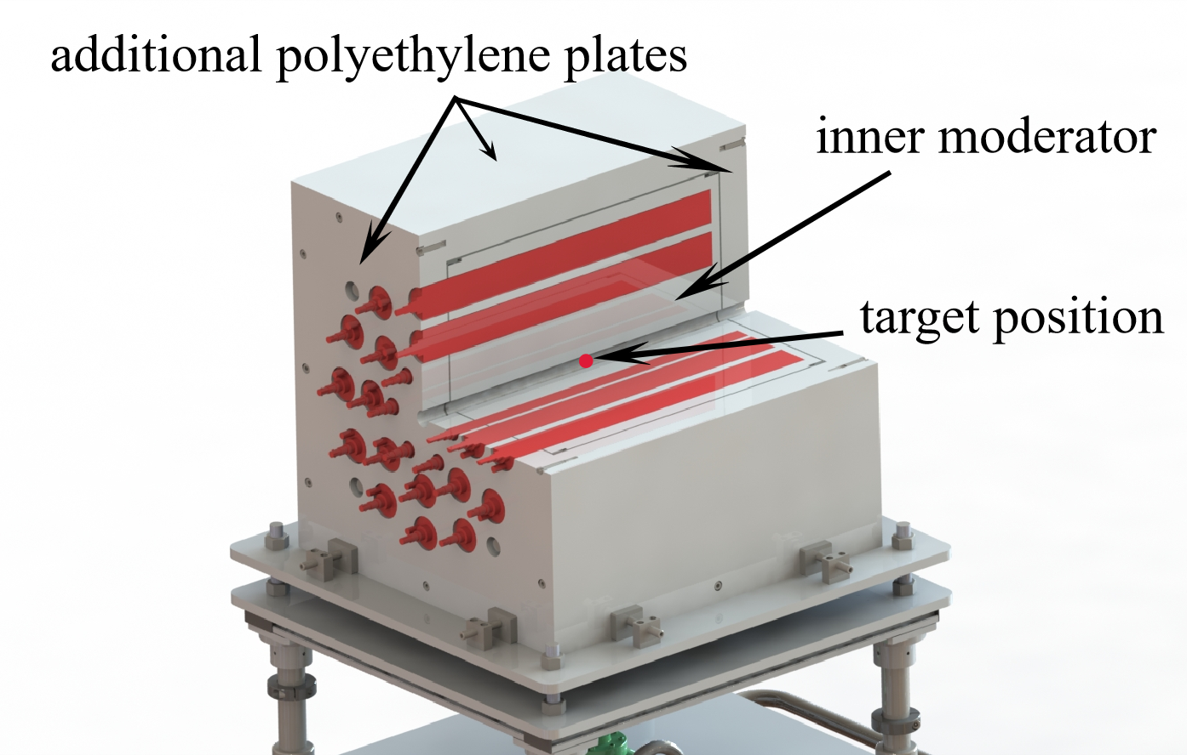
³He flat efficiency detector array
4π ³He (26) neutron detector array
the neutron detection efficiency of ³He array
trends of the inner and outer layers are complementary, resulting in a flat efficiency of ~40%.
5
Notes:
ok, the left picture shows the 3He flat efficiency detector array. it comprises 26 3He tubes, and there are three layers from inside to outside . Our target was set at the geometric center of this array. Meanwhile, Both the inside and outside were filled with polyethylene with boron to thermalize neutrons.
and the right picture shows the efficiency of the detector array. We can see there are four lines in total. these three colourful lines represent the efficiency of layer1,layer2 and layer3, and the black one is the total. we can find the red line and green line show opposite trends, so they are almost complementary. but the blue line looks like a flat platform, when the neutron energy is from 1 MeV to 3 MeV, it‘s almost a constant. So the total one can also be considered as a constant ~40%。of course, in our measurement, the accurate efficiency was determined by the Ring ratio technique.

Slide 7
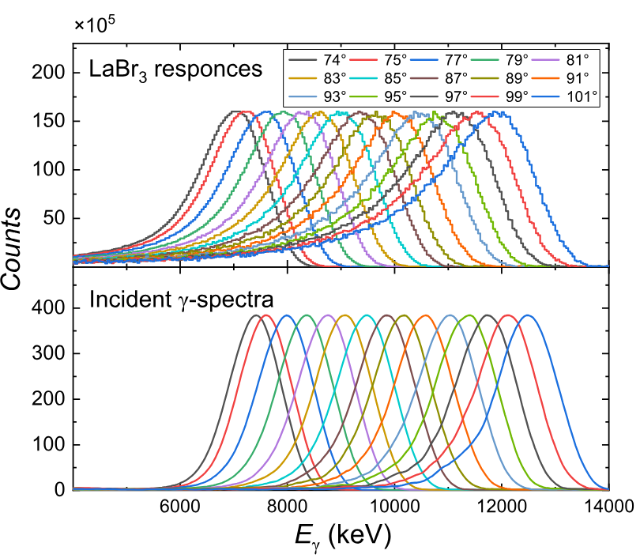
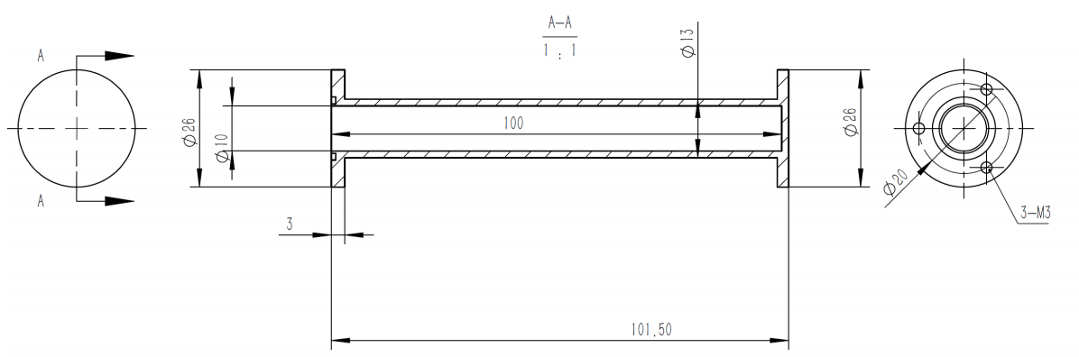
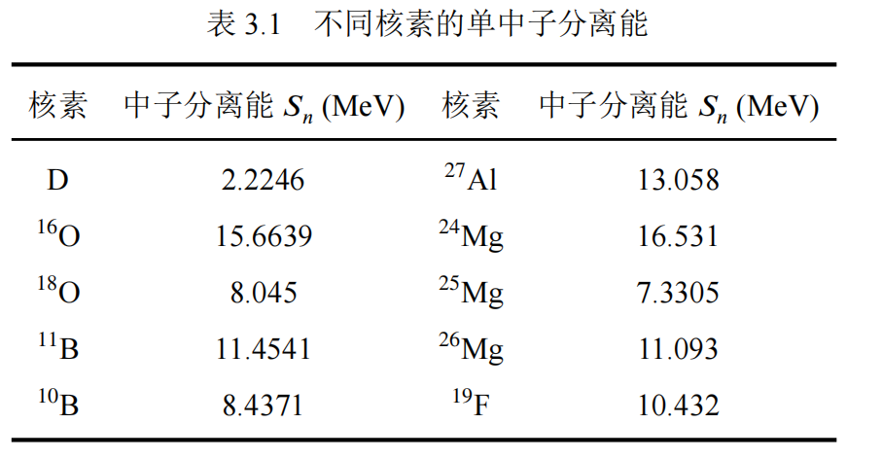


LaBr₃ and Target
high purity D₂O target
Nuclide S_{n}(MeV) Nuclide S_{n}(MeV)
Impurities and S_{n} in the target
SLEGS typical gamma energy spectrum
almost only natural neutron background
6
Notes:
this left picture show the typical gamma energy spectrum measured by LaBr3 detector. the upper panel shows the responces of the detector, and the lower panel is the reconstructed gamma spectrum. we can find it looks like a gaussian distribution with a width about several hundreds keV.
and the right one is out high purity D target, we use an aluminum tube, and fill it with heavy water. the length of the taget is 100 mm. Here I list all the possible impurities in the target and corresponding neutron separation energies. we can find the separation energy of all the impurities is much higher than the energy region in our measurement. so in the data analysis ,we can almost only consider the natural neutron background, it’s really a excellent target for us.

Slide 8
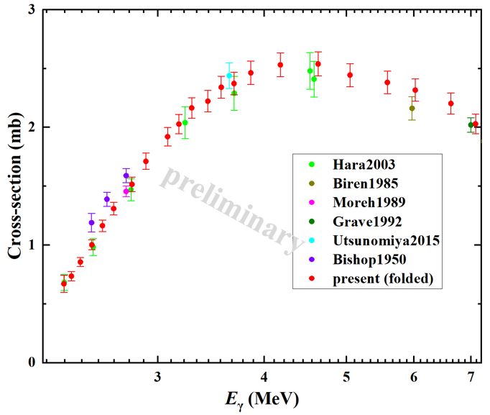
Measurement
In this measurement:
22 data points covering 2.3~7.2 MeV;
continuous、consistent and accurate;
convolution of σ and γ spectra;
called them ‘folded’ or ‘quasi-monochromatic’.
Need to derive true monochromatic photoneutron cross sections!!!
S_{n} = 2.224 MeV
7
Notes:
this slide show the basic procedure in our measurement. we measured 22 data points in total from about 2.3MeV to 7.2MeV，we marked them with red points in the left picture. we can see it’s really a continuous、consistent and accurate measurement. But we should note, these data is just preliminary data, because they represent the convolution of the real sigma and gamma spectra, for one point ,it corresponds to a gamma distribution in this picture. we can call them “folded” or “quasi-monochromatic” cross section.
We can’t use them to make subsequent astrophysical calculations，so we still need to work further to derive true monochromatic photoneutron cross sections.

Slide 9
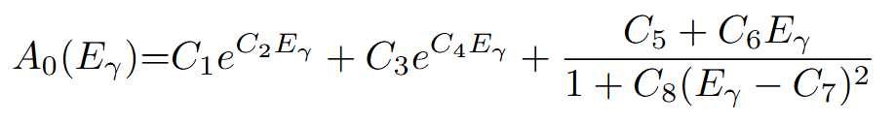

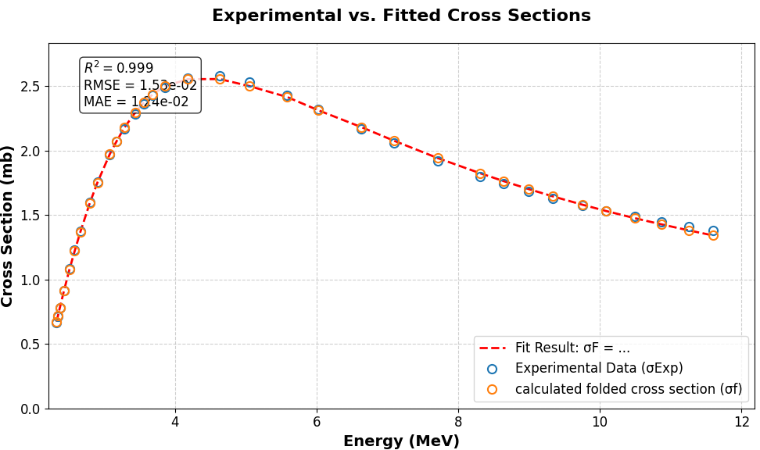
Method to obtain monochromatic σ
4π·A₀
convolution
γ spectrum
Fit
8 param
experimental folded data
Fit well!
Fit well!
P. Rossi, et al. Phys. Rev. C 40:5 (1989)
8
Notes:
and now I want to briefly introduce our method to derive the monochromatic sigma. We found a A-zero expression in this paper. It can describe the previous high energy experimental data well, including the total cross-section and angular distribution. and the 4Pi times the A-zero is the total cross section. so we firstly make the convolution of the A-0 and gamma-spectrum, and then fit them to our experimental folded data. through this process, we can determine the 8 parameters in the A0, and finally determine the true monochromatic σ. this picture shows the fitting, the red ones is the convolution, and the blue ones is experimental data, they fit very well!

Slide 10
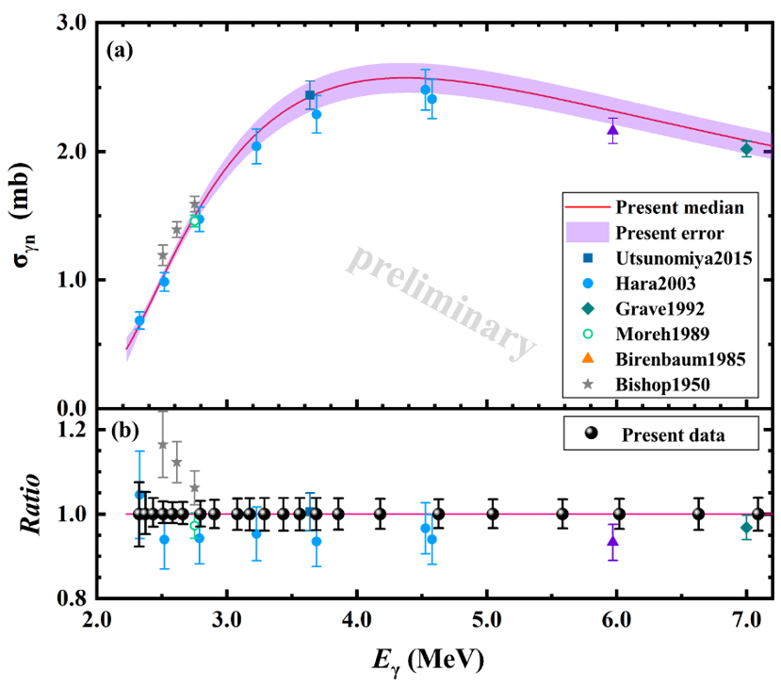
Result 1: D(γ,n) monochromatic σ
Obtained the most accurate data
continuous and consistent
error: 3~4%
Provided new criteria for evaluation
1.2~2.2 times more accurate than Hara et al.
Hara's data is significantly lower and can be removed in future evaluations
9
Notes:
next step, we plot our new results together with previous data. the red line is our median value, and the shadow is our error band. maybe it’s difficult to compare it with others, so we plot the ratio. the black ones is our new data. Now we can say we have obtained the most accurate data. and they are continuous and consistent. the error bar is about 3~4%.
in the past, the blue points were measured by hara in 2003, this dataset was usually considered as the criteria to evaluate the D(g,n) cross section. But hara‘s data is also a kind of folded cross-section. So it’s unreasonable before. But now, we have true continuous ,consistent, and the most accurate data, we can use them as a new criteria for evaluation. through the comparison, we can also find hara‘s data is significantly lower, it shows the the limitation of the folded cross-section from another perspective.

Slide 11
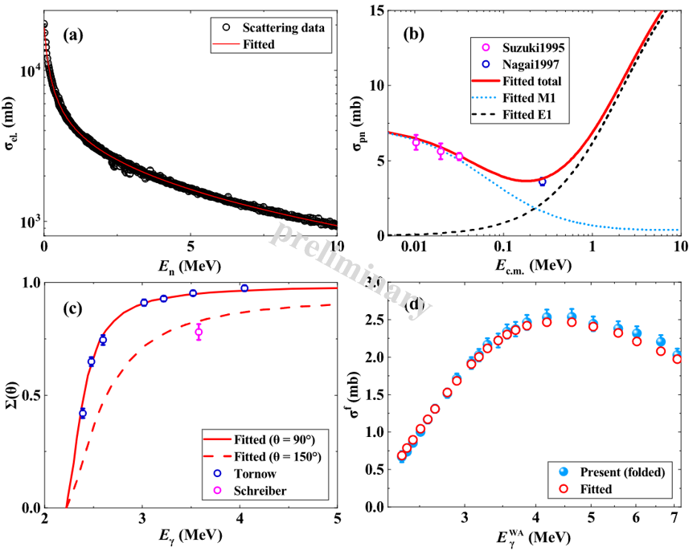
Result 2：Re-evaluation of ¹H(n,γ)D cross-section
Global multi-channel fitting based on MCMC and dEFT：
1. np scattering data (E_{c.m.} < 5 MeV)
2. ¹H(n, γ)D cross-section data
3. Thermal neutron capture data
4. D(γ,n) cross-section data
5. photon analyzing power data
Removed unreasonable Hara’s data; new SLEGS precise data and new np scattering dataset were added.
np scattering cross-section channel
np capture cross-section channel
photon analyzing
power
D(γ,n) cross-
section channel
Thanks very much to Prof. Ando from Daegu University!!!
10
Notes:
based on the analysis above, then, we need to turn our focus to the cross-section of p(n,g)D. we make a Global multi-channel fitting based on the MCMC and dEFT with the help of professor ando from。。。. In this fitting, we include five channels, they are np scattering data, p(n,g)D cross-section data, Thermal neutron capture data, and the new D(γ,n) cross-section, and finally photon analyzing power data. here, We need to express our thanks to Professor Ando, he help us complete this calculation.
In his talk, similar evaluation has been made, but in our new evaluation, we removed Hara’s data and add new SLEGS precise data and new np scattering dataset.

Slide 12
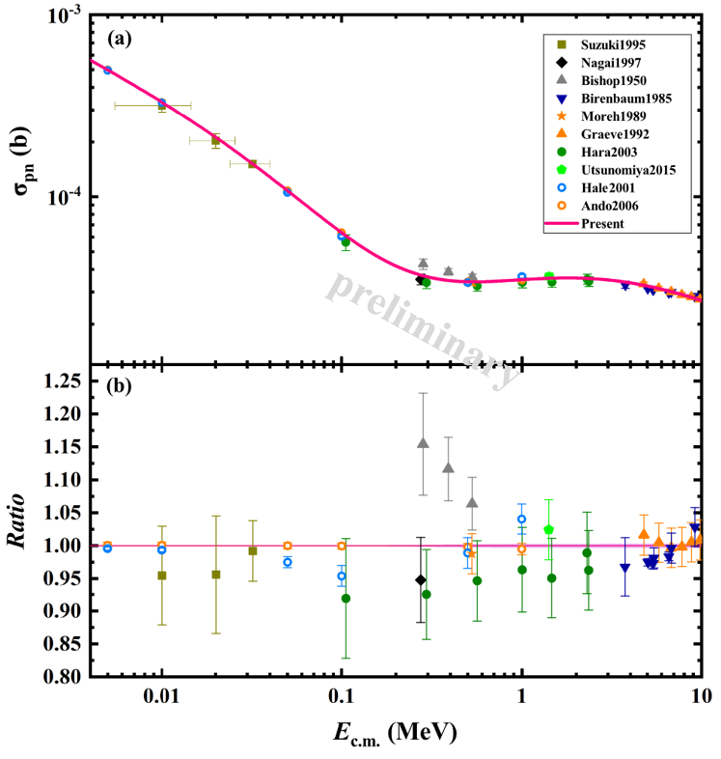
Result 2：Re-evaluation of ¹H(n,γ)D cross-section
Obtained pn capture cross-section in the range of 0.005~10 MeV;
Error~0.12%, 3 times improved than previous (>0.4%)
Significant differences (>4% at E_{c.m.}=0.1, 1 MeV) were observed between the R-Matrix results and others;
Our new evalution suggests that there may be some uncertain errors in Hale R-Matrix.
11
Notes:
Ok， the red line is our new pn capture cross-section, the error bar is about 0.12%. It’s so small, so we can’t see it on the plot. But Compared with previous accuracy, we have 3 times improved！
Besides, in ando’s talk, he mentioned the Hale R-Matrix results, in this picture it is marked with blue point. we can see this one。。。this one.. and this one. there are Significant differences between the R-Matrix and others. our new evalution suggests that there may be some uncertain errors in his R-Matrix calculation.

Slide 13
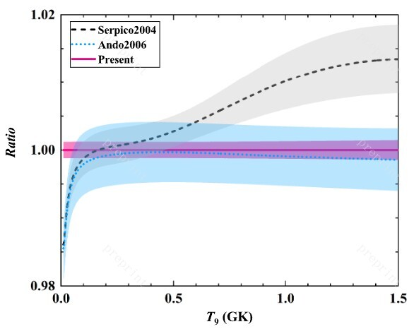
Result 3：¹H(n,γ)D rate
The reaction rate (T=0.009~10 GK) was calculated using pn capture cross-section (5×10⁻⁹~10 MeV);
Uncertainty reduced by 2~4 times!
Subsequent astrophysical calculations have been completed by Prof. Kajino’s group (Beihang University), and more detailed results will be presented in the future.
12
Notes:
and further, with the cross-secton, we calculate the reaction rate of pn capture, from 0.009~10 GK. the red one is our new rate. we can find we reduced the Uncertainty by 2times~4 times! It is a significant improvement.
Besides, subsequent astrophysical calculations have been completed by Prof. Kajino’s group (Beihang University), and more details will be presented in the future.

Slide 14
Summary
1. We directly measured the D(γ, n) reaction on SLEGS, covering the energy region of astrophysical interest and providing continuous, consistent, and accurate cross-section data for the first time.
2. We re-evaluated the cross-section of ¹H(n, γ)D (BBN key reaction ), reducing the uncertainty from ~0.4% to ~0.12% and clarifying the discrepancies between the previous datasets.
3. We determined the most accurate ¹H(n, γ)D rates within the BBN temperature range, achieving a 3-4 fold reduction in uncertainty. More detailed astrophysical implications will be presented in the near future.
13
Notes:
Ok, finally, let’s make a brief summary.
at first, We directly measured the D(γ, n) reaction on SLEGS, and get continuous, consistent, and accurate cross-section data for the first time.
Secondly, We evaluated the cross-section of pn capture, and reduce the uncertainty 2 times to 4times
Finally, We determined the most accurate pn capture rates in the BBN temperature range, and we will show More detailed astrophysical implications maybe in this month or next month with the help of professor kajino and his group.

Slide 15





Collaboration
Fudan Univ.：Y. J. Chen, J. J. He (Supervisor), H. Zhang
SARI/SLEGS：G. T. Fan, H. W. Wang, Z. R. Hao, et al.
Beihang Univ.：T. Kajino, H. R. Fan, Y. D. Luo, et al.
Daegu Univ.: S. Ando
Beijing Normal Univ.：L. Y. Zhang, Z. L. Shen
Thank you all !
14
Notes:
and this is our Collaboration group, professor jianjun is my Supervisor. in our measurement, the staffs and students at SLEGS help us a lot. and Professor kajino and Ando help us make some important caculations.
OK， that’s all , thank you!

Slide 17



A0 expression
Legendre polynomial
σ_{total} = A₀*4π

Slide 18
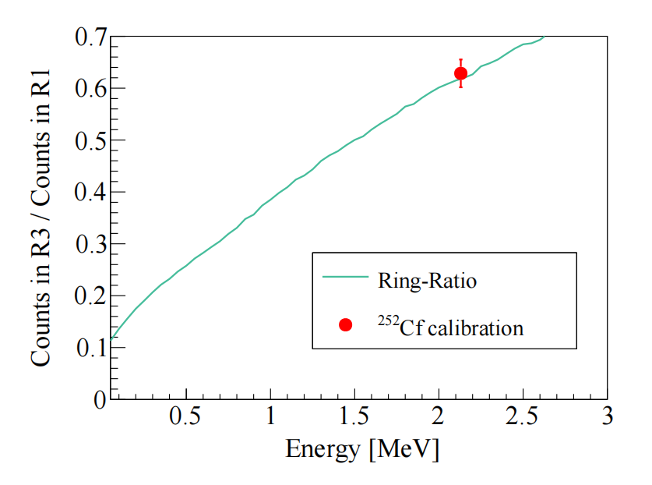
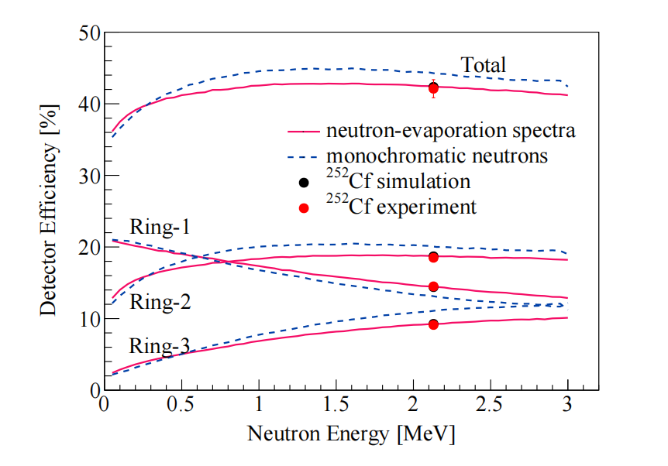
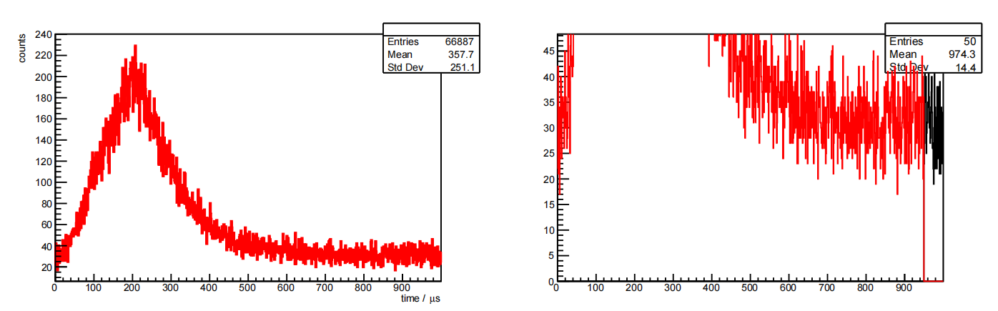

Ring Ratio Method
Ring-Ratio method
平均中子能量
平均效率$εn$
平坦效率探测器的“平坦”用于减小推算平均效率的误差
提取三个环的计数N_{n}
中子时间分布

Slide 19
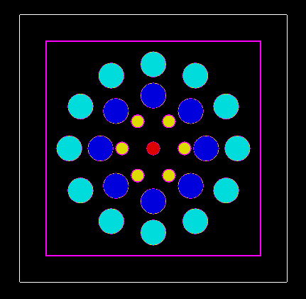
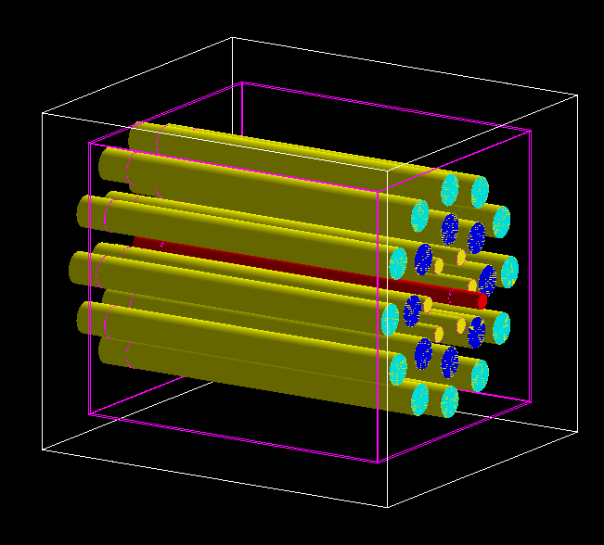
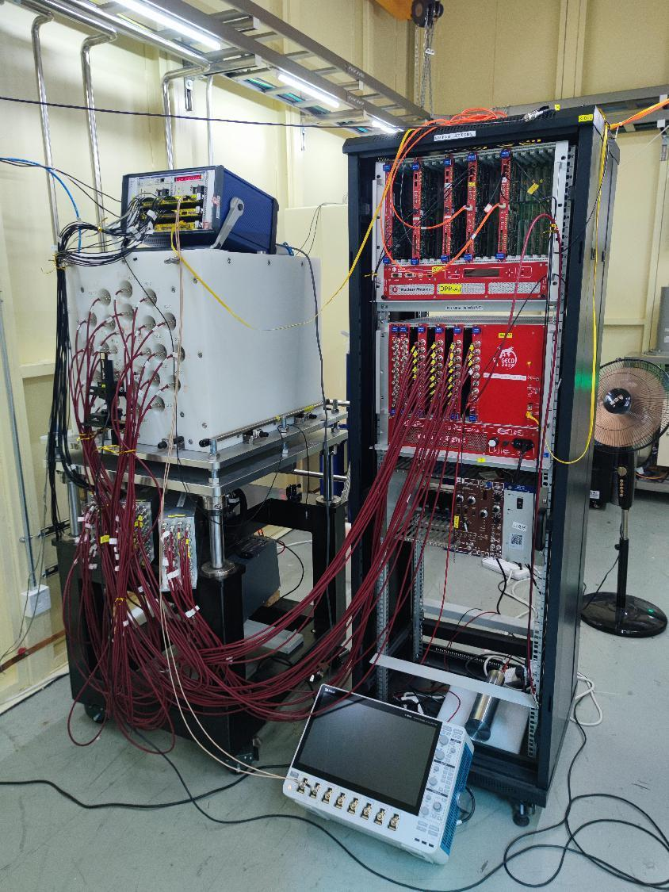
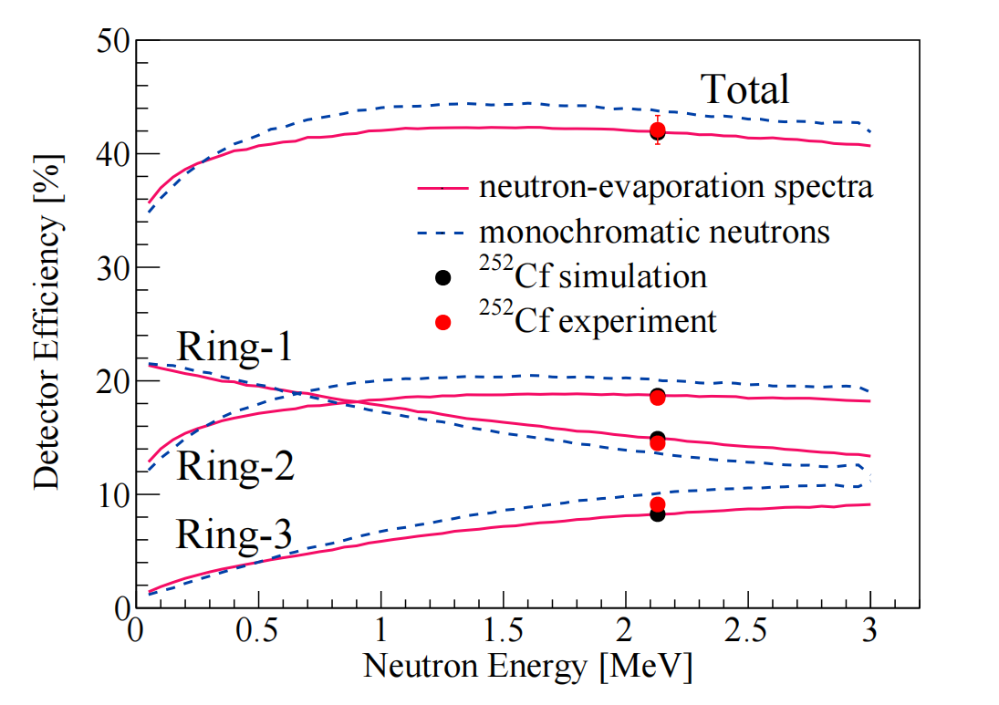
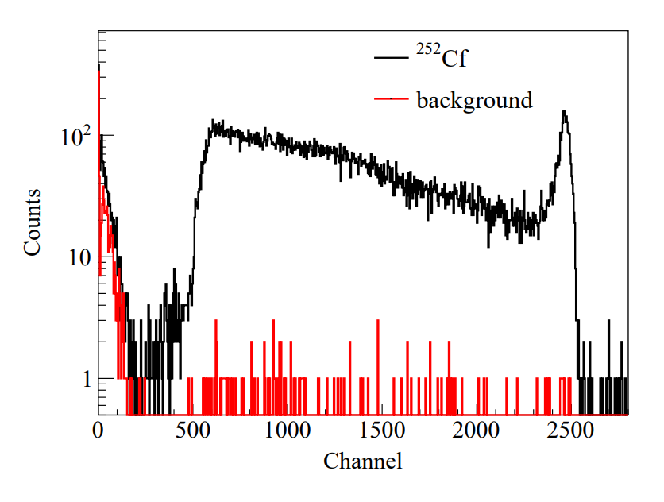
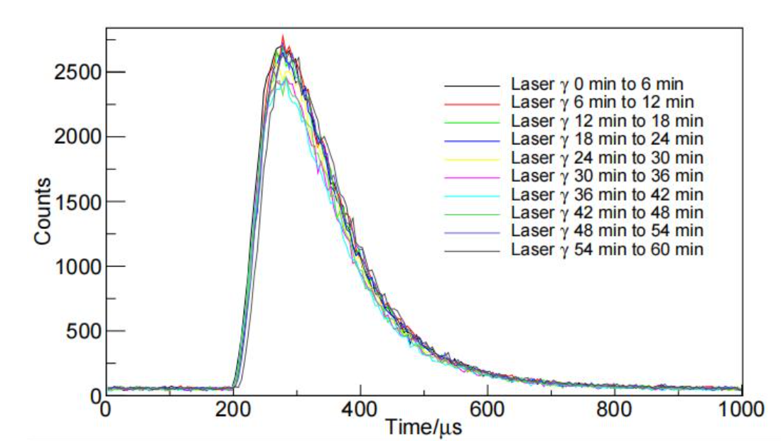
FED
SLEGS 平坦效率探测器(FED)
郝子锐, 范功涛, 刘龙祥,等. 4π平坦效率3He中子探测器阵列的设计与模拟分析[J]. 核技术, 2020, 43(11):9.
慢化体：45 mm×45 cm×55 cm 聚乙烯
正比计数器：³He×26（2 atm）
排列状态：3环 （6-8-12）距离中心 65 mm, 110 mm, 175 mm
探测器效率：42.32% - 34.83%
3He管单管能谱
单中子到达时间谱
探测器效率曲线及其对于²⁵²Cf源的效率

Slide 20
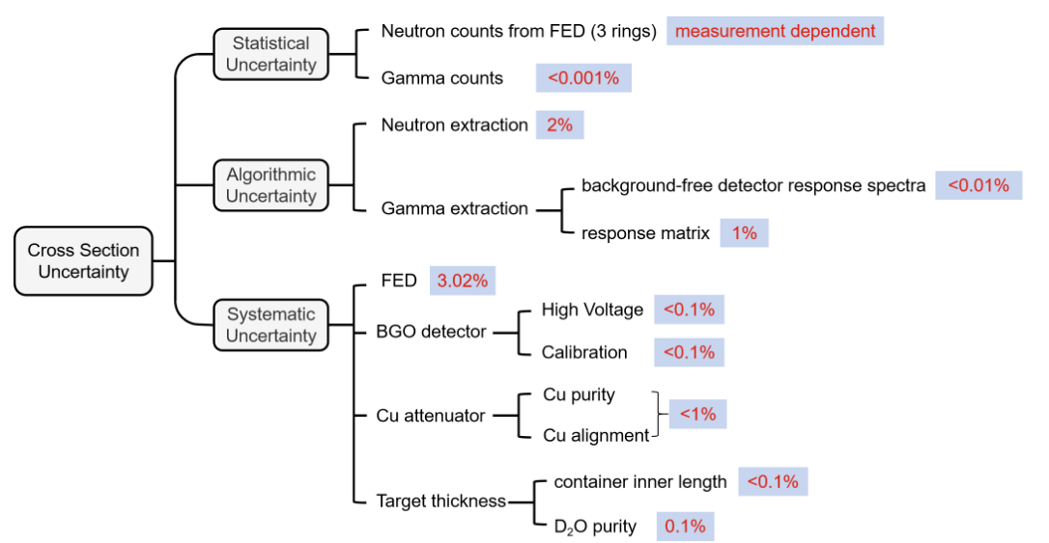
误差分析

Slide 21
—xx
原始氘丰度是通过观测遥远类星体视线方向上高红移的宇宙云来确定的
中子寿命（对氘丰度的影响可以忽略不计，但是对4He丰度有显著影响，对大爆炸核合成的影响已研究过）
宇宙重子密度
11个关键反应的反应率
不同的BBN代码生成的丰度值差异很大，可能是由于使用的核物理输入不同。需要验证相同输入下BBN代码的一致性，另外蒙卡版本的PRIMAT代码的不确定性总是比其他代码小得多，所以还需要在其他其他代码加入蒙卡方法后交叉检验
1.现在不确定度小主要是用的理论模型，缺少实验数据验证
2.这个BBN代码计算的结果误差显著小，可能比较局限
3. 一直缺少dg截面的评估数据
4.r矩阵结果

