Slide 1

Polarization properties of laser Compton slant scattering gamma beam at SLEGS
Xiangfei Wang
Gongtao Fan, Hanghua Xu, Kaijie Chen, Hongwei Wang
on behalf of the SLEGS Team
Notes:
Hello everyone, my name is Wang Xiangfei. The title of my report is Polarization properties of laser Compton slant scattering gamma beam at SLEGS.

Slide 2
Contents
Research Background
Experimental Detection and Simulation
Summary
Notes:
My report is divided into the following sections:

Slide 3
Research Background
Notes:
First, the research background

Slide 4
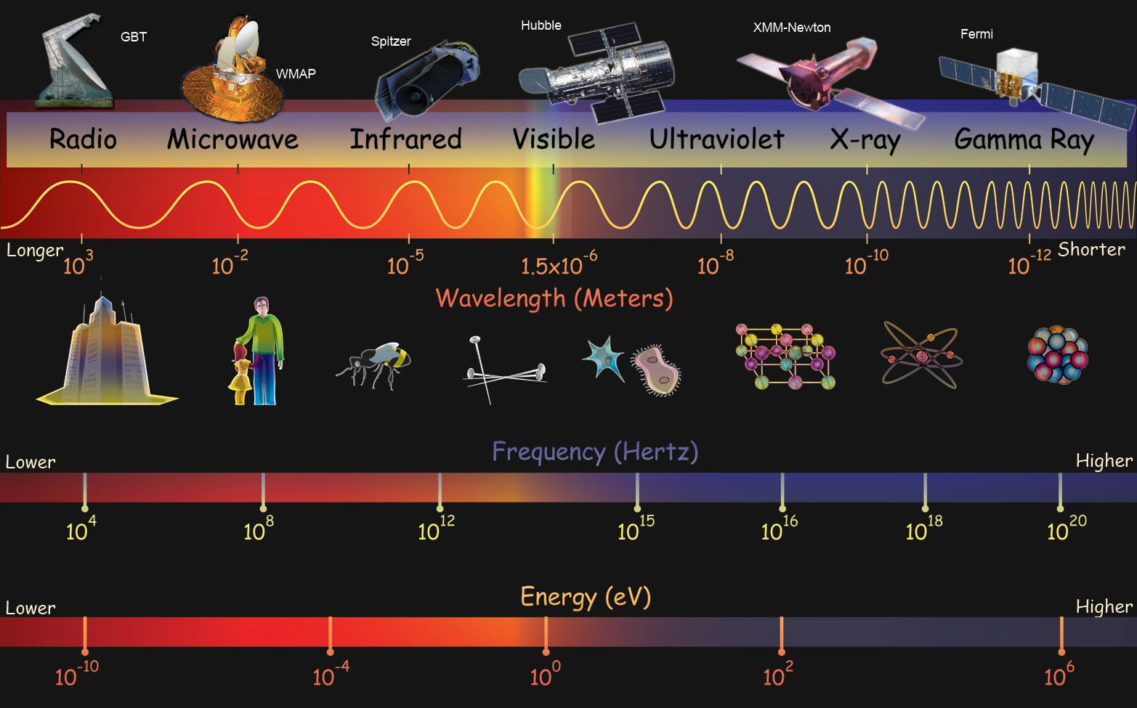
Different energy photons VS the size of matter
H. R. Weller et al., “Research Opportunities at the Upgraded HIγ S Facility,” Prog. Part. Nucl. Phys. Vol 62, Issue 1, p. 257-303 (2009).
Notes:
Photons are an important research probe.
Photons of different energies can be used to detect different levels of matter.
MeV photons correspond to the nuclear matter level, and photons greater than 140 MeV can detect the properties of quark-level matter inside nucleons.

Slide 5
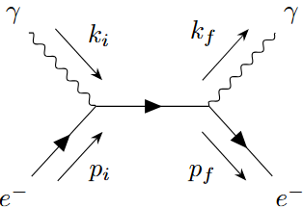
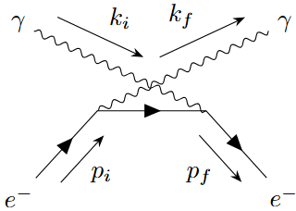






X/γ ray from Compton scattering
Low-energy laser photons scatter with electrons to produce high-energy photons. The differential cross-section calculation method is shown in the formula below[1].
$$\text{E}\text{g}=\frac{\text{(1 −}\text{β}\text{cos}\text{θ}\text{i}\text{)}{\text{E}}_{p}}{\text{1 −}\text{β}\text{cos}\text{θ}\text{f}\text{ +(1−}\text{cos}\text{θ}\text{p}\text{)}{\text{E}}_{p}\text{/}{\text{E}}_{\text{e}}}$$
Fig. 1.
$$\text{cos}\text{θ}\text{p}\text{ = }\text{cos}\text{θ}\text{i} \text{cos}\text{θ}\text{f}\text{ + }\text{sin}\text{θ}\text{i} \text{sin}\text{θ}\text{f} \text{cos}\text{(}\text{φ}\text{i}\text{ − }\text{φ}\text{f}\text{)}$$
y
$$\frac{\text{dσ}}{\text{d}Yd{\text{φ}}_{\text{f}}}\text{= } \frac{\text{8}{{\text{r}}_{\text{e}}}^{2}}{\text{X} 2}\text{ \{}\text{[}\text{ (}\frac{\text{1}}{\text{X}}\text{−}\frac{\text{1}}{\text{Y}}\text{) }\text{2}\text{+}\frac{\text{1}}{\text{X}}\text{−}\frac{\text{1}}{\text{Y}}\text{]}\text{+}\frac{\text{1}}{\text{4}}\text{(}\frac{\text{X}}{\text{Y}}\text{+}\frac{\text{Y}}{\text{X}}\text{)\}}$$
$$\text{−}\text{[}\text{ (}\frac{\text{1}}{\text{X}}\text{−}\frac{\text{1}}{\text{Y}}\text{) }\text{2}\text{+}\frac{\text{1}}{\text{X}}\text{−}\frac{\text{1}}{\text{Y}}\text{]}\text{(}ξ3+ξ′3\text{)}$$
$$+ξ1ξ′1(\frac{\text{1}}{\text{X}}\text{−}\frac{\text{1}}{\text{Y}}+\frac{\text{1}}{\text{2}})$$
$$+ξ2ξ′2\frac{\text{1}}{\text{4}}\text{(}\frac{\text{X}}{\text{Y}}\text{+}\frac{\text{Y}}{\text{X}})(\frac{\text{2}}{\text{X}}\text{−}\frac{\text{2}}{\text{Y}}+1)$$
$$+ξ3ξ′3\text{[}\text{ (}\frac{\text{1}}{\text{X}}\text{−}\frac{\text{1}}{\text{Y}}\text{) }\text{2}\text{+}\frac{\text{1}}{\text{X}}\text{−}\frac{\text{1}}{\text{Y}}\text{+}\frac{\text{1}}{\text{2}}\text{]}$$
x
Laser
$$\text{φ}\text{i}$$
$$\text{θ}\text{i}$$
z
e
$$\text{θ}\text{f}$$
$$\text{φ}\text{f}$$
γ
$$\frac{\text{dσ}}{\text{d}\text{Ω}}\text{= } \frac{\text{8}{\text{r}}_{\text{e}}\text{2}}{\text{X} 2} \text{\{}\text{[1+}{\text{P}}_{\text{t}}\text{cos}\text{(2}\text{τ}\text{ −2}{\text{φ}}_{\text{f}}\text{)][} \text{(}\frac{\text{1}}{\text{X}}\text{−}\frac{\text{1}}{\text{Y}}\text{) }\text{2}\text{+}\frac{\text{1}}{\text{X}}\text{−}\frac{\text{1}}{\text{Y}}\text{]}\text{+}\frac{\text{1}}{\text{4}}\text{(}\frac{\text{X}}{\text{Y}}\text{+}\frac{\text{Y}}{\text{X}}\text{)}\text{\}}(\frac{\text{E}\text{g}}{\text{mc} \text{2}}\text{)}\text{2}$$
[1] SUN C, WU Y K. Theoretical and simulation studies of characteristics of a Compton light source [J]. Physical Review Special Topics - Accelerators and Beams, 2011, 14(4).
Notes:
We use the inverse Compton scattering method to generate gamma rays.
This method uses low-energy photons to scatter with high-energy electrons to produce high-energy photons.
The differential cross-section calculation method is shown in the formula below.
It can be seen that for scattered photons, the linear polarization degree and polarization direction of different incident photons affect the spatial intensity distribution of scattered photons.

Slide 6
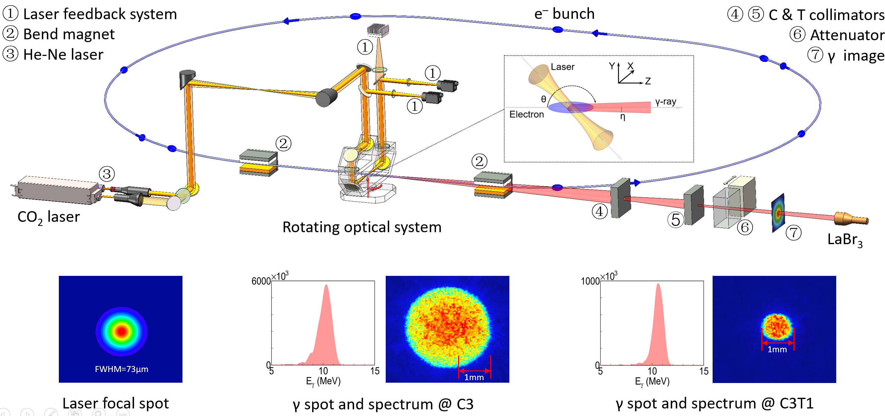
Laser Compton scattering at SLEGS-slant scattering
Notes:
The schematic diagram of the laser Compton scattering oblique incidence structure is shown in the figure.
The gamma beam at the SLEGS beamline is generated by collisions between a CO₂ laser and a 3.5GeV electron beam from a storage ring.
The gamma rays generated are collimated sequentially through two collimators, the C collimator and the T collimator.
It features the world's first LCSS device capable of continuously tuning gamma energy by adjusting the angle between the laser and electron beams.
It can produce gamma rays in the range of 0.66-21.8MeV.
Additionally, there is spot imaging and energy spectrum distribution for the T3 and T1 holes.

Slide 7
Experimental Detection and Theoretical Simulation
Notes:
Next is Experimental Detection and Theoretical Simulation.

Slide 8
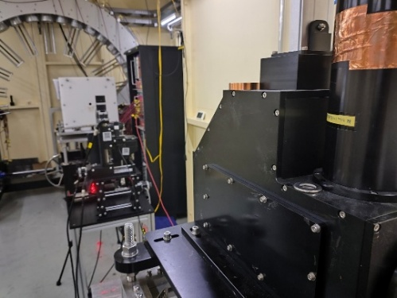
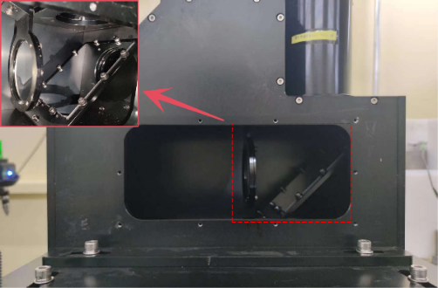
Linear polarized gamma beam spot measured by GSM
Fig 1
Fig 2
The detector used for gamma beam detection is shown in Fig 1 (b) The detector mainly consists of an LYSO crystal, reflector, optical lens, CCD camera, aluminum housing, and base stand.
Fig 2 shows a photo of the detector's internal structure, and the detector's position in the beamline and an external photo.
Notes:
First, let's introduce the gamma camera.
The structure of the gamma camera and its position in the beamline are shown in the figure.
The device uses the fluorescence effect of LYSO to detect gamma rays.
The emitted fluorescence is reflected by a reflector and converged by a optical lens, ultimately producing a signal in the CCD to obtain the measurement results.

Slide 9
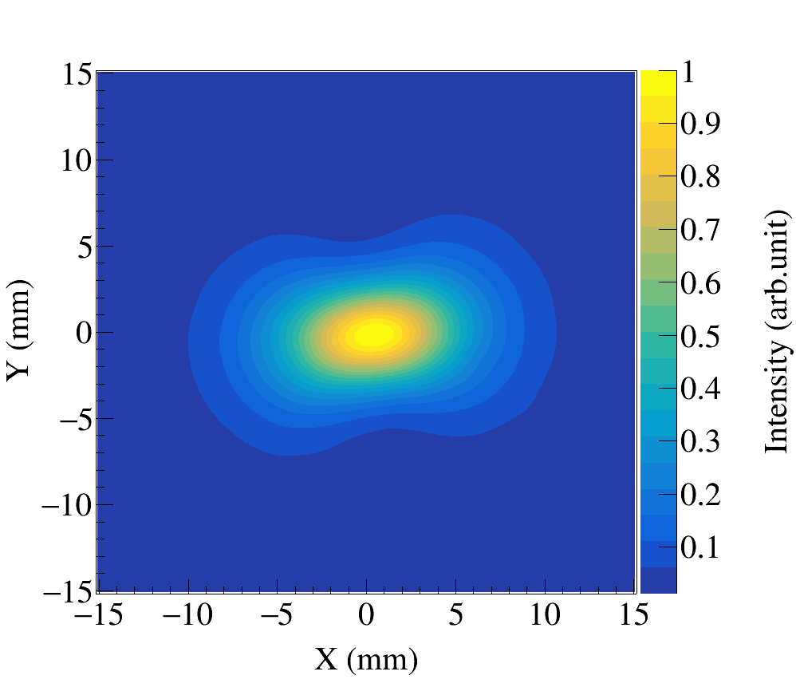
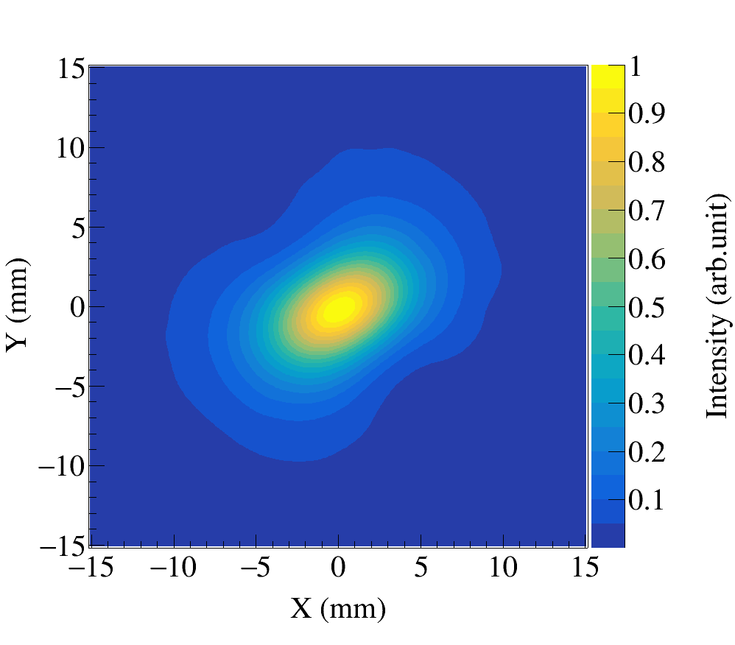
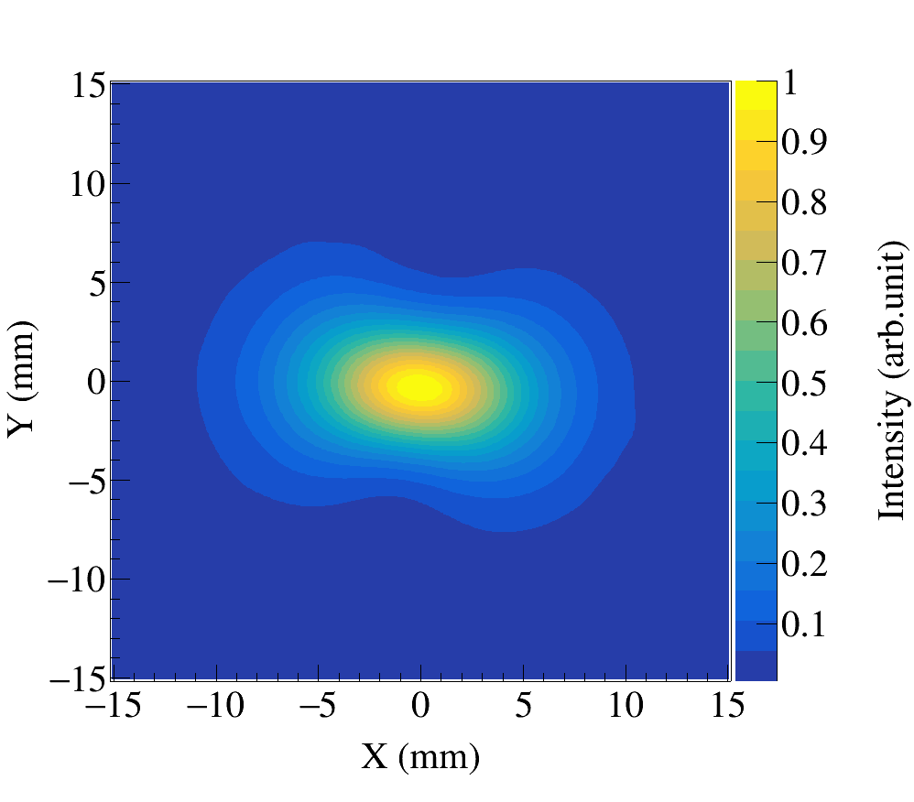
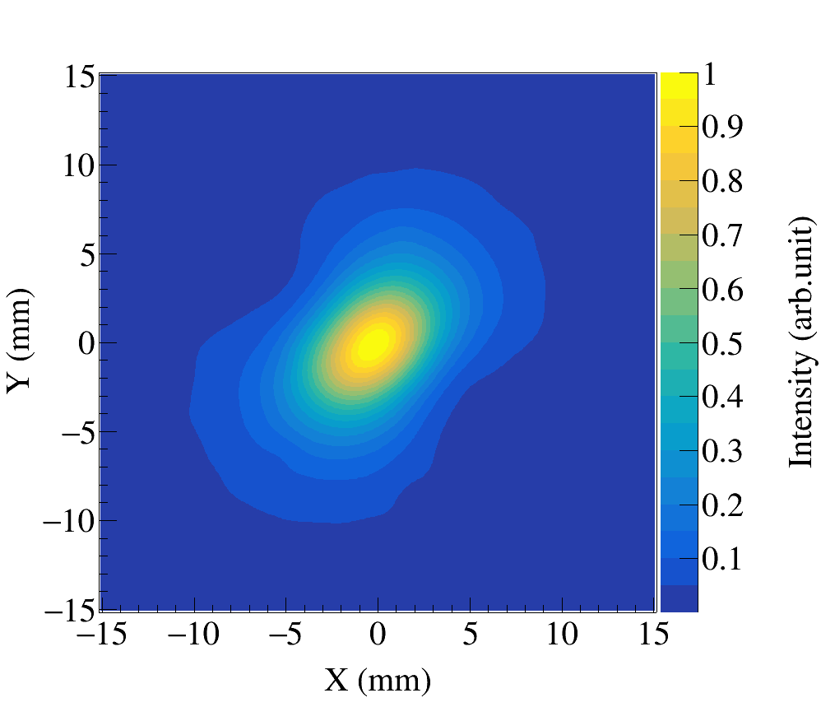
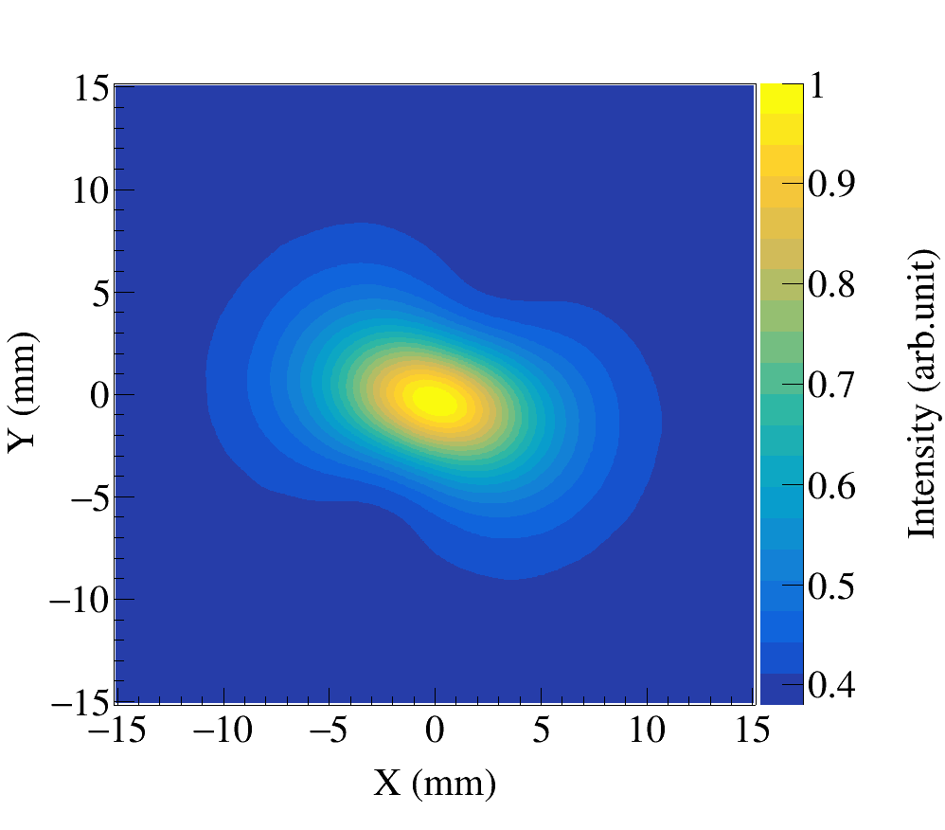
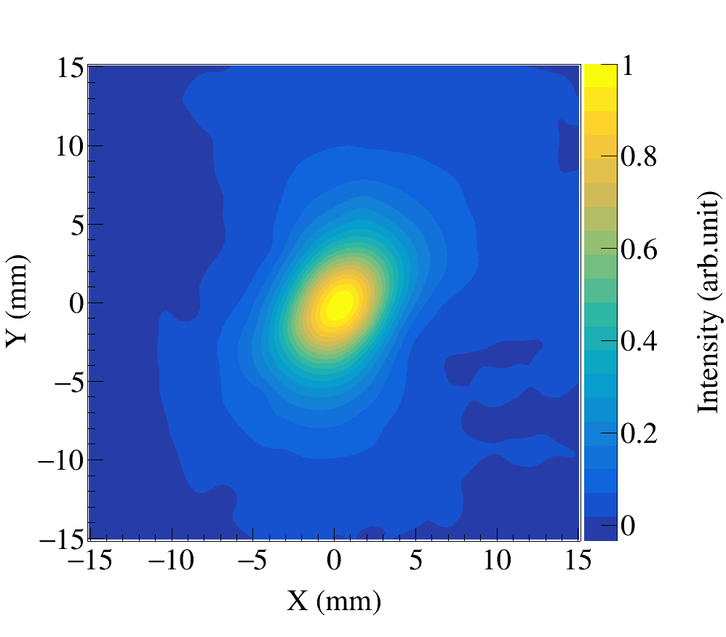
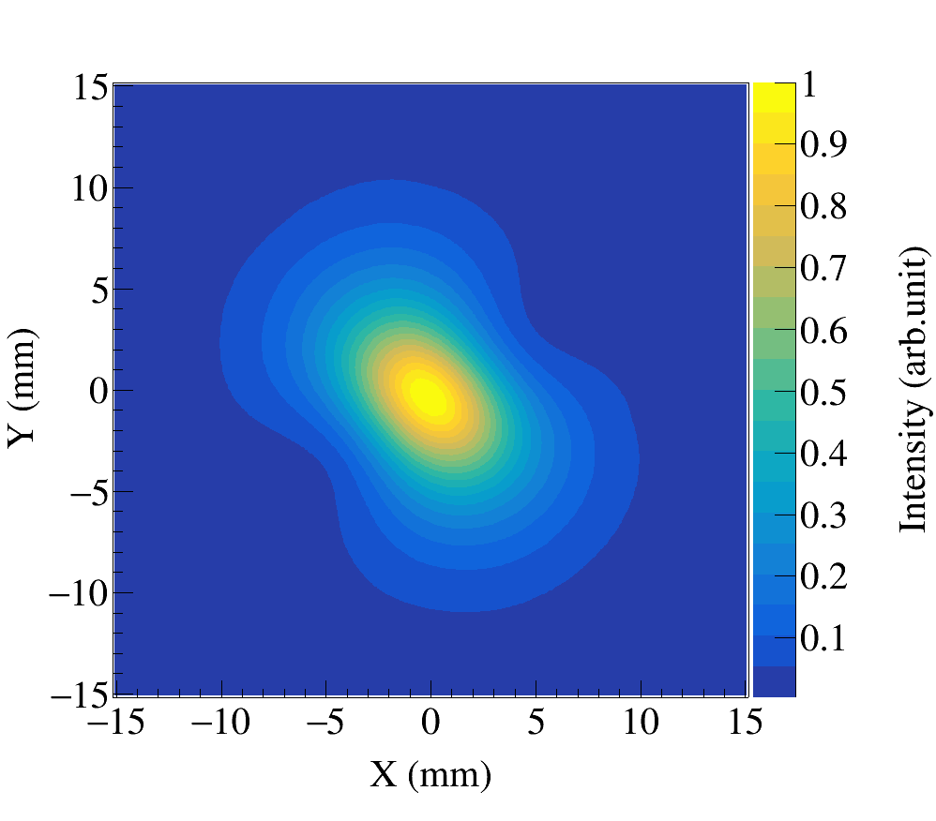
Linear polarized gamma beam spot at different slant incident angles
We performed imaging of gamma rays at different incident angles.
Gamma ray energy & flux increase
θ=90º
θ=75º
θ=105º
θ=60º
θ=120º
laser
θ
θ=30º
θ=150º
η
electron
gamma-ray
Notes:
We performed imaging of gamma rays at different incident angles.
It can be seen that the shape of the light spot changes at different angles.
This is caused by the oblique incidence structure, where the polarization direction of the incident laser changes with the angle of incidence.
At the same time, as the scattering angle increases, the energy and flux of the scattered gamma rays also increase, ultimately making the spot pattern clearer.

Slide 10
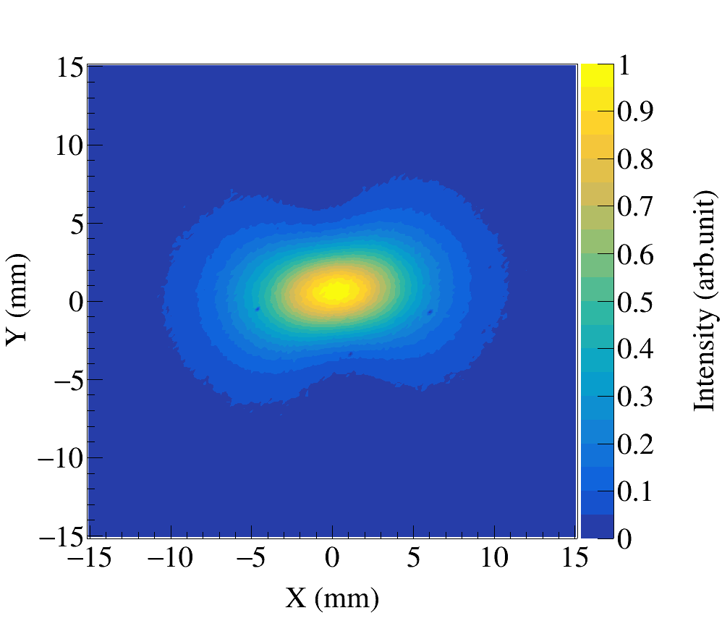
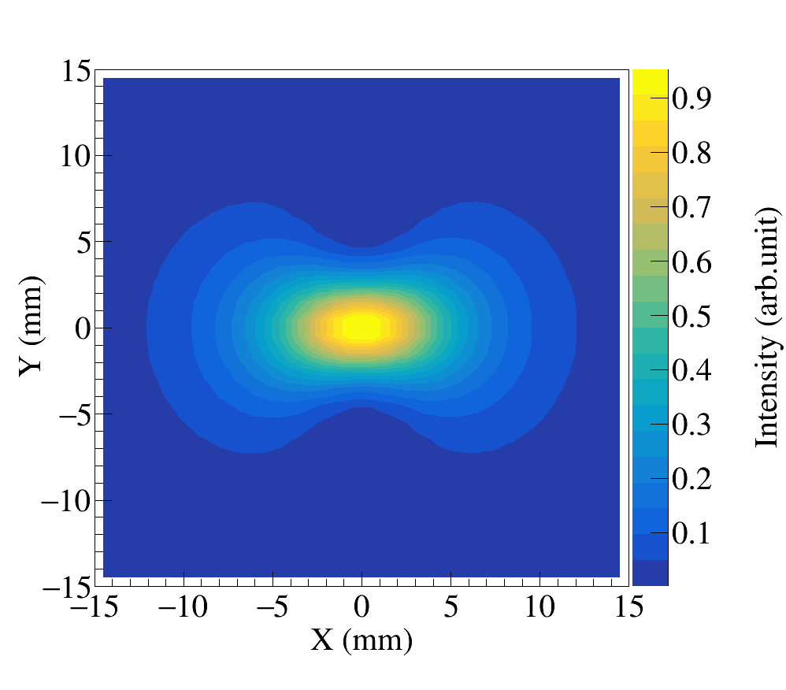
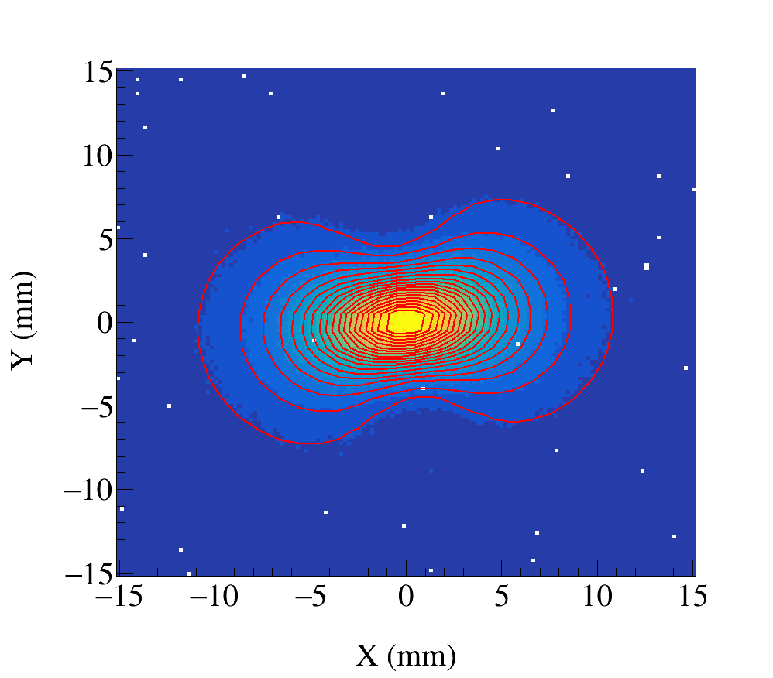
Preliminary DOP and AOP from GSM
Fig 1
Fig 2
1. Imaging Experiment
  The gamma camera mentioned above was used to measure the gamma spot, yielding the spot image shown. Fig 1 shows the imaging result of the spot obtained at 90° slant incidence.
2. Formula Simulation
  The differential cross-section formula for polarized laser scattering with unpolarized electrons, mentioned earlier, was used to simulate the spot. Fig 2 shows the simulation result for the spot obtained at 90° slant incidence.
3. Formula Fitting
  The formula used in the simulation was applied to fit the measured spot to obtain its polarization degree and direction. Fig 3 shows the fitting result for the 90° slant incidence case. Table 1 shows the fitting results.
Table 1
Fig 3
Fitting result
Para. | Value | Error
DOP | 0.893 | 0.076
AOP | 1.69 | 0.05
Notes:
Take a 90-degree incidence as an example.
We first used the gamma camera to conduct imaging experiments on the light spot.
Then, we used the formula mentioned above to reproduce the light spot to ensure the correctness of the formula.
Finally, we used the formula to fit and obtain the DOP and AOP.

Slide 11
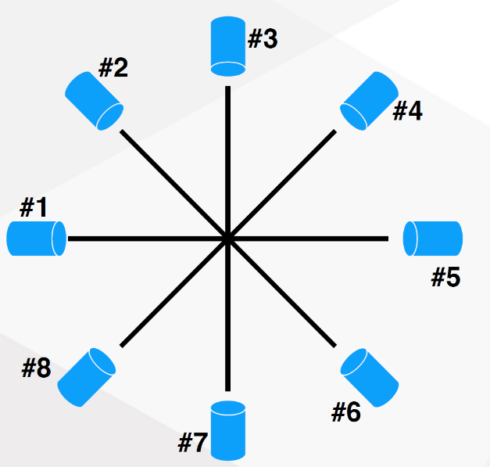

Polarization properties measured by LaBr₃ array-setup
Notes:
We then used the device in the figure to further measure the polarization properties of the light spot at a scattering angle of 45 degrees.
This device includes eight lanthanum bromide probes and one BGO probe.
We use the lanthanum bromide probes to measure the energy of scattered gamma rays and the BGO probe to measure the energy of transmitted gamma rays.

Slide 12
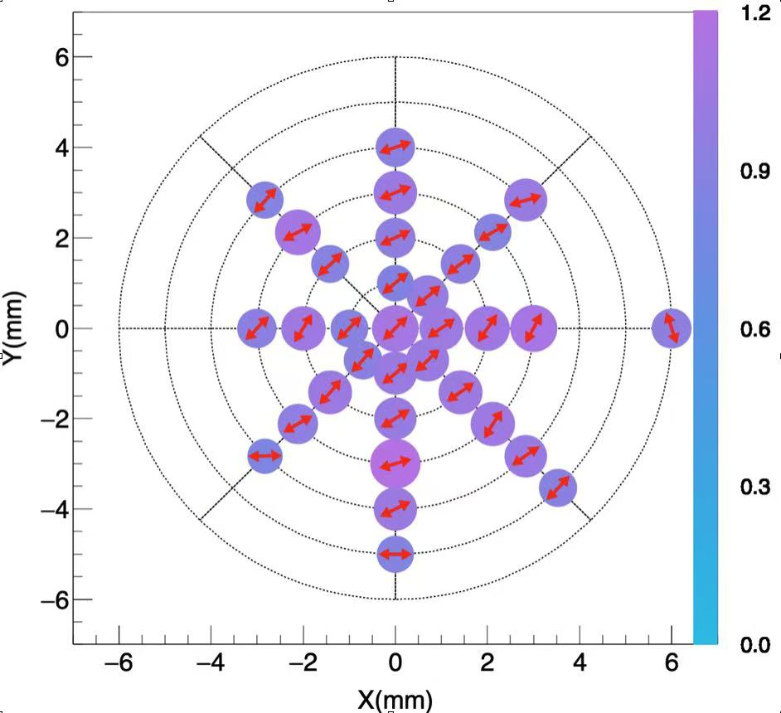
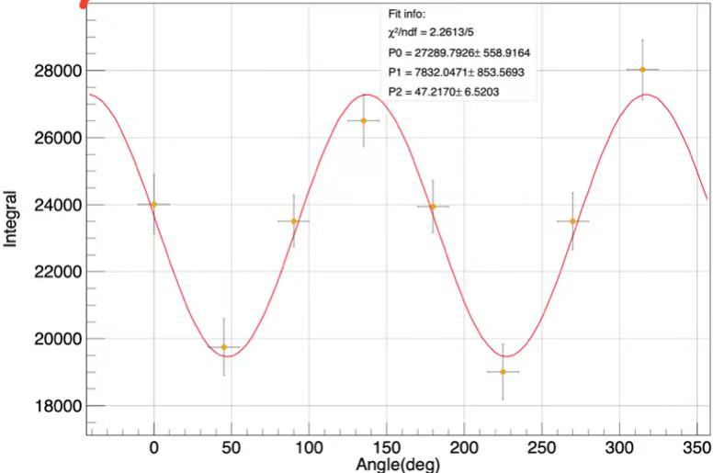
Preliminary DOP and AOP from LaBr₃ array
The detection results in a central polarization close to 1, but slightly different from the 0.9 obtained from the imaging method fit, requiring further correction of the imaging method.
Notes:
The detection results in a central polarization close to 1, but slightly different from the 0.9 obtained from the imaging method fit, requiring further correction of the imaging method.

Slide 13
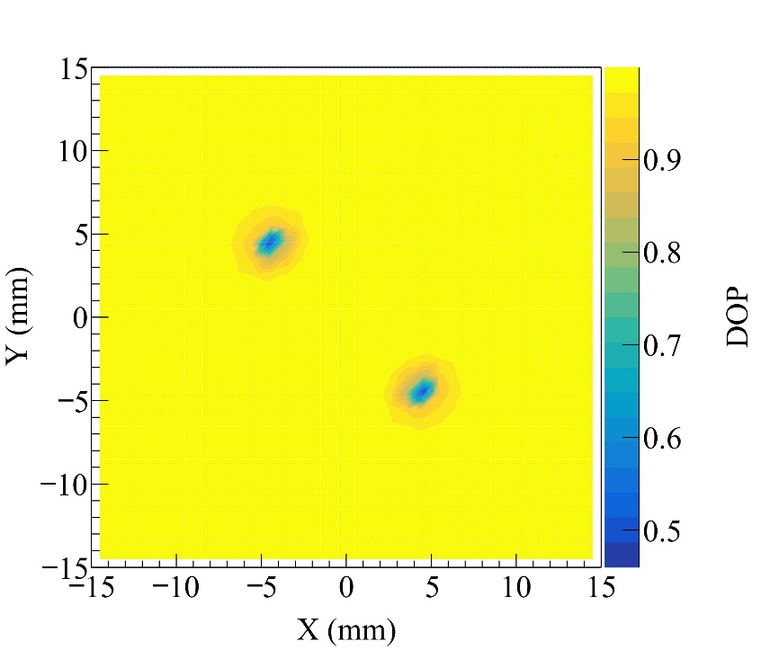
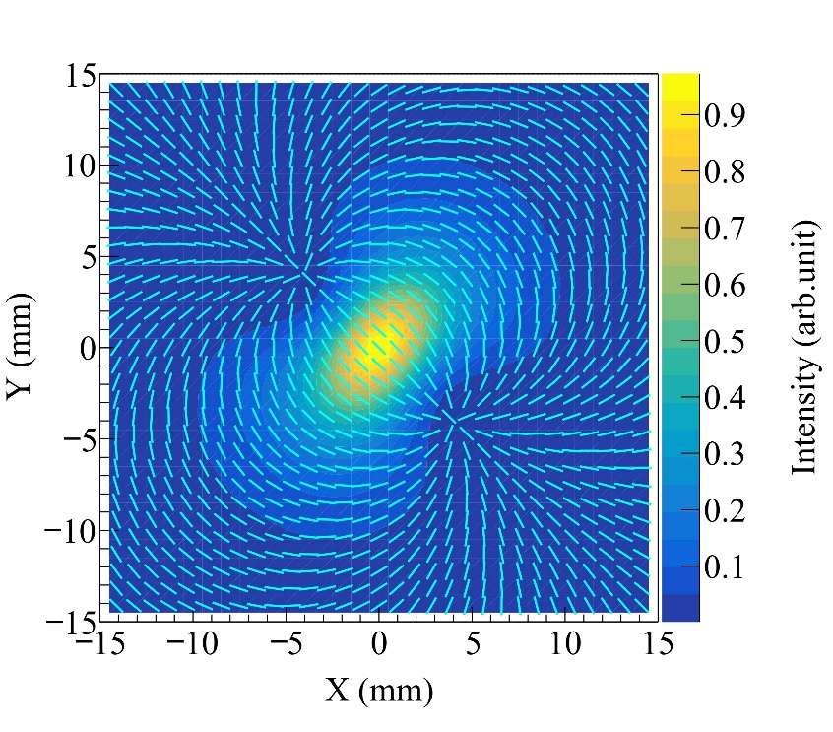
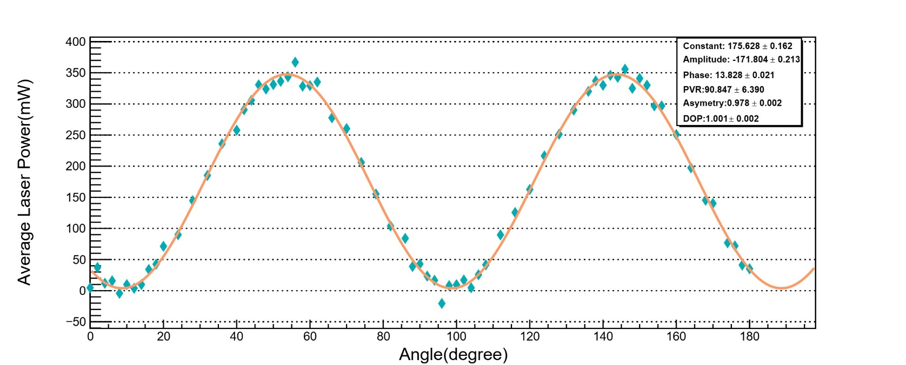
Fig 2
Preliminary DOP and AOP from LaBr₃ array
Measurement of laser polarization
  We first used the Brewster angle method to measure the polarization degree of the laser. Fig 1 shows the measurement results, indicating that the polarization degree of the laser is close to 1.
2. Simulation of polarization degree and polarization direction of T1 collimation
  Fig 2 and 3 show the degree of polarization (DOP) and angle of polarization (AOP) of a laser with a polarization degree of 1 at a 45-degree angle of incidence using T1 collimation holes at different positions.
Fig 3
Fig 1
Notes:
We then measured the polarization of the laser using the Brewster angle method, and the results showed that the laser was nearly completely polarized.
Using completely polarized lasers, we simulated the polarization degree and polarization direction obtained by measuring the scattered light at different positions in the light spot using T1 collimating holes.
It can be seen that there are some differences between the simulated light spot and the light spot measured using the lanthanum bromide probe.
This is the result of the two methods using different imaging equipment, and there is a mirror relationship between the two.

Slide 14
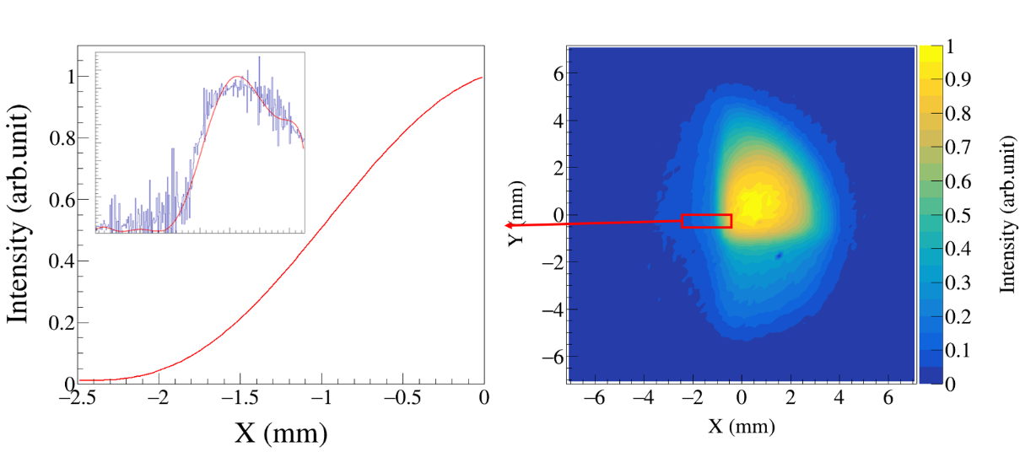
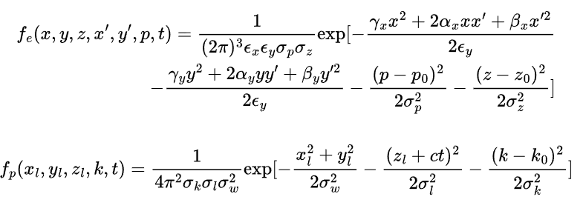
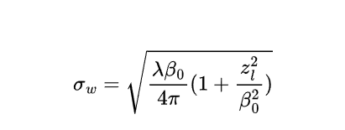
Further GSM data analysis
Fig 1
1.Addition of electron phase space distribution and laser spatial distribution
  The intensity function of the electron phase space (PS.) distribution in the accelerator and the spatial intensity distribution function of the laser were added simultaneously. The corresponding spot was obtained using the Twiss parameter of the accelerator. The corresponding calculations are shown in the formula on the right.
2. Extracting the Point Diffusion Function
  Fig 1 shows the measurement results of the detector using the knife-edge method. We then used polynomial fitting to obtain the detector's point diffusion function.
Notes:
Based on previous measurement results, it was determined that the theoretical model used previously needed to be revised.
The first corrections we considered adding were phase space corrections for the electron beam and intensity corrections for different positions of the laser.
Then, based on this, we added corrections obtained from measurements of the point diffusion function.

Slide 15
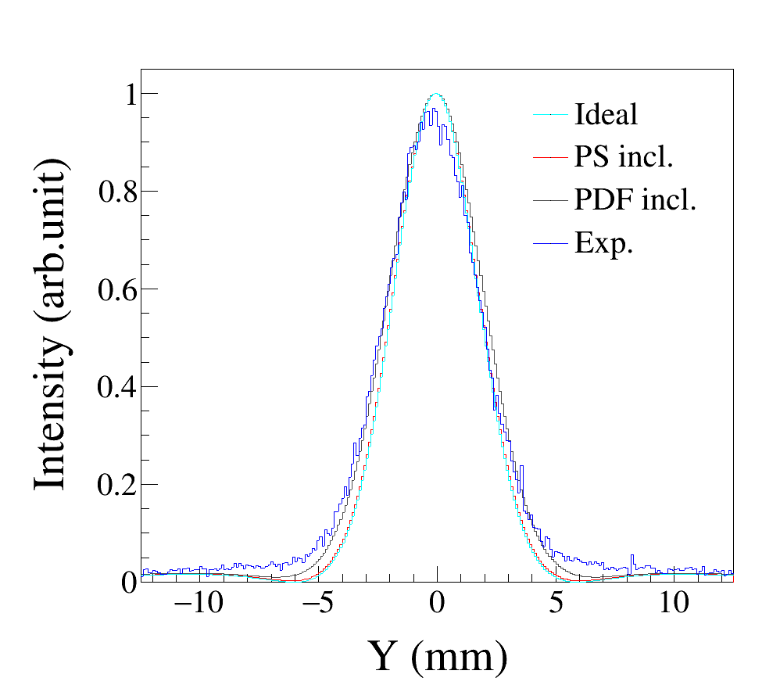
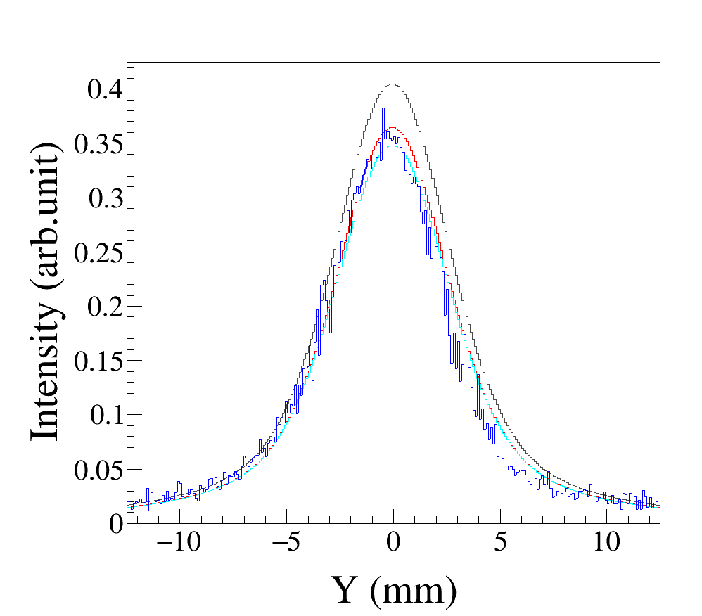
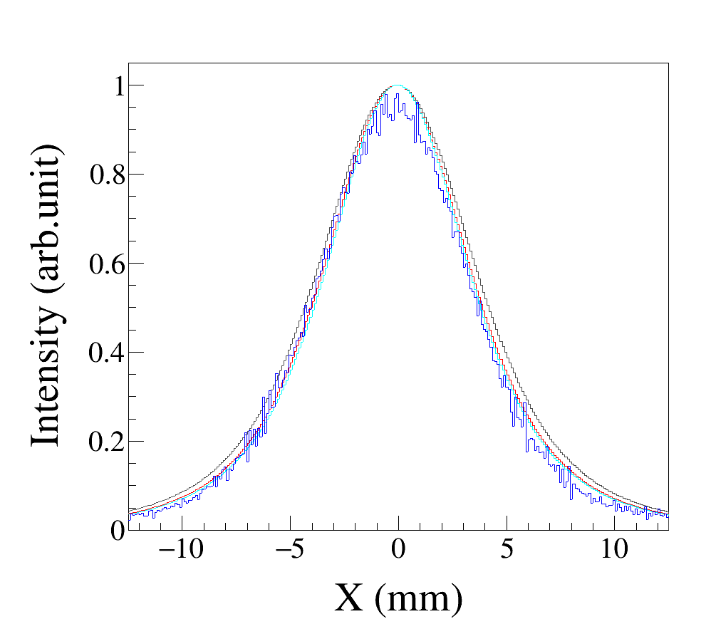
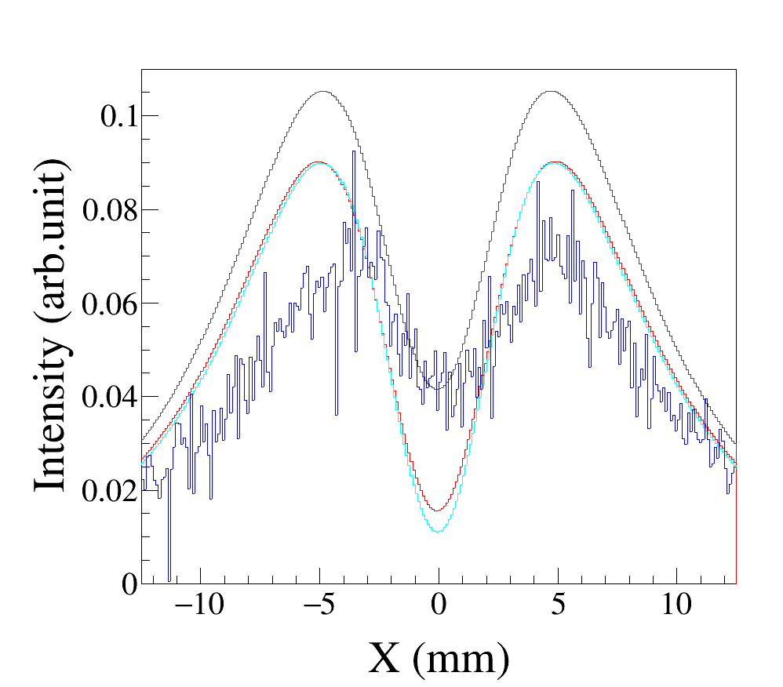
Further GSM data analysis
3. Comparison of Spot Slices at Different Positions
  Fig 1(a) shows our measurement results at an incidence angle of 90°. Slice analysis of the measurement results revealed:
  a. At the center (X=0, Y=0): Flux is high and agrees well with the theoretical curve.
  b. Away from the center (X=5, Y=5): There is a significant deviation from the theoretical curve.
Fig 1
(b)
X=0
(c)
X=5
(a)
  Ideal：Calculation based on single-particle scattering cross-section.
  PS incl.：Includes electron phase space and laser position distribution.
  PDF incl.：Includes the gamma camera's point diffusion function.
  Exp.：Experimental value.
(d)
Y=0
(e)
Y=5
Notes:
After obtaining each correction, add them to the simulation function separately and compare them with the experimental results.
You can see that the fit is good at the center, but there are still problems at the edges, which need further correction.

Slide 16
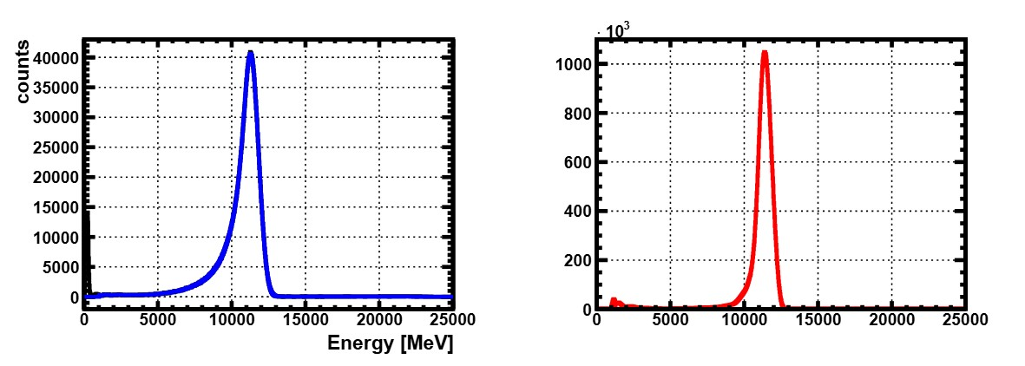
Further GSM data analysis
1. Gamma Camera Calibration
  Calibrated BGO detectors and the gamma camera were used to measure the beam under the same conditions for the same duration, ultimately achieving calibration of the gamma camera.
2. Detection with BGO Detector
  A calibrated BGO detector was used to measure the energy spectrum at the center of a collimated spot (1mm diameter aperture) for 1 hour. Fig 1 shows the detection result for the center of the 90° scattering spot.
  a. Result directly detected from the gamma beam carrying a bremsstrahlung background after attenuation by copper.
  b. Spectrum reconstructed before attenuation by copper, after subtracting background.
(a)
(b)
Fig 1
Notes:
So we considered adding an energy correction.
We measured the energy spectrum under the T1 collimation hole using a BGO detector and reverse-engineered it to obtain the energy spectrum irradiated onto the gamma camera.

Slide 17
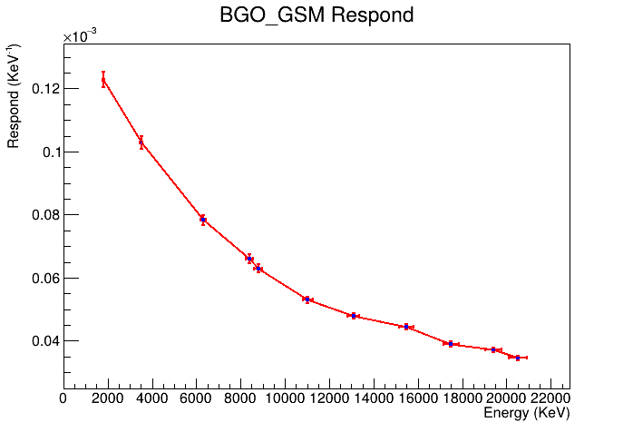
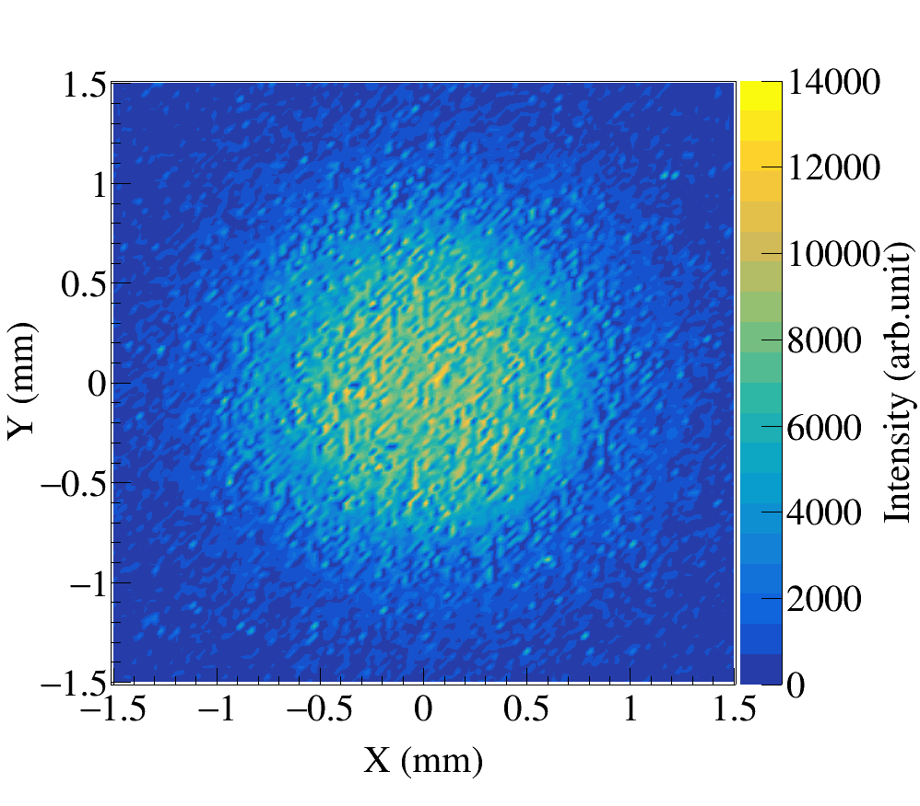
Further GSM data analysis
3. Detection with Gamma Camera
  The same gamma beam was used for direct detection without copper attenuation. Fig 2 shows the imaging result.
4. Energy Response Curve
  The ratio of the total count within a 3mm x 3mm square on the gamma camera to the energy deposition obtained by the BGO detector yielded the energy response curve shown in Fig 1
Fig 1
Fig 2
Notes:
Then, gamma rays were irradiated for the same amount of time using a gamma camera.
By comparing the total count within a certain range on the gamma camera with the energy deposition of the BGO probe, a quasi-monoenergetic energy correction curve was obtained.

Slide 18
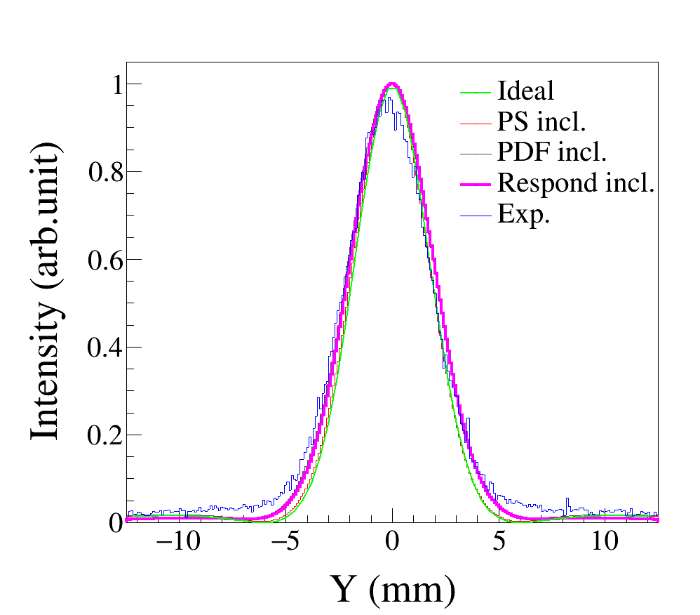
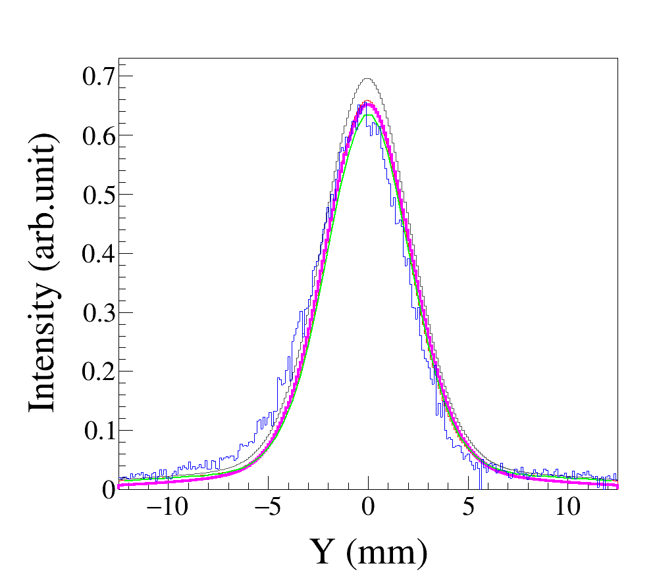
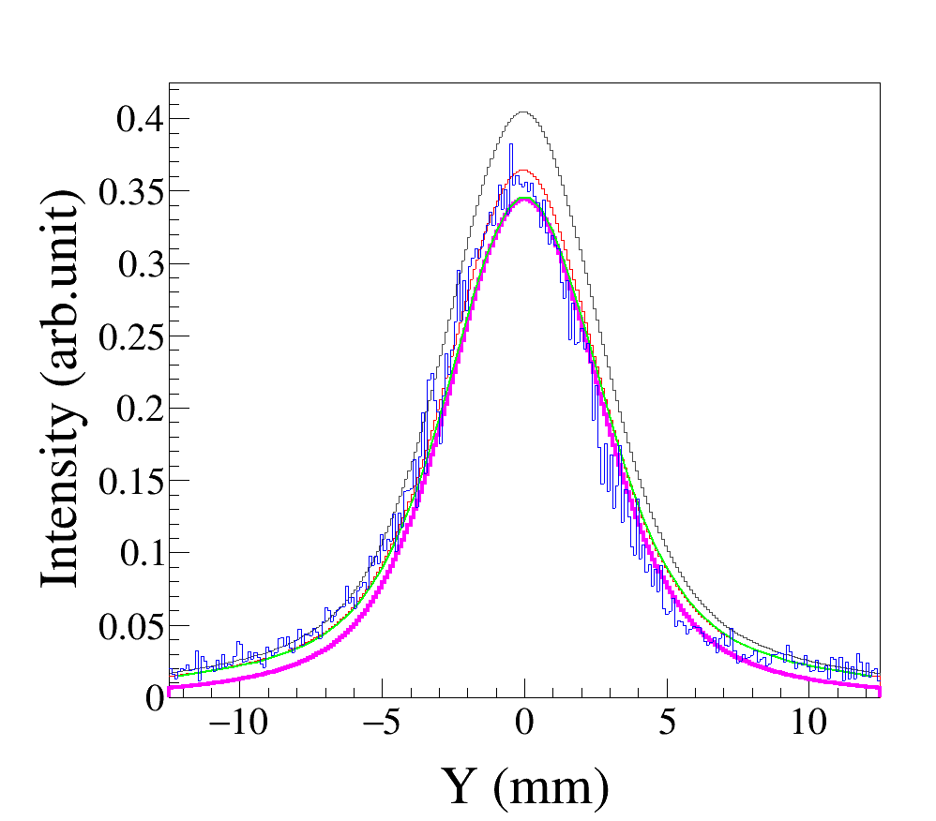
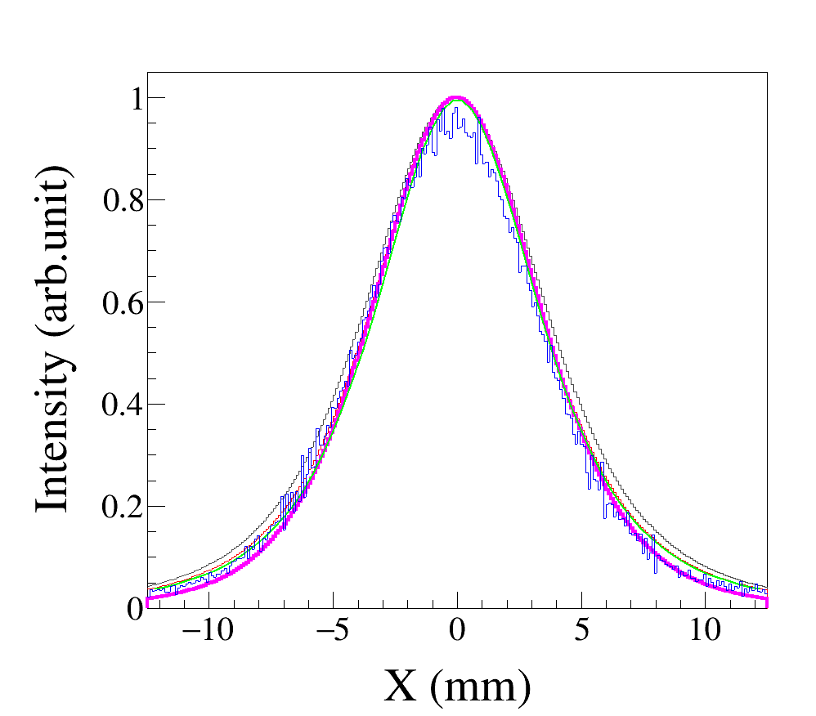
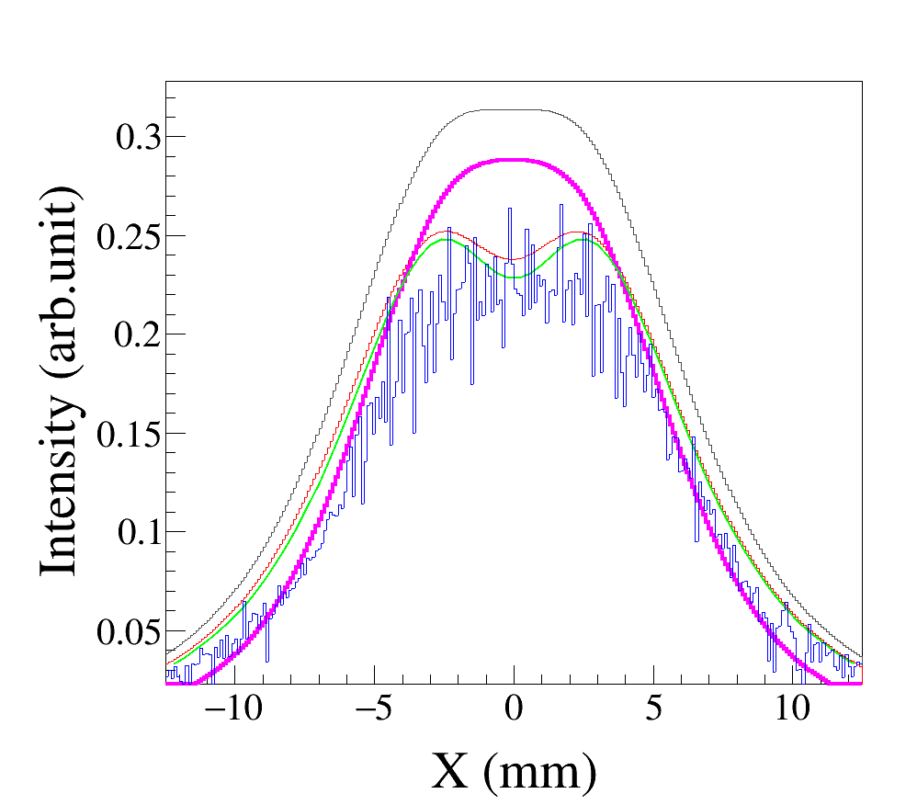
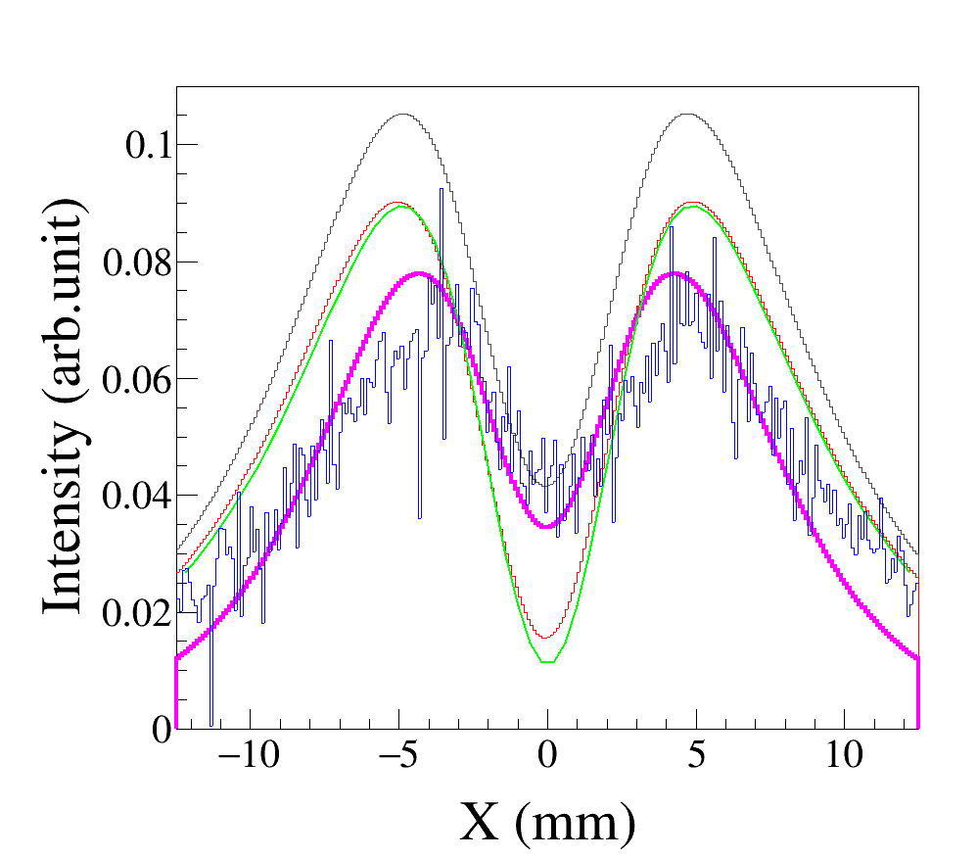
Further GSM data analysis
Including Energy Response
After incorporating all previous physical effects, the energy response at different positions (shown by magenta lines) was also included:
  a1, a2: Slices at X=0 and Y=0. a1 is X=0, a2 is Y=0. Good agreement after slicing.
  b1, b2: Slices at X=3 and Y=3. b1 is X=3, b2 is Y=3. Agreement is poor at Y=3.
  c1, c2: Slices at X=5 and Y=5. c1 is X=5, c2 is Y=5. Shows significant improvement compared to other results.
(a1)
(b1)
(c1)
(a2)
(b2)
(c2)
Notes:
By adding the energy correction together with all previous corrections to the simulation function, we can see that the simulation results have been significantly optimized.
Next, we will further optimize this model and ultimately obtain the exact polarization properties and corresponding errors.

Slide 19
Summary
Notes:
Finally, let's summarize.

Slide 20
Imaged spots at multiple angles.
Attempted to reproduce the spots by incorporating various physical effects.
Performed quasi-monoenergetic calibration of the detector.
Gamma ray obtained by the laser Compton scattering method approach has good polarization properties
Thank you for your attention!

