Slide 1

Nonlinear wave-particle and wave-wave interactions during rf heating and current drive in MCF plasma
“极端等离子体：从夸克胶子到聚变能”研讨会
@ 2025年8月12日-13日，上海 复旦大学
Zhe Gao
Department of Engineering Physics, Tsinghua University, Beijing 100084
gaozhe@tsinghua.edu.cn
Main collaborators: Kunyu Chen, Jiale Chen, Zikai Huang, Zhihao Su, Zhiyuan Liu, Aihui Zhao, and Long Zeng
*Supported by NSFC, under Grant No. 12335014.

Slide 2
Introduction
Plasma wave is one of the most fundamental concepts in plasma physics.
Plasma wave physics is complex
  Body： ion，electron
  Drive： pressure，electrostatic， electromagnetic
  Interaction： linear，quasilinear and nonlinear
  Boundary: free, ideal, sheath
Nonlinear wave physics extensively studied in laser plasma，but not sufficient in MCF plasma，however，becomes more important with the increase of wave power required in fusion device.
  nonlinear interactions in MCF plasmas very different from those in laser plasmas.
Here, some understandings on pondermotive force (a typical nonlinear wave-particle interaction) and parametric process (a typical nonlinear wave-wave interaction) in MCF plasma are introduced

Slide 3
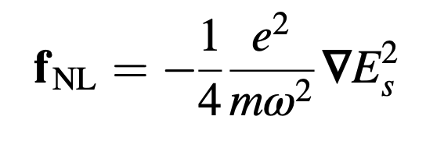
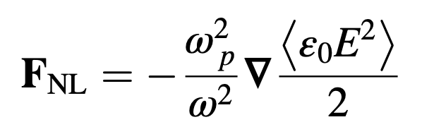
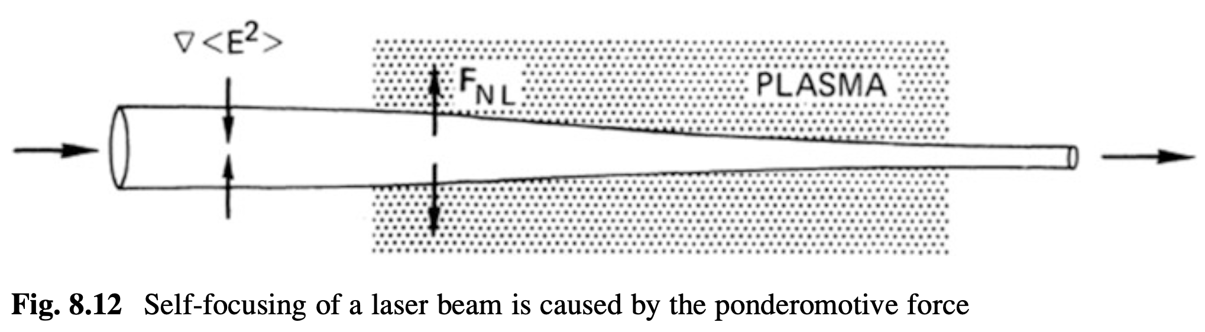
Pondermotive force in cold plasma (classical picture)
here
Vanishing at the inhomogeneity of the background field << that of applied rf fields
In cold plasma, is pure imaginary
Reduce to classical picture of pondermotive force, for example in FF Chen’s textbook
with the well-known ponderomotive potential

Slide 4
Pondermotive force on single particle in thermal plasma
In thermal plasma, has the real part due to the resonant absorption (Landau or cyclotron)
(resonant) momentum input
(nonresonant) PF:
along the direction of the gradient
*power absorption (actually its real part):

Slide 5
Generalized ponderomotive force on a mass of plasma
The force on a mass of plasma = Σ forces on each particle
However, it is redistributed by stress.
This redistribution might be important since there encounter different resistances at different locations
Polarization stress
Reynolds stress
Nonlinear stress due to finite temperature
V(r) ~ F(r) /μ(r) ➔ ΣδF=0, but ΣδV≠0

Slide 6
Generalized ponderomotive force on a mass of plasma
RF kinetic theory [Jaeger et al PoP2000, Chen and Gao PoP 2013, 2014] gives complete formulae for local rf force in inhomogeneous plasma [Chen and Gao PoP 2014]
Nonresonant Ponderomitive Force (PF)
with correction of finite temperature
Direct Drive Force (DDF)
Resonant Ponderomotive force (RPF)
z, B_{0，}平行
P_{rf}
y， 极向
x，径向

Slide 7
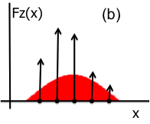
Re-distributed parallel force by RPF
Transporter:
second-order; resonant
Passenger:
zero-order, also resonant
* Reynolds-type stress cannot contribute to the transport of parallel momentum after gyro-averaging
The redistributed parallel force might be important for nearly perpendicular propagating waves and/or ion-absorbed waves
[Gao, Chen and Fisch PRL 2013]

Slide 8
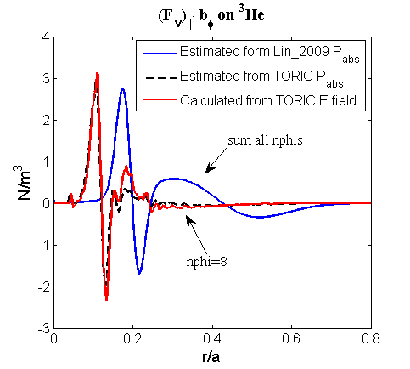
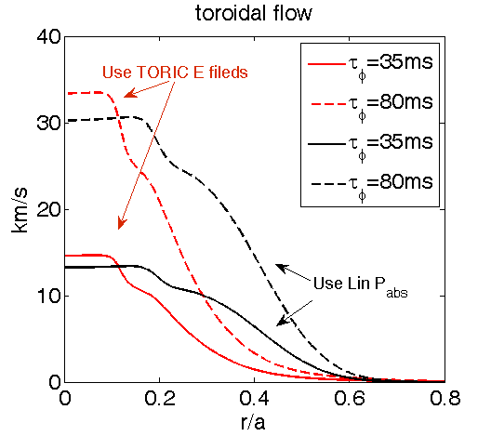
Significant flow drive with MC ICH might be related with the effect of parallel RPF
MC
Force independent to k spectrum
MH
@C-Mod Lin PoP2009
Little force for symmetric k spec.
The parallel RPF can drive significant co-Ip toroidal flow, which may bridge the gap between the experimental observation and the prediction of Rice scaling.

Slide 9
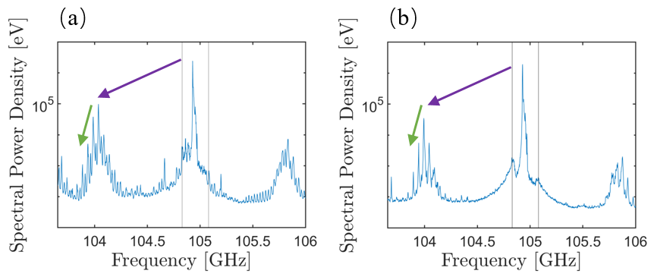
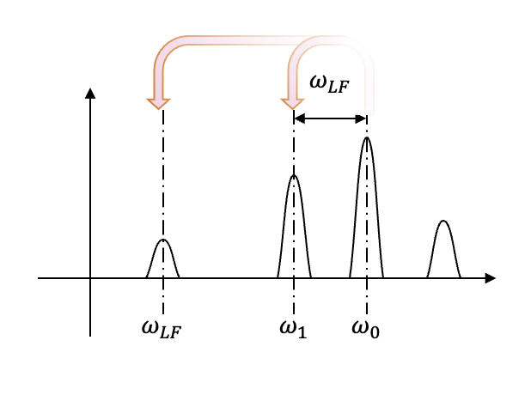
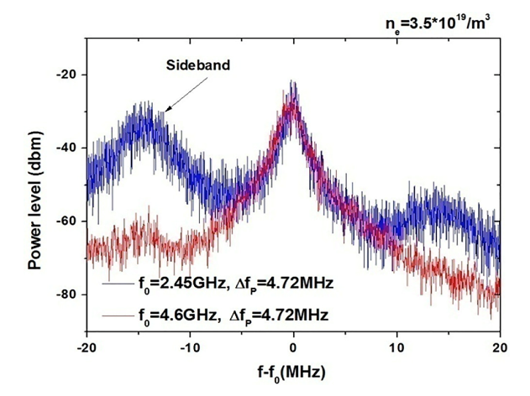
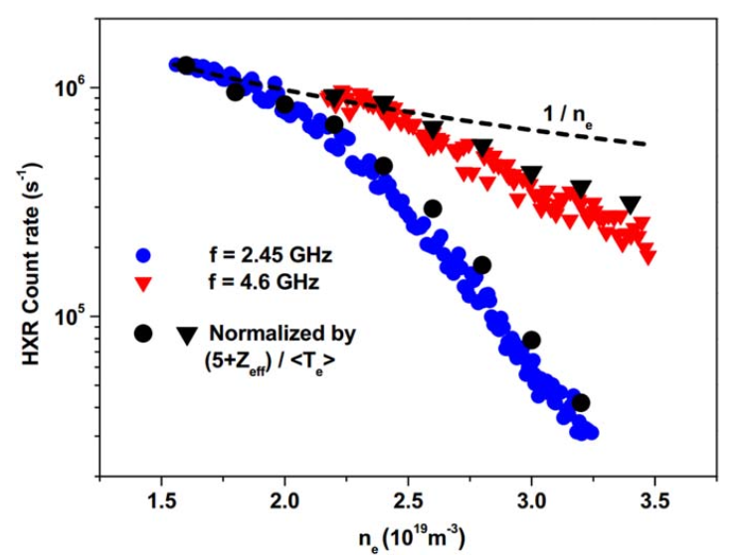
Parametric process/ parametric decay instability
Parametric process/ Parametric Decay Instability (PDI) is a common and important nonlinear wave-wave interaction.
PDIs result in unexpected power deposition and/or degradation of efficiency of H&CD. For example, PDIs at the edge may responsible for the failure of LHCD in high density plasma.
LHW@EAST MH Li 2022
ECRH@AUG Hansen 2019

Slide 10
Earlier theories of PDI cannot apply in MCF cases
Earlier theories of parametric instability established in the 1970s, mainly focusing on stimulated scattering in laser plasma [Rosenbluth 1972, 1973, White 1974, Cohen 1976, Chen 1977, Liu 1986]
  Usually resonant decay with only quasilinear treatment
  Convective instability is saturated by wavenumber mismatch due to plasma inhomogeneity or finite width of the pump.
  Usually absolute instability is excited in laser plasma, so other nonlinearities should be involved
In MCF plasma, PDI is typically displaying as quasi-mode decay, such as nonlinear ion landau damping （ion sound quasi-mode decay， ISQM） or nonlinear ion cyclotron harmonic damping (ICQM）.
Quasilinear coupling is not enough
  Mismatch of the wavenumber cannot be given
both absolute instability and convective instability not properly calculated

Slide 11
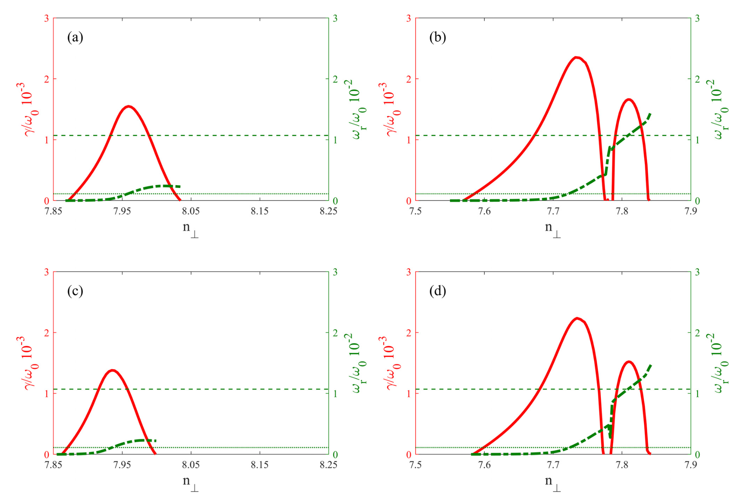
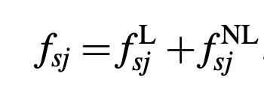
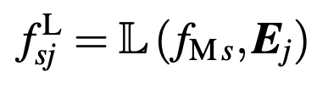
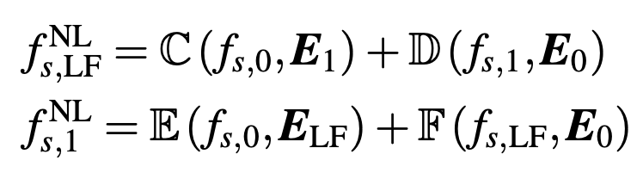
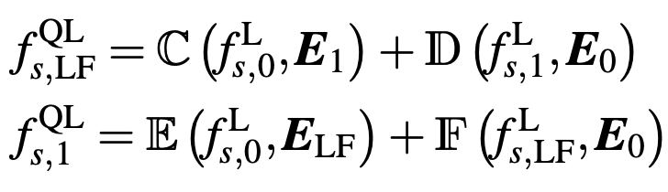
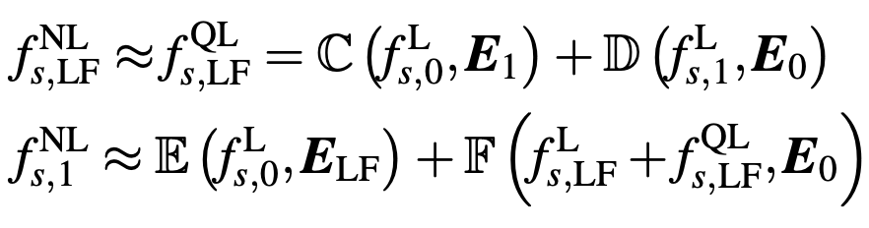



Coupling for quasi-mode decay
[Liu PoP2019, Gao NF 2025]
QL-QL：
QL-NL：
resonant decay：
$$f^{L}≫f^{NL}$$
quasi-mode decay：
$$f_{LF}^{L}\sim f_{LF}^{NL},$$
$$f_{1}^{L}≫f_{1}^{NL}$$

Slide 12
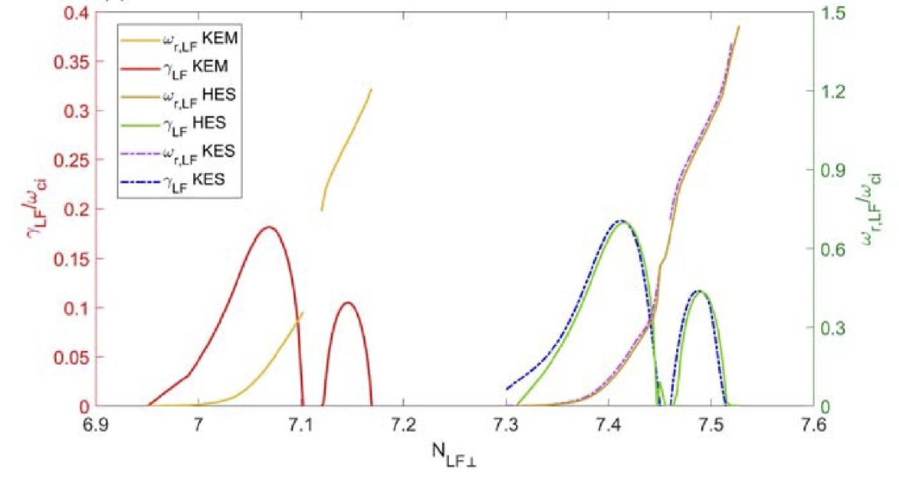
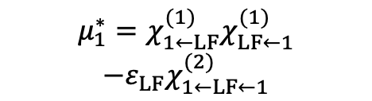
Fortunately, the coupling is mainly ES and fluid
$$μ_{1}^{∗}=χ_{1←LF}^{(1)}χ_{LF←1}^{(1)}$$
$$−ε_{LF}χ_{1←LF←1}^{(2)}$$
ES Limit
same explicit form as from the fluid-kinetic hybrid approach
Noted that kinetic effect in the linear response and EM effect in the linear dispersion relation of the pump should be kept.
LHW@JET [Gao NF 2025]

Slide 13
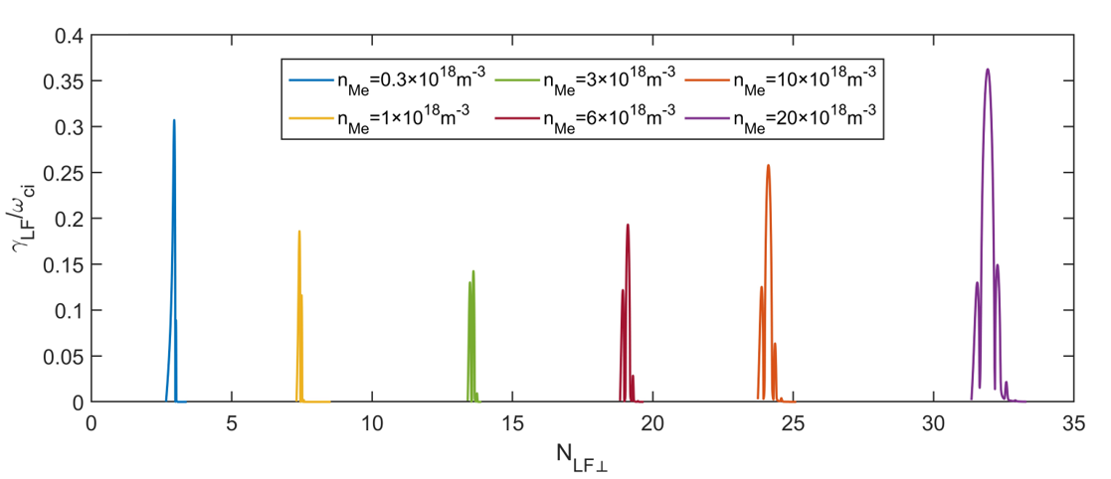
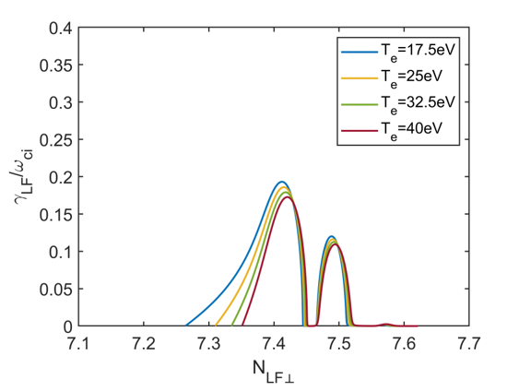
Main results from the local model
(with homogeneous wave and plasma)
ISQM decay is usually suppressed by increasing plasma density
ICQM decay is destabilized by increasing plasma density
Both suppressed by plasma temperature and magnetic field
LHW@JET [Gao et al NF 2025]

Slide 14
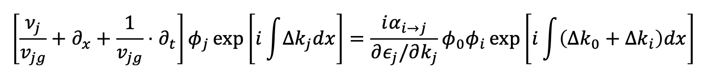
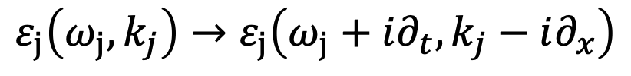
From local to nonlocal：to characterize the inhomogeneity
PDI Equation（ES）：
Rosenbluth approach: for resonant decay ($εj\sim 0)$
x
$$ε_{j}\left(ω_{j},k_{j}\right)→ε_{j}\left(ω_{j}+i∂_{t},k_{j}−i∂_{x}\right)$$

Slide 15
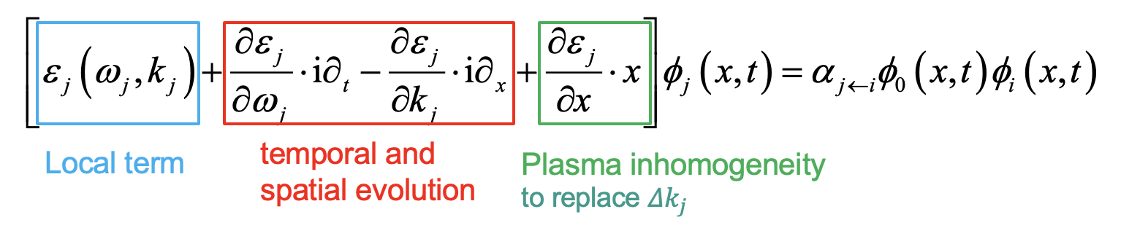

From local to nonlocal：to characterize the inhomogeneity
PDI Equation（ES）：
Rosenbluth approach: for resonant decay ($εj\sim 0)$
Our approach: for quasi-mode decay ($εLF≫1)$
x
$$ε_{j}\left(ω_{j},k_{j}\right)→ε_{j}\left(ω_{j}+i∂_{t},k_{j}−i∂_{x}\right)$$
$$ε_{j}\left(ω_{j},k_{j},x=0\right)→ε_{j}\left(ω_{j}+i∂_{t},k_{j}−i∂_{x},x\right)$$

Slide 16
Eigenvalue problem of the nonlocal equations
Eliminating time, the nonlocal coupling equations turn to Schrödinger form:
Dimensionless parameters: coordinate , amplitude , plasma inhomogeneity , finite pump profile , growth and/or damping rate (complex), coupling coefficient
absolute instability: not an initial value (natural boundary condition)
convective instability: with initial value (Laplace transform ):
The Hamiltonian is non Hermitian!
Initial value

Slide 17
On the absolute instability
Absolute instability: PDI can’t be saturated by plasma inhomogeneity, the solutions are the superposition of time eigenmodes
Estimating the threshold of a quasi-mode decay with a WKB analysis on the complex plane for finite pump profile:
  Due to exponential relation between coupling coefficient and damping rate, there is no absolute instability for quasi-mode decay in MCF plasma
  Back to resonant decay with weak damping [White 1974]
[Chen and Gao, Communications in Theoretical Physics, 2025]

Slide 18
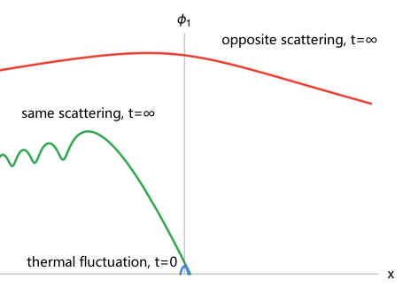
On the convective instability: resonant decay
Convective instability: PDIs are saturated by plasma inhomogeneity, the steady-state solution can be get by setting
The solutions are different in different scattering direction and the convective amplification factor are defined as:
  Same scattering direction ( )
  Opposite scattering direction ( )
For resonant decay, similar results obtained as in Rosenbluth with a tiny correction [Chen and Gao, PPCF 2025]

Slide 19
On the convective instability: quasi-mode decay
No opposite scattering in quasi-mode decay due to strong damping.
For same-direction scattering, the convective amplification factor is,
  the PDI growth rate
plasma inhomogeneity
Finite pump width，actually finite trajectory length
[Chen and Gao, NF 2025]

Slide 20
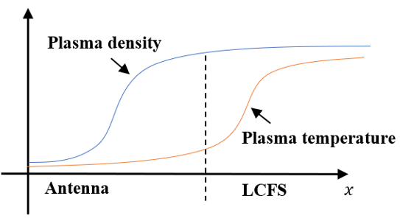
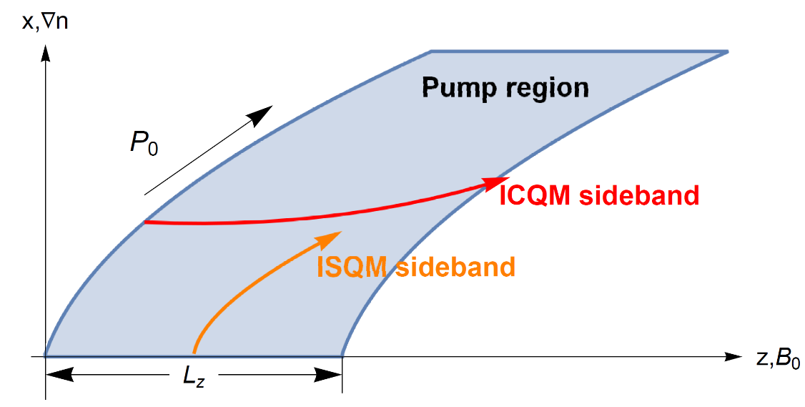
Nonlocal model around the SOL in tokamak
Decay channels: ISQM+ICQM
Plasma inhomogeneity exits in x-direction (radial)
Finite pump profile exits mainly in z-direction (toroidal)
ISQM
ICQM

Slide 21
PIPERS code：ray tracing + PDI
Energy conservation equations constrained by PDIs
  The pump damping and low frequency wave terms are omitted
  The initial value of PDI is the electrostatic thermal noise
The convective amplification factor is integrated along the trajectories of the sideband waves around the SOL
[Huang et al, submitted to NF 2025]

Slide 22
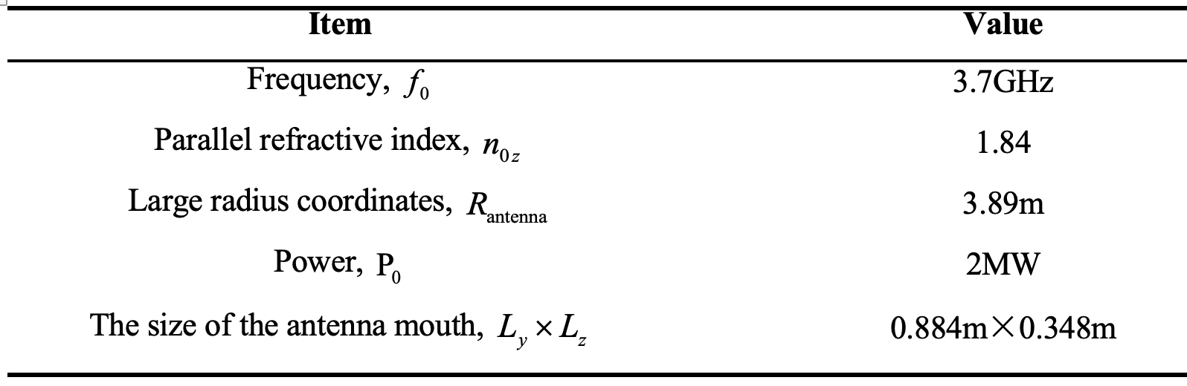
An Example for LHCD experiment
[parameter profiles
@JET Cesario 2006]

Slide 23
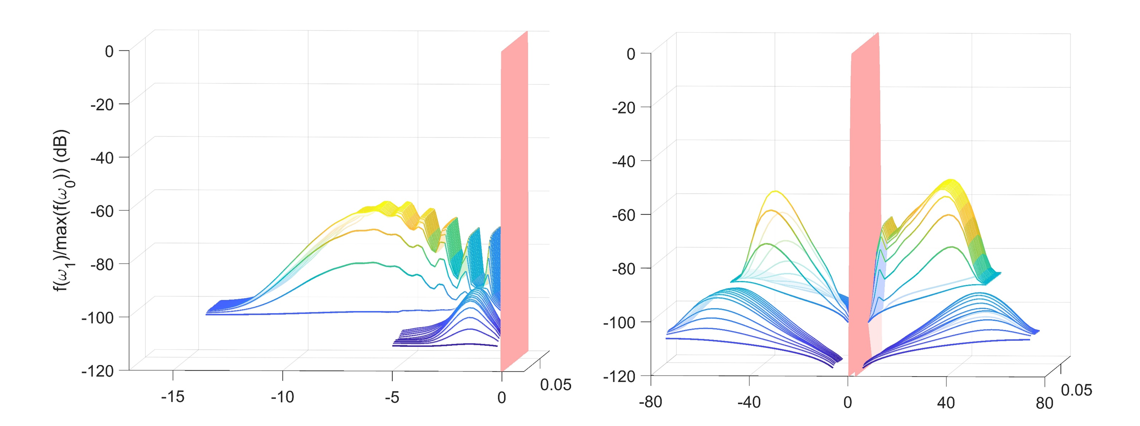
Spectrum evolution and power transfer
Frequency sidebands and wavenumber broadening appears
But no significant power transfer occurs since PDI is weak

Slide 24
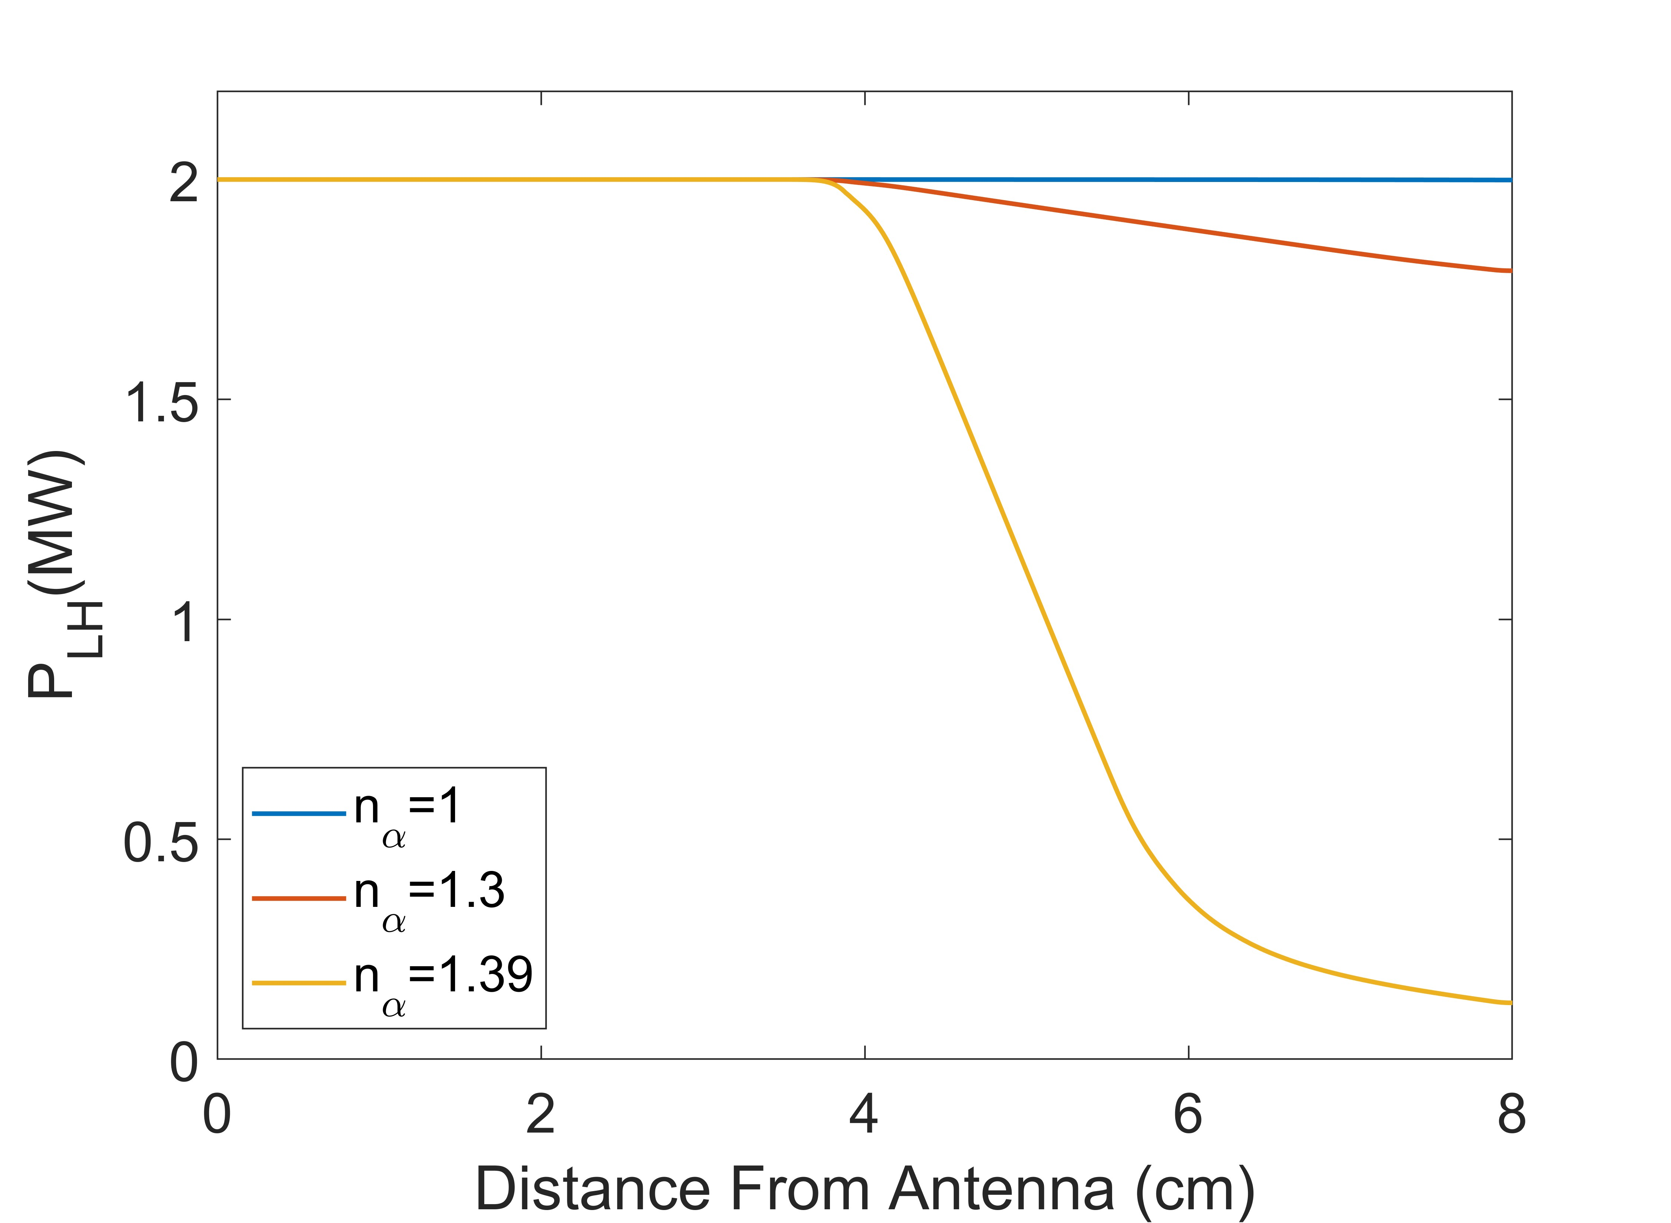
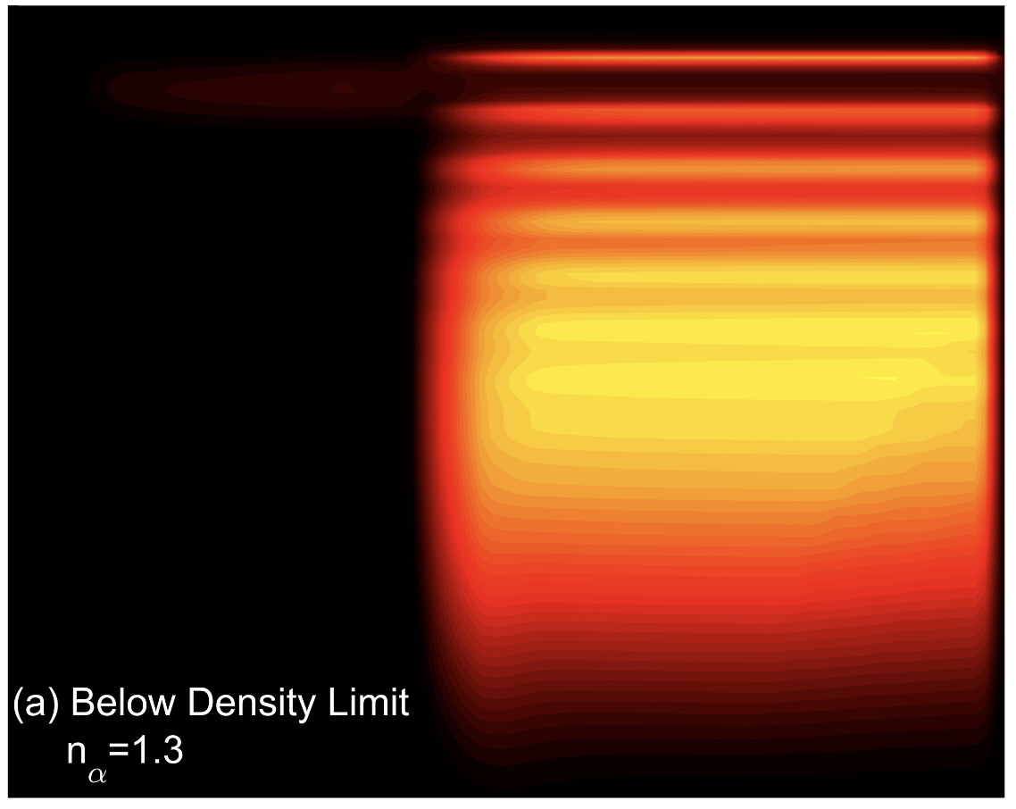


The density limit observed in simulation
When the density increase above a limit, PDI become stronger and the pump is exhausted due to significant power transferring to sidebands

Slide 25
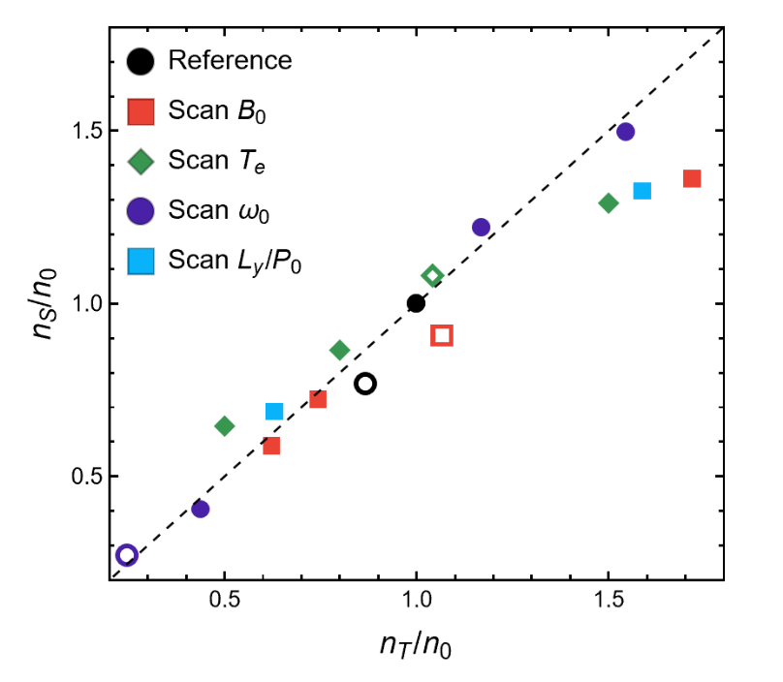
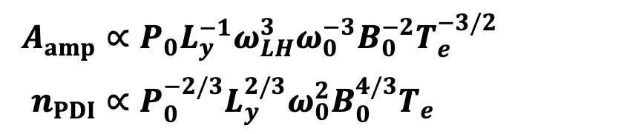
A theoretical scaling relation of the density limit
When the convective amplification factor is above a certain value, the PDI become strong enough to exhaust the pump
$A_{amp}∝P_{0}L_{y}^{−1}ω_{LH}^{3}ω_{0}^{−3}B_{0}^{−2}T_{e}^{−3/2}$
$n_{PDI}∝P_{0}^{−2/3}L_{y}^{2/3}ω_{0}^{2}B_{0}^{4/3}T_{e}$
The simulation results agree quite well with the theoretical scaling relation
[Chen et al, NF letter 2025]

Slide 26
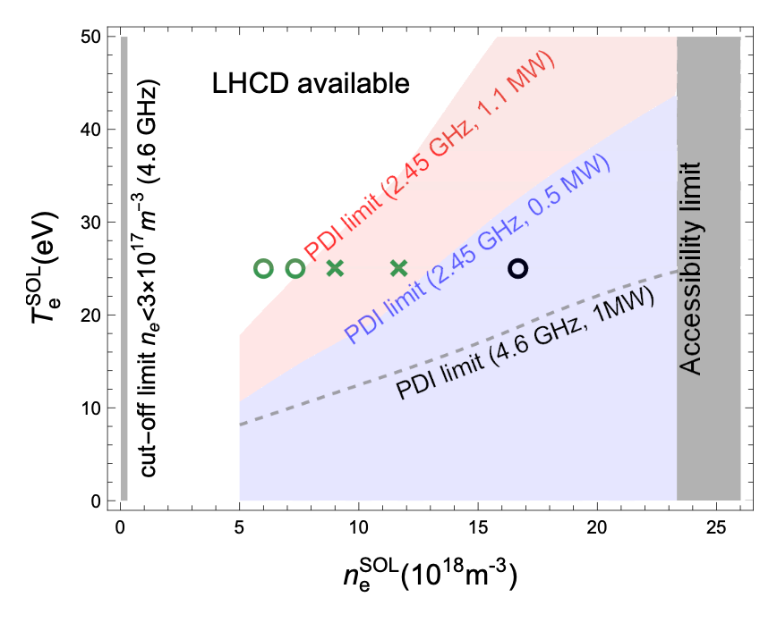
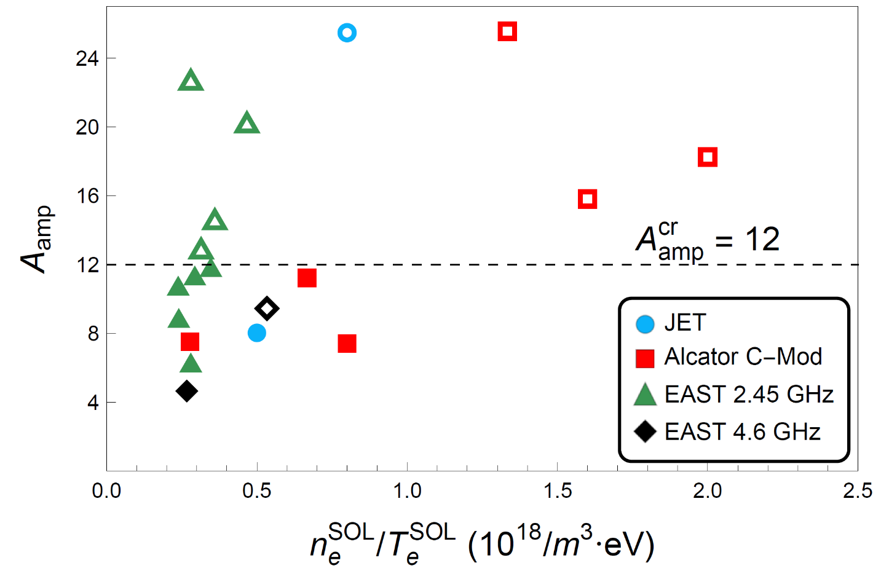
A critical convective amplification factor may be found
Theoretical estimation agrees with experimental observations
However, more targeted experiments with precise diagnostics required
[Chen et al, NF letter 2025]

Slide 27
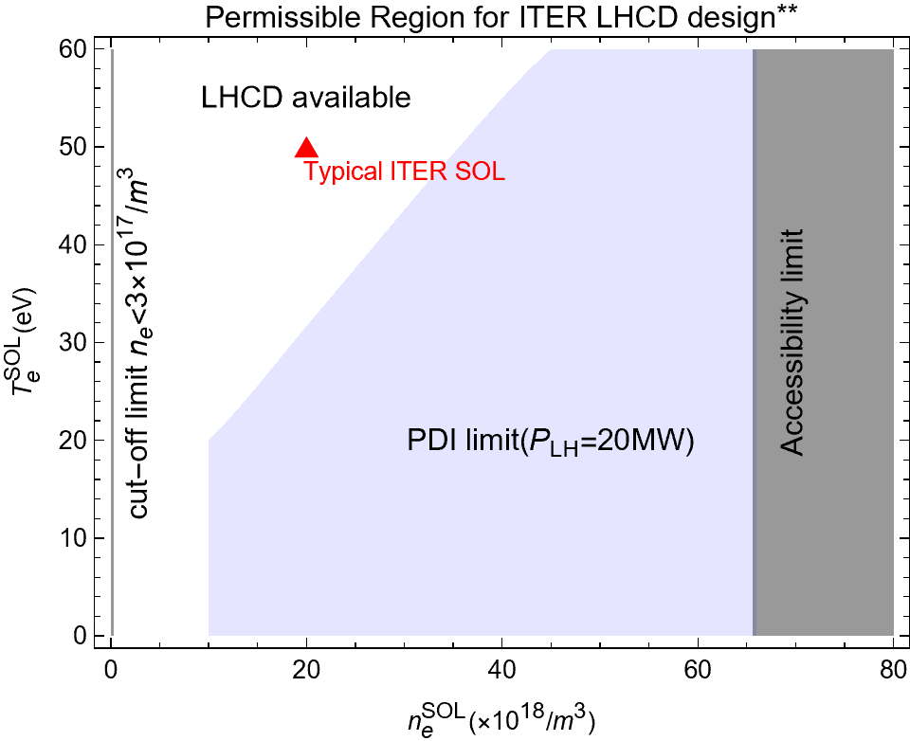
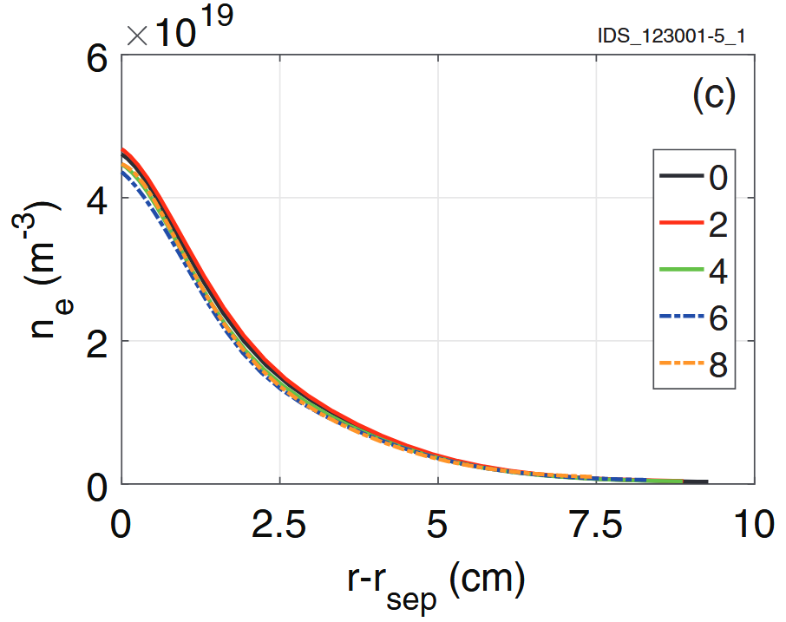
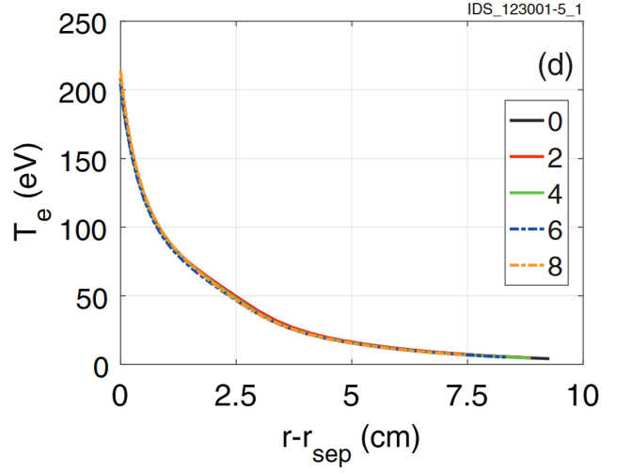
Discussion：LHCD on ITER
Using the ITER SOL parameters to simulate, the density is far from the density limit on ITER due to the high SOL temperature, high B and high LHW frequency
It may indicate that LHCD on ITER is still effective……
[Carli 2018]

Slide 28
Brief Summary
With the increase of wave power injected in present and future fusion device, nonlinear effects gradually strengthen and cannot be ignored.
Nonlinear interactions in MCF plasmas exhibit very different characteristics from those in laser plasmas, and therefore need new research efforts.
Two examples of new theory development and possible roles in MCF plasma, pondermotive force and parametric decay process, are shown respectively.

