Slide 1
  Perfect Liquid at RHIC
刘 峰
华中师范大学粒子物理研究所
Thanks to S.S. Shi ,N. Xu for exciting discussions !
2025年8月13日 复旦大学

Slide 2
Outline
  Introduction
  Perfect Liquid at RHIC
  Probing the QCD Phase Transition via the BES
  Summary

Slide 3

Two Puzzles of Modern Physics
-- T.D.Lee
Missing Symmetry – all present theories are based on symmetry, but most symmetry quantum numbers are NOT conserved.
Unseen Quarks – all hadrons are made of quarks, yet NO individual quark has been observed.
强作用的夸克
和胶子禁闭在
核子内
nucleus
-
atom
matter

Slide 4
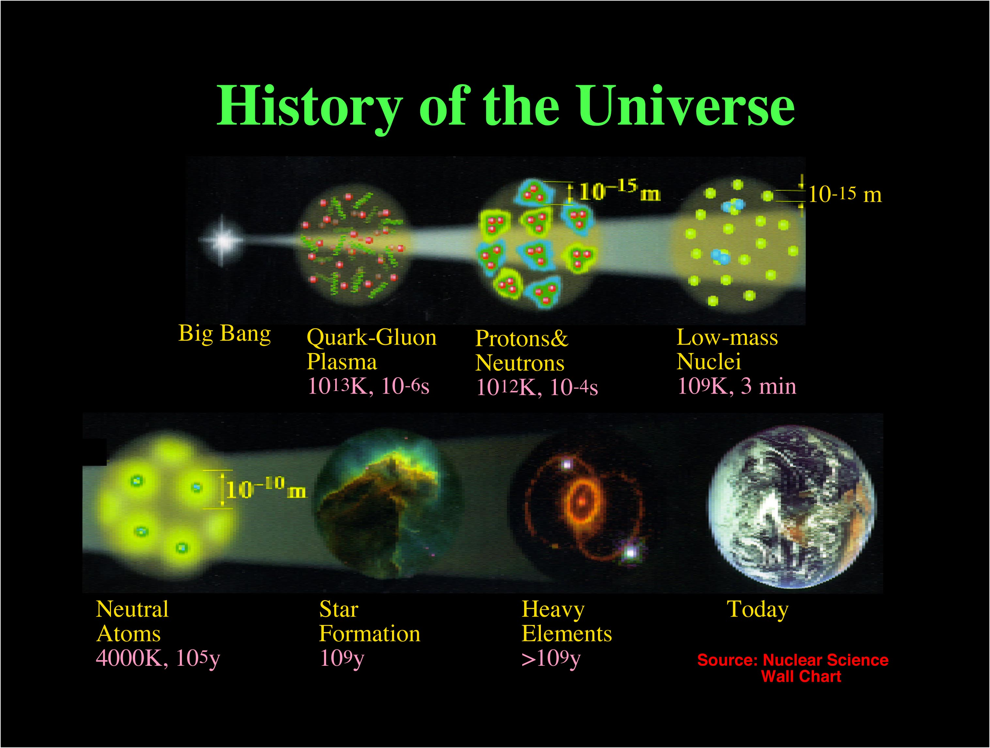

Slide 5
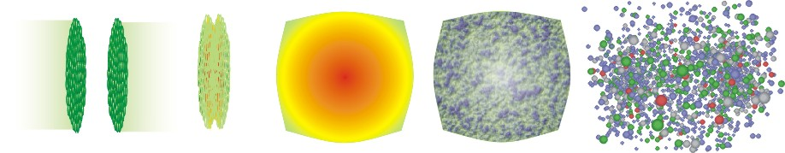

Why Heavy Ion Collisions
QGP and
hydrodynamic expansion
hadronic phase
and freeze-out
initial state
pre-equilibrium
hadronization
Pre-equilibrium parton hard scattering.
QGP thermal and Expansion Stage: 1-10fm/c
Collective expansion, Parton energy loss et al.,
Hadronization: Recombination and coalescence.
Freeze out Stage: ~10-15fm/c
Chemical freeze out: Inelastic scatt. cease.
Kinetic freeze out: Elastic scatt. cease.
Experimental probes:
1) Penetrating probes: “jets”,HF
2) Bulk probes :Elliptic flow, radial flow
3) Fluctuation:
Notes:
重离子碰撞的时空演化如图1.3所示。在实验室中，以相对论速度运动的原子核表现为洛伦兹收缩。碰撞后，大量能量沉积在相互作用区。如果能量密度足够大，所创造的系统的温度超过临界温度Tc，预计会发生相变，形成一个由限定夸克和胶子组成的火球。夸克和胶子之间的相互作用可能导致热化和化学平衡。随后介质的膨胀由QGP的状态方程控制。当系统膨胀并冷却到临界温度Tc时，强子化发生，夸克和胶子受到限制。由于强子的形成时间有限，该体系很可能经历自由夸克和胶子与强子同时存在的混合相。一旦所有的夸克和胶子都被限制在强子里，这个系统就变成了强子气体。随着强子气体继续膨胀，温度降至化学冻结温度Tch，强子之间的非弹性散射停止，强子种类的相对丰度将不再改变。当体系被稀释到强子不再有弹性地相互作用，体系变成自由流动时，就会发生动力学冻结，用Tfo表示。

Slide 6
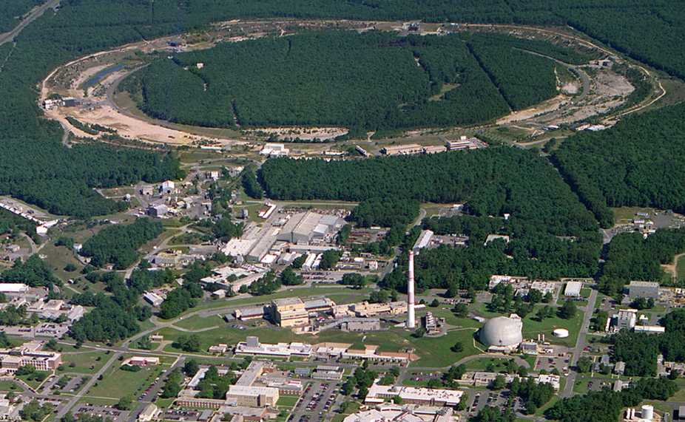
Relativistic Heavy Ion Collider
Brookhaven National Laboratory (BNL), Upton, NY
PHOBOS
BRAHMS
RHIC
PHENIX
STAR
v = 0.99995⋅c = 186,000 miles/sec
Au + Au at 200 GeV
RHIC: The high-energy heavy-ion collider
(i) Dedicated QCD collider, 3.8 km
(ii) √s_{NN} = 200 - 5 GeV
Fixed Target: 3 - 7.7 GeV
(iii) U, Pb, Au, Cu, d, p
RHIC: The highest energy
polarized proton collider!
√s = 200, 500 GeV
AGS
Au+Au Head-on Collisions → 40x10¹² eV ~ 6 micro-Joule
Human Ear Sensitivity ~ 10⁻¹¹ erg = 10⁻¹⁸ Joule
A very loud Bang, indeed, if E→ Sound……
TANDEMS
Animation M. Lisa

Slide 7
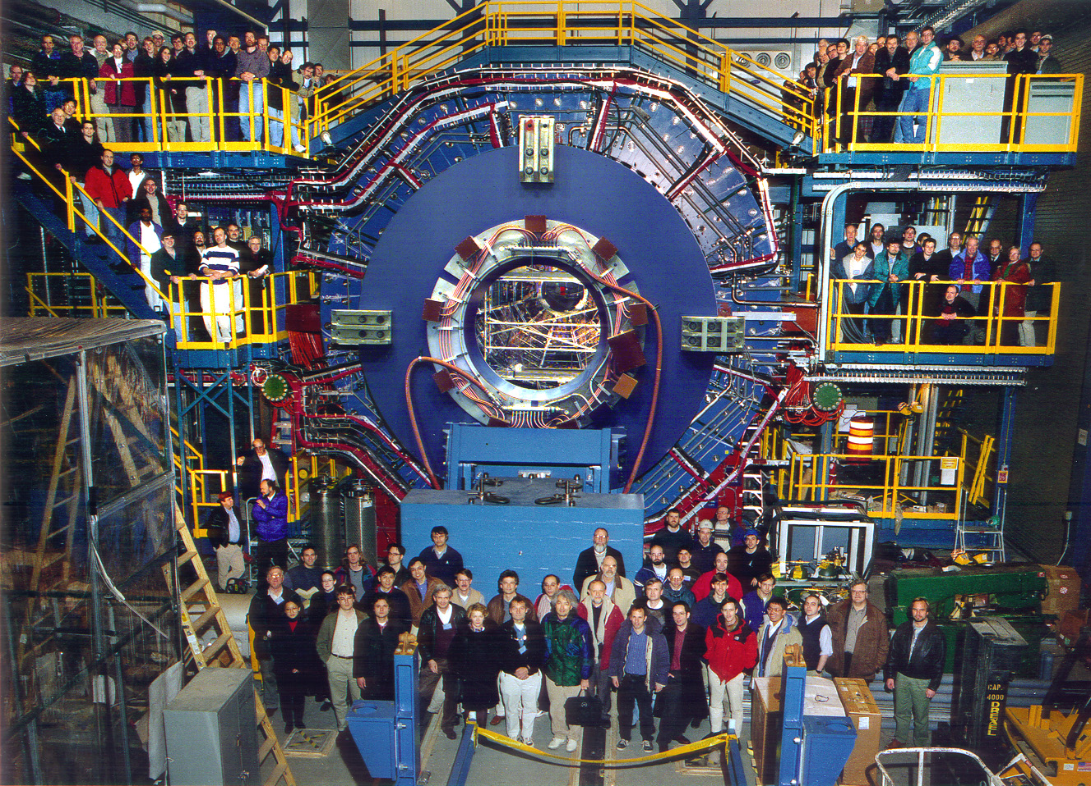
STAR Collaboration
STAR
773 collaborators
76 institutions (10)
14 countries

Slide 8

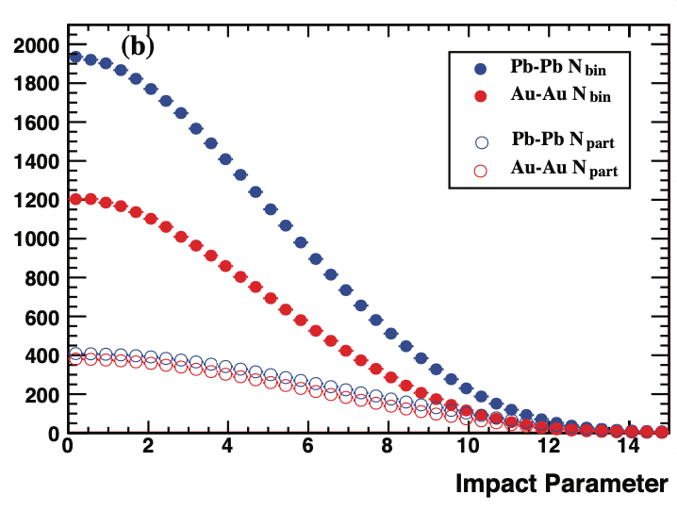
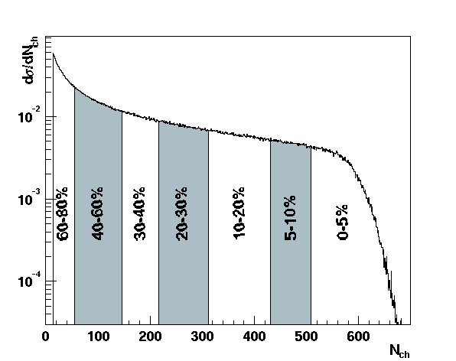
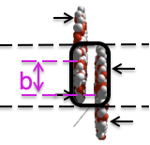
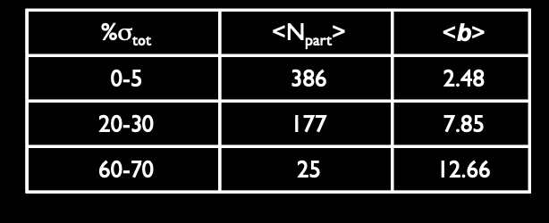
Collision Geometry
Au + Au √s_{NN} = 200 GeV
⇔
Charged particle multiplicity
collision centrality
⇔
Determines the magnitude of the impact parameter
Notes:
对于STAR中的Au+Au碰撞，中心性选择基于TPC测量的yan快度|η| < 0.5区间内未校正的初级带电粒子数。中心度分类是用这个多重分布的分数来计算的。格劳伯计算是用蒙特卡罗计算来进行。中心度0-5%的定义，对应于占总横截面5%的最中心碰撞，而70-80%是最外围碰撞。最小偏置是指最中心的0 ~ 80%的强子截面。将计算得到的dσ/dNpart或dσ/dNbin分布总几何截面的分bin 按 比例公共分式划分为相应的bin，提取每个中心度bin的平均Npart或Nbin。

Slide 9
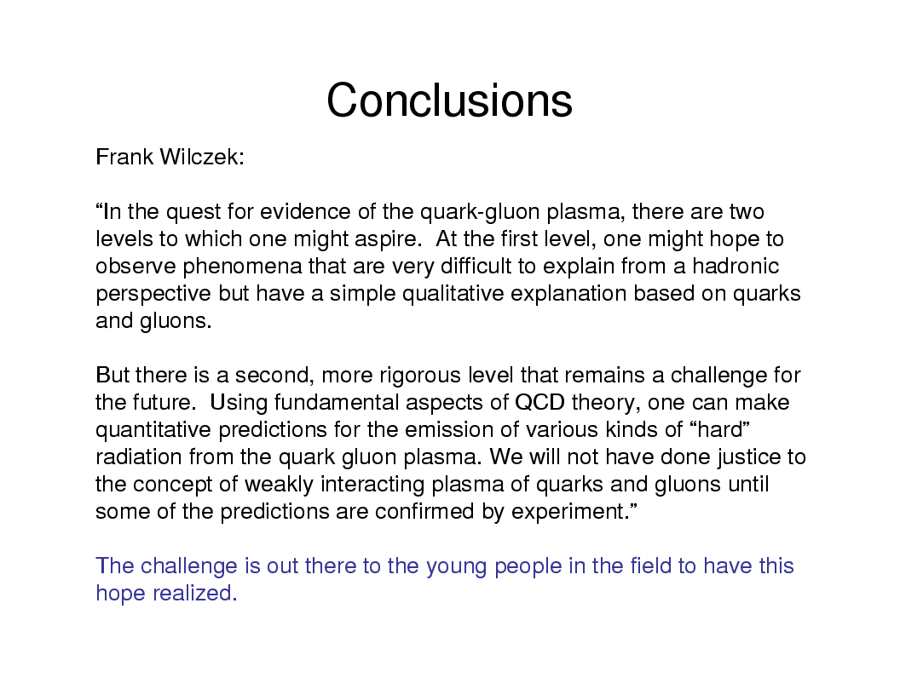
观察的现象从强子的角度很难解释，但有一个基于夸克和胶子的简单定性解释

Slide 10
Outline
  Introduction
  Perfect Liquid at RHIC
  Spectra
  Elliptic flow v₂
  Perfect Liquid
  Probing the QCD Phase Transition via the BES
  Summary

Slide 11
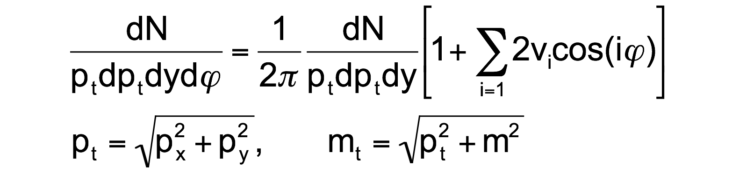
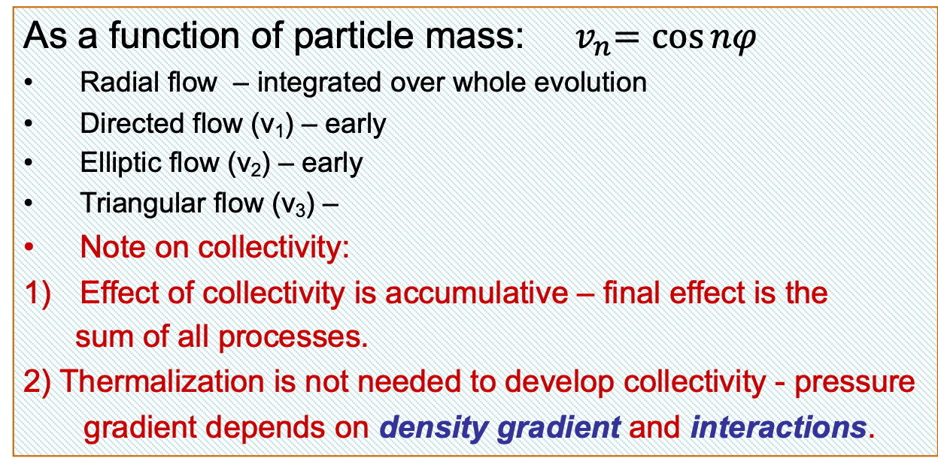
Transverse Flow Observables
As a function of particle mass: ${ v}_{n}=\cos{nφ}$
Radial flow – integrated over whole evolution
Directed flow (v₁) – early
Elliptic flow (v₂) – early
Triangular flow (v₃) –
Note on collectivity:
Effect of collectivity is accumulative – final effect is the
sum of all processes.
2) Thermalization is not needed to develop collectivity - pressure
gradient depends on density gradient and interactions.

Slide 12
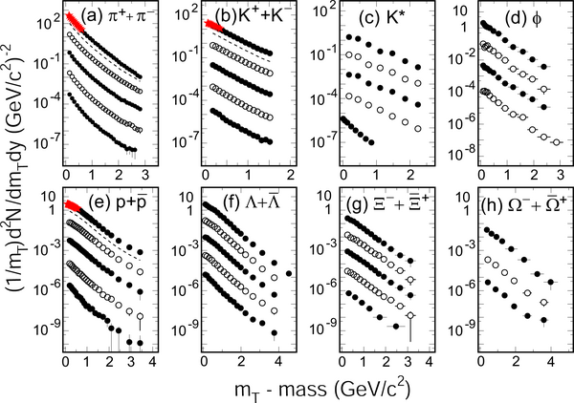
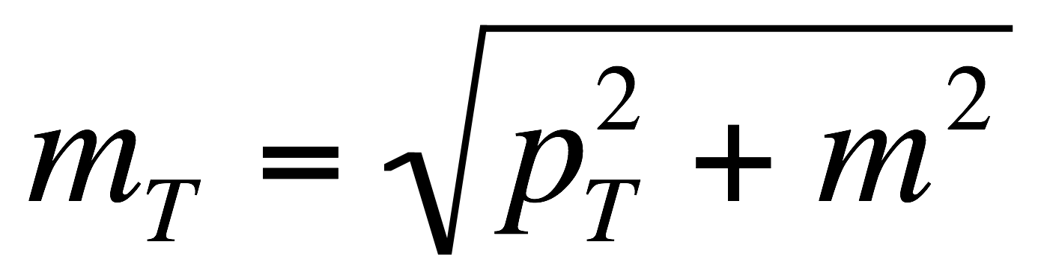
Hadron Spectra From RHIC
mid-rapidity, p+p and Au+Au collisions at 200 GeV
5%
10-20%
20-40%
40-60%
60-80%
STAR:NPA757,102(05)
(F. Wang) NPA715,
466c (03) , JPG30,
S693(04) .
PHENIX: PRC 69 ,
034909(04) .
(Huang, Long)
PRL 89, 092301(02);
F. Wang) PLB 595,
143(04).
(Nu) PRC 70, 041901 (04),
(F. Liu, F. Wang)PRL 92, 112301(04)
Hadron spectra reflect the properties of the bulk of the matter at kinetic freezeout
In central collisions, m_{T} distributions become more concave ⇒ collective flow !

Slide 13
Thermal Model Fits (Blast-Wave)
Source is assumed to be:
  Local thermal equilibrated
  Boosted radically
boosted
  E.Schnedermann, J.Sollfrank, and U.Heinz, Phys. Rev. C48, 2462(1993)
random
Extract thermal temperature T_{fo} and velocity parameter ⟨β_{T}⟩
Notes:
At first, I want to show a short explanation of a model to describe the pt distribution.
This model is established to describe particle mass dependence of pt distribution in low pT region.
The source is in local thermal equilibration and it s boosted.
Simply take boltzmann distibution and take enregy term as four momentum with flow effect.
Here we consider transverse direction and then the transverse momentum distribution is described this formula.
The parameters to characterized the system is temperature and flow velocity.

Slide 14
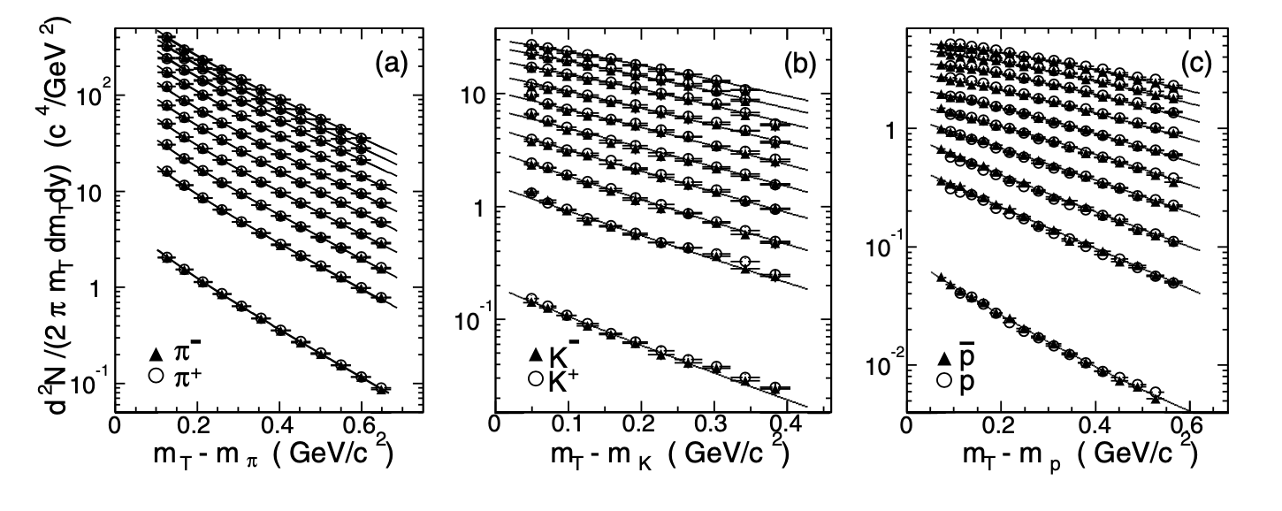
Hadron Spectra From RHIC
mid-rapidity, p+p and Au+Au collisions at 200 GeV
5%
10-20%
20-40%
40-60%
60-80%
STAR :Phys. Rev. Lett. 92, 112301 (2004)
谱线与blast wave 模型下的粒子谱线吻合。该拟合较好地描述了所有粒子的谱，
可以用模型的两个参数来表征::一个单一的动力学冻结温度和一个共同的横向流速度。

Slide 15
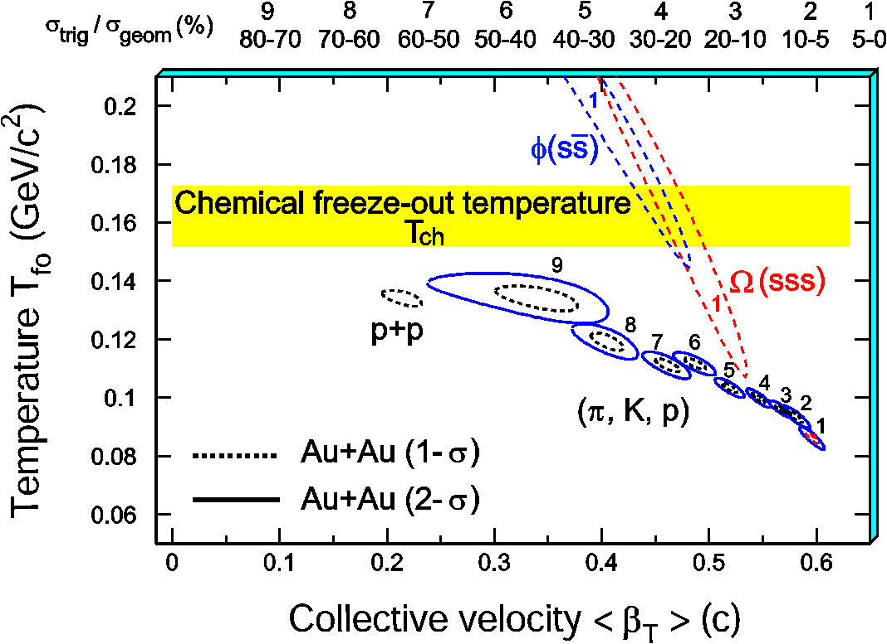
Thermal fits: T_{fo} vs. < β_{Τ} > at 200GeV
1) π, K, and p change
smoothly from peripheral
to central collisions.
2) At the most central
collisions, <β_{T}> reaches
0.6c.
3) Multi-strange particles φ,
Ω are found at higher T_{fo}
(T~T_{ch}) and lower <β_{T}>
Sensitive to early partonic stage!
How about v₂?
STAR:NPA757,102(05) , (F. Wang) NPA715, 466c (03) ;
P. Braun-Munzinger, J. Stachel, J. Wessels, N. Xu, Phys. Lett. B 344 (1995) 43;
P. Braun-Munzinger, I. Heppe, J. Stachel, Phys. Lett. B 465 (1999) 15.

Slide 16
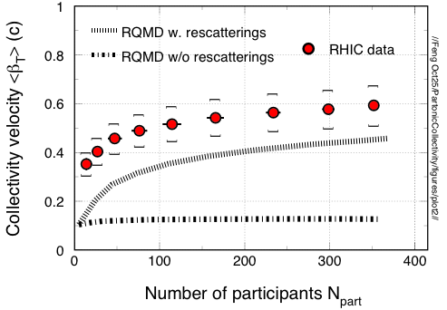
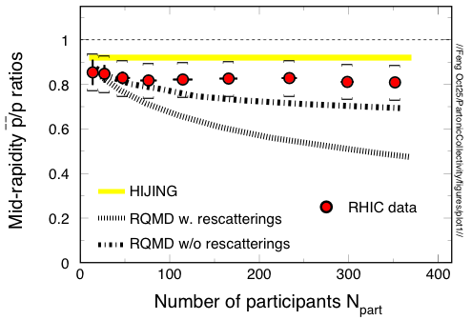
Tests with Transport Model
Re-scatterings are import for collectivity !
Hadronic Re-scatterings can not reproduced the anti-proton over proton ratios as a function of centrality.
⇒ re-scattering at earlier pre-hadronic stage?

Slide 17
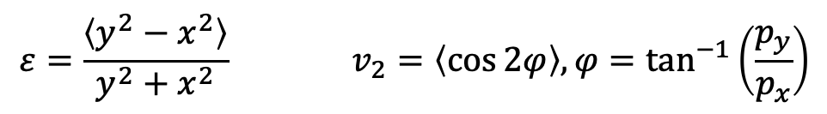
Anisotropy parameter v₂
Sensitive to initial/final conditions and equation of state (EOS) !
coordinate-space-anisotropy ⇔ momentum-space-anisotropy
$$ε=\frac{\left\langle y^{2}−x^{2}\right\rangle }{y^{2}+x^{2}} v_{2}=\left\langle \cos{2φ}\right\rangle , φ=\tan^{−1}\left(\frac{p_{y}}{p_{x}}\right)$$
v₂ : a probe of the dynamics governing the system’s evolution
Flow : represents the collective motion of particles.

Slide 18
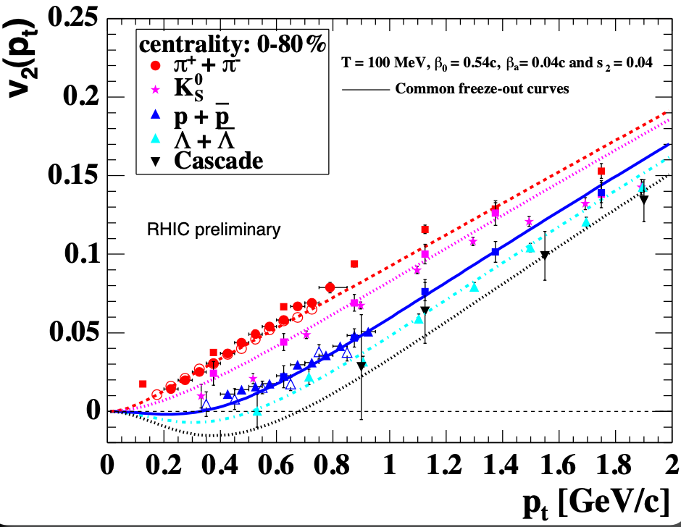
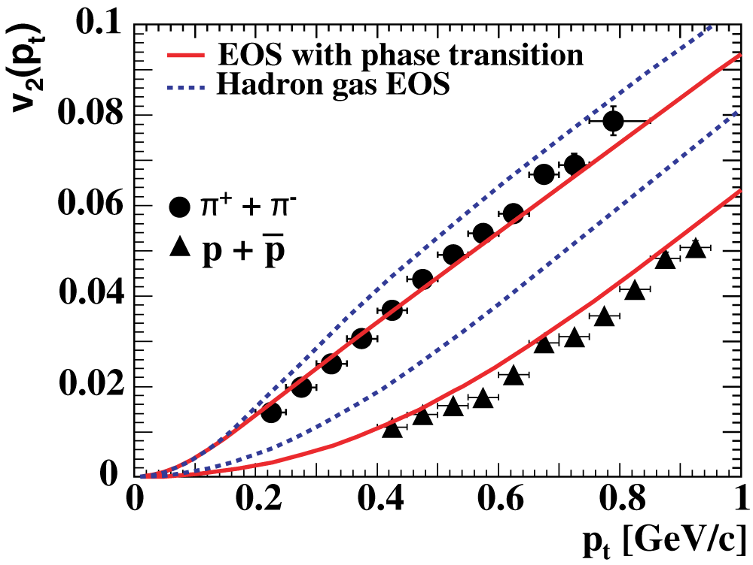
v₂ at Low p_{T} Region:Mass dependence
pions to Cascade follow the mass dependence at low-p_{t}
Ideal hydro not perfect agreement but plasma EoS favored
Notes:
在流体力学中，集体径向运动使粒子获得更高的平均动量，较重的粒子比较轻的粒子获得更多的动量。这导致谱在低横动量处变得平坦。这种平坦在低pt时减小了v2，因此粒子越重，v2(pt)的增加越多就越向更大的pt移动。理想流体力学假设在系统形成时完全局部热化，随后是由状态方程(EoS)控制演化。 椭圆流对粒子质量和横向动量的依赖细节对状态方程很敏感。图显示了两个状态方程中介子和(反)质子v2(pt):的流体动力学模型预测，完整曲线是包含从QGP到强子气体相变效应的EoS，虚线是没有相变的强子EoS。很明显，使用包含相变的EoS进行流体计算可以更好地描述测量结果。与质子相比，介子的相变效应不那么明显。这是可以理解的，因为较轻的粒子受温度的影响更大，因此对集体速度不太敏感，而集体速度对EoS敏感。

Slide 19
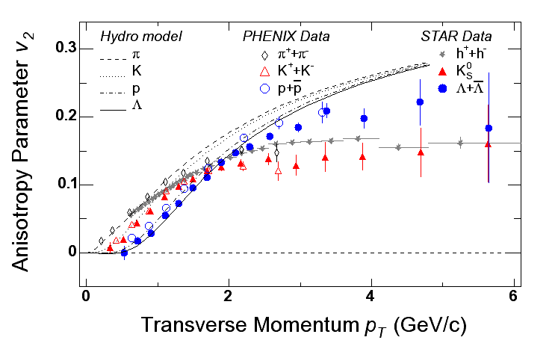
Elliptic Flow v₂
PRL 92 (2004) 052302; PRL 91 (2003) 182301
Hydro calculations break-down at higher p_{T} (as expected).
How is v₂ established at p_{T} above 2 GeV/c?
Why is baryon v₂ so large?

Slide 20
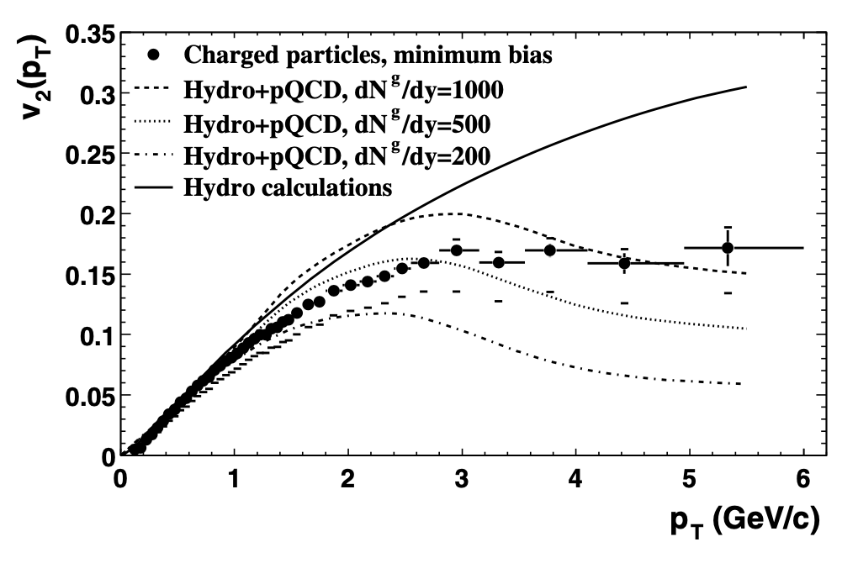
parton energy loss
M. Gyulassy, I. Vitev and X.N. Wang, Phys. Rev. Lett. 86, 2537(2001).
能量损失喷注淬火 ~ 传播部分子穿过的路径长度。高横向动量下粒子产生方位各向异性
Notes:
在Au+Au碰撞中，在足够高的横向动量下，强子产额被认为包含了很大一部分来自于初始硬散射产生的高能部分子的碎裂。基于微扰QCD (pQCD)的计算预测，高能部分子穿越核物质通过胶子辐射损失能量。
能量损失(喷注淬火) 预计强烈依赖于所产生系统的色荷密度和传播部分子穿过的路径长度。在非中心重离子碰撞中，几何重叠区在横向平面呈扁桃形，其短轴在反应平面内。根据方位发射角的不同，平均说来部分子穿过这样一个系统的粒子经历不同的路径长度，因此能量损失也不同。这导致在高横向动量下粒子产生的方位各向异性。因此，在高pt下，观察到的椭圆流确实对初始胶子密度提供了约束。图中的虚线表示基于静态介质中能量损失计算的理论预测
左下图显示了在200 GeV半中心区(20-60%)Au+Au碰撞区 带电粒子v2作为横向动量的函数。这些v2值分别由事件平面法(记为v2{EP})和二粒子累积法和四粒子累积法(记为v2{2}和v2{4})得到。通过这三种方法获得的值存在系统性差异，特别是基于二粒子和四粒子相关性的方法之间的差异。图中清楚地表明，差值随着横向动量的增大而增大。在5 GeV/c以上，v2{4}比v2{2}和v2{EP}低50%。另一方面，v2{2}和v2{EP}之间的差值小于5%，并且与横向动量近似无关。v2{2}和v2{4}之间的差异可以用非效应和起伏的结合来解释，其中横向动量依赖性的差异可能是由非流动引起。一般情况下，如果起伏足够小，真实的v2介于(v2{2} + v2{4})/2和v2{4}之间。
观察到的趋势(与使用的方法无关)是v2随pt增加，在3 GeV/c左右达到最大值，然后再次下降。高pt处较大的v2{4}与部分能量损失的情景相一致。

Slide 21
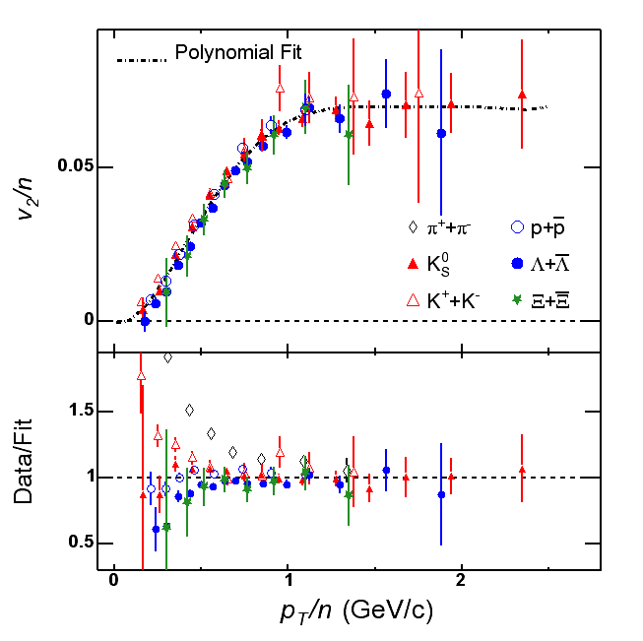
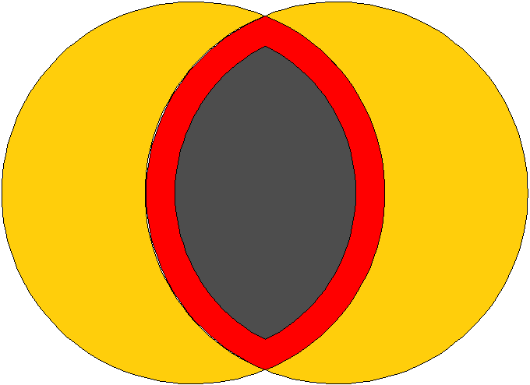
Constituent Quark Degree of Freedom
Hadronization Scheme for
Bulk Partonic Matter:
K_{S} – two quark coalescence
– three quark coalescence
from the partonic matter surface?!
Particle v₂ may be related to
quark matter anisotropy !!

Slide 22
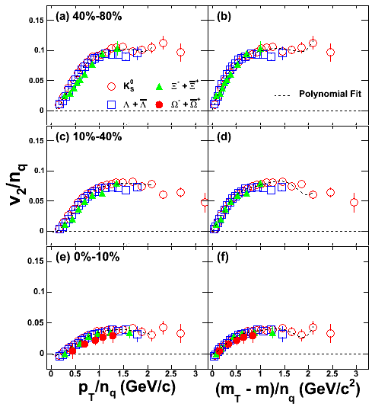
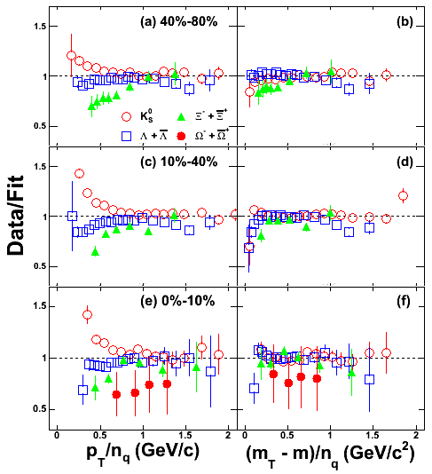
Centrality Dependence of NQ Scaling
m_{T} -n_{q} scaling is observed at all centrality bins.

Slide 23
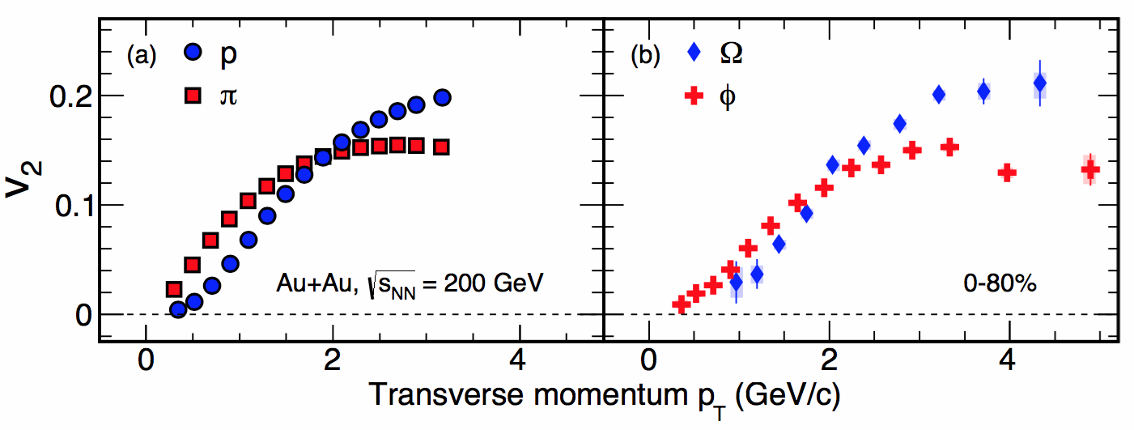
Partonic Collectivity at RHIC
STAR: Phys. Rev. Lett.118, 212301 (2017),STAR: Phys. Rev. Lett.116, 062301 (2016)
u- and d-quarks s-quarks c-quarks
Low p_{T} (≤ 2 GeV/c): hydrodynamic mass ordering
High p_{T} (> 2 GeV/c): number of quarks scaling
含有 u, d, s, c-夸克的强子中都表现出很强的集体运动，这表明夸克-胶子等离子体 (QGP) 热化核物质在高能核-核碰撞中的产生;
➔ Partonic Collectivity, necessary for QGP!
➔ De-confinement in Au+Au collisions at RHIC!

Slide 24
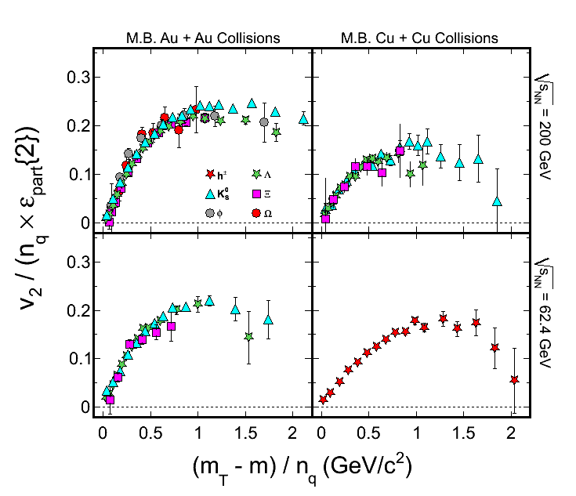
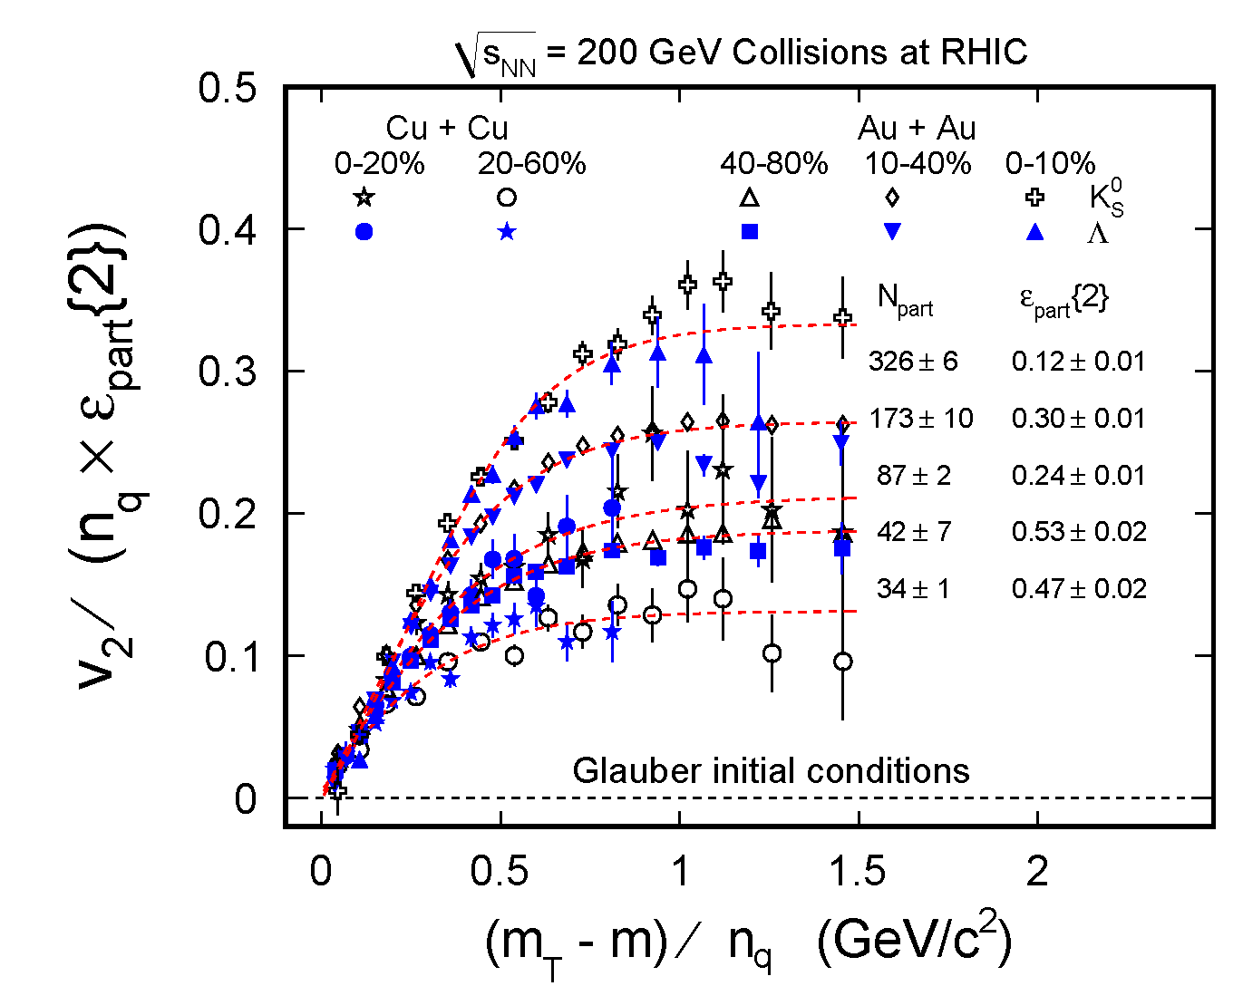
System and Energy Dependence
STAR Au + Au 62.4 GeV : PRC75, 054906 (2007), PRC81, 044902 (2010),
ε_{part}{2}: J. Y. Ollitrault, A. M. Poskanzer and S. A. Voloshin, PRC80, 014904 (2009)
Minimum bias events
Au+Au and Cu+Cu at 200 GeV Scaled by eccentricity remove the initial geometry
  NQ scaling for each centrality bin
Collective flow: depends on the number of participants
  Larger v₂/ε_{part} indicates stronger collective flow in more central collisions.
Notes:
24
24
Glauber model has been used to calculate the eccentricities, but it is similar in the case of CGC model.
(i) There is a clear number of quark (NQ) scaling for all systems and beam energies
studied here. (Due to the limited statics, this test is not done for Cu+Cu collisions at
√𝑠𝑁𝑁 = 62.4 GeV.) It indicate the partonic collectivity has been built up at RHIC.
(ii) After removing the initial geometry by eccentricity, stronger collective flow can be observed in the larger system.

Slide 25

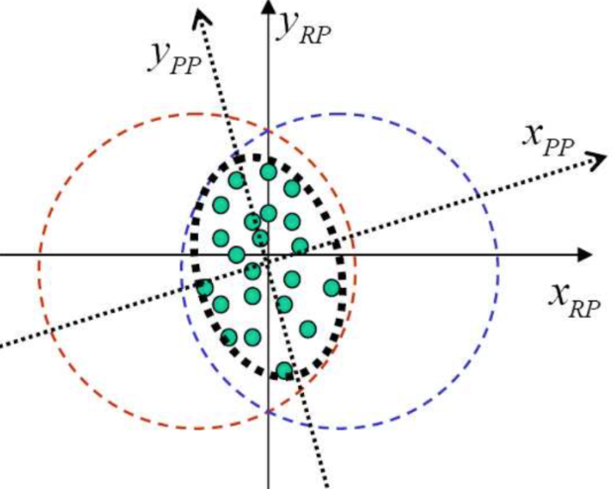
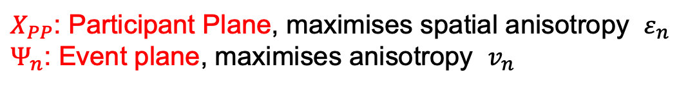
Flow Fluctuations
Flow
Out-of-plane
Y
In-plane
Reaction
plane
Flow
X
Reaction plane defined by impact parameter and beam direction
$X_{PP}$: Participant Plane, maximises spatial anisotropy $ε_{n}$
$Ψ_{n}$: Event plane, maximises anisotropy $v_{n}$
Notes:
由于各向异性流动依赖于再散射，因此对系统早期的热化程度非常敏感。在Au+Au等重核相互作用中，除了最边缘碰撞外εstd和εpart的平均值非常相似。然而，对于小系统，核子位置的起伏对于所有的中心度都非常重要，并且平均偏心率可以根据它的计算方式而有很大的变化

Slide 26
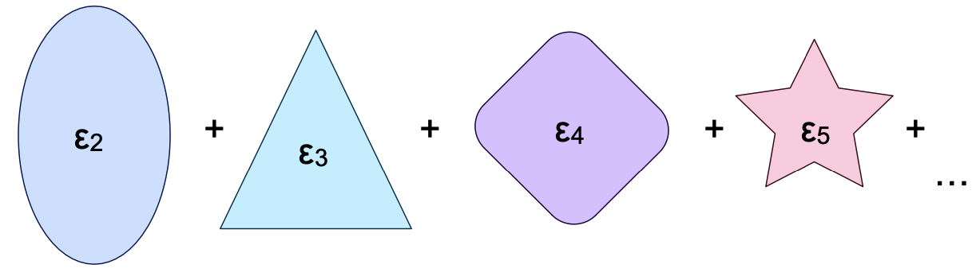
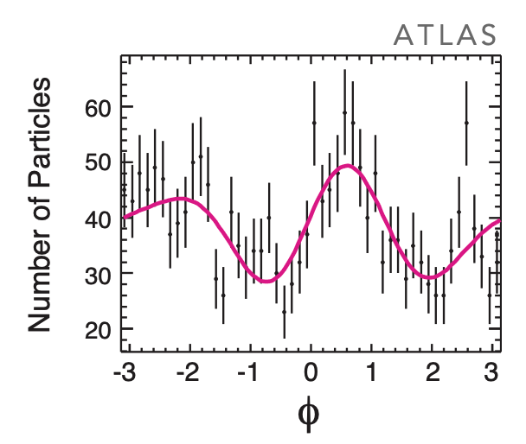
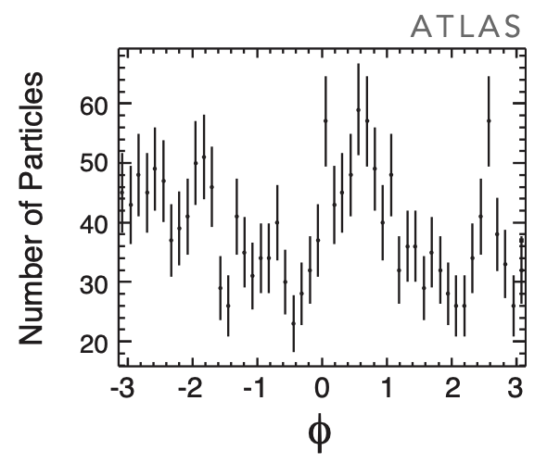
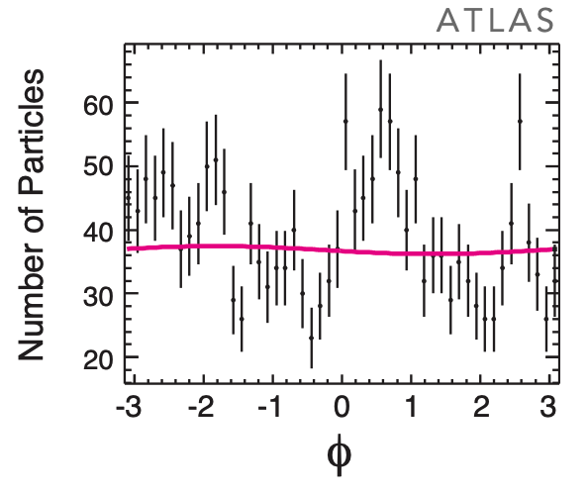
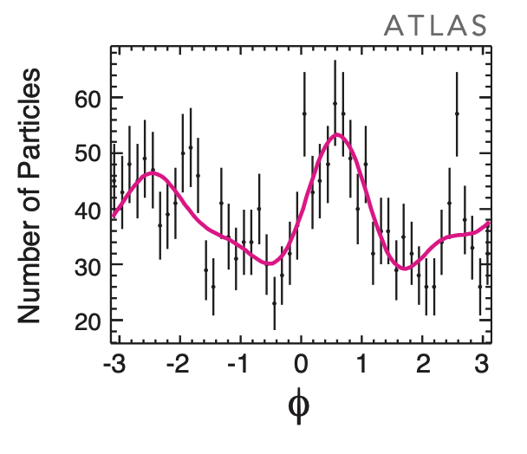
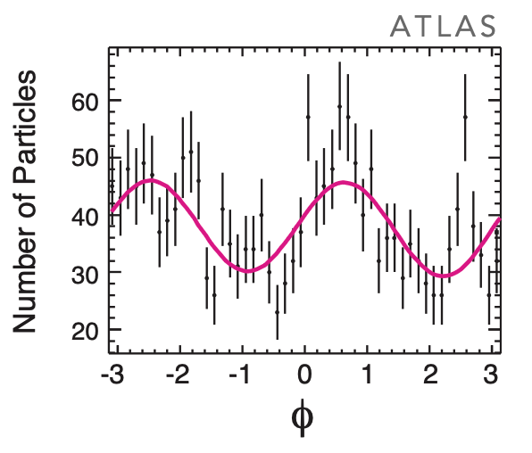
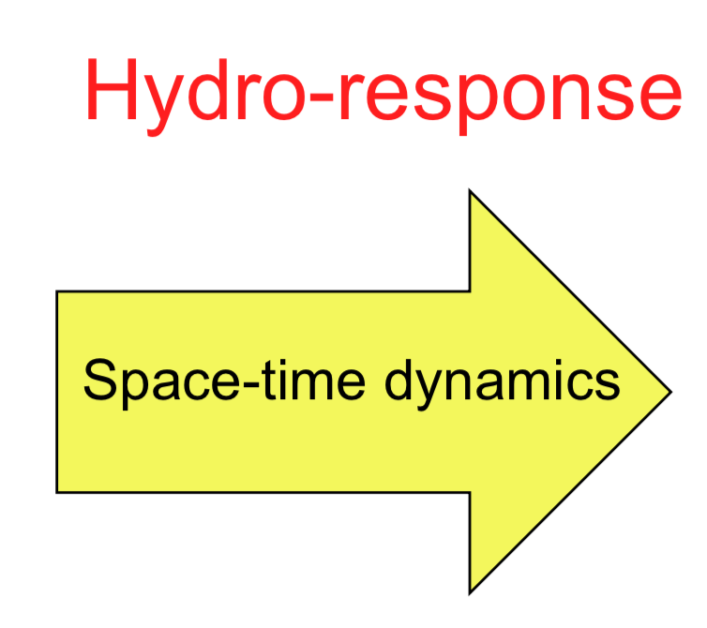
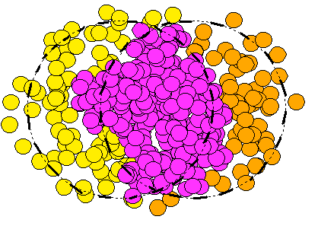


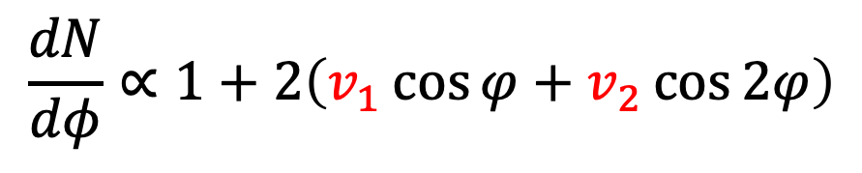
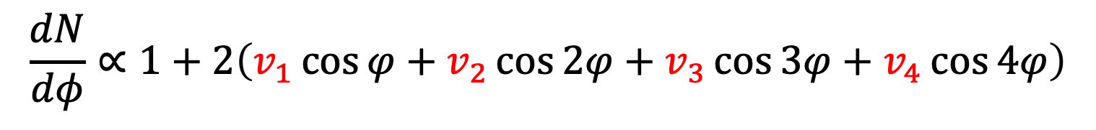
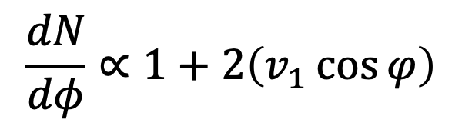
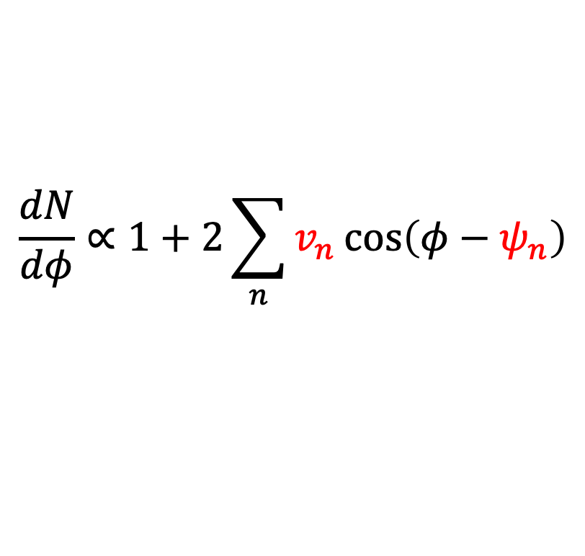
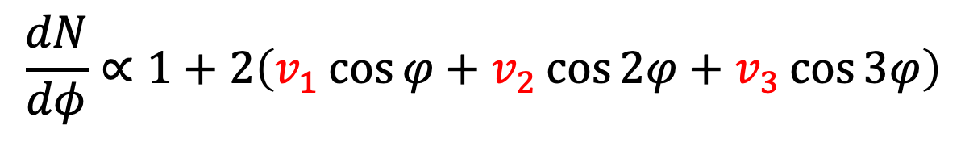
Harmonics in hydro-picture
Initial state
ε₂
ε₃
ε₄
$$\frac{dN}{dφ}∝1+2\left(v_{1}\cos{φ}\right)$$
$$\frac{dN}{dφ}∝1+2\sum_{n}{v_{n}\cos\left(φ−ψ_{n}\right)}$$
$$\frac{dN}{dφ}∝1+2\left(v_{1}\cos{φ}+v_{2}\cos{2φ}+v_{3}\cos{3φ+v_{4}\cos{4φ}}\right)$$
$$\frac{dN}{dφ}∝1+2\left(v_{1}\cos{φ}+v_{2}\cos{2φ}\right)$$
$$\frac{dN}{dφ}∝1+2\left(v_{1}\cos{φ}+v_{2}\cos{2φ}+v_{3}\cos{3φ}\right)$$

Slide 27
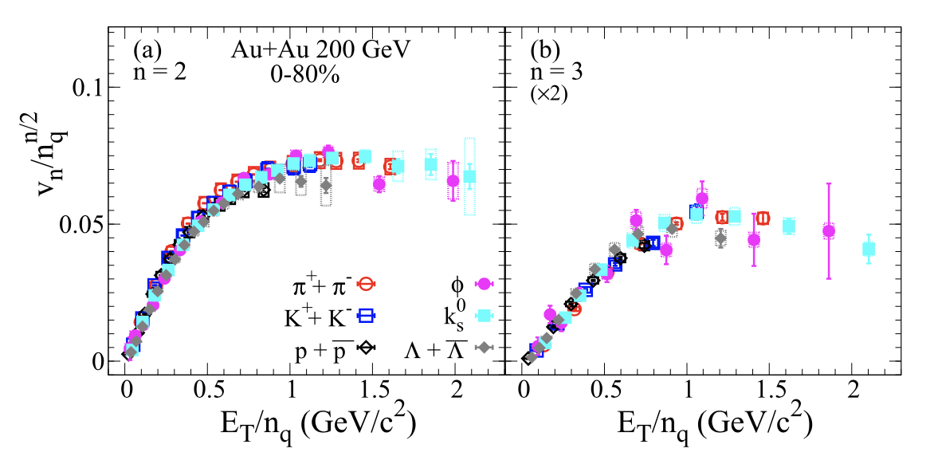
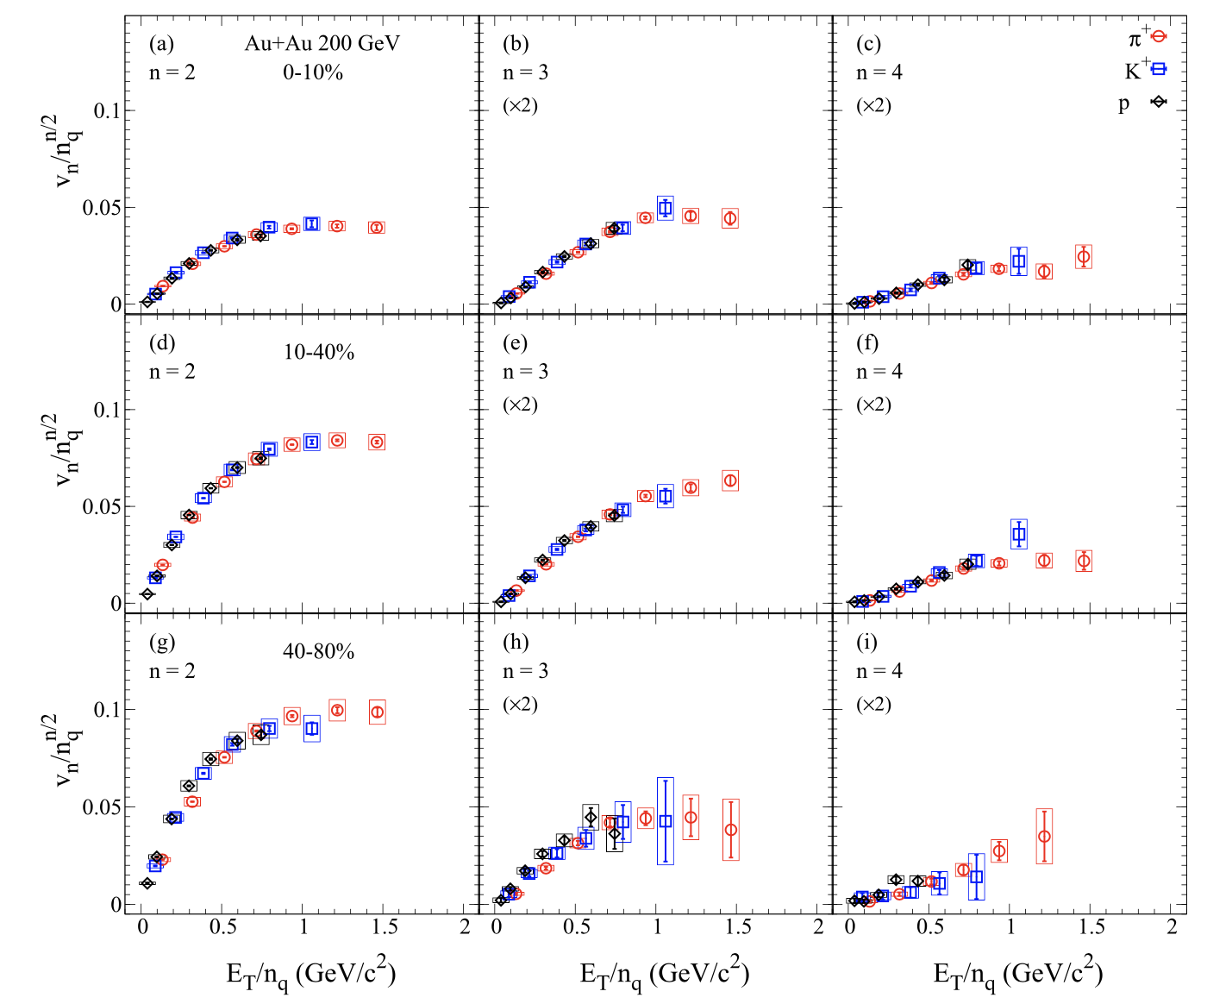
Higher-order Flow in 200 GeV
RHIC top energy
Light flavor, strange particles and φ mesons
Follow the NCQ scaling up to v₄
Partonic collectivity
STAR: Phys. Rev. C.105, 064911 (2022)
R. Lacey, J. Phys. G, Nucl. Part. Phys. 38 (2011) 124048.
Notes:
27

Slide 28
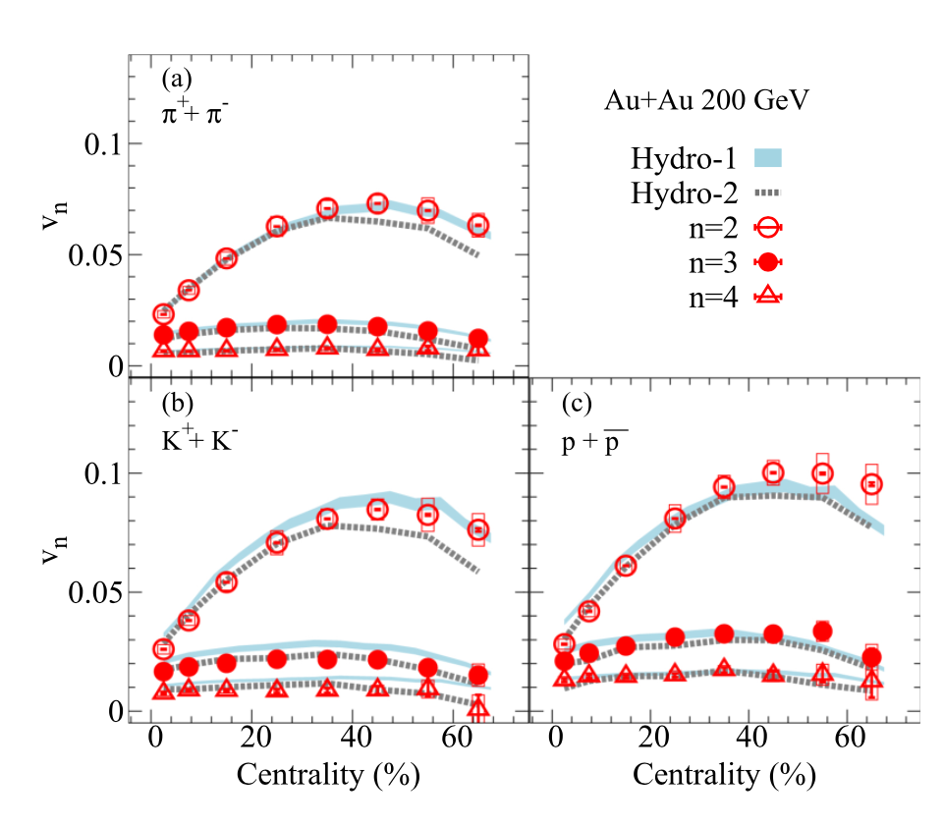
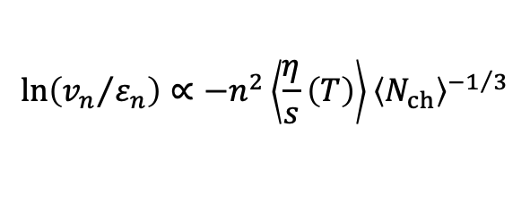
Higher-order Flow in 200 GeV
the v_{n} values decrease with increasing harmonic order. reflects the increase of viscous effects with increasing harmonic order
$$ln\left({v_{n}}/{ε_{n}}\right)∝−n^{2}\left\langle \frac{η}{s}\left(T\right)\right\rangle {\left\langle N_{ch}\right\rangle }^{−1/3}$$
The weakening centrality dependence for higher flow is caused by the dominating geometry fluctuations.
STAR: Phys. Rev. C.105, 064911 (2022)
Notes:
28

Slide 29
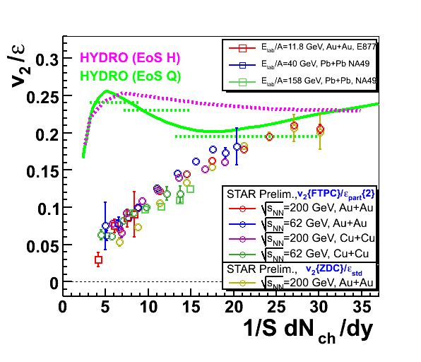
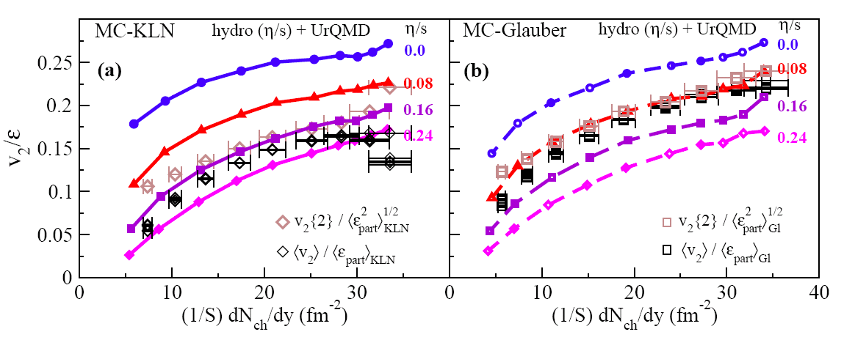
Perfect Liquid at RHIC
v₂/ε approaches the limit of ideal hydrodynamics
Small value of specific viscosity over entropy η/s
Model uncertainty dominated by initial eccentricity ε
Model: Song et al. arXiv:1011.2783
1/S dNch/dy (fm⁻²)

Slide 30


Viscosity and the Perfect Fluid
H₂O
N₂
He
hadronic
partonic
η/s ≥ 1/4π
2) η/s(QCD matter) < η/s(QED matter)
Caption: The viscosity to entropy ratio versus a reduced temperature.
Lacey et al. PRL 98:092301(07)
hep-lat/0406009
hep-ph/0604138

Slide 31

sQGP at RHIC
强耦合的夸克胶子等离子体(sQGP) 在RHIC 产生
s 强耦合
QGP：
1）夸克胶子解禁闭在大于 强子尺度的范围自由运动
2） 色中性
重子(qqq) p(uud), n(udd), $Λ\left(uds\right),Ω(sss)$
介子$(q\overline{q})$ $π^{+}\left(u\overline{d}\right), K^{+}$ $\left(u\overline{s}\right), ϕ$ $\left(s\overline{s}\right)$
夸克有 3种颜色， 胶子有颜色
强子： 色中性， 不带色

Slide 32
Outline
  Introduction
  Perfect Liquid at RHIC
  Probing the QCD Phase Transition via the BES
  Summary

Slide 33

Beam Energy Scan at RHIC
Observables:
1st order phase transition
(1) Azimuthally sensitive HBT
(2) Directed flow v₁
Partonic vs. hadronic dof
(3) R_{AA}: N.M.F.
(4) Charge separation
(5) v₂ - NCQ scaling
Critical point, correl. length
(6) Fluctuations
Chiral symmetry restoration
(7) Di-lepton production
Study QCD Phase Structure
- Signals for onset of sQGP
- Signals for phase boundary
- Signals for critical point
√s_{NN} = 7.7, 9.2,11.5, 14.5, 17.3,19.6, 27, 39,54.4 GeV
FXT : 3 - 7.7 GeV

Slide 34
BES-I & II at RHIC (2010-2017, 2018-2021)
Collider mode
Au+Au Collisions
FXT mode
√s_{NN} (GeV) | Events (10⁶) | BES II / BES I | μ_{B} (MeV) | T_{CH} (MeV)
200 | 238 | 2010 | 25 | 166
62.4 | 46 | 2010 | 73 | 165
54.4 | 1200 | 2017 | 83 | 165
39 | 86 | 2010 | 112 | 164
27 | 30 (560) | 2011/2018 | 156 | 162
19.6 | 538 / 15 | 2019/2011 | 206 | 160
14.5 | 325 / 13 | 2019/2014 | 264 | 156
11.5 | 230 / 7 | 2020/2010 | 315 | 152
9.2 | 160 / 0.3 | 2020/2008 | 355 | 140
7.7 | 100 / 3 | 2021/2010 | 420 | 140
17.3 | 250 | 2021 | 230 | 158
√s_{NN} (GeV) | Events (10⁶) | BES II / BES I | μ_{B} (MeV) | T_{CH} (MeV)
7.7 | 50+112 | 2019+2020 | 420 | 140
6.2 | 118 | 2020 | 487 | 130
5.2 | 103 | 2020 | 541 | 121
4.5 | 108 | 2020 | 589 | 112
3.9 | 117 | 2020 | 633 | 102
3.5 | 116 | 2020 | 666 | 93
3.2 | 200 | 2019 | 699 | 86
3.0 | 259 | 2018 | 750 | 80
3.0 | 2000 | 2021 | 750 | 80
(μB, T_{CH}) : J. Cleymans et al., PRC73, 034905 (2006)
STAR, arXiv:1007.2613
https://drupal.star.bnl.gov/STAR/starnotes/public/sn0493
https://drupal.star.bnl.gov/STAR/starnotes/public/sn0598
Most precise data to map the QCD phase diagram :
3 ≤ √s_{NN} ≤ 200 GeV, 25 < μ_{B} < 750 MeV

Slide 35

NCQ Scaling Test
BES-I
STAR: Phys. Rev. Lett.110, 142301(2013)
Phys. Rev. C 88, 014902(2013)
Phys. Rev. C 93, 014907(2016)
BESI: v₂ of multi-strange hadrons and φ mesons seems dropping when collision energy < 20 GeV
BESII: precise measurements will offer information on partonic vs. hadronic degree of freedom:
QCD phase structure

Slide 36


Disappearance of NCQ Scaling
BES-II: 3 GeV
STAR: Phys. Lett. B 827 (2022) 137003; Phys. Rev. C.107 (2023) 024912
At 3 GeV, the measured midrapidity $v_{2}$ for all particles are negative and NCQ scaling is absent
Equation-of-State dominated by baryonic interactions
→ The hadronic degree of freedom dominates

Slide 37

3 GeV 动力学冻结温度
暗示3GeV所产生的热密核物质与高能量相比具有不同的状态方程

Slide 38

NCQ scaling of v₂ at 3 - 4.5 GeV
  Hadronic interaction. Partonic collectivity
STAR: Phys. Rev. Lett. 135, 072301 (2025)
NCQ scaling completely breaks below 3.2 GeV
NCQ scaling becomes better gradually from 3.2 to 4.5 GeV

Slide 39
Onset of NCQ Scaling
BES-II: 3
STAR: Phys. Rev. Lett. 135, 072301 (2025)

Slide 40
Summary
1) Copiously produced hadrons freeze-out:
  T_{fo} = 100 MeV, β_{T} = 0.6 (c) > β_{T}(SPS)
  Much stronger collective flow observed in collisions at RHIC than collisions at lower beam energies. Early partonic interactions are responsible for the increase of pressure gradient at RHIC.
2) Collectivity: Partonic Collectivity at RHIC
Hydrodynamic Description of Bulk Particle
Constituent Quark scaling work for v₂ ，v₃， v₄
3) The matter behavior like a quantum liquid with small η/s
4) Beam Energy Scan
Onset of NCQ scaling: 3.2 to 4.5 GeV

Slide 41


Equation of State
EoS usually given by lattice QCD calculations and hadron resonance gas model
Energy density ε GeV/fm³
Equation of state:
EOS I : ideal gas of massless partons
EOS H: resonance gas:
EOS Q: connecting an ideal gas of massless partons at high temperature to a Hagdorn hadron resonance gas at low temperature via a first-order phase transition.
T_{crit}= 165 MeV, B^{1/4} = 0.23 GeV ε_{lat}=1.15 GeV/fm³
P. Kolb et al., Phys. Rev. C62, 054909 (2000).

Slide 42



QCD Phase Transition Temperature
Ideal gas of quark-gluon system in thermal equilibrium:
Pion Gas Quark Gluon Plasma
QGP side
□ Strange quark neither massless nor massive
Bag constant stand-in for QCD vacuum fluctuations
□ Ignores (strong!) interactions
Hadron side
□ Pions hardly massless relative to 140 MeV
Ignores exponential growth at higher T
□ Ignores (strong!) interactions

Slide 43
弱相互作用的夸克和胶子等离子体的概念还有待于实验的证实

