Slide 1
From Anomalous γ Absorption to UPC:
A Century of Photoproduction Experiments
Wangmei Zha
University of Science and Technology of China
The 1st ALICE Experiment and Heavy-Ion Physics Workshop,
Fudan University, Shanghai − 09/11/2025

Slide 2
Concise Roadmap
Historical prelude
UPC essentials and Key processes
How do we measure
Representative results
What we learn & what’s next

Slide 3
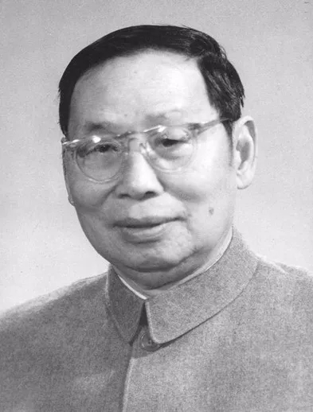
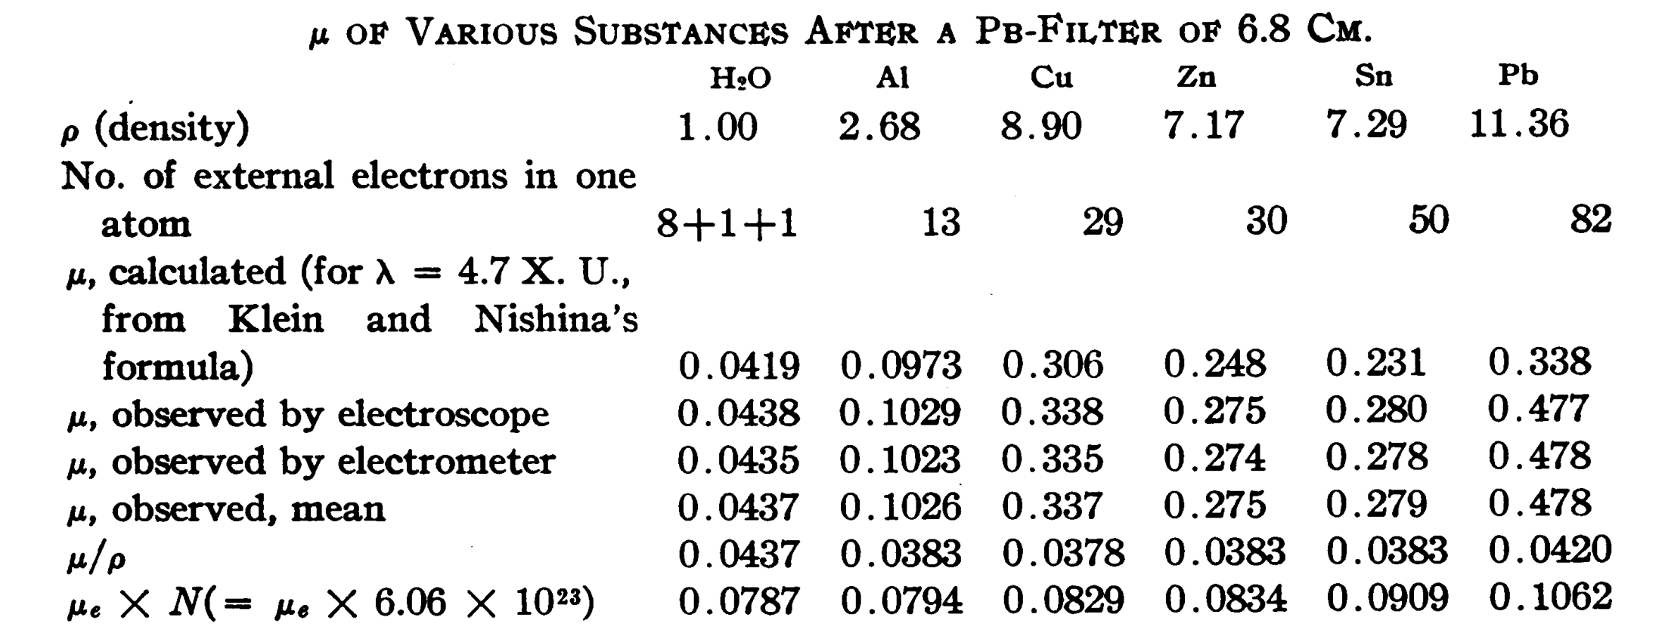
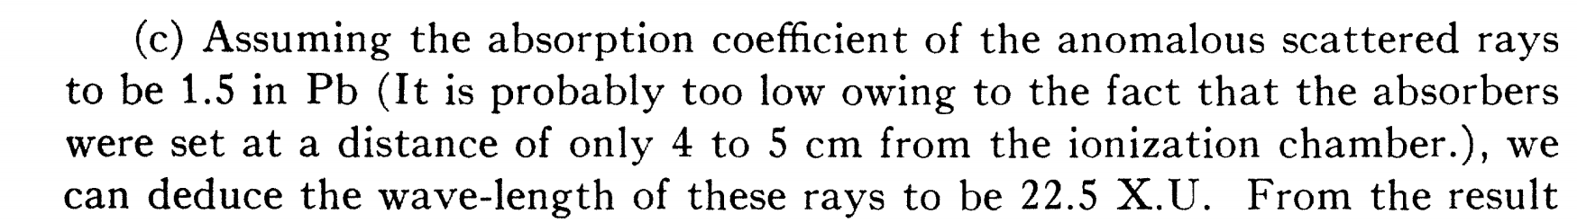
“Anomalous” Absorption & Scattering of Hard γ Rays
赵忠尧
（1902-1998）
C.Y. Chao, PNAS 16 (1930)
C.Y. Chao, Phys. Rev. 36 (1930) 1519
≈0.55MeV

Slide 4
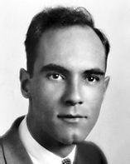
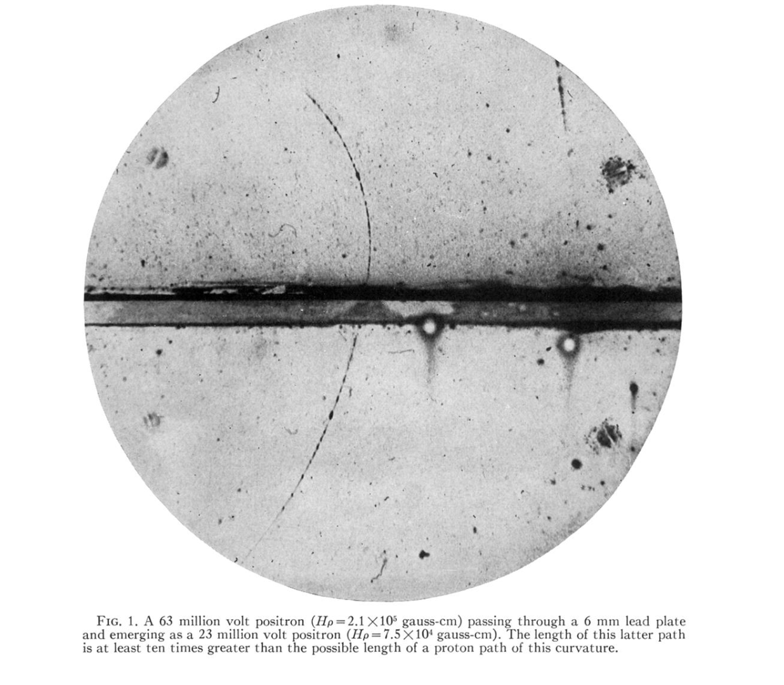
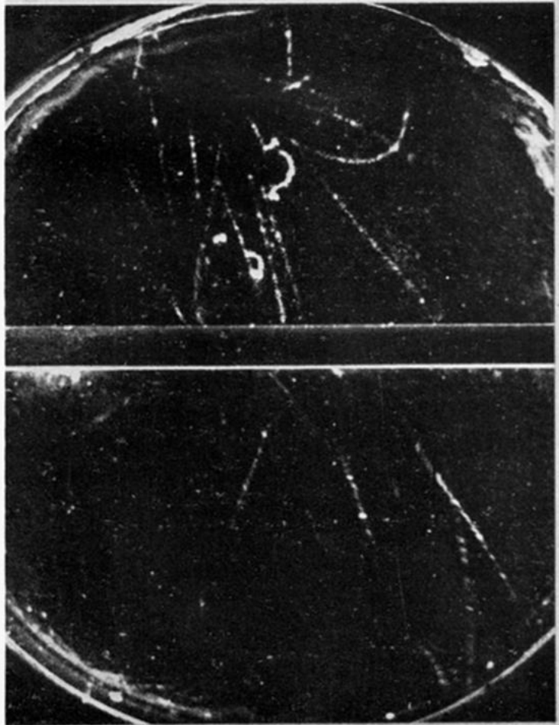
Positron Discovery & Pair Production
Anderson
（1905-1991）
C. D. Anderson, Phys. Rev. 43 (1933) 491
P. M. S. Blackett and G. P. S. Occhialini,
Proc. R. Soc. Lond. A 139 (1933) 699

Slide 5
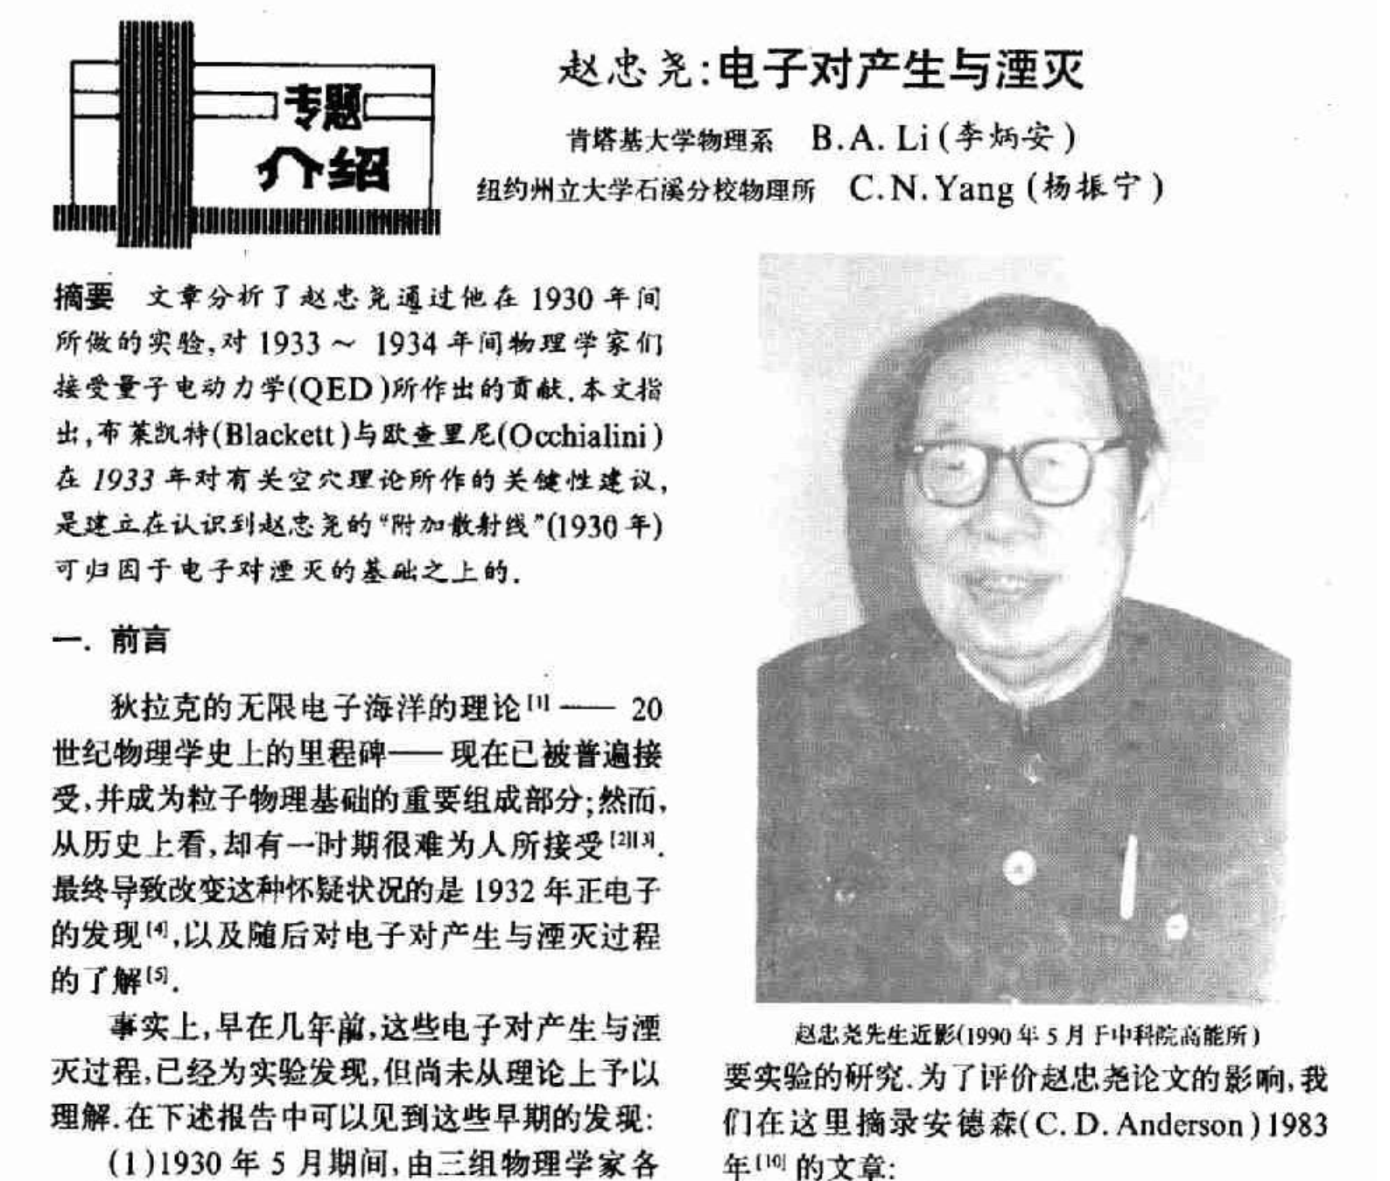
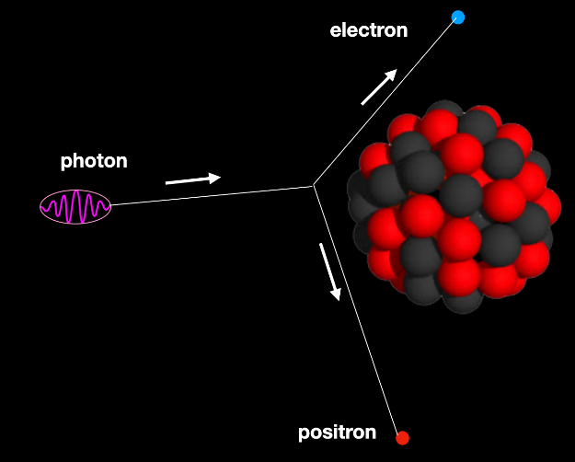
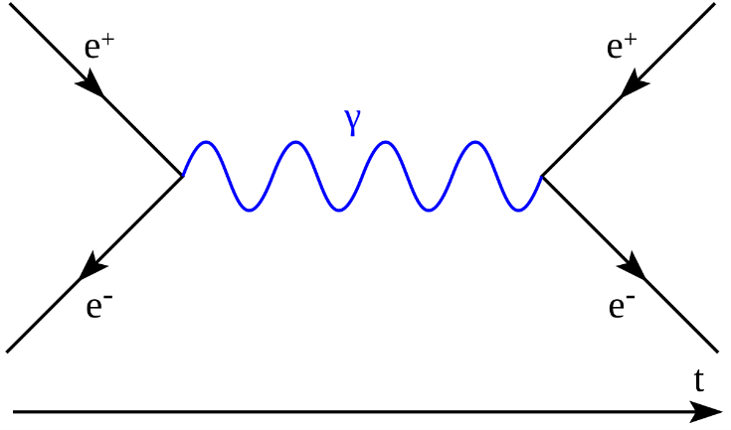
Positron Discovery & Pair Production

Slide 6
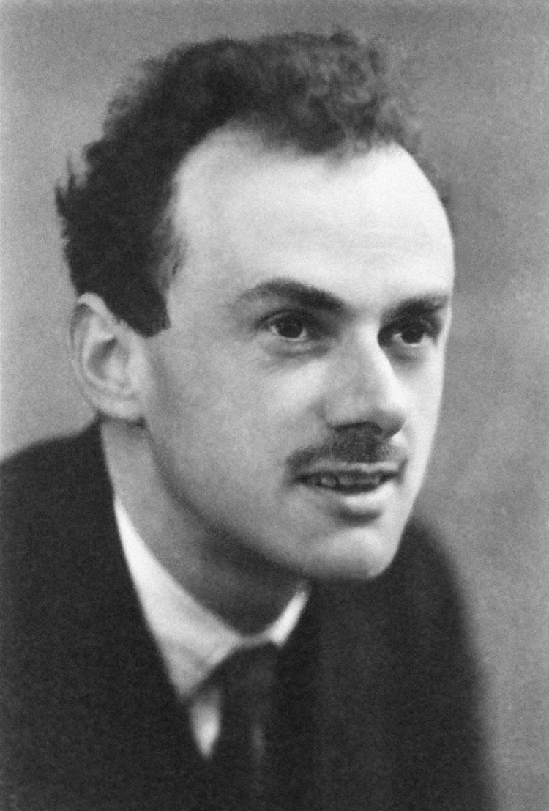
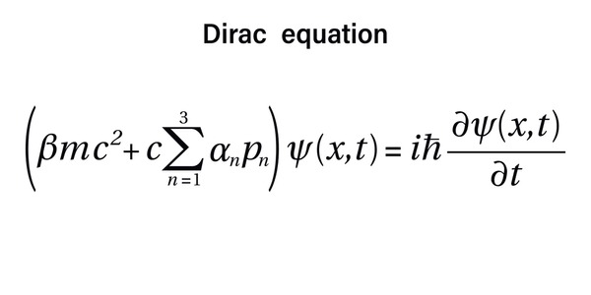
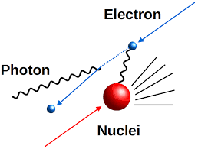
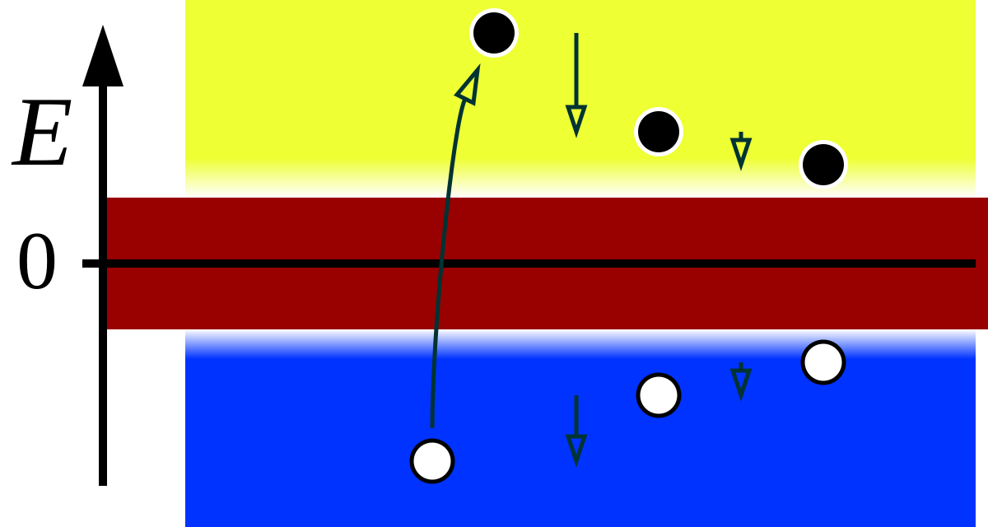
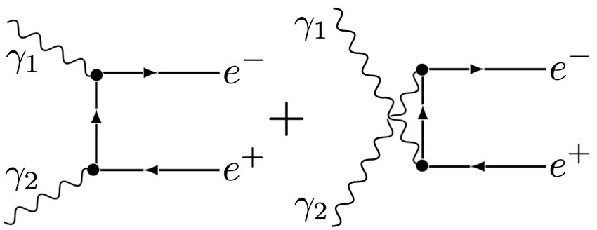
Positron Discovery & Pair Production
H. Bethe, W. Heitler,
Proc. Roy. Soc. A 146 (1934) 83
Dirac
（1902-1984）
Dirac, Proc. Roy. Soc. A 117 (1928) 610
Dirac, Proc. Roy. Soc. A 118 (1928) 351
Dirac, Proc. Roy. Soc. A 126 (1930) 360
G. Breit, J. A. Wheeler,
Phys. Rev.46 (1934) 1087

Slide 7
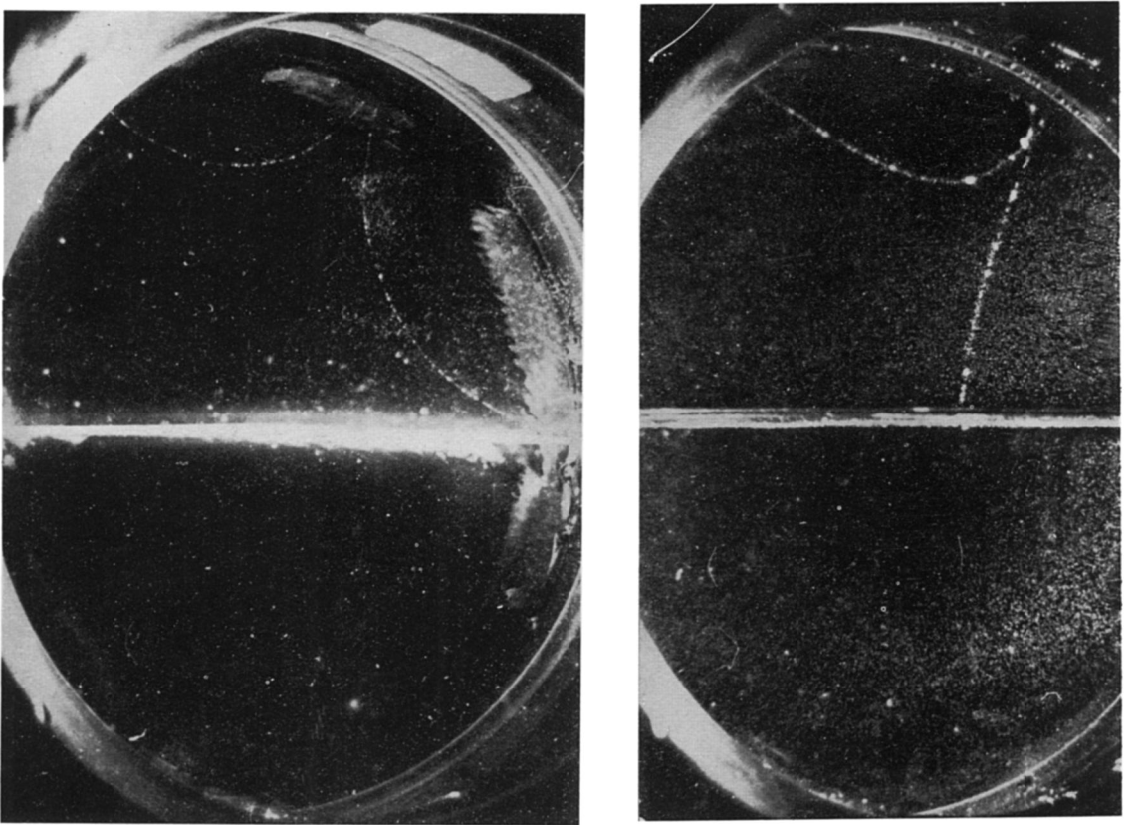
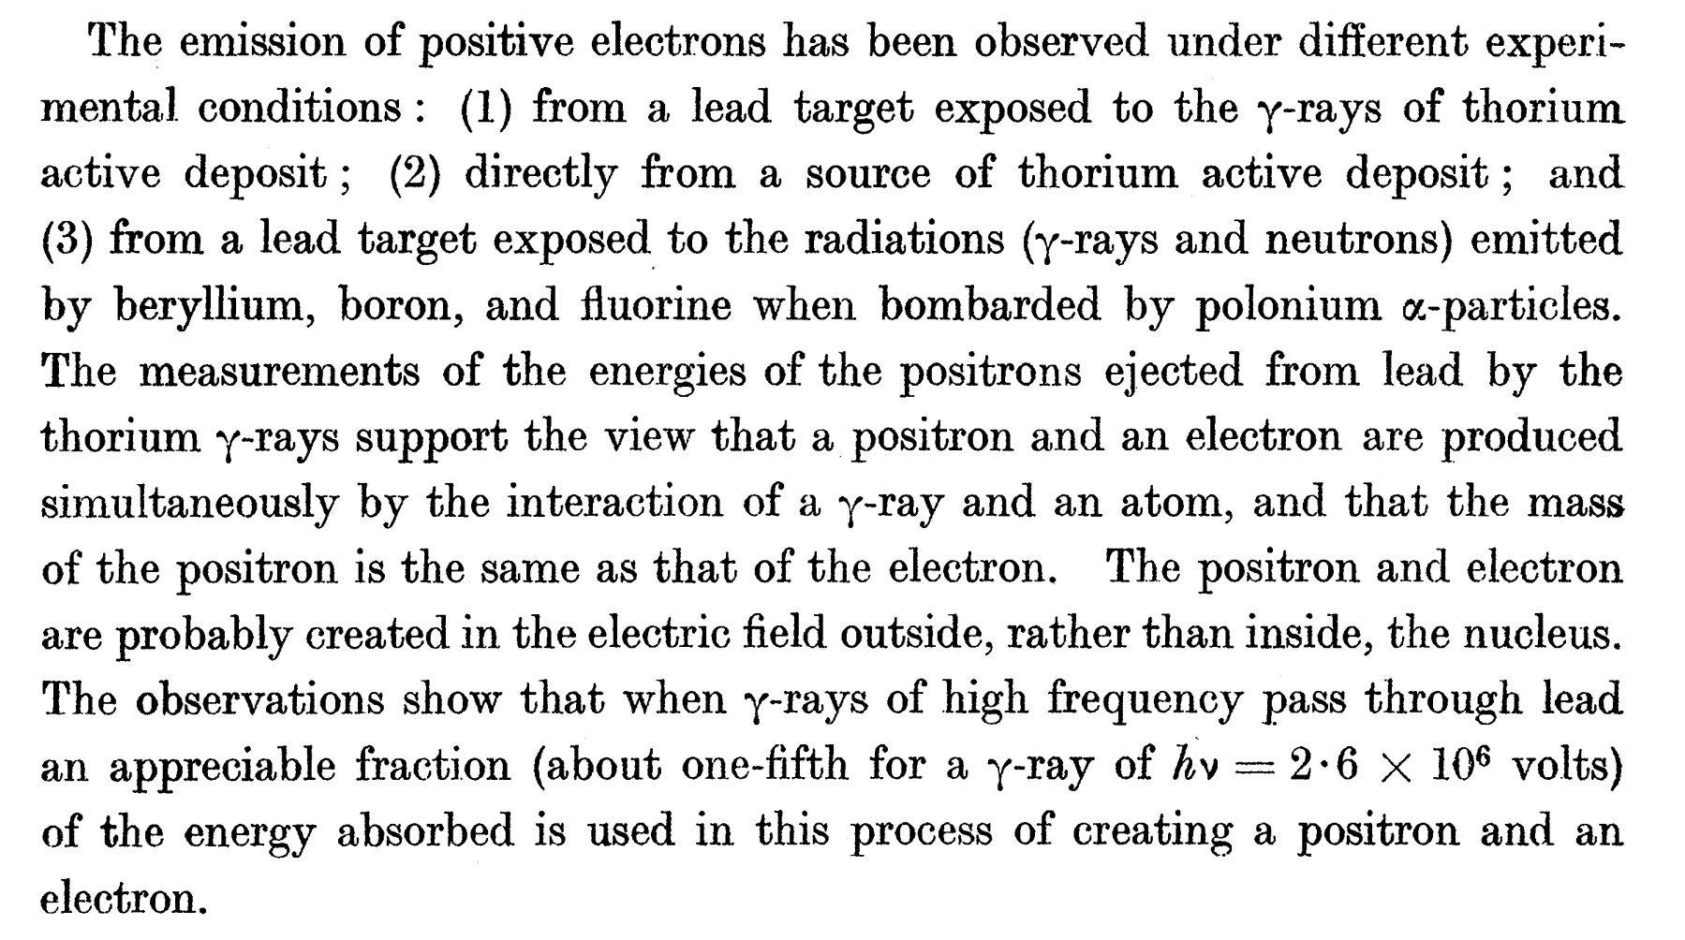
First Experiment of B-H Process
J. Chadwick, P. M. S. Blackett, G. P. S. Occhialini, Proc. Roy. Soc. A 144 (1934) 235

Slide 8
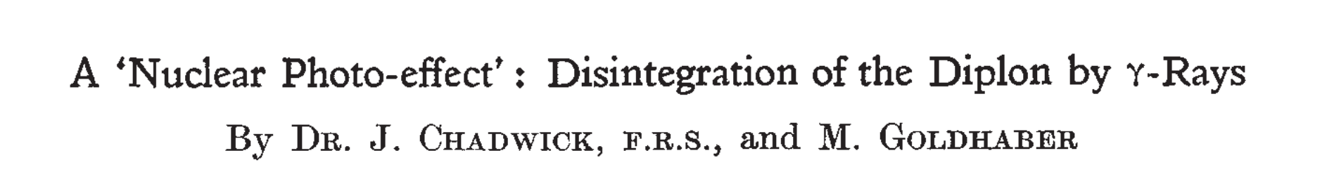
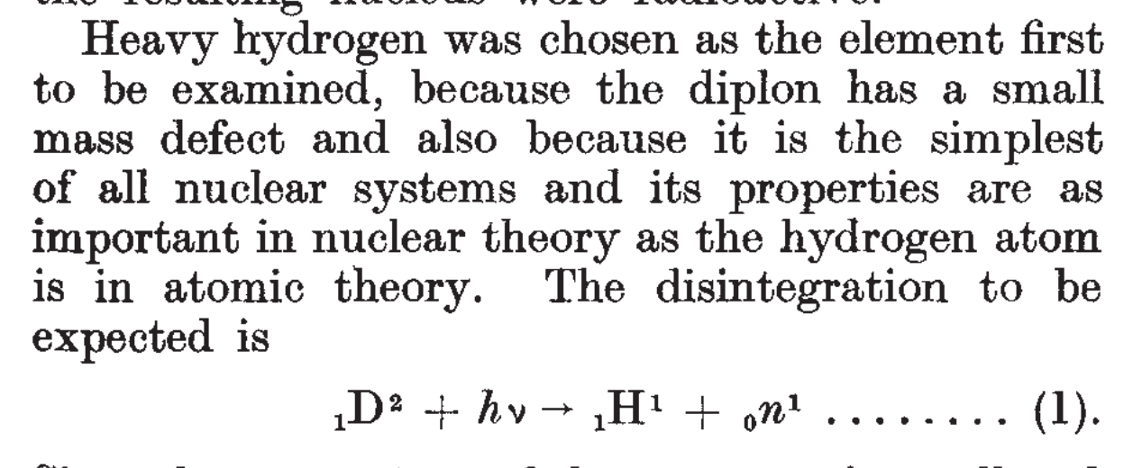
Dissociation of Nuclei by γ Ray
J. Chadwick, M. Goldhaber, Nature (1934) 237

Slide 9
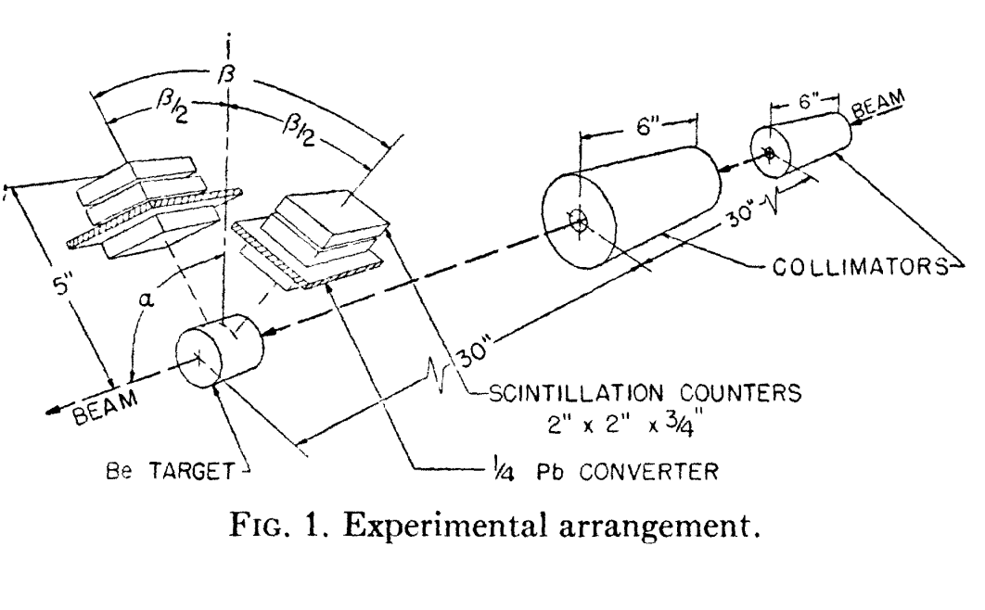
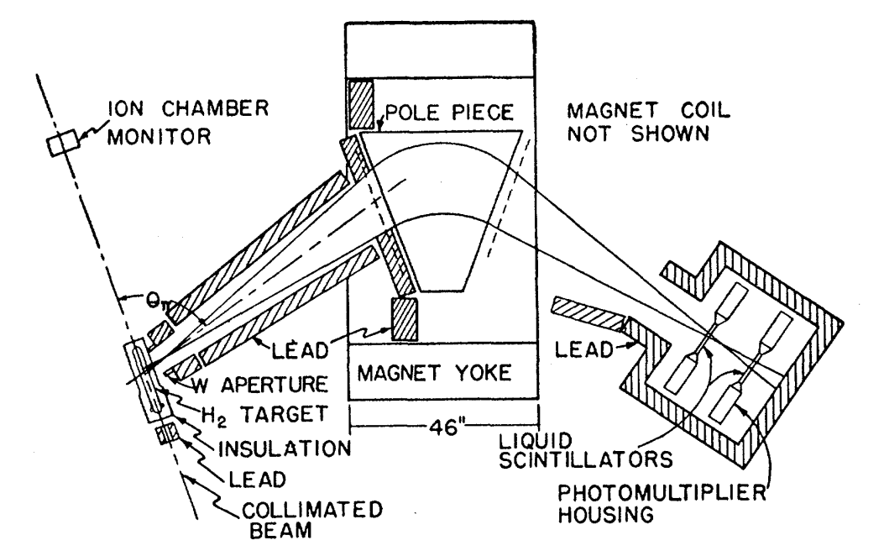


Pion Photoproduction
$$γ+N→π^{0}+N$$
$$γ+p→π^{+}+n$$
J. Steinberger, W. K. H. Panofsky and J. Steller, Phys. Rev. 78 (1950) 802
R. L. Walker, Phys. Rev. 99 (1955) 210

Slide 10
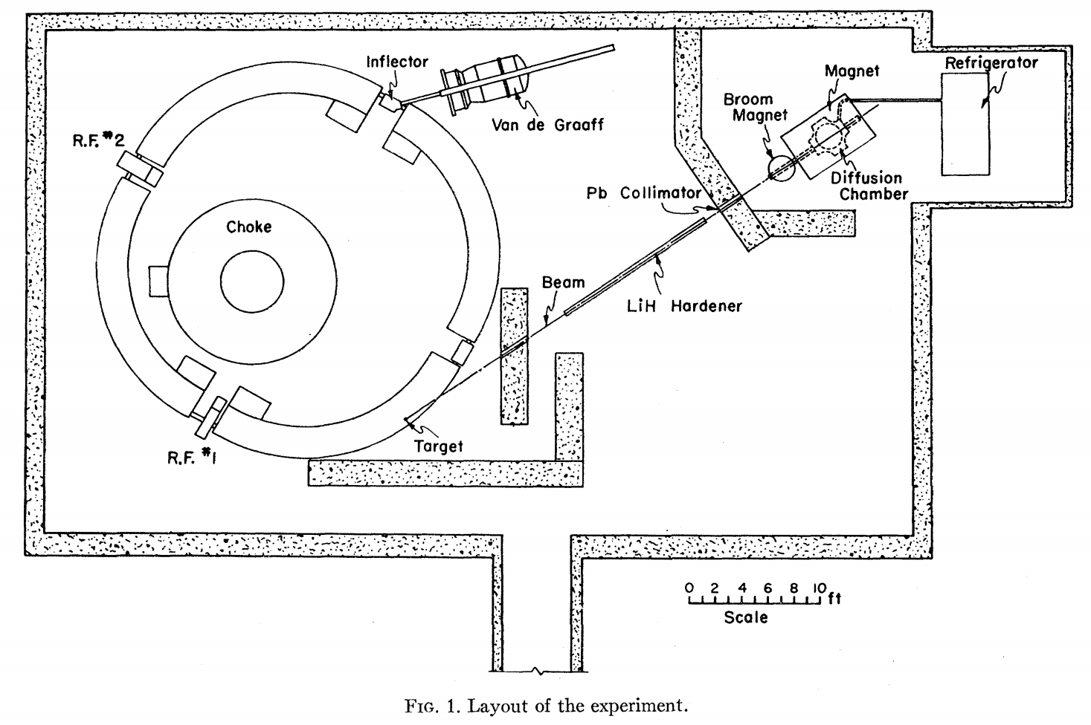
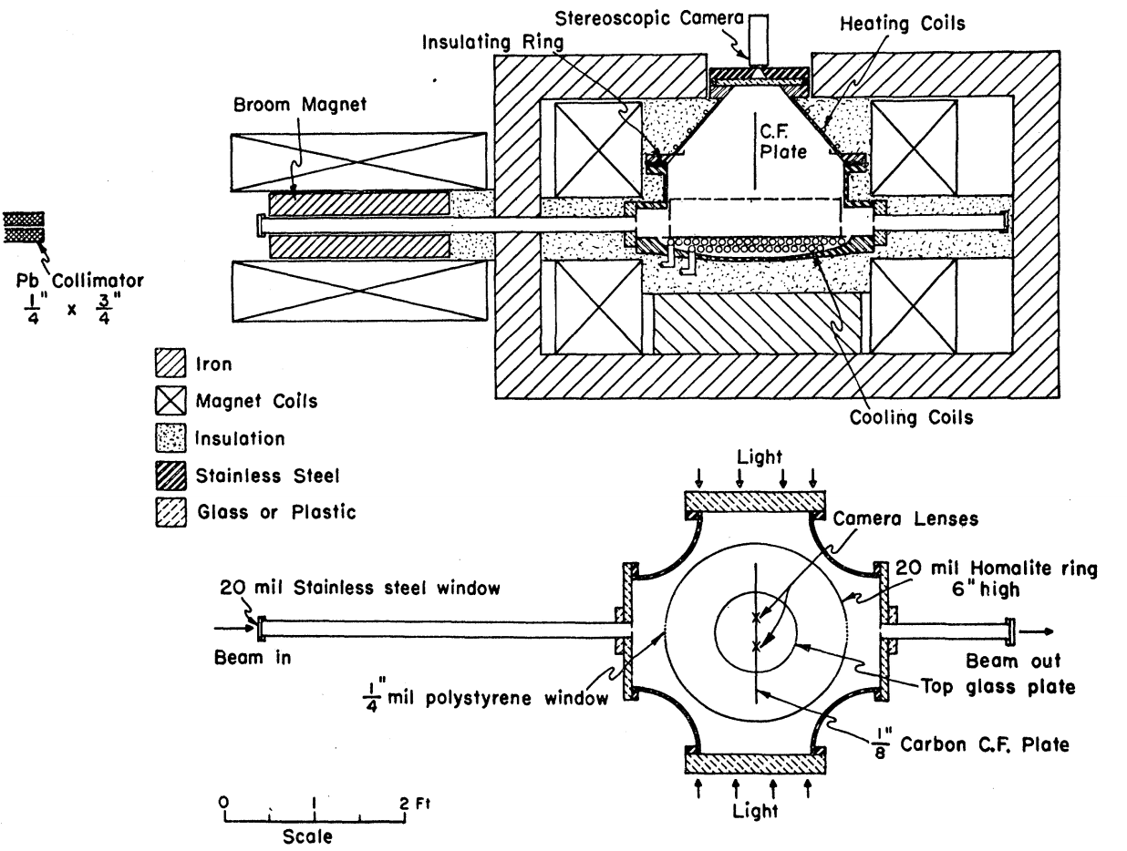

Multi-pion Potoproduction
$$γ+N→π^{+}+π^{−}+N$$
J. M. Sellen etal. , Phys. Rev. 113 (1959) 1323
H. R. Crouch etal., Phys. Rev. Lett. 13 (1964) 636
Bubble Chamber

Slide 11

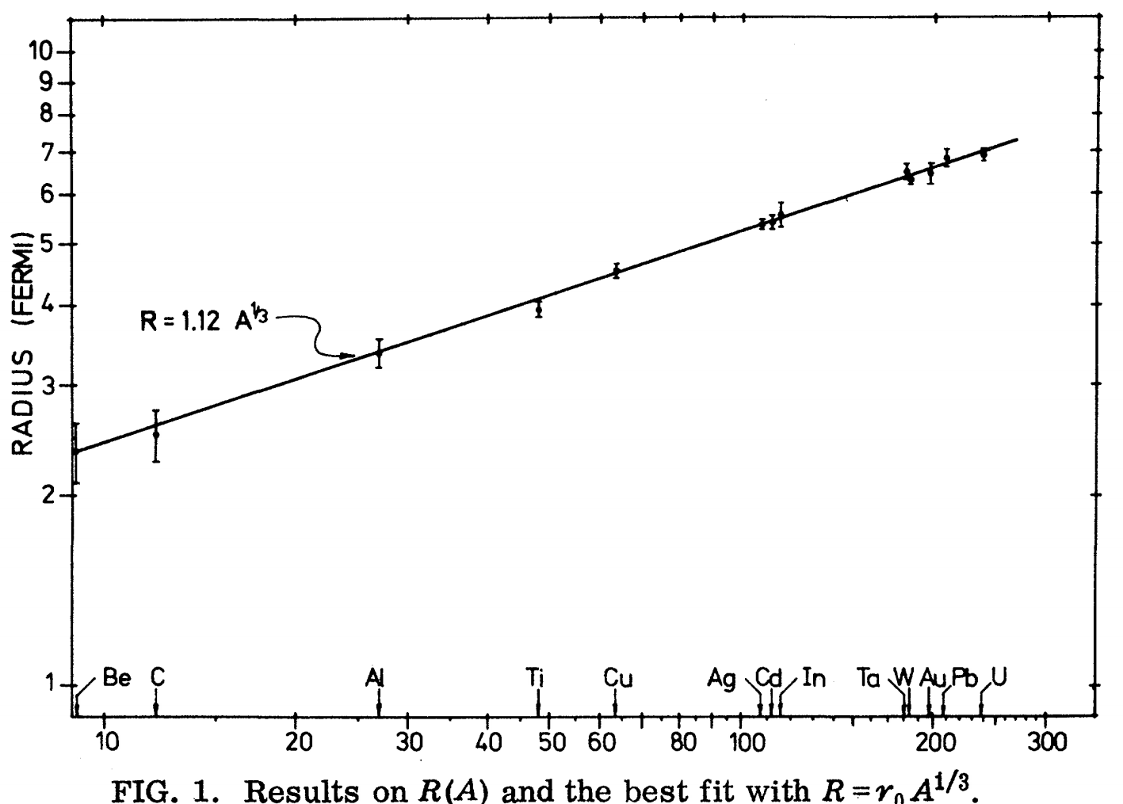
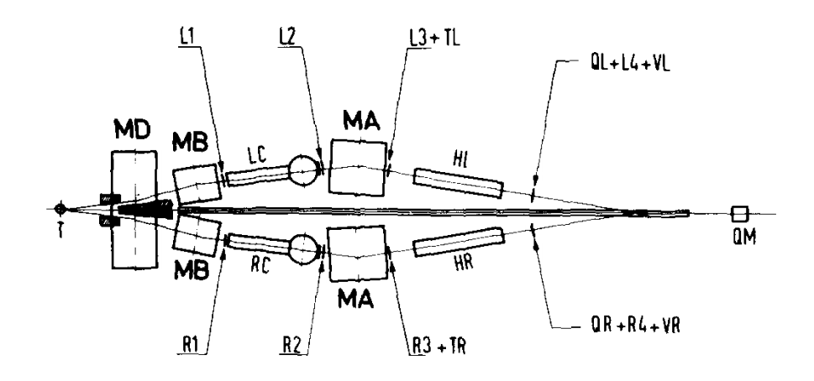
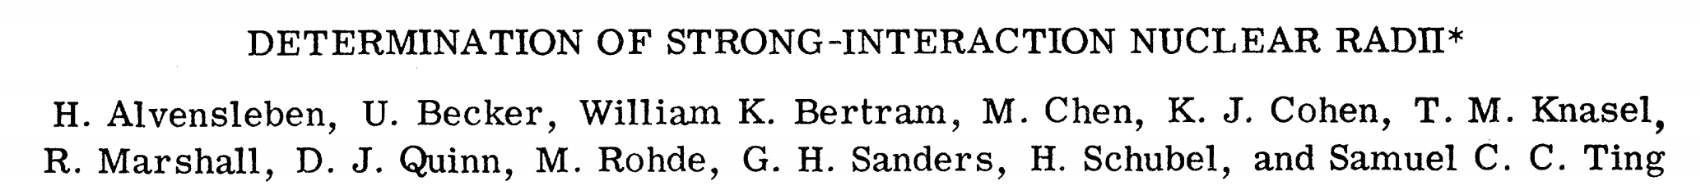
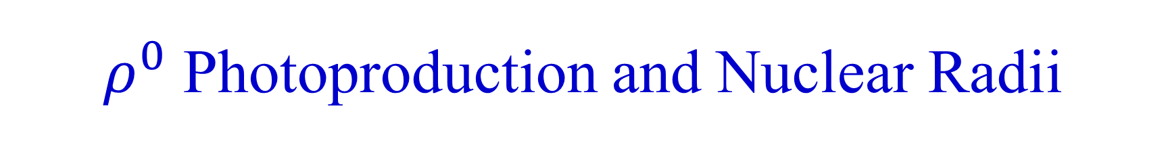

$ρ^{0}$ Photoproduction and Nuclear Radii
$$γ+A→ρ^{0}+A→π^{+}+π^{−}+A$$
丁肇中
（1936-）
H. Alvensleben etal., Phys. Rev. Lett. 24 (1970) 786
H. Alvensleben etal., Phys. Rev. Lett. 24 (1970) 792

Slide 12
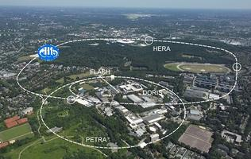
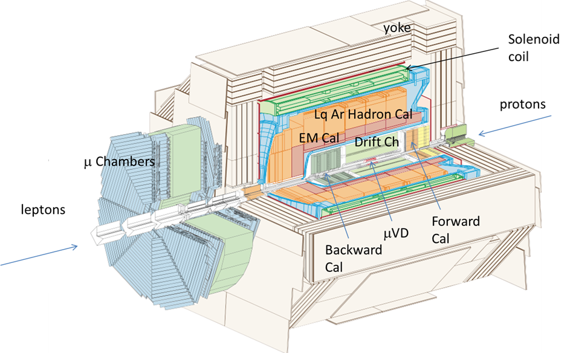
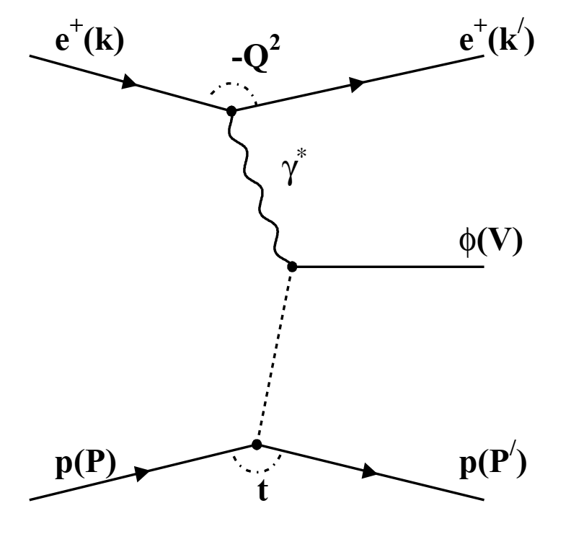
HERA Era — The Photoproduction Factory
27.5 GeV e × 920 GeV p
1992–2007
H1 Detector System

Slide 13
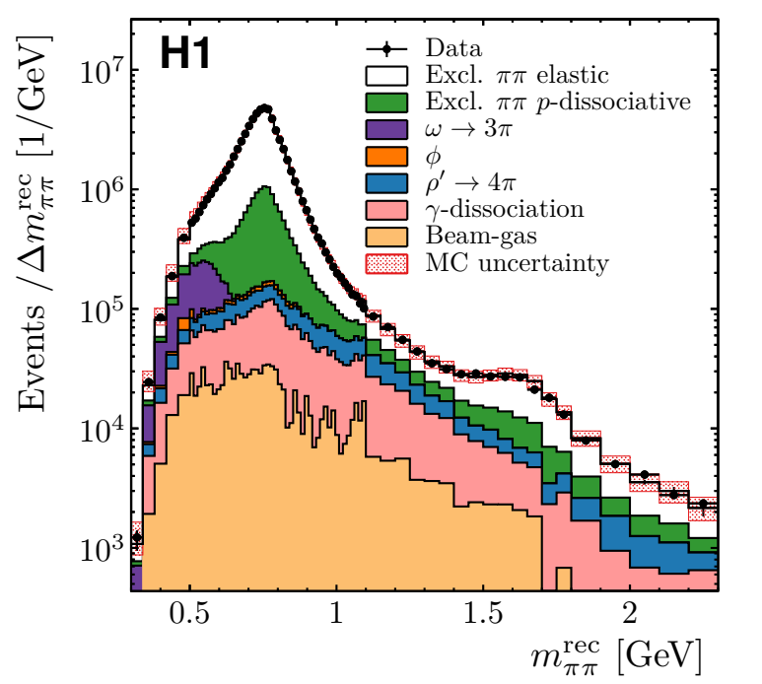
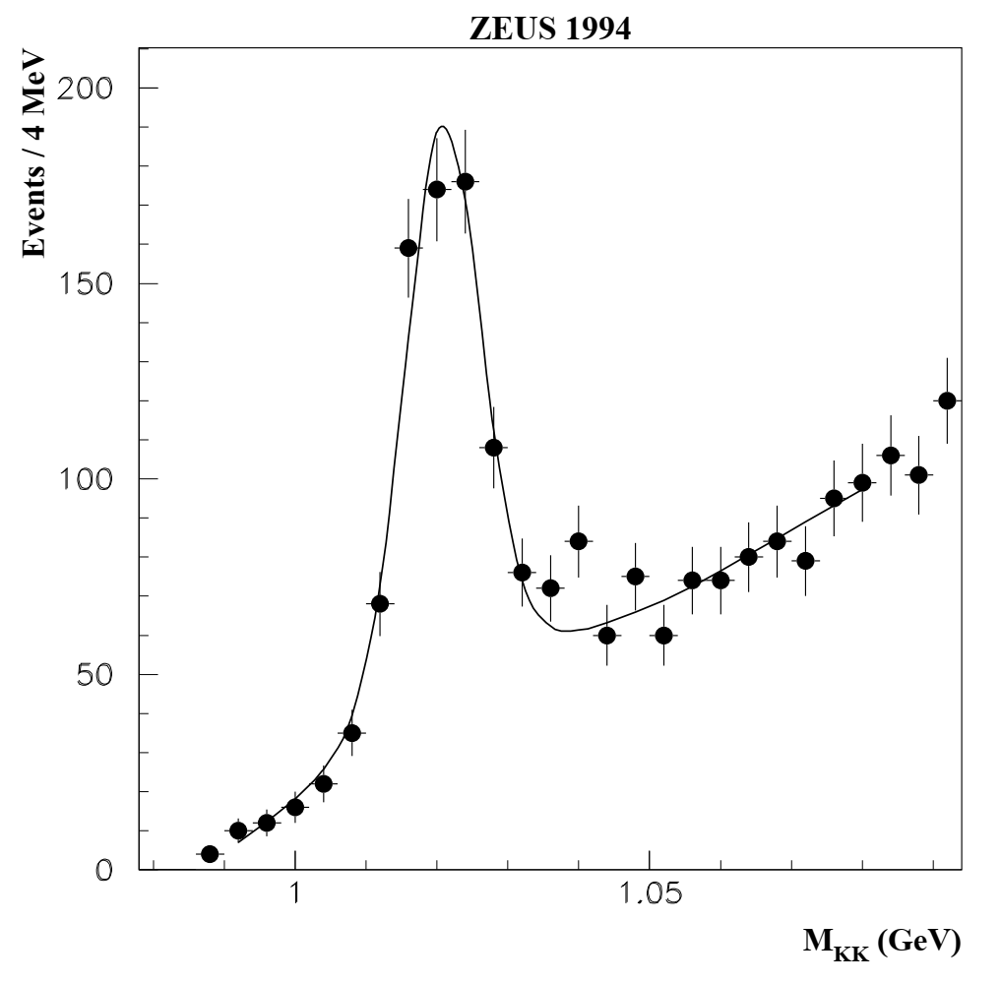
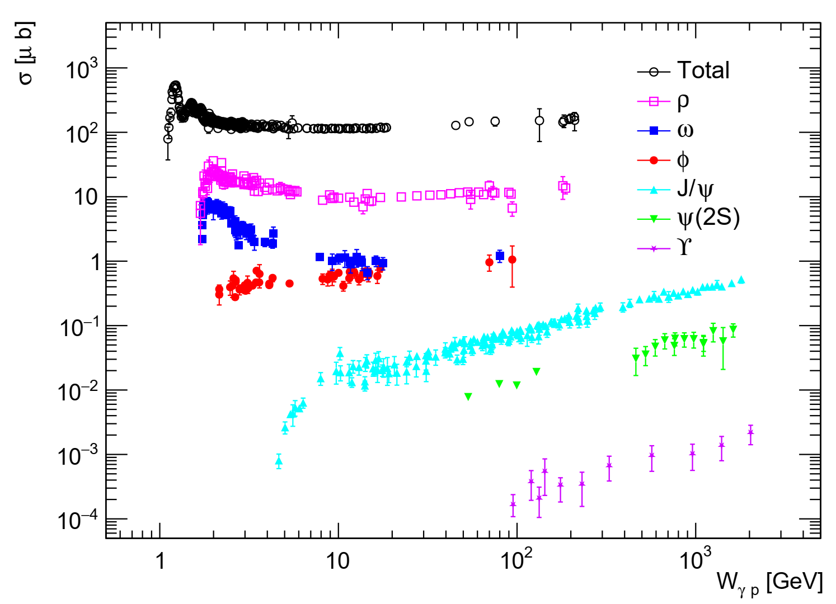
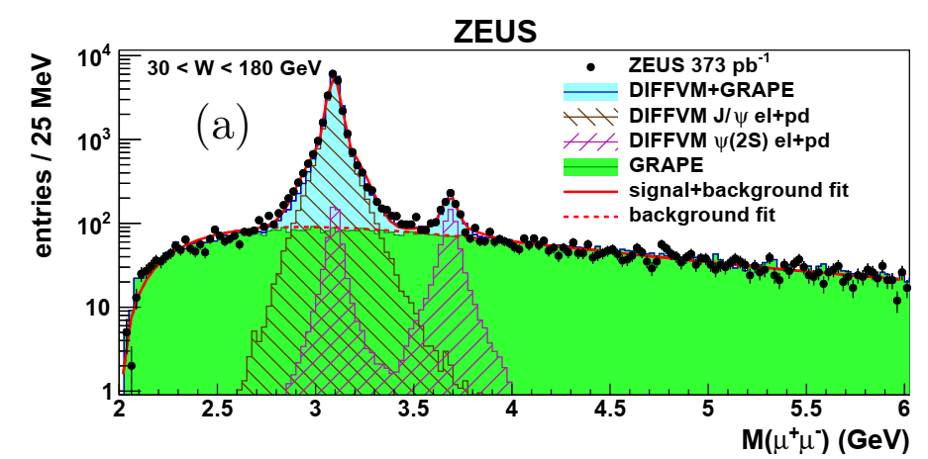
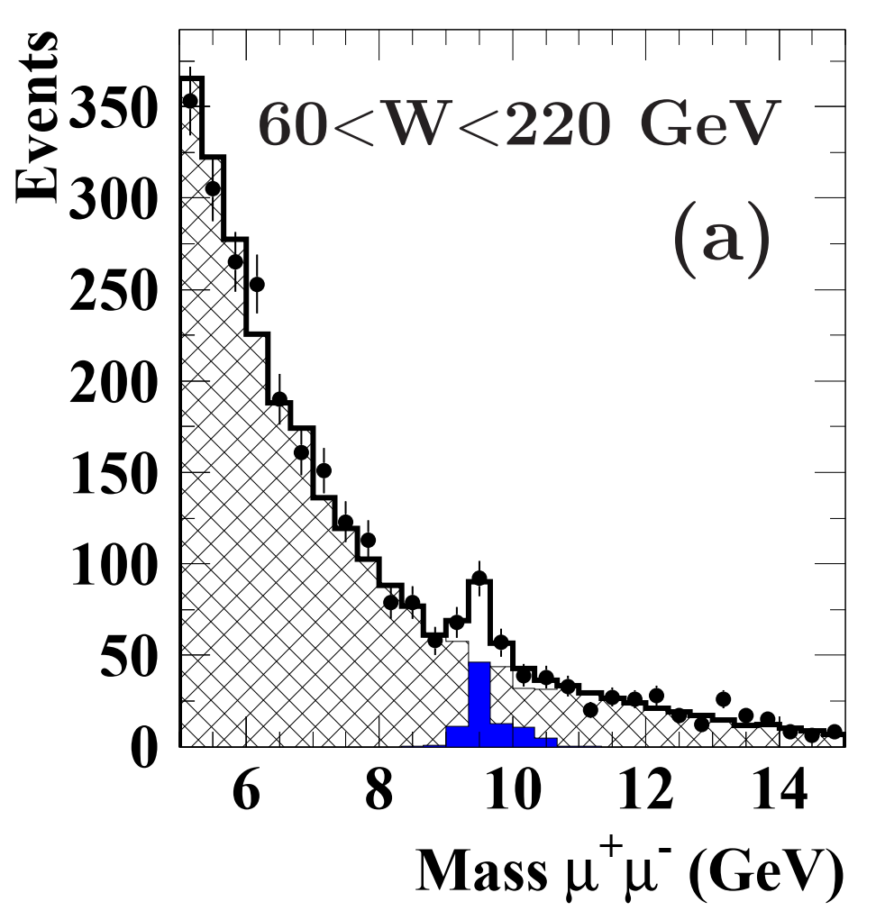
Exclusive Photoproduction @ HERA
H1 Collaboration, Eur. Phys. J. C 80 (2020) 1189
ZEUS Collaboration, JHEP 12 (2022) 164
ZEUS Collaboration, Phys. Lett. B 680 (2009) 4
ZEUS Collaboration, Phys. Lett. B 377 (1996) 259
J. D. Brandenburg etal., PPNP 143 (2025) 104174

Slide 14
From Sources & Accelerators to Detectors
Photon sources & accelerators (how we got the γ’s)
Radioisotope γ (1920s–40s): natural lines → first photonuclear effects & anomalous absorption studies
Bremsstrahlung (1940s–today): thick-target X-ray/γ from e− linacs/cyclotrons; later, high-rate tagged-photon facilities
Coherent bremsstrahlung (1960s–): diamond crystals → linearly polarized γ (tunable peaks)
Inverse Compton scattering (1990s–): laser⊗e− beam → quasi-monochromatic, polarized γ (MeV–GeV); compact sources for precision γ-nuclear studies
Colliders (1990s–): HERA ep (equivalent photon flux from the electron) → VM “photoproduction factory”
RHIC/LHC (2000s–): ultra-peripheral A+A/p+A → Z²-enhanced EPA photons; coherent J/ψ/ρ, γγ→ℓℓ, etc
Detectors (how we saw the events)
Ionization chamber / electrometer (1920s–30s): rate & absorption; threshold signatures
Wilson cloud chamber → bubble chamber (1930s–60s): visible tracks; curvature 𝑝=𝑞𝐵𝑟
Spark chambers (1960s): fast imaging; start of triggerable
MWPC / drift chambers (1968–): high-rate, precision tracking; large solid angle
TPC (late-1970s–): 3D tracking + 𝑑𝐸/𝑑𝑥dE/dx PID; cornerstone for heavy-ion collisions
Modern calorimetry & muon systems: EM/HAD calorimeters for γ/e ID and E-scale; muon spectrometers
Silicon trackers & forward taggers (1990s–today): vertexing, tracking; Roman pots/forward proton spectrometers
Trigger/DAQ evolution: scaler → coincidence logic → multi-level triggers

Slide 15
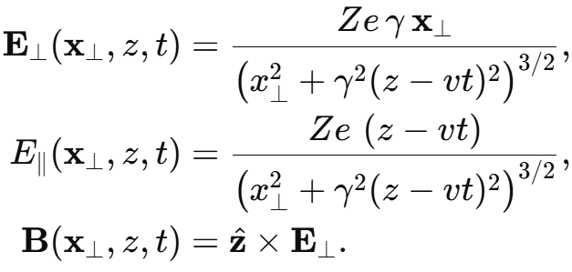
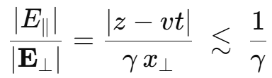


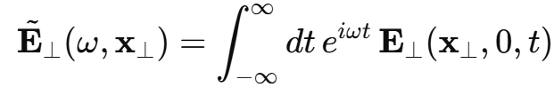
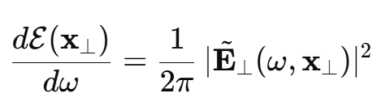

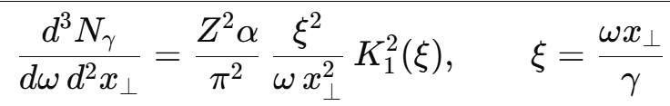
Equivalent Photon Approximation
Fields of a fast ion: dominantly transverse
Energy flow from the fields (Poynting vector)

Slide 16
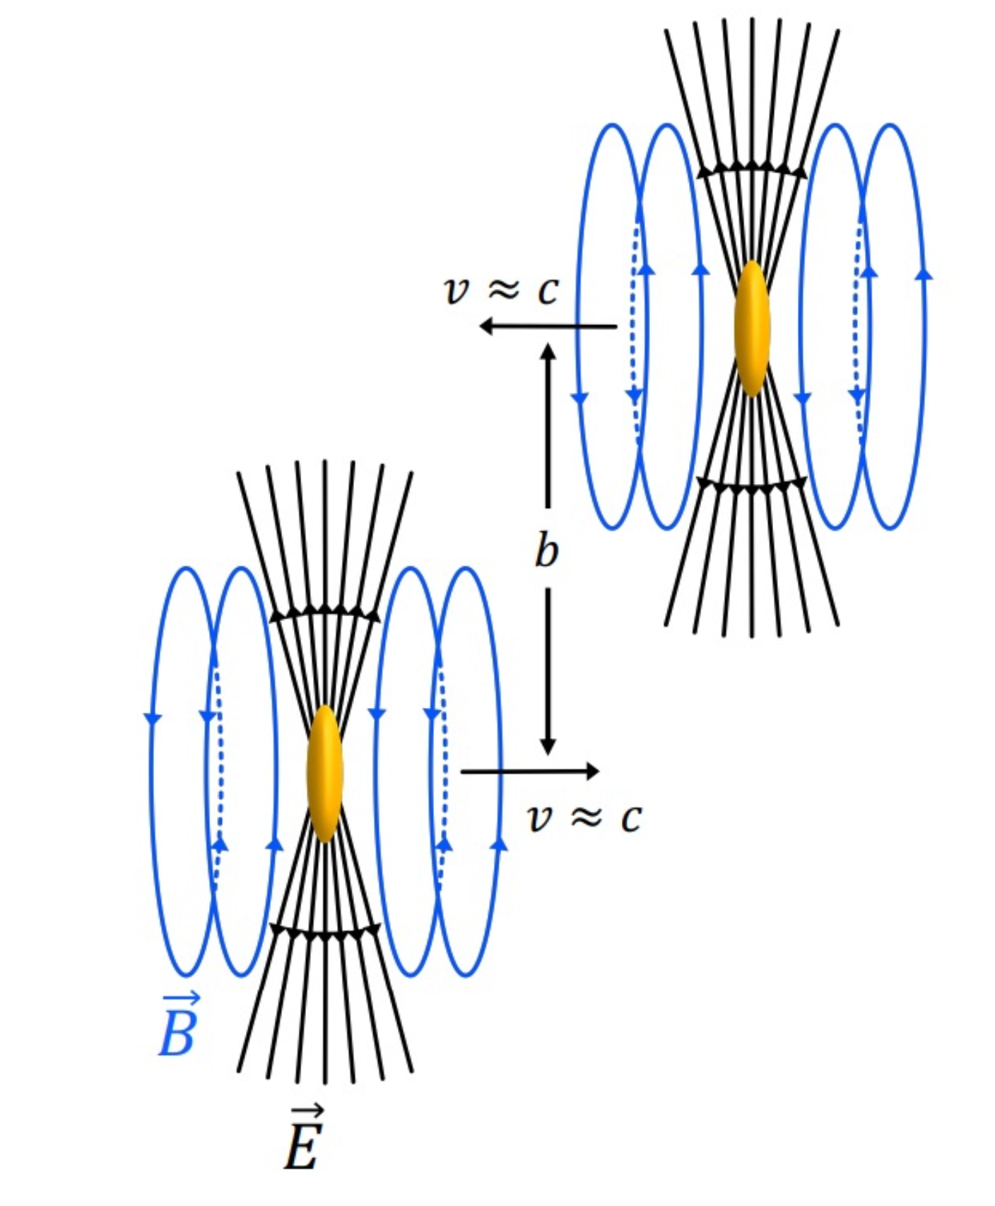
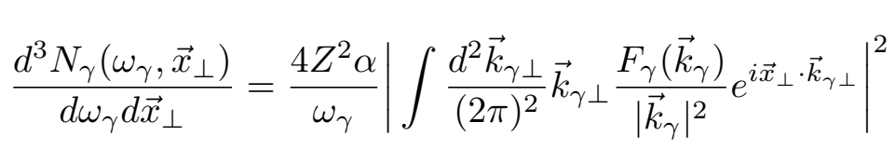
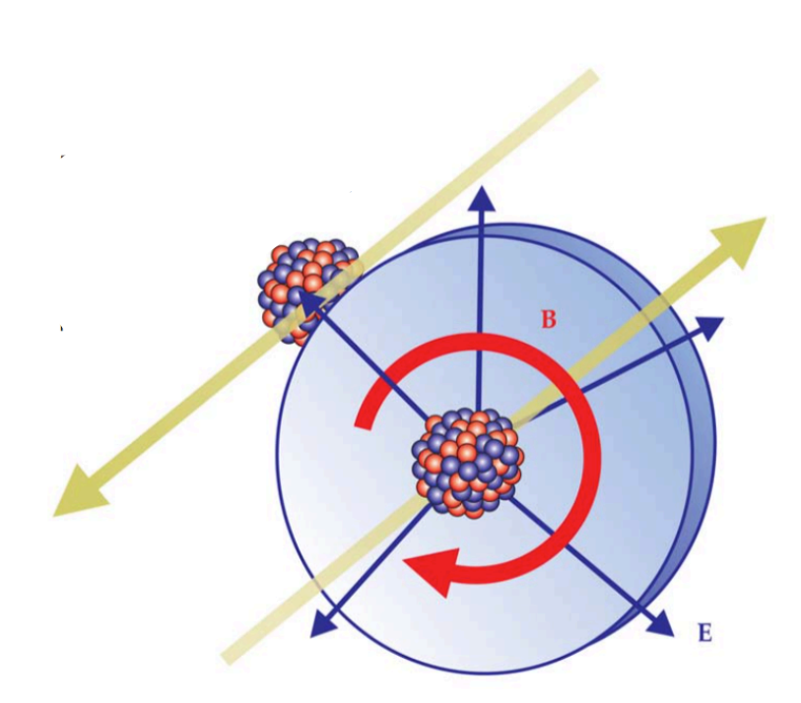
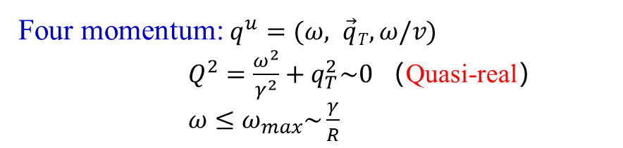
The Quasi-real Photons in Heavy-ion Collisions
E.J. Williams, Phys. Rev. 45 (1934) 729-730
Equivalent Photon Approximation
C.F. von Weizsacker, Z. Phys. 88 (1934) 612-625
Four momentum: $q^{u}=(ω, \vec{q}T,ω/v)$
$Q^{2}=\frac{ω^{2}}{γ^{2}}+q_{T}^{2}\sim 0$ （Quasi-real）
$ω≤ω_{max}\sim \frac{γ}{R}$
View “quasi-real” photons as partons
Larger transverse extend
R_{Nuc} ∼ 6.3 fm (Au) R_{photons} >> R_{Nuc}
Strong interactions without nuclear overalp
Ultra-peripheral collisions (UPC， b>2R_{Nuc})
S. Klein, Physics Today 70(10) (2017) 40

Slide 17
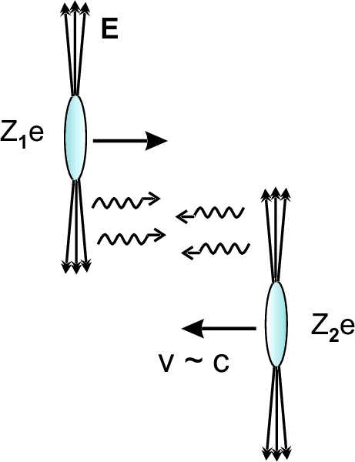
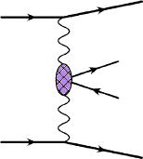
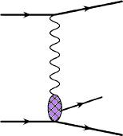
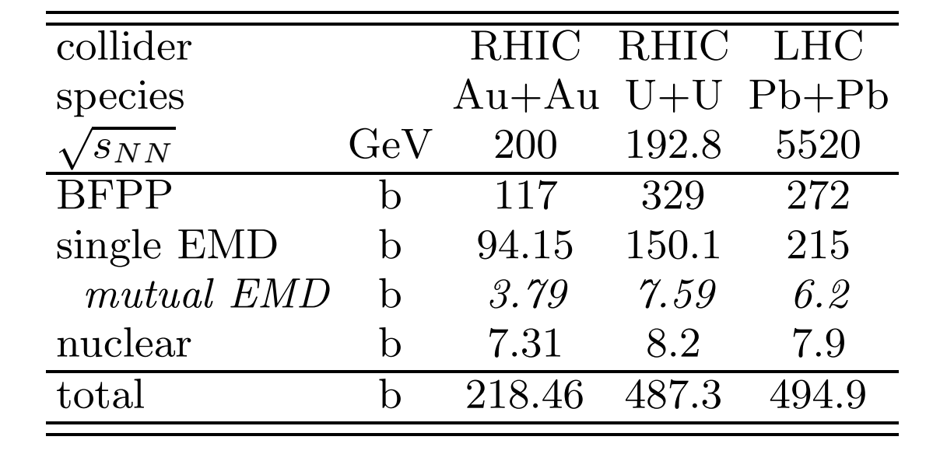
The Collisions of the Electromagnetic Field
Ann. Rev. Nucl. Part. Sci.55:271
(2005)
=
+
V=ρ , ω , φ , J/ψ
Photon-photon
interactions
Photon-nucleus
interactions
Electromagnetic interaction
PRC 89 (2014) 014906
The abundant photon induced reactions
UPC related physics
=
The physics of photoproduction

Slide 18
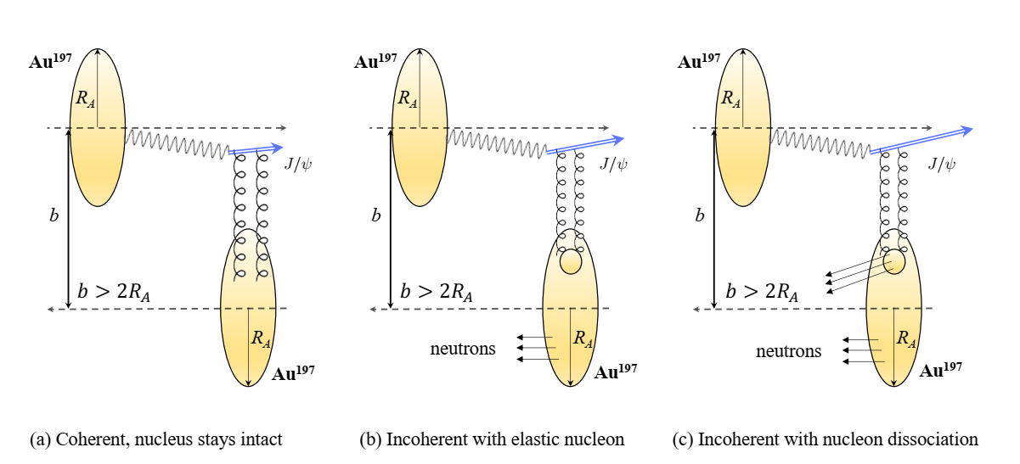
Coherent & Incoherent

Slide 19
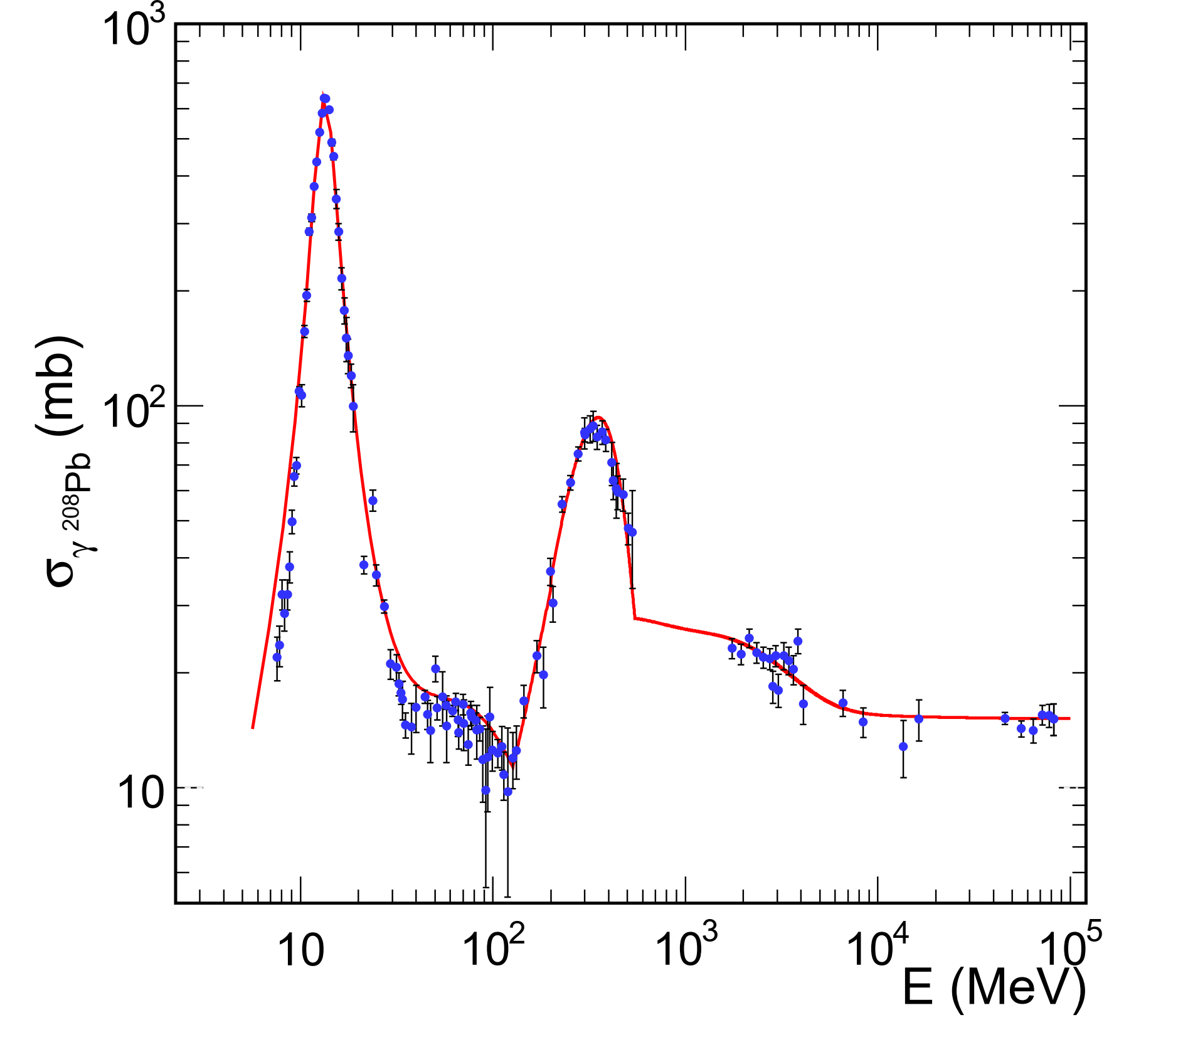
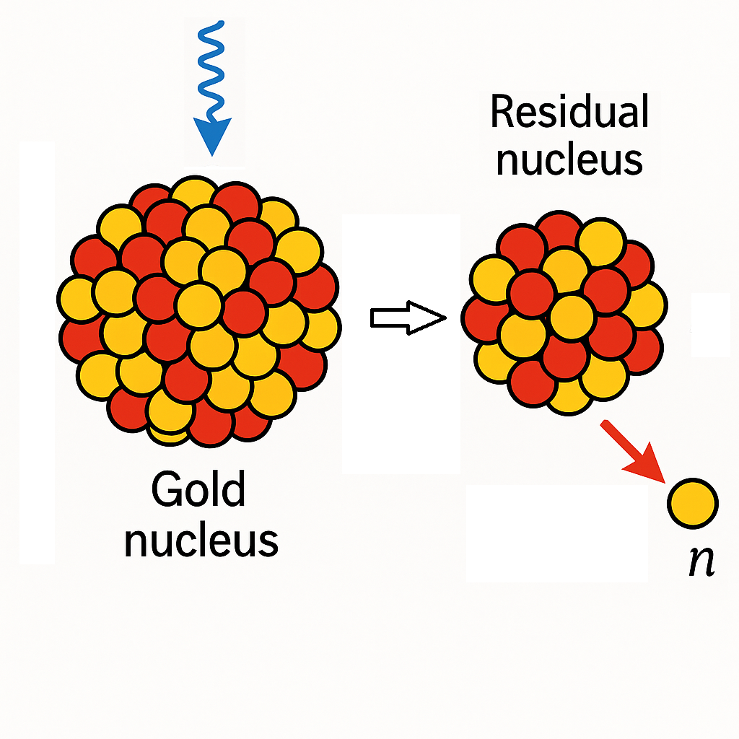
Coulomb Dissociation/Neutron Tagging
Giant Dipole Resonance
Quasi-Deuteron
Δ(1232) nucleon resonance
Higher nucleon resonance regions (N*)
Meson photoproduction
Deep inelastic region
Coulomb Dissociation
Revealing Nuclear Structures: Deformation, Symmetry Energy, Neutron Skin, Shell Structures...
M. K. Gawenda etal., Phys. Rev. C 89 (2014) 054907

Slide 20

Typical Detector Setup

Slide 21



Typical UPC Event
Event activity = 2 Forward activity veto
Luminosity? Detector response?

Slide 22
Some Event Generator
STARlight — the classic UPC workhorse (γγ and coherent/incoherent VM photoproduction; ZDC neutron modes included)
SuperChic — central exclusive production (CEP) incl. heavy-ion modes (pA/AA), γγ and γ-initiated processes with soft-survival
UPCgen: a Monte Carlo simulation program for dilepton pair production
gammaUPC: A new MC generator for γγ processes in UPCs
CepGen — generic CEP/UPC generator (γγ dileptons, W±)
Sartre — dipole-model generator for exclusive VM/DVCS; widely used for UPC coherent/incoherent shape/fluctuation studies
FPMC (Forward Physics MC) — CEP in pp (γγ and pomeron exchanges)
PYTHIA 8 (photon-induced/photoproduction extensions) — framework hooks and examples to do γγ/γA in UPC-like setups
nOOn — add forward neutrons from EM dissociation on top of your UPC events
RELDIS — model/code for electromagnetic dissociation (single/mutual) and neutron multiplicities; standard reference for ZDC neutron spectra in Pb–Pb/Au–Au

Slide 23




Collision of Two Light Quanta
NA45, Phys. Lett. B 332 (1994) 471-476
STAR, Phys. Rev. C 70 (2004) 031902
STAR, Phys. Rev. Lett. 127 (2021) 052302
Breit-Wheeler Process
Observation of B-W Process！
G. Breit and J. A. Wheeler, Phys. Rev. 46 (1934) 1087

Slide 24



Collision of Two Light Quanta
CMS, Rep. Prog. Phys. 87 (2024) 107801

Slide 25



Collision of Two Light Quanta
ATLAS, Nature Phys. 13 (2017) 852
ATLAS, Phys.Rev.Lett. 123 (2019) 052001
CMS-PAS-HIN-21-015

Slide 26


Linear Polarization of The Light Quanta
C. Li, J. Zhou, Y.-j. Zhou, Phys. Lett. B 795, 576 (2019)
Linearly Polarized Photons
STAR, Phys. Rev. Lett. 127 (2021) 052302
Experimental Confirmation of Linear Polarization in the Photoproduction Process!
Fourth-Order Cosine Oscillations in the Electron Emission Angle of the Breit-Wheeler Process

Slide 27




Gamma-nucleus Collision
Sensitive to the gluon distribution:
$$x=\frac{M_{V}e^{±y}}{\sqrt{s}} Q^{2}=M_{V}^{2}/4$$

Slide 28



Double-slit Interference
Indistinguishable：
Photon emitter?
Target?
Two source
Double slit experiment at Fermi scale!
Au+Au
200GeV
Destructive Interference
W. Zha etal., Phys. Rev. C99 (2019),061901
b = 15fm

Slide 29


Double-slit Interference
Indistinguishable：
Photon emitter?
Target?
Two source
Double slit experiment at Fermi scale!
Au+Au
200GeV
Destructive Interference
W. Zha etal., Phys. Rev. C99 (2019),061901
b = 15fm

Slide 30

Double-slit Interference
Indistinguishable：
Photon emitter?
Target?
Two source
Double slit experiment at Fermi scale!
Au+Au
200GeV
Destructive Interference
STAR，Sci. Adv. 9 (2023) eabq3903
b = 15fm

Slide 31




Linear Polarization in γA
Linearly polarization along impact parameter
New approach to determine reaction plane
Directly related to initial geometry
No event by event fluctuation
No non-flow effect
Must accompanied by photoproduction
X. Wu et al., PRR 4 (2022) L042048

Slide 32

Linearly Polarization and Interference
Linearly polarization along impact parameter
Double-Slit interference
Modulation of degree of linearly polarization
+
=
W. Zha et al., Phys. Rev. D103 (2021) 033007

Slide 33


Spin-interference in UPCs
STAR，Sci. Adv. 9 (2023) eabq3903
p+Au： Negligible interference
Modulation of degree of linearly polarization
Incoherent contribution not excluded
Dipole model：H. Xing etal., JHEP10 (2020) 064
VMD: PRD103 (2021) 033007

Slide 34

Some Interesting Features
The lifte time of ρ : ~1.3fm/c
The interference behavior by decay daughters !
Truly one by one experiment
The slit separation : ~40fm
Entanglement？

Slide 35


The spin-interference of J/ψ
Kaiyang Wang，QM2025
H. Mäntysaari etal., Phys. Rev. C 109 (2024) 024908
Negative sign of modulation
Evidence of J/ψ spin-interference!
Irrelevant to life time

Slide 36














Spin-interference of Drell-Soding Process
S.D. Drell, Phys. Rev. Lett. 5 (1960) 278
P. Soding Phys. Lett. 19 (1966) 702
$$π^{+}$$
$$π^{−}$$
$$π^{+}$$
$$π^{−}$$
gold ion A
gold ion B
$$π^{+}$$
$$π^{−}$$
$$π^{+}$$
$$π^{−}$$
gold ion A
gold ion B

Slide 37


Spin-interference of Drell-Soding Process
Modulation of decay azimuthal angle
Entanglement enabled spin-interference

Slide 38


Spin-interference between γγ and γA
Hagiwara et al.,, Phys. Rev. D 103 (2021) 074013
Significant 1st order and 3rd cosine modulation
Spin-interference between different angular momentum
Two photon process: 0 or 2 one photon process: 1

Slide 39





Associated Production in γ–γ and γ–A Interactions
$$γ+γ→μ^{+}+μ^{−}$$
$$+$$
$$γ+A→ρ^{0}→π^{+}+π^{−}$$
ATLAS, CERN-EP-2025-071
Experimental observations of multiphoton-induced processes!

Slide 40
What we learn & what’s next
Quasi-real photons as beams: Ultra-peripheral A+A and p+A provide intense, linearly polarized EPA photons with Z² enhancement
γγ & γA are precision tools: Breit–Wheeler, vector-meson photoproduction, Coulomb dissociation, and neutron tagging together probe QED in strong fields and small-x gluons in nuclei.
Polarization & interference are goldmines: Linear polarization along b and two-source interference enable spin-interference studies and access to spatial/quantum correlations—down to the Fermi scale.
Multi-photon & associated production emerge: Experimental indications show multi-photon–induced and associated processes are measurable with modern triggers and forward detectors.
Neutron-tagged control of geometry Precision γγ program γA tomography Associated & multi-photon channels

