Slide 1



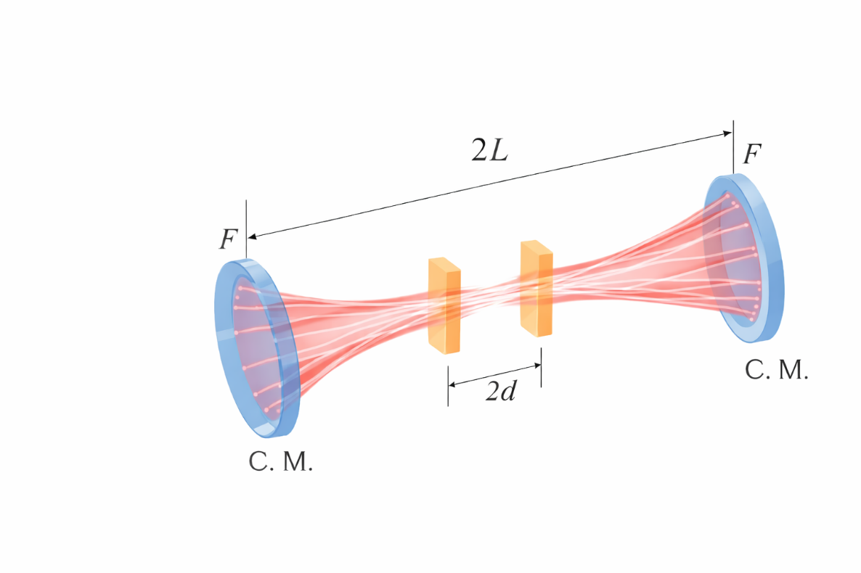
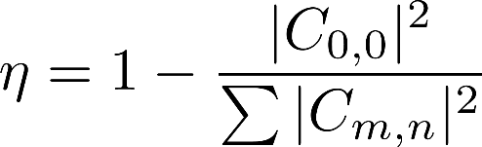
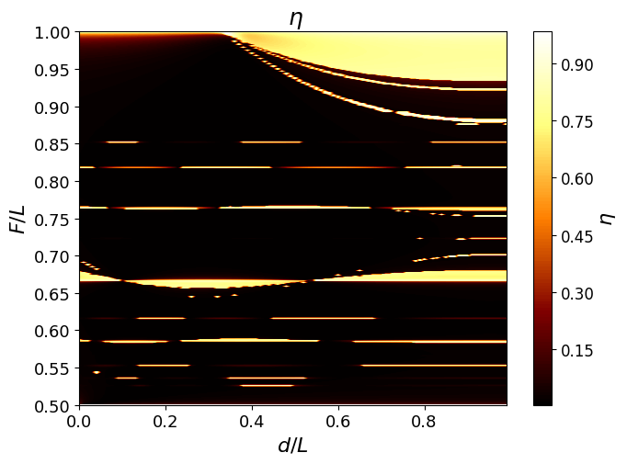
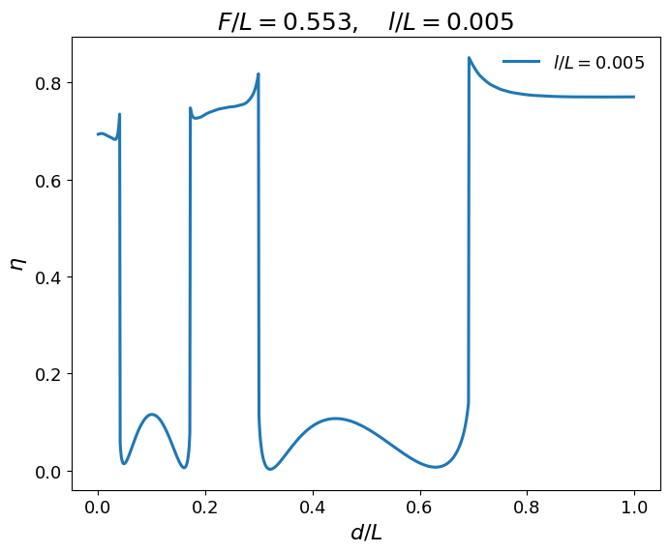
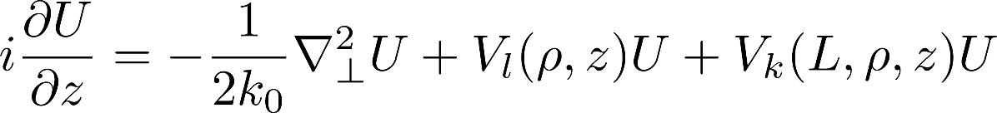
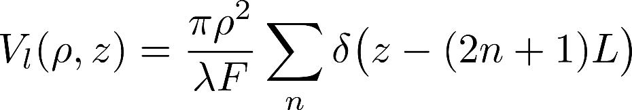
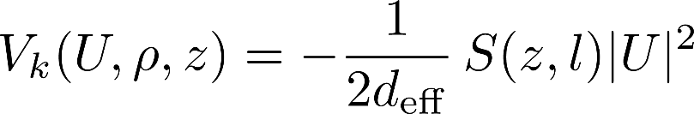
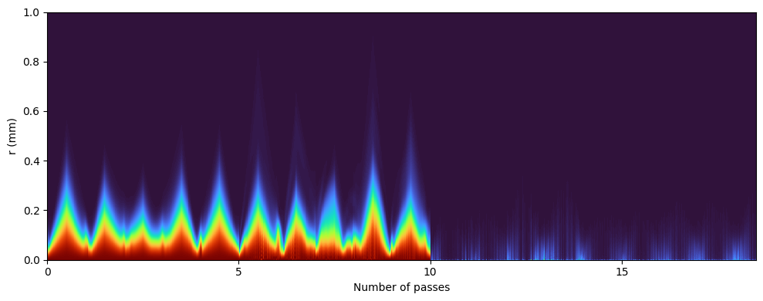
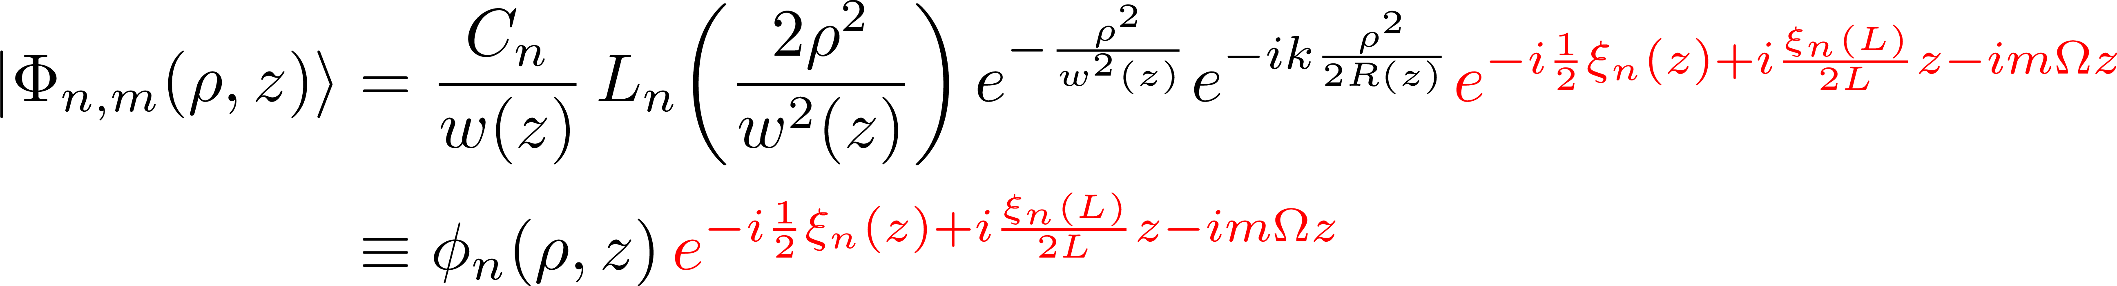
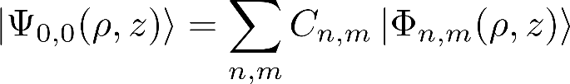
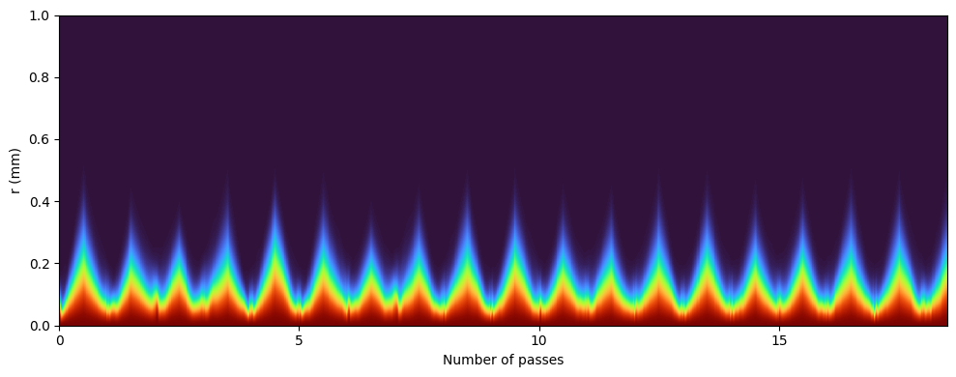
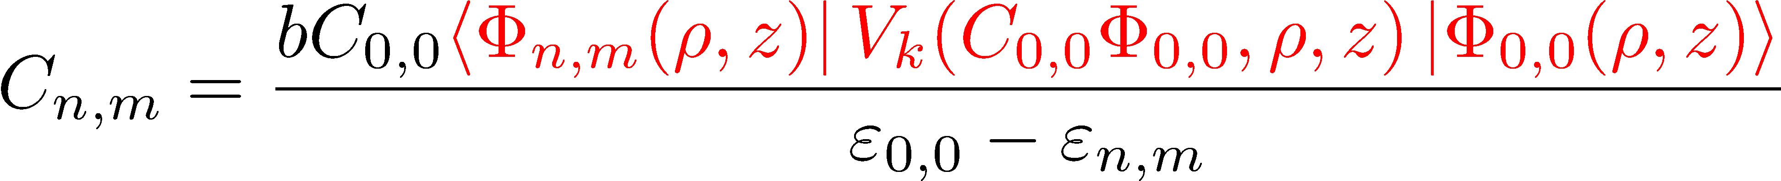

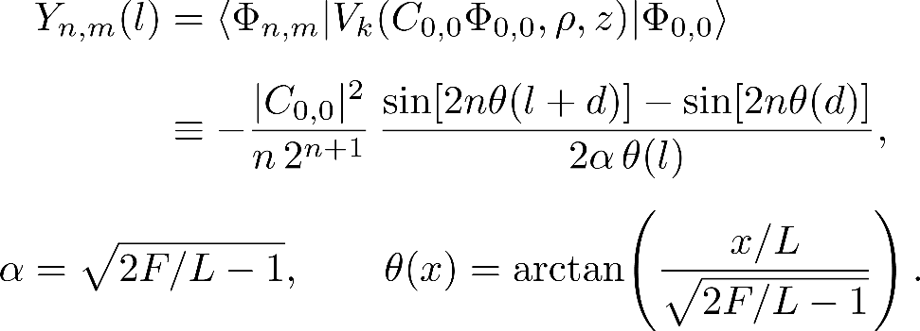
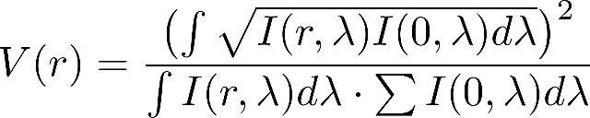
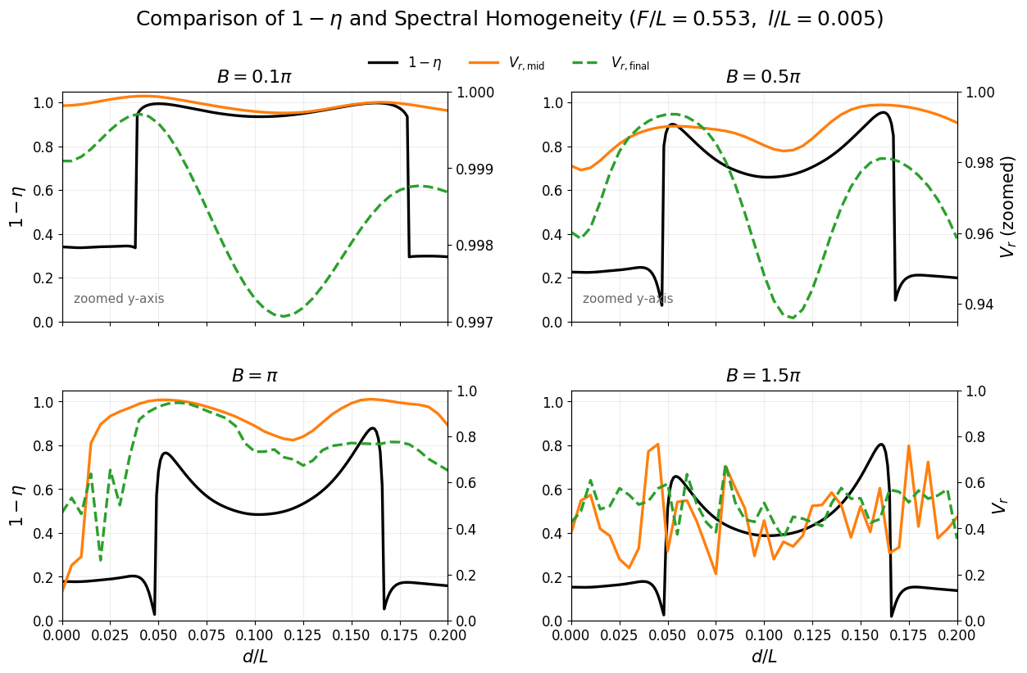
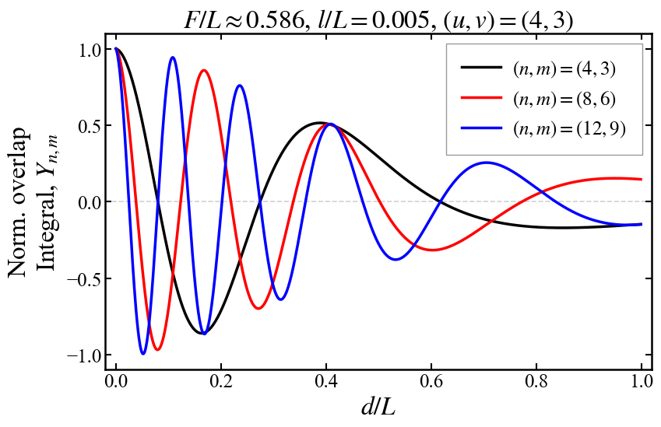






Floquet Theory for Multi-pass Cell
Yige Cao¹ , Dali Feng¹, Zhensheng Tao¹
1 Department of Physics and State Key Laboratory of Surface Physics, Fudan University, Shanghai 200433, China
E-mail address: Zhensheng Tao, ZhenshengTao@fudan.edu.cn.
Ⅰ Introduction
Multi-pass Cell (MPC)
High-order-mode energy fraction
l
2D
1D
Corresponding Nonlinear Schrödinger equation(NLSE)
boundary condition:
weak nonlinearity:
$$d/L=0.05$$
Ⅲ Numerical Results
Ⅱ Analytical Results
NLSE simulation: propagation of $I(r)$ along $z$
Floquet state
Collapse
$$d/L\text{=0}$$
expansion:
under perturbation:
$$d/L\text{=0.05}$$
degenerate condition:
overlap integral $Y_{nm}(l)$:
Spectral homogeneity
High-order mode
suppression
Ⅵ Conclusion
+ A complete orthogonal Floquet basis is derived from the Laguerre–Gaussian basis for the multi-pass cavity.
+ High-order mode excitation is evaluated by calculating the overlap integrals between the fundamental mode and higher-order modes.
+ The Energy Leak Factor provides a quantitative measure of modal leakage, and NLSE simulations show good agreement with the theoretical predictions.

