Slide 1

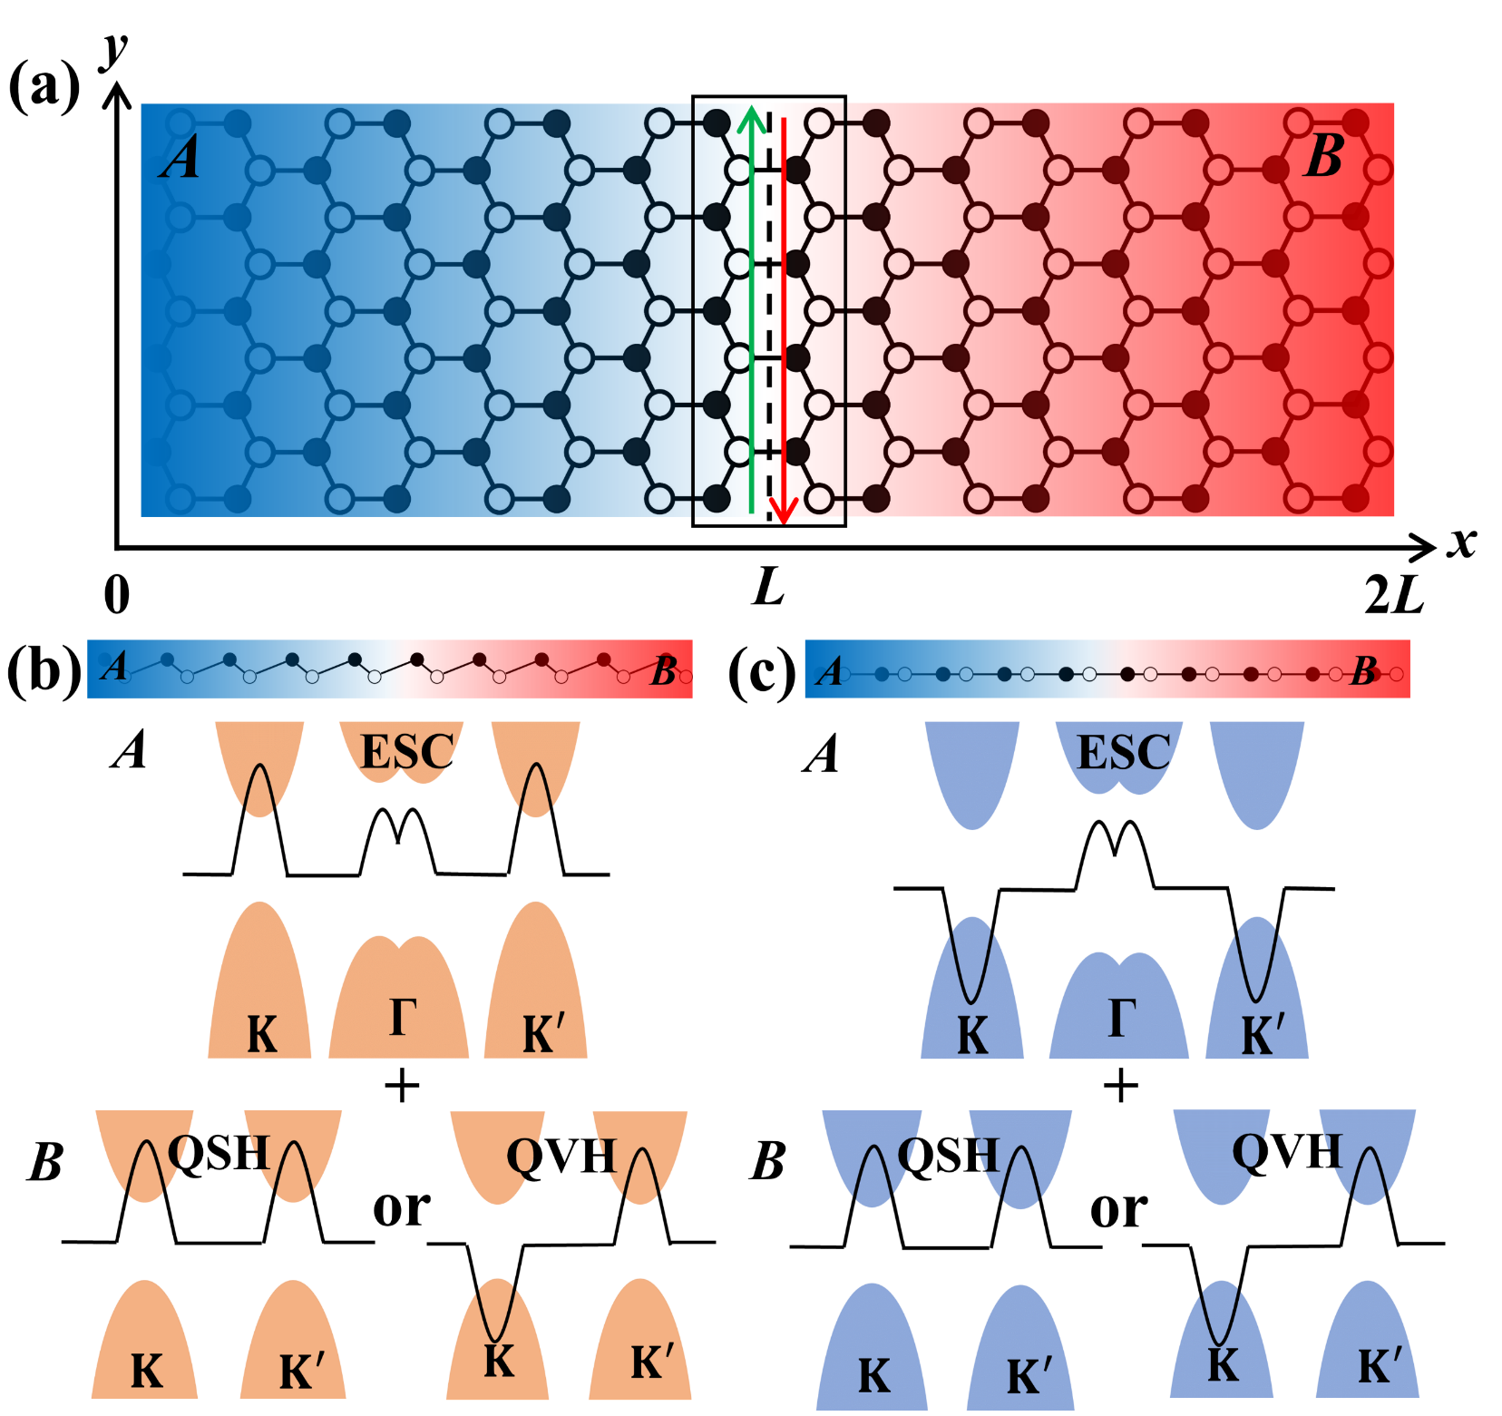
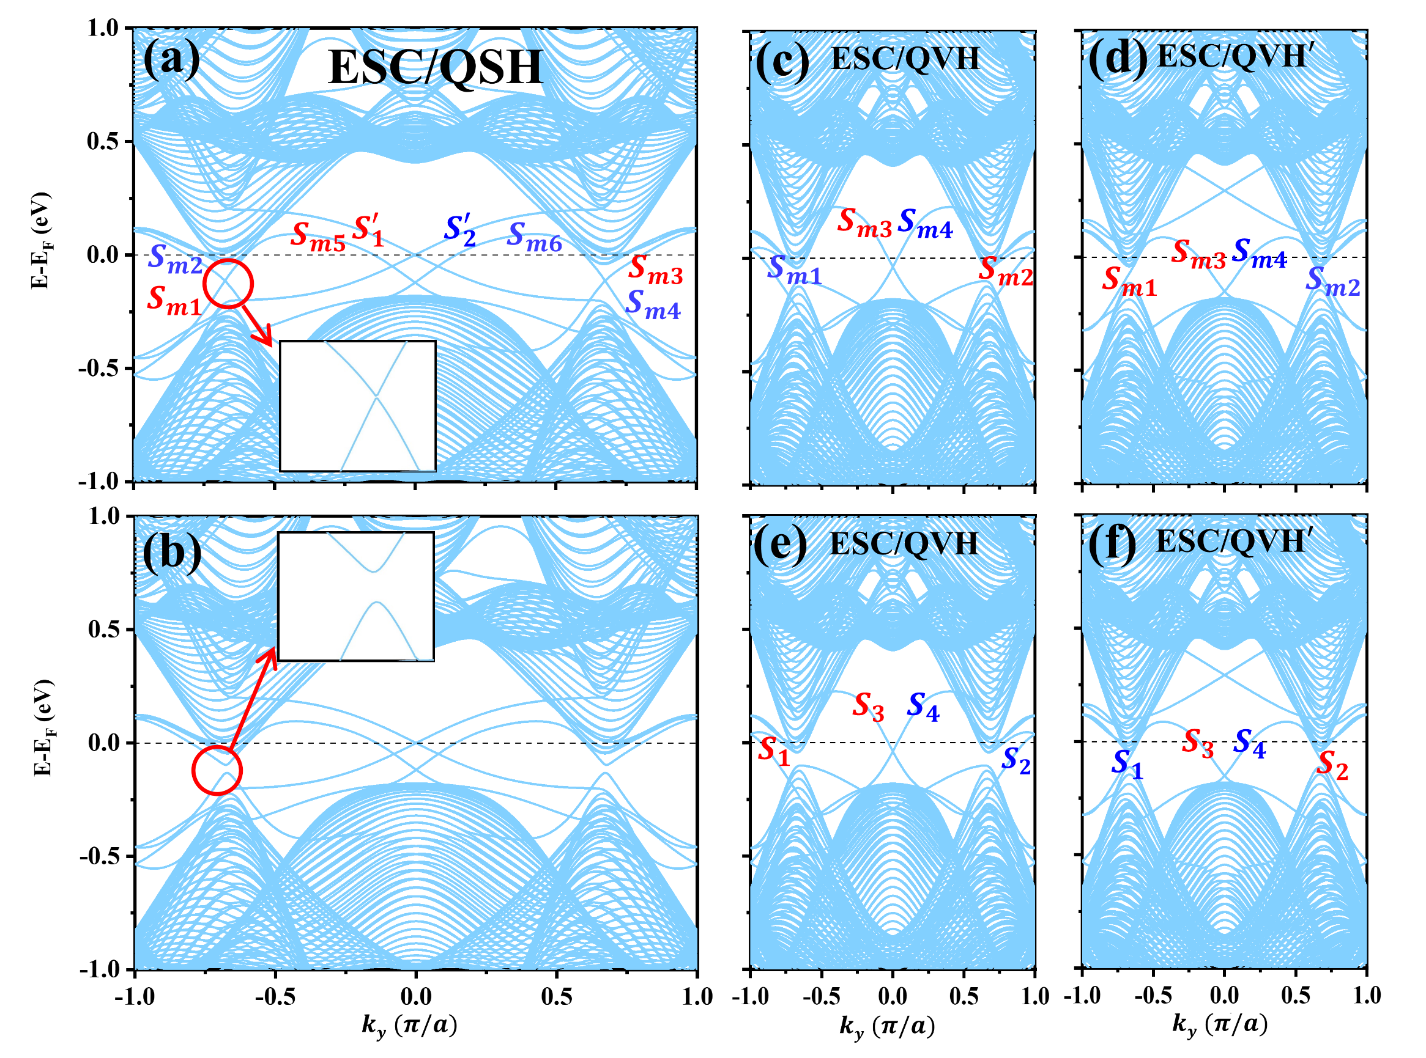
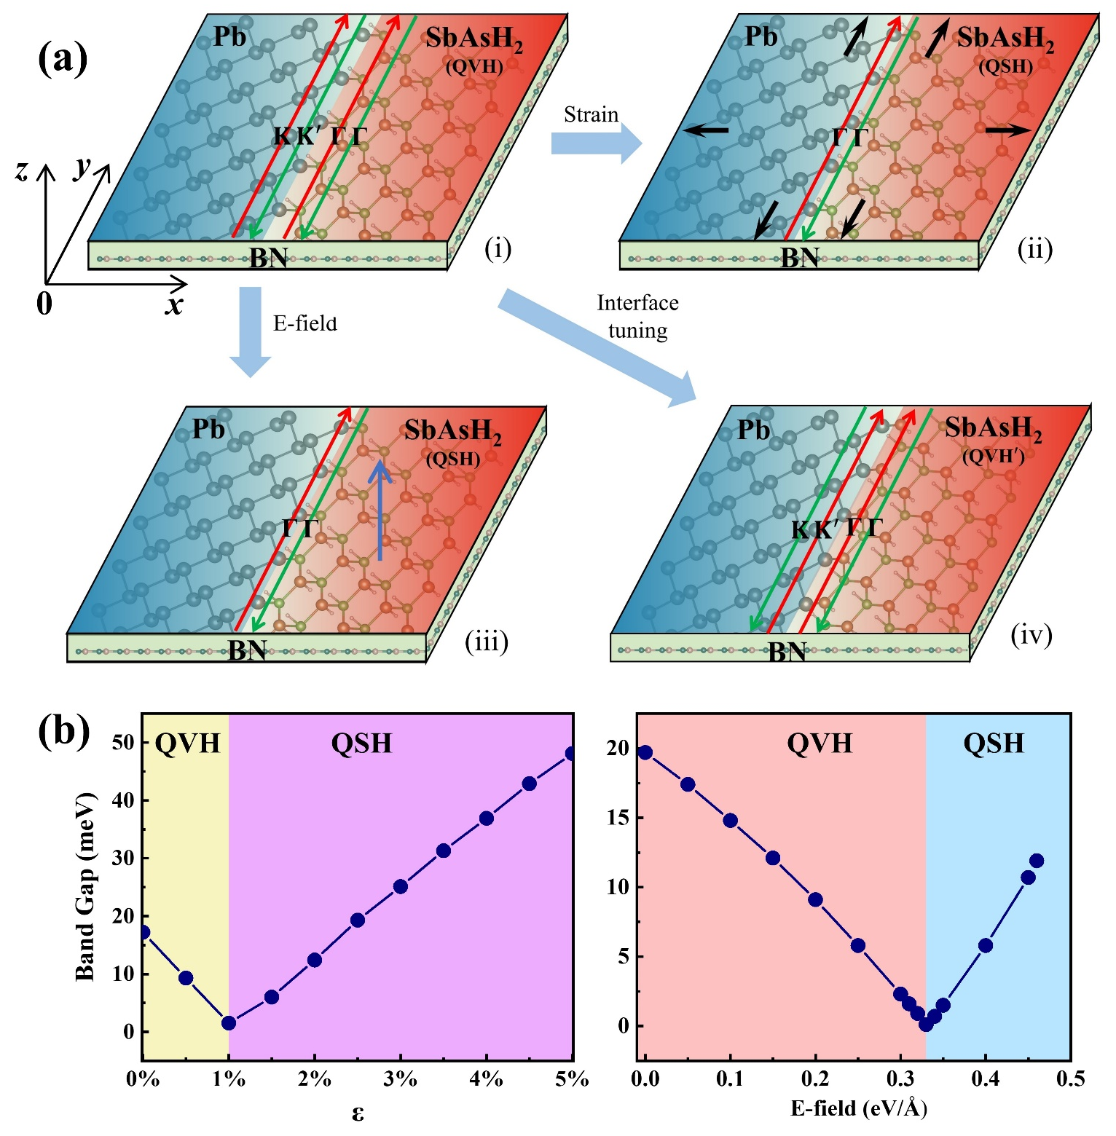
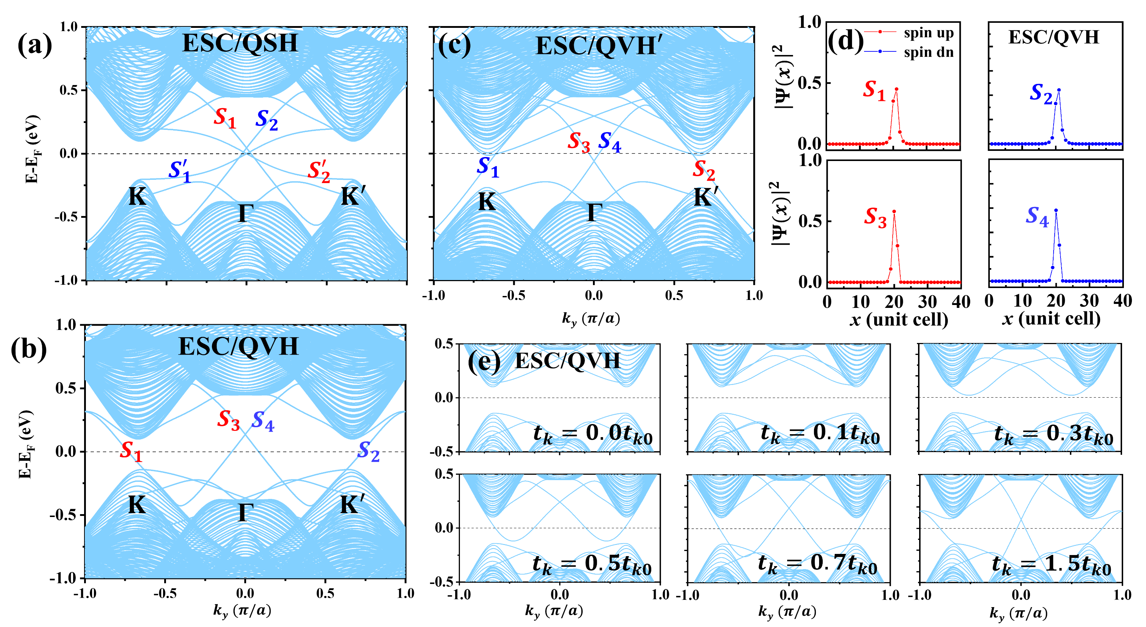
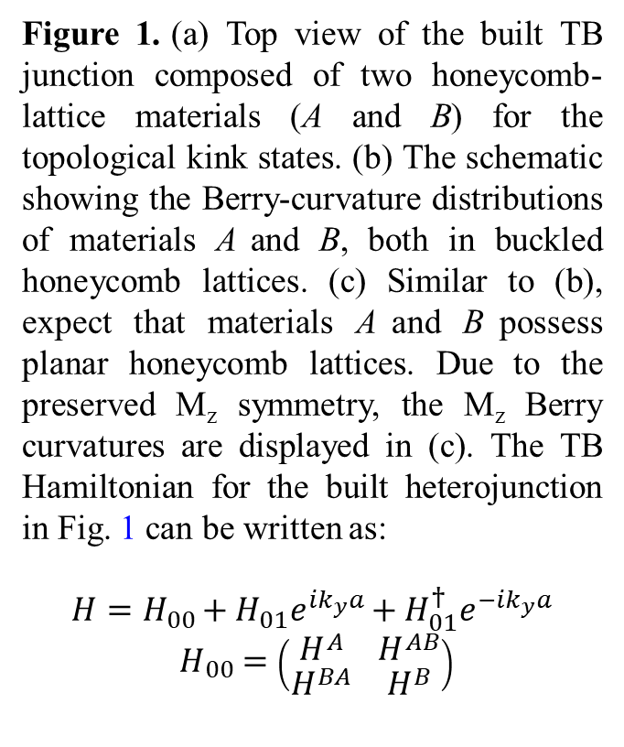
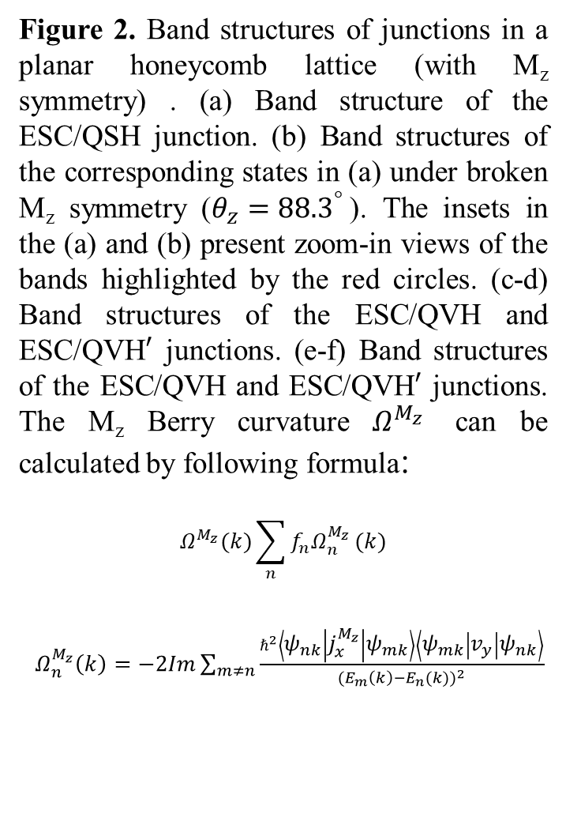
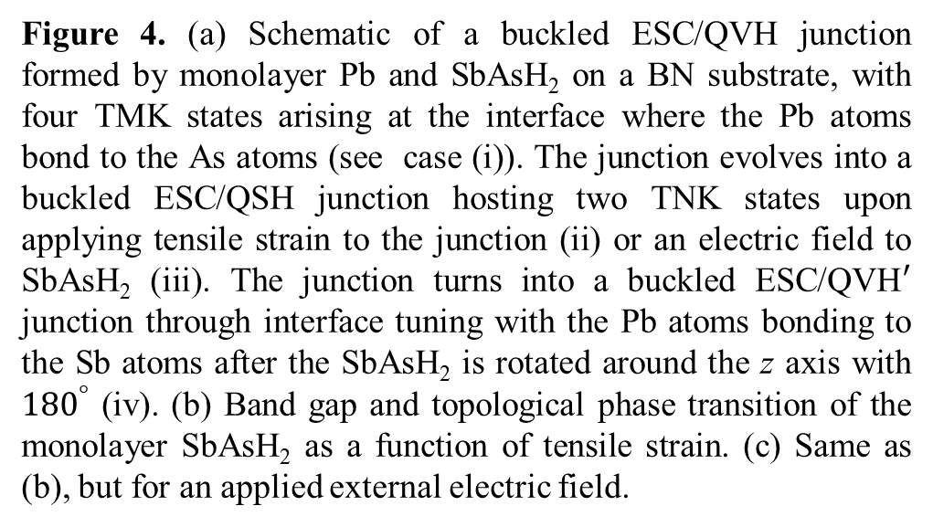
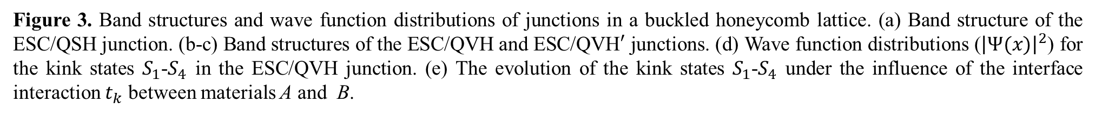
Emergence of topological multifold/crystalline kink states with even-spin-Chern insulators
Zhijian Li¹, Hongyan Zhao¹,Wei Xu¹,Yang Xue^{3,1}, and Zhongqin Yang^{1,2*}
1 State Key Laboratory of Surface Physics and Key Laboratory of Computational Physical Sciences (MOE) & Department of Physics, Fudan University, Shanghai 200433, China
2 Shanghai Qi Zhi Institute, Shanghai 200030, China
3 School of Science, East China University of Science and Technology, Shanghai 200237, China
Abstract
Topological kink states are inherently tied to valley-based topological charges, and extending this framework is critical for boosting quantum transport efficiency. Using tight-binding models, we demonstrate that even-spin-Chern (ESC) insulators offer a versatile platform for realizing new classes of topological kink states when integrated with quantum spin/valley Hall (QSH/QVH) insulators. A buckled ESC/QVH junction hosts topological multifold kink (TMK) states arising from multiple topological charge sources, yielding very large spin-polarized, dissipationless chiral channels. A planar ESC/QSH junction supports a mirror-protected topological crystalline kink (TCK) state with six channels that markedly enhance the transport efficiency. Interfacial hopping governs the emergence of gapless topological kink states. Density functional theory calculations identify the Pb/SbAsH₂ junction as an exemplary candidate for realizing disparate TMK states. Our work establishes ESC insulators as a promising foundation for high-performance quantum topological devices and provides novel insights into the classification and microscopic origins of topological kink states.
Figure 1. (a) Top view of the built TB junction composed of two honeycomb-lattice materials (A and B) for the topological kink states. (b) The schematic showing the Berry-curvature distributions of materials A and B, both in buckled honeycomb lattices. (c) Similar to (b), expect that materials A and B possess planar honeycomb lattices. Due to the preserved M_{z} symmetry, the M_{z} Berry curvatures are displayed in (c). The TB Hamiltonian for the built heterojunction in Fig. 1 can be written as:
$$H=H_{00}+H_{01}e^{ik_{y}a}+H_{01}^{†}e^{−ik_{y}a}$$
$H_{00}=\left(\begin{matrix}H^{A} & H^{AB} \\ H^{BA} & H^{B}\end{matrix}\right)$
Figure 2. Band structures of junctions in a planar honeycomb lattice (with M_{z} symmetry) . (a) Band structure of the ESC/QSH junction. (b) Band structures of the corresponding states in (a) under broken M_{z} symmetry ($θ_{z}={88.3}^{°}$). The insets in the (a) and (b) present zoom-in views of the bands highlighted by the red circles. (c-d) Band structures of the ESC/QVH and ESC/QVH$′$ junctions. (e-f) Band structures of the ESC/QVH and ESC/QVH$′$ junctions. The M_{z} Berry curvature $Ω^{M_{z}}$ can be calculated by following formula:
$$Ω^{M_{z}}(k)\sum_{n}{f_{n}Ω_{n}^{M_{z}}}(k)$$
$Ω_{n}^{M_{z}}\left(k\right)=−2Im\sum_{m≠n}{\frac{ℏ^{2}\left\langle ψ_{nk} | j_{x}^{M_{z}} | ψ_{mk}\right\rangle \left\langle ψ_{mk} | v_{y} | ψ_{nk}\right\rangle }{{(E_{m}\left(k\right)−E_{n}(k))}^{2}}}$
Figure 4. (a) Schematic of a buckled ESC/QVH junction formed by monolayer Pb and SbAsH₂ on a BN substrate, with four TMK states arising at the interface where the Pb atoms bond to the As atoms (see case (i)). The junction evolves into a buckled ESC/QSH junction hosting two TNK states upon applying tensile strain to the junction (ii) or an electric field to SbAsH₂ (iii). The junction turns into a buckled ESC/QVH$′$ junction through interface tuning with the Pb atoms bonding to the Sb atoms after the SbAsH₂ is rotated around the z axis with ${180}^{°}$ (iv). (b) Band gap and topological phase transition of the monolayer SbAsH₂ as a function of tensile strain. (c) Same as (b), but for an applied external electric field.
Conclusions
Combining tight-binding modeling and first-principles calculations, we identify even-spin-Chern insulators (ESCs) as a robust platform for novel topological kink states. Buckled honeycomb lattice ESC/QVH junctions host multifold topological kink states, originating from multiple topological charge sources, which exhibit large spin-polarized chiral transport and unique spin-velocity-valley locking. Planar ESC/QSH junctions realize a new mirror-protected topological kink state with six gapless channels, the highest reported to date. Interfacial hopping strength is the key factor governing gapless kink state emergence. First-principles calculations show the Pb/SbAsH₂ heterojunction is a realistic material platform for these states, tunable among ESC/QVH, ESC/QSH, and ESC/QVH′ configurations via strain, electric field, and interfacial engineering. Our results extend the valley-based kink state paradigm and enable high-capacity topological quantum transport.
Figure 3. Band structures and wave function distributions of junctions in a buckled honeycomb lattice. (a) Band structure of the ESC/QSH junction. (b-c) Band structures of the ESC/QVH and ESC/QVH$′$ junctions. (d) Wave function distributions (${\left|Ψ(x)\right|}^{2}$) for the kink states $S_{1}$-$S_{4}$ in the ESC/QVH junction. (e) The evolution of the kink states $S_{1}$-$S_{4}$ under the influence of the interface interaction $t_{k}$ between materials A and B.
Contact
References
Zhijian Li
Zhongqin Yang’s Group
Email: 23110190041@m.fudan.edu.cn
Phone: 18800206382
[1] I. Martin, Y. M. Blanter, and A. F. Morpurgo, Topological confinement in bilayer graphene, Phys. Rev. Lett. 100, 036804 (2008).
[2] X. Li, F. Zhang, Q. Niu, and A. H. MacDonald, Spontaneous layer-pseudospin domain walls in bilayer graphene, Phys. Rev. Lett. 113, 116803 (2014).
[3] K. Huang, H. Fu, K. Watanabe, T. Taniguchi, and J. Zhu, High-temperature quantum valley Hall effect with quantized resistance and a topological switch, Science 385, 657 (2024).

