Slide 1
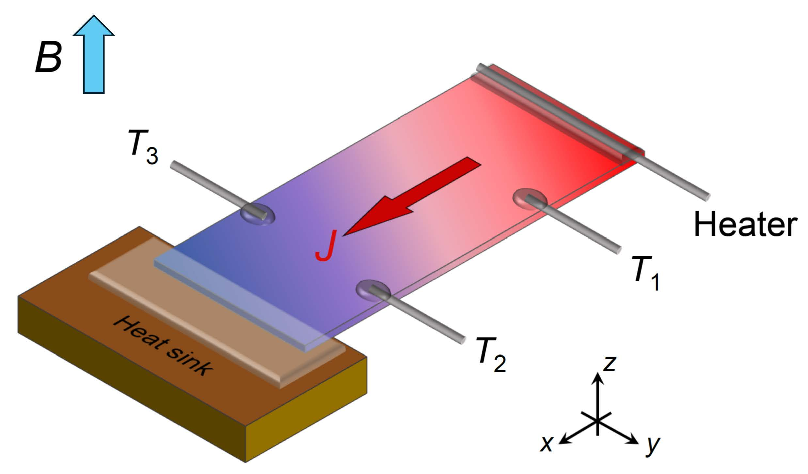
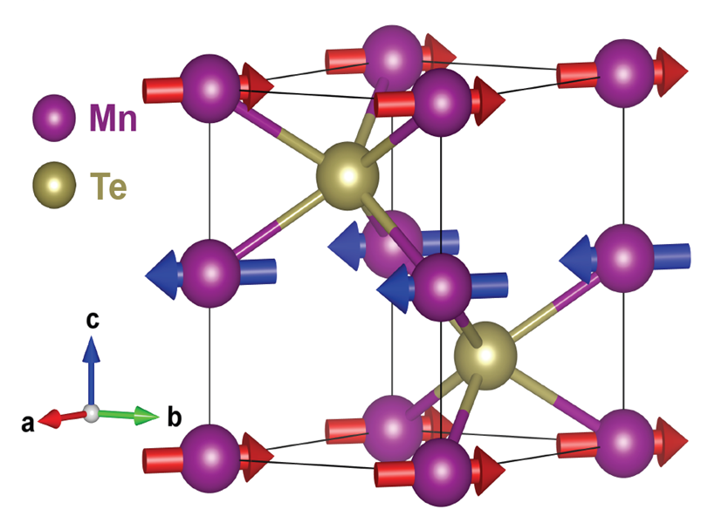
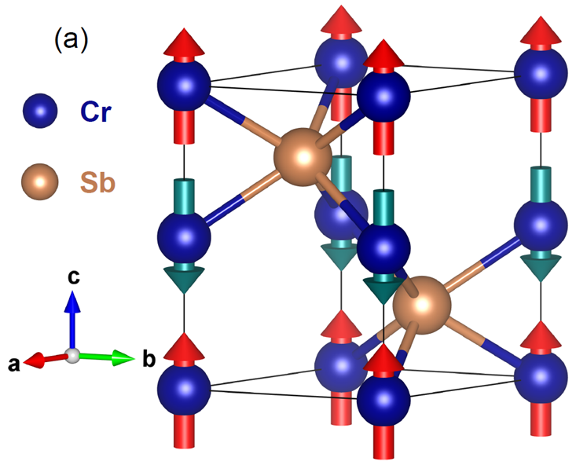
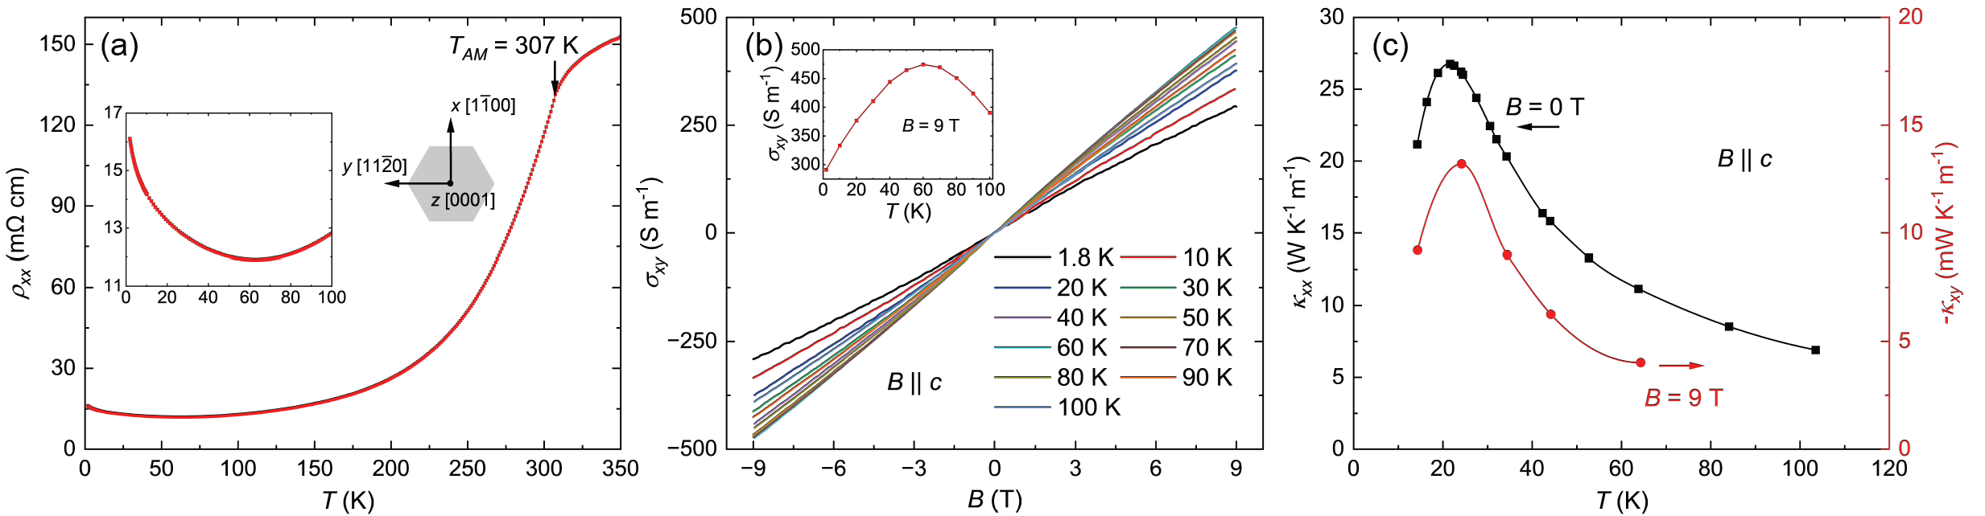
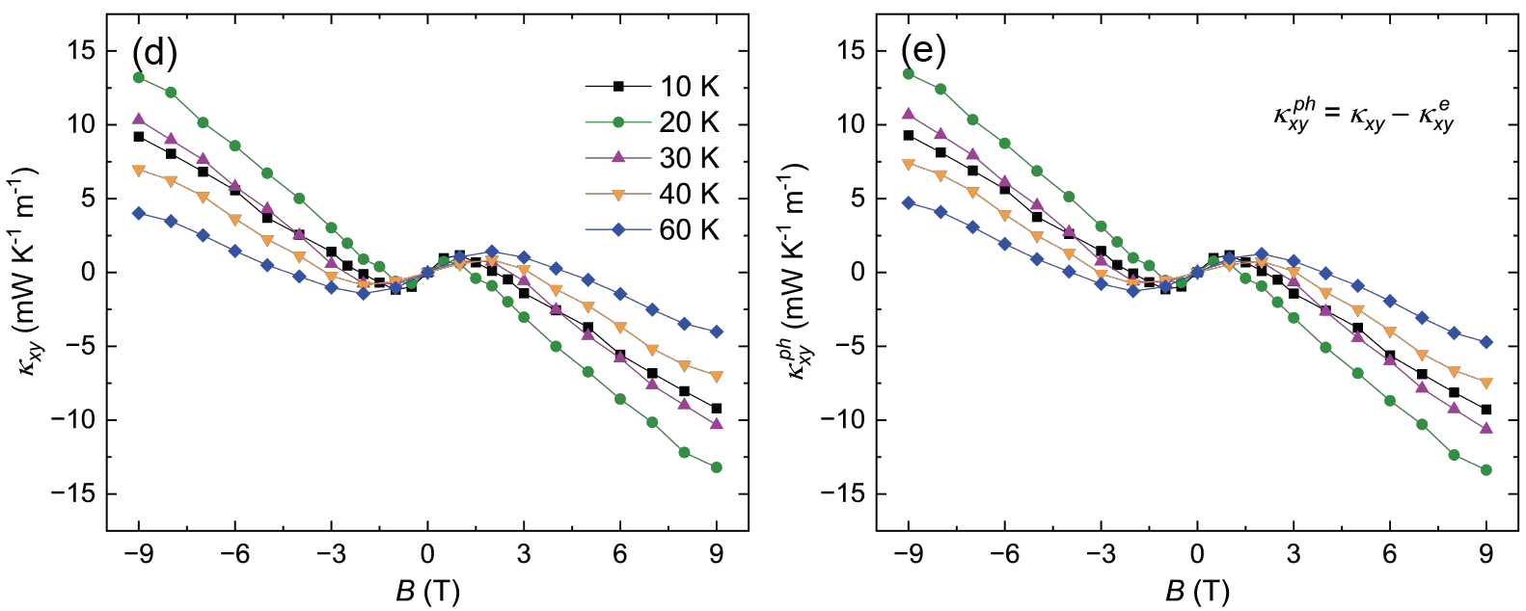
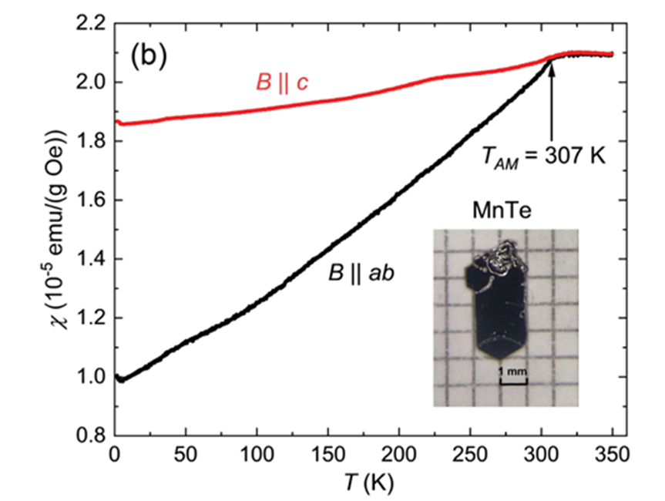
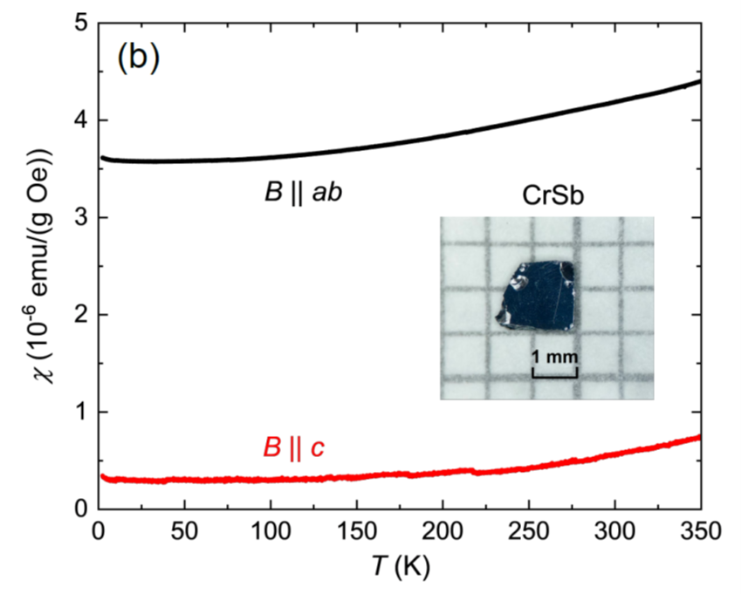
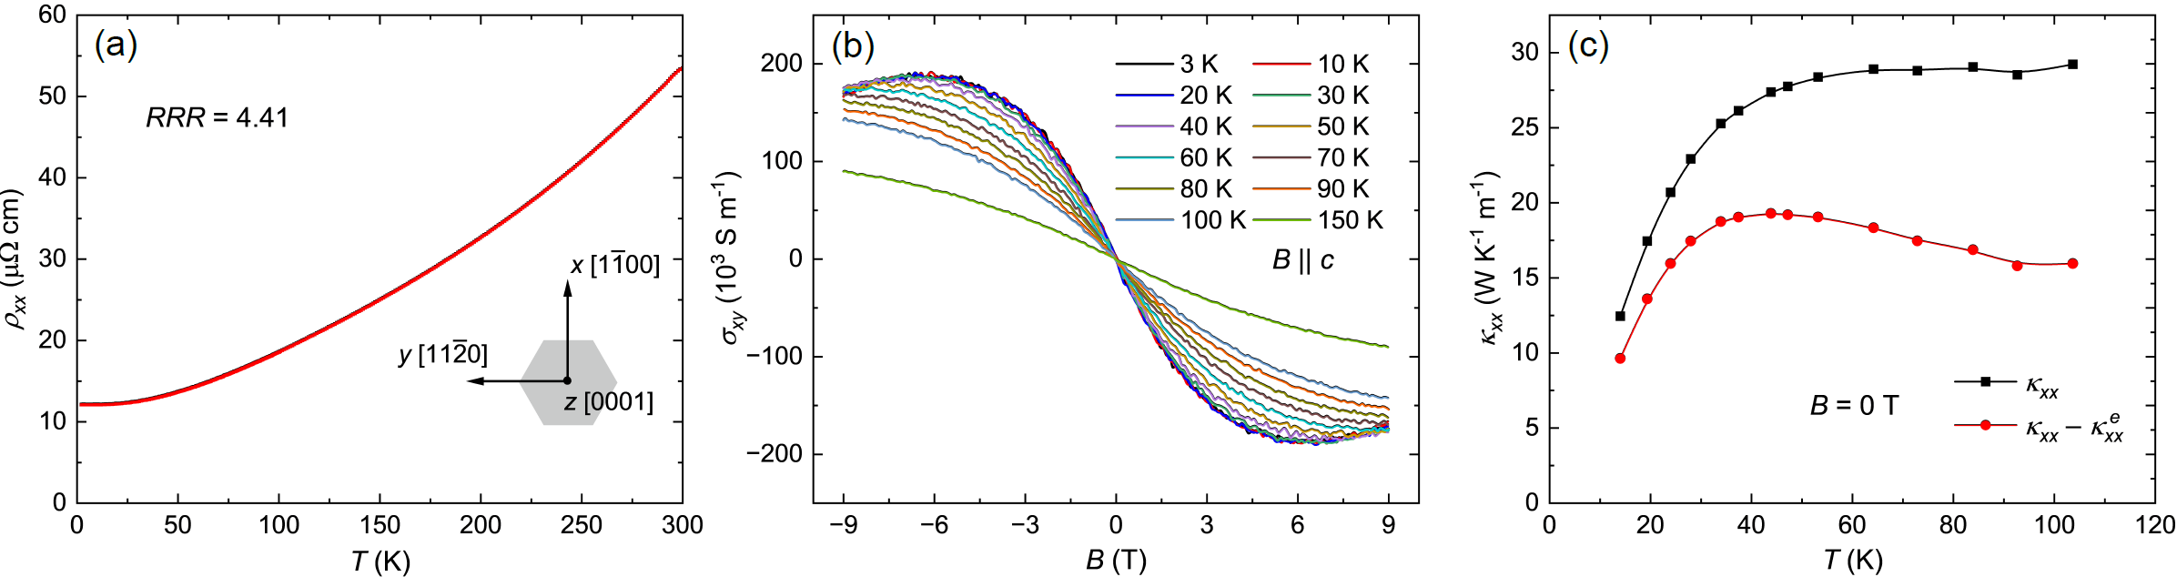
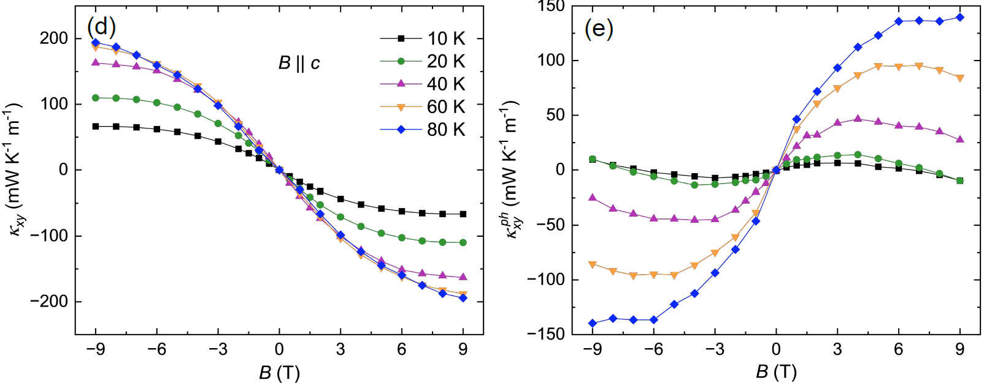
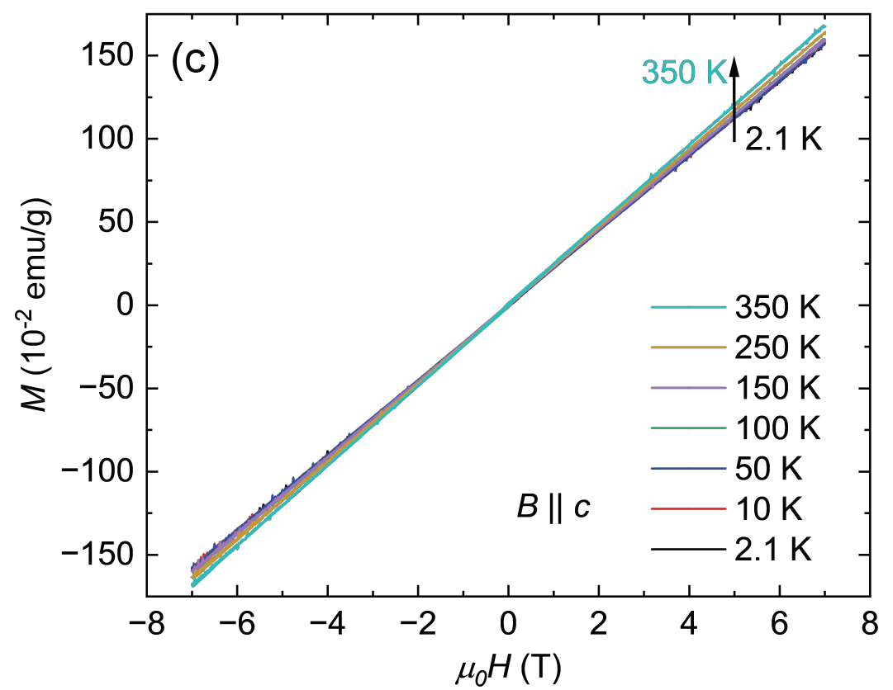
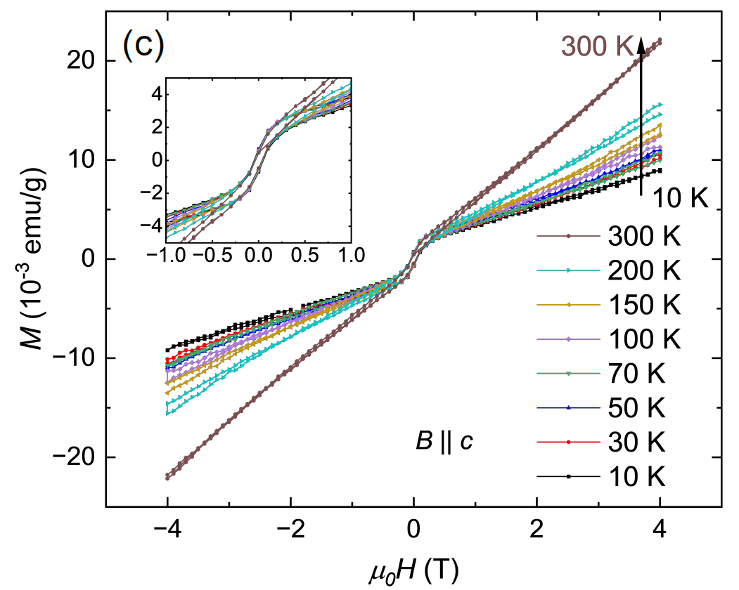
Observation of anomalous thermal Hall effect in altermagnet candidates MnTe and CrSb
Wenbo Wan,^{1,2,*} Xu Zhang,^{1,*,†} Yixuan Luo,³ Yanfeng Guo,^{3,4,‡} and Shiyan Li^{1,2,5,6,#}
¹State Key Laboratory of Surface Physics, and Department of Physics, Fudan University, Shanghai 200438, China
²Shanghai Research Center for Quantum Sciences, Shanghai 201315, China
³State Key Laboratory of Quantum Functional Materials, School of Physical Science and Technology, ShanghaiTech University, Shanghai 201210, China
⁴ShanghaiTech Laboratory for Topological Physics, ShanghaiTech University, Shanghai 201210, China
⁵Shanghai Branch, Hefei National Laboratory, Shanghai 201315, China
⁶Collaborative Innovation Center of Advanced Microstructures, Nanjing 210093, China
Preprint at arXiv:2604.03183
Abstract
Altermagnets (AMs), recently proposed as a third category of collinear magnets, combine the features of zero net magnetization in antiferromagnets (AFMs) with a ferromagnet-like spin splitting. Although abundant spectroscopic evidence for altermagnetism has been reported, experimental observation of the anomalous Hall effect (AHE), a phenomenon well known in ferromagnets (FMs), remains scarce. Here, we shift the paradigm from charge to heat carriers and report a systematic study of the thermal Hall effect (THE) in two representative altermagnet candidates, MnTe and CrSb. In both materials, we observe a pronounced anomalous phonon thermal Hall signal, with no electrical counterpart observed, which we attribute to the coupling of the distinctive magnetic structure with phonons. Our findings establish the anomalous phonon thermal Hall effect as an intrinsic feature of altermagnets, and provide a sensitive probe for identifying this new kind of quantum magnet. Moreover, it directly links the Néel vector to lattice vibrations, opening prospects for low-loss phononic devices and thermally readable memories.
Crystal structure of MnTe and CrSb
Electrical and thermal transport measurements of MnTe
Both materials are NiAs-type structure (P6₃/mmc).
Spins are aligned along ab plane in MnTe while along c axis in CrSb.
Altermagnetism relates to nonmagnetic ligands (Te and Sb).
Temperature-dependent susceptibility
Electrical and thermal transport measurements of CrSb
Magnetic transition temperature T_{AM} = 307 K and > 700 K (above the upper limit of measurements), for MnTe and CrSb respectively.
Clear magnetic anisotropy appears below T_{AM}, consistent with the direction of Néel vector.
Anomalous phonon THE versus M(H) curves
MnTe
MnTe
Both materials show no AHE signal, with multi-carrier effect of CrSb.
Phonons dominate longitudinal thermal transport in semiconducting MnTe while electrons have significant contribution in metallic CrSb.
Field-dependent thermal Hall conductivities behave different in MnTe and CrSb.
After subtracting the electronic contribution by Wiedemann–Franz law, both exhibit similar nonlinear field dependence.
CrSb
CrSb
Summary
In summary, we have measured THE of two altermagnet candidates, semiconducting MnTe and metallic CrSb, and report the observation of a robust anomalous phonon κ_{xy} in both materials after subtracting the carrier and conventional phonon contributions. The observed field scales and magnetization behavior rule out weak ferromagnetism as the primary cause and point toward a Néel-vector- and lattice-symmetry-driven origin, possibly mediated or amplified by magnon–phonon hybridization. Our results extend THE studies into altermagnets, highlight the important role phonons are playing, and motivate further theoretical and experimental work to identify the microscopic mechanism.
After subtracting the linear term, the anomalous phonon THE is extracted, analogous to the THE in FMs.
Mismatch of saturation field between anomalous phonon THE and M(H) curves––not from FM magnon
These results suggest a Néel-vector-driven anomalous phonon THE in Ams.
Annual Academic Conference of Physics Department, Fudan University (2026)

