Slide 1
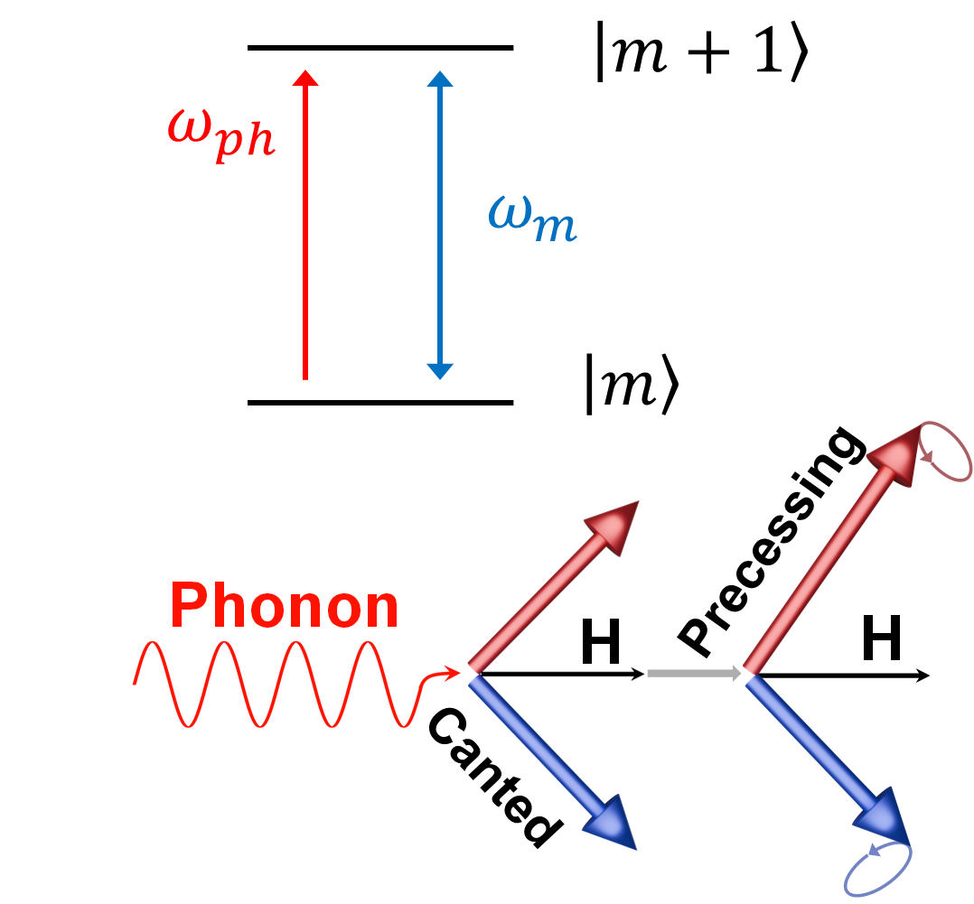
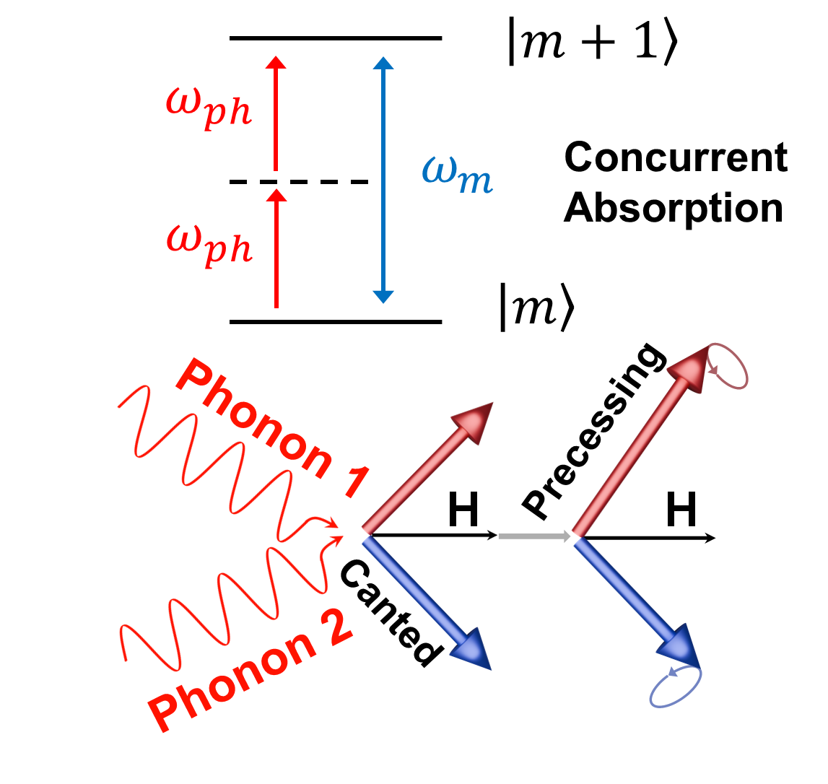
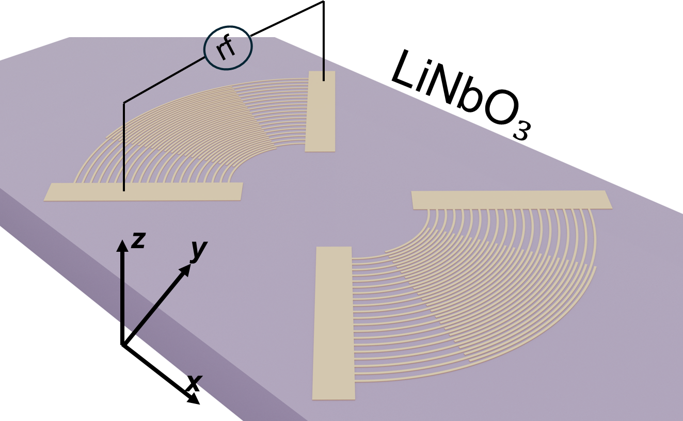
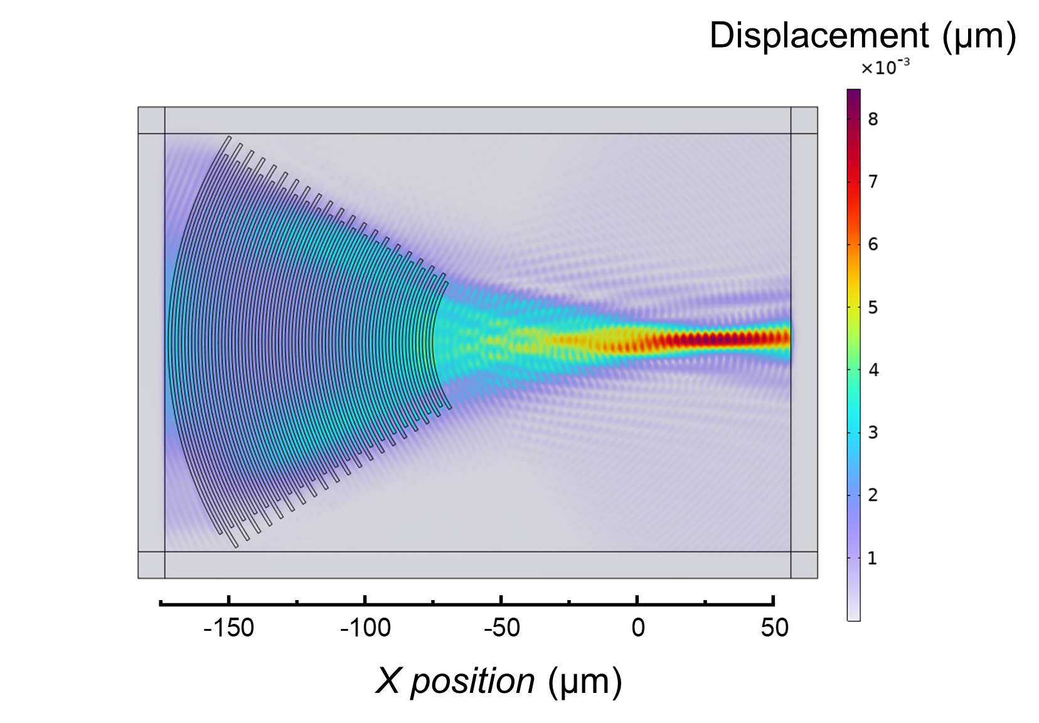
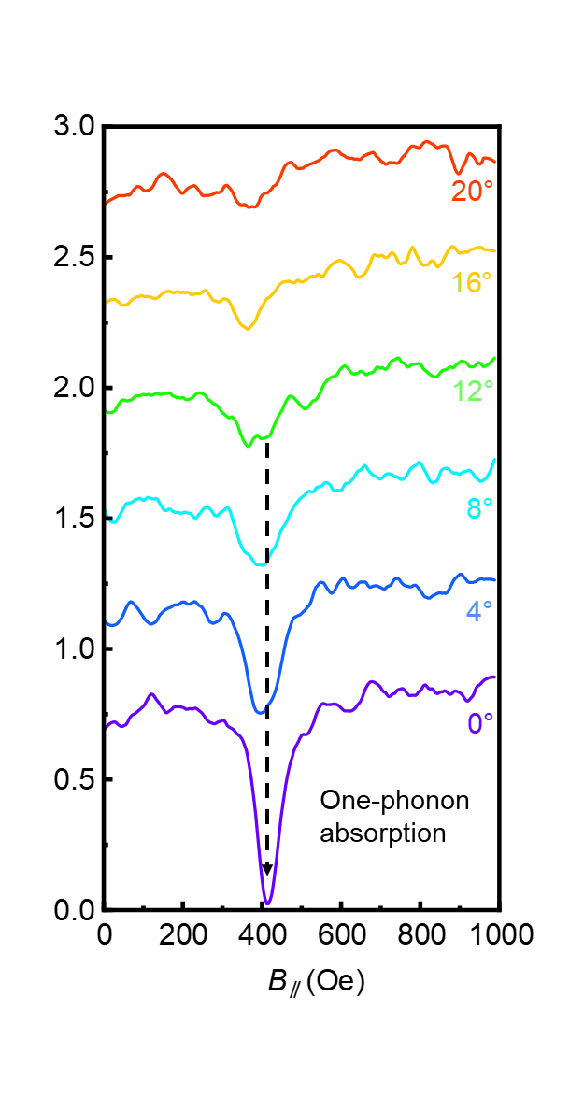
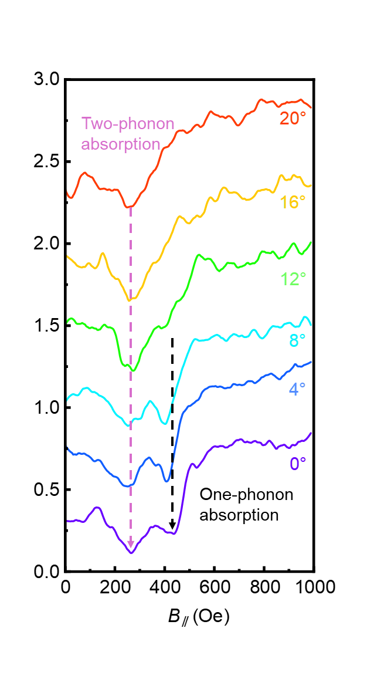
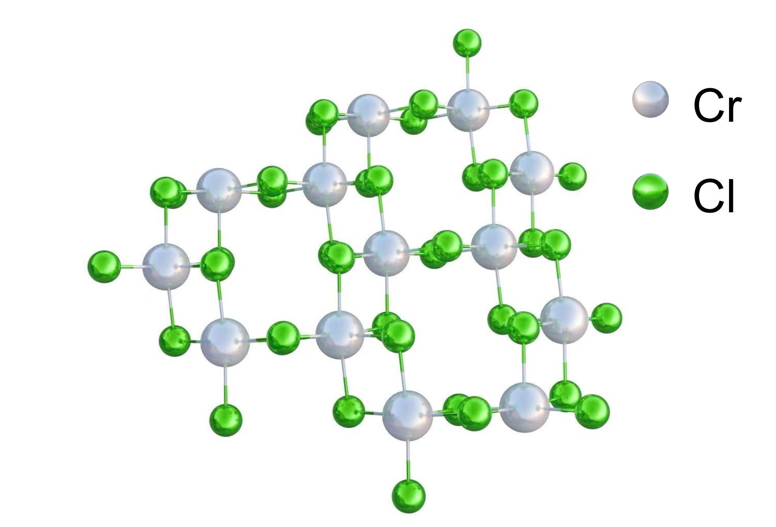
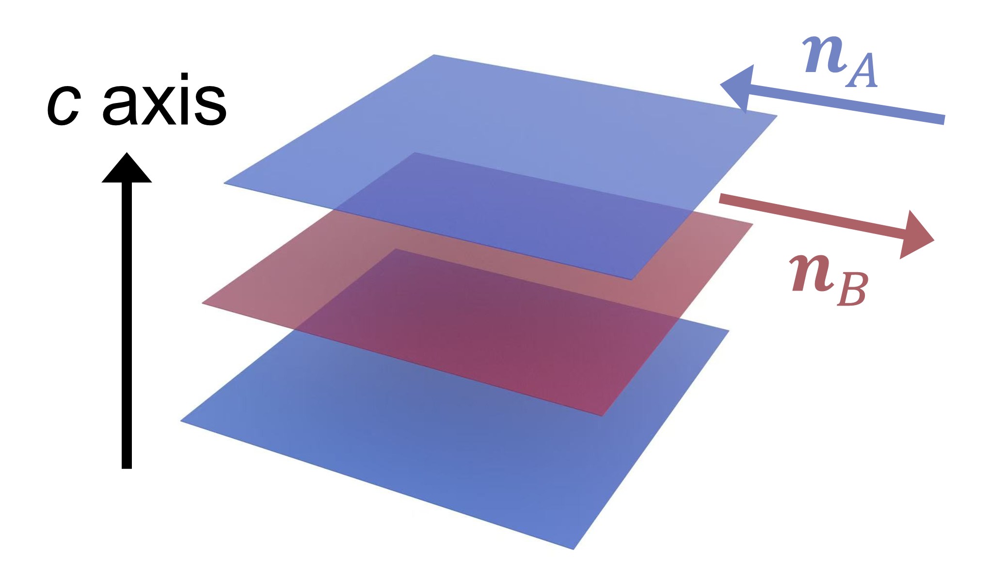
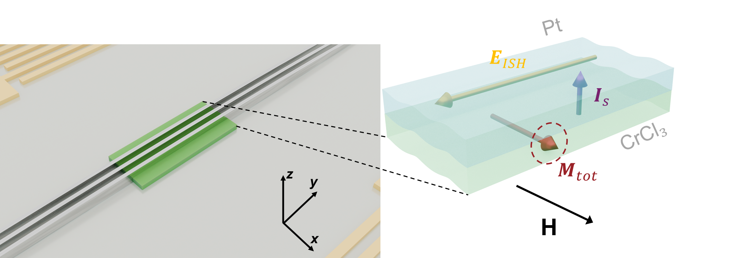
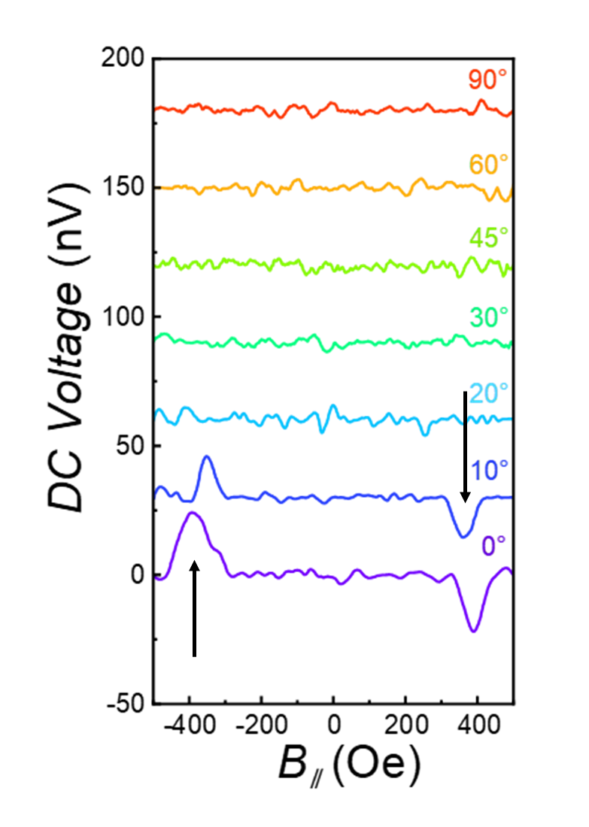
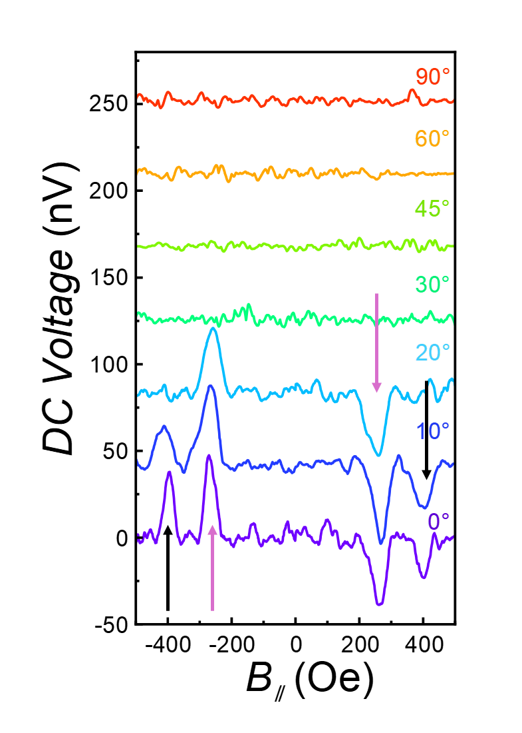
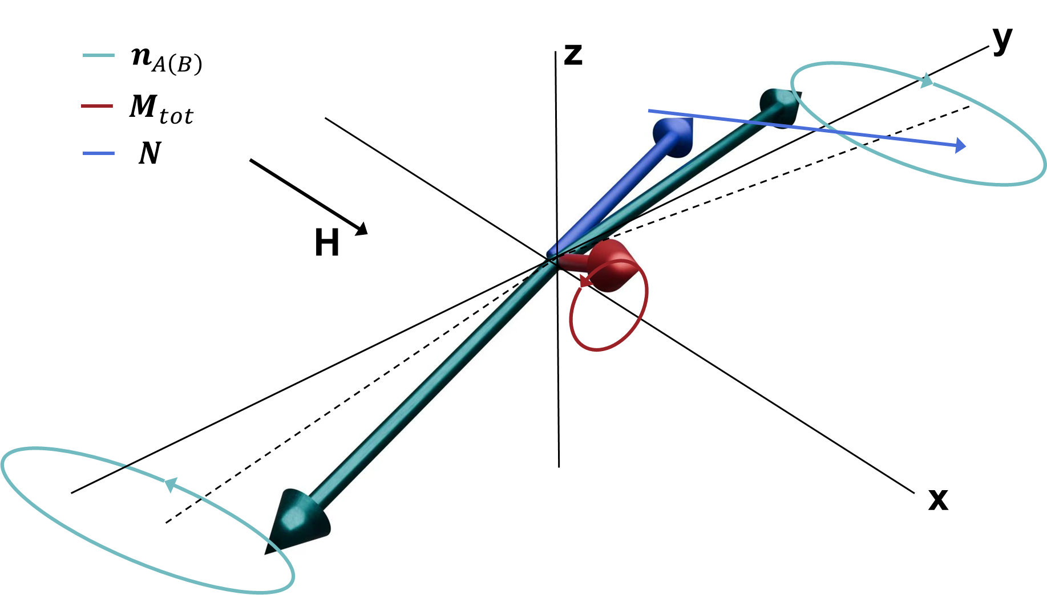
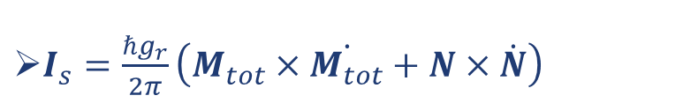
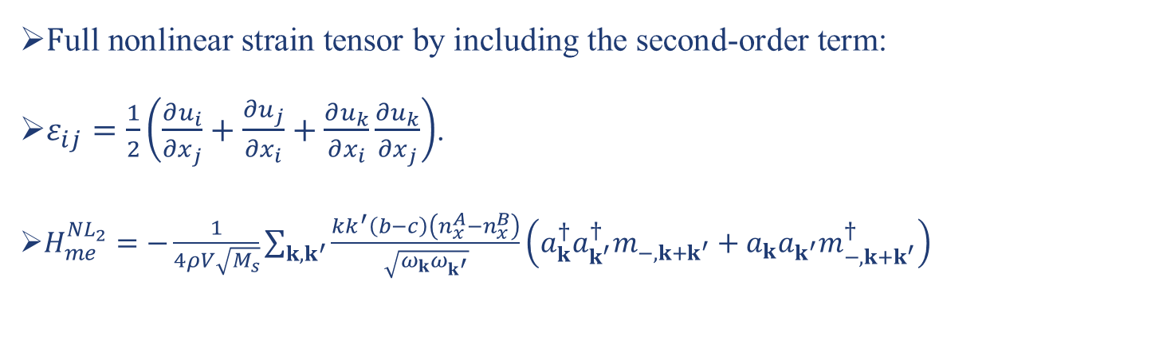

Observation of Two-Phonon Antiferromagnetic Resonance and Acoustically Driven Spin Current in an Antiferromagnet
Kai Xiong^{1,2#}, Changyong Lei^{3#}, Xiangyu Cao^{1,2#}, Jie Ren^{3*}, Faxian Xiu^{1,2,4,5*}
Abstract:
Acoustic spintronics exploits surface acoustic waves to control spin dynamics, yet research has largely been confined to linear magnon-phonon coupling in ferromagnets. Extending this to the nonlinear regime and to antiferromagnetic materials—which promise terahertz operation and are free from stray fields—remains a formidable challenge. Here, we report the first observation of two-phonon antiferromagnetic resonance and the demonstration of two-phonon-assisted acoustic spin pumping in an antiferromagnet. We theoretically show that including higher-order terms of the strain tensor in the magnetoelastic interaction Hamiltonian leads to a nonlinear two-phonon absorption process, which becomes dominant when the local phonon energy density is sufficiently high. We experimentally validate this prediction using focused interdigital transducers to locally enhance the phonon density in the van der Waals antiferromagnet chromium trichloride (CrCl₃), thereby observing distinct two-phonon absorption signatures in acoustic antiferromagnetic resonance. Furthermore, by resonantly driving the acoustic magnon mode of CrCl₃, we achieve acoustic antiferromagnetic spin pumping, generating pure spin currents detected via the inverse spin Hall effect. These pure direct current (DC) spin signals additionally confirm the existence of the two-phonon absorption process. Our work unveils a nonlinear pathway for high-frequency magnon control using low-frequency acoustic waves and opens an avenue for acoustic antiferromagnetic spintronic devices.
Theory of nonlinear magnon-phonon coupling
Two-phonon absorption based on enhanced phonon energy density
$\text{F}\text{ull} \text{nonlinear} \text{strain} \text{tensor} \text{by} \text{including} \text{the} \text{second}\text{−}\text{order} \text{term}\text{: }$
$ε_{ij}=\frac{1}{2}\left(\frac{∂u_{i}}{∂x_{j}}+\frac{∂u_{j}}{∂x_{i}}+\frac{∂u_{k}}{∂x_{i}}\frac{∂u_{k}}{∂x_{j}}\right)$.
$H_{me}^{NL_{2}}=−\frac{1}{4ρV\sqrt{M_{s}}}\sum_{k,k^{′}}{\frac{kk^{′}\left(b−c\right)\left(n_{x}^{A}−n_{x}^{B}\right)}{\sqrt{ω_{k}ω_{k^{′}}}}\left(a_{k}^{†}a_{k^{′}}^{†}m_{−,{k+k}^{′}}+a_{k}a_{k^{′}}m_{−,{k+k}^{′}}^{†}\right)}$
Conventional IDT
Focused IDT
Transmisson
Transmisson
$$G_{xy}^{ }=\frac{2πe^{3}}{h^{2}}\frac{Bl^{2}}{[1+{\left(μ_{s}B\right)}^{2}]}$$
Acoustic spin pumping in the antiferromagnetic system
Only one absorption peak in conventional IDT structure.
Two absorption peaks exist in focused IDT structure.
The antisymmetric acoustic spin pumping signal in the conventional structure.
Acoustic spin pumping signals corresponding to single-phonon and two-phonon absorption in the focused structure.
Conclusion
$I_{s}=\frac{ℏg_{r}}{2π}\left(M_{tot}×\dot{M_{tot}}+N×\dot{N}\right)$
Our measurements utilizing focused IDTs have revealed two-phonon absorption modes in the weakly interlayer-coupled antiferromagnetic material CrCl₃ through acoustic antiferromagnetic resonance experiments.
Furthermore, we have achieved acoustic antiferromagnetic spin pumping.
Under Review at Nature Electronics

