Slide 1



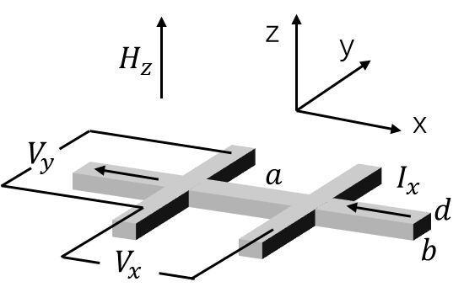
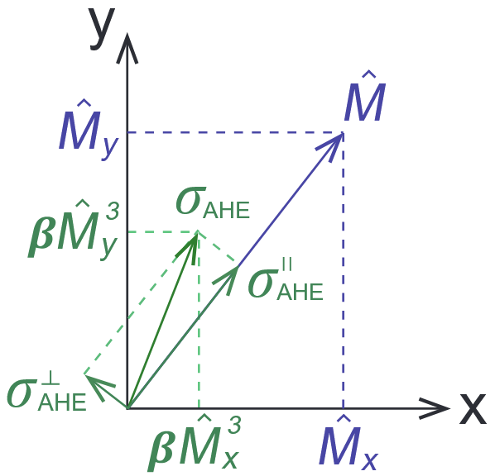
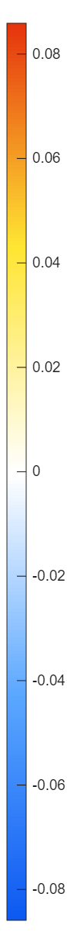
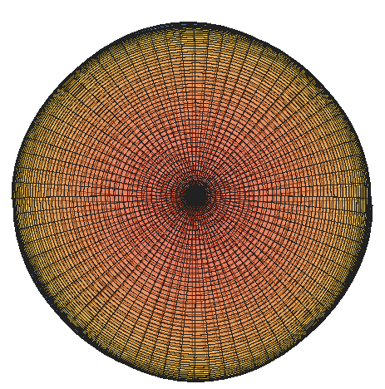
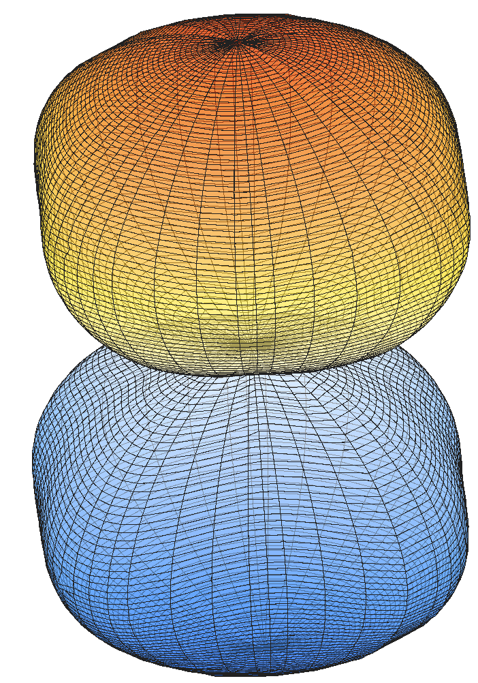
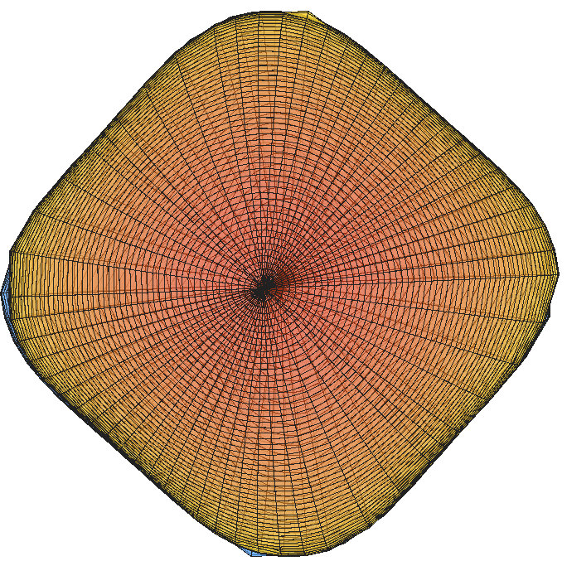
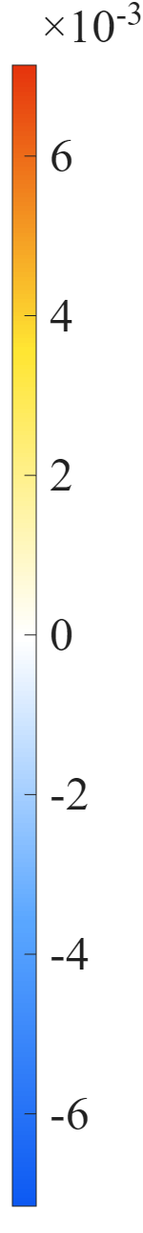
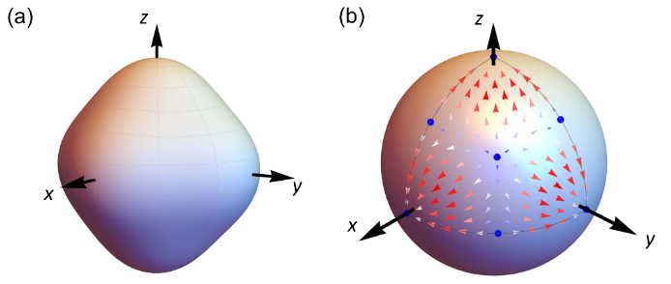
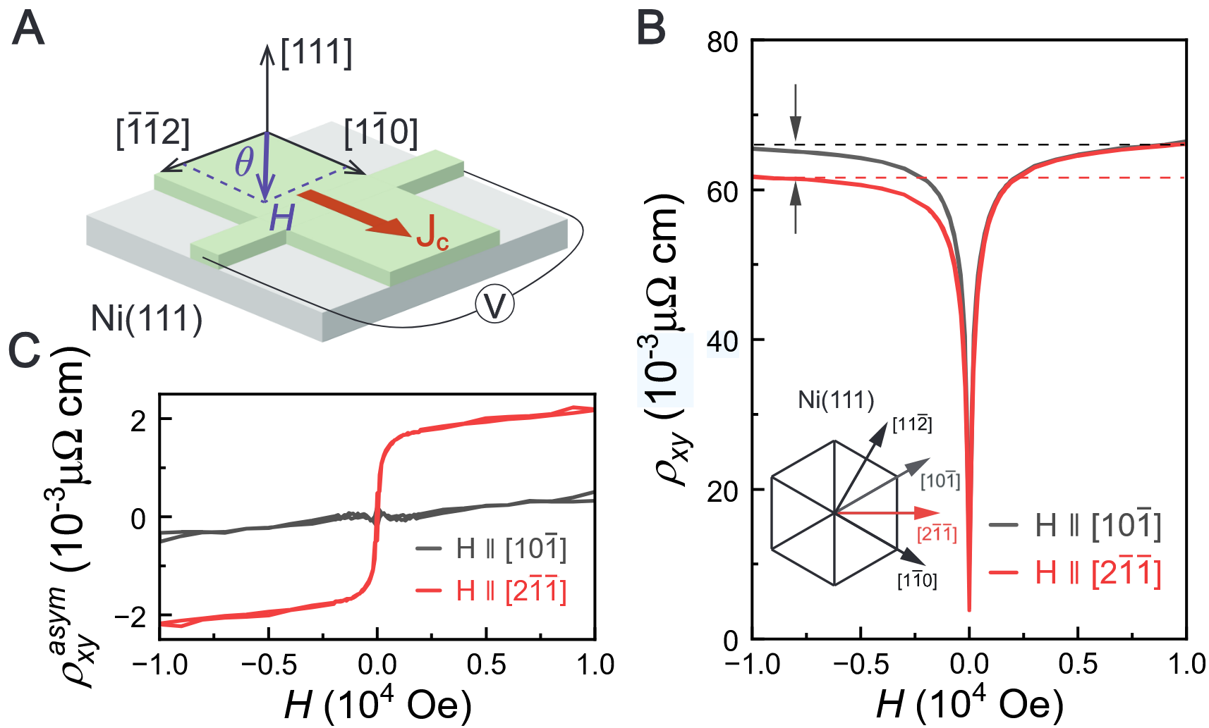
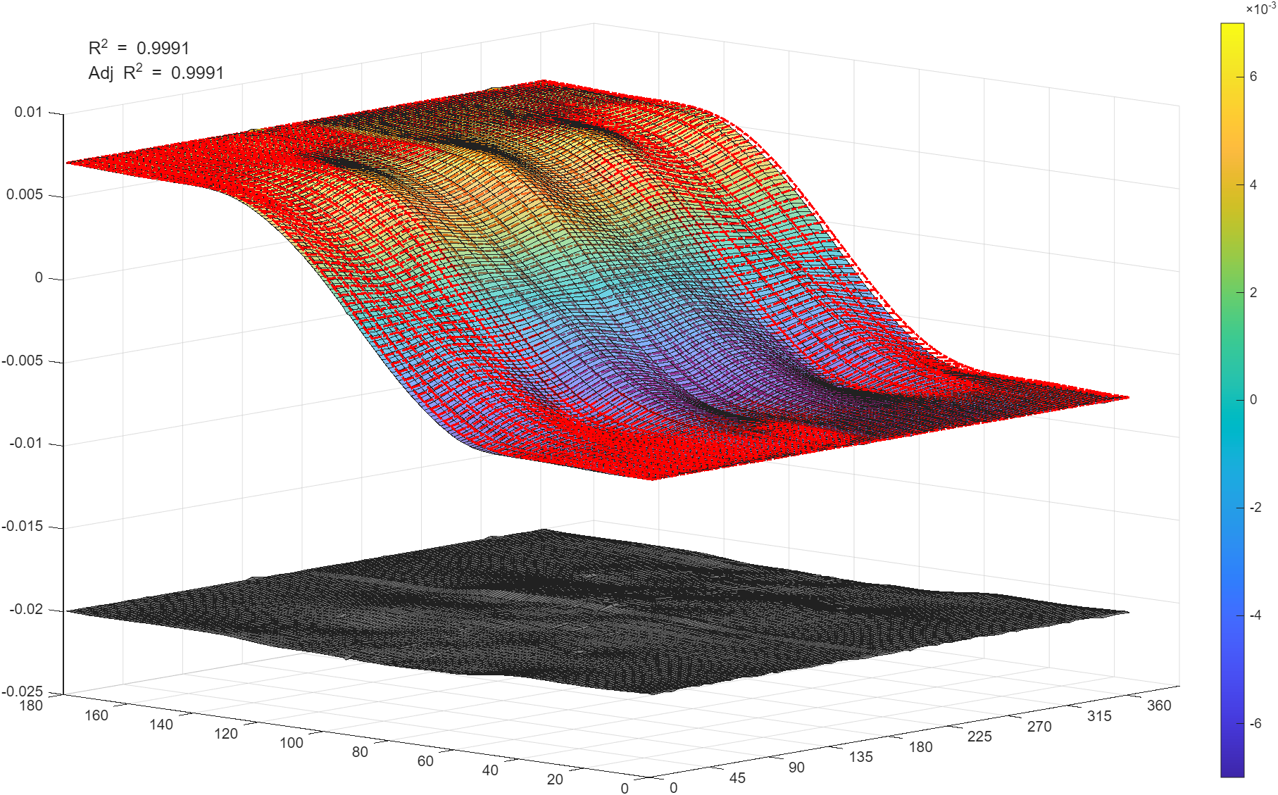
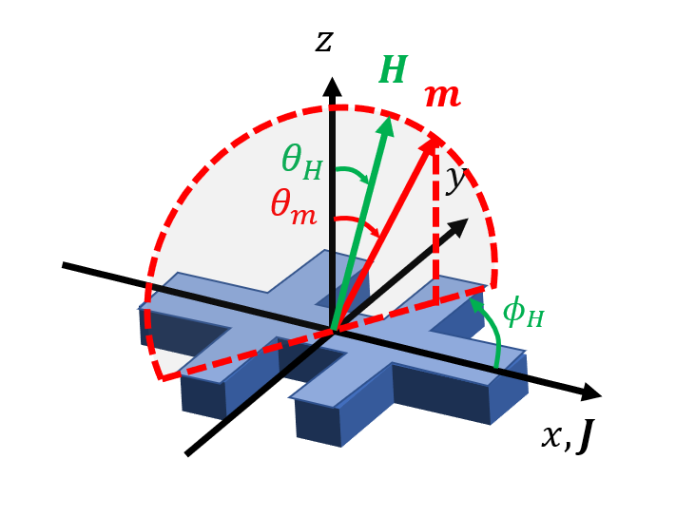
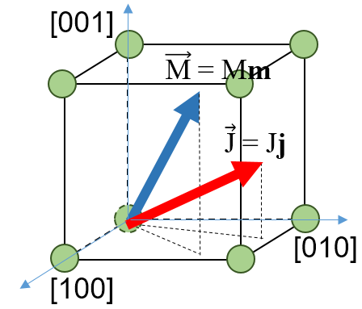



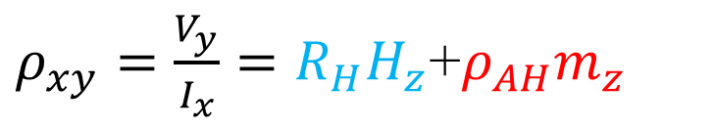




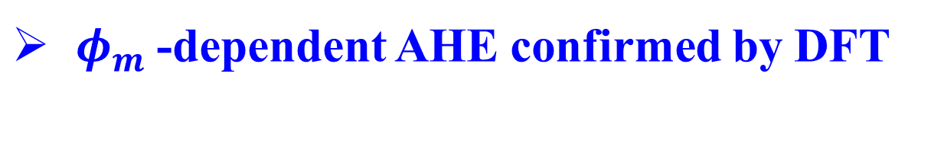


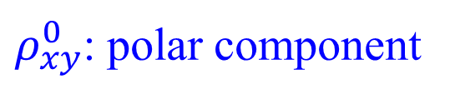
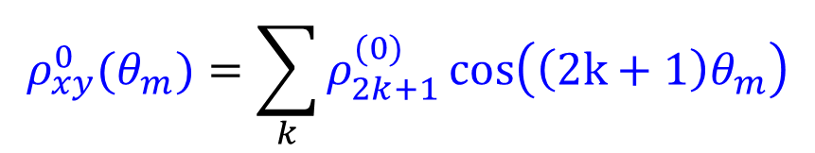
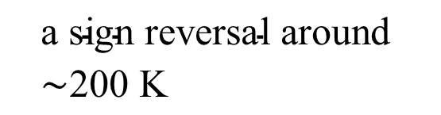




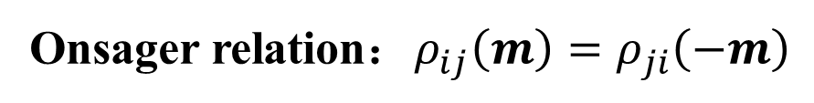


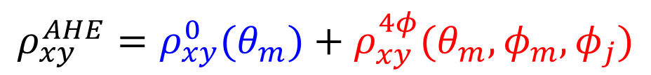






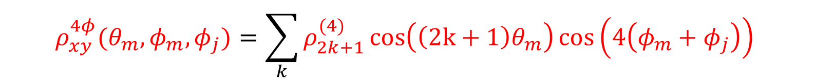

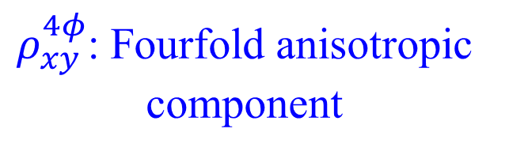

Anisotropic High-Order Anomalous Hall Effect in Epitaxial Nickel Thin Films
Lean Li¹, Yue Chen¹, Haoran Chen¹, Yizi Feng¹,
Yuanfei Fan¹,Yan Huang¹, Zhe Yuan³, Yizheng Wu¹
*Email: 25110190049@m.fudan.edu.cn
¹Department of Physics, State Key Laboratory of Surface Physics, Fudan University, Shanghai 200433, China
²Center for Advanced Quantum Studies and Department of Physics, Beijing Normal University, Beijing 100875, China
Introduction
3D angular mapping of anisotropic AHE
Anomalous Hall effect
AHE always proportional to Mz？
residual
(AHE)
Conventional AHE
3D full mapping of Ni(001) AHE
T=5 K
$$m_{z}$$
$$2ρ_{AH}$$
$$ρ_{xy}^{AHE}{∝m}_{z}$$
$$H_{z}$$
T=300 K
$$H_{z}$$
$$ρ_{xy}^{AHE}\sim cos⁡(4φ_{m})$$
Beyond Mz-proportional AHE？
$$H_{y}$$
$$ρ_{AHE}(μΩ∙cm)$$
$ρ_{xy}=\frac{V_{y}}{I_{x}}=R_{H}H_{z}$+$ρ_{AH}m_{z}$
$$H_{y}$$
$$H_{y}$$
$$ρ_{AHE}(μΩ∙cm)$$
Ordinary Hall
Anomalous Hall
W. Peng et al., arXiv:2402.15741 (2024)
$$ρ_{xy}^{AHE}=ρ_{xy}^{AHE}(θ_{m},φ_{m})$$
$$H_{x}$$
$$H_{x}$$
$$H_{y}$$
High-order AHE from multipolar response
In-plane AHE: evidence beyond Mz
$$H_{x}$$
$$H_{x}$$
In-plane anomalous Hall effect
300K:Weak anisotropic
5K:Fourfold in-plane Symmetry
High order
Spin-orbit coupling
Global fitting by symmetry model​
$φ_{m}$​-dependent AHE confirmed by DFT
$$σ_{i}^{H}=α{\hat{M}}_{i}+β{\hat{M}}_{i}^{3}$$
High order
Spin-dependent transport
W. Peng et al., arXiv:2402.15741 (2024)
Liu et al., Phys. Rev. X 15, 031006 (2025).
Can high-order AHE harmonics carry in-plane crystalline anisotropy?
Observation of anisotropic angular-dependent AHE
Measurement geometry:
T=300 K
T=5 K
Symmetry-model fitting formula
$$ρ_{xy}^{AHE}=ρ_{xy}^{0}(θ_{m})+ρ_{xy}^{4φ}(θ_{m},φ_{m},φ_{j})$$
$$σ_{xy}^{AHE}(0°)≠σ_{xy}^{AHE}(45°)$$
Full 3D angular mapping visualizes fourfold crystalline anisotropy in high-order AHE.
Ni(20 nm)/LAO(001)
Extraction of intrinsic AHE and high-order harmonics
$ρ_{xy}^{AHE}(θ_{m}, 0°)≠$ $ρ_{xy}^{AHE}(θ_{m}, 45°)$
Anisotropy enhanced in 5K
Ordinary Hall Subtraction
AHE contains an in-plane-sensitive component
$$ρ_{xy}^{raw}=R_{0}B_{z}+ρ_{xy}^{AHE}$$
Multi-cycle angular measurement
Temperature evolution of anisotropic high-order AHE
$$ρ_{xy}^{AHE}=ρ_{xy}^{raw}−R_{0}Bcos(θ_{H})$$
Phenomenological model of AHE based on crystal symmetry
Muti field verification
From Ohm’s law $E_{i}=ρ_{ij}J_{j}$, expansion of $ρ_{ij}$ on $m$:
AHE curves nearly collapse
$$ρ_{ij}\left(m\right)=a_{ij}+a_{kij}m_{k}+a_{klmij}m_{k}m_{l}m_{m}+…$$
Onsager relation：$ρ_{ij}\left(m\right)=ρ_{ji}\left(−m\right)$
Up to 19-fold AHE
Cubic crystalline symmetry
Fourier verification of high-order AHE
W. Döring, Ann. Phys. 424, 259 (1938)
Multi-cycle angular measurement
Fast Fourier transformation
$$ρ_{ij}(θ_{m},φ_{m},φ_{j})=\sum_{k}{ρ_{2k+1}^{(0)}\cos\left(\left(2k+1\right)θ_{m}\right)}+\sum_{k}{ρ_{2k+1}^{(4)}\cos\left(\left(2k+1\right)θ_{m}\right)\cos\left(4\left(φ_{m}+φ_{j}\right)\right)}$$
High-order expansion of AHE
$$ρ_{xy}^{0}(θ_{m})=\sum_{k}{ρ_{2k+1}^{(0)}\cos\left(\left(2k+1\right)θ_{m}\right)}$$
$$ρ_{xy}^{AHE}(θ_{m},φ_{m},φ_{j})=ρ_{xy}^{0}(θ_{m})+ρ_{xy}^{4φ}(θ_{m},φ_{m},φ_{j})$$
$$ρ_{xy}^{4φ}(θ_{m},φ_{m},φ_{j})=\sum_{k}{ρ_{2k+1}^{(4)}\cos\left(\left(2k+1\right)θ_{m}\right)\cos\left(4\left(φ_{m}+φ_{j}\right)\right)}$$
$${Δρ}_{xy}^{0}\left(θ_{m}\right)=ρ_{xy}^{AHE}\left(θ_{m},φ_{m}=0°,φ_{j}=0°\right)+ρ_{xy}^{AHE}\left(θ_{m},φ_{m}=45°,φ_{j}=0°\right)={2ρ}_{xy}^{0}(θ_{m})$$
$${Δρ}_{xy}^{4φ}\left(θ_{m}\right)=ρ_{xy}^{AHE}\left(θ_{m},φ_{m}=0°,φ_{j}=0°\right)−ρ_{xy}^{AHE}\left(θ_{m},φ_{m}=45°,φ_{j}=0°\right)={2ρ}_{xy}^{4φ}(θ_{m})$$
Temperature dependence of separated AHE components
Both polar and anisotropic AHE host high-order harmonics.
$ρ_{xy}^{0}$: polar component
Beyond the conventional Mz​ picture.
$$\text{regular} \text{temperature} \text{evolution} \text{dominated} \text{by} \text{the} \text{first}\text{−}\text{order} \text{term}\text{.}$$
OHE-subtracted AHE reveals robust odd-order harmonics up to 19 fold beyond the conventional Mz picture.
Summary
$ρ_{xy}^{4φ}$: Fourfold anisotropic component
High-order AHE harmonics up to 19th order in Ni(001)
In-plane-sensitive AHE beyond the conventional Mz​ picture
Fourfold anisotropy visualized by full 3D angular mapping
Distinct temperature evolution of two AHE components
$$\text{a} \text{sign} \text{reversal} \text{around}\text{ ∼200 }\text{K}$$
Polar and in-plane-sensitive AHE components exhibit distinct temperature evolution.

