Slide 1
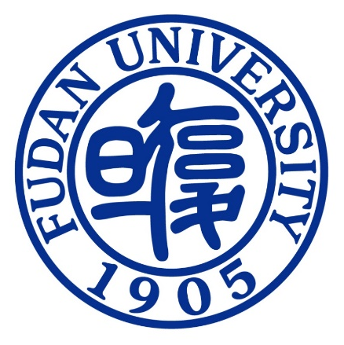
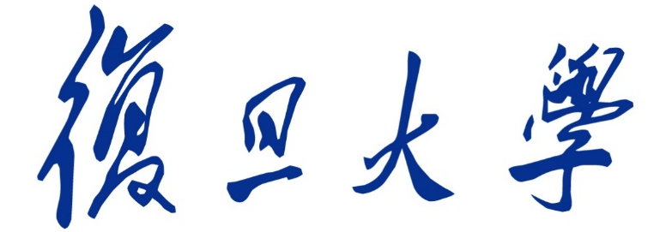

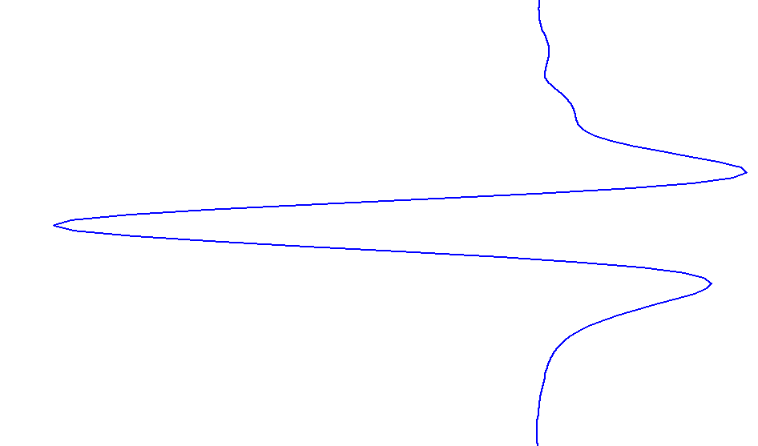
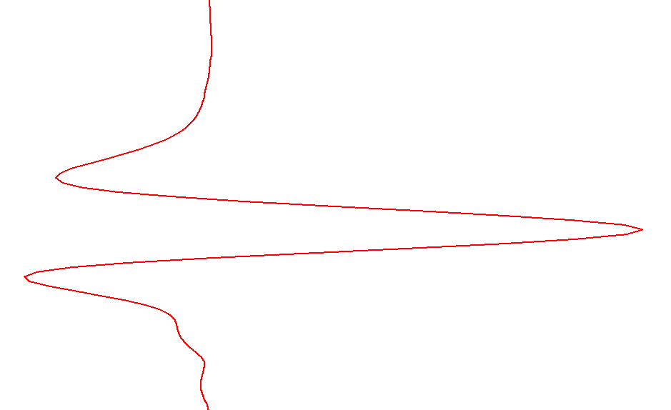
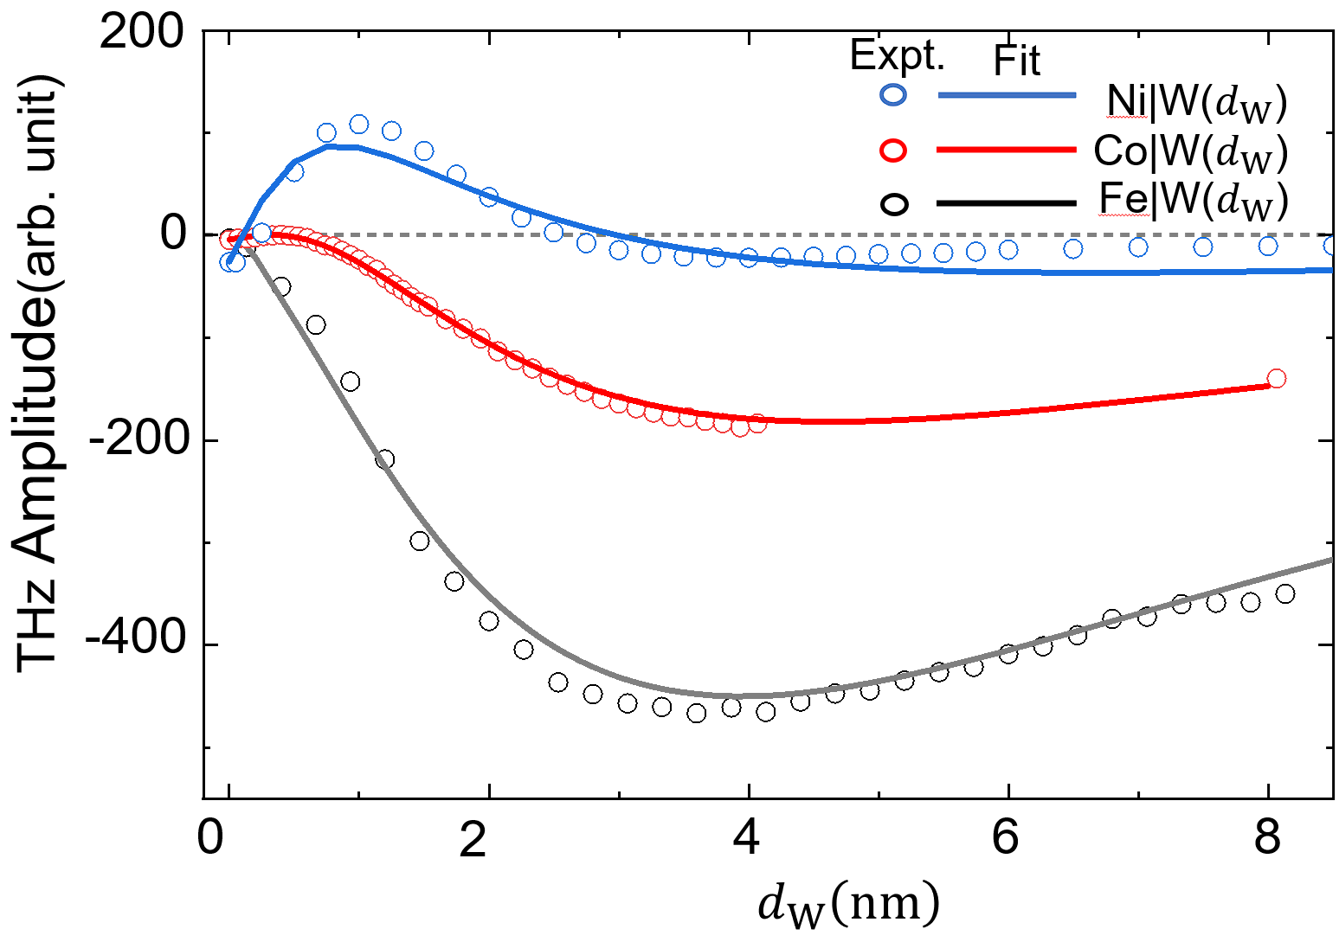
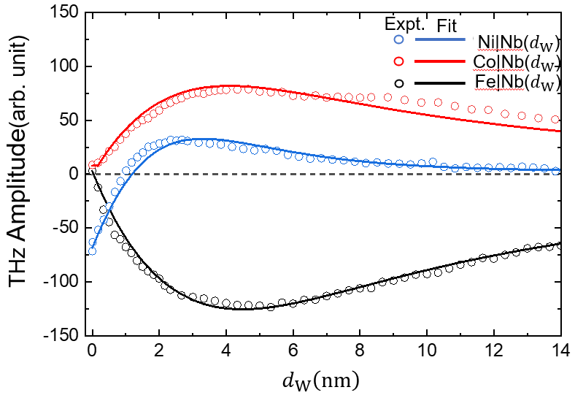
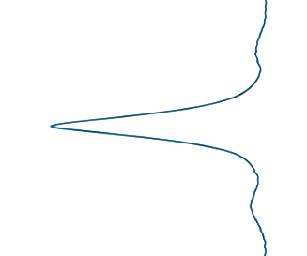
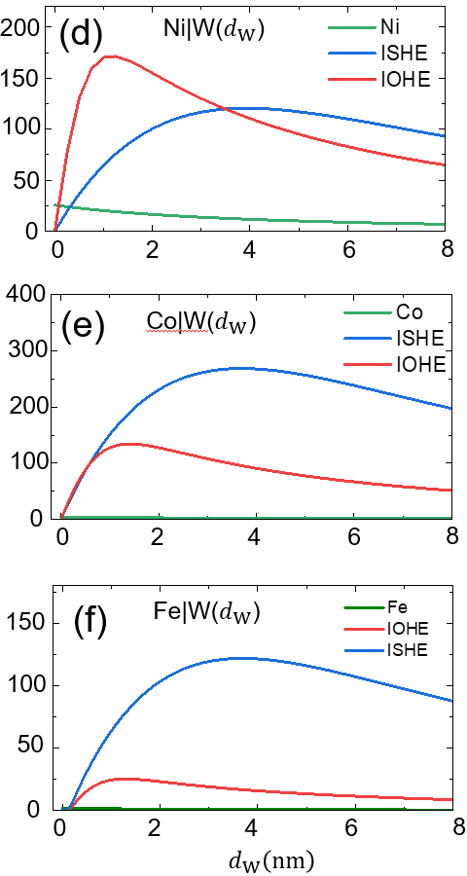
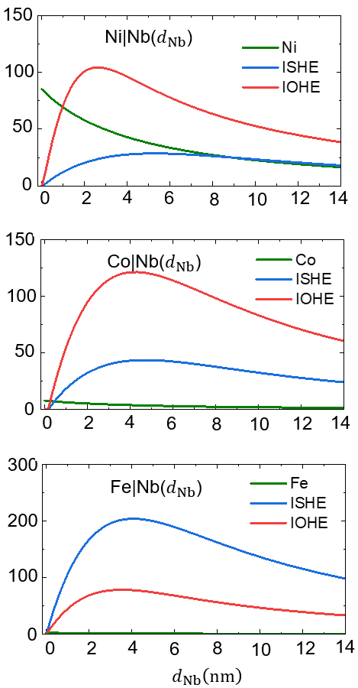
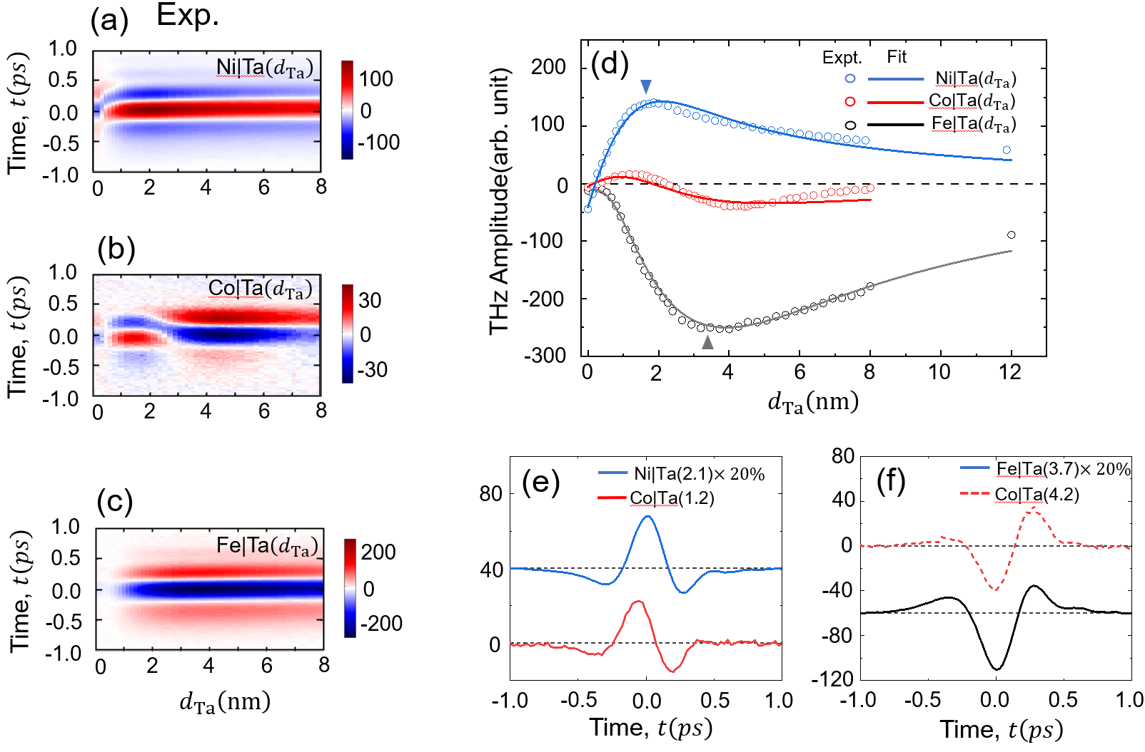
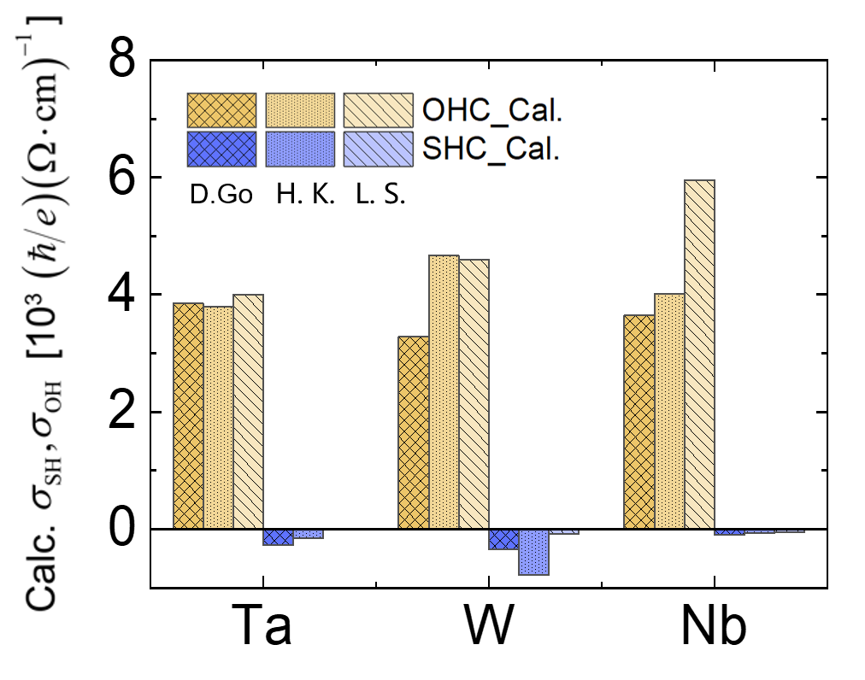
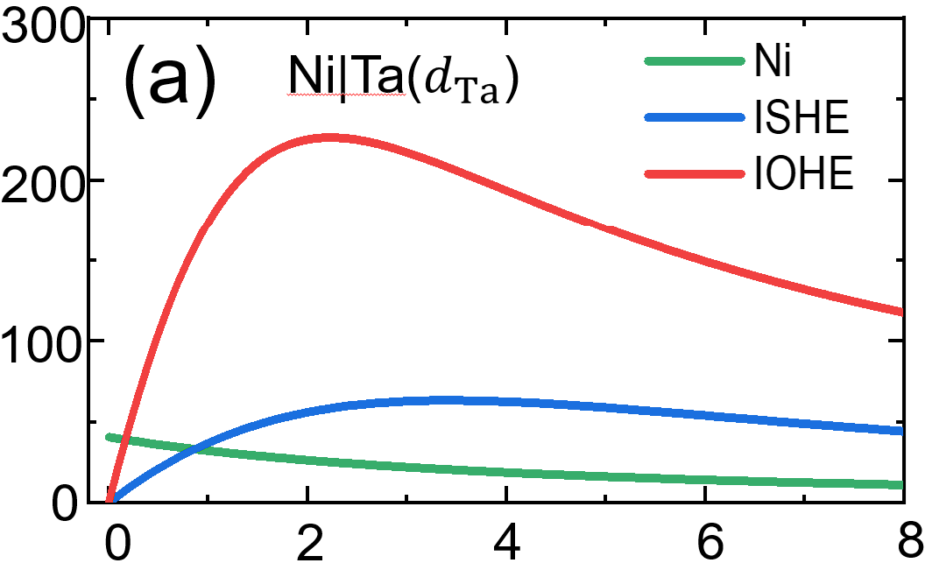
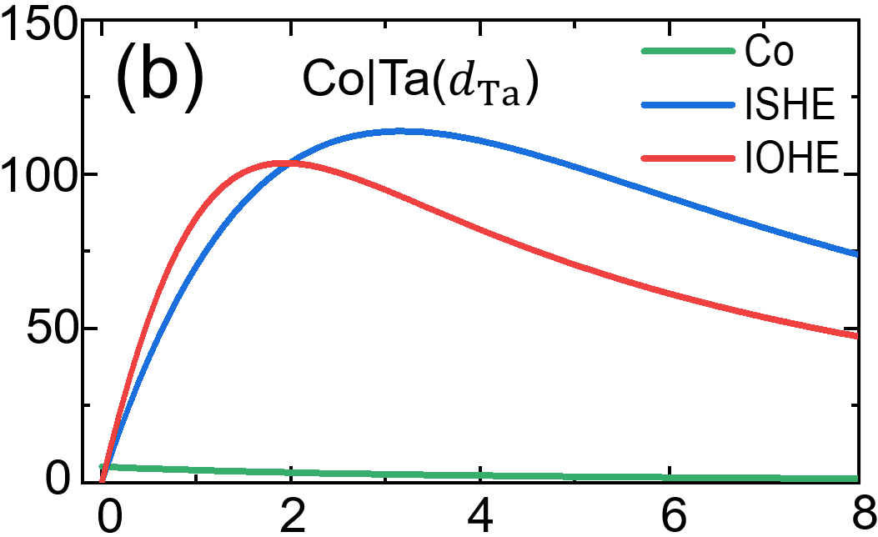
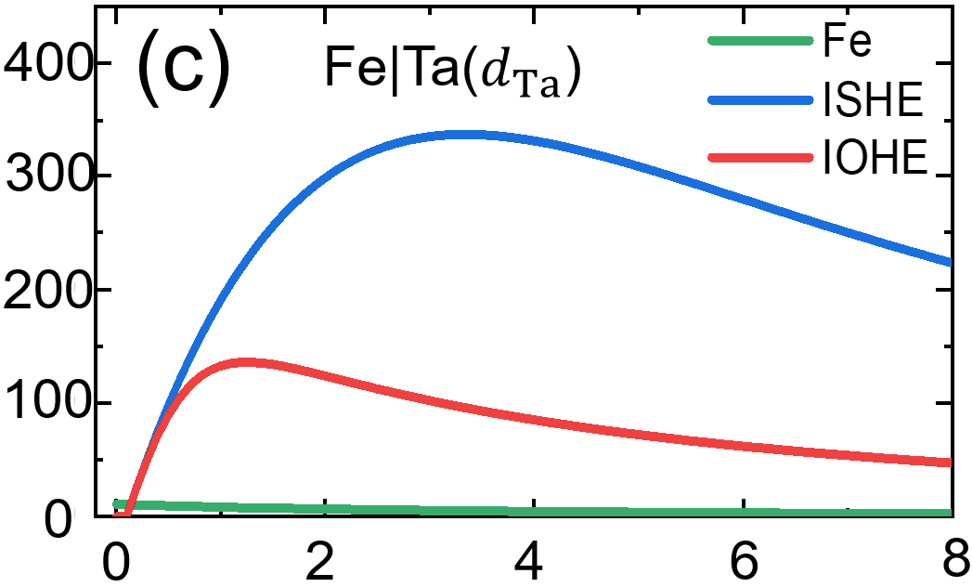
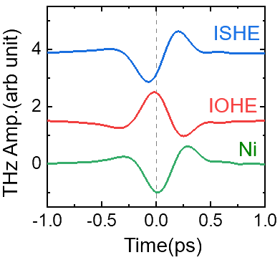













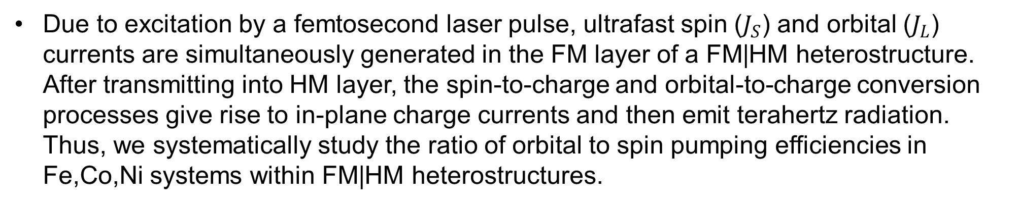



Orbital and Spin Pumping Efficiency in 3d Ferromagnetic Metal Fe Co Ni.
Tongyang Guan, Jiahao Liu, Yuxiao Mo, Yizheng Wu, Zhensheng Tao
¹State Key Laboratory of Surface Physics and Department of Physics and Key Laboratory of Micro and Nano Photonic Structures (MOE), Fudan University, Shanghai 200433, China.
2Shanghai Key Laboratory of Metasurfaces for Light Manipulation, Fudan University, Shanghai 200433, P R China.
E-mail address: wuyizheng@fudan.edu.cn; zhenshengtao@fudan.edu.cn.
Ⅰ Introduction
Wedge-shaped FM|HM heterostructure
3. Experimental Results of FM|W and FM|Nb heterostructure
$$\vec{E_{s}(t)}$$
$THz$ pulse
$$\vec{E_{L}(t)}$$
z
$$γ_{SH}$$
$$γ_{OH}$$
$$λ_{S}$$
$$λ_{L}$$
platform
wedge range
platform
$$d_{HM}$$
$$HM$$
$$d_{FM}$$
$$FM$$
$$\vec{B}$$
thickness scan
4. Fitting results of FM|W and FM|Nb heterostructure
130fs
1030nm
Due to excitation by a femtosecond laser pulse, ultrafast spin ($J_{S}$) and orbital ($J_{L}$) currents are simultaneously generated in the FM layer of a FM|HM heterostructure. After transmitting into HM layer, the spin-to-charge and orbital-to-charge conversion processes give rise to in-plane charge currents and then emit terahertz radiation. Thus, we systematically study the ratio of orbital to spin pumping efficiencies in Fe,Co,Ni systems within FM|HM heterostructures.
Abs. THz Amplitude (arb. unit)
Ⅱ Main Results
Experimental Results of FM|Ta heterostructure
5. The ratio of orbital to spin pumping efficiencies
Donfwook Go
Donfwook Go
Leandro Salemi
Leandro Salemi
$$\frac{a_{L}}{a_{S}}$$
H kontani
$$\frac{a_{L}}{a_{S}}$$
H kontani
FeTa
CoTa
NiTa
Donfwook Go
Leandro Salemi
2. Fitting results of FM|Ta heterostructure
$$\frac{a_{L}}{a_{S}}$$
H kontani
Abs. THz Amplitude (arb. unit)
$$d_{Ta}\left(nm\right)$$
[1] Lee, Dongjoon, et al. "Orbital torque in magnetic bilayers." Nature communications 12.1 (2021): 6710.
$E\left(t,d_{HM}\right)=A_{S}\left(d_{HM}\right)ℰ_{S}\left(t\right)+A_{L}\left(d_{HM}\right)ℰ_{L}\left(t\right)$
$+A_{FM}\left(d_{HM}\right)ℰ_{FM}\left(t\right)$
[2] Salemi, Leandro, and Peter M. Oppeneer. "Theory of magnetic spin and orbital Hall and Nernst effects in bulk ferromagnets." Physical Review B 106.2 (2022): 024410.
[3] Lee, Soogil, et al. "Efficient conversion of orbital Hall current to spin current for spin-orbit torque switching." Communications physics 4.1 (2021): 234.
Ⅲ Conclusion
In conclusion, we find that the orbital pumping efficiency follows the trend of Fe < Co < Ni. This trend is consistent with previous theoretical studies. This observation suggests that the mechanism underlying orbital current generation is likely correlated with the spin-orbit coupling (SOC) in ferromagnetic metals.
[1] Lee, Dongjoon, et al. "Orbital torque in magnetic bilayers." Nature communications 12.1 (2021): 6710.

