Slide 1



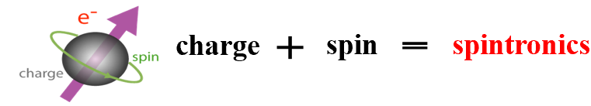
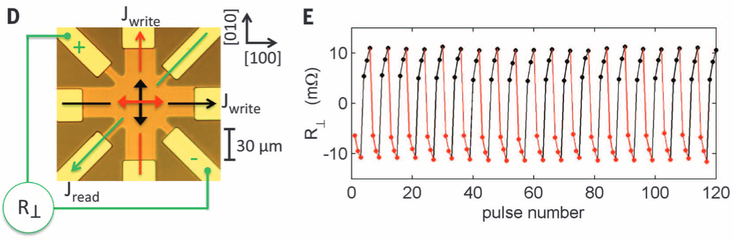
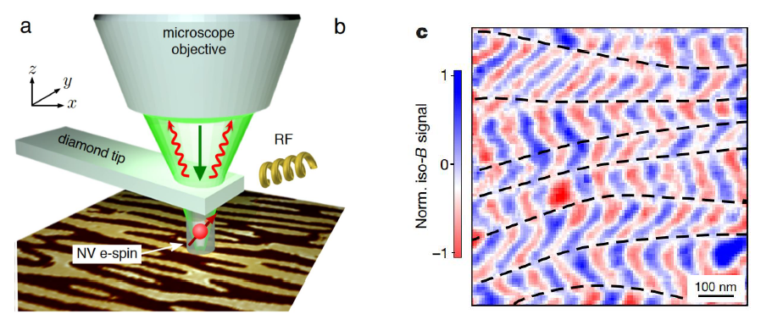
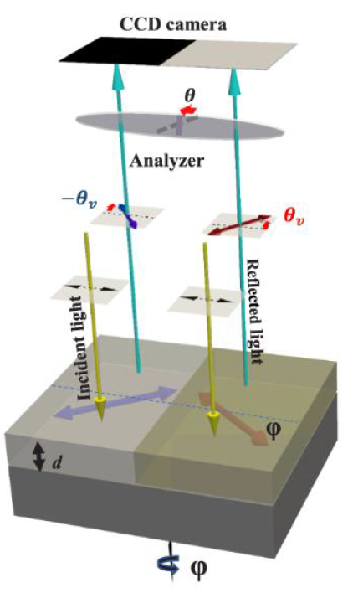
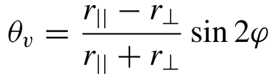
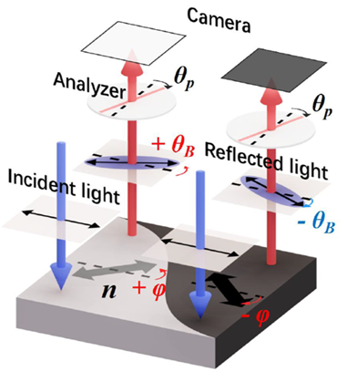
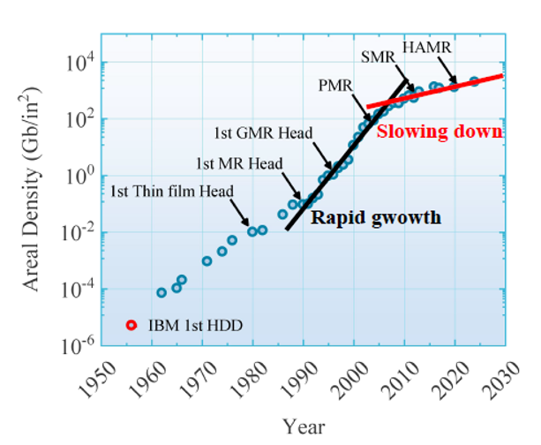
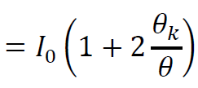
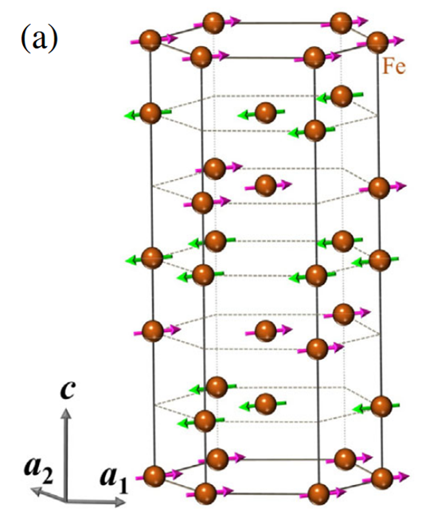
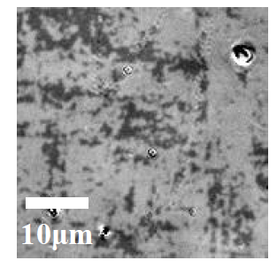
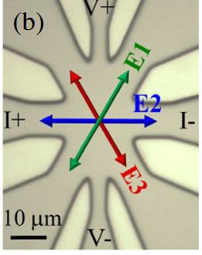
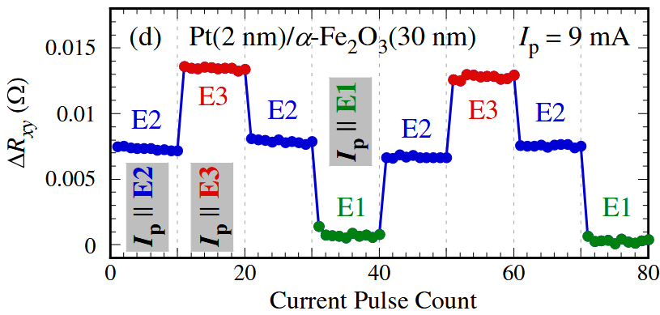
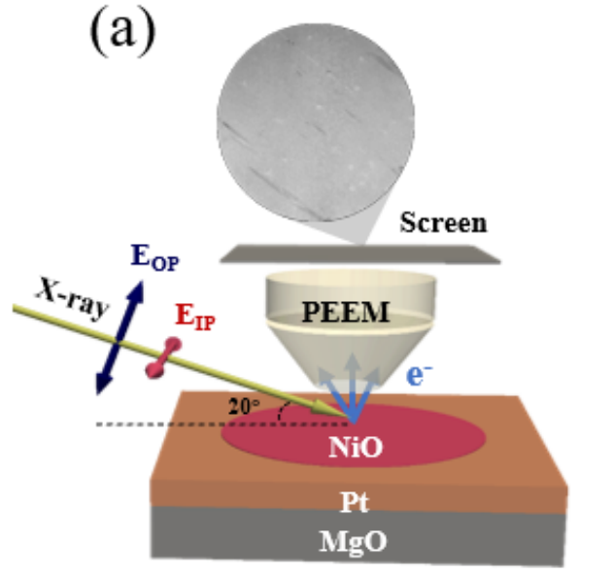
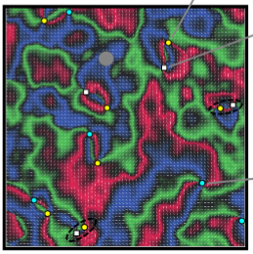
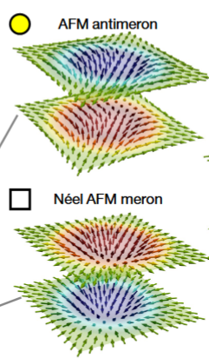
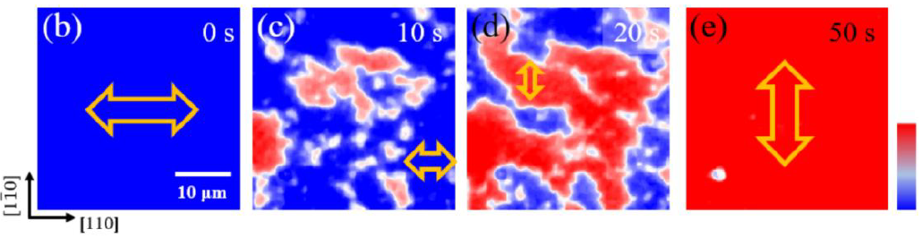
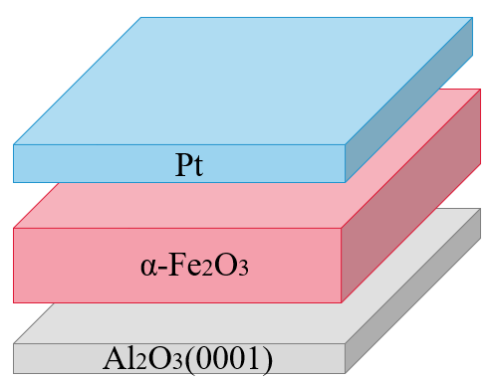
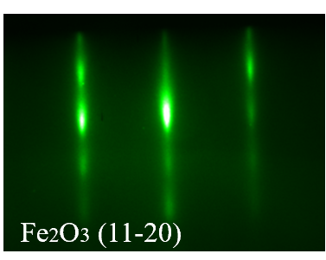
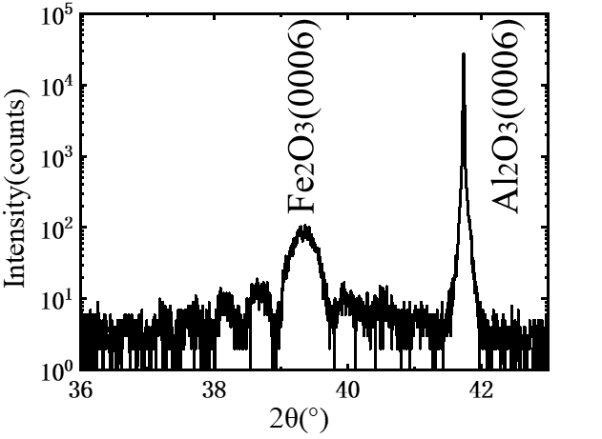
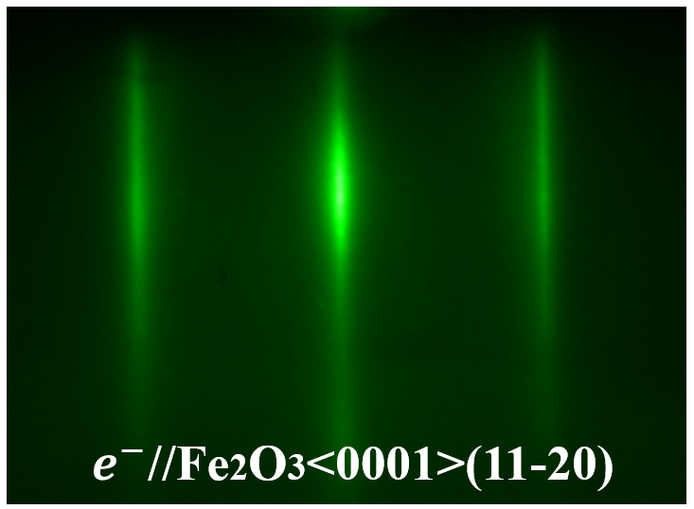
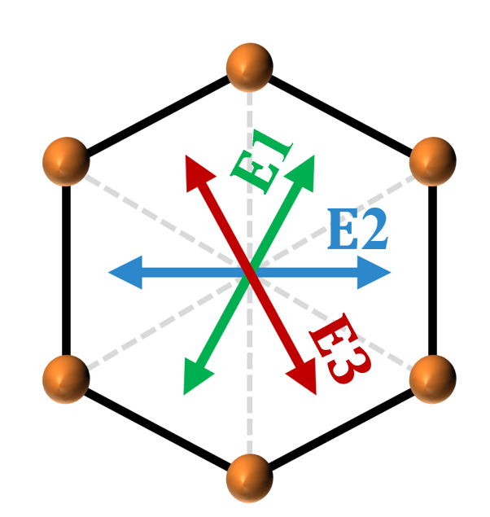
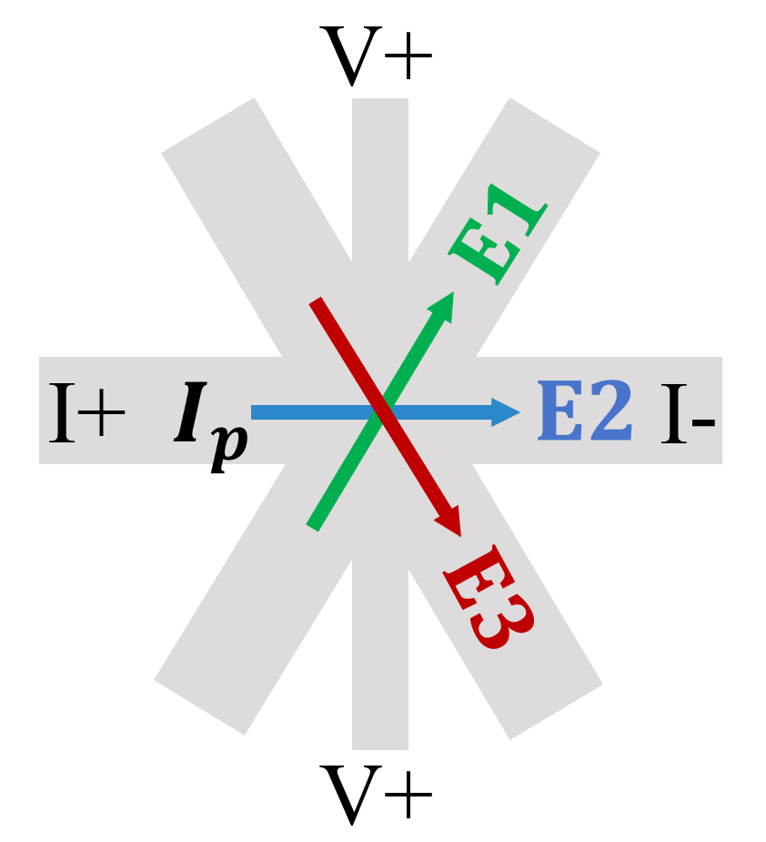
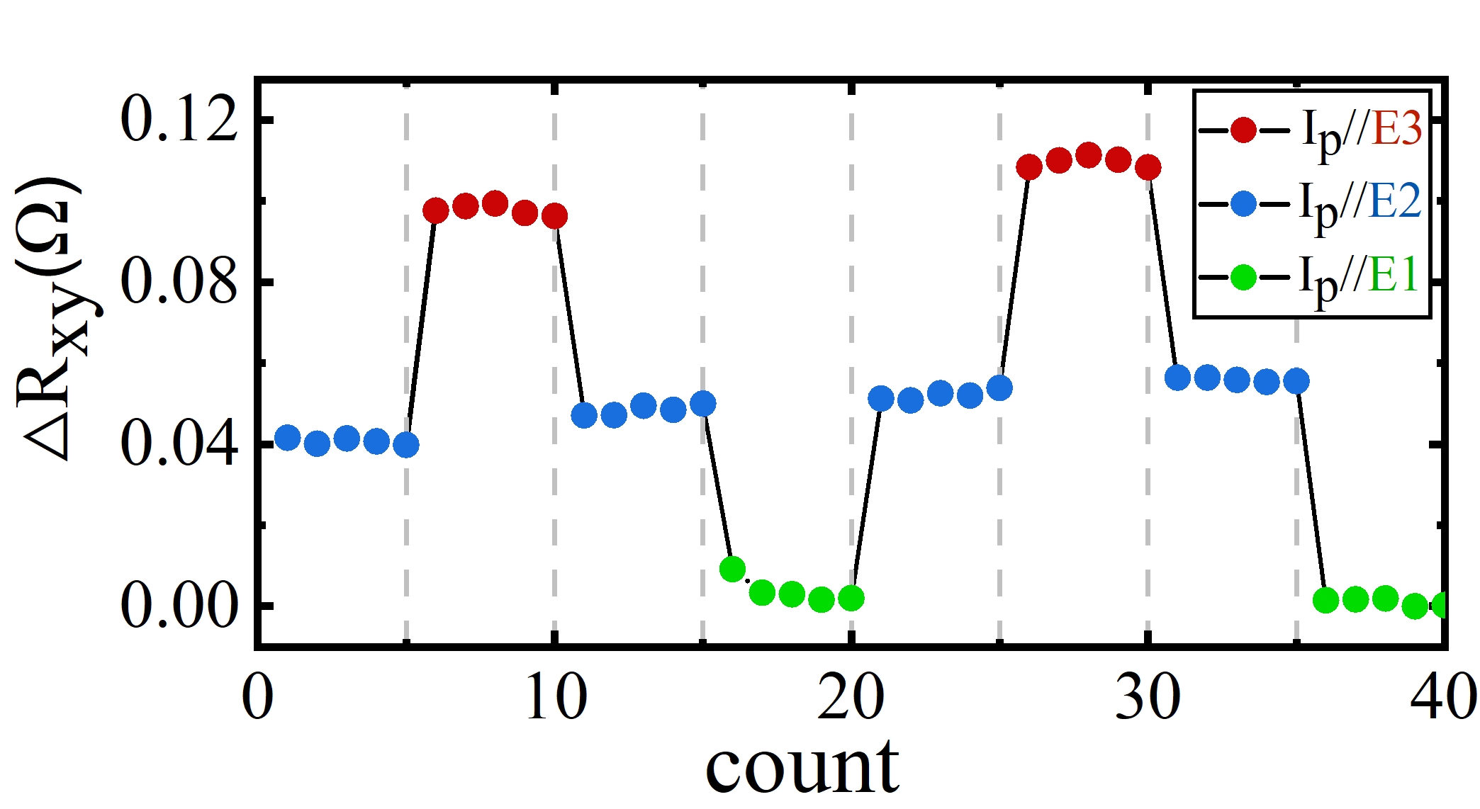
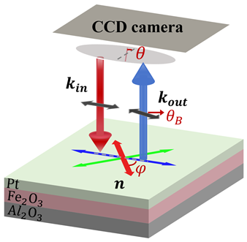
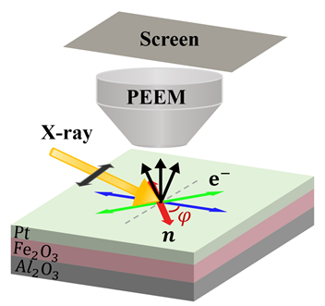
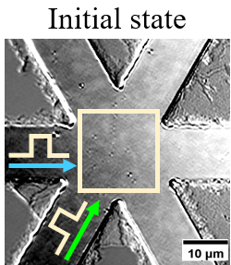
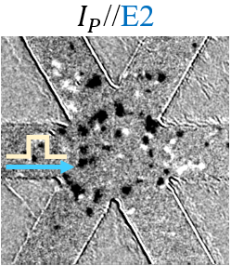
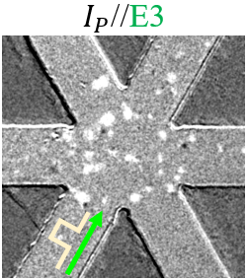
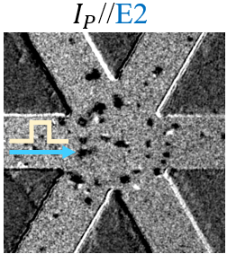
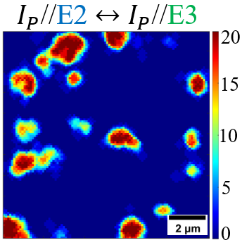
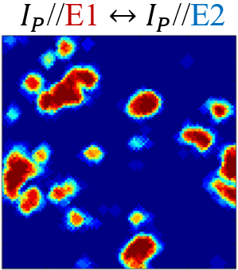
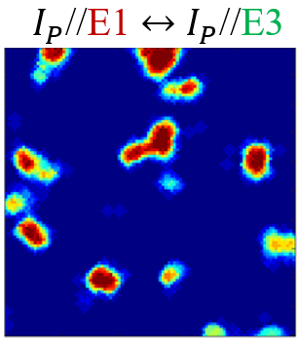
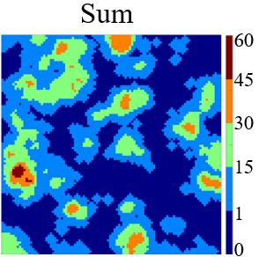
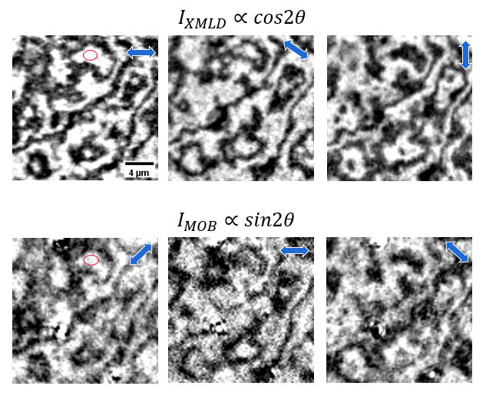
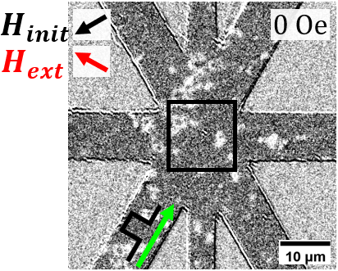
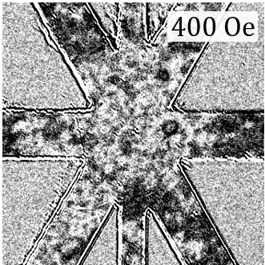
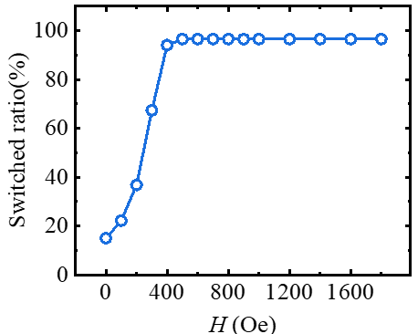
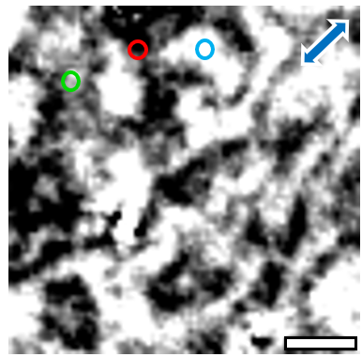
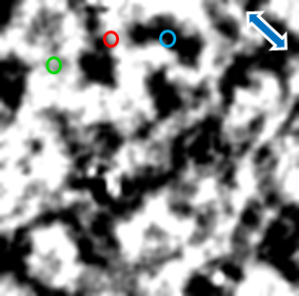
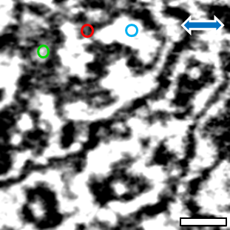
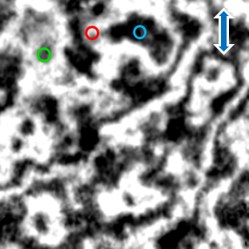
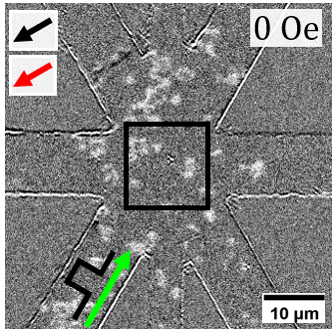
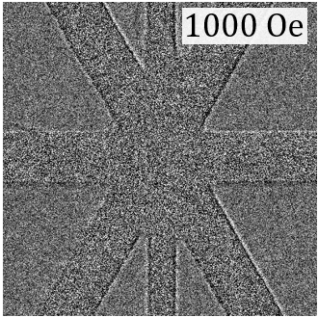
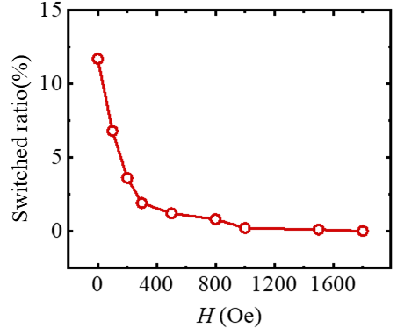
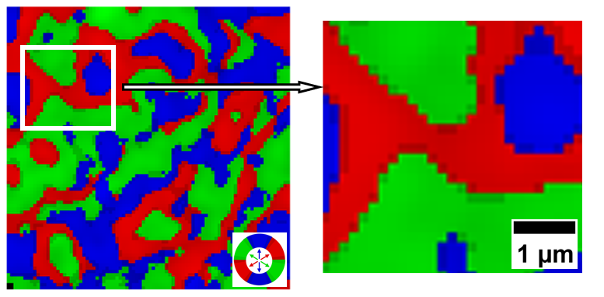
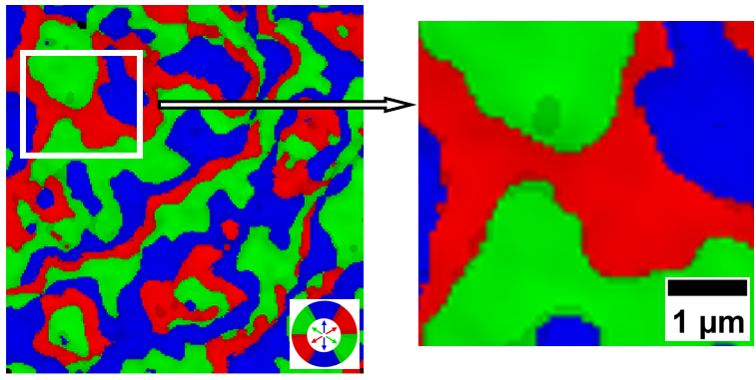


Imaging and Manipulating Antiferromagnetic Domains in α-Fe2O3
Meiqi Xiao, Tong Wu, Yizheng Wu*
Department of Physics, Fudan University,Shanghai,China
Motivetion
Antiferromagnetic
Spintronics
Switching of AFM domains
Imaging AFM domains
Imaging hematite domain based on MOB
_{AFM metals CuMnAs PHE}
_{NV-center microscopy}
_{Kerr microscopy MOB effect}
NiO
P. Wadley et al., Science 351, 587 (2016)
I. Gross et al., Nature 549, 252 (2017)
_{AFM insulators} _{/Pt SMR}
Fe2O3
_{XMLD-PEEM}
Magnetic-field-driven switching
Curious about switching behavior
MOB imaging experience
Compatible with magnetic fields
No stray fields
High-density storage
Ultrafast dynamic (THz)
High energy efficiency
CoO/Pt
Yang Cheng et al., PRL 124, 027202 (2016)
Hariom Jani et al., Nature 590, 74-79 (2021)
Jia Xu et al., Phys. Rev. L. 128, 137201 (2022)
Sample preparation and measurement
Domain wall motion
Sample structure
Structure characterization
Current-driven AFM domain switching
Electrical Switching of Tristate Antiferromagnetic Neel Order
        _{AFM/HM bilayer}
        High quality single crystal film
AFM domain changes in response to current pulses
Measurement
        Imaging AFM domain by MOB and XMLD
Imaging of α-Fe2O3 domain
Mapping of Neel vector order
Magnetic-Field-Assisted Modulation
Calculating the Néel vector axis from images with rotated sample
MOB
$$I_{asy}∝sin2φ$$
XMLD
$$I_{asy}∝cos2φ$$
MOB
XMLD
Summary
Fe2O3 domains can be observed using Kerr microscopy.
Directly visualized how different current directions affect switching regions, revealing that pure current switching only reaches ~60%.
Small in-plane magnetic field significantly enhances switching efficiency, and demonstrates dual modulation by field direction.
MOB and XMLD results are consistent.
Notes:
与铁磁体相比，AFM 自旋动力学通常发生在更快的时间尺度上，并且相对不受磁场的影响。它们也不会生成宏观场。这使得它们既有很好的自旋电子学应用前景又具有挑战性。反铁磁畴的操控和读取是反铁磁自旋电子学中的核心问题。尽管如此，据报道，在AFM薄膜中使用电子传输特征（例如霍尔效应）来推断畴重新定向的电流诱导开关[5\u201214]。显微镜已被用于研究金属AFM中的结构域切换[17,18]，但关于绝缘AFM的此类研究的报道很少。因此，获得有关 AFM 对电脉冲响应的更直接信息对于促进对其自旋动力学的理解至关重要

