Slide 1
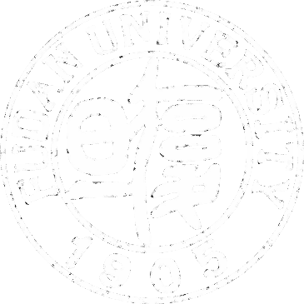
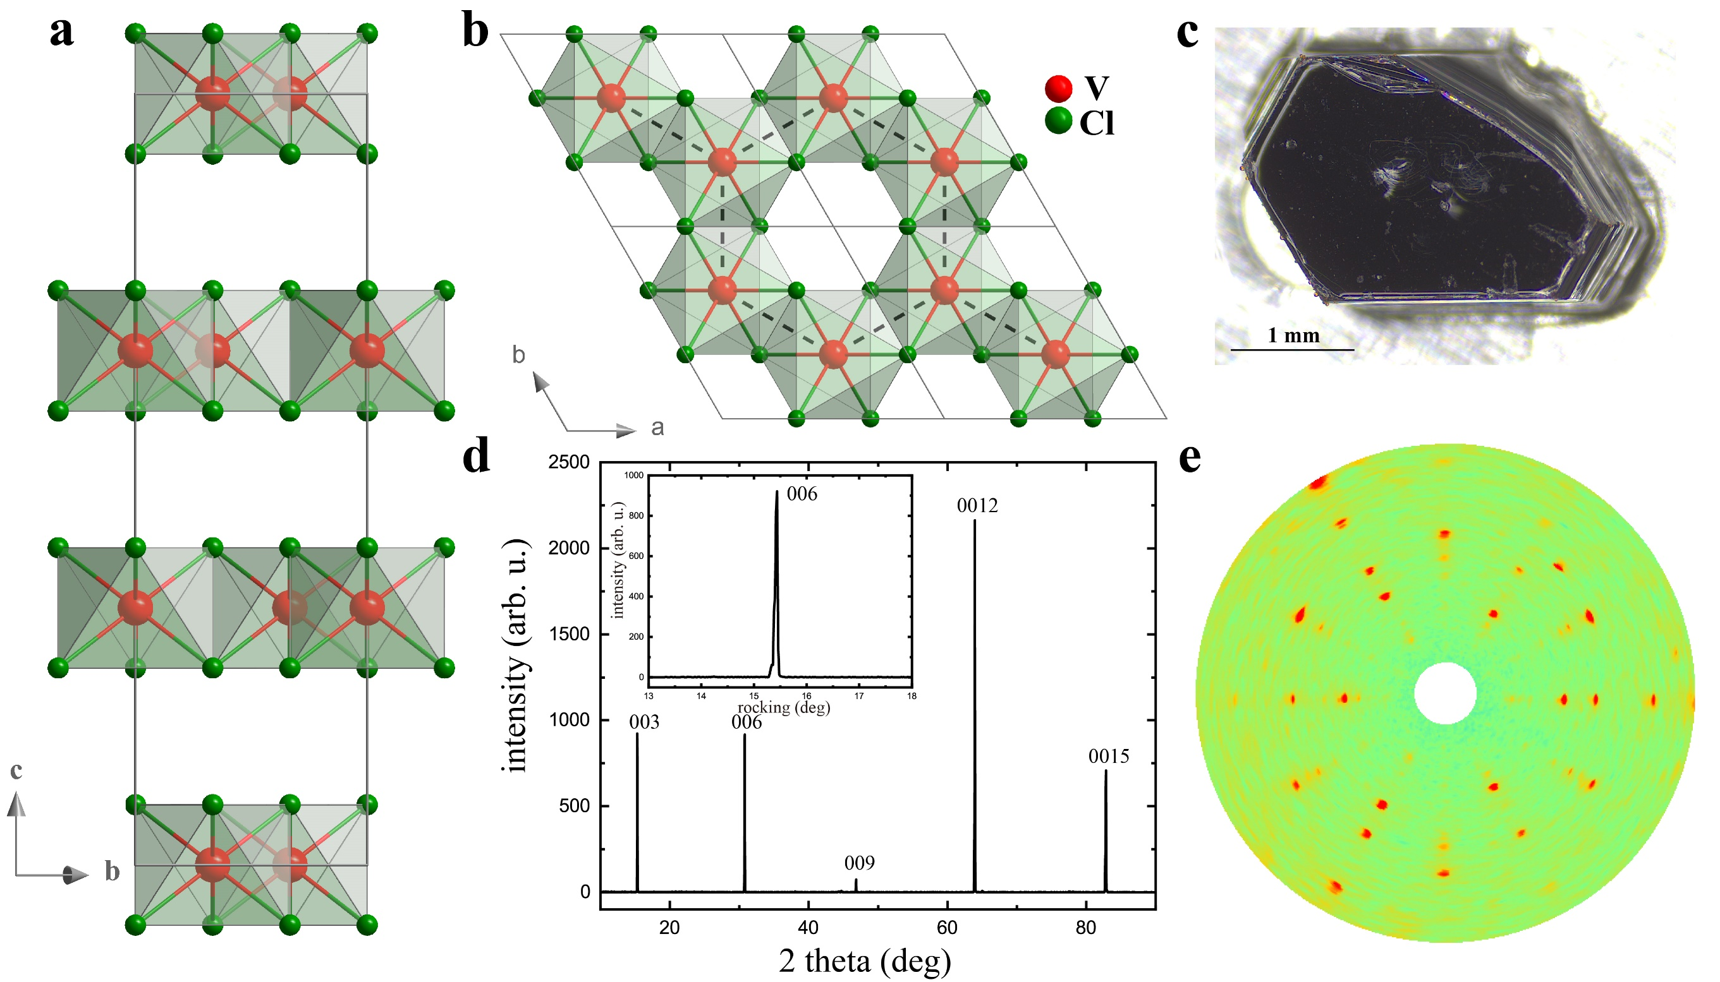
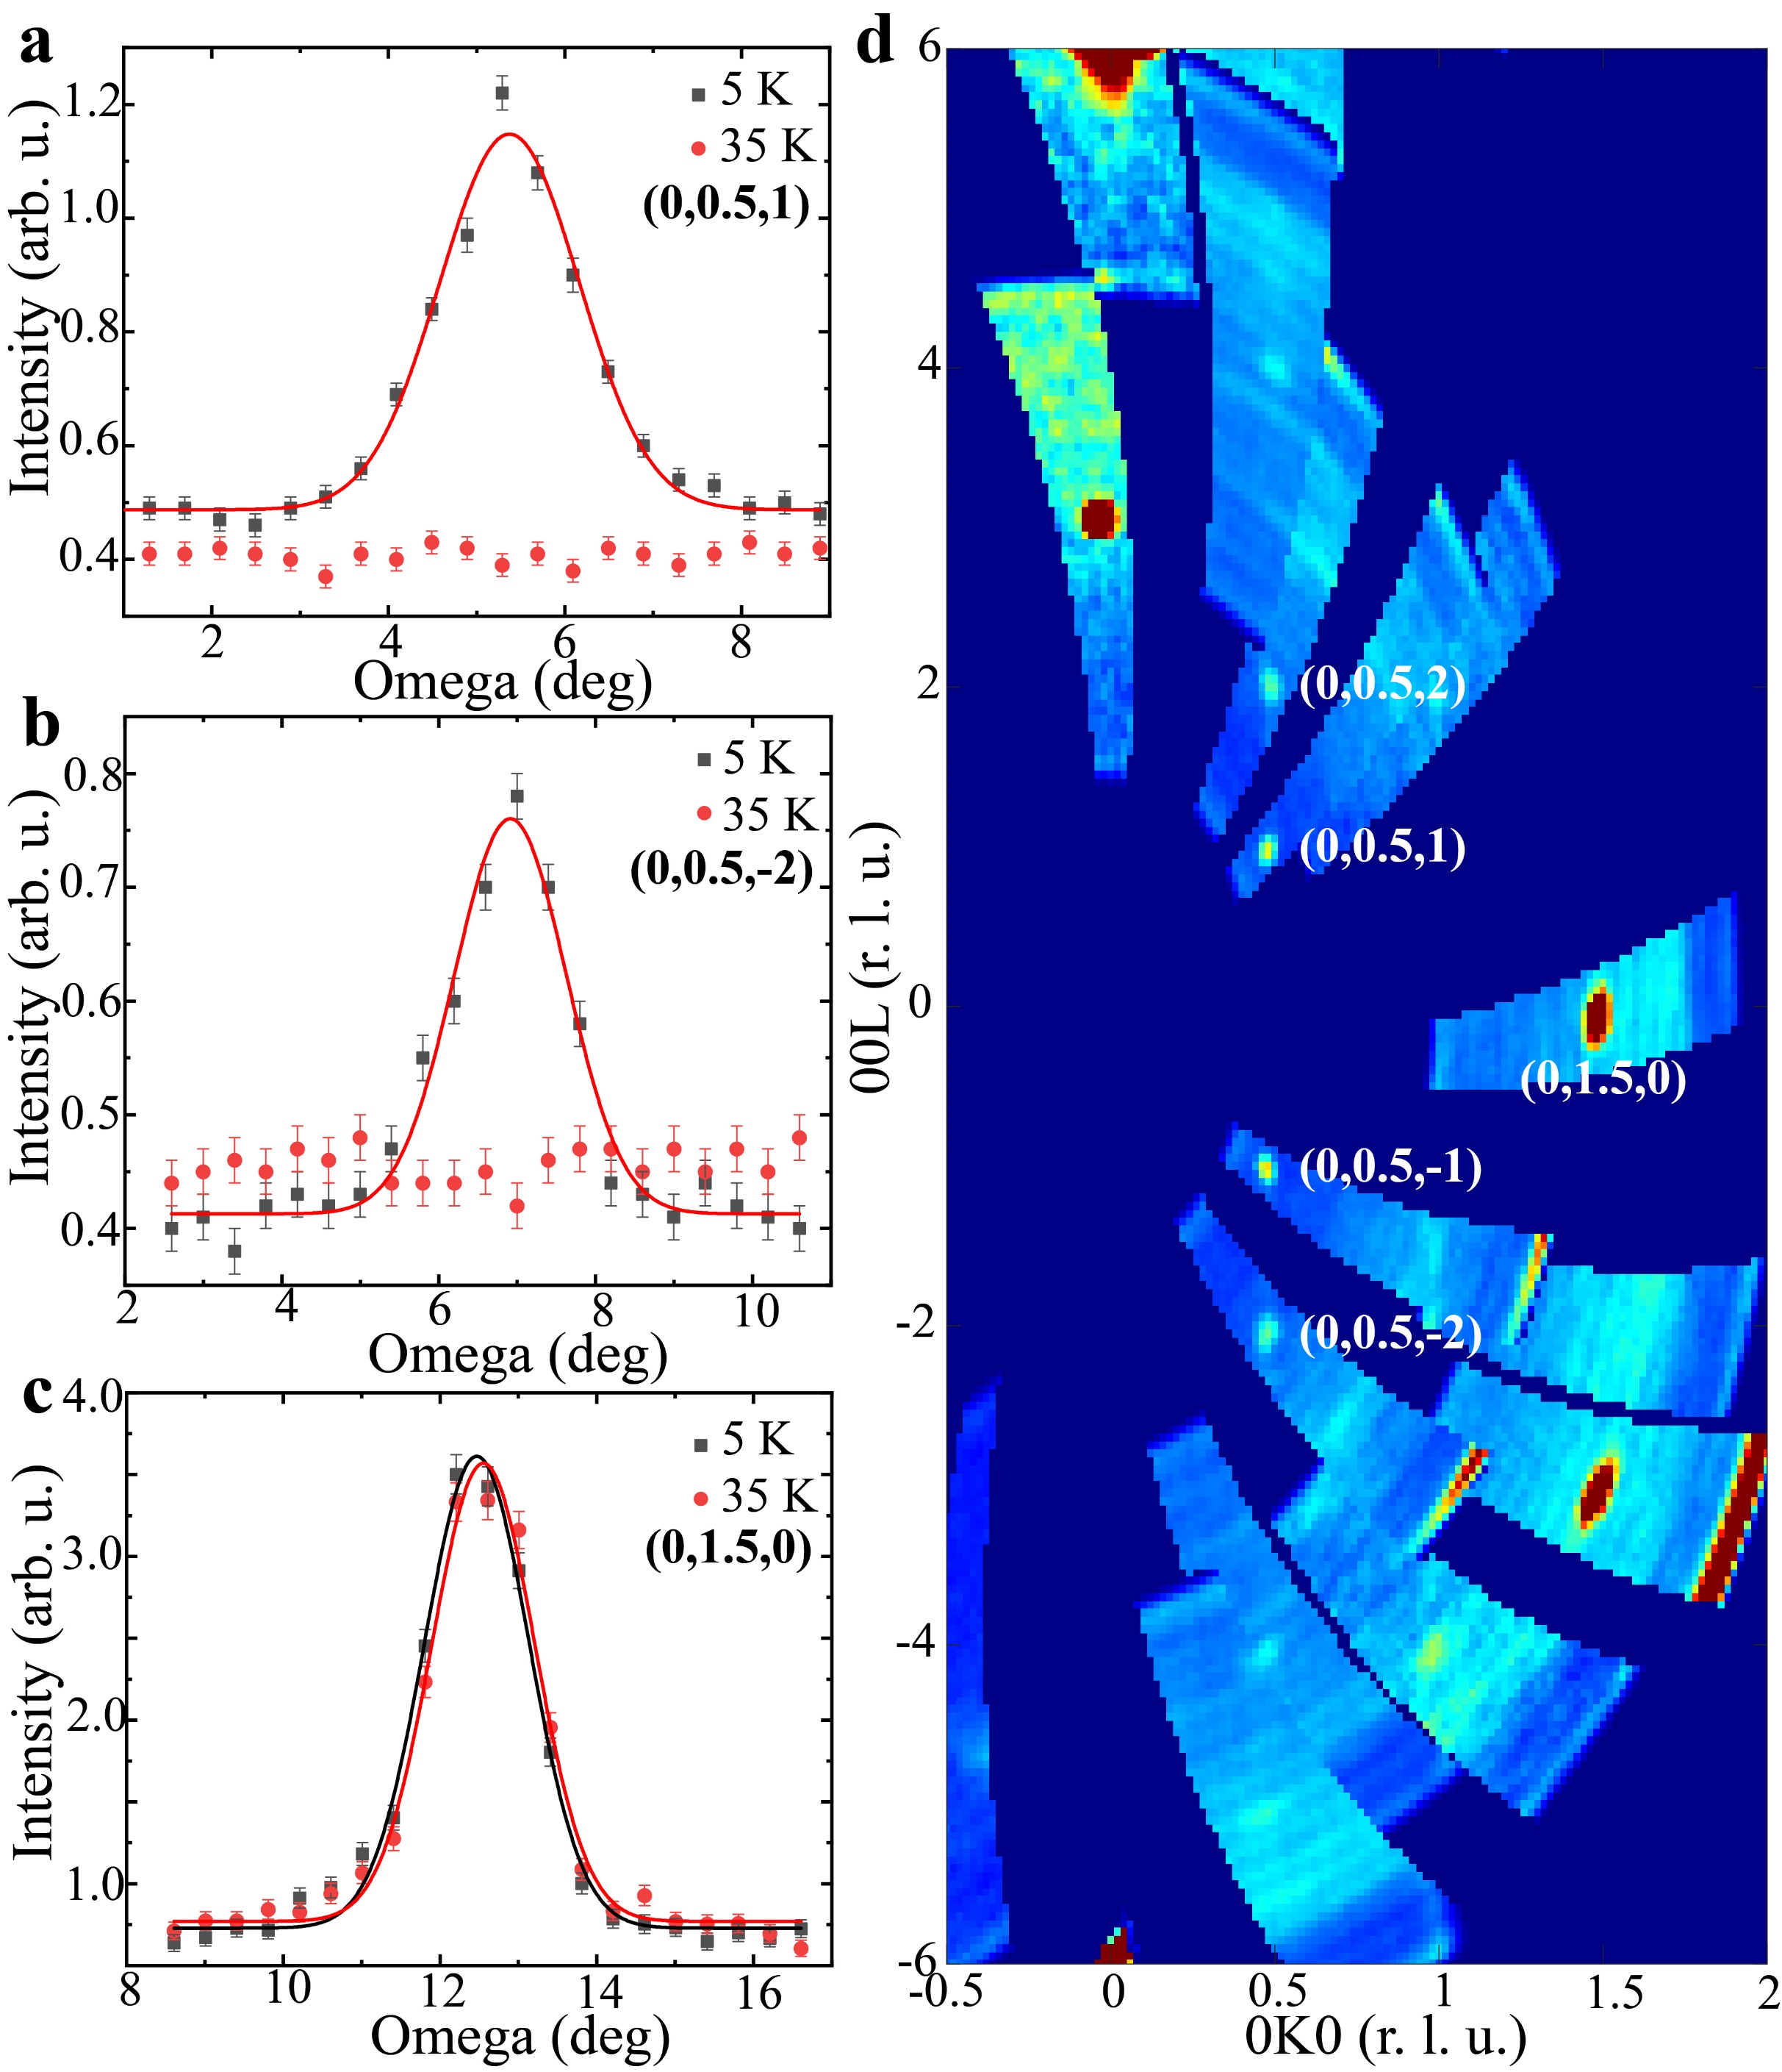
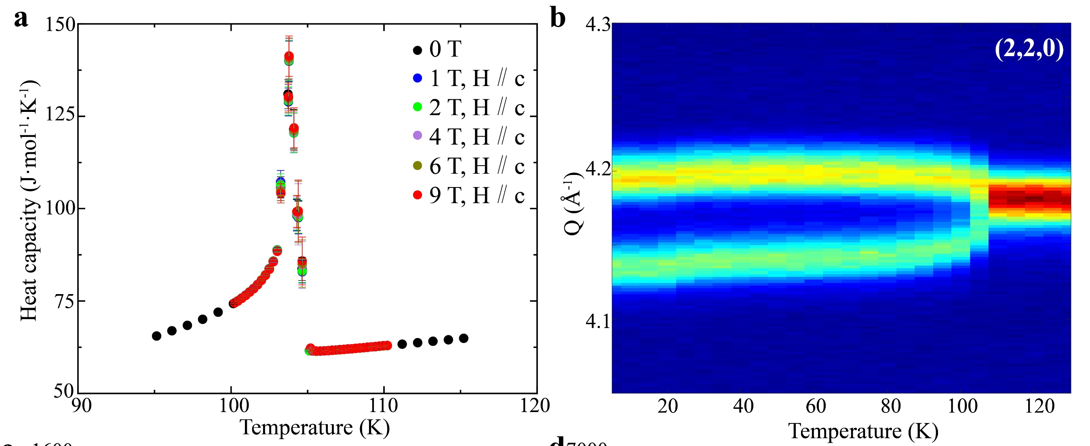
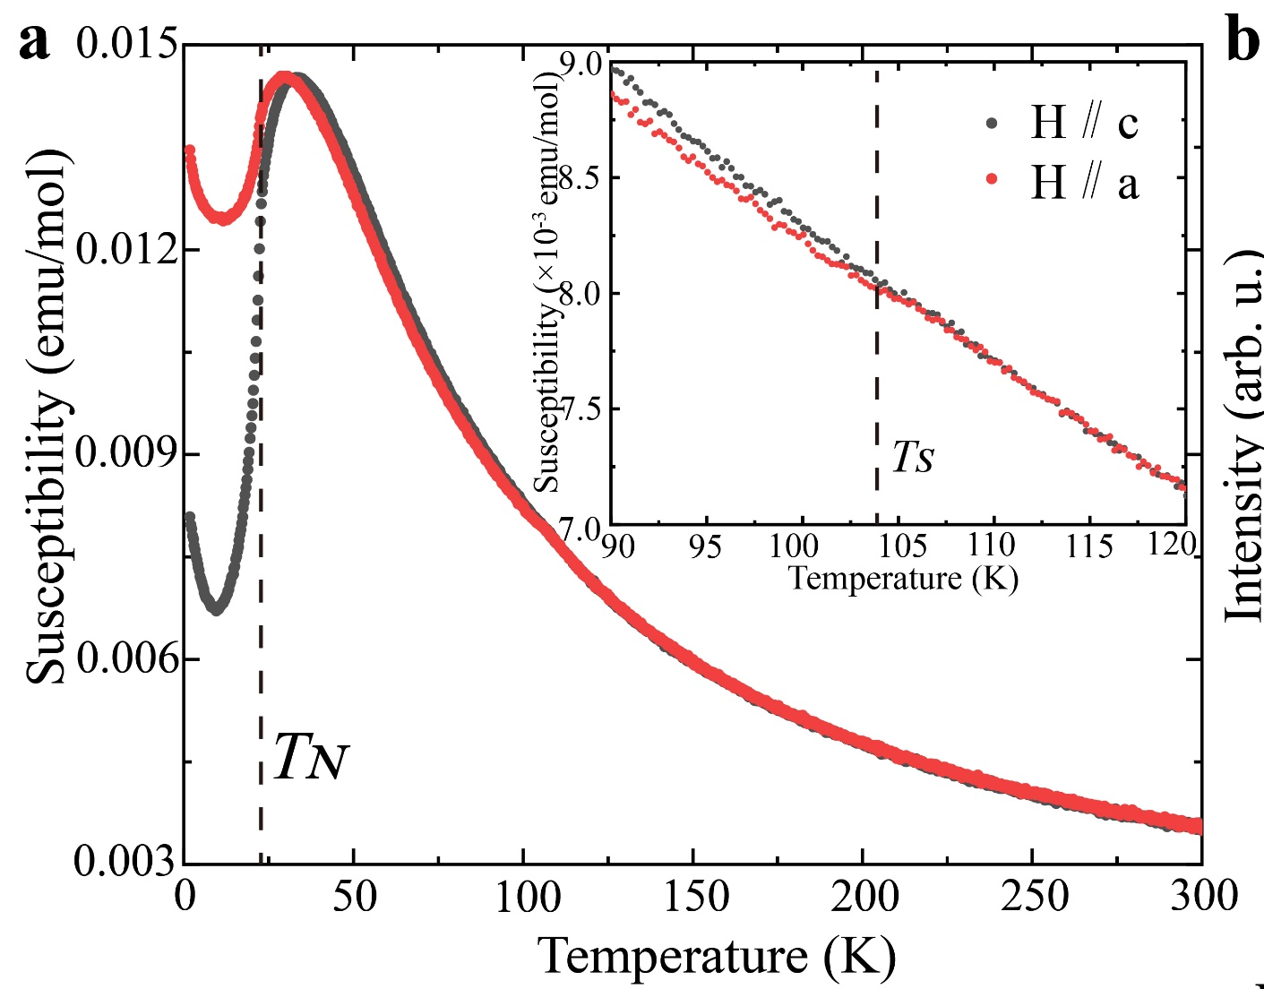
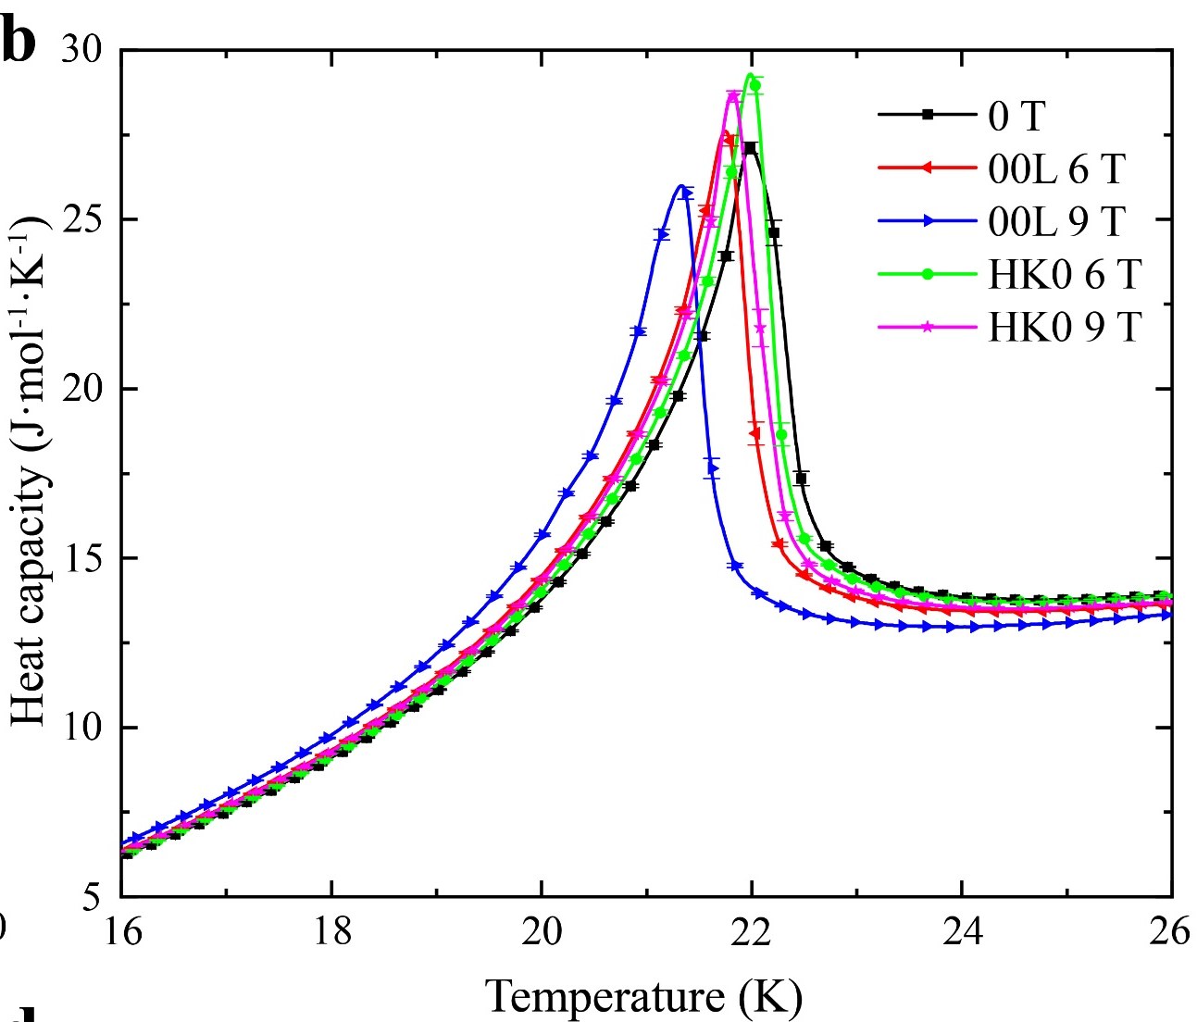
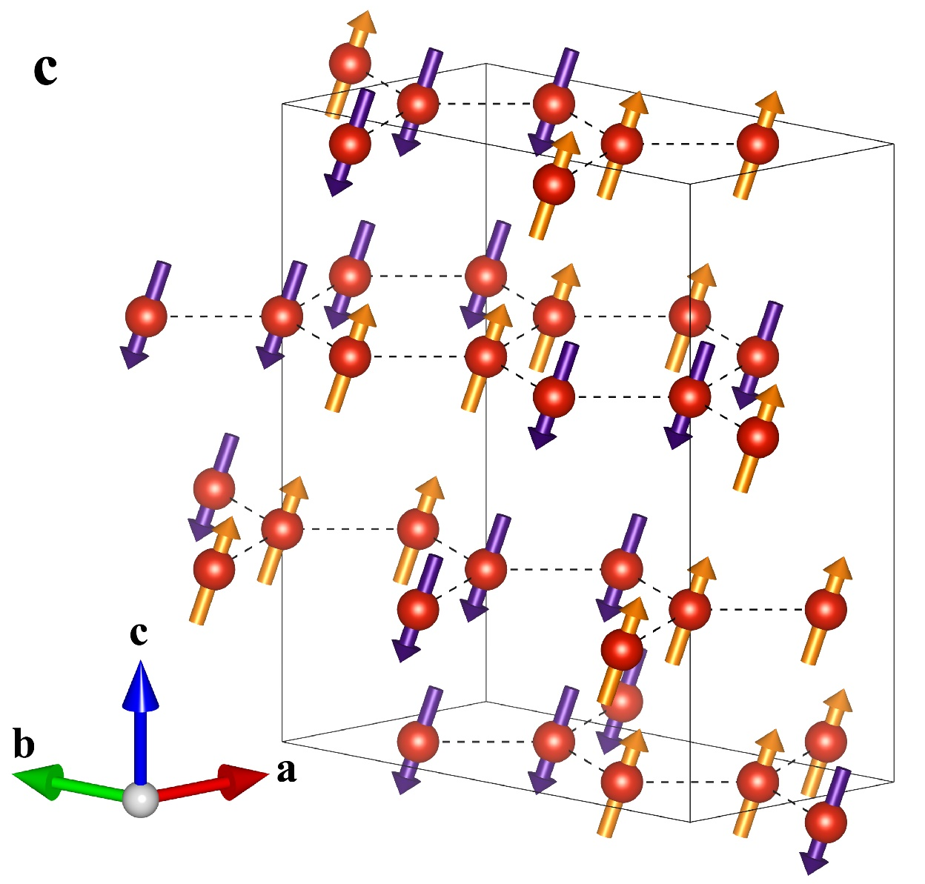

Magnetic Order in the van der Waals magnet VCl₃
Zeyu Kao,¹ Yiqing Hao,² Yimeng Gu,¹ Lixing Chen,¹ Enkang Zhang,¹ Hao Zhang,¹ Fabio Orlandi,³ Pascal Manuel,³
Junfeng Wang,⁴ Chao Dong,⁴ Chuanying Xi,⁵ Zefeng Chen,⁶ Changsong Xu,⁶ and Jun Zhao^{1,7,*}
¹State Key Laboratory of Surface Physics and Department of Physics, Fudan University, Shanghai 200433, China
²Neutron Scattering Division, Oak Ridge National Laboratory, Oak Ridge, Tennessee 37831, USA
³ISIS Pulsed Neutron and Muon Source, Science and Technology Facility Council, Rutherford Appleton Laboratory, Harwell Campus, Didcot OX11 0QX, United Kingdom
⁴Wuhan National High Magnetic Field Center and School of Physics, Huazhong University of Science and Technology, Wuhan 430074, China
⁵Anhui Key Laboratory of Low-Energy Quantum Materials and Devices, High Magnetic Field Laboratory, HFIPS, Chinese Academy of Sciences, Hefei, Anhui 230031, China
⁶Key Laboratory of Computational Physical Sciences (Ministry of Education), Institute of Computational Physical Sciences, State Key Laboratory of Surface Physics, and Department of Physics, Fudan University, Shanghai 200433, China
⁷Institute of Nanoelectronics and Quantum Computing, Fudan University, Shanghai 200433, China
Abstract
VCl₃ is a newly synthesized layered van der Waals magnet in the vanadium trihalide family. Using high-quality single crystals, we combined thermodynamic measurements, magnetization, and single-crystal neutron diffraction to determine its structural and magnetic properties. VCl₃ crystallizes
crystallizes in a BiI₃-type structure at room temperature and undergoes a structural phase transition at T_{S} = 103.7 K, followed by antiferromagnetic ordering below T_{N} = 21.8 K. Neutron diffraction identifies a zigzag antiferromagnetic ground state with propagation vector k = (0, 0.5, 1). The ordered V³⁺ moments are mainly oriented along the c axis but are canted by about 21° toward the a axis, giving a total ordered moment of 1.09 μ_{B} per V³⁺. Field-dependent magnetization reveals strong anisotropy and a plateau-like feature near half magnetization for fields along the c axis, indicating an unconventional field-induced magnetic phase. These findings establish VCl₃ as a promising platform for exploring anisotropic magnetism and field-tunable phases in vanadium-based honeycomb magnets.
Single crystal structure
Neutron diffraction taken on single crystal VCl₃ at HB-3A, HFIR.
(a)
(b)
(c)
(a)
(d)
(d)
(e)
(b)
Schematic illustrations of the crystal structure of VCl₃ viewed along the (a) a axis and (b) c axis. (c) Photograph of a high-quality VCl₃ single crystal. (d) X-ray diffraction pattern of the cleaved surface measured at room temperature. The inset shows the rocking curve of the (0, 0, 6) reflection. (e) X-ray Laue diffraction pattern taken along the c axis.
(c)
Structural and magnetic phase transition
(a)
(b)
(a) and (b) A high- and low-temperature comparison of two representative inequivalent magnetic Bragg peaks, highlighting the emergence of magnetic intensity at low temperature. (c) Temperature comparison of the (0, 1.5, 0) peak, which shows negligible change, indicating that the signal is a spurious reflection arising from half-wavelength neutrons rather than a magnetic origin. (d) Neutron diffraction mapping of the (0, K, L) reciprocal plane at the base temperature obtained on HB-3A, ORNL, revealing a distinct set of magnetic Bragg peaks.
(c)
(d)
Magnetic structure and magnetization measurement
(a)
(b)
(a) Heat capacity measured from 95 to 115 K as a function of temperature. (b) Temperature dependence of the Bragg peak (2, 2, 0). The heat map was generated using raw data from scans of the (2, 2, 0) peak at temperatures ranging from 5 to 130 K with an interval of 5 K. (c) Magnetic susceptibility measured from 1.8 to 300 K under an external field of 500 Oe. The inset provides a zoomed-in view of the structural phase transition. (d) Low-temperature heat capacity under external magnetic fields along the c axis and a axis.
(a) Overall illustration of the zigzag antiferromagnetic structure of VCl₃ as determined by least squares refinement. The total ordered moment is 1.09(2) µ_{B}. (b) Magnetization curve obtained from laboratory-based vibrating sample magnetometry (VSM), steady high magnetic field measurements (SF), and pulsed field experiments (PF) under external magnetic fields along the c axis and a axis. The inset shows the raw derivative data from the pulsed field measurement, where a clear two-step transition is observed.
Zeyu Kao, et al. Phys. Rev. B 113, 094428 (2026). (Editors’ Suggestion）

