Slide 1
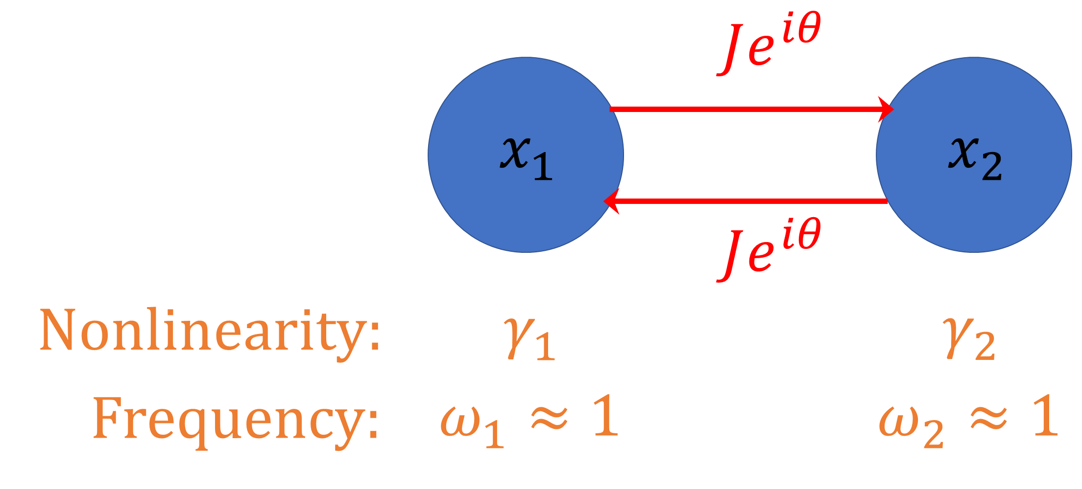
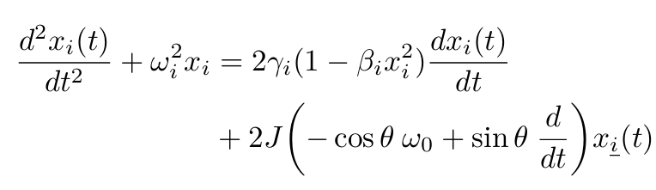
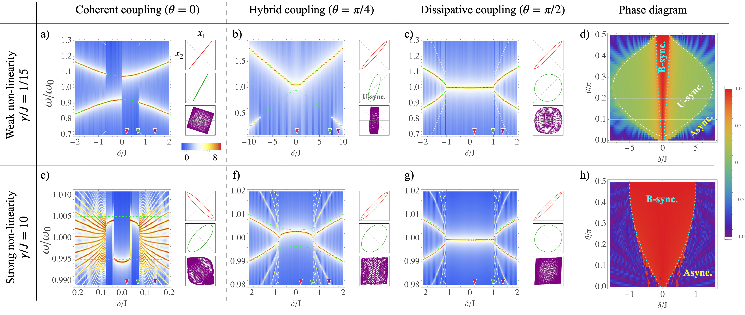
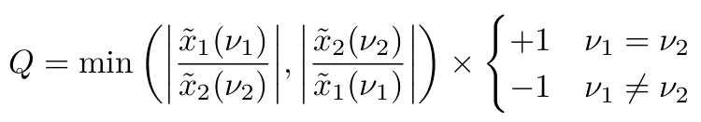
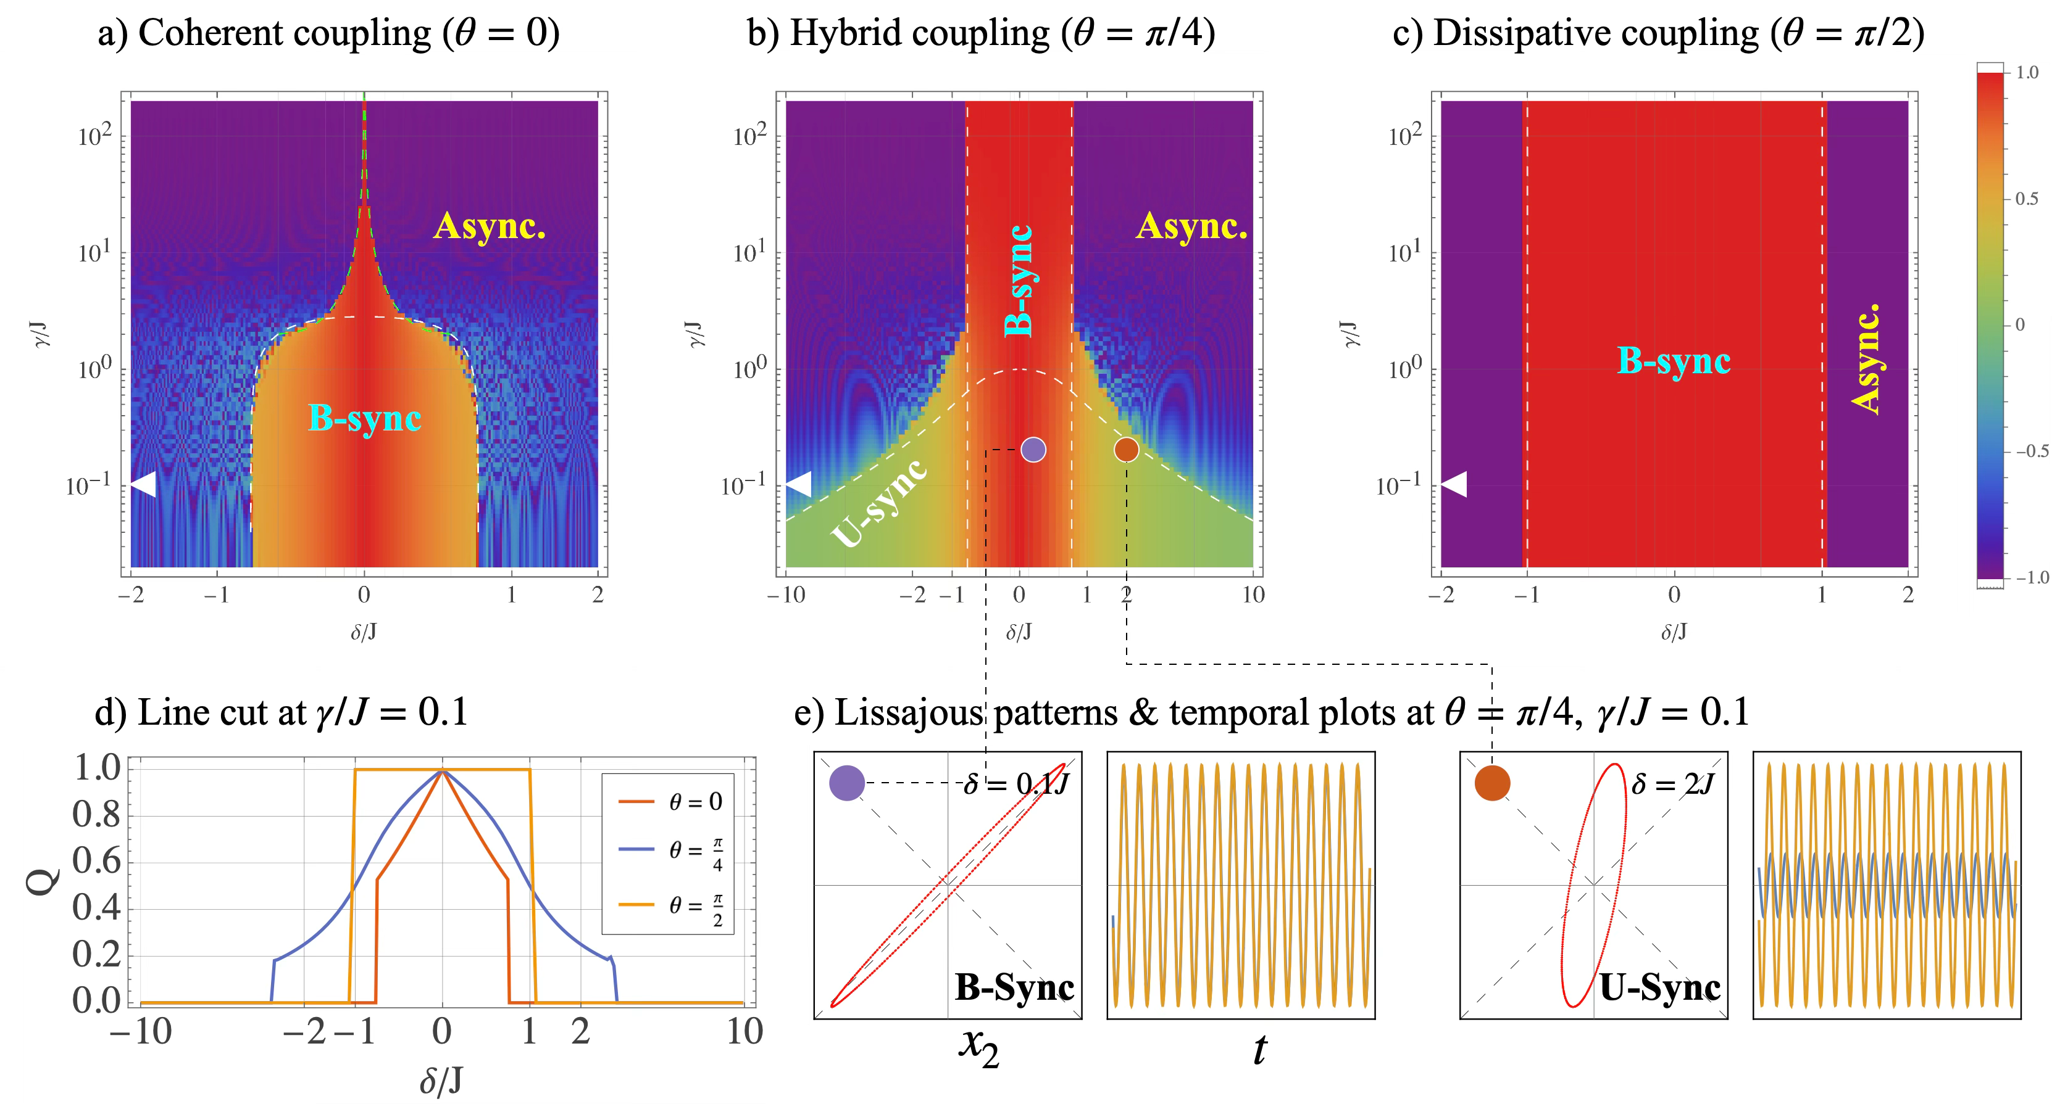
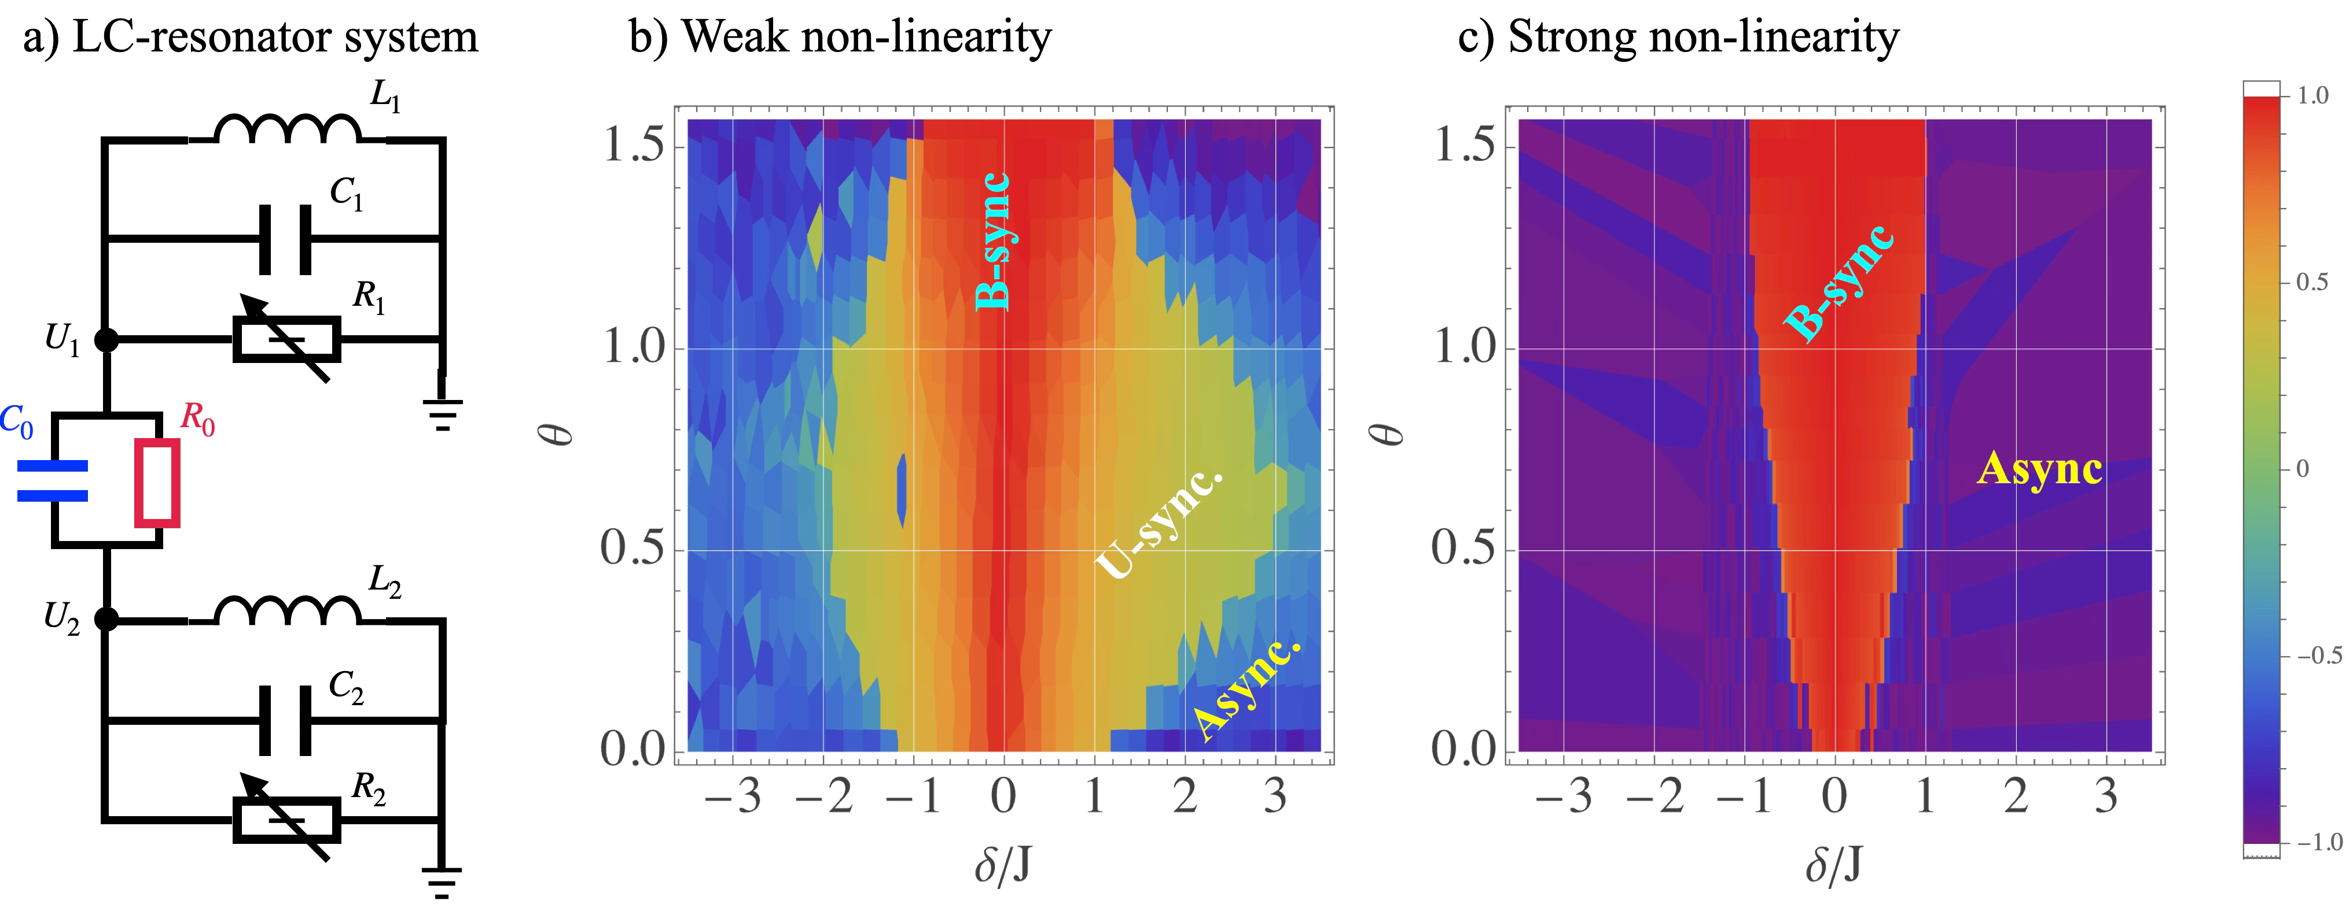


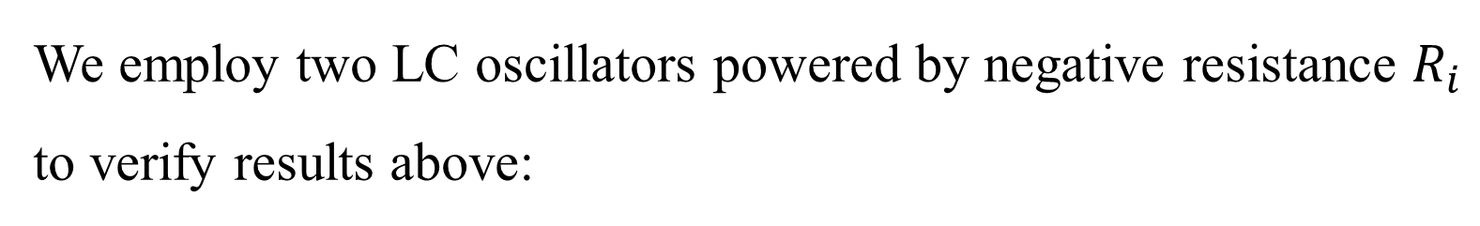
Synchronization Enhancement by Dissipative Coupling
Jiongjie Wang, ^{1,}* Xiangshan Zeng, ^{1,}* and Jiang Xiao^{1 †}
1 Department of Physics and State Key Laboratory of Surface Physics, Fudan University, Shanghai 200433, China
† xiaojiang@fudan.edu.cn
Abstract
Model
For a system of two weakly coupled Van der Pol oscillators:
dissipative coupling yields a substantially wider synchronization window than coherent coupling
hybrid coherent–dissipative coupling can extend this window even further in weak nonlinearity case, albeit with synchronized states of unequal amplitudes
Simulation Results
Sync. Window
Lissajous patterns
Sum spectra $S\left(ω\right)=\left|{\tilde{x}}_{1}\left(ω\right)\right|+\left|{\tilde{x}}_{2}\left(ω\right)\right|$ for weak (a–c) and strong (e–f) nonlinearity.
The phase diagram of synchronization quality $Q$ for weak (d) and strong (h) nonlinearity.
Nonlinearity Impart
Experiment Verification
Detect the synchronization quality $Q$ as a function of $δ$ and $γ$:
We employ two LC oscillators powered by negative resistance $R_{i}$ to verify results above:
Reference
[1] J. K. Arkady Pikovsky, Michael Rosenblum, Synchronization.
A universal concept in nonlinear sciences, 1st ed., Cambridge
Nonlinear Science Series (Cambridge University Press, 2001).
[2] W. Yu, J. Wang, H. Y. Yuan, and J. Xiao, Phys. Rev. Lett. 123,227201 (2019).
[3] C.Lu, M.Kim, Y.Yang, Y.S.Gui, and C.-M.Hu, J.Appl.Phys. 134, 221101 (2023).
[4] A. P. Kuznetsov, N. V. Stankevich, and L. V. Turukina, Physica D: Nonlinear Phenomena 238, 1203 (2009).

