Slide 1
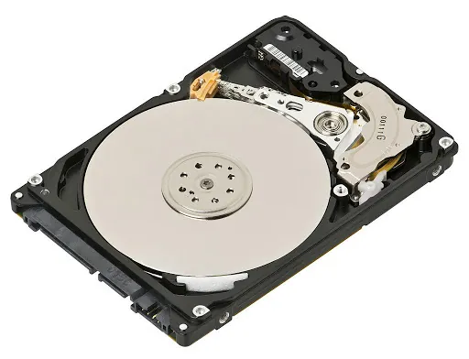
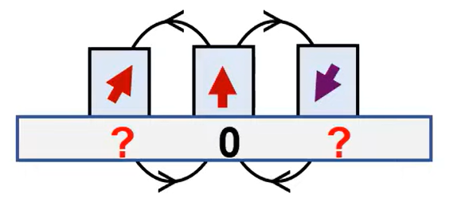
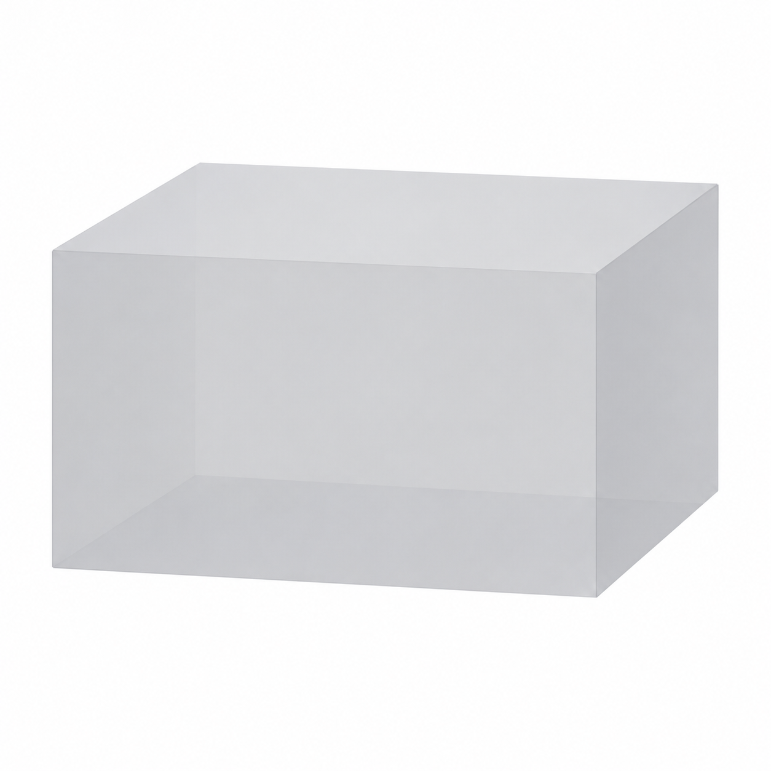
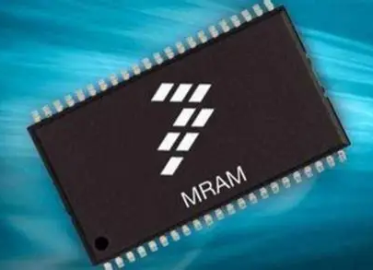

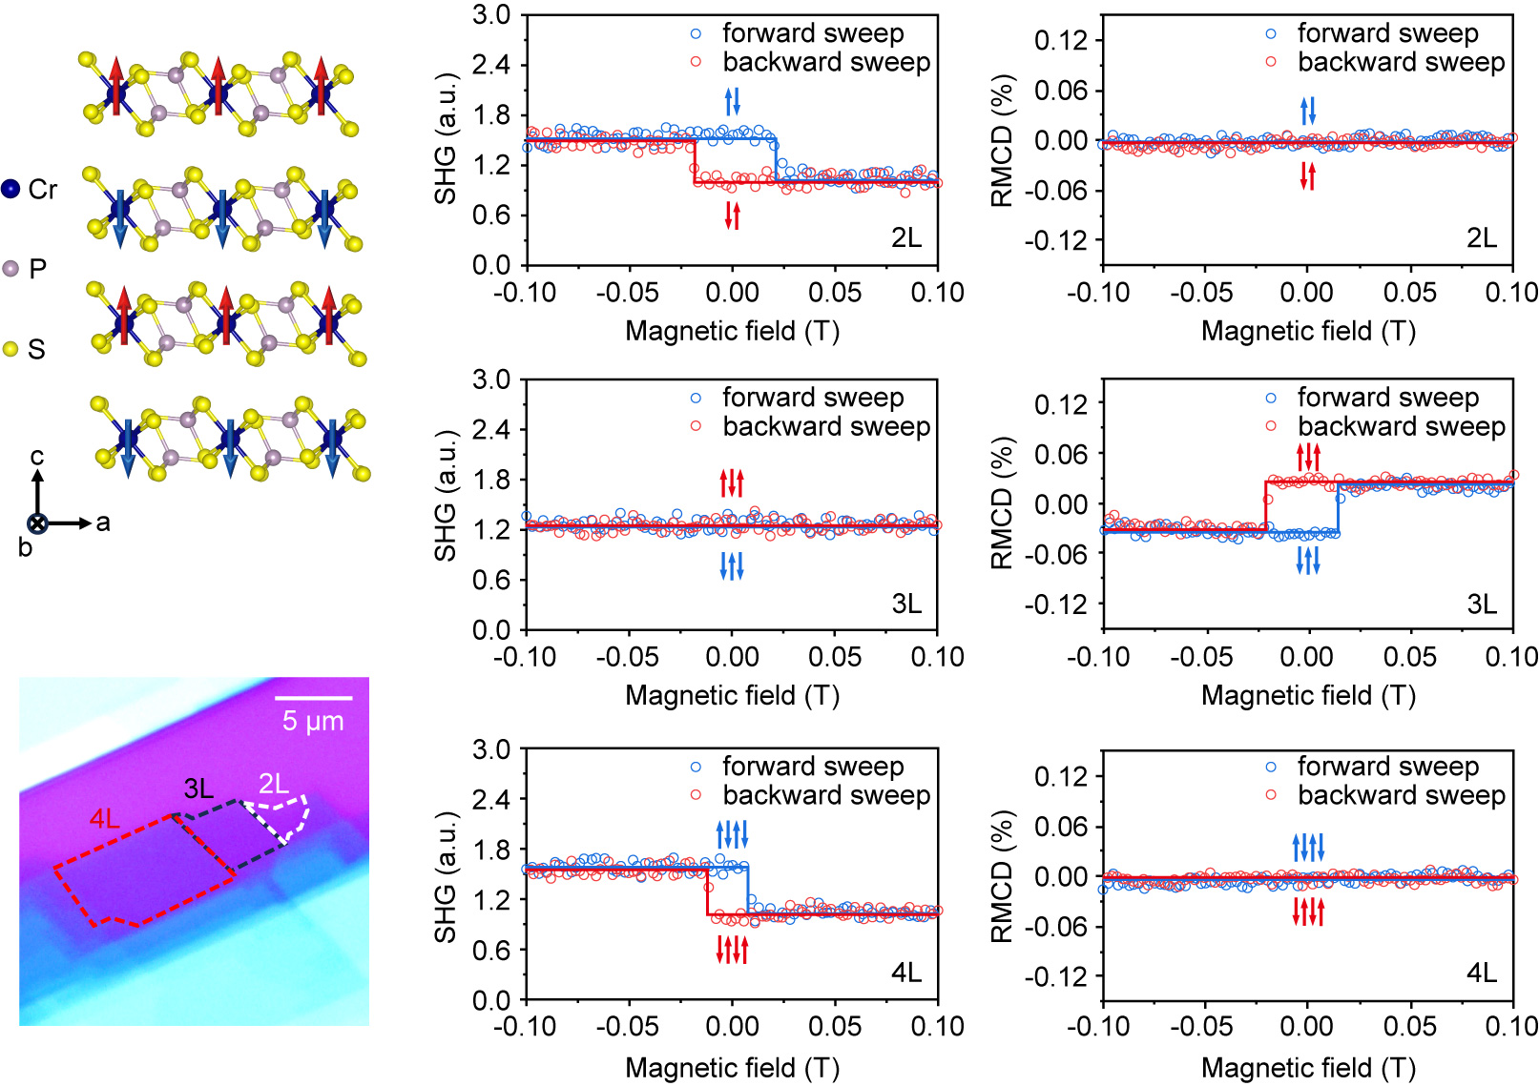
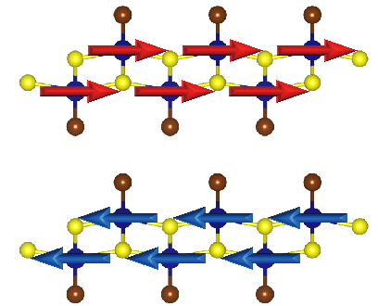
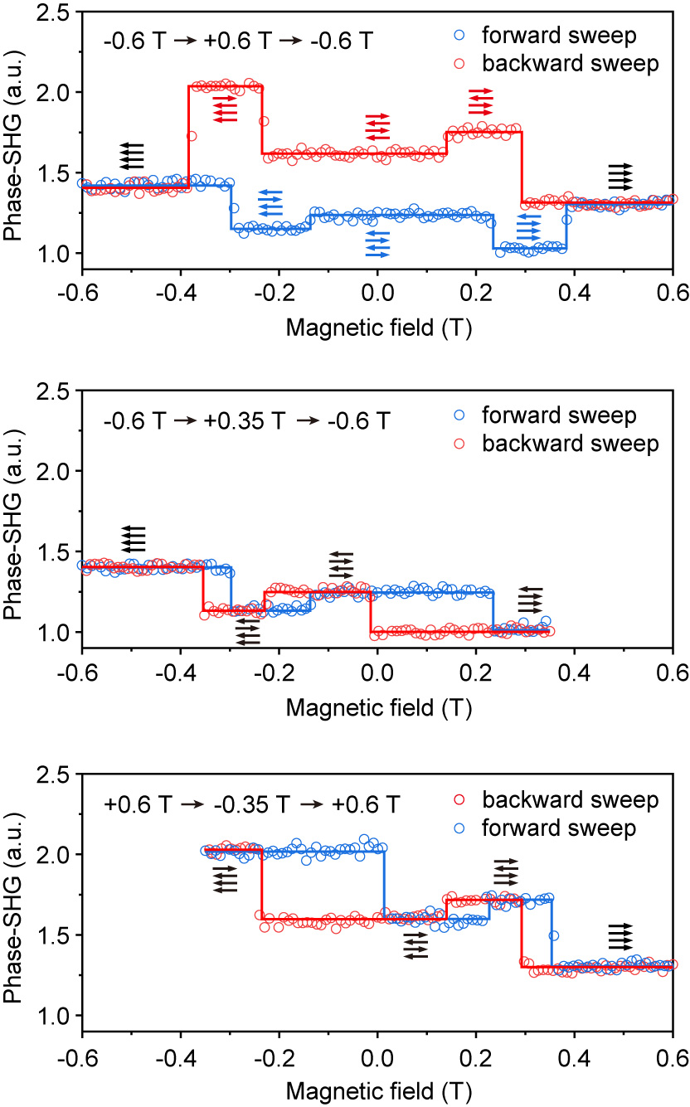
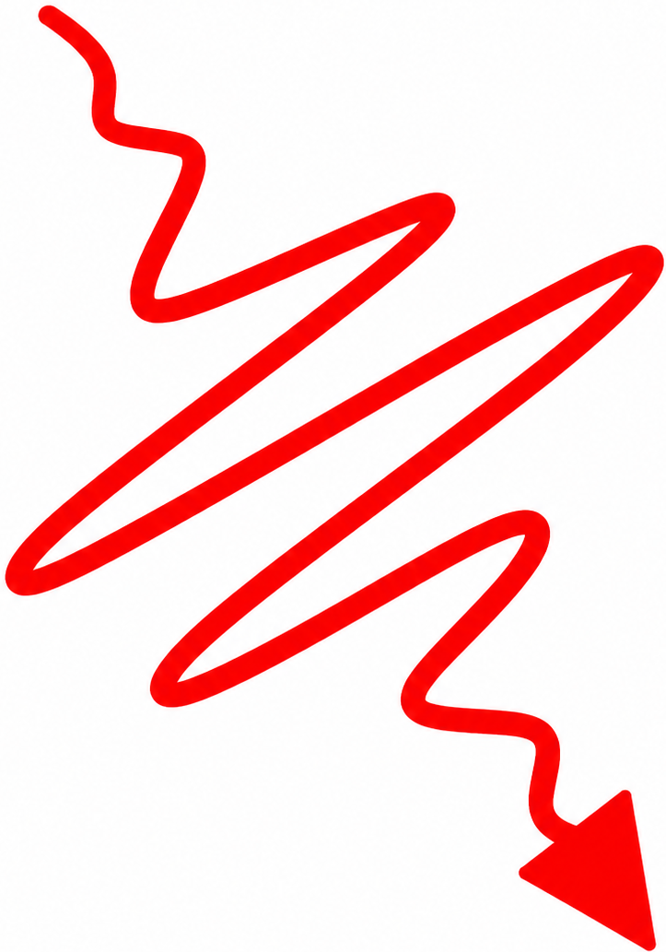
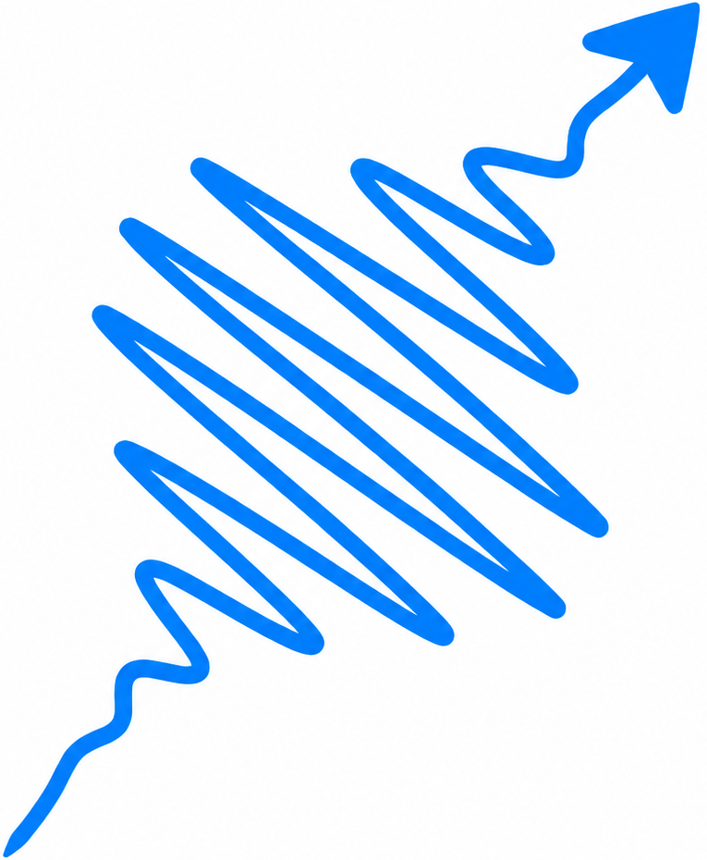
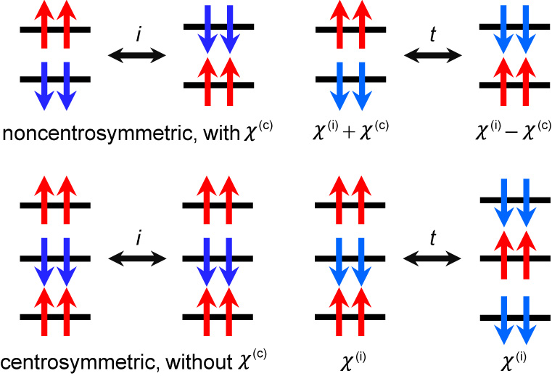
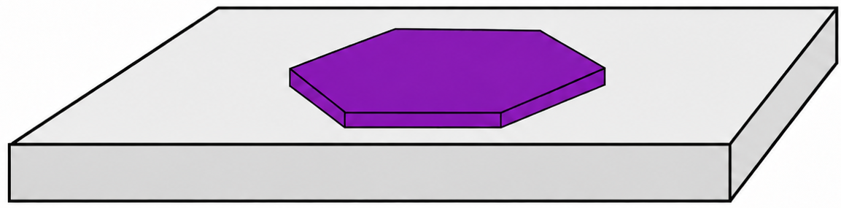
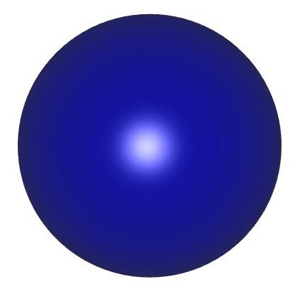
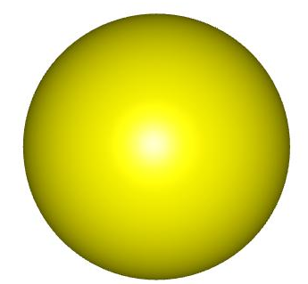
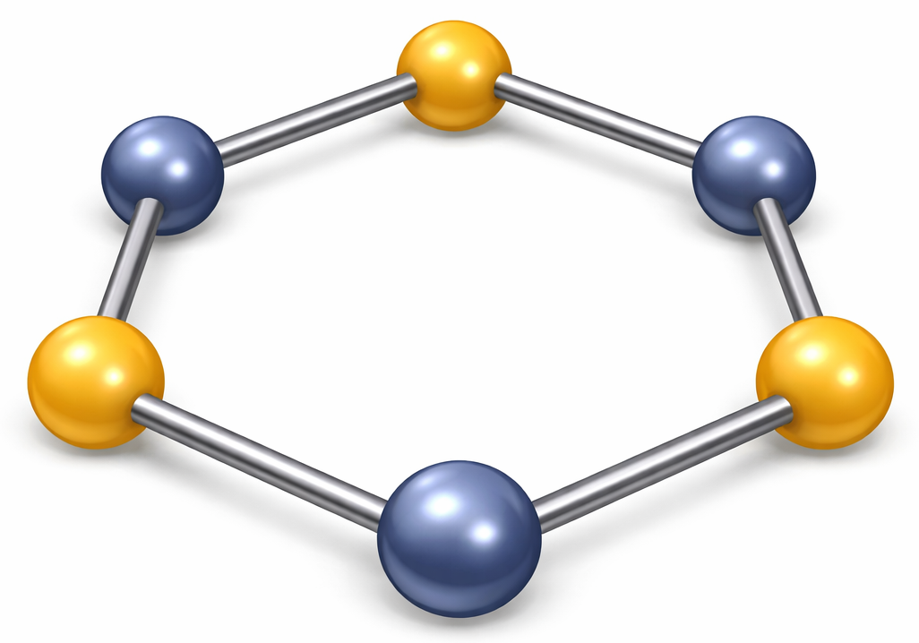
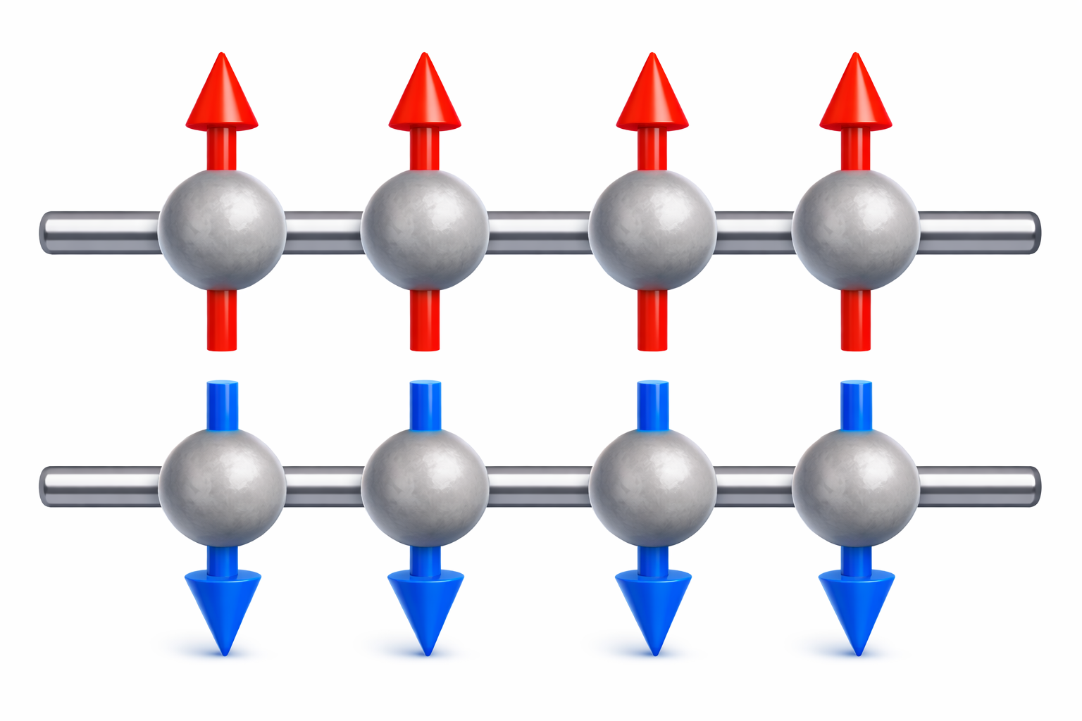
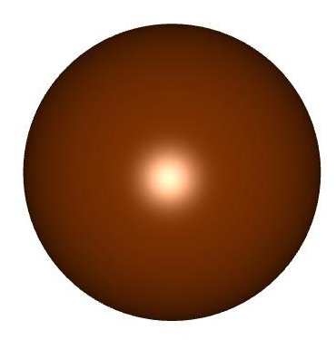

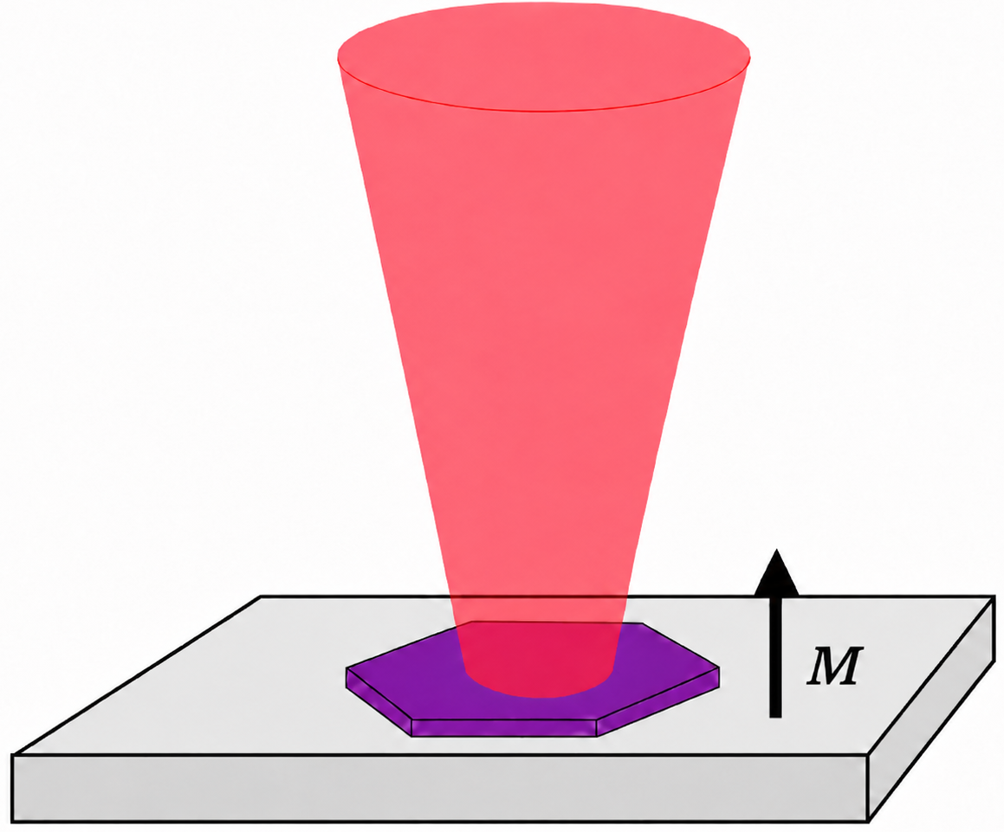
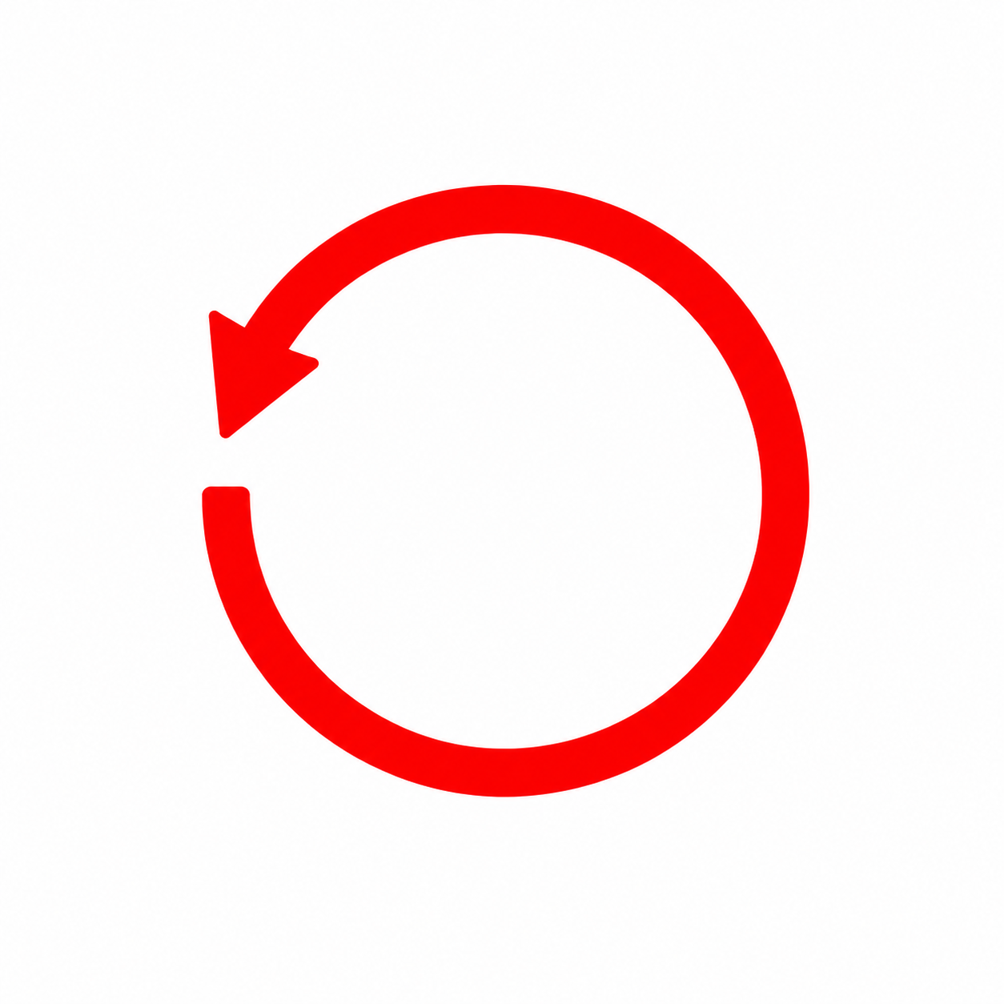
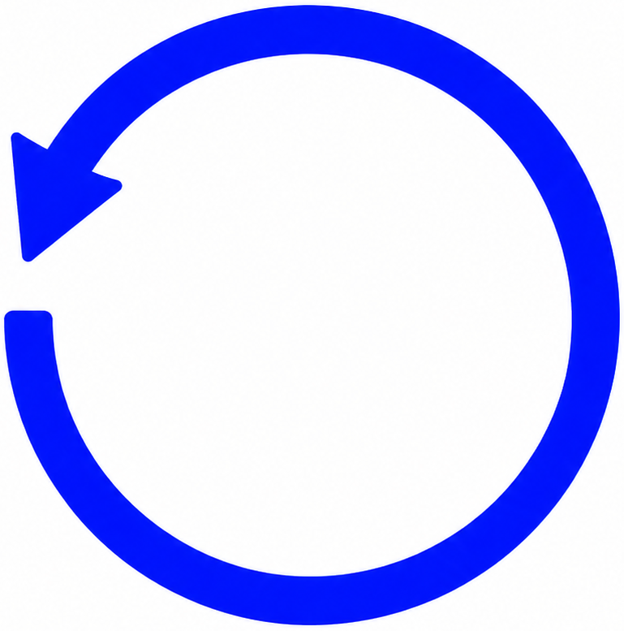
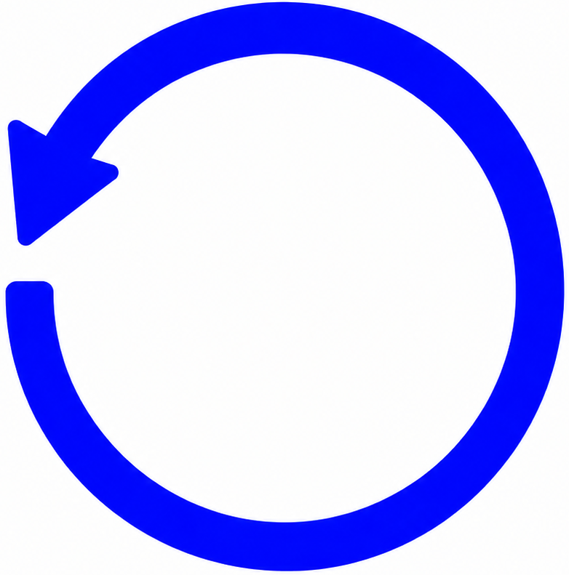
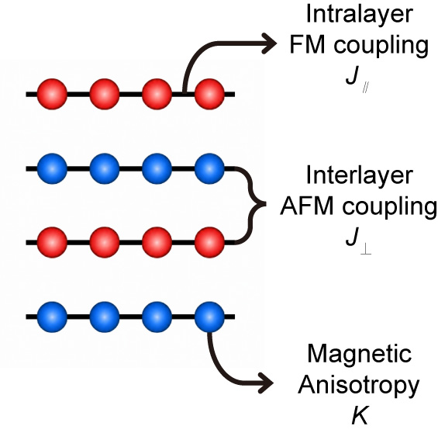
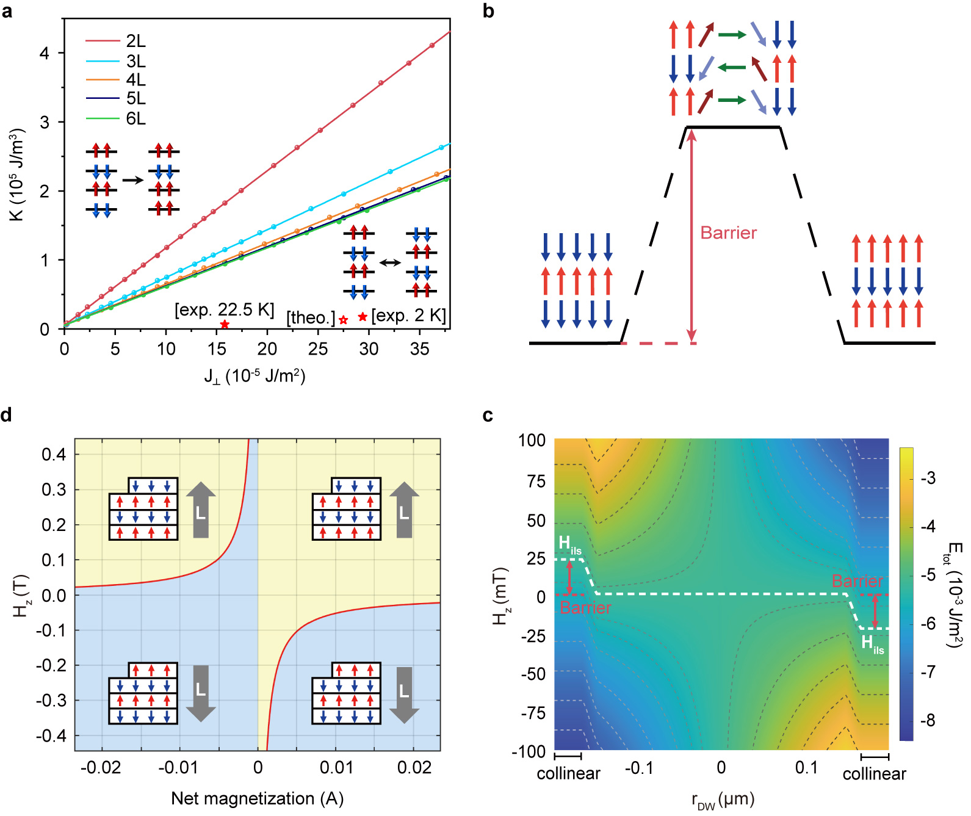
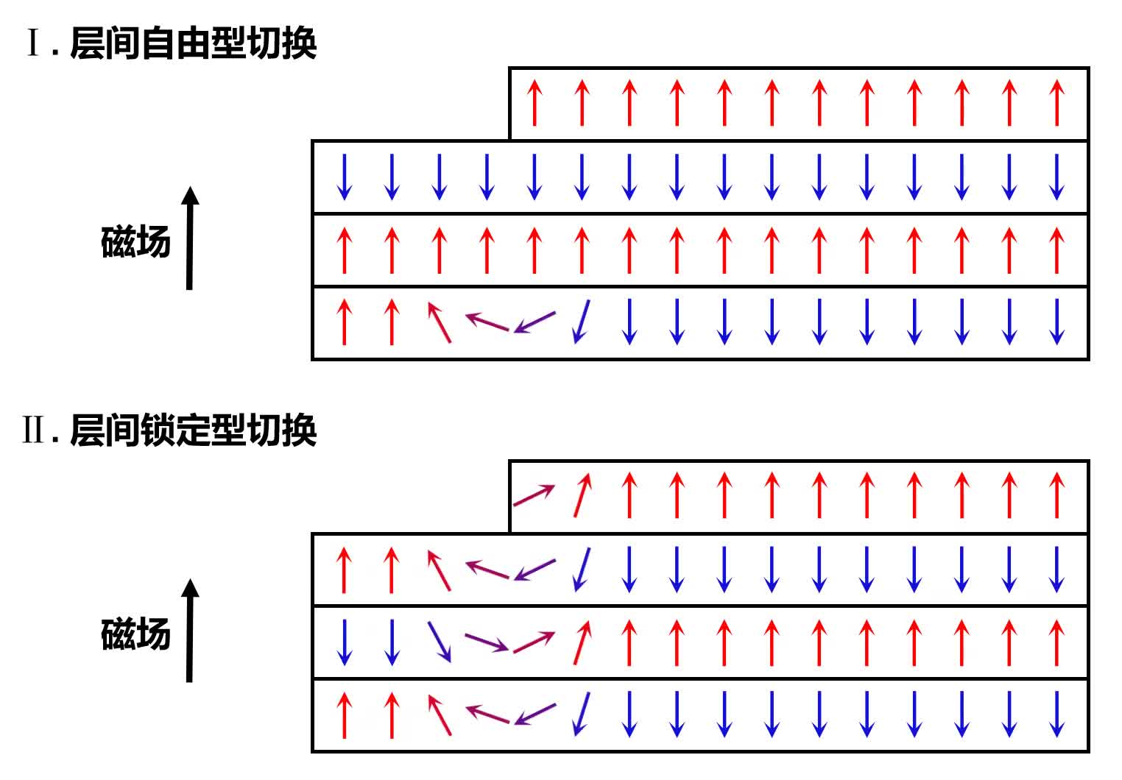
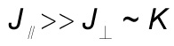
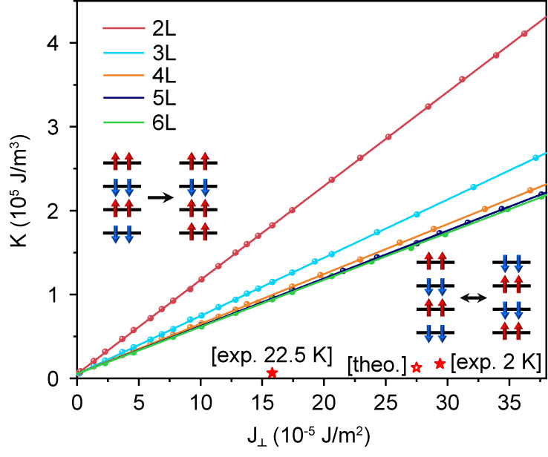















复旦大学物理学系
Department of Physics, Fudan University
Ferromagnet-like binary switching of a Stoner–Wohlfarth antiferromagnet
Zhanshan Wang^{1†}, Yining Xiang^{2, 3†}, Ruohan Chen¹, Zeyuan Sun^{1, 2}, Canyu Hong¹, Xinyu Chen¹, Jingjing Gao¹, Shuang Wu¹, Zhongxun Guo¹, Yi Chen⁴, Qixi Mi⁴, Zhongkai Liu⁴, Shaohua Yan⁵, Hechang Lei⁵, Wei Ruan¹, Yuanbo Zhang^{1, 2}, Weichao Yu², Wei-Tao Liu¹, Zhe Yuan^{2, 3*}, Shiwei Wu^{1, 2*}
¹ State Key Laboratory of Surface Physics, Key Laboratory of Micro and Nano Photonic Structures (MOE), and Department of Physics, Fudan University, Shanghai 200433, China ² Institute for Nanoelectronic Devices and Quantum Computing, and Zhangjiang Fudan International Innovation Center, Fudan University, Shanghai 200433, China ³ Interdisciplinary Center for Theoretical Physics and Information Sciences, Fudan University, Shanghai 200433, China ⁴ School of Physical Science and Technology, ShanghaiTech University, Shanghai 201210, China ⁵ School of Physics and Beijing Key Laboratory of Optoelectronic Functional Materials & MicroNano Devices, Renmin University of China, Beijing 100872, China
Background & Motivation
Stone–Wohlfarth ferromagnets
From ferromagnets to antiferromagnets
Stoner–Wohlfarth antiferromagnets?
Stoner-Wohlfarth model:
(1948)
$$H=−K{\left(\hat{M}⋅\hat{z}\right)}^{2}−μ_{0}M_{s}\hat{M}⋅H_{ext}$$
Applications
Ferromagnets
Antiferromagnets
3D
2D layered
2D layered
Uniaxial anisotropy
Zeeman energy
“1”:
“0”:
“1”:
“0”:
$$L$$
$$M$$
4
$$L$$
“Hydrogen model for ferromagnetism”
Stray field
No stray field
-2
0
2
Stoner–Wohlfarth ferromagnets
Hard disk drive
$$Hext$$
-4
$$Hext$$
$$Hext$$
$$M$$
3D
2D
0
1
0
0
1
0
Low density
High density
✗
$$Hext$$
-M
+M
GHz
THz
-M
+M
Magnetic random
access memory
Low speed
High speed
-L
+L
M=0
M=2
-L
?
+L
Coherent binary switching of the whole magnetization – single-domain
Hard to switch
Not binary
Is there a Stoner–Wohlfarth antiferromagnet – a single-domain antiferromagnet whose Néel vector 𝐿 can be binary-switched by the magnetic field?
Experimental results
Methods
Interlayer-locked switching in CrPS₄
Interlayer-free switching in CrSBr
Second Harmonic Generation (SHG)
CrPS₄
Even-layer
(M=0)
CrSBr
Broken inversion symmetry
$$ω$$
$$ω$$
$$2ω$$
Cr
Crystallographic
Magnetic
i: spatial inversion
S
Noncentrosymmetric
Br
Reflective Magnetic Circular Dichroism
(RMCD)
One-step ferromagnet-like switching
Odd-layer
(M≠0)
Multi-step layer-by-layer flipping
Non-zero magnetization
in:
Switched under a weak coercive field < 0.1 T
Requires a large field to be polarized to the ferromagnetic state
out:
Centrosymmetric
We observed a ferromagnet-like binary switching in the layered antiferromagnet CrPS₄ – a characteristic of the Stoner–Wohlfarth antiferromagnet.
Simulations & Calculations
Micromagnetic simulations
Vertical magnetic reversal dynamics
Lateral magnetic reversal dynamics
2D layered antiferromagnet
Extended Stoner–Wohlfarth model
Domain wall propagation
Layer-sharing effect
$$H=\sum_{i}{\left[A{\left(∇_{∥}{\hat{M}}_{i}\right)}^{2}+\frac{J_{⊥}}{2}\left({\hat{M}}_{i}⋅{\hat{M}}_{i−1}+{\hat{M}}_{i}⋅{\hat{M}}_{i+1}\right)−K{\left({\hat{M}}_{i}⋅\hat{z}\right)}^{2}−μ_{0}M_{s}{\hat{M}}_{i}⋅H_{ext}\right]}$$
I. Interlayer-free switching
Intralayer exchange
Interlayer exchange
Uniaxial anisotropy
Zeeman energy
H_{ext}
I. Interlayer-free
switching
II. Interlayer-locked
switching
II. Interlayer-locked switching
Exchange length:
Odd-layer CrPS₄
H_{ext}
Even-layer CrPS₄
$$l_{ex}=\sqrt{\frac{J_{⊥}d}{2K}}$$
M=0
M=2
Criterion
-L
+L
Typical materials:
CrSBr, CrI₃
$$\frac{l_{ex}}{d}<1$$
$$\frac{l_{ex}}{d}>1$$
Typical materials:
CrPS₄, MnBi₂Te₄
Competition between $J_{⊥}$and $K$
Stoner–Wohlfarth antiferromagnets
We proposed an extended Stoner–Wohlfarth model to describe the magnetic dynamics of layered AFMs and a criterion for Stoner–Wohlfarth AFMs.
Conclusions
Reveal the ferromagnet-like binary switching in layered antiferromagnets.
Establish a universal framework for understanding magnetization reversal in layered antiferromagnets.
Nature 650, 340–345 (2026)

