Slide 1


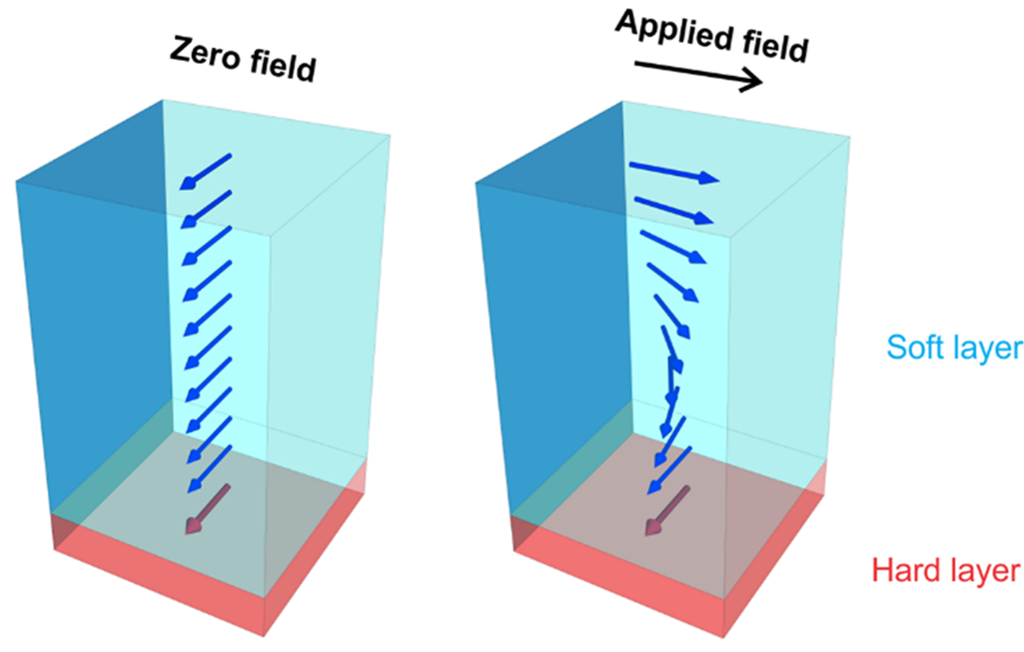
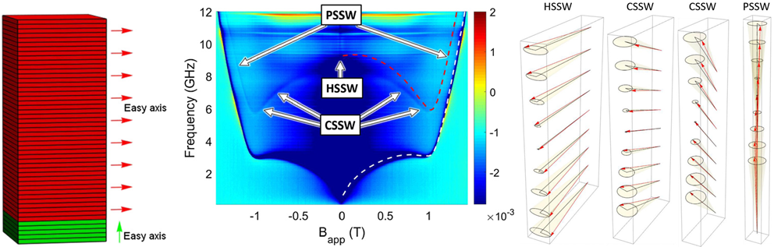
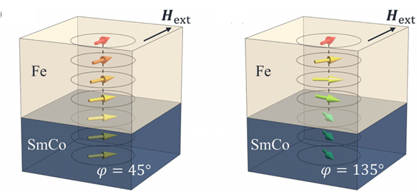
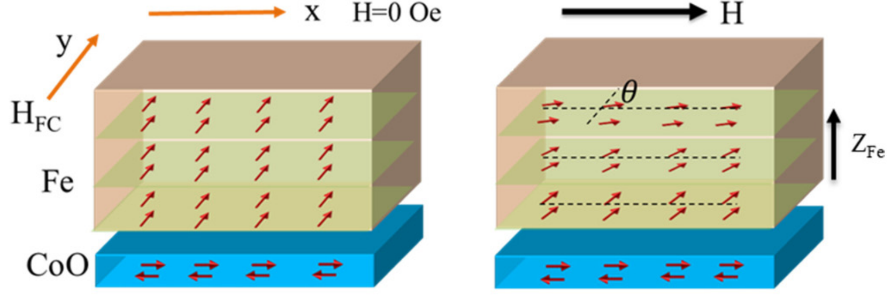
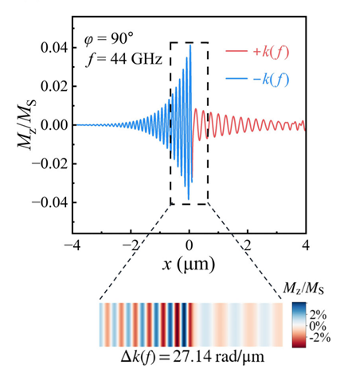
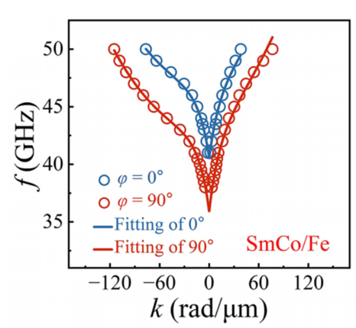
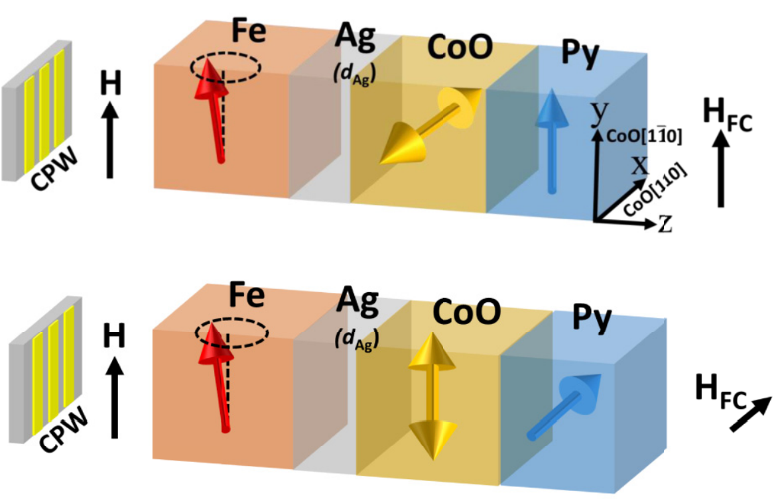
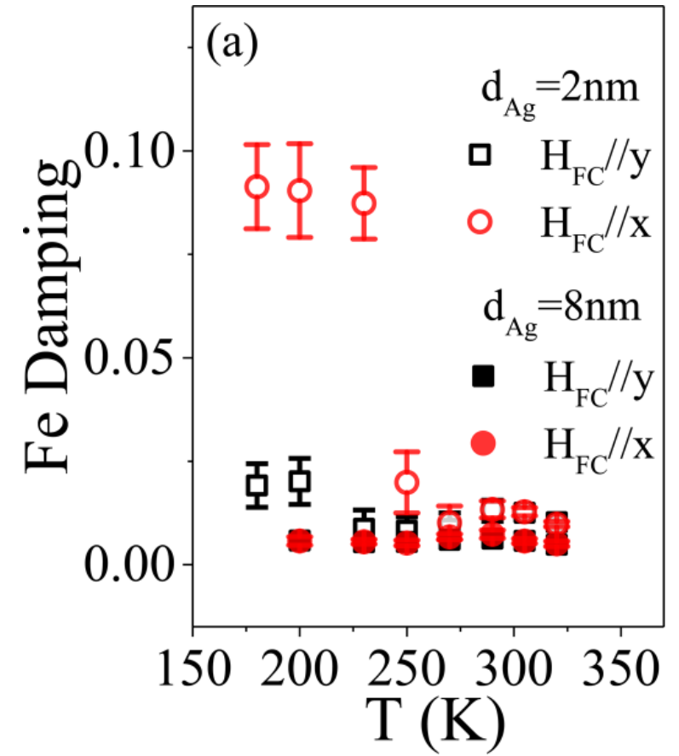
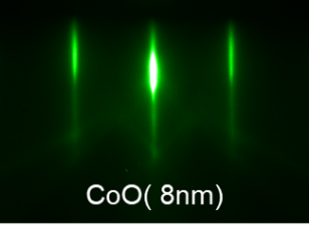
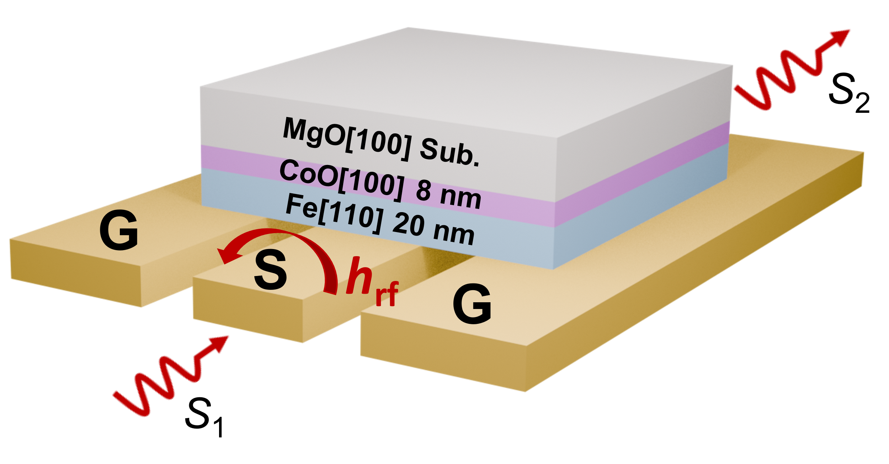
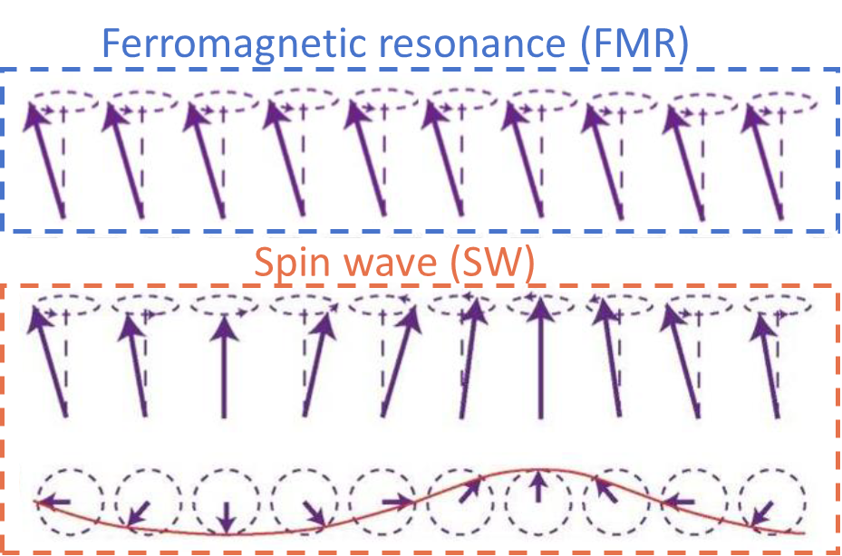
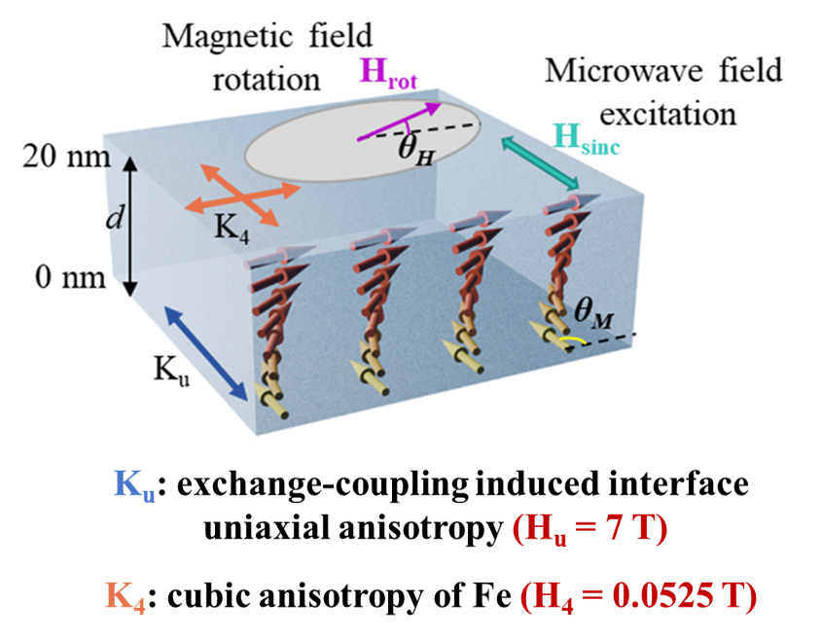
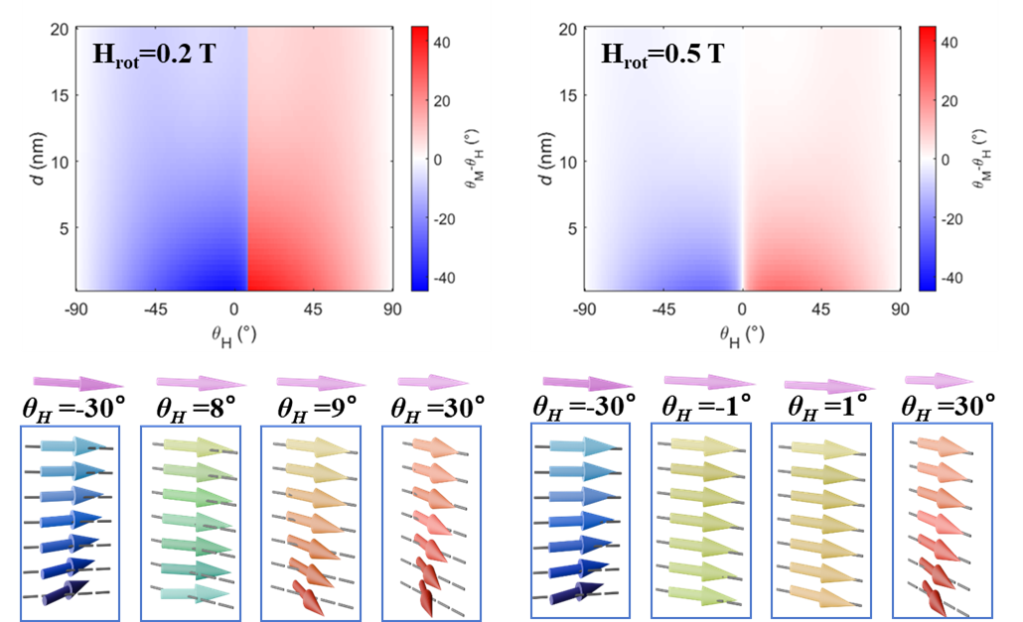
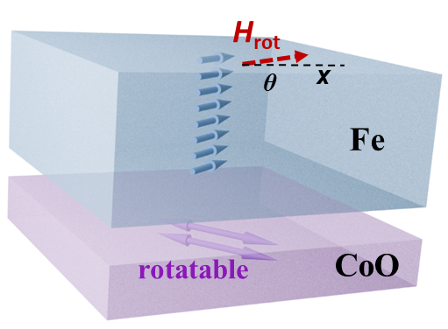
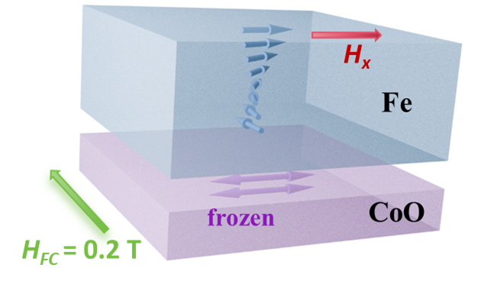
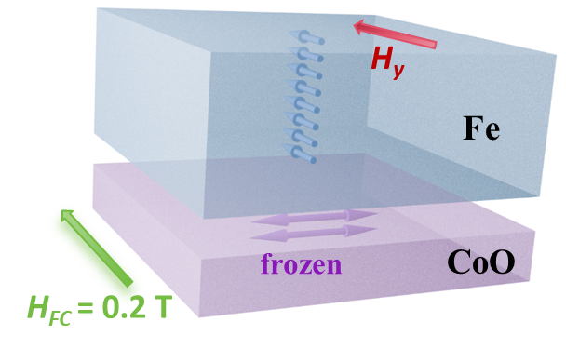
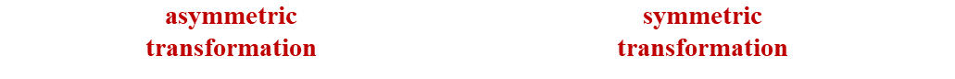
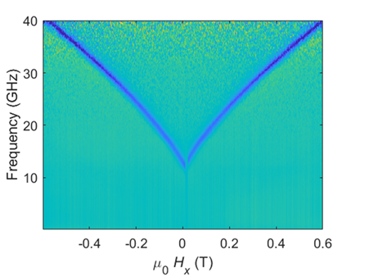
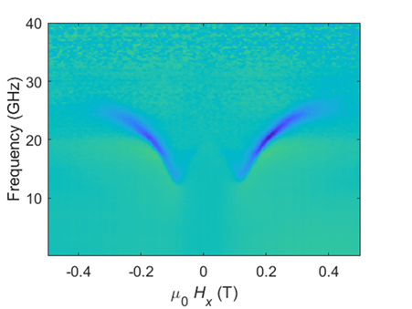
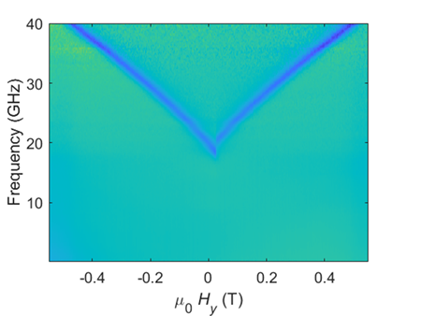
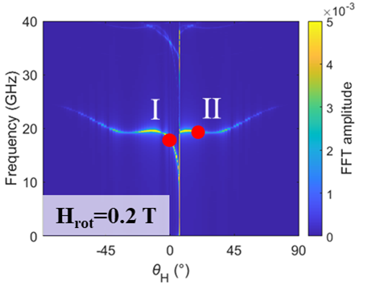
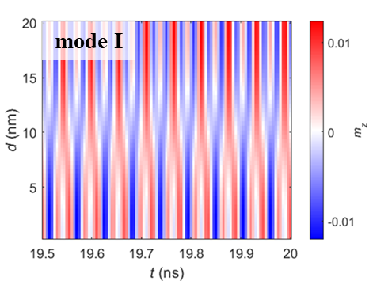
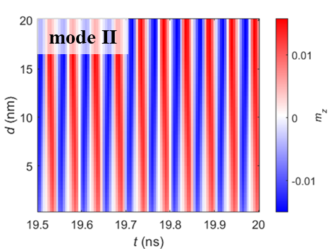
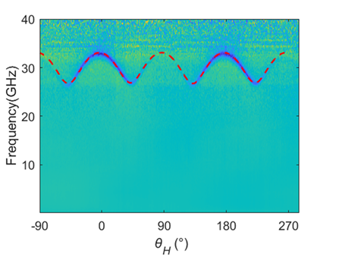
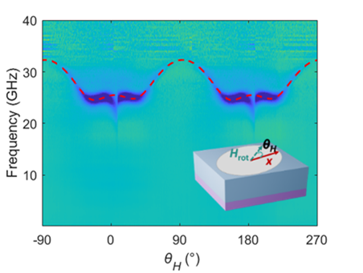
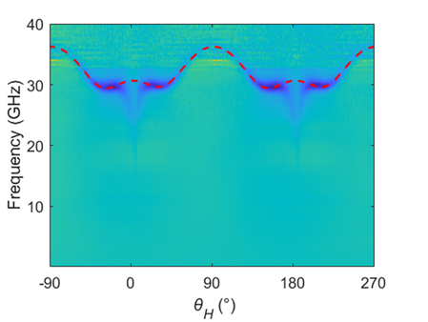
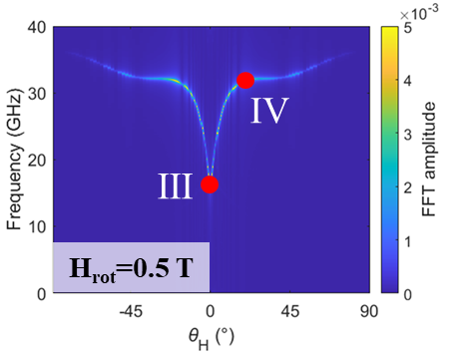
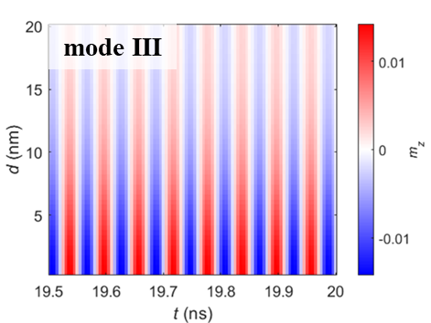
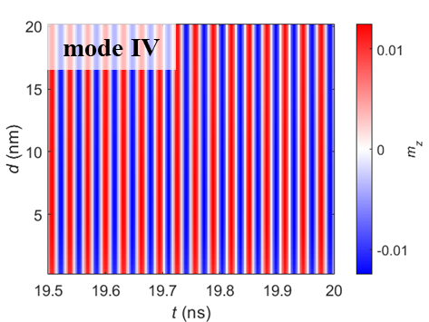
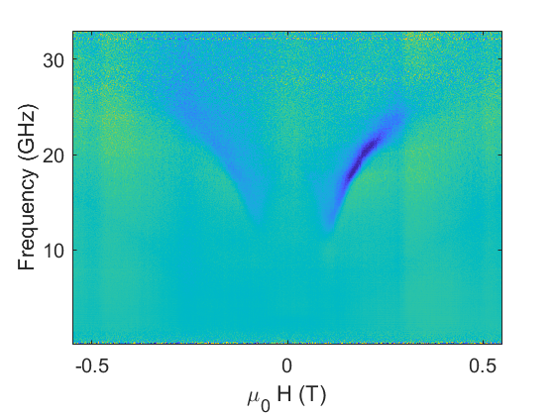
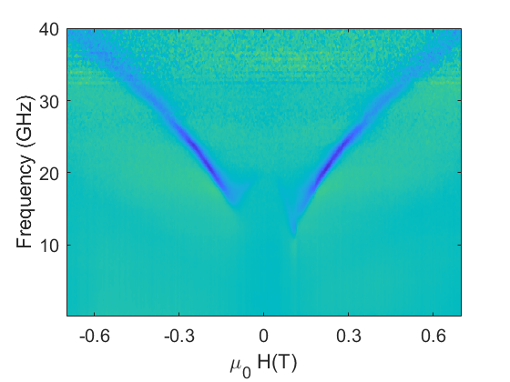

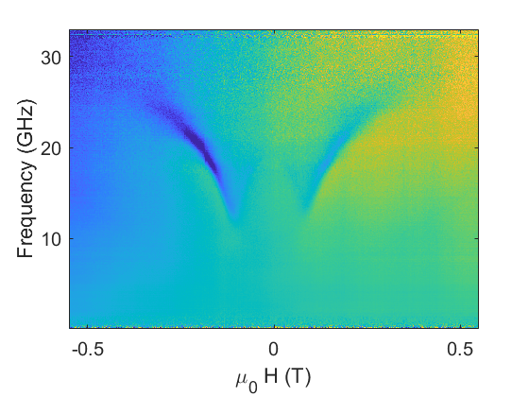
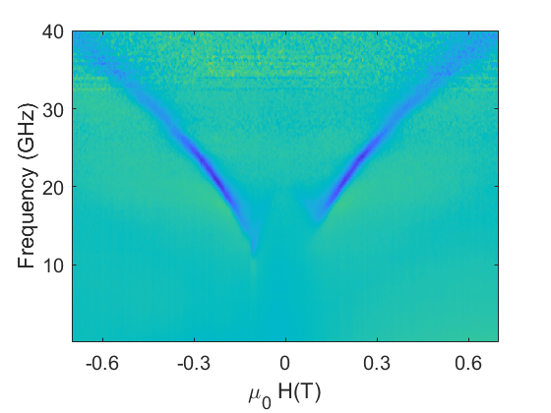
Dynamic Properties of Exchange Spirals in Fe/CoO
Bilayer with Strong Interfacial Exchange Coupling
Yuanfei Fan, Hongyue Xu, Tong Wu, Yizheng Wu*
Department of Physics, Fudan University, Shanghai, China
Background & Motivation
Magnetic exchange spirals
Spin dynamics of exchange spirals
Exchange spiral in FM/AFM
Hard/soft FM bilayers
Canted standing spin-wave modes
Nonreciprocal spin-wave propagation
Fe/CoO bilayer
Strong interfacial exchange coupling
Py
[CO/Pt]_{n}
Q. Li, et al. Phys. Rev. B (2017)
Exchange spirals
in Fe/CoO bilayer
Anisotropic damping in Fe/CoO
Spin dynamic properties in Fe/CoO?
A. Frisk, et al. Phys. Rev. Applied (2023)
M. Dabrowski, et al. New J. Phys. (2021)
M. X. Jiang, et al. Phys. Rev. B (2025)
M. Yang, et al. Phys. Rev. B (2020)
Non‑collinear spin structure
Spiral dynamics in FM/FM systems
Unexplored spiral dynamics in FM/AFM
Experimental methods and theory
Micromagnetic simulation of exchange spirals
RHEED pattern
FMR measurement
Basic theory
Structure of exchange spirals under different H_{rot}
Simulation configuration
Layer-resolved magnetization profiles
In-plane FMR measurements
300 K
50 K after field cooling
H along x-axis
H along y-axis
Interfacial exchange coupling (anisotropic field) → Exchange spiral
Simulation of spin dynamics
Sweeping field
Sweeping field
Dynamic response of exchange spiral
FMR spectrum
Layer-resolved precession modes
Rotating field
Rotating field
Uniform precession model
H_{rot}=0.4 T
Non‑collinear spiral state
H_{rot}=0.4 T
H_{rot}=0.3 T
H_{rot}=0.4 T
$${\left(\frac{ω}{γ}\right)}^{2}=\left(H\cos\left(φ_{M}−φ_{H}\right)+4πM+\frac{3}{4}H_{k_{4}}−\frac{1}{4}H_{k_{4}}\cos{4\left(φ_{M}−φ_{k_{4}}\right)}+H_{k_{u}}cos2\left(φ_{M}−φ_{k_{u}}\right)\right)\left(H\cos\left(φ_{M}−φ_{H}\right)−H_{k_{4}}\cos{4\left(φ_{M}−φ_{k_{4}}\right)}+H_{k_{u}}cos2\left(φ_{M}−φ_{k_{u}}\right)\right)$$
Non-uniform effective field H_{eff} → Non-uniform precession dynamics
Spiral → frequency dip / linewidth anomaly / asymmetric switching
PNR characterization of exchange spirals
Angular-dependent dynamic properties
Magnetization depth profiles (spiral vs. uniform)
Anisotropic damping
Unidirectional asymmetry
Anisotropic interfacial dissipation
Asymmetric dissipation
Chirality switching
θ_{rot}=2°
θ_{rot}=15°
Non‑collinear spiral state
Direct evidence of the interfacial spiral
Conclusion
CoO spin disorder
Exchange spirals were studied by ferromagnetic resonance (FMR).
The structure of exchange spirals was confirmed by micromagnetic simulation and PNR.
Spin-wave excitation modes of spirals with different structures were simulated.
ΔH_{Fe//CoO} ≫ ΔH_{Fe⟂CoO}
Nonreciprocal
Interfacial exchange coupling → unique dynamic properties

