Slide 1

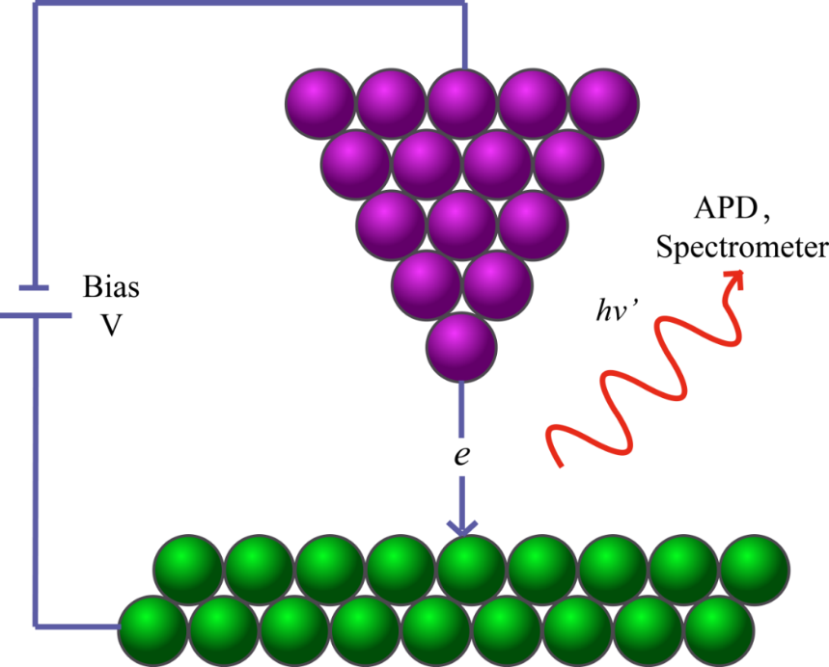
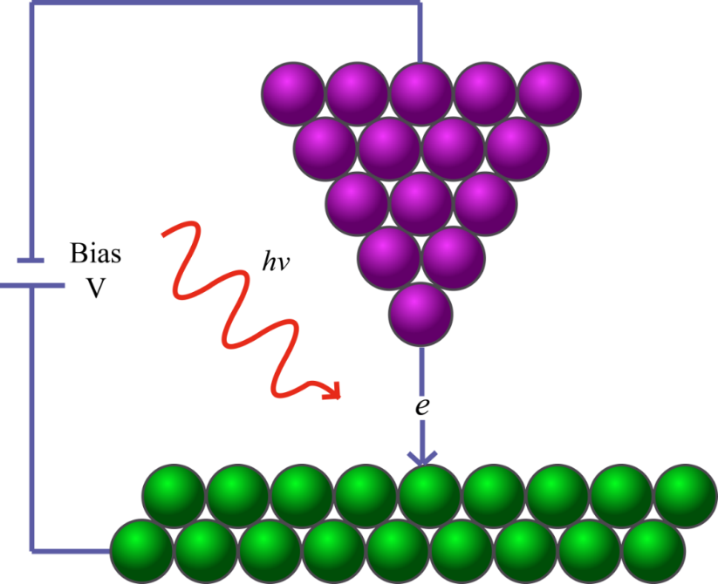
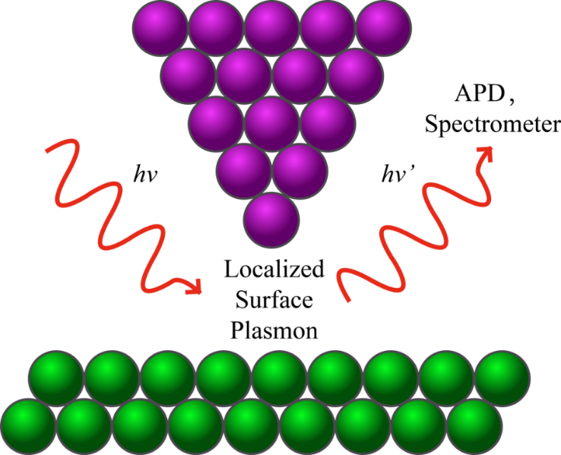

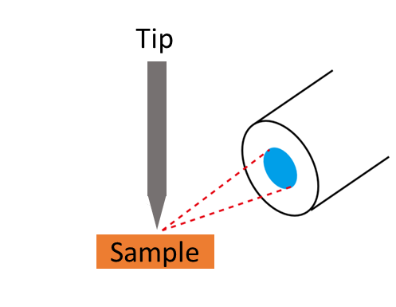
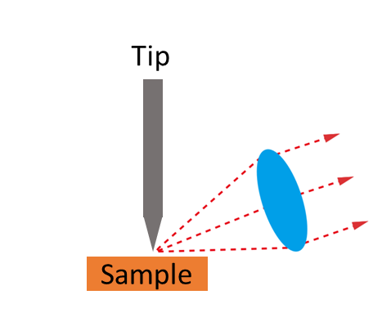
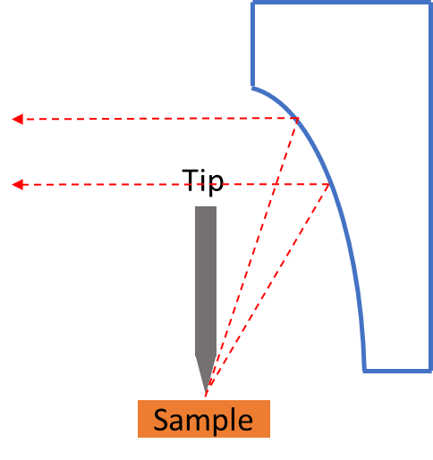
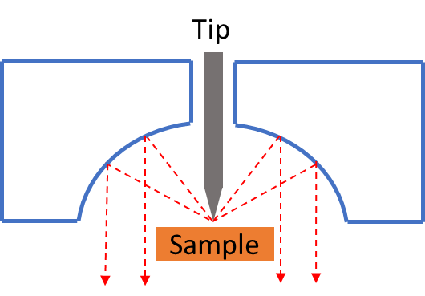
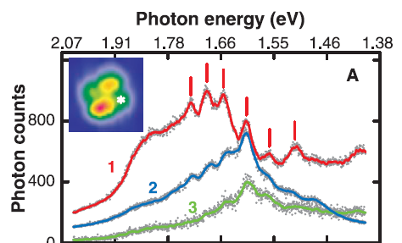
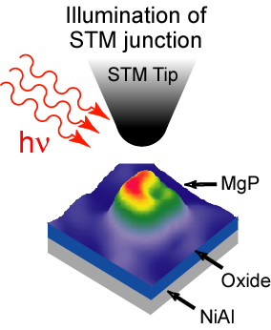
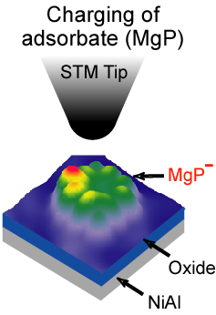
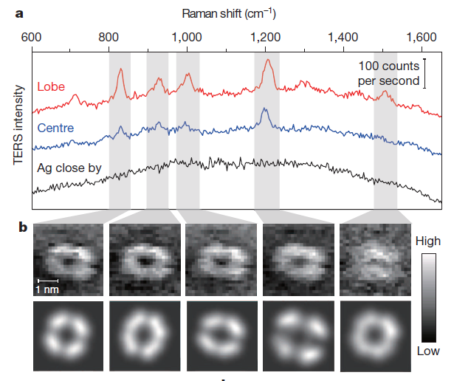
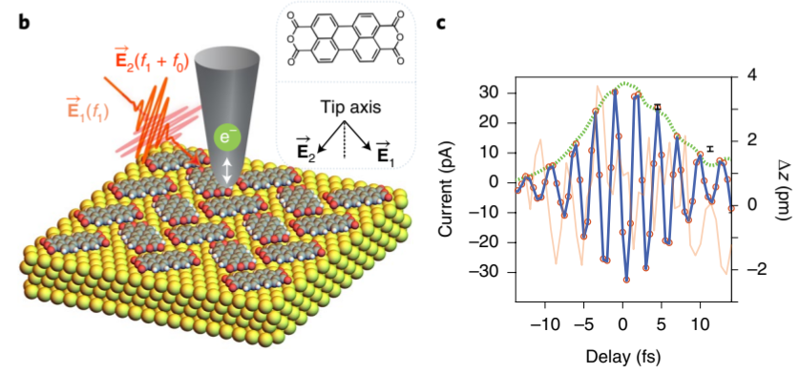

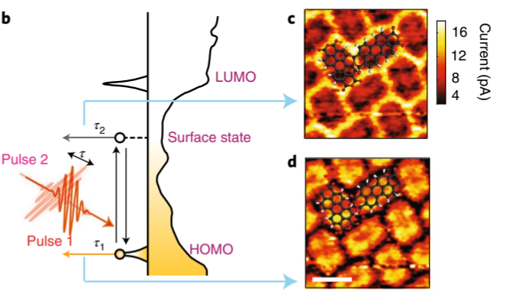
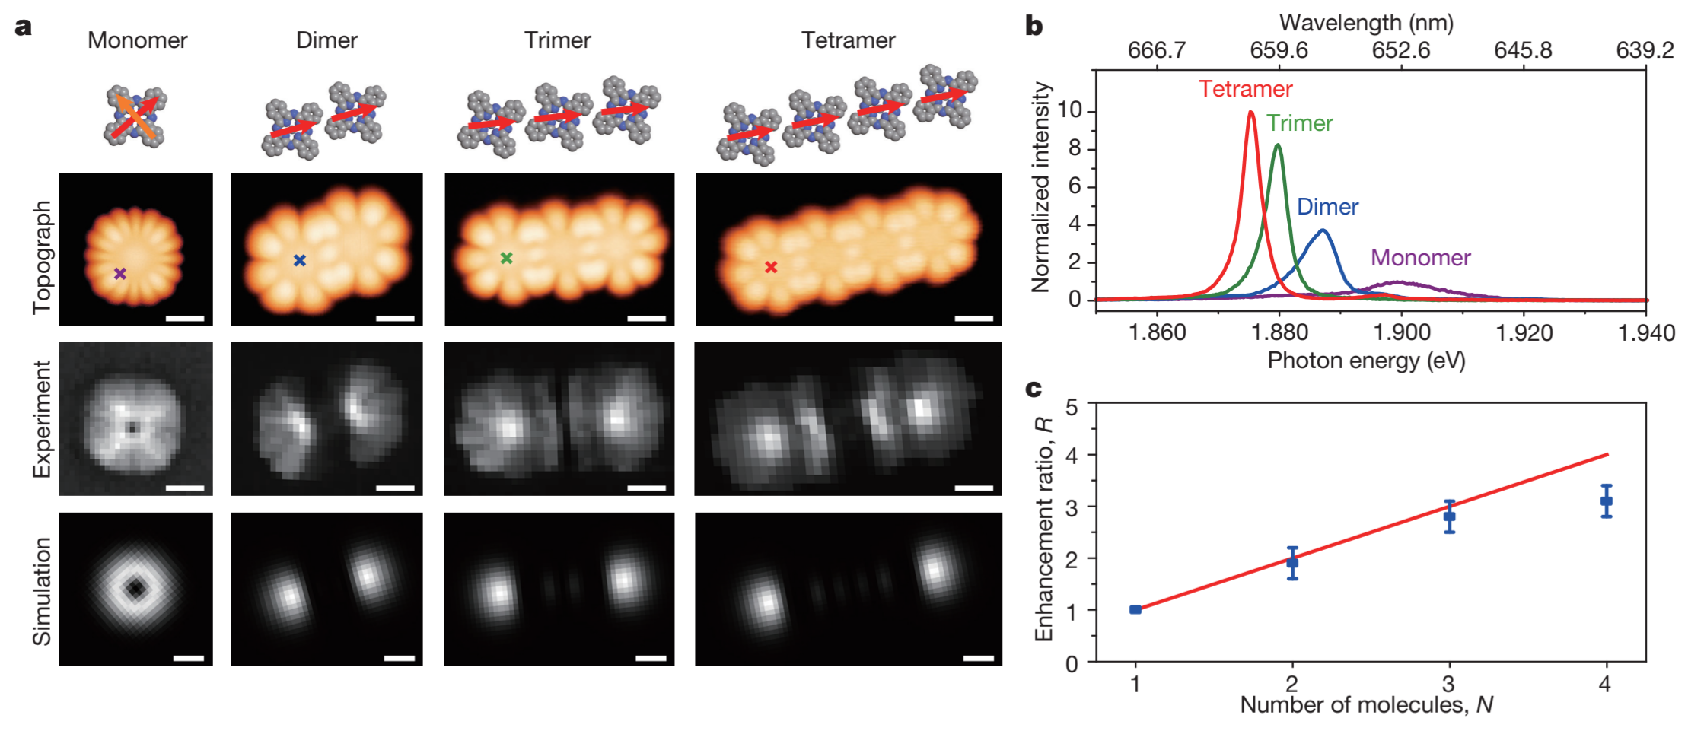
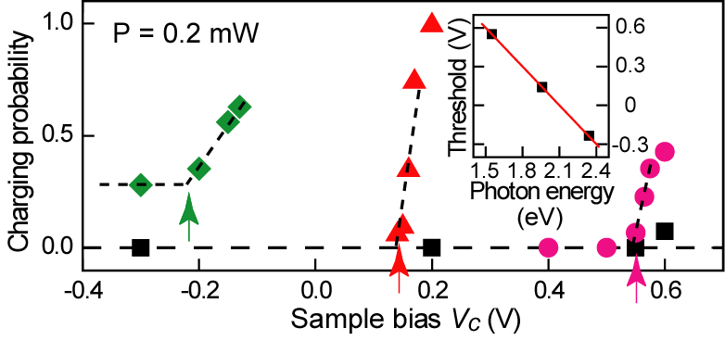
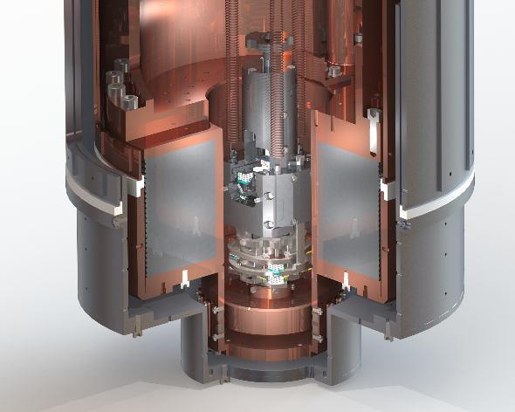
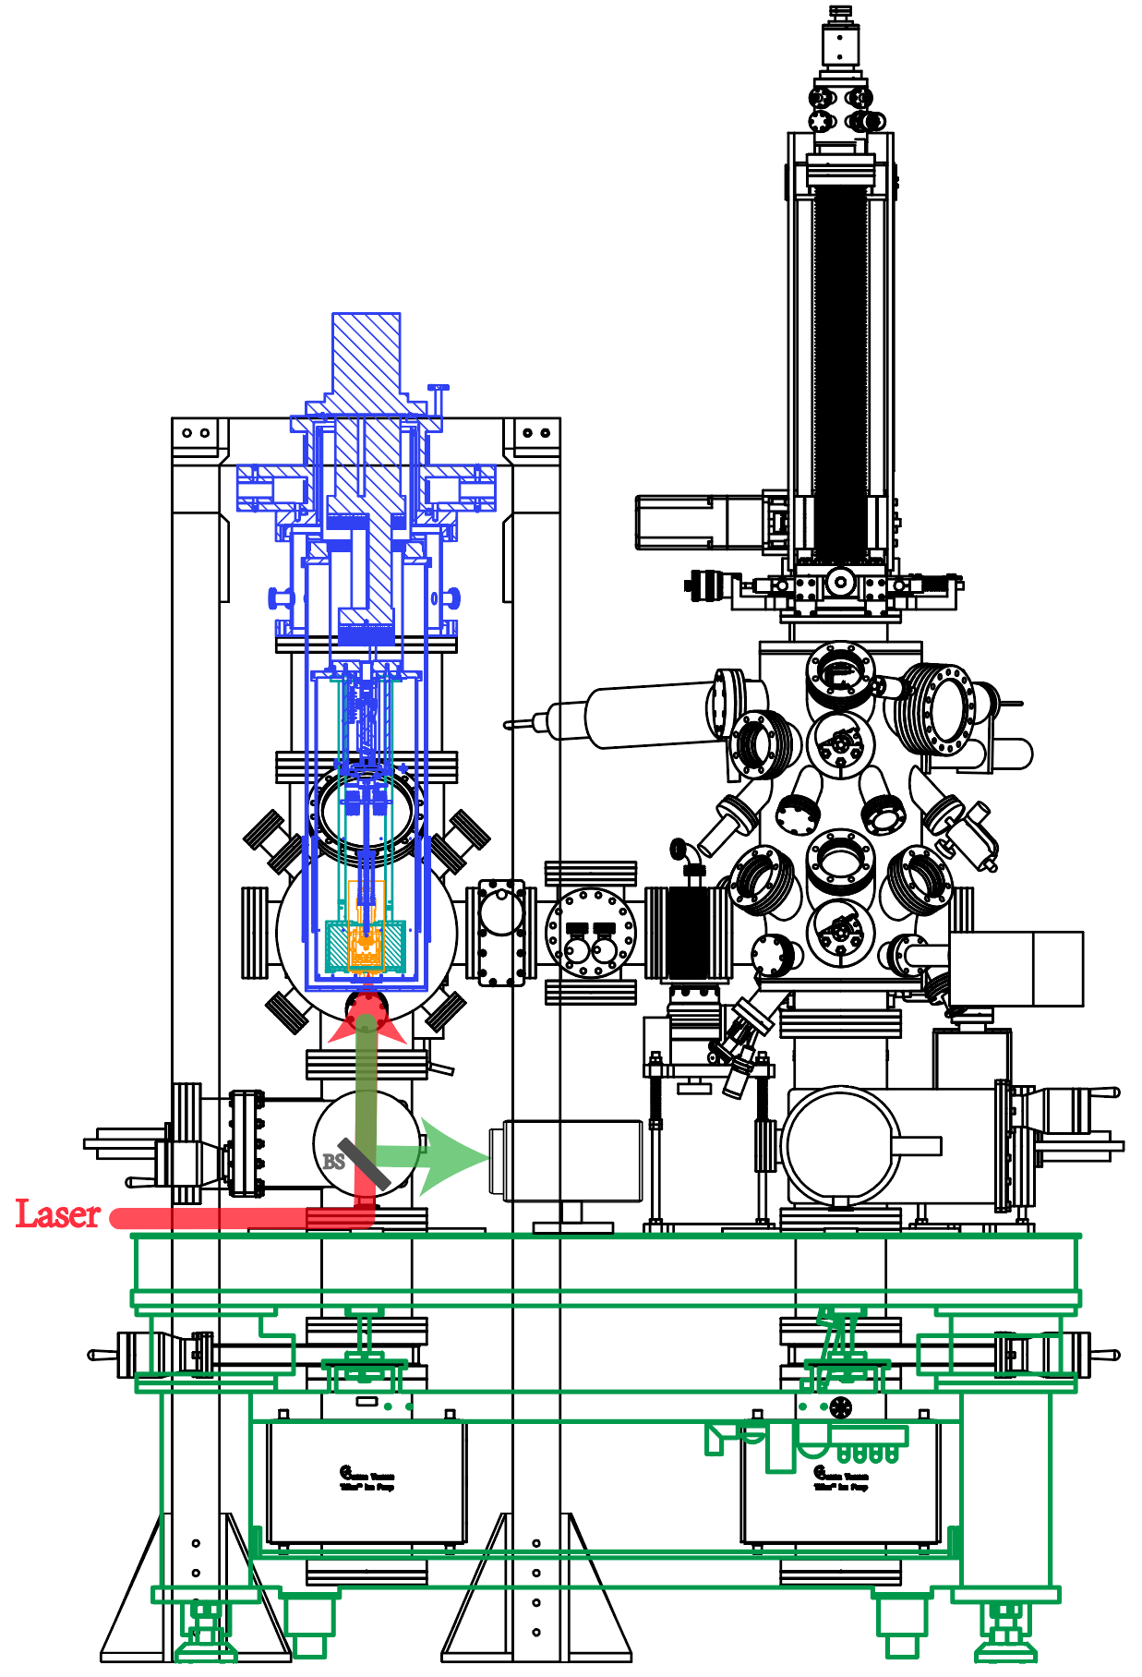
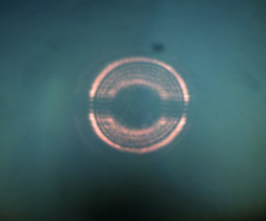
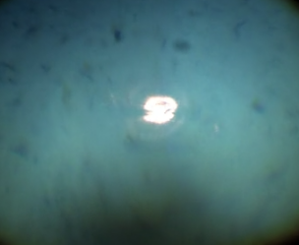
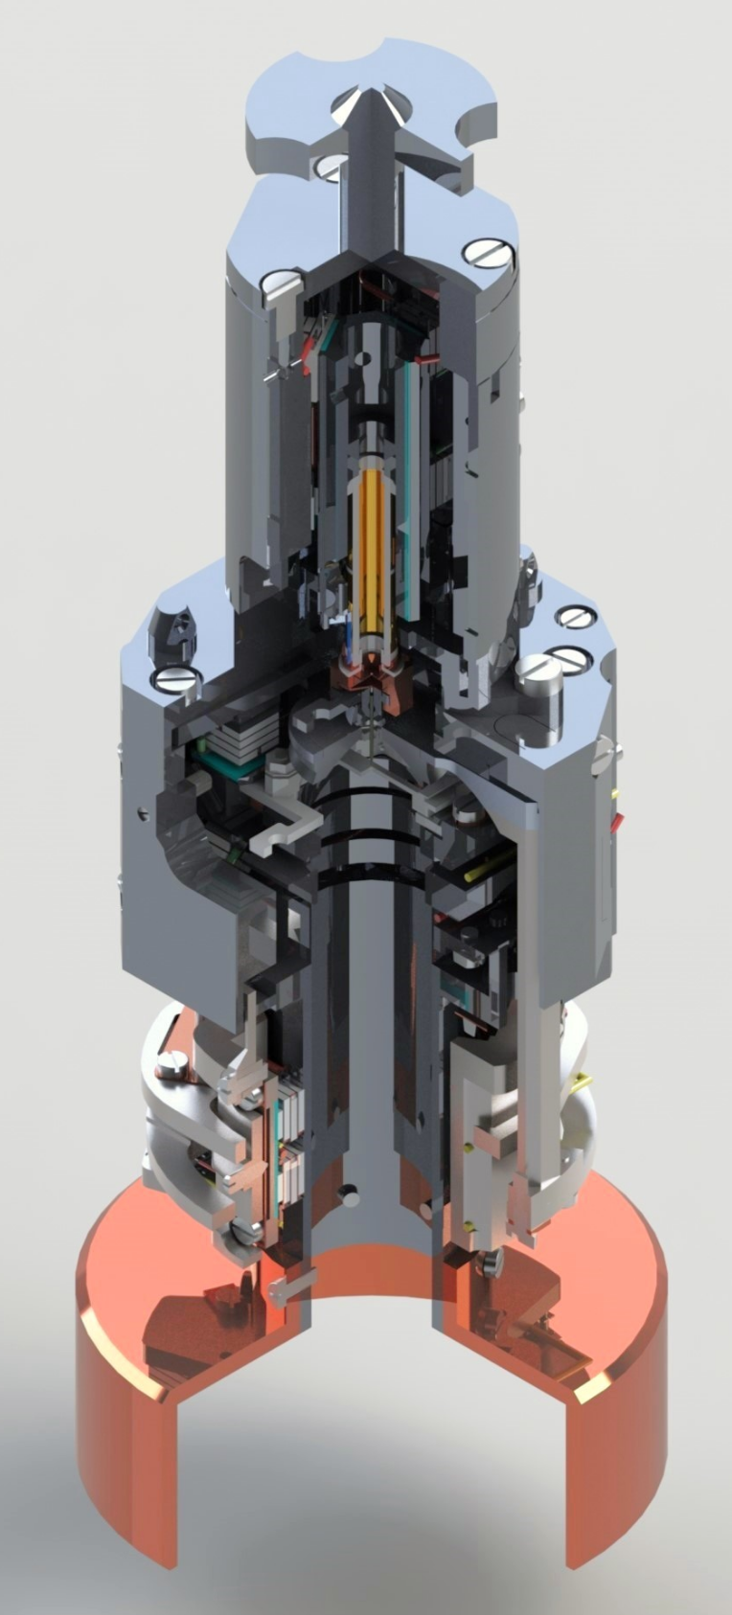
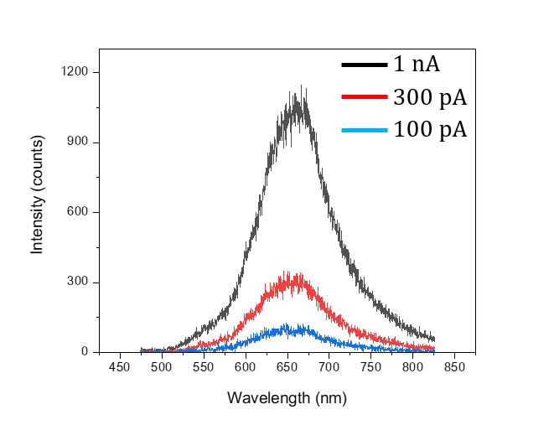
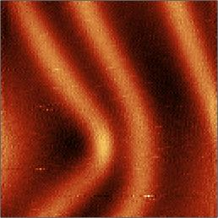
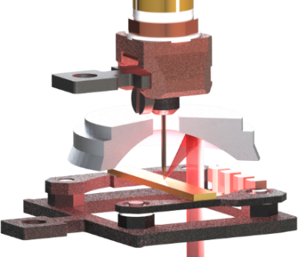
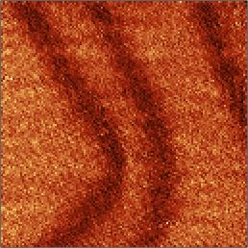
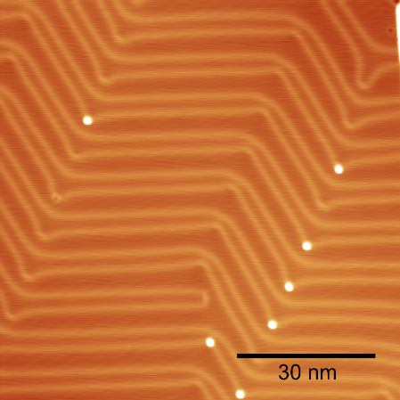
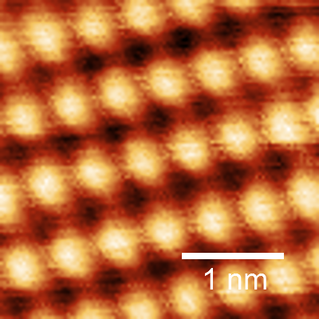
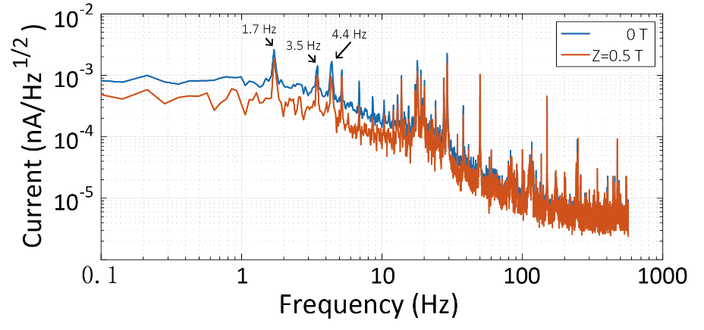
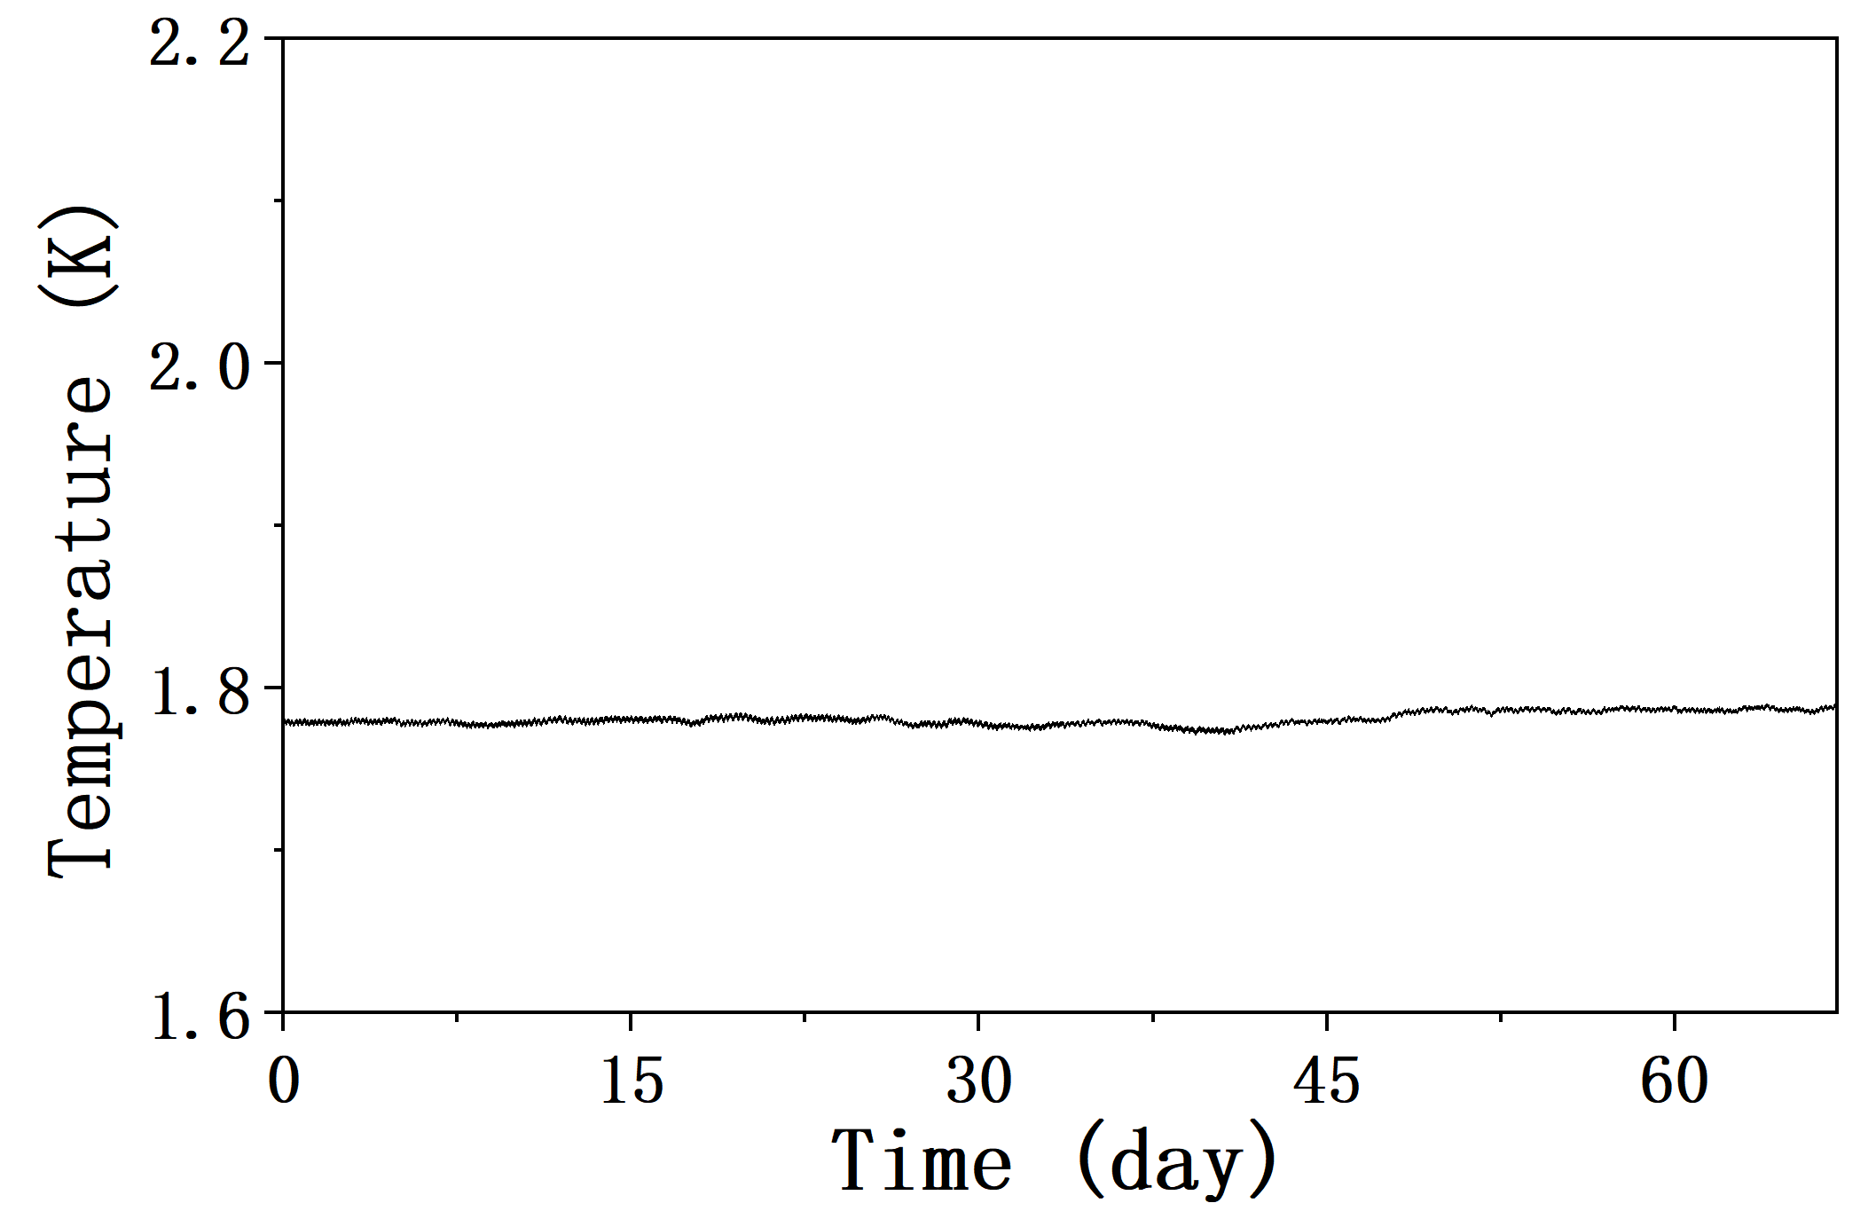

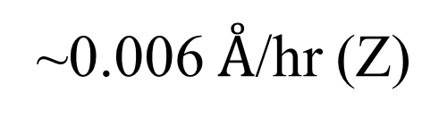
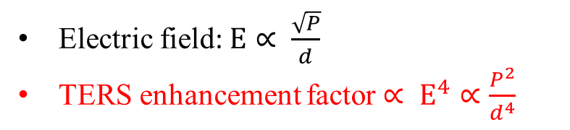
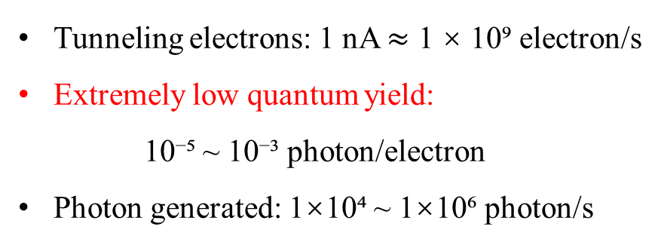
复旦大学物理学系
Department of physics, Fudan University
A cryogen-free low temperature scanning tunneling microscope
integrating an on-axis parabolic mirror in magnetic field
Zerui Wang, Yuhao Rao, Suyang Wang, Zeyuan Sun, Shiwei Wu
Background and Motivation
STM with Optics
Spatial, Spectral and Temporal resolution
Challenge for STM with Optics
STM induced Luminescence (STML)
Photo-induced
Process
Tip Enhanced Optical Spectroscopy and Microscopy
STM with
Pump-Probe Technique
Light collection efficiency determines whether the signal can be detected!
Laser excitation field
determines the signal enhancement!
Tunneling electrons: 1 nA $≈$ 1 × 10⁹ electron/s
Extremely low quantum yield:
10⁻⁵ ~ 10⁻³ photon/electron
Photon generated: 1×10⁴ ~ 1×10⁶ photon/s
Electric field:$E∝ \frac{\sqrt{P}}{d}$
TERS enhancement factor$∝ E^{4}∝\frac{P^{2}}{d^{4}}$
Comparison of photon collection modes
STML of a Single Molecule
Photo-induced Charge Transfer of a Single Molecule
Raman Spectroscopy of a Single Molecule
Space-time-resolved imaging of quantum coherent interference
 | Fiber | Lens | Off-axis parabolic mirror | On-axis parabolic mirror
Numerical aperture | - | 0.5 | 0.85 | 0.82
Solid angle coverage | 0.33 sr | 0.82 sr | 4.50 sr | 4.21 sr
Collection efficiency | 5.3% | 13% | 72% | 67%
Focus laser spot | - | 1.5 μm (112 μm) | 0.91 μm (2 μm) | 0.94 μm
Temperature | RT | 5 K | 100 K | Cryogen-free 1.78 K
Magnetic field | - | - | - | Z: 3.5T
Reference | Ushioda @RIKEN | Zhenchao Dong @USTC | Zagonel @UNIZAMP | This work
X. H. Qiu, et al, Science. 299, 542 (2003).
Y. Zhang, et al. Nature 531, 623–627 (2016).
S. W. Wu, et al, Science. 312, 1362 (2006).
R. Zhang, et al, Nature. 498, 82 (2013).
M. Garg, et al. Nat. Photon. 16, 196–202 (2022).
High-quality photon maps with sub-molecular resolution are relatively rare!
Our home-built experimental setup
Cryogen-free STM with an on-axis parabolic mirror in magnetic field
Scanner with an UHV superconducting magnet
Cryogen-free interface
Preparation chamber
&
Loadlock chamber
Defocused Laser
Focused laser
Tip Z motor
STM induced luminescence on Au(111) surface with a Ag tip
Sample XY motor
Supporting
frame
STML spectra
Mirror XYZ motor
Detector
2 nm
Damping frame
On-axis parabolic mirror
NA ~ 0.82
Active vibration isolation table
2 nm
Herringbone on Au (111)
STM performance
Conclusion
STM combined with optics provides simultaneous access to atomic-scale topography, electronic structure, chemical fingerprints, and temporal dynamics. However, collection and excitation efficiency are the main instrumental challenges.
We have developed a cryogen-free low-temperature STM with an on-axis parabolic mirror (NA = 0.82) compatible with high magnetic fields (Z:3.5T).
This system overcomes the critical photon collection bottleneck in STM-optics experiments and enables high-sensitivity luminescence and TERS measurements under extreme conditions.
Ga atoms on GaAs (110)
STM current noise level
Cryogen-free low temperature
Unlimited holding time
STM thermal drift
Base temperature：
1.781 K ± 0.004 K
~0.006 $Å$/hr (Z)
Acknowledgments
The instrumentation project was supported by the Natural Science Foundation of China (grant No. 12427807, PI: Prof. Shiwei Wu).

