Slide 1

DrSai: AI Agents for BESIII Analysis and Beyond
Ke Li (like@ihep.ac.cn)

Slide 2

Outline
Agent
Goal-driven AI Scientists
The DrSai project
IHEP AI infrastructure
Status and plan
Summary and outlook
Tools
Memory
Skills
Rules

Slide 3
Towards Agentic AI for HEP
Step N.1
What is the purpose?
What are the input/output?
Setup tools or make a new one
Monitoring & test
What is the next step?
Etc.
.
Step N
Step N.2
.
.
Driven by
expert
Too many complex and empirical knowledge
Step N.n
Detector
DAQ
Reconstruction
Selections
Statistical analysis
Generator
Simulation
Traditional HEP analysis

Slide 4
Towards Agentic AI for HEP
Step N.1
What is the purpose?
What are the input/output?
Setup tools or make a new one
Monitoring & test
What is the next step?
Etc.
.
Step N
Step N.2
.
.
Driven by
expert
Too many complex and empirical knowledge
Step N.n
Expertise is often unstructured, though some can be represented by natural language.
Today, we can leverage LLMs to build an AI partner for scientists.
  The AI partner designs and conducts the entire workflow based on human commands and feedback.
In the future, with a well-defined representation of knowledge, we can further develop an AI scientist.
  Humans would only need to propose a goal — and leave everything else to the AI.
Already
completed

Slide 5
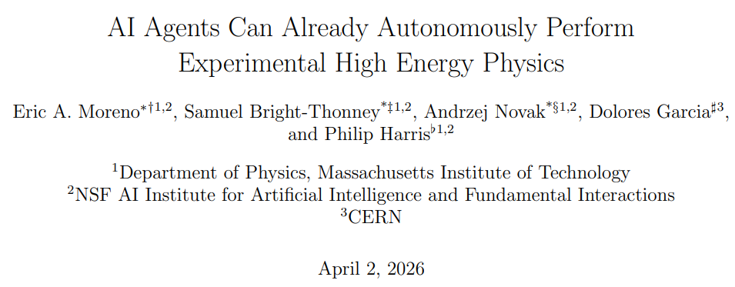
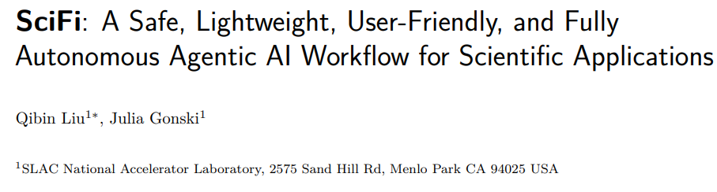
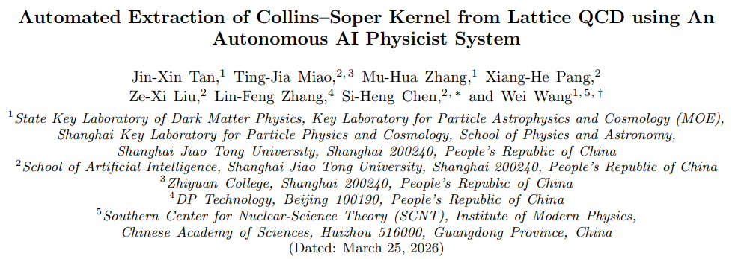
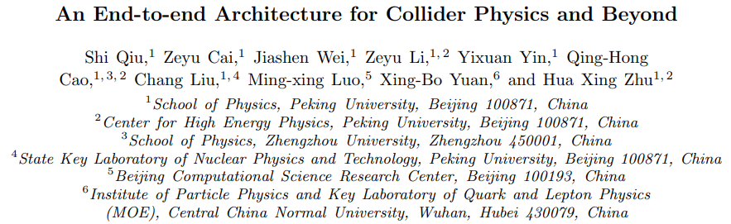
HEP specific agents
Industrial AI is moving fast and works well
Why we still need agents for HEP ?
  Analysis knowledge and data are internal to the collaboration
  Workflow orchestration & validation require domain experts
arXiv:2603.20179
arXiv:2604.13180
arXiv:2603.14553
arXiv:2603.22471

Slide 6
The DrSai project
Purpose: Pioneering autonomous physics discovery at BESIII (and beyond) through Agentic AI
Traditional software,
ML models, etc.
Expertise -> Skills;
Analyses representation-> DSL; Internal notes -> RAG
Orchestration: Skills+DSL+RAG+ human correction
DrSai
Tools + Knowledge + Strategy
LLMs

Slide 7







DrSai Evolution Milestones
Physics results
Measure the hadronic cross sections below 2GeV using DrSai
Working Group formed
Dr.Sai V1: Feasibility verified
Dr.Sai V2: Protetype
DrSai V3: Ready for analysis
Core team of ~20 established to explore multi-agents architecture right after GPT-3
Core system setup and toolchains integrated to verify basic technical feasibility.
Capable of simple analysis through fixed workflows. Validated via 10 re-measurement tests.
Refactored. Internal testing phase. Knowledge and expertise interpreted into skills and DSL.
ChatGPT (GPT-3.5)
Manus
Claude Code 2.1
Extending to other experiments
DeeoSeek-V2
DeepSeek-V4

Slide 8
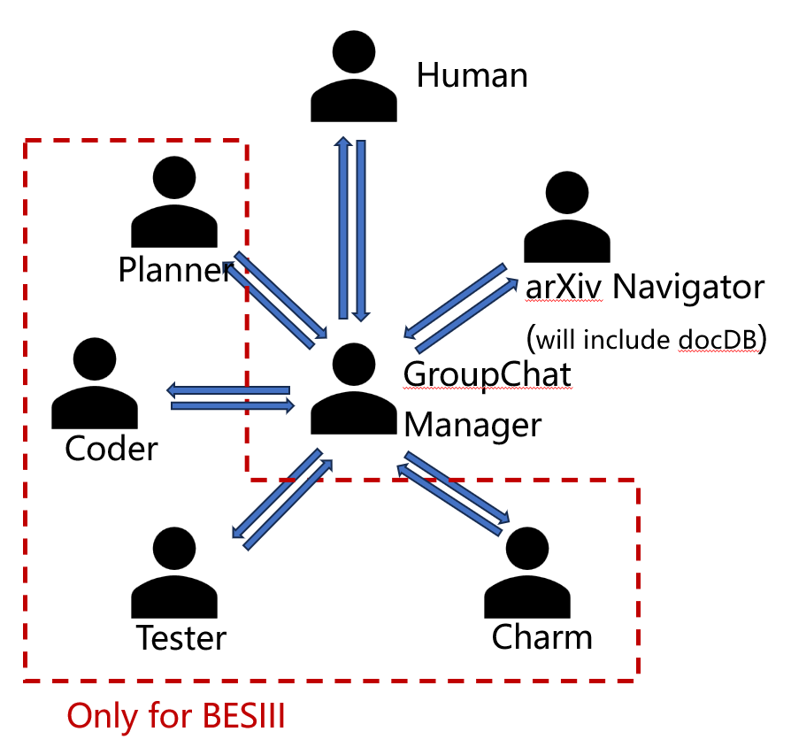
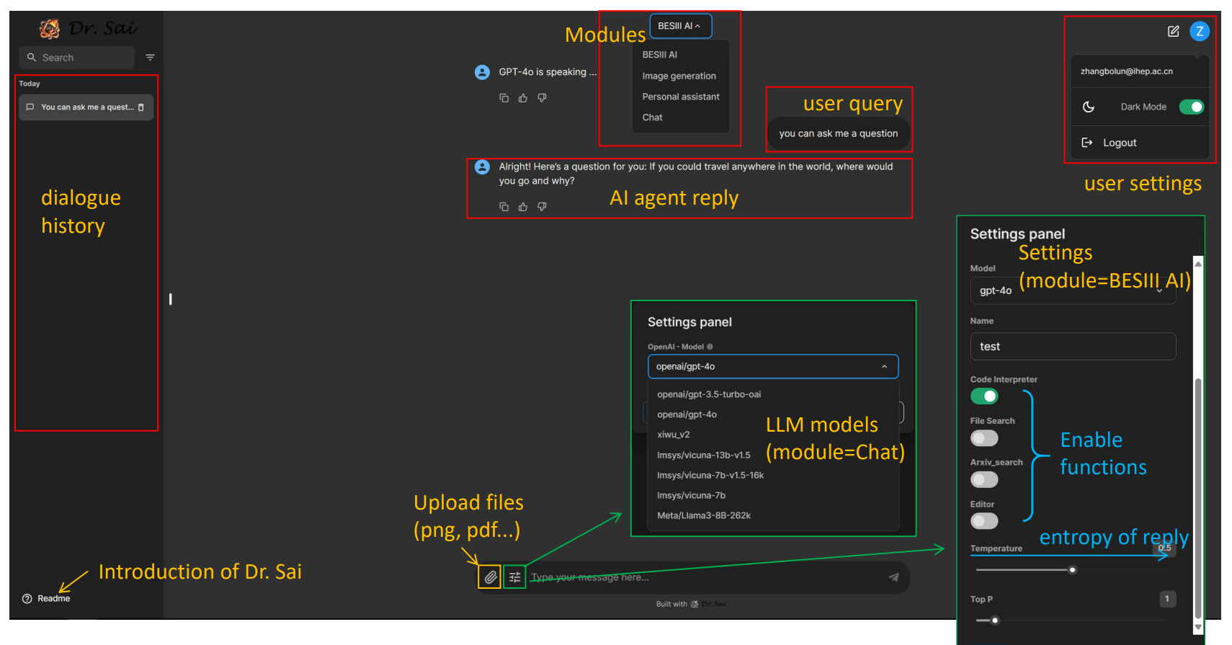
DrSai V1
Developed based on open-source multi-agents framework: AutoGen.
Deploy workers to wrap-up the tools
Tested LLMs on intent understanding, orchestration, tool invocation, etc.
Verified feasibility
More details in the talk at ICHEP2024

Slide 9
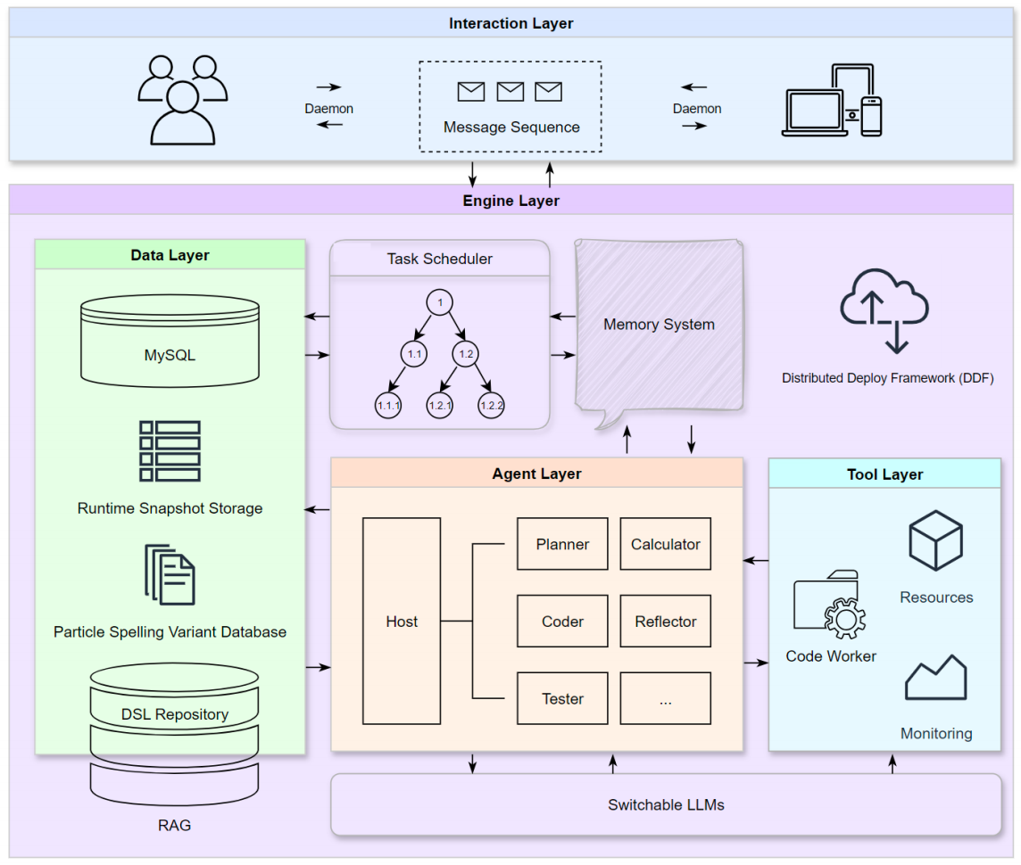
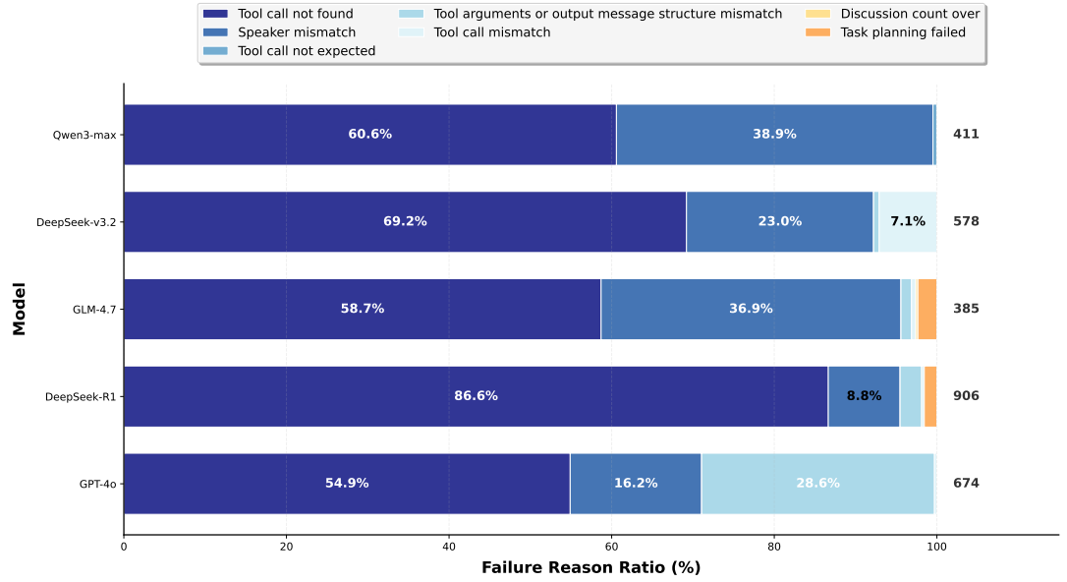
DrSai V2
Make BESIII analysis agent-based
Analysis represented via DSL (preliminary)
Built a benchmark for BESIII analysis
Tested several LLMs
arXiv:2604.22541

Slide 10
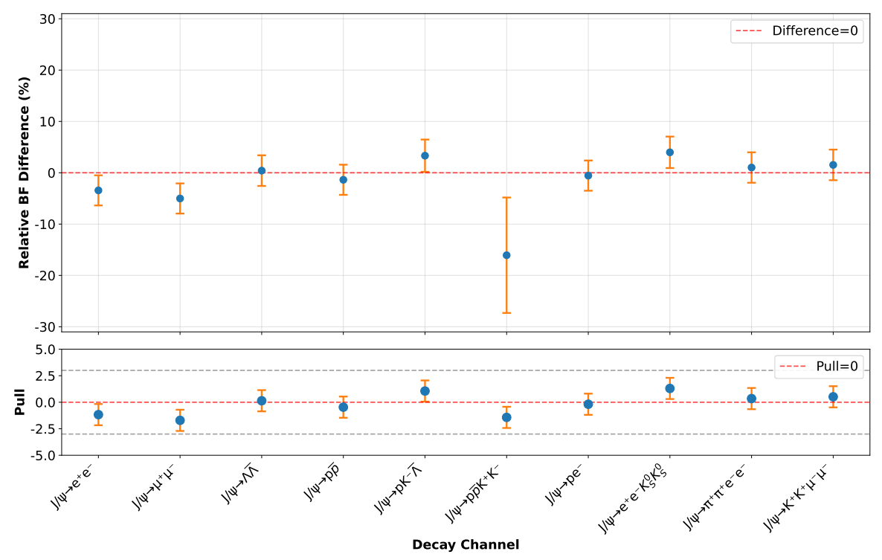


DrSai V2
The whole system was validated by re-measuring known branching fractions (BFs） of the $J/ψ$ decays !
  Built a sample using MC with all known decays
  Use $ψ\left(3686\right)→π^{+}π^{−}J/ψ$ process to measure the BFs of $J/ψ$
  DrSai V2 performed the whole analysis
    From simulation to preliminary systematics study
  All the measured BFs showed good consistency with injected values
  First full chain validation of DrSai on a realistic physics analysis pipeline

Slide 11
Identified Core Challenges
Knowledge & Self-Evolution
Reasoning & Task planning
Often unstructured (experience, intuition). How to make it computable, reasonable, and continuously growing?
High level goals need complex and hallucinations-free decomposition + environment-aware reflections
Solution
Solution
Domain-Specific-Language (DSL) represent analysis with an on-the-fly extraction and iterative refinement from expert feedback
Expert guides the system to orchestrate workflows for multiple analyses → distills into Skills → next workflow iteratively refined
Tools/codes & Execution
Infrastructures & Safety
Complex software system, and must align with physics goals, as well as auto-checking
Scaling bottlenecks (GPU costs) vs. data privacy and autonomous safety risks
Solution
Solution
Error‑Aware GraphRAG – stores long connections.
DSL/Skill align with code blocks or tools, enabling multiple checkpoints (e.g., injection tests).
Local deployment of open-source LLM (DeepSeek) at IHEP + Cloud support.
Only allow predefined operations.

Slide 12
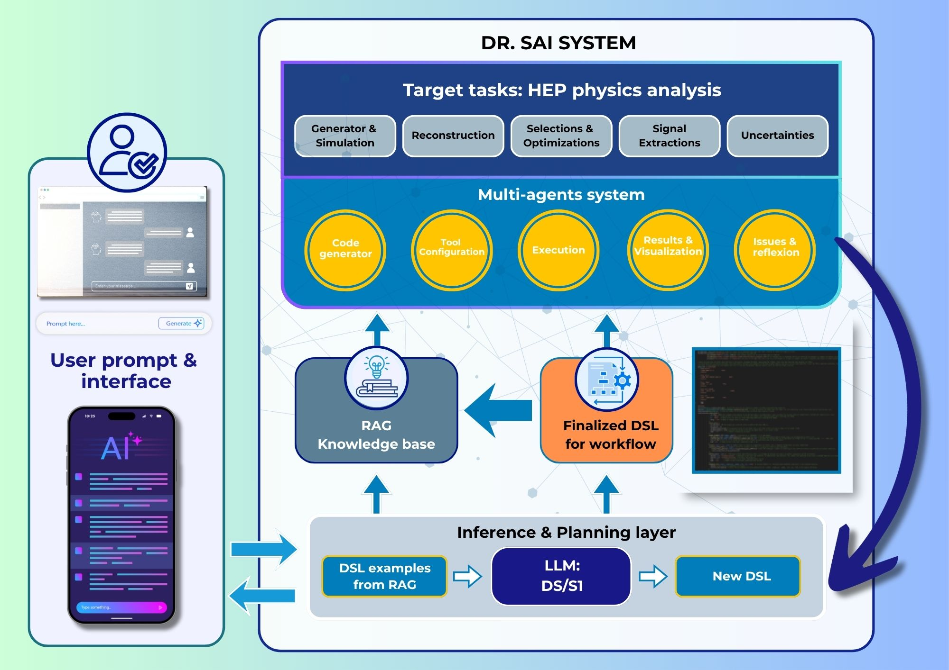
DrSai V3
With DrSai V2, we have identified four core challenges and developed corresponding solutions
Major updates
  AutoGen-based framework -> Claude Code agent runtime
    Also DeepSeek-TUI, Cline, etc.
  A set of analysis Skills – built and refined
  Hundreds of DSLs extracted from published papers
  Error‑aware GraphRAG for code generation
  Agentic RAG for internal notes of previous analyses
Front. Phys., 2026, 21(9): 096401

Slide 13
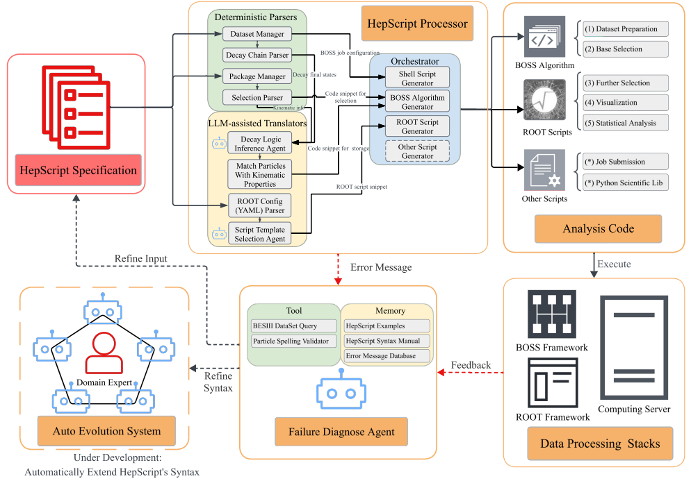
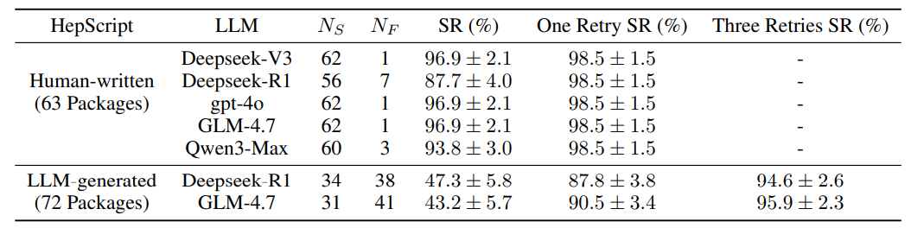
Analysis representation: HepScript (a DSL)
Represent BESIII analysis
  Pseudocode in Ruby/YAML format
Bridges high-level intent with code/tools
Defines a constrained action space
The majority are mapped into code blocks
  Only a small part need conversion by LLM
Scalable: automatically extracted from published paper or generated on-the-fly for new analysis
Good accuracy for generation of analysis algorithms
arXiv:2605.01423

Slide 14
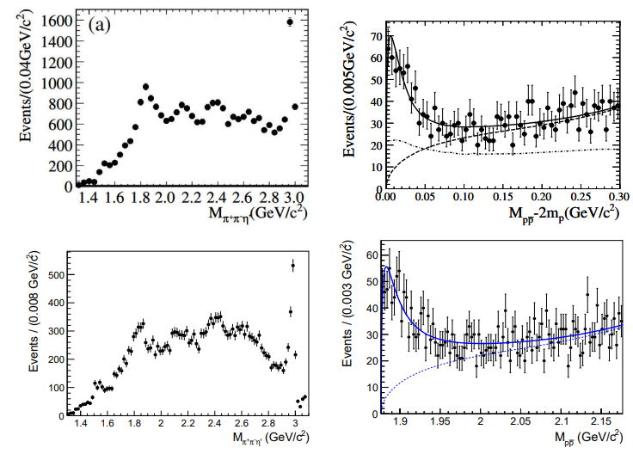
HepScript-driven analysis reproduction
Necessary for real-world complex analysis
A showcase: re-produce the previous analysis
Used in the DrSai V3 for intent understanding, information completion, and code generation
From publication
Published paper
HepScript
Configs/ software
LLM
LLM
LLM
Analysis pipeline: simulation, reconstruction, selection, statistical analysis
Re-produced using HepScript
Only for technical validation

Slide 15
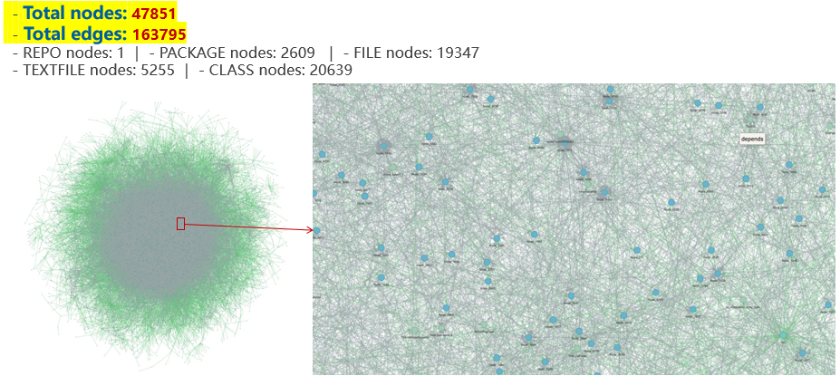
Domain code/script generation
Complex code dependencies at HEP
  LLMs struggle to reason over large-scale, intricate dependency correctly and efficiently
We start with open-source software - ROOT
  Massive interconnections -> a large graph
    Nodes : class, package, etc.
    Edges : contains, extends, depends
  Obvious improvement on accuracy
  Further improvement from Error-Aware RAG
    First find the related subGraph, then feed LLM
This method can be easily applied to HEP software development
Graph for whole ROOT source code
Zoom in
Github Repo:
https://github.com/yues36067-cmd/ROOTER

Slide 16
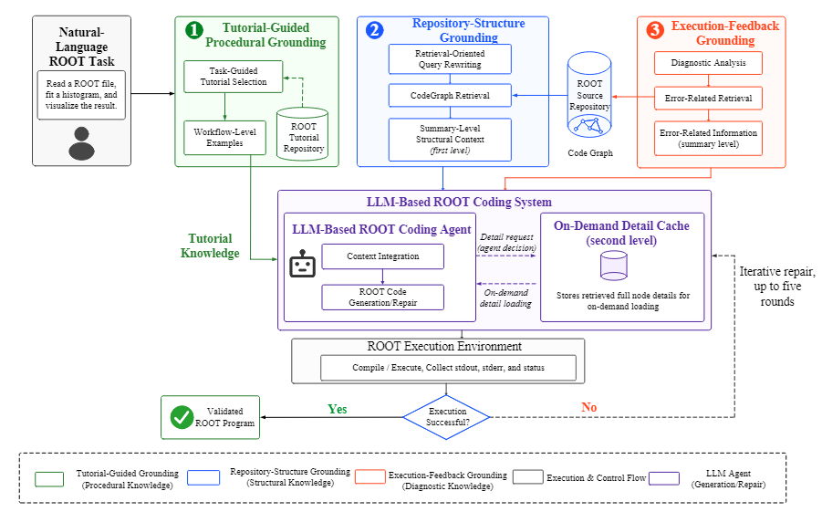
Agentic generation
Overall Workflow
  Intent understanding & semantic conversion
  Similar‑example retrieval from tutorials
  Intent‑driven dependency extraction
  Code execution with error handling

Slide 17
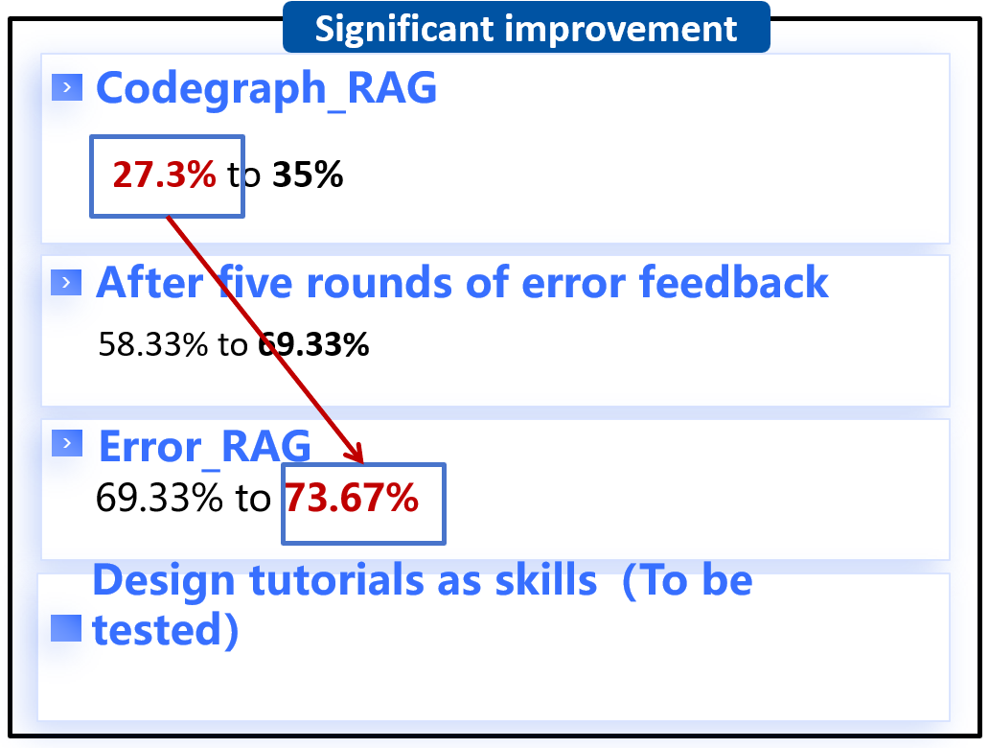
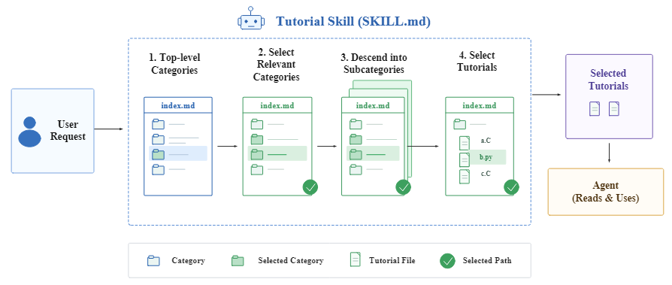
Domain code/script generation
Two benchmarks and evaluation methods have been developed
  Good improvement on accuracy
  LLM: deepseek V4 pro
  Testing claude code with opus4.8/fable5
Integrated to DrSai, works well
On-going: Agent with Skills + RAG

Slide 18
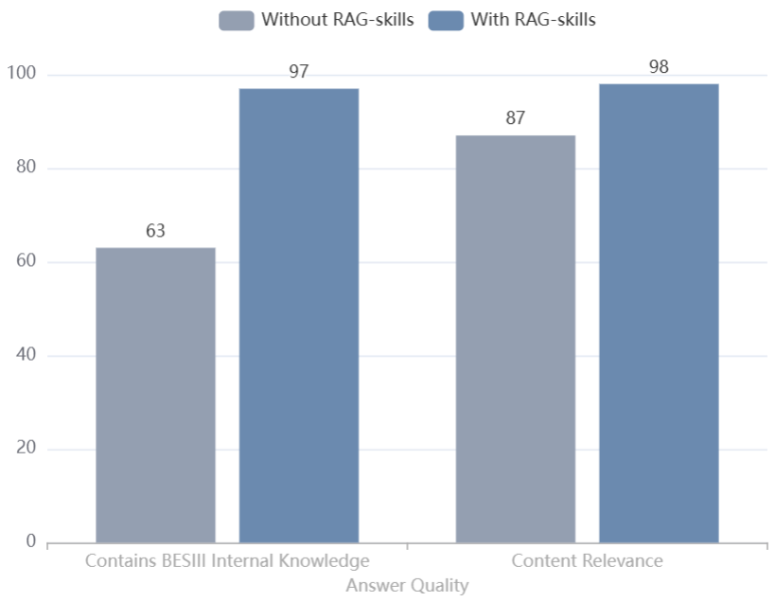
Query system with Agentic RAG
Multiple sources: internal notes, websites, talks, etc.
  Multi-modal parsing via Miner-U; Embedding model using Bge-M3
Previous analyses at BESIII are chunked by analysis steps and sub-steps
  Object selection, optimization, signal extraction, systematic uncertainty, etc.
Metadata are defined for each analysis
  Goal, dataset, observables, etc.
Agentic retrieval with Skills
  Hybrid: Grep + RAG (dense and sparse channels)
    Routed by LLM
User can ask the previous analysis details
  How to deal with xxx systematics ?
  How to suppress xxx background ?
  Etc.
The system will be used to provide suggestions for new analysis

Slide 19
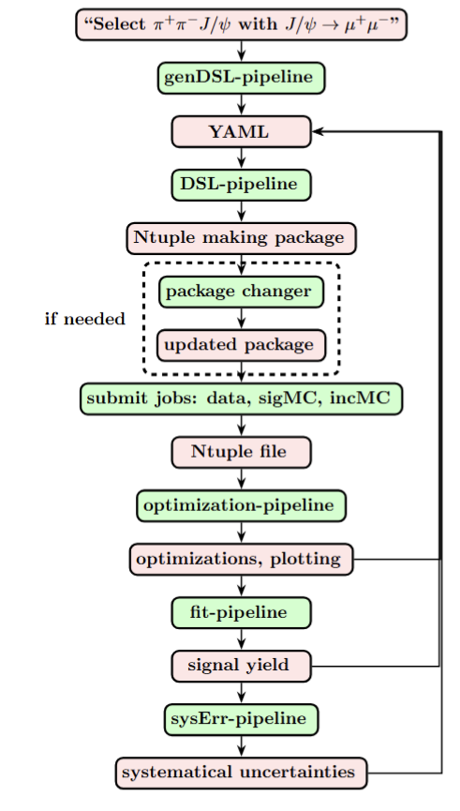
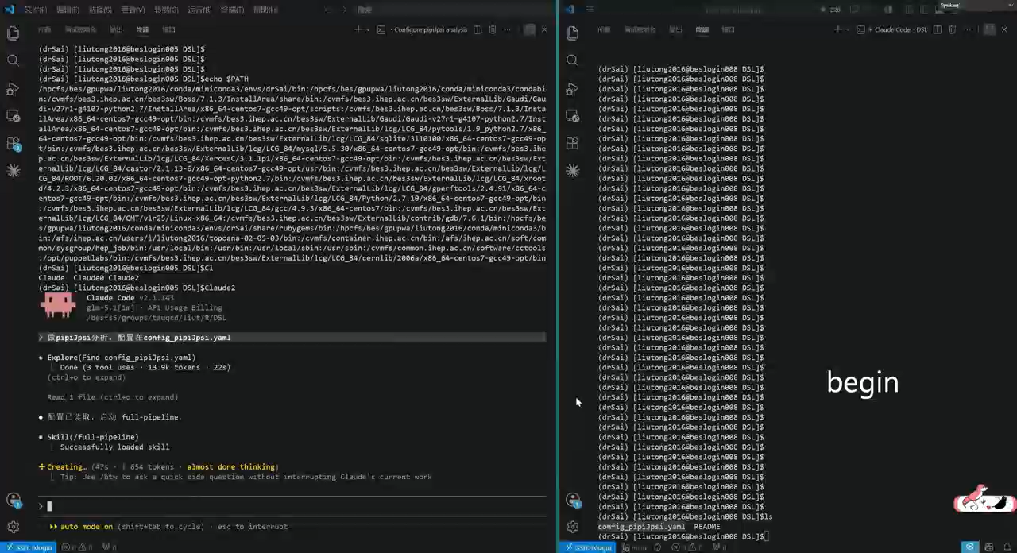
A recording for Zc(3900) re-discovery
Skills
Input/Output

Slide 20
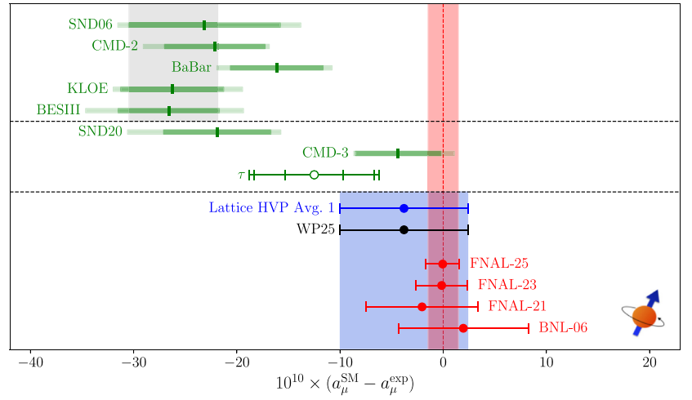
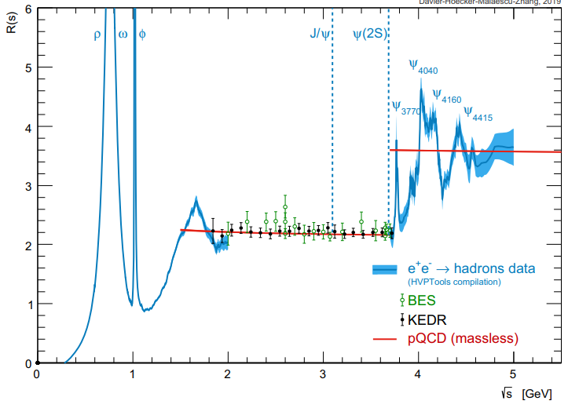
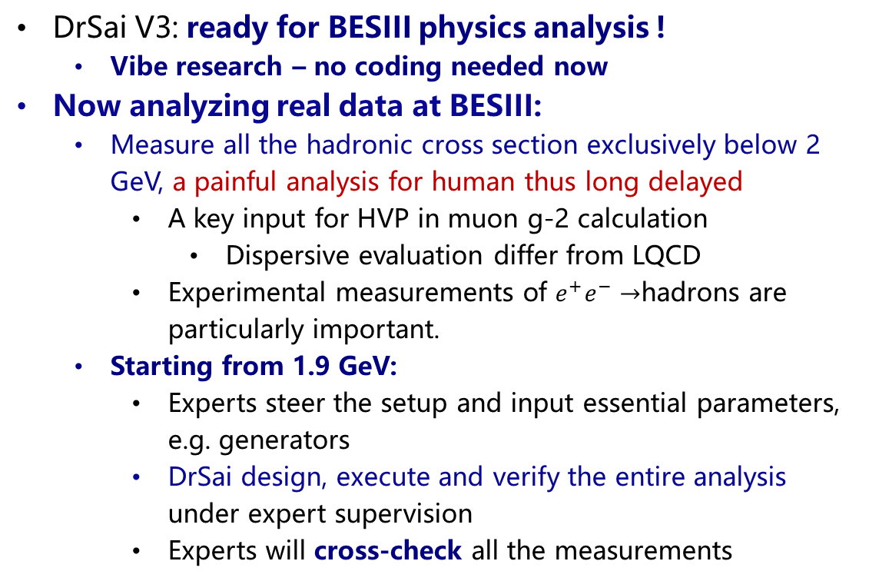
Analysis using DrSai at BESIII
DrSai V3: ready for BESIII physics analysis !
  Vibe research – no coding needed now
Now analyzing real data at BESIII:
  Measure all the hadronic cross section exclusively below 2 GeV, a painful analysis for human thus long delayed
    A key input for HVP in muon g-2 calculation
      Dispersive evaluation differ from LQCD
    Experimental measurements of $e^{+}e^{−}→$hadrons are particularly important.
  Starting from 1.9 GeV:
    Experts steer the setup and input essential parameters, e.g. generators
    DrSai design, execute and verify the entire analysis under expert supervision
    Experts will cross-check all the measurements
Physics Reports
1143 (2025) 1-158
Eur. Phys. J. C 80, 241 (2020)

Slide 21
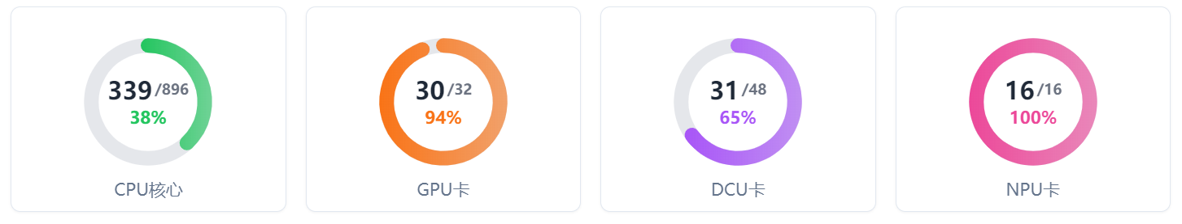
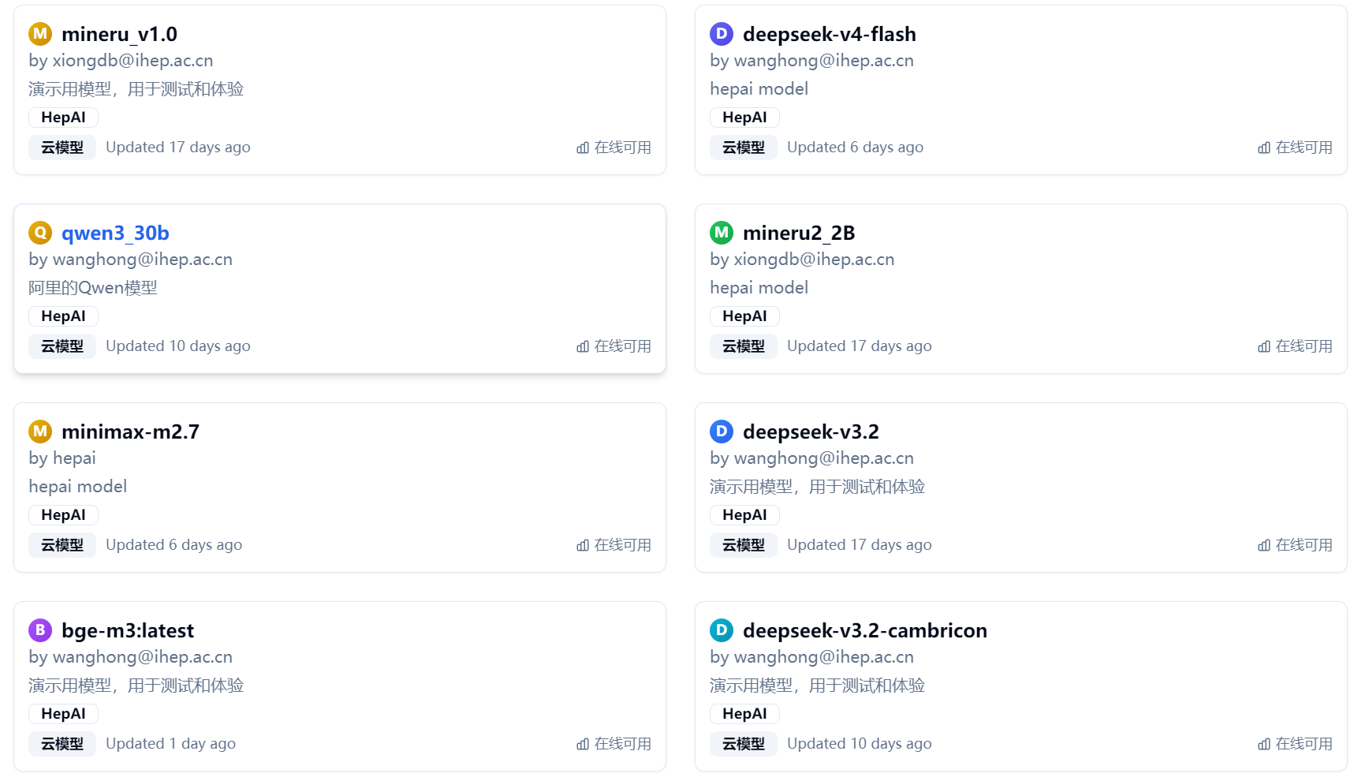
AI Infrastructure at IHEP
New dedicated AI platform:
  2240 CPU cores, 40 GPU, 48 DCU, 16 NPU
  More (2X) are coming
LLMs access and deployment
  Unified API via Distributed Deployment Framework
  Hybrid solution: local deployment + commercial cloud
    Open-source LLMs (e.g. DeepSeek)
    High concurrency
    Ensure data security
  Closed-source LLMs accessible via API
  Cache-hit techniques reduce the cost to 2-10%

Slide 22
DrSai Collaboration
DrSai is already yielding physics results
  Physicists interact with DrSai using natural language, only a few times with zero coding!
Now extending to other experiments:
  Jiangmen Underground Neutrino observatory (JUNO)
  Large High Altitude Air Shower Observatory (LHAASO)
  Neutron/Light source, etc.
We are forming a DrSai collaboration
  Solving Agentic AI challenges together
  Shared AI infrastructure & computing resources in collaboration
  Please subscribe: drsai@maillist.ihep.ac.cn (link)

Slide 23
Summary and outlook
DrSai: an agent-based system advancing HEP experiment
  Project launched at June 2023
  Major challenges identified → multiple solutions proposed & developed
  Current approach:
    Industrial coding agent + LLM
    Skills + DSL + RAG : encode expertise, analysis representation, and technical memory
AI partner is being realized today
  First physics results expected by the end of 2026
Many challenges remain towards AI scientist – but we are actively solving them
  How to add physics knowledge/rule/check in a reasonable approach?
  As AI evolves rapidly, we are adapting our strategy accordingly
Thanks for your attention !

Slide 24
Back-up

Slide 25
DrSai – development roadmap
2023.06: Working group launched (~20 people)
2024.06: V1, Feasibility tested and verified
  Setup the system, all tools integrated
2025.06: V2, The prototype was conducted
  Capable of very simple analysis with fixed workflow
  Validated by performing re-measurements
2026.06: V3, under internal testing
  Knowledge extracted into DSLs
  Expertise distilled into Skills
  Analyzing real data now, expect to have the first“AI-driven”experimental results by end of 2026 !
arXiv:2604.22541

Slide 26
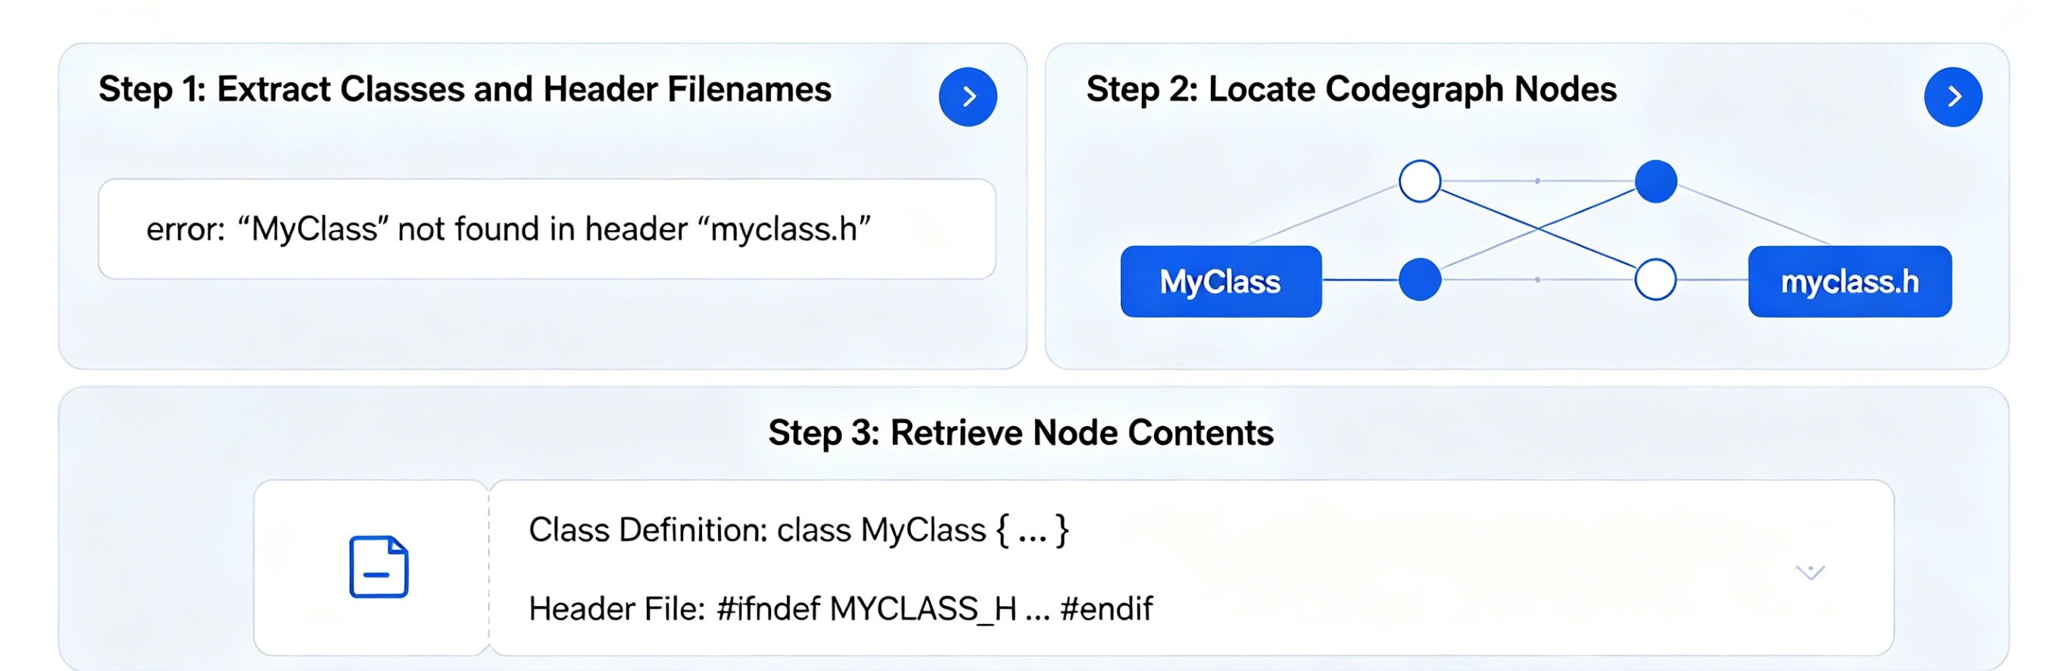
Error-Aware Retrieval and Skills
Another retrieval by identifying the sources of errors
  Improve the accuracy obviously
Further improvement by introducing a set of Skills
Two benchmarks and evaluation methods are provided
Error Aware Retrieval
Average Score
w/o ROOT Skills
86.24
w/ ROOT Skills
91.23
Files evaluated: 50 base, 47 skill-version outputs.
Language uplift
C +6.57
Python +3.20
+4.99 avg score
https://github.com/yues36067-cmd/ROOTER.git

Slide 27
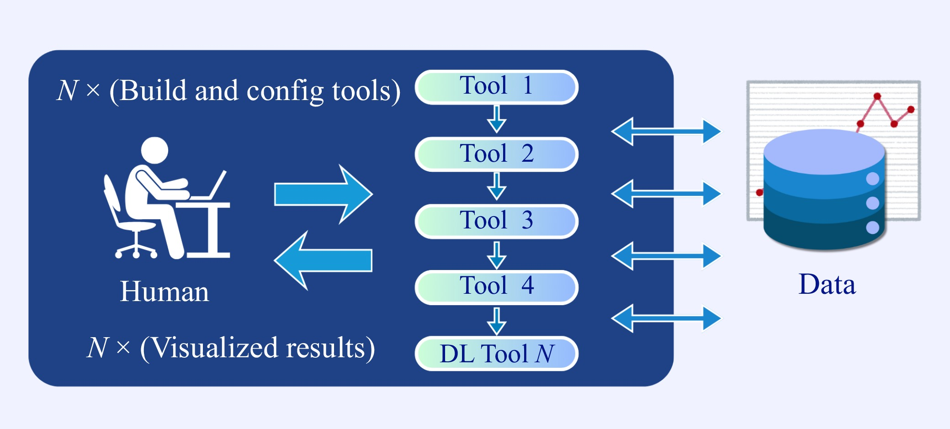
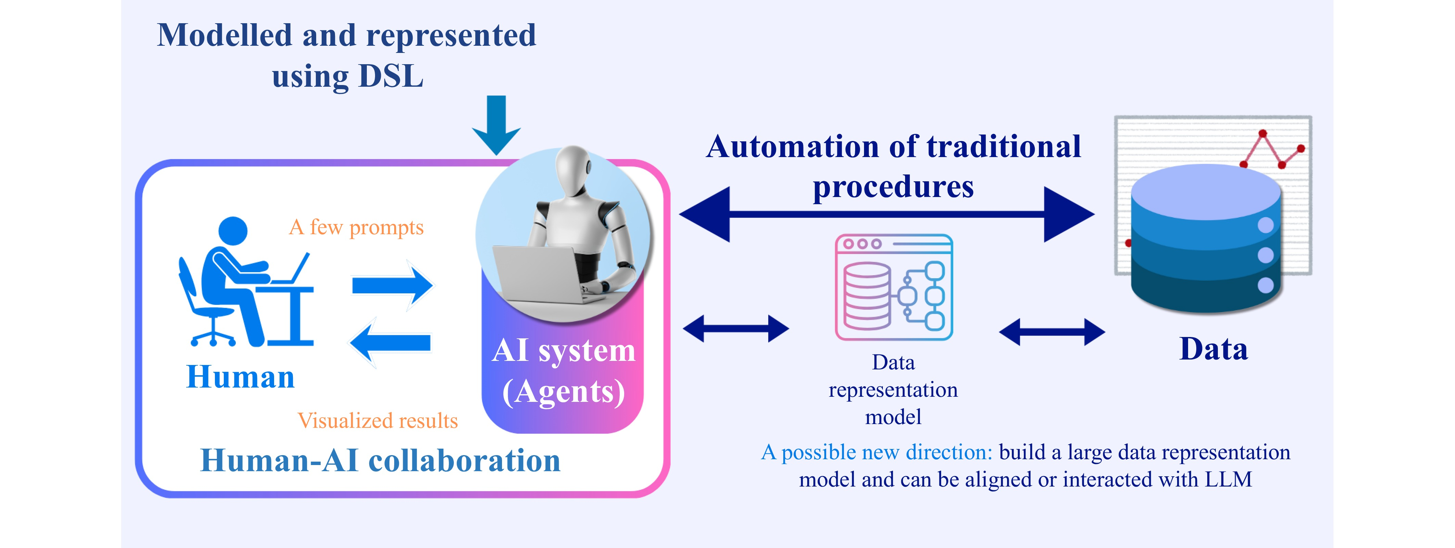
AI scientists: Goal-driven autonomy
An AI system with structured knowledge representation and autonomous research capabilities
Can perform the full research loop and continue revolution:
  Goal → Design → Execute → Analyze → Generate new knowledge
Key distinction from AI Partner:
  AI Partner: relies on human commands and operate through “vibe research”
  AI Scientist: human only need to sets high‑level goals
Already
completed

Slide 28
Millestone developments
Setup the system, standardize and integrate all the tools, including BESIII Offline Software System(BOSS) and HTCondor
Done at 2024.06
Represent the knowledges on how to used tools and analysis procedures into a DSL, automatically extracted from published papers
Done at 2025.06
Distill human expertise into Skills on how to perform analysis, including workflow definition and tests (i.e. input/output test)
Done at 2026.05

Slide 29
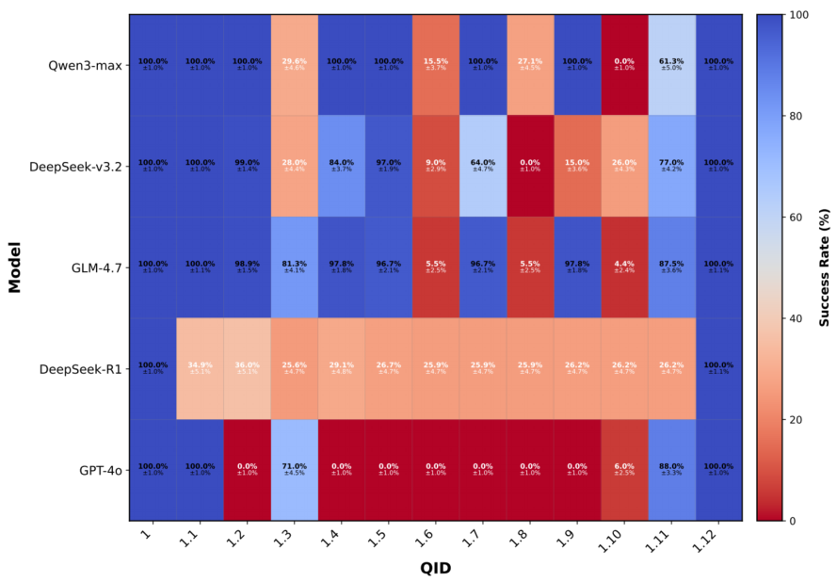
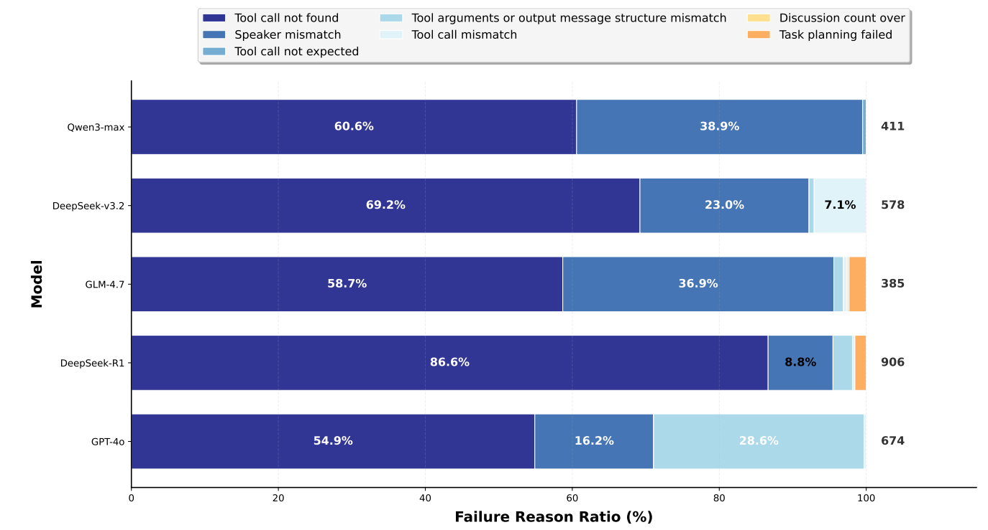
Demonstration of DrSai V2
Performance study and error analysis were conducted using LLMs at 2025
  Tool call was the bottlenecks
We are finalizing the DrSai V3 now, and will make a more comprehensive study

Slide 30
AI infrastructures at IHEP

