Slide 1
Does the Hoyle state of ¹²C appear in the calculation with the strong short-range repulsion?
H. Takemoto, T. Myo, M. Lyu, H. Horiuchi, H. Toki, Q. Zhao,
N. Wan, and M. Isaka

Slide 2
THSR + UCOM
The AV4’ potential was used as nucleon-nucleon interaction, which is constructed projecting the AV18 potential. It is the central potential with strong short-range repulsion.
The Unitary Correlation Operator Method (UCOM) was applied to treat the short-range correlation.
The THSR wave function was used to describe 4n-nuclei, which is slightly modified to improve convergence in Monte Carlo integration.

Slide 3
UCOM
The unitary correlation operator is defined by
$$\hat{C}=\text{exp}\left(−i\sum_{i=1}^{A}{\sum_{j=i+1}^{A}{{\hat{g}}_{ij}}}\right), {\hat{g}}_{ij}=\frac{1}{2}\left\{{\hat{p}}_{rij}s\left(r_{ij}\right)+s(r_{ij}){\hat{p}}_{rij}\right\}$$
where ${\hat{p}}_{rij}$ is the component of the relative momentum parallel to the relative coordinate ${\vec{r}}_{ij}$, and ${\hat{g}}_{ij}$ is a Hermitian operator.

Slide 4
UCOM
The relative distance $r$ and the operator ${\hat{p}}_{r}$ are transformed as
$${\hat{c}}^{†}r\hat{c}=R_{+}\left(r\right), {\hat{c}}^{†}{\hat{p}}_{r}\hat{c}=\sqrt{\frac{1}{R_{+}^{′}(r)}}{\hat{p}}_{r}\sqrt{\frac{1}{R_{+}^{′}(r)}}$$
where $\hat{c}=\text{exp}(−i\hat{g})$, and $R_{+}\left(r\right)$ is connected to $s\left(r\right)$ by
$$\frac{dR_{+}(r)}{dr}=\frac{s\left(R_{+}(r)\right)}{s(r)}$$
Ref) H. Feldmeier, T. Neff, R. Roth and J. Schnack, NPA 632, 61(1998).

Slide 5
UCOM
The transformed Hamiltonian within the two-body approximation is
$${\tilde{H}=\hat{C}}^{†}\hat{H}\hat{C}={\hat{C}}^{†}\hat{T}\hat{C}+{\hat{C}}^{†}\hat{V}\hat{C}=\tilde{T}+\tilde{V}$$
where
$$\tilde{T}≃\sum_{i=1}^{A}{{\hat{t}}_{i}−{\hat{T}}_{\text{c}\text{.}\text{m}\text{.}}}+\sum_{i=1}^{A}{\sum_{j=i+1}^{A}{{\hat{u}}_{ij}}}, \tilde{V}≃\sum_{i=1}^{A}{\sum_{j=i+1}^{A}{v_{ij}\left(R_{+}\left(r_{ij}\right)\right)}}.$$
The two-body potential ${\hat{u}}_{ij}$ contains terms dependent on the momentum and angular momentum of the relative motion.
Ref) H. Feldmeier, T. Neff, R. Roth and J. Schnack, NPA 632, 61(1998).

Slide 6
UCOM
The function of $R_{+}\left(r\right)$ is assumed as
$$R_{+}^{even}\left(r\right)=r+α{\left(\frac{r}{β}\right)}^{γ}\exp\left[−\exp\left(\frac{r}{β}\right)\right]$$
$$R_{+}^{odd}\left(r\right)=r+α\left[1−\exp\left(−\frac{r}{γ}\right)\right]\exp\left[−\exp\left(\frac{r}{β}\right)\right]$$
which is the same form in
Ref) T. Neff and H. Feldmeier, NPA 715, 311(2004).

Slide 7
UCOM
The parameters in $R_{+}\left(r\right)$ for AV4’ are taken from Ref) T. Myo, et.al., PRC 99 024312 (2019):
 | α | β | γ
¹E | 1.36 | 0.98 | 0.33
³E | 1.24 | 0.94 | 0.39
¹O | 1.50 | 1.26 | 0.87
³O | 0.69 | 1.39 | 0.28
$$R_{+}^{even}\left(r\right)=r+α{\left(\frac{r}{β}\right)}^{γ}\exp\left[−\exp\left(\frac{r}{β}\right)\right]，R_{+}^{odd}\left(r\right)=r+α\left[1−\exp\left(−\frac{r}{γ}\right)\right]\exp\left[−\exp\left(\frac{r}{β}\right)\right]$$
which is determined by minimizing the energy of the symmetric nuclear matter in the finite particle-number calculation with a mass number A = 132.

Slide 8
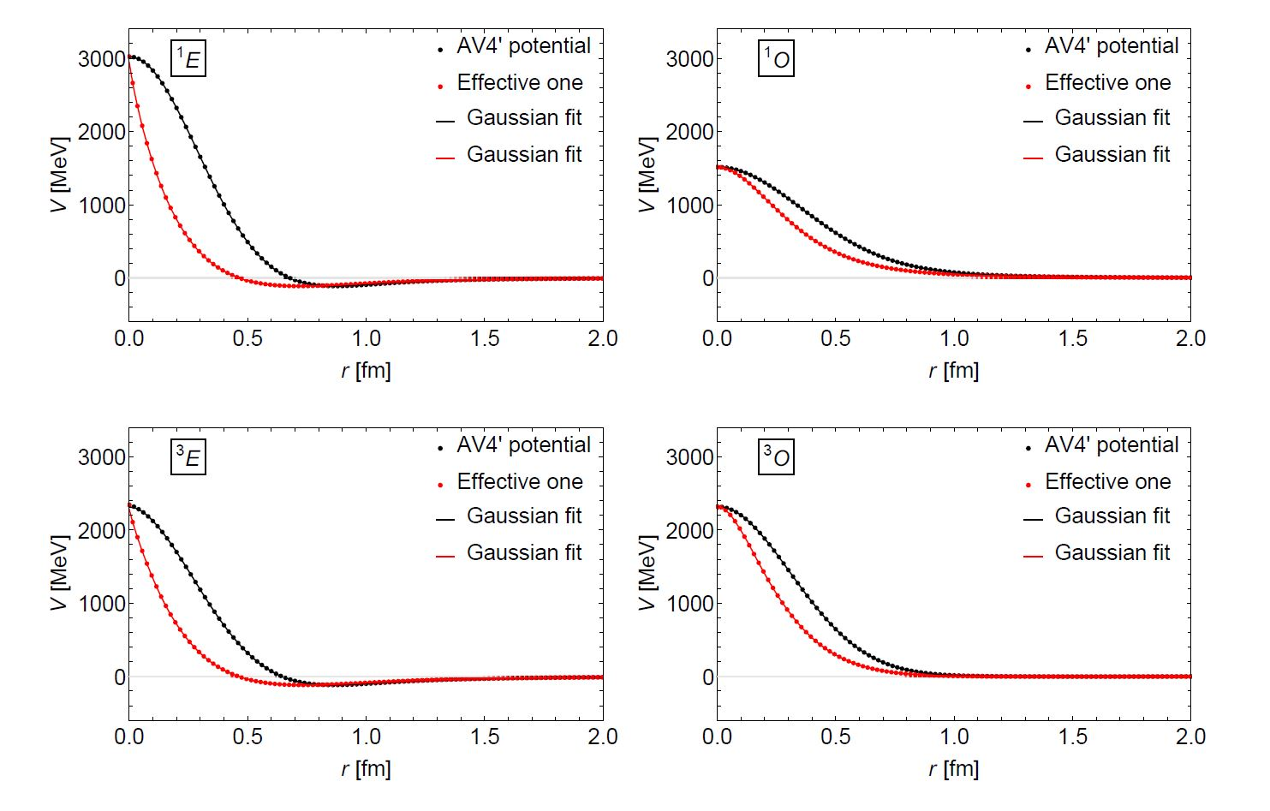
Effect of UCOM on AV4’
Potential curve in each channel
The black and red points denote the AV4’ potential before and after the UCOM transformation.
The lines are the fits of 15 Gaussian, which are used in the following calculations.

Slide 9
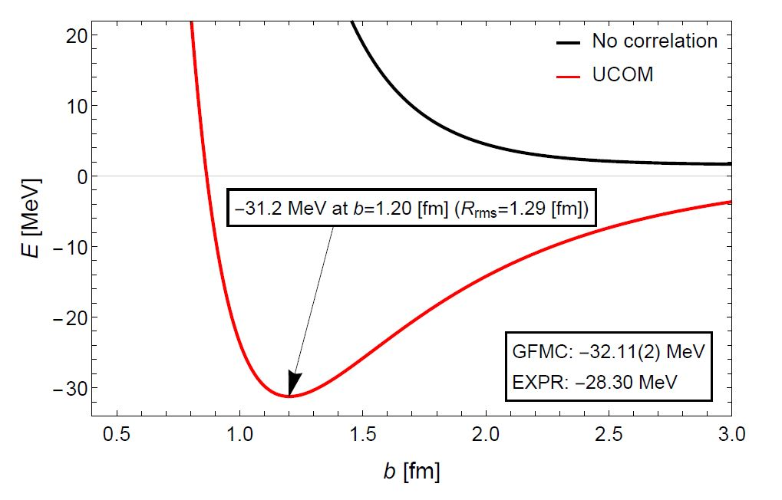
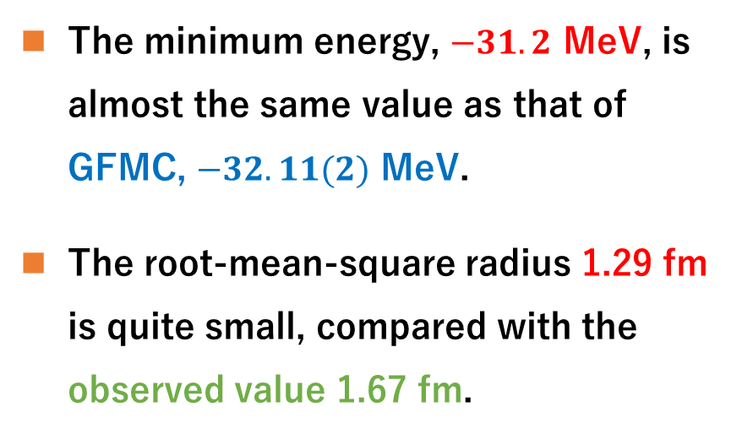
Effect of UCOM on AV4’
Energy of ⁴He with the (0s)⁴ configuration
$$ψ_{0}\left(α\right)=\frac{1}{\sqrt{4!}}\text{det}\prod_{i=1}^{4}{φ_{0}\left(r_{i}\right)χ_{i}(ξ_{i})}, φ_{R}\left(r\right)={\left(\frac{b}{\sqrt{π}}\right)}^{3/2}\exp\left[−\frac{b^{2}}{2}{\left(r−R\right)}^{2}\right]$$
The minimum energy, $−31.2$ MeV, is almost the same value as that of GFMC, $−32.11(2)$ MeV.
The root-mean-square radius 1.29 fm is quite small, compared with the observed value 1.67 fm.

Slide 10
THSR wave function
The original THST wave function
$$\left.|Ψ_{THSR}\right\rangle =\frac{1}{\sqrt{N}}\prod_{i=1}^{N}{{\hat{I}}_{000}\left(R_{i}\right)}\left.|Ψ_{Brink}\right\rangle , {\hat{I}}_{000}\left(R\right)={\left(\frac{1}{2πB^{2}}\right)}^{3/2}\iiint{dR}e^{−R^{2}/2B^{2}}$$
$$\left.|Ψ_{Brink}\right\rangle =\frac{1}{\sqrt{A!}}\det{ψ_{R_{i}}\left(α_{i}\right)}, ψ_{R}\left(α\right)=\prod_{i=1}^{4}{φ_{R}\left(r_{i}\right)χ_{i}(ξ_{i})}, χ_{1,2,3,4}=p_{↑},p_{↓},n_{↑},n_{↓}$$
$$φ_{R}\left(r\right)={\left(\frac{b}{\sqrt{π}}\right)}^{3/2}\exp\left[−\frac{b^{2}}{2}{\left(r−R\right)}^{2}\right], R_{G}=\frac{1}{n}\sum_{i=1}^{n}{R_{αi}}≠0$$
The THSR wave function was slightly modified to improve the convergence in the Monte Carlo integration:
$$\left.|Ψ_{THSR}\right\rangle =\frac{1}{\sqrt{N}}\prod_{i=1}^{N}{{\hat{I}}_{000}}\left(R_{i}\right) δ\left(R_{G}\right) \left.|Ψ_{Brink}\right\rangle$$

Slide 11
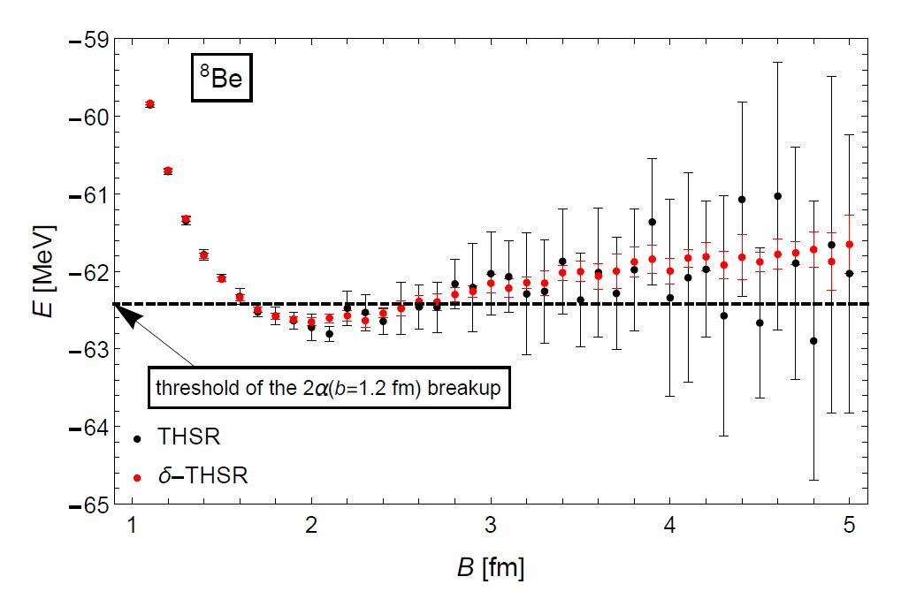
Improvement of the convergence
in the Monte Carlo integration
Energy of ⁸Be described by THSR and δ-THSR wave functions
One million points were taken in the Monte Carlo integration.
The mean values (points) and the standard error (error bars) were evaluated from ten samples.
The accuracy is drastically improved by using δ-THSR wave functions.

Slide 12
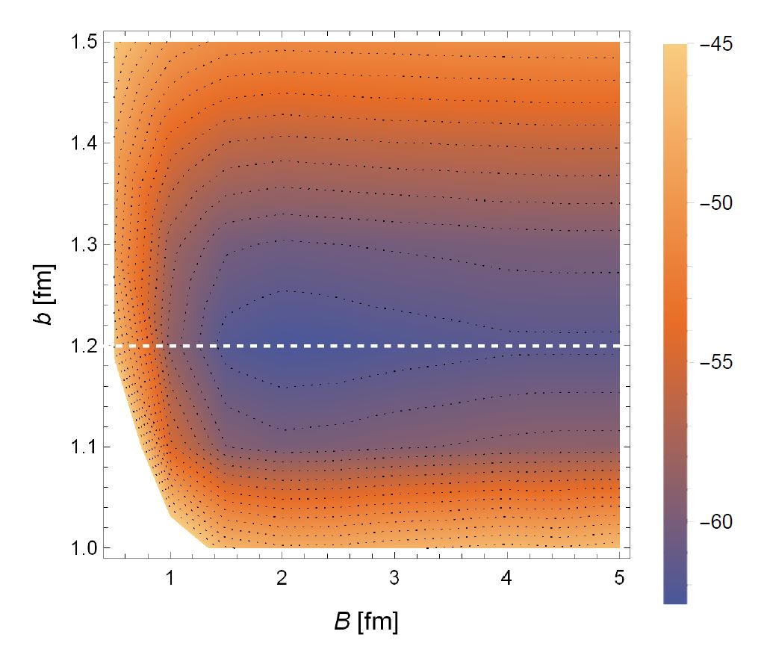
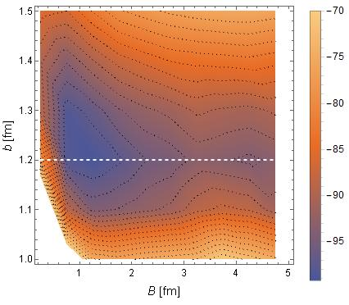
Results
Energy contour maps of ⁸Be (the left panel) and ¹²C (the right panel)
Energy valleys are along $b=1.2$ fm which corresponds to the free alpha particle.
※ Energies of ¹²C in the region with large B values have not converged yet.

Slide 13
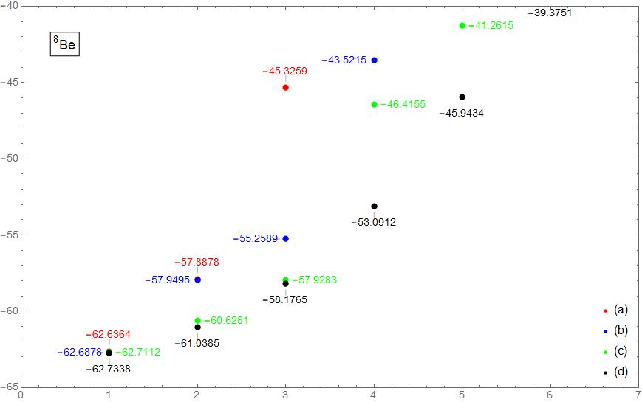
Results
GCM calculation of ⁸Be with respect to the B parameter (b=1.2 fm).
(a) B=1.0, 1.5, and 2.0 fm.
(b) B=1.0, 1.5, 2.0, and 2.5 fm
(c) B=1.0, 1.5, …, and 3.0 fm
(d) B=1.0, 1.5, …, and 3.5 fm

Slide 14
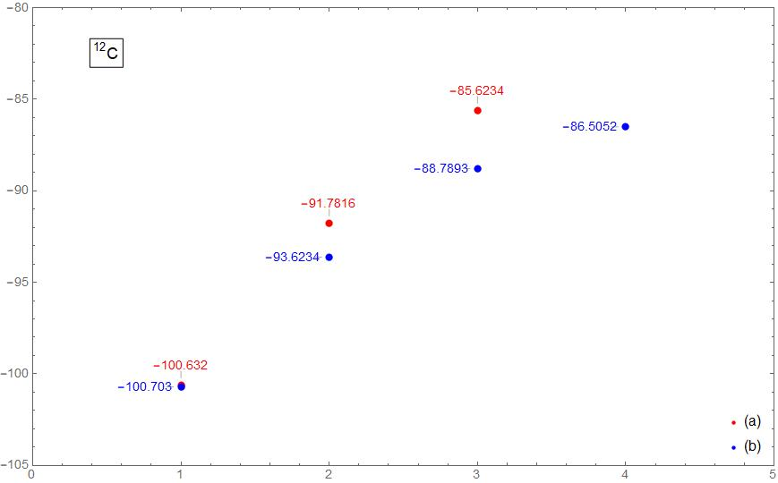
Results
GCM calculation of ¹²C with respect to the B parameter (b=1.2 fm).
(a) B=0.5, 1.0, 2.0, and
4.0 fm.
(b) B=0.5, 0.5×1.5, 0.5×1.5², …, and 0.5×1.5⁶ =5.6953125 fm

Slide 15
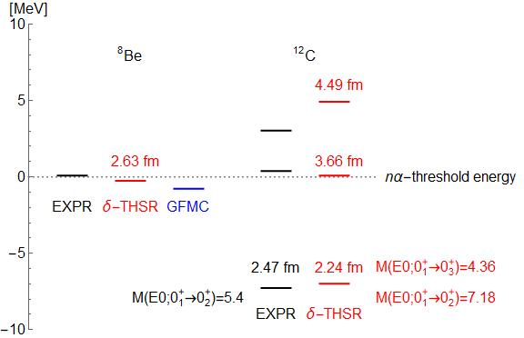
Summary
Energy levels were measured from the nα-threshold energy.
⁸Be were slightly bound by using AV4’, that is,
δ-THSR: $−0.25$ MeV
GFMC: $−0.78$ MeV
below the threshold.
The lowest energy of 12C was consistent with the observed value.
The second lowest energy was around the threshold?
※ Values for ¹²C is preliminary.

