Slide 1
High-momentum components in the ⁴He nucleus caused by inter-nucleon correlations
[Phys. Lett. B 805, 135421 (2020)]
Mengjiao Lyu
College of Science, Nanjing University of Aeronautics and Astronautics (NUAA)
in collaboration with
Takayuki Myo, Hiroshi Toki, Hisashi Horiuchi,
Chang Xu, and Niu Wan
Workshop on recent progress in THSR research,
Mar. 8th, 2021

Slide 2
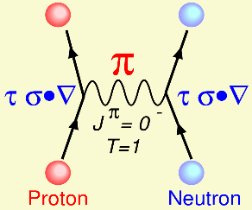
The bare interaction between nucleons
The bare nucleon-nucleon (NN) interaction consists of:
strong short-range repulsion
strong tensor attraction ( > 50% of total attraction)
$$V_{π}=V_{central}+V_{tensor}$$
$$V_{tensor}∝\left(τ_{1}⋅τ_{2}\right)⋅S_{12}$$
$S_{12}=3(σ_{1}⋅\hat{r}$) $\left(σ_{2}⋅\hat{r}\right)$
$−(σ_{1}⋅σ_{1}$)
Tensor force as the dominant effect of the single-pion exchange
AV8’ bare interaction
[1] S. C. Pieper and R. B. Wiringa, Annu. Rev. Nucl. Part. Sci. 51, 53 (2001).

Slide 3
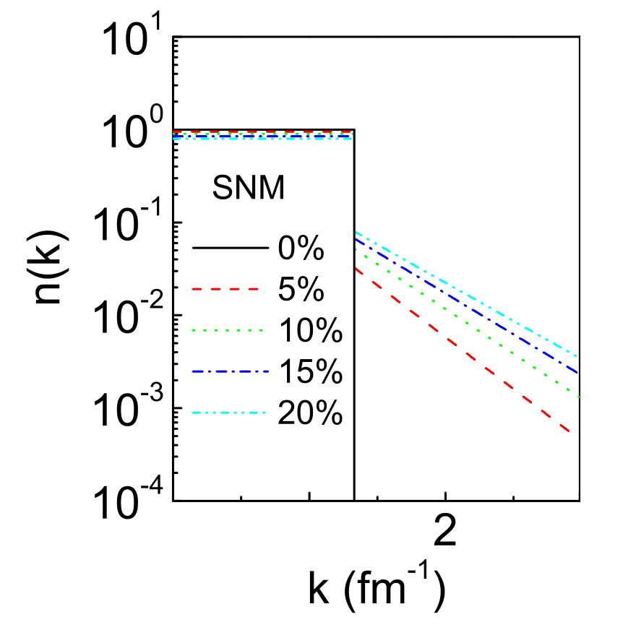
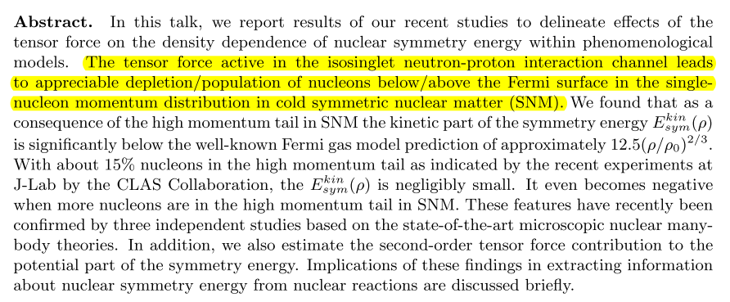
High-momentum components in nuclear matter
[1] R. B. Wiringa, V. G. J. Stoks, and R. Schiavilla, Phys. Rev. C 51, 38 (1995).

Slide 4
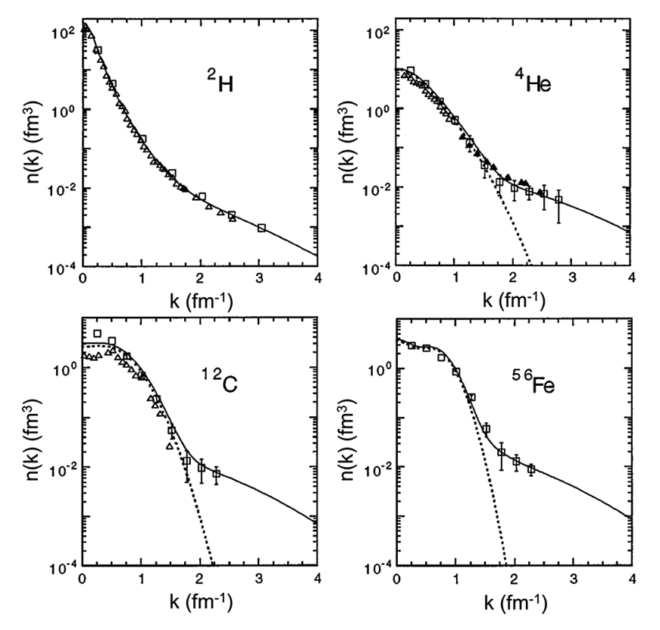
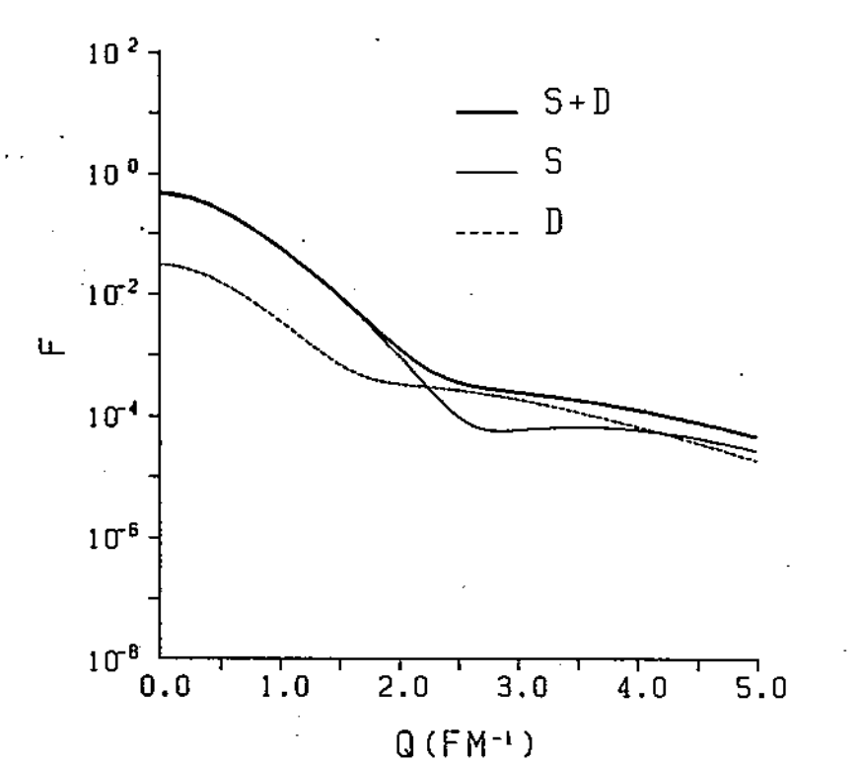
High-momentum components in nuclei
Nucleon momentum distribution extracted from experimental values
Ciofi degli Atti et al., Phys. Rev. C 53, 1689 (1996)
D-state contribution in the single-nucleon momentum distribution of ⁴He. (ATMS calculation using Reid potential)
H. Morita, Y. Akaishi, and H. Tanaka, Prog. Theor. Phys. 79, 863 (1988)
……
[1] R. B. Wiringa, V. G. J. Stoks, and R. Schiavilla, Phys. Rev. C 51, 38 (1995).

Slide 5
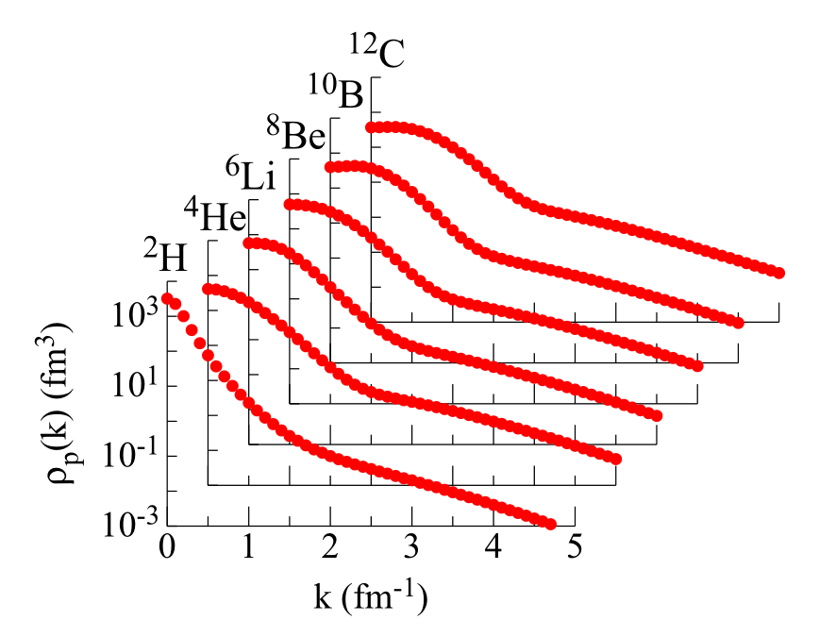
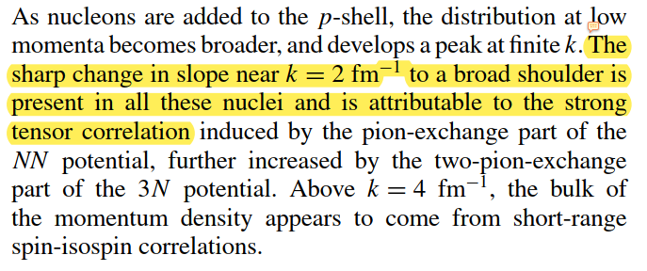
High-momentum components in nuclei (II)
GFMC calculation of light nuclei
(using AV18 potential)
R. B. Wiringa et al., Phys. Rev. C 89, 024305 (2014)
……
[1] R. B. Wiringa, V. G. J. Stoks, and R. Schiavilla, Phys. Rev. C 51, 38 (1995).

Slide 6
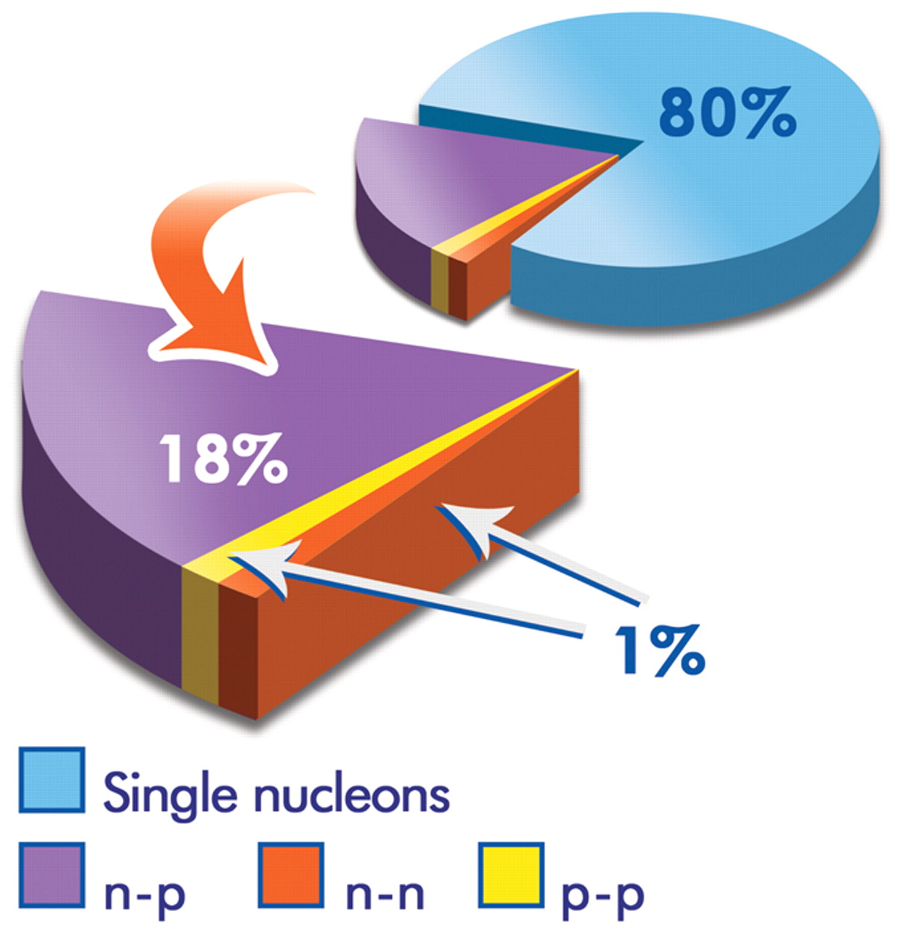
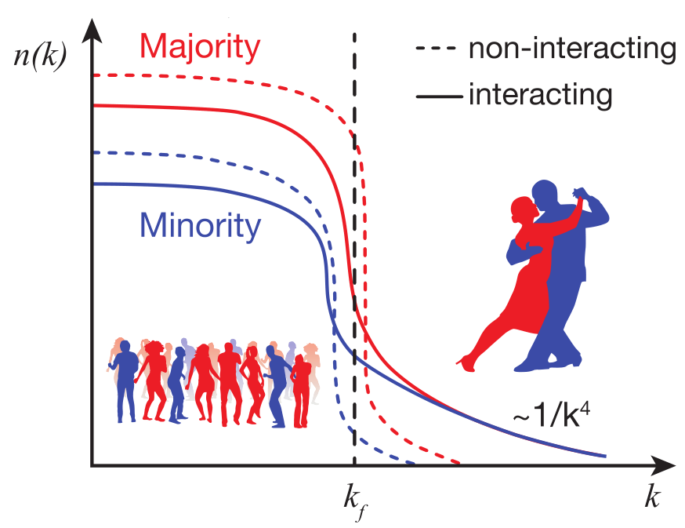
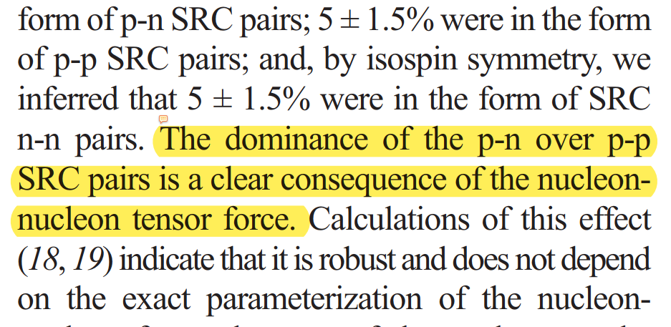
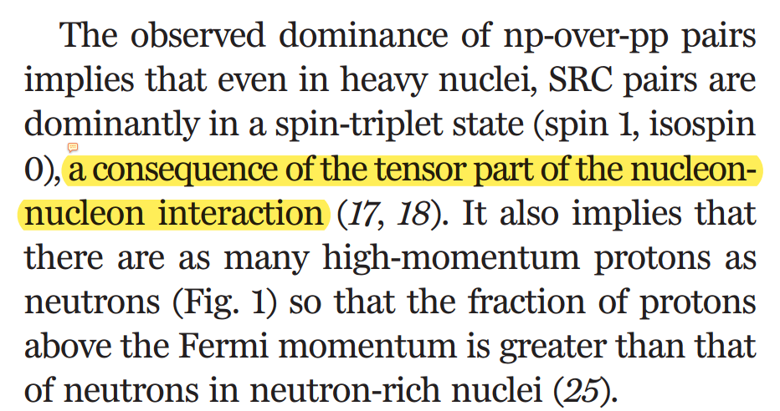
Inter-nucleon correlations (tensor channel)
The average fraction of nucleons in 12C.
R. Subedi et. al., Science 320, 1476-1478 (2008).
O. Hen, et al., Science 346, 614 (2014).

Slide 7
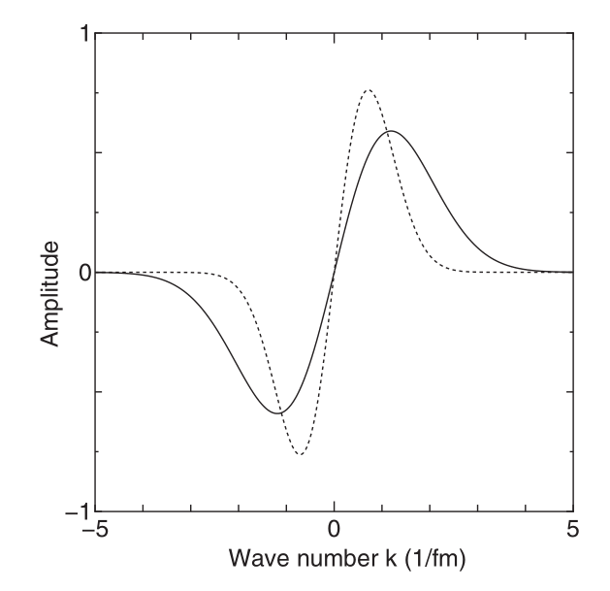
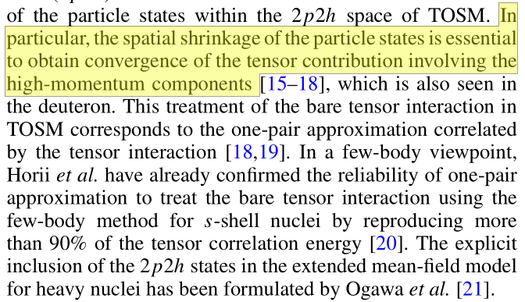
Inter-nucleon correlations (theoretical view)
Normal Shell Model
Tensor-Optimized Shell Model
(TOSM)*
Fourier transformation of the p-orbit,
showing extended momentum distirubtion
N. Itagaki and A. Tohsaki, Phys. Rev. C 97 014304 (2018).
Spatial shrinkage of p-orbit in TOSM T. Myo, et al., Phys. Rev. C 84, 034315 (2011)

Slide 8
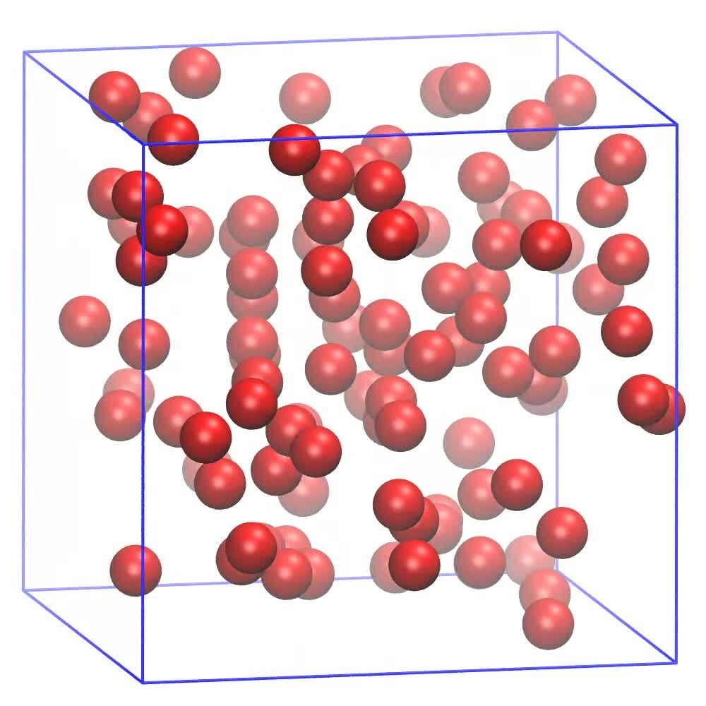
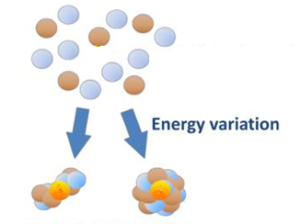
Antisymmetrized Molecular Dynamics (AMD)
Molecular Dynamics for gas atoms
Nuclear Molecular Dynamics
Antisymmetrized Molecular Dynamics (AMD)

Slide 9
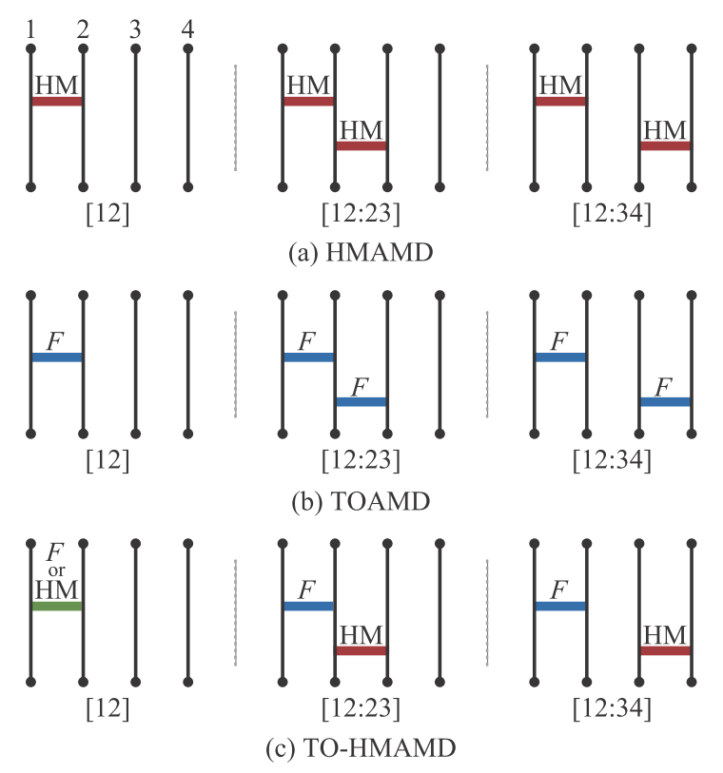
Treatment of inter-nucleon correlations in AMD
The Antisymmetrized Molecular Dynamics (AMD) wave function adopted as the reference state
where $φ$ is single nucleon state of Gaussian form
$NN$-correlation is not explicitly described in AMD reference function
Correlation diagrams of AMD based approaches

Slide 10
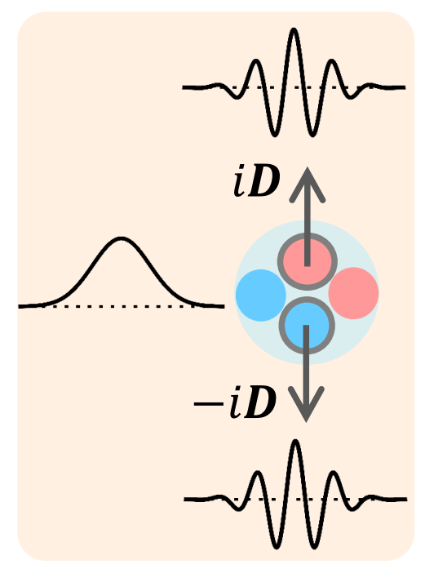
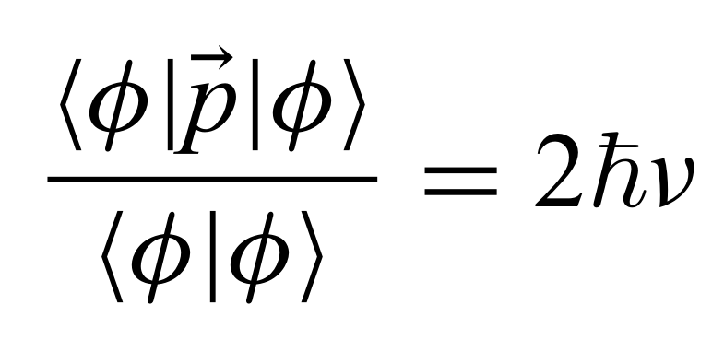
The $NN$ correlations as high-momentum (HM) pairs
NN correlations included into AMD by introducing HM excitation of NN-pairs, namely HMAMD [1]
Mathematically described by the imaginary shifts for Gaussian wave packets (nucleon wave functions)
Applications in both finite nuclei [1-2] and nuclear matter [3,4]
D
[1] T. Myo, H. Toki, K. Ikeda, …, M. Lyu, …, Prog. Theor. Exp. Phys. 2017, 111D01 (2017).
[2] T. Myo, Prog. Theor. Exp. Phys. 2018, 031D01 (2018).
[3] T. Myo, H. Takemoto, M. Lyu, N. Wan, C. Xu, …, Phys. Rev. C 99, 024312 (2019).
[4] N. Wan, T. Myo, C. Xu, …, M. Lyu, Chin. Phys. C, to be published (2020).

Slide 11
Imaginary shifts in HMAMD (³H)
D_{z}
D_{x}
$$p$$
$$n$$
$$p$$
$$n$$
$$n$$
$$n$$
$$⨁$$
D
$$n$$
$$n$$
$$n$$
$$n$$
$$p$$
$$p$$
$$⨁$$
$$n$$
$$p$$
$$n$$
$$p$$
$$n$$
$$n$$
⁝
$$D_{p↑,n↑}$$
$${−D}_{p↑,n↑}$$
$$D_{p↑,n↓}$$
$${−D}_{p↑,n↓}$$
$$D_{n↑,n↑}$$
$${−D}_{n↑,n↑}$$
Single and Double HM pairs in different directions
11

Slide 12
Angular momentum projection of HMAMD bases
$$p$$
$$p$$
$$p$$
$${\hat{P}}_{MK}^{J}$$
$$n$$
$$n$$
$$n$$
$$n$$
$$n$$
$$n$$
³H, HMAMD, rotated in space
³H, HMAMD, angular momentum projected
³H, HMAMD
$${\hat{P}}_{MK}^{J}=\frac{2J+1}{8π^{2}}\int{{{(D}_{MK}^{J})}^{∗}\left(Ω\right)R\left(Ω\right)d(Ω)}$$

Slide 13
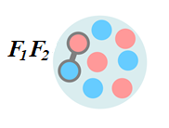
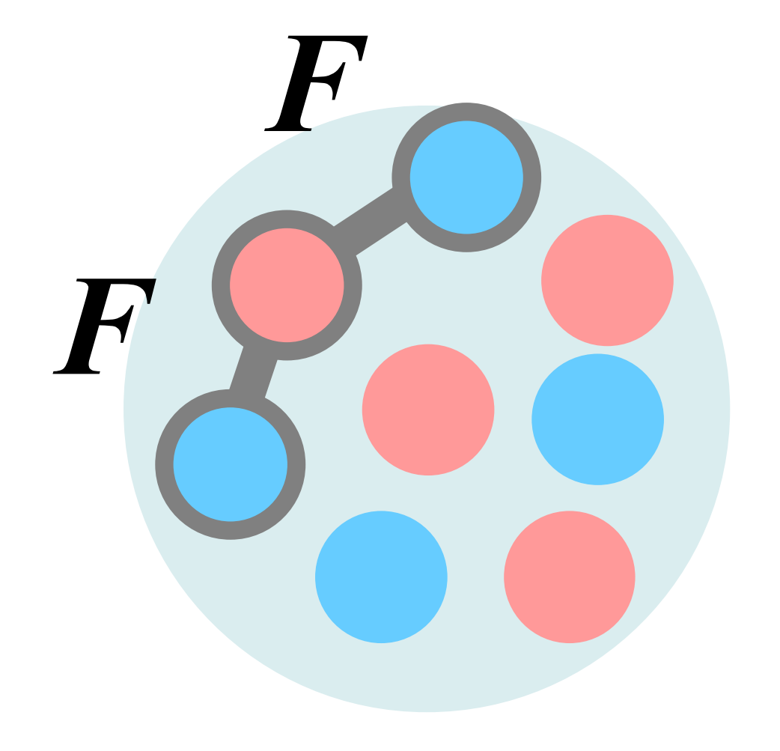
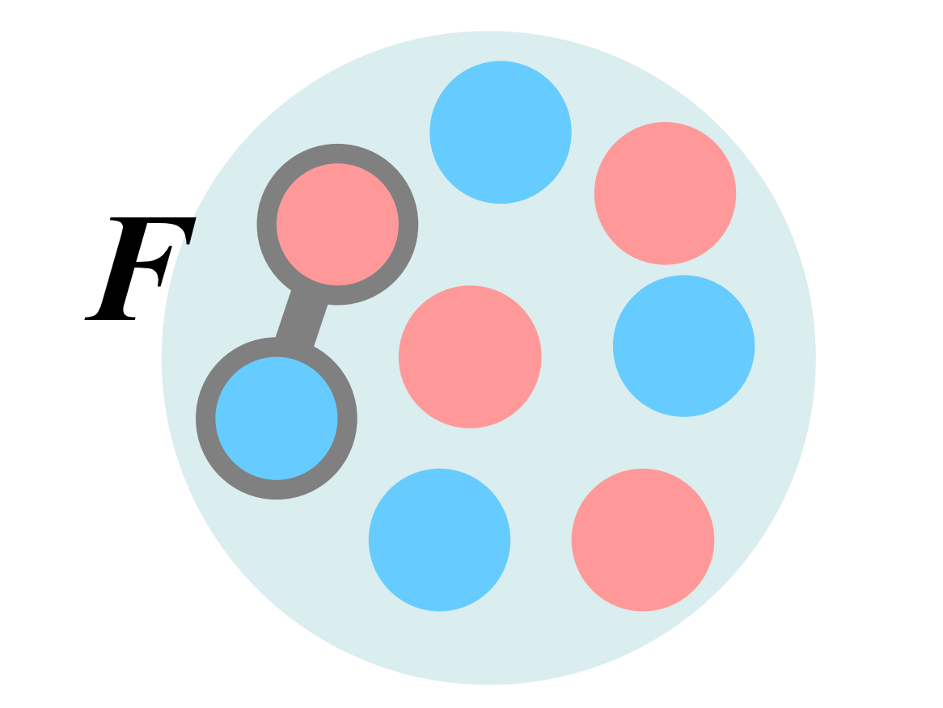
The TOAMD treatment of NN correlation
The general formulation of TOAMD wave function [1]
$$|Φ_{TOAMD}〉=(1+F_{D_{1}}+F_{S_{1}}+F_{D_{2}}F_{S_{2}}+F_{D_{3}}F_{D_{4}}+F_{S_{3}}F_{S_{4}}+⋯)|Φ_{AMD}〉$$
Single correlation function (1F-term)
Double correlation function (2F-term, ladder)
Double correlation function (2F-term, 3-body)
$$F1$$
$$F1$$
$$F1$$
$$F2$$
$$F2$$
[1] T. Myo, H. Toki, et al., Prog. Theor. Exp. Phys. 2015, 073D02 (2015).
[2] T. Myo, H. Toki, et al., Phys. Lett. B 769, 213 (2017).
[3] T. Myo, M. Lyu, H. Toki, et al., Prog. Theor. Exp. Phys. 2021, ptab002 (2021).

Slide 14
The formulation of TO-HMAMD
The general formulation of TO-HMAMD wave function [1]
$$|Φ_{HM−TOAMD}〉=\left(1+F_{D}+F_{S}+⋯\right)|Φ_{HMAMD}〉$$
_{(Single} _{F-TOAMD)}
_{(Single} _{HM pair)}
Model space of the TO-HMAMD
6 channels of correlation function F_{D,S} (2+4)
$a$ ($n_{G}$) :ranges in Gaussian expansion for F
types of HM pairs (8 for ⁴He)
$n_{D}$: magnitudes of imaginary shifts
About 2000 bases for s-shell nuclei
[1] M. Lyu, M. Isaka, T. Myo, et al., Prog. Theor. Exp. Phys. 2018, 011D01 (2018)

Slide 15
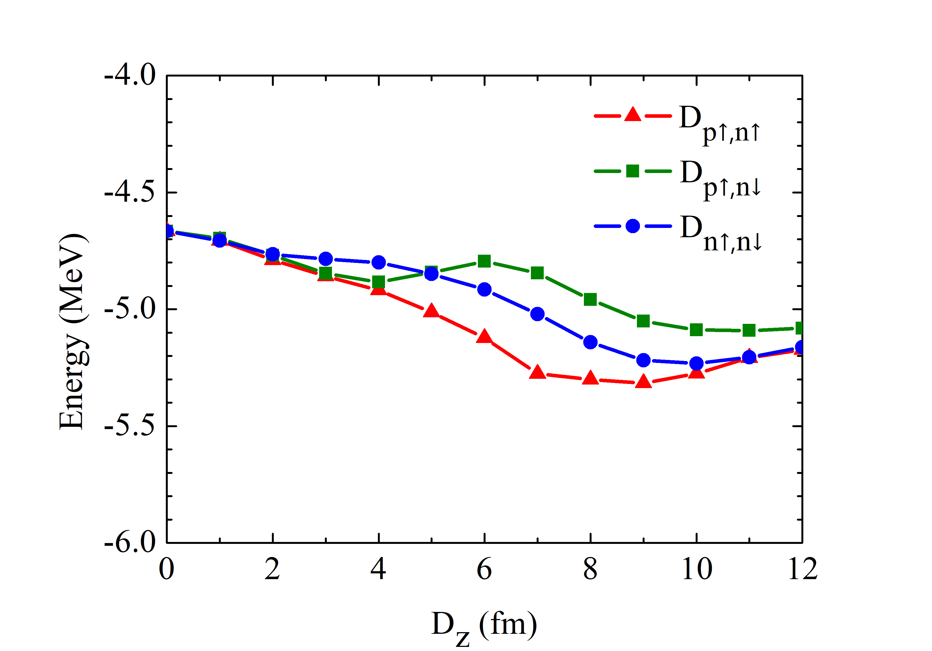
Energy curves of ³H with single HM pair
Single nucleon state in
high-momentum pair
with imaginary shift $\vec{D}$
Tensor
minimum
$$e^{−ν{\left({\vec{r}}_{1}−{\vec{Z}}_{1}±i \vec{D}\right)}^{2}}$$
Short range minimum
[1] M. Lyu, M. Isaka, T. Myo, et al., Prog. Theor. Exp. Phys. 2018, 011D01 (2018)

Slide 16
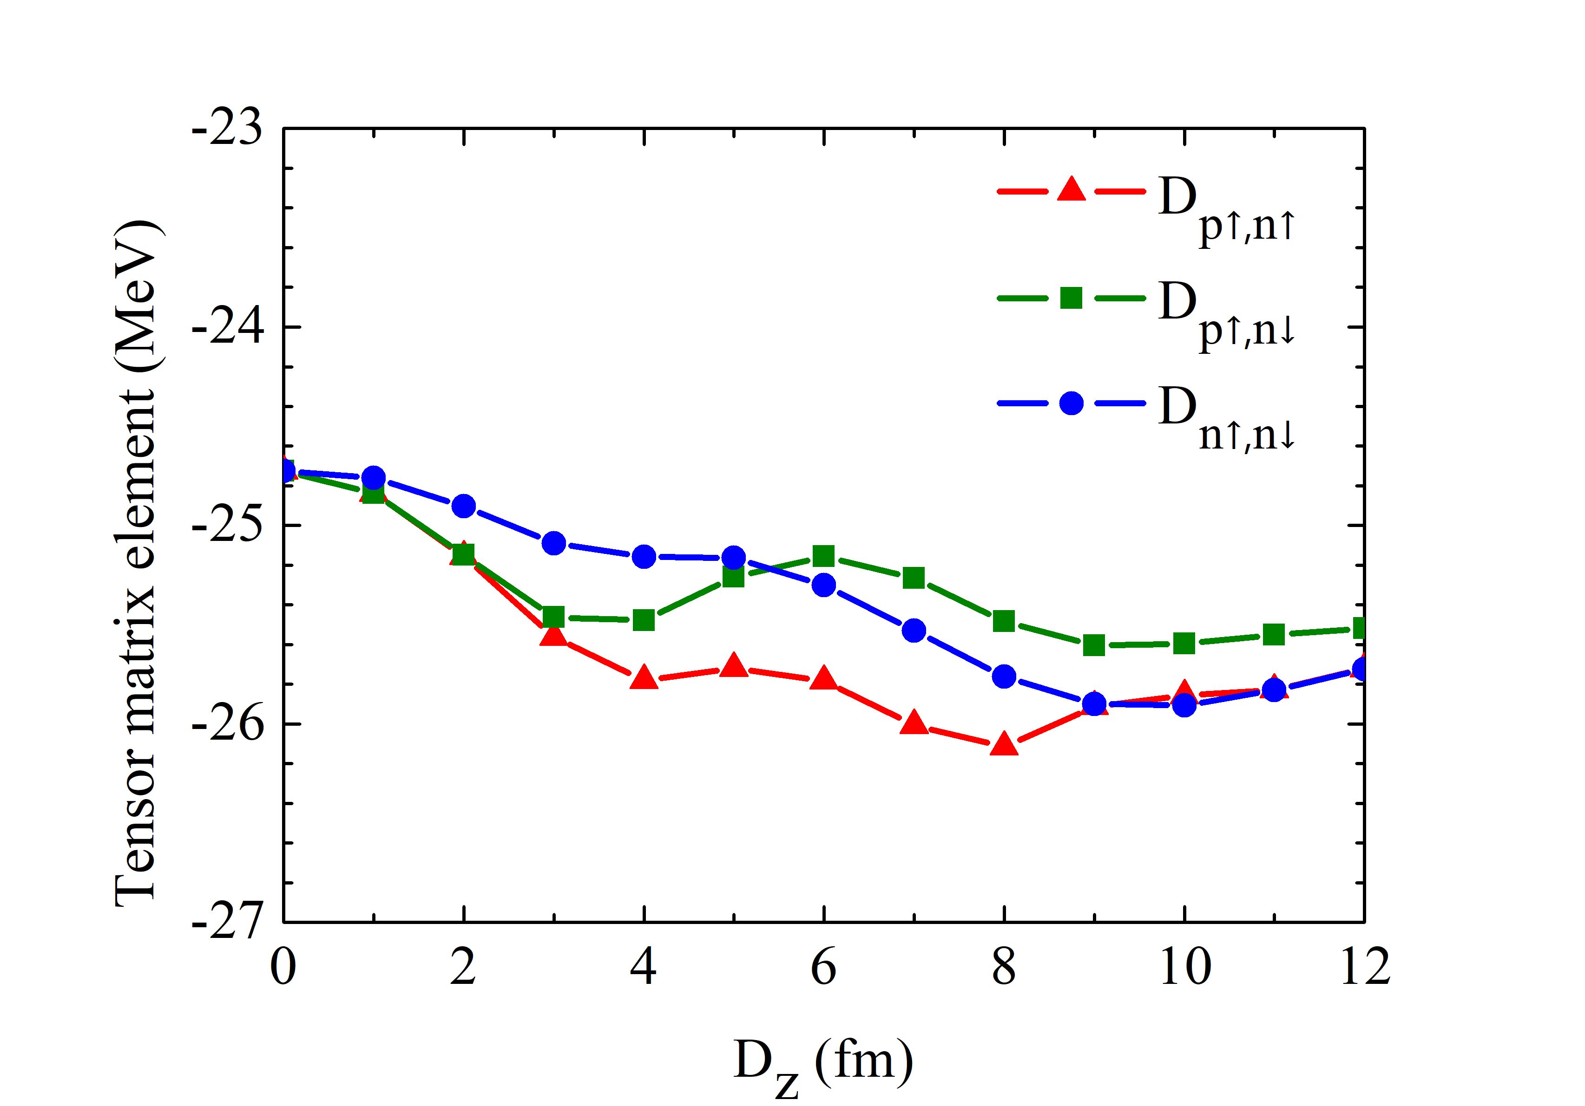
Tensor curves of ³H with single HM pair
Single nucleon state in
high-momentum pair
with imaginary shift $\vec{D}$
$$e^{−ν{\left({\vec{r}}_{1}−{\vec{Z}}_{1}±i \vec{D}\right)}^{2}}$$
Tensor
minimum

Slide 17
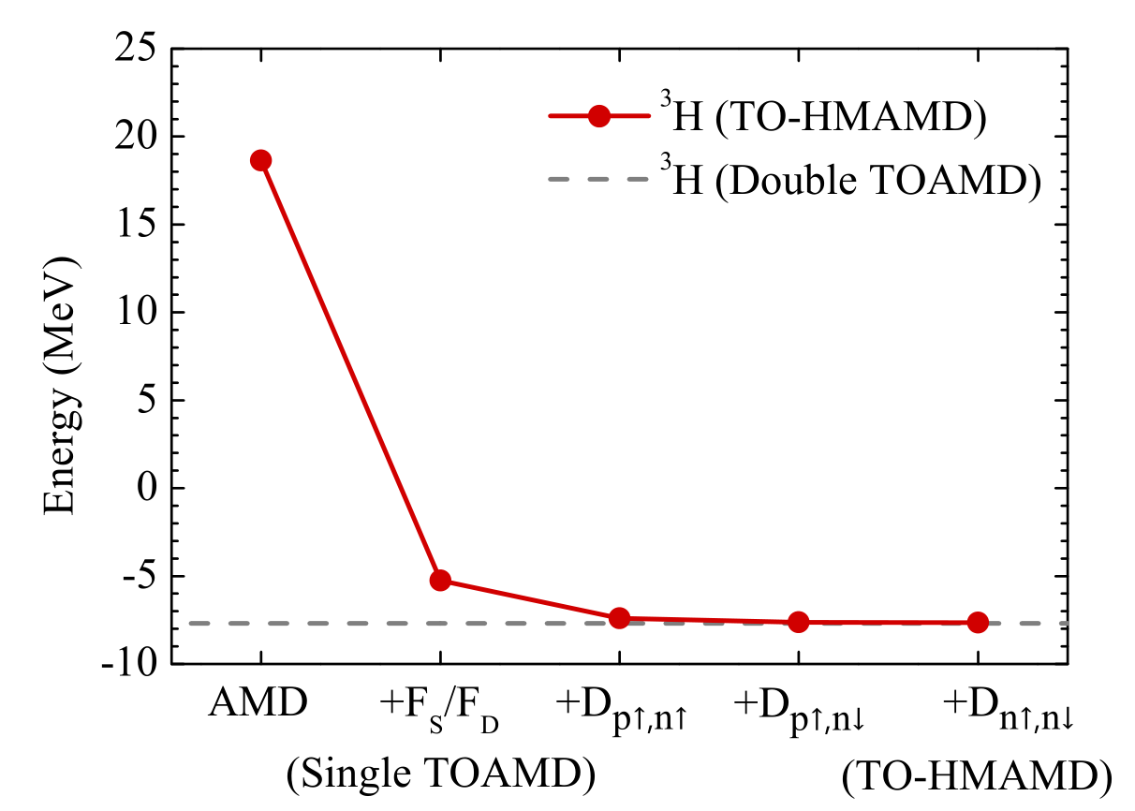
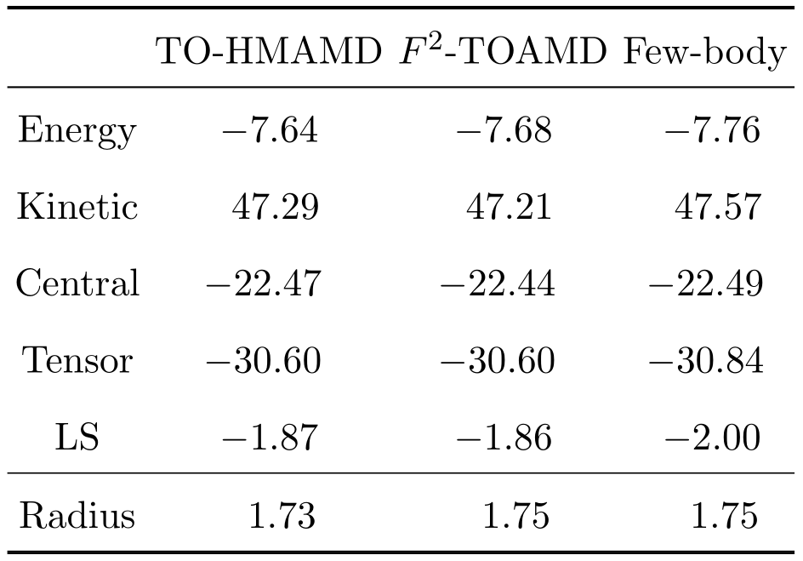
Energy, radius and components of ³H
[1] M. Lyu, M. Isaka, T. Myo, et al., Prog. Theor. Exp. Phys. 2018, 011D01 (2018)

Slide 18
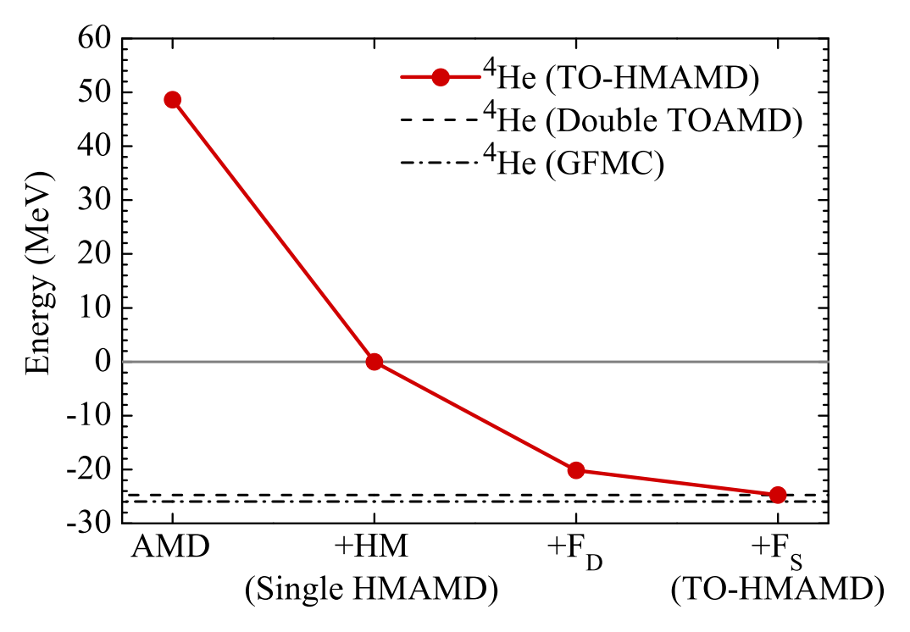
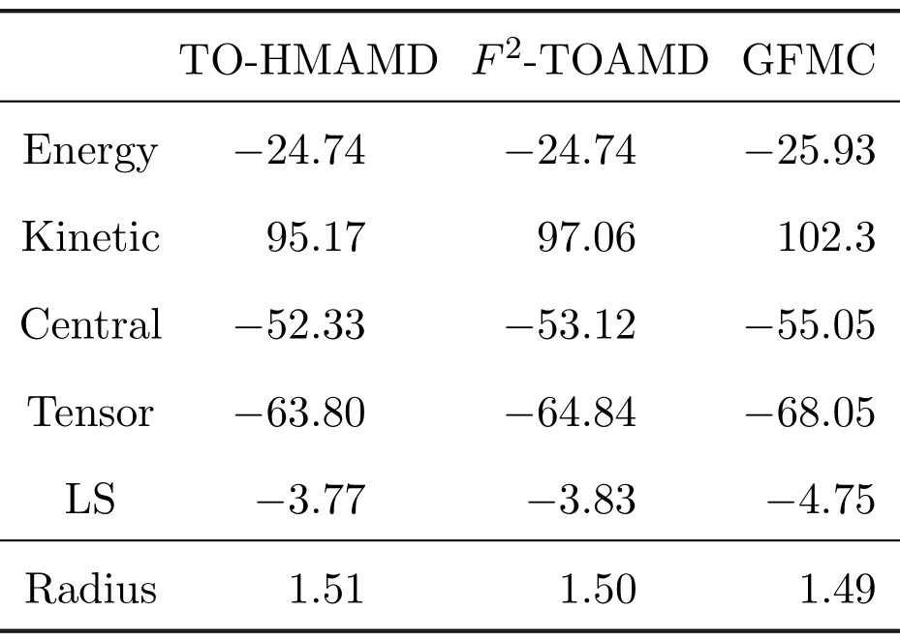
Energy, radius and components of ⁴He
[1] M. Lyu, T. Myo, M. Isaka, et al., Phys. Rev. C 98, 064002 (2018)

Slide 19
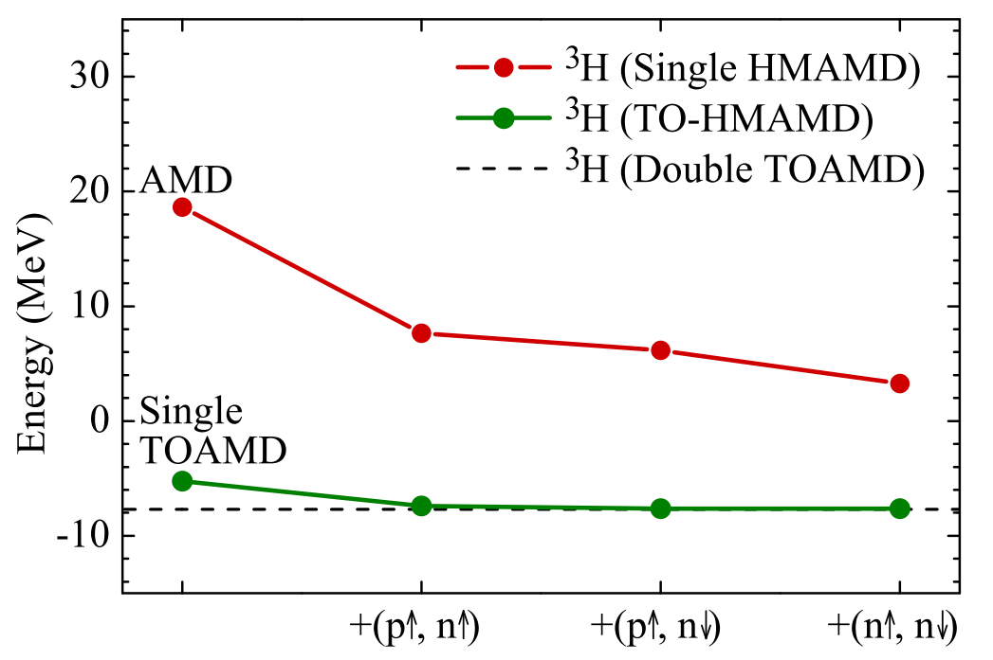
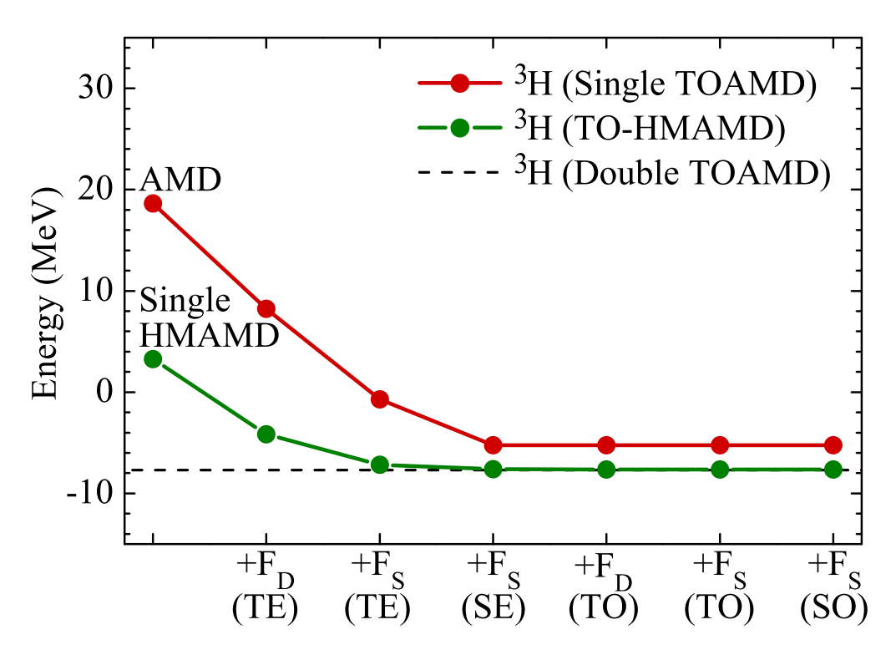
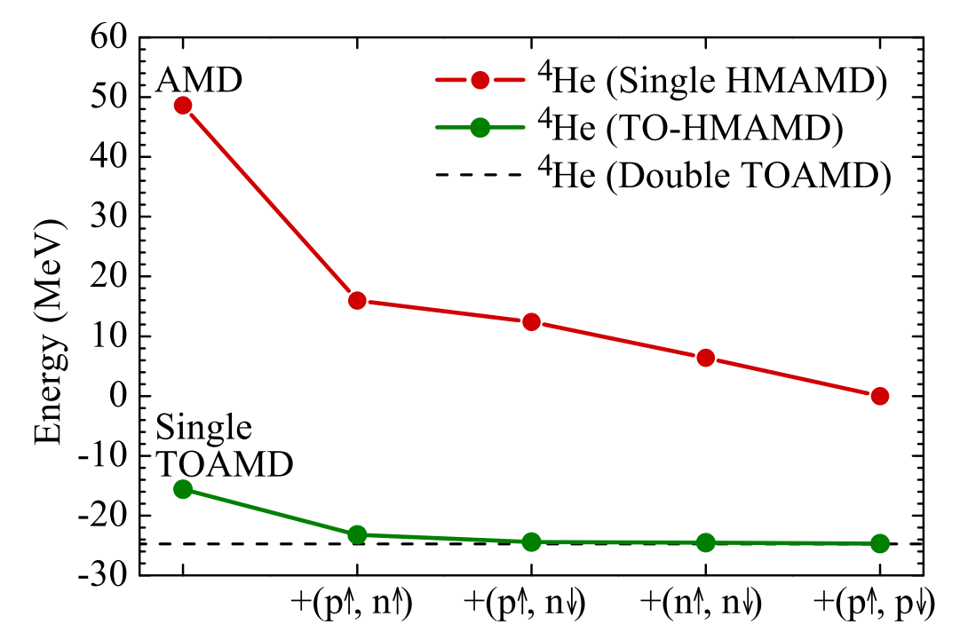
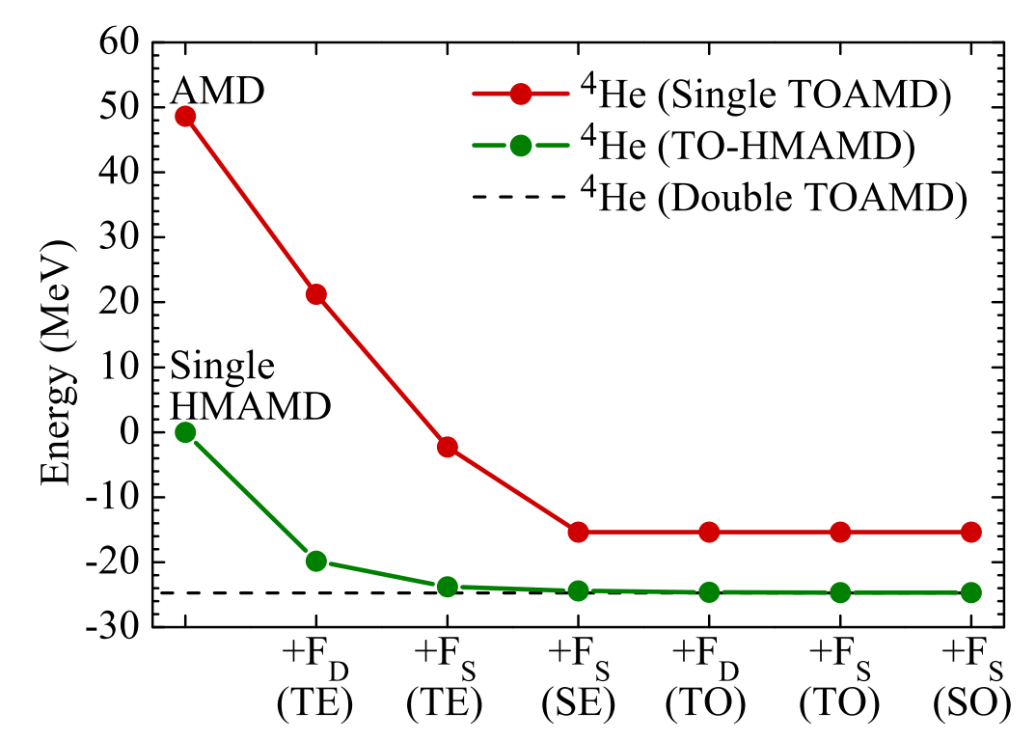
Energy convergence with respect to NN channels

Slide 20
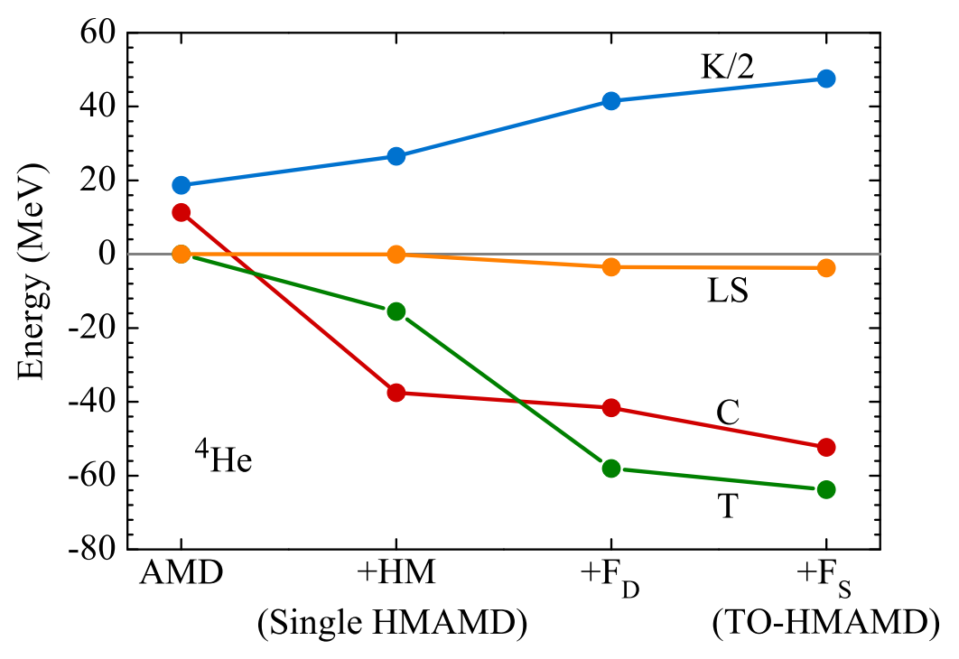
Convergence of Hamiltonian components (⁴He)
High-momentum

Slide 21
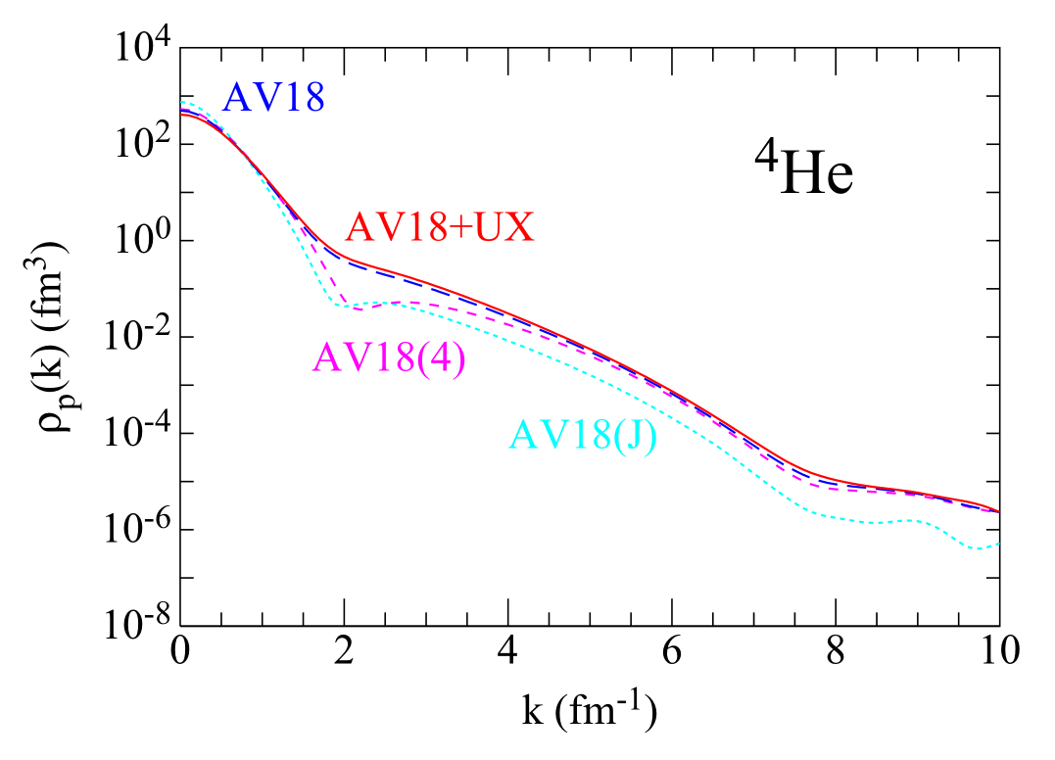
“high-momentum” components in nuclei?
— suggestion from Prof. C. Xu, in visiting RCNP, 2019
Proton momentum distribution by GFMC [Wiringa et al., Phys. Rev. C 89, 024305 (2014)].

Slide 22
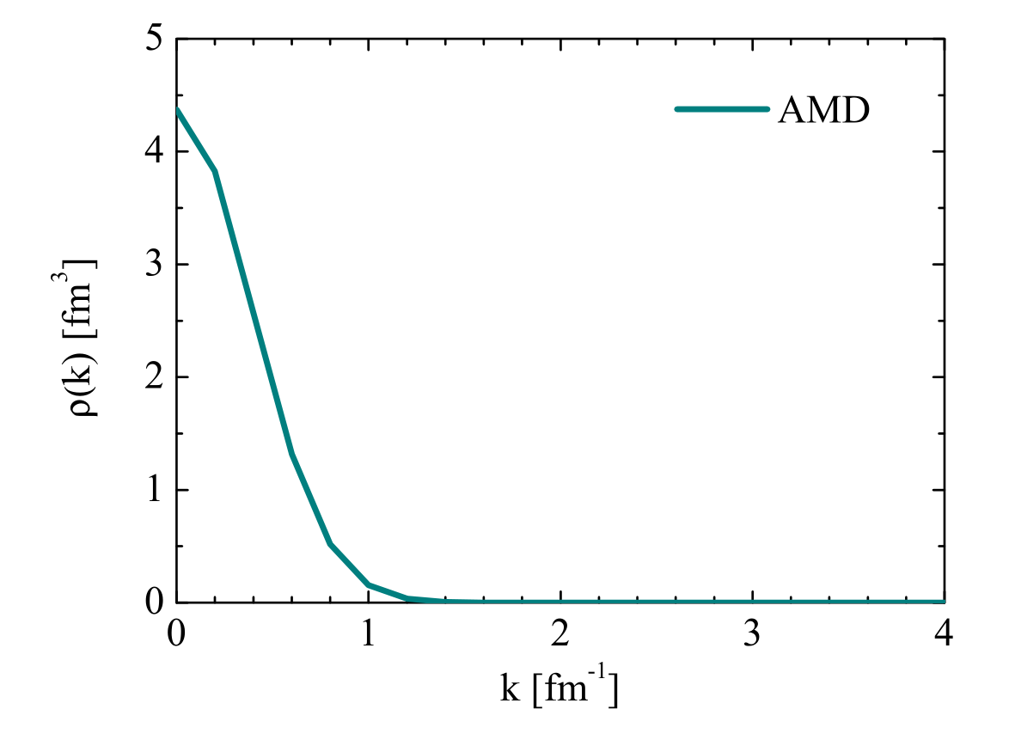
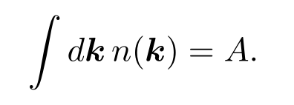
Momentum distribution of AMD wave function
Formulated of momentum distribution in AMD formalism
Center-of-mass motion correctly treated
Formulation is also applicable for HMAMD wave function
⁴He
Normalized as
Momentum distribution described by AMD reference wave function (⁴He)

Slide 23
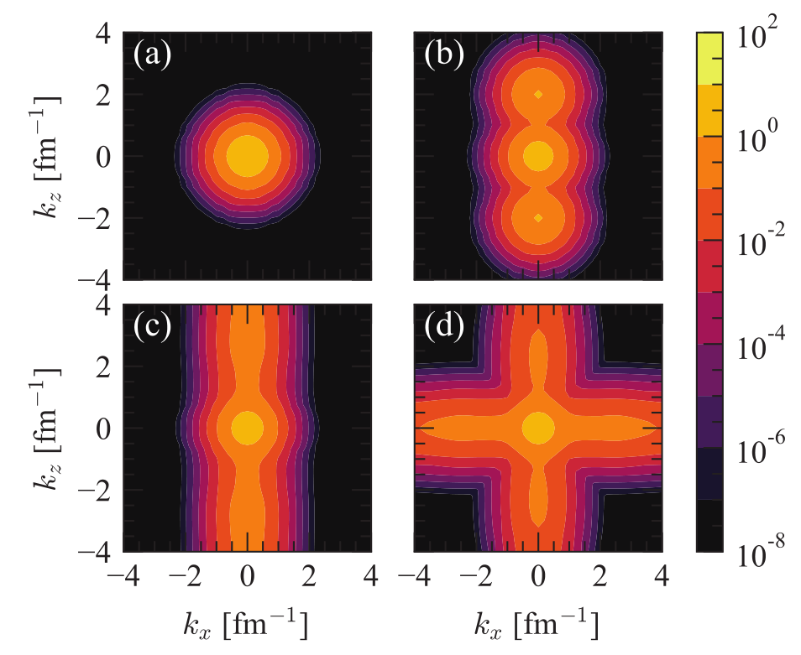
Intrinsic momentum distribution of HM-AMD bases
D=0
$$D_{z}=5 {fm}^{−1}$$
Single base
Single base
$$∑D_{z}$$
$$∑D_{z}⊕∑D_{x}$$
Superposed
Superposed

Slide 24
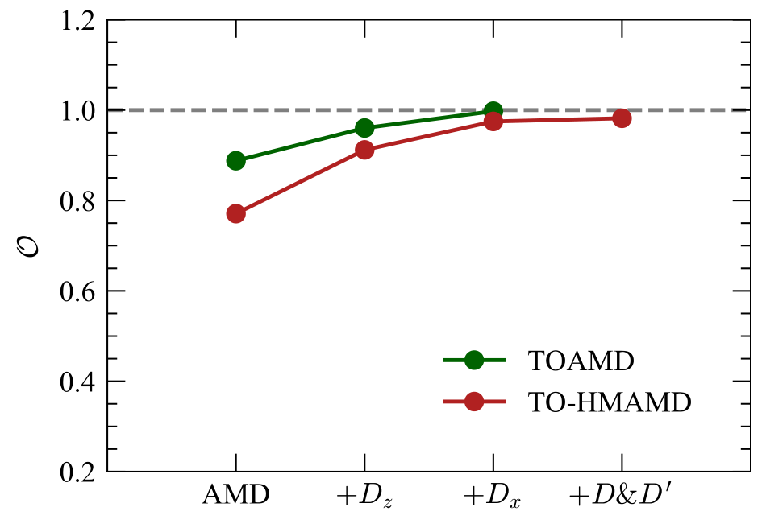
“Translation” from TO-HMAMD to HMAMD
We expand the ab initio wave function $|Ψ⟩$ by the HMAMD bases
Quality of expansion denoted by overlap
O = $\left\langle Ψ \right| \sum_{i}{c_{i}}|Φ_{i}⟩$
0 $≤$ O $≤$ 1
汉

Slide 25
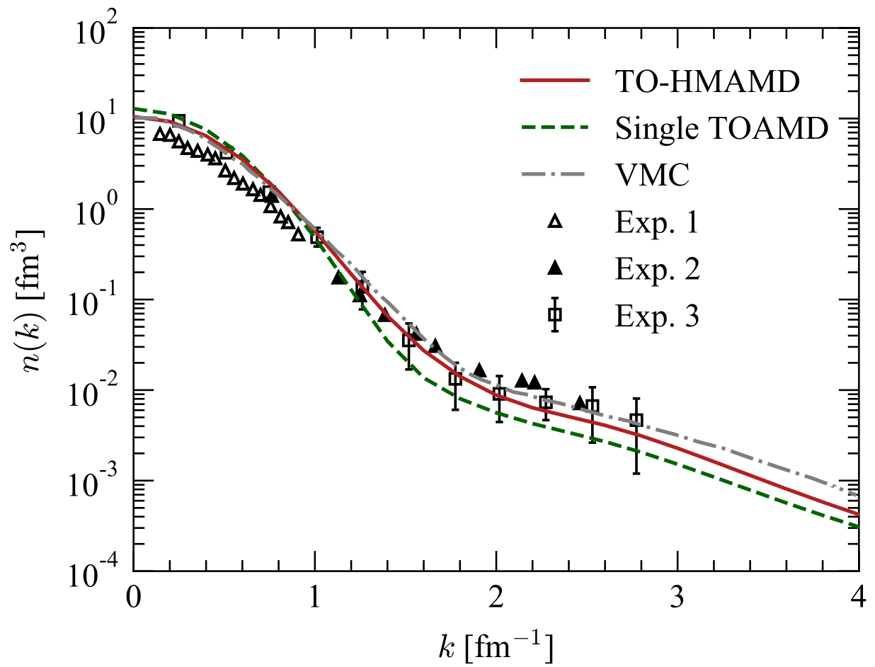
High-momentum components of ⁴He
“Have you compared results with other ab initio calculations?” — Prof. O. Hen, 2020
[1] M. Lyu, T. Myo, H. Toki, H. Horiuchi, C. Xu, and N. Wan,
Phys. Lett. B 805, 135421 (2020)

Slide 26
Experimental manifestation for tensor correlation?
— question from Prof. Hosaka, 2019
？
High-momentum components of 4He
Convergence of Hamiltonian components

Slide 27
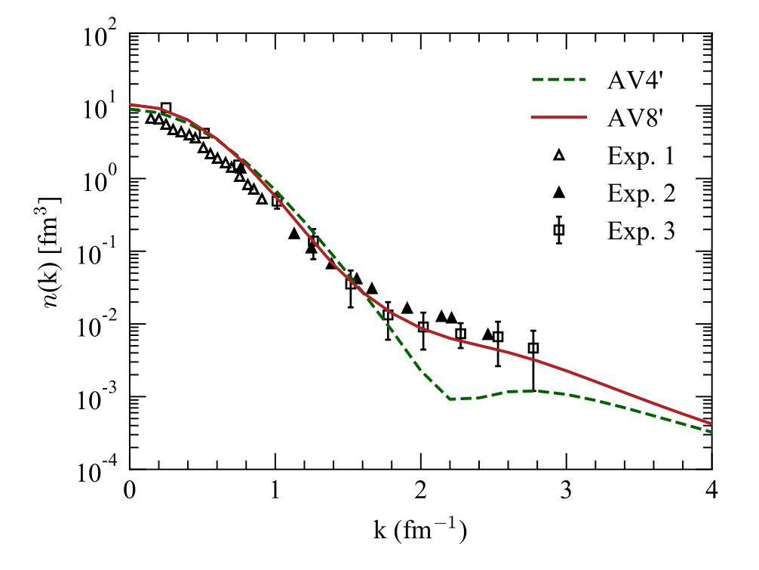
Manifestation of tensor correlation in nuclei
with tensor
without tensor
Nucleon momentum distribution of ⁴He calculated with the AV4 ′ and the AV8 ′ interaction

Slide 28
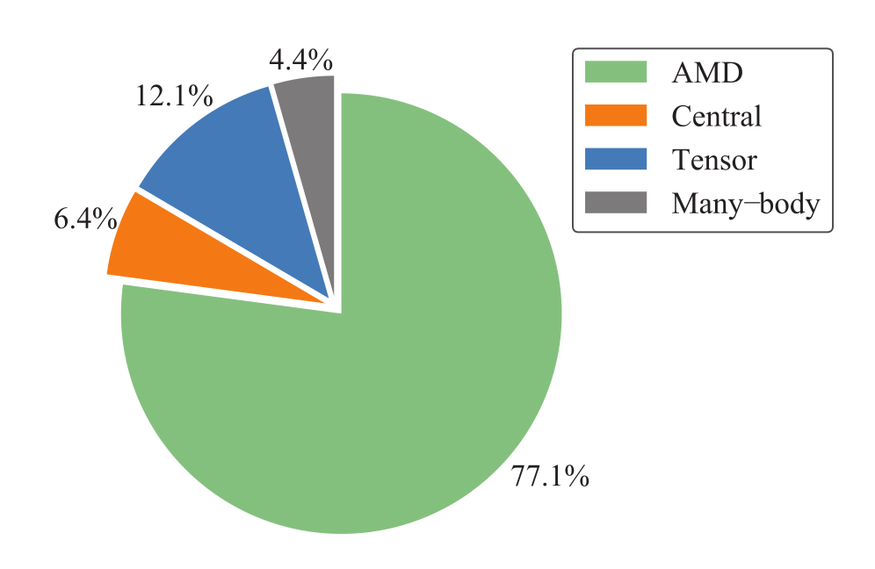
Decomposition of ⁴He wave function
ab initio wave function (TO-HMAMD)
First order
Probability of orthogonal components
Central
AMD
Middle-range
Short-range
Tensor
Many-body
$$1$$
$${+F}_{S}$$
$${+F}_{S}$$
$${+F}_{D}$$
$$+FF$$
Concept diagram of decomposition

Slide 29
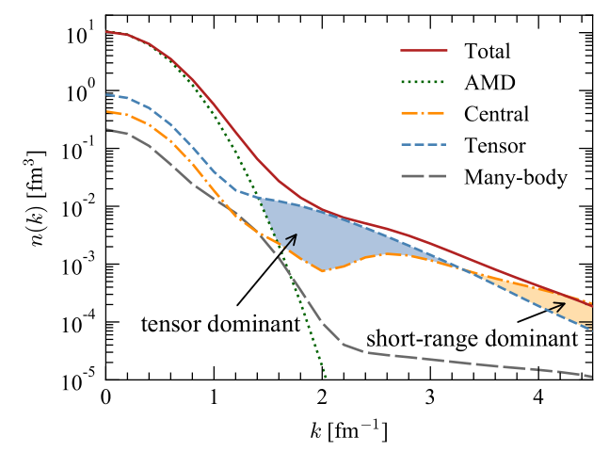
Physical origin of high-momentum Momentum components
Decomposition of nucleon momentum distribution in ⁴He

Slide 30
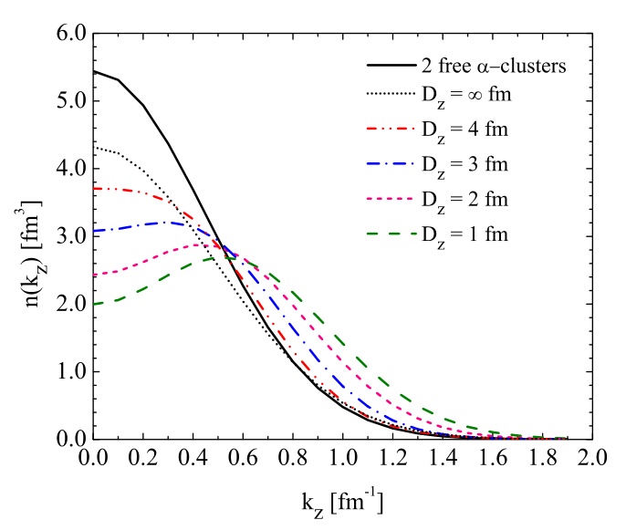
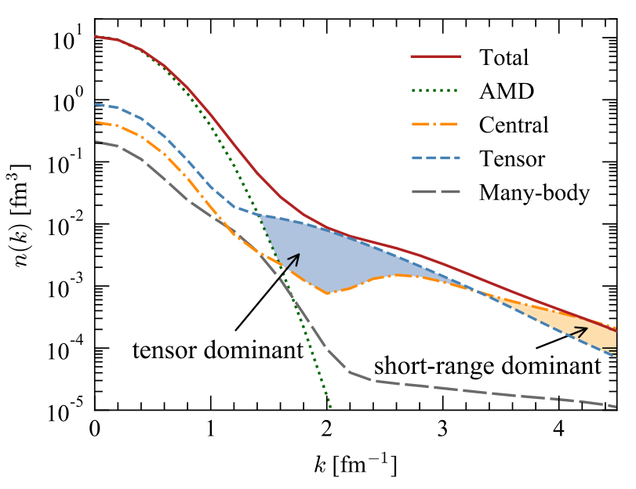
Clustering state in momentum space?
⁴He
$$k_{F}$$
Clustering effects in low-momentum region less than the Fermi momentum $k_{F}$=1.4 fm⁻¹
⁸Be ($α+α$)
$$k_{F}$$
Intrinsic nucleon momentum distributions of the $8Be$ along z-axis
[1] S. Li, T. Myo, Q. Zhao, H. Toki, H. Horiuchi, C. Xu, J. Liu, M. Lyu, Z. Ren,
Phys. Rev. C 101, 064307 (2020)
[1] S. C. Pieper and R. B. Wiringa, Annu. Rev. Nucl. Part. Sci. 51, 53 (2001).

Slide 31
Summary
We formulate the TO-HMAMD framework for ab initio calculations of atomic nuclei.
Well reproduction of binding energy, Hamiltionian components and radii for s-shell nuclei ³H and ⁴He.
Nucleon momentum distribution calculated for ⁴He, reproduce experimental results precisely.
Manifestation of tensor-correlation using momentum distribution.
Probability of components (AMD, middle/short-range, tensor, and many-body) extracted from ab initio wave function of ⁴He.
Physical origin of high-momentum components revealed though decomposition of nucleon momentum distribution.

Slide 32
Thank you very much
College of Science @NUAA Jiangning Campus
Many thanks and best wishes
to all collaborators!

Slide 33
Back up slides

Slide 34
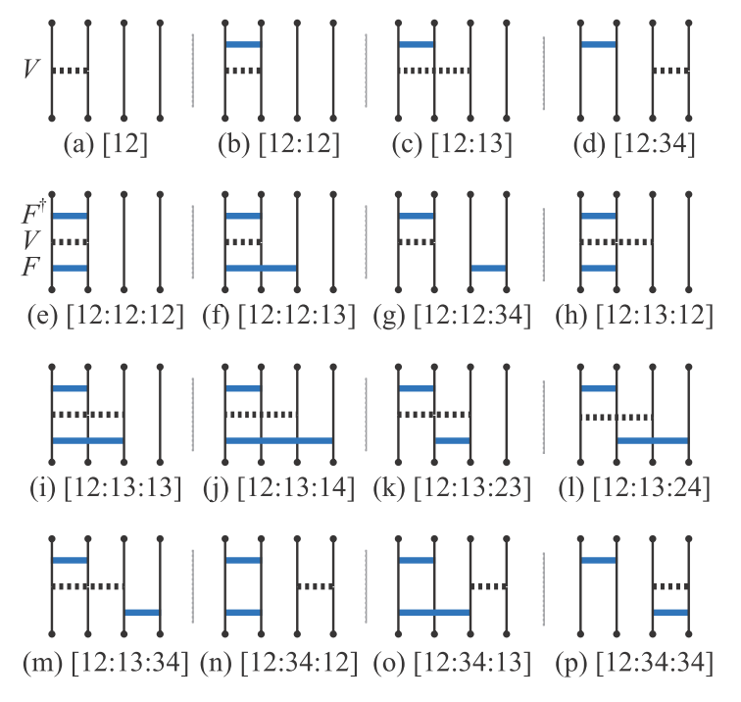
Comparison of AMD based approaches
Table Analytical and numerical efforts for
three models
Fig. Diagrams of cluster expansions in
Single TOAMD

Slide 35
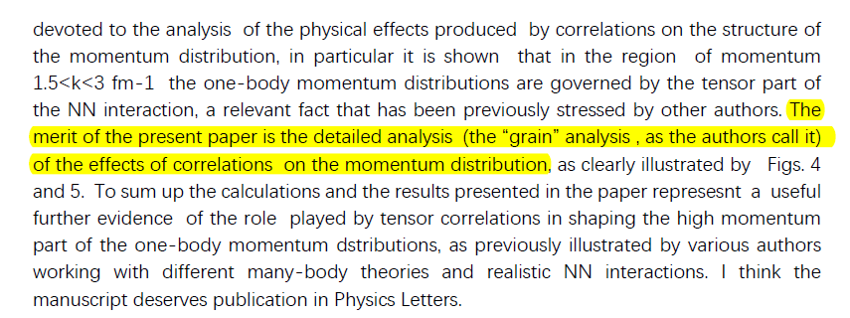
Physical origin of high-momentum Momentum components
Comment from one of the referee’s reports

