Slide 1
宇宙线能谱中的胶子凝聚效应
阮建红
华东师范大学
粒子物理与核物理上海研讨会 2019.12

Slide 2
主要内容
一、胶子凝聚现象
1. 对QCD演化方程的修正
2. 胶子凝聚（Gluon Condensation）
二、高能宇宙线能谱中的GC效应
1. Gamma光谱
2. 正电子谱
3.正电子谱与Gamma光谱的关联
三、小结

Slide 3
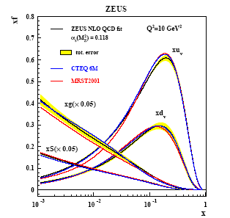
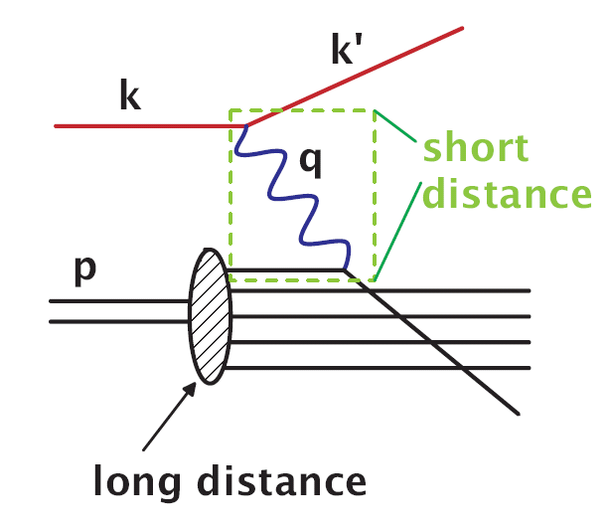
1、对QCD演化方程的修正
质子是宇宙的最基本组分之一.质子由夸克和胶子组成.胶子支配了高能质子相互作用

Slide 4

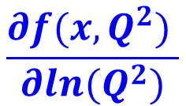
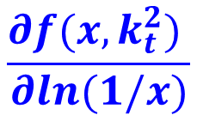
Fusion
Evolution equation
DGLAP
Chaos
Gluon condensation
BFKL

Slide 5
对BFKL方程的小x修正
Nuclear Physics B 911 (2016) 1-35
Nuclear Physics B 916 (2017) 647-668

Slide 6
The result of our equation

Slide 7
2. 胶子凝聚
Gluon condensation

Slide 8
Gluon Condensation
The cross-section of inclusive gluon mini-jet production at high energy p − p Collisions is
The number of secondary particles is proportional to it if we neglect the mechanism of fragmentation of gluons into secondary particles.

Slide 9
二、高能宇宙线能谱中的GC效应
1、超高能宇宙线可能达到产生GC的域能。
2、超新星遗迹是产生高能宇宙射线的重要源头, 其中质子和原子核的碰撞有可能出现胶子凝聚。
3、宇宙线能谱呈现power-law规律，若有GC出现，则有明显power-law broken现象

Slide 10
1、Gamma-Ray spectrum

Slide 11
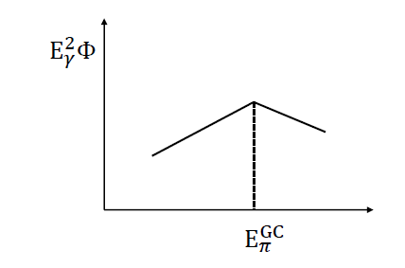
Gamma-Ray spectrum

Slide 12
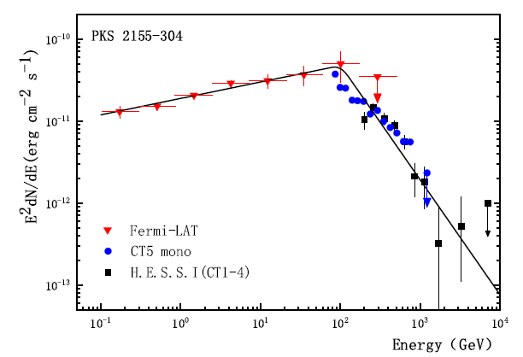

Slide 13
2、Electron-positron spectra

Slide 14
Electron-positron spectra

Slide 15
AMS 测量的重要成果
P.R.L 122, 041102 (2019)

Slide 16
Using the GC-model Equation (a dashed curve) to fit the positron flux (Aguilar et al. 2019). The contributions of background (a point curve) are taken from a diffuse model (Aguilar et al. 2013). The solid curve is the total spectrum.

Slide 17
3、正电子谱与Gamma光谱的关联
1.应在银河系找到伴随的gamma信号.它的能谱有明显的特征: 一条在双对数图上的折断直线 ,折断点为400GeV.
2. gamma谱折断处二侧的斜率由正电子谱形状决定.

Slide 18
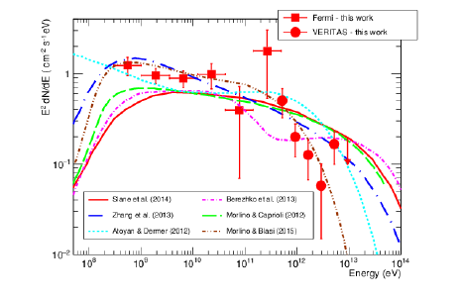
VARITAS and Fermi-LAT 2017
gamma-ray spectrum for Tycho

Slide 19
The predicted cosmic gamma-ray spectrum by the GC-model Equation and comparisons with the Fermi-LAT and VERITAS data for Tycho (Archambault et al. 2017).

Slide 20
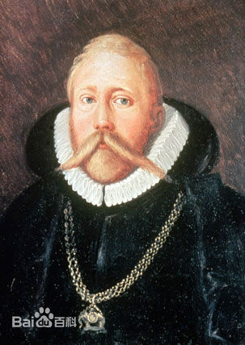
Tycho 1572
1572年11月11日丹麦天文字学家Tycho记录了用肉眼观察到的在仙后座出现一颗明亮的星, 此星编号SN1572, 又称第谷星, 这是一颗爆发的超新星 。

Slide 21
Summary
（1）Gluon condensation(GC) in proton is an exciting theoretic result, it will change our traditional of understanding proton behavior at high energy.
（2）Large number of gluons will accumulate near a certain energy when the GC effects occurring, this phenomenon provides a possible source of the broken power-law in the energy spectra of cosmic rays.
（3）Gluon condensation will open a window for exposing the new phenomena about astrophysics and high energy physics.

Slide 22
Thank You

