Slide 1
Description of rotational nuclei in the Nucleon-Pair Approximation of the nuclear shell model
Dec. 09, 2019 联合学术交流会
GuanJian Fu
Tongji University
Introduction: rotational nuclei in the NSM, IBM, and NPA
Optimized NPA solution: conjugate gradient (CG) method
Selecting nucleon pairs from HF
Summary

Slide 2
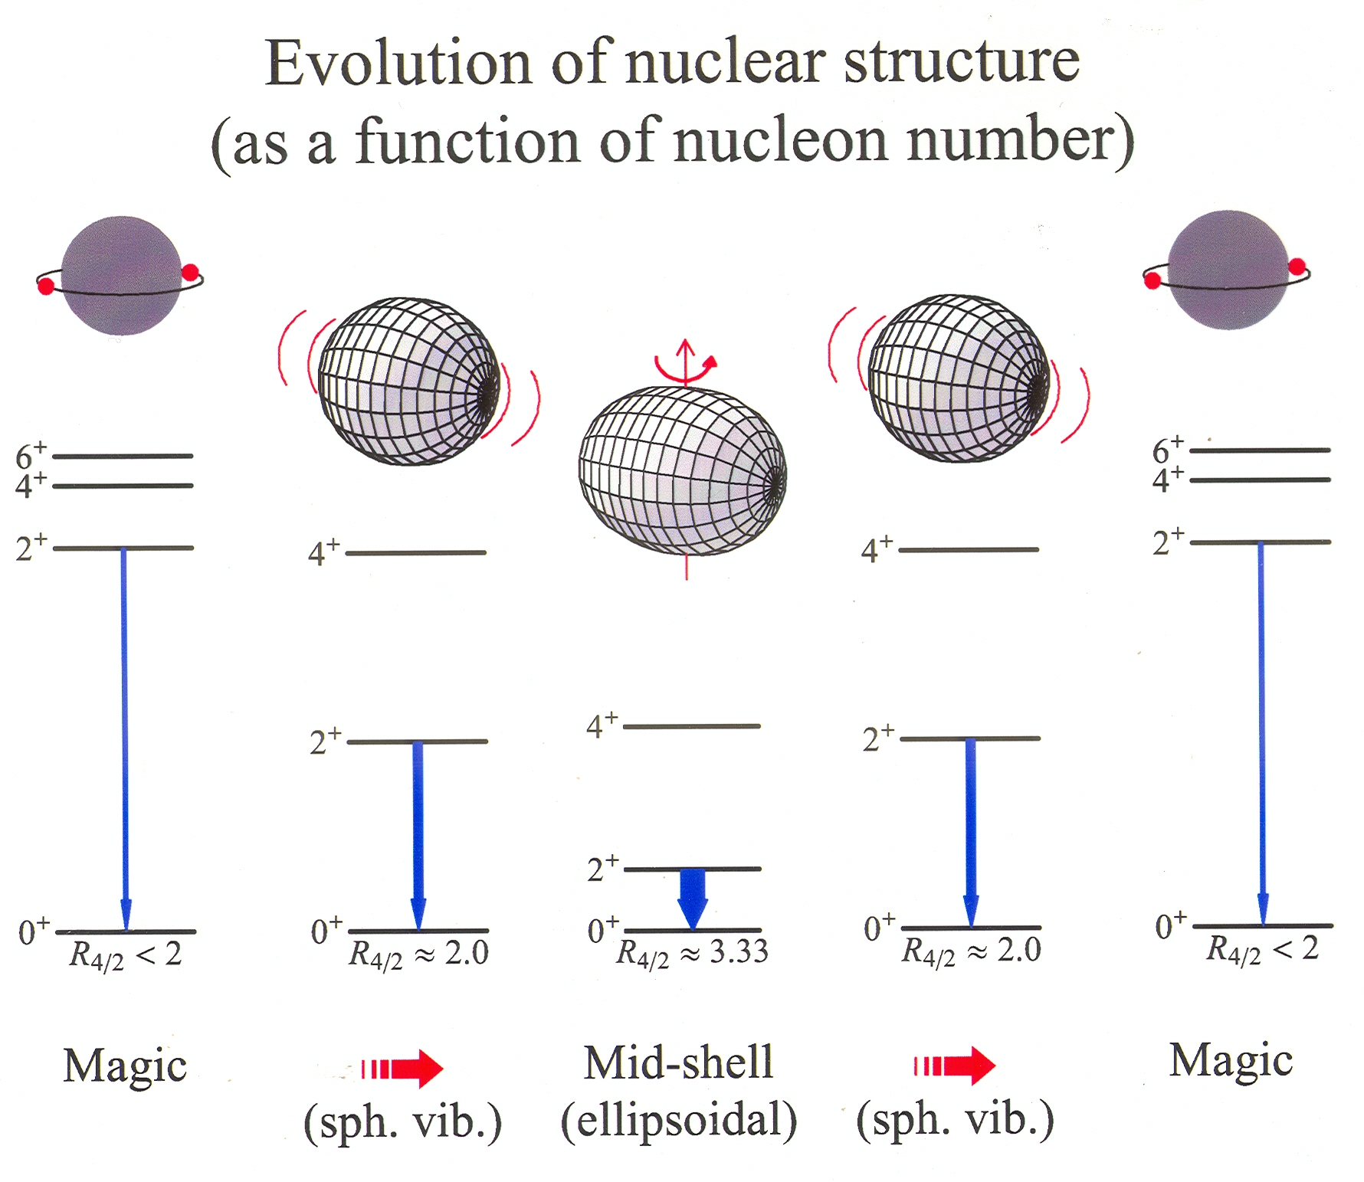
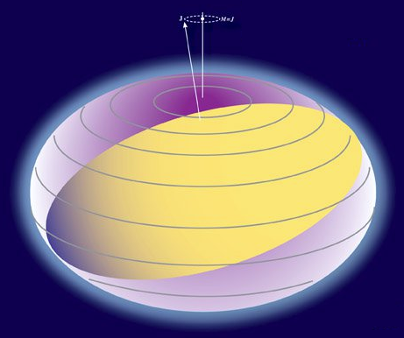
Nuclear collective behavior
Models based on deformation

Slide 3
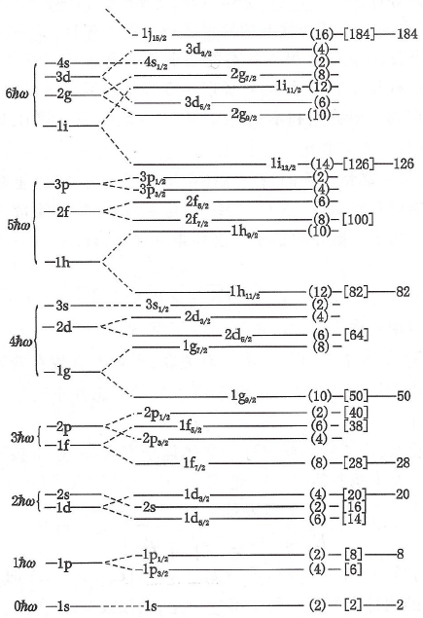

Rotational motion in the nuclear shell model
Elliott’s SU(3) model:
Quadrupole interaction
One or many H.O. major shells
a new perspective: the SU(3) symmetry
Q operator → quadrupole deformation

Slide 4
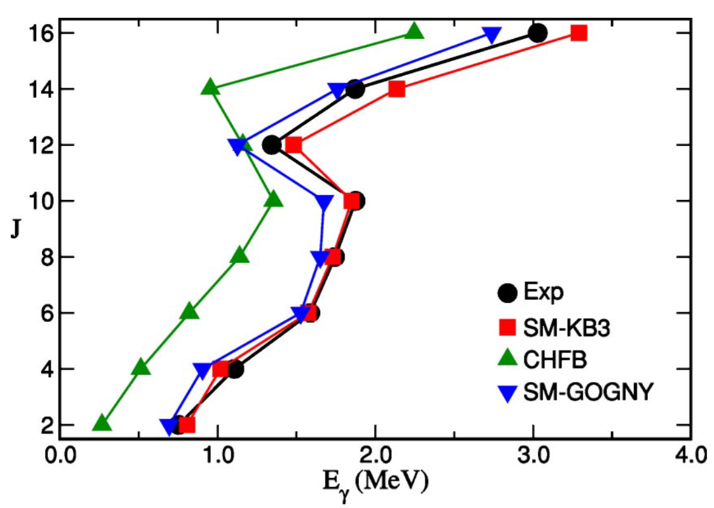
Rotational motion in the nuclear shell model
0
Yrast band in Cr-48
0

Slide 5
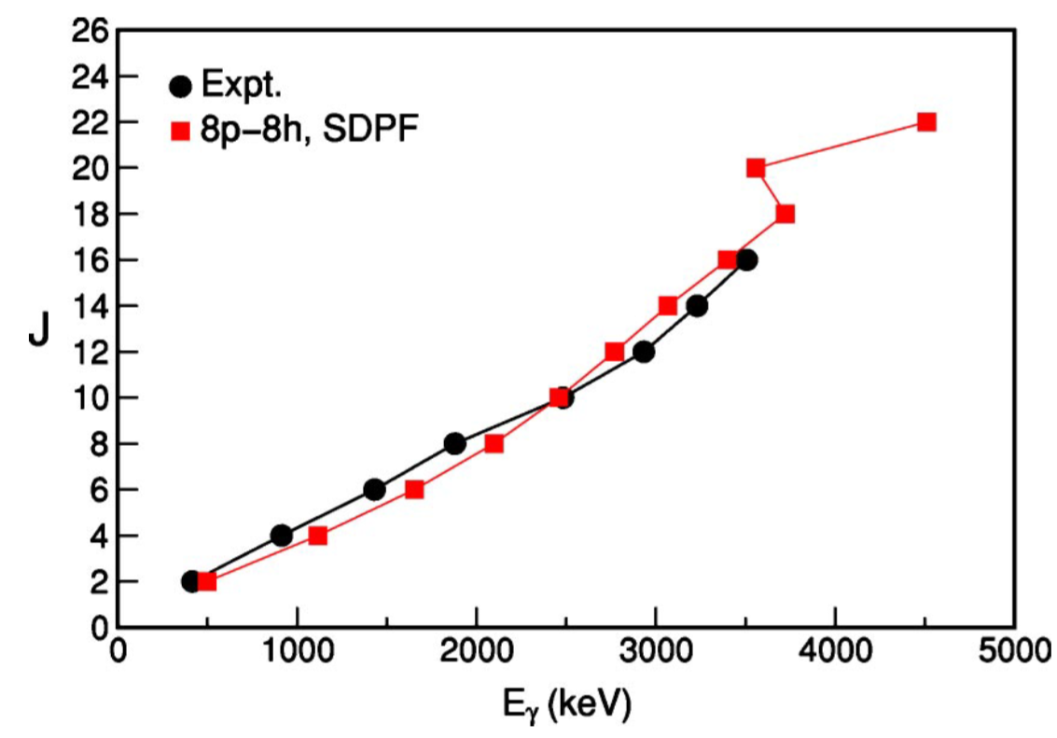
Rotational motion in the nuclear shell model
0
Yrast band in Cr-48
0
Superdeformed band in Ca-40

Slide 6


Rotational motion in the nuclear shell model
Elliott’s SU(3) model:
Quadrupole interaction
One or many H.O. major shells
a new perspective: the SU(3) symmetry
Q operator → quadrupole deformation
For heavy-mass regions:
strong spin-orbit couplings, SU(3) broken
one HO major shell is not enough, intruder orbits, pseudo- and quasi-SU(3)
configuration space is too gigantic
Need truncation!

Slide 7

Truncations of the model space
Shell model, full configuration interaction
Cooper pairs with good angular momentum r:
Nucleon-pair approximation (NPA):
Cooper pair => boson; Interacting boson model (IBM):
The NPA is a truncation of the shell-model configuration space.

Slide 8
Validity of the IBM (U6)
Deformed
Sph.
The microscopic foundation of the IBM SU3 is not well understood.
Notes:
8

Slide 9
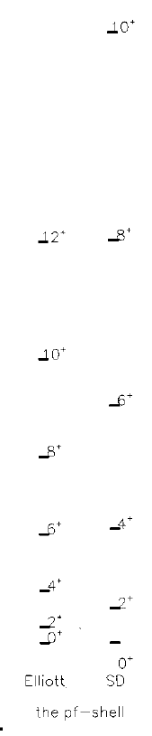
Validity of the NPA
Elliott’s SU(3)
For nearly spherical nuclei:
compare SM wave functions with NPA wave functions,
overlap > 90% for 0+ within the SD-pair truncation
For rotational nuclei:
can reproduce rotational band (parameters)
under the same interaction: NPA predicts much smaller moment of inertia and B(E2) than NSM does
Difficulty: Selecting good pairs is a long-standing problem; no one has successfully reproduced rotational bands by the NPA in a large space with effective interactions.
Structure coefficients of the SD pairs?
Higher-spin pairs?
Exact
SD
the pf shell

Slide 10
Outline
Introduction: rotational nuclei in the NSM, IBM, and NPA
Optimized NPA solution: conjugate gradient (CG) method
Selecting nucleon pairs from HF
Summary

Slide 11
Elliott’s SU(3) limit reproduced by CG method
In the NPA, determine inner structure of pairs for deformed nuclei remains to be a long-standing problem. The traditional “BCS + commutation with Q” or seniority-based (GS) pairs do not work well for deformed nuclides.
New method such as CG: minimize g.s. energy by iterative NPA calculations;
numerically optimal solution
6p6n in the pf shell

Slide 12
Elliott’s SU(3) limit reproduced by CG method
In the NPA, determine inner structure of pairs for deformed nuclei remains to be a long-standing problem. The traditional “BCS + commutation with Q” or seniority-based (GS) pairs do not work well for deformed nuclides.
New method such as CG: minimize g.s. energy by iterative NPA calculations;
numerically optimal solution
6p6n in the sdg shell

Slide 13
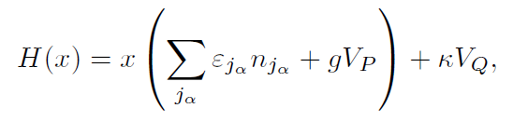
Shape evolution driven by interactions
6p6n in the pf shell with
ε_{jα}: s.p. energy from kb3g;
V_{P}: pairing interaction;
V_{Q}: SU(3) quadrupole interaction.
GS works for spherical
I^{π} = 2⁺
I^{π} = 4⁺
CG works for rotational

Slide 14
Shape evolution driven by interactions
6p6n in the pf shell with
ε_{jα}: s.p. energy from kb3g;
V_{P}: pairing interaction;
V_{Q}: SU(3) quadrupole interaction
I^{π} = 2⁺
I^{π} = 4⁺

Slide 15
Shape evolution driven by interactions
6p6n in the pf shell with
ε_{jα}: s.p. energy from kb3g;
V_{P}: pairing interaction;
V_{Q}: SU(3) quadrupole interaction
CG works for rotational
I^{π} = 2⁺
GS works for spherical
I^{π} = 4⁺
I^{π} = 4⁺

Slide 16

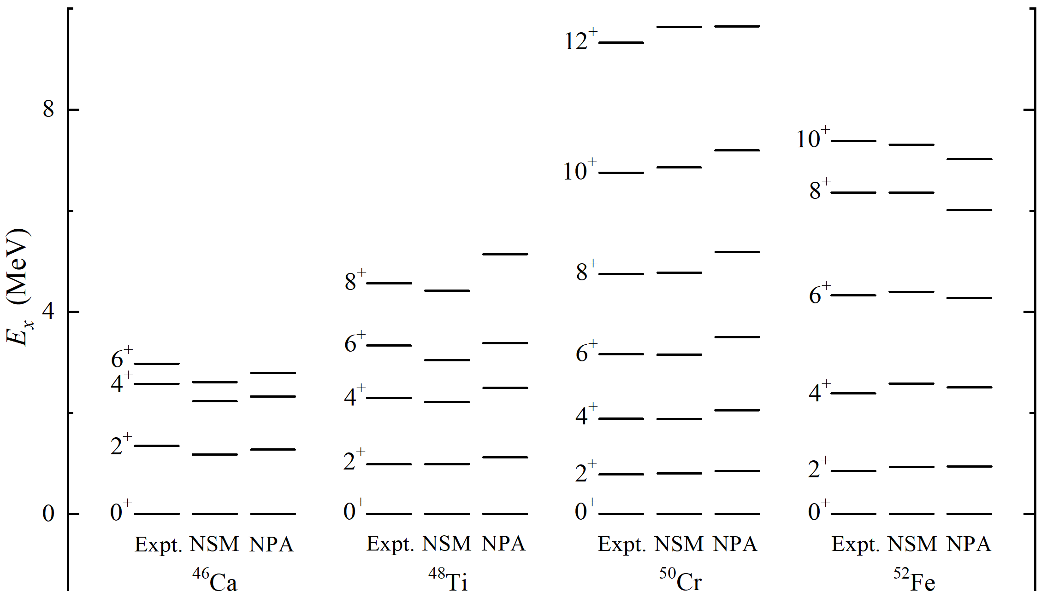
N = 26 isotones
pf shell + KB3G interaction
NPA:

Slide 17
Outline
Introduction: rotational nuclei in the NSM, IBM, and NPA
Optimized NPA solution: conjugate gradient (CG) method
Selecting nucleon pairs from HF
Summary

Slide 18
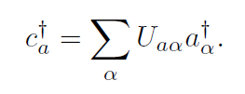
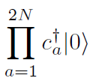
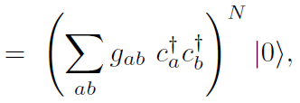



Pairs obtained from the HF basis
Solve the HF equation in the shell-model space with effective interactions. (SHERPA)
unitary transformation:
HF s.p. basis
NSM s.p. basis
The HF state of 2N valence protons is written by a pair-condensate state.
the phase of pair is arbitrary
HF pair => pairs with good spin in the NSM basis
selecting pairs with large y_{JM}, it tells us what pairs are important in advance!

Slide 19
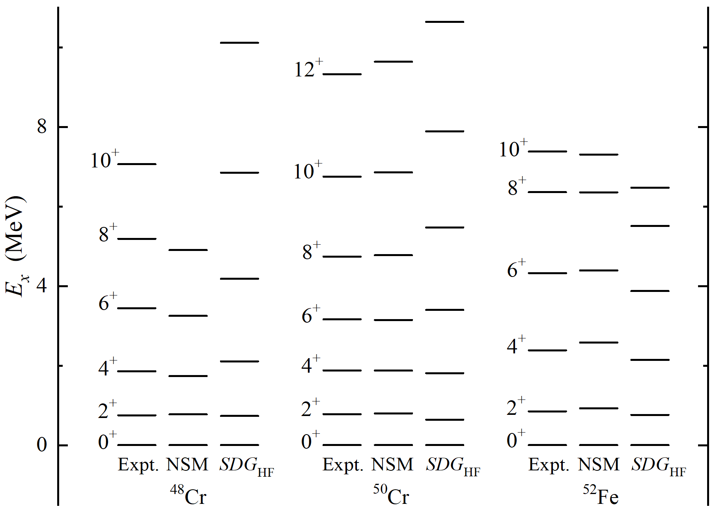
From HF to NPA
HF: selecting pairs from HF states
pf shell + KB3G interaction

Slide 20
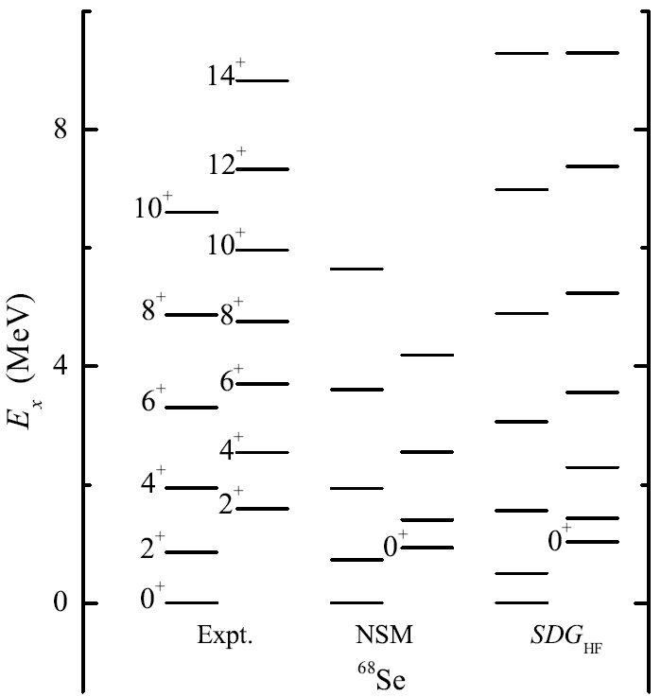
From HF to NPA
1p_{1/2}1p_{3/2}0f_{5/2}0g_{9/2} shell + JUN45 interaction
oblate
prolate

Slide 21
From HF to NPA
1p_{1/2}1p_{3/2}0f_{5/2}0g_{9/2} shell + JUN45 interaction
I : two bands are calculated based on two HF solutions, HF1 and HF2, respecitively;
II: we mixed the states obtained from HF1 and HF2.
NSM

Slide 22
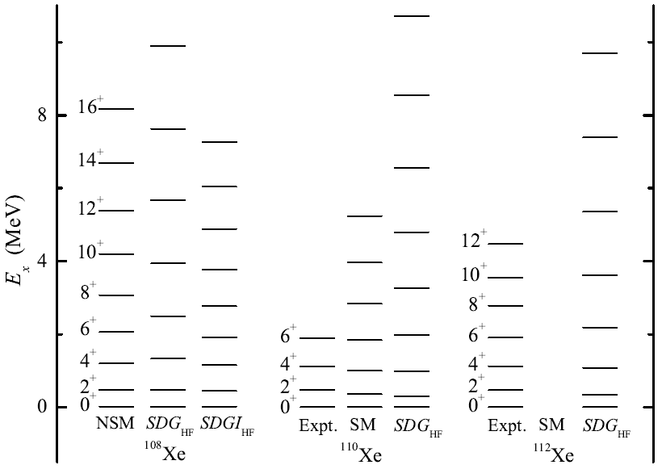
From HF to NPA
2s_{1/2}1d_{3/2}1d_{5/2}0g_{7/2}0h_{11/2} (50-82) shell + Bonn potential
NSM
NSM

Slide 23
Outline
Introduction: rotational nuclei in the NSM, IBM, and NPA
Optimized NPA solution: conjugate gradient (CG) method
Selecting nucleon pairs from HF
Summary

Slide 24
Summary
We study deformed nuclei using the NPA in the framework of the shell model, by selecting good pairs using the CG method and from the HF.
We find the SDG_{CG} pair truncation precisely reproduces the Elliott’s SU(3) of the 6p6n system in the pf shell, and the SDGI_{CG} pair truncation reproduces the Elliott’s SU(3) in the sdg shell.
The CG method works very well for the rotational motion, and the traditional GS method works for nearly spherical nuclei. CG + GS reproduces nuclear shape evolution.
We can select good pairs from the HF. Our preliminary results show that the SDG_{HF} pair truncation can well reproduce low-lying rotational bands.

Slide 25
Thanks for your attentions！

Slide 26
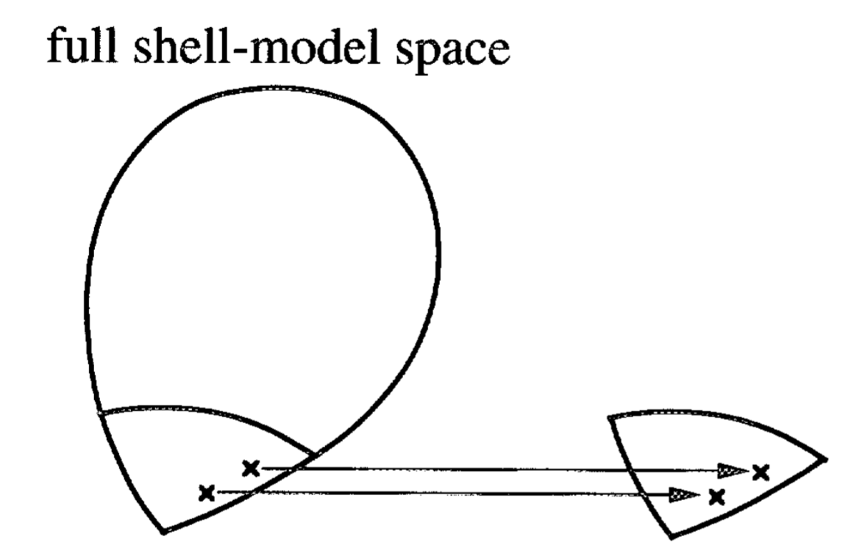
1: From Elliott’s SU(3) to IBM SU(3)
The SDG-pair truncation precisely reproduces the Elliott’s SU(3) of the 6p6n system in the pf shell.
This might indicate a direct sdg-boson mapping from the shell-model SU(3) Hamiltonian
Selecting pairs
OAI mapping?
NPA space
IBM space

Slide 27
2: triaxially and octupole deformed nuclei
HF pair => pairs with good spin in the NSM basis
Generally, for given J one obtains 2J+1 different pairs for different M.
A HF state can have arbitrary orientation with the same physical meaning, but y_{JM} will be changed.
The truth is the 2J+1 pairs are not linearly independent.
orthogonalization: diagonalize the norm matrix of pair
Numerically, axially deformed: 1 pair
triaxially deformed: 2 pairs
octupole deformed: parity-nonconserving pairs
y_{JM} are rotation invariant

Slide 28
3: improved pairing in the HF basis
The HF state of 2N valence protons is written by a pair-condensate state.
the phase of pair is arbitrary
Consider pairing in the HF basis:
where is obtained by minimizing the energy

Slide 29
4: nuclear phase transition
Aim: Gd isotopes, treating 7 pairs in the 2s_{1/2}1d_{3/2}1d_{5/2}0g_{7/2}0h_{11/2} (50-82) shell
Need an m-scheme NPA code
Expand the NPA basis in the m-scheme NSM basis => trans. matrix
build Hamiltonian matrix in the m-scheme NSM basis (e.g., BIGSTICK)
The norm and Hamiltonian matrices in the NPA basis can be obtained by large-scale matrix multiplication
Diagonalization
If possible, we wish to study phase transitions such as
spherical ⬄ quadrupole deformed
quadrupole deformed ⬄ quadrupole + octupole deformed

Slide 30
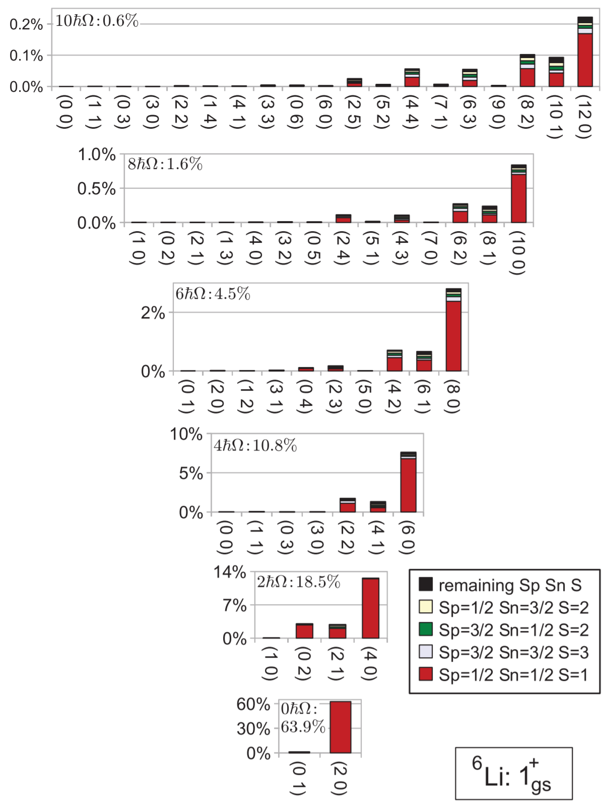
Rotational motion in terms of the shell model

Slide 31
Microscopic foundation of the IBM
e.g. OAI mapping

Slide 32
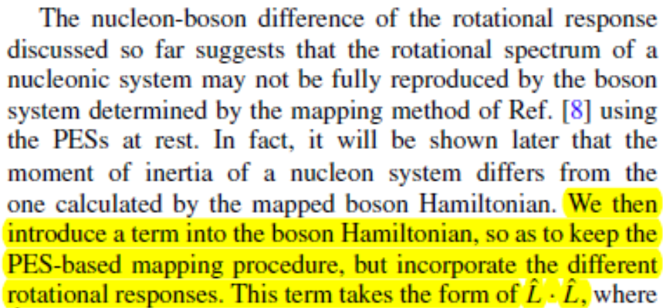
Microscopic foundation of the IBM
For deformed nuclei, require manually add a term to reproduce moment of inertia…

