Slide 1
Theoretical studies on alpha-decay half-lives of N = 125, 126 and 127 isotones
Zhen Wang
Prof. Zhongzhou Ren’s Group
School of Physics Science & Engineering, Tongji University

Slide 2
Outline
Introduction
Buck-Merchant-Perez Cluster Model
The Cluster-Formation Model (CFM)
Z-dependent α-Preformation Factor
Numerical Results and Discussion
Summary

Slide 3
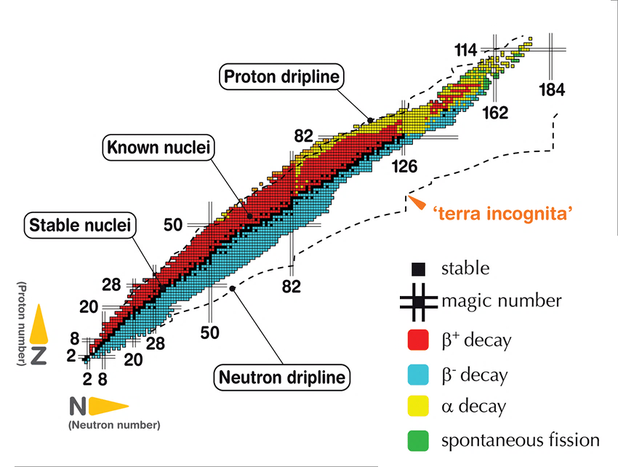
Introduction
Chart of Nuclei

Slide 4
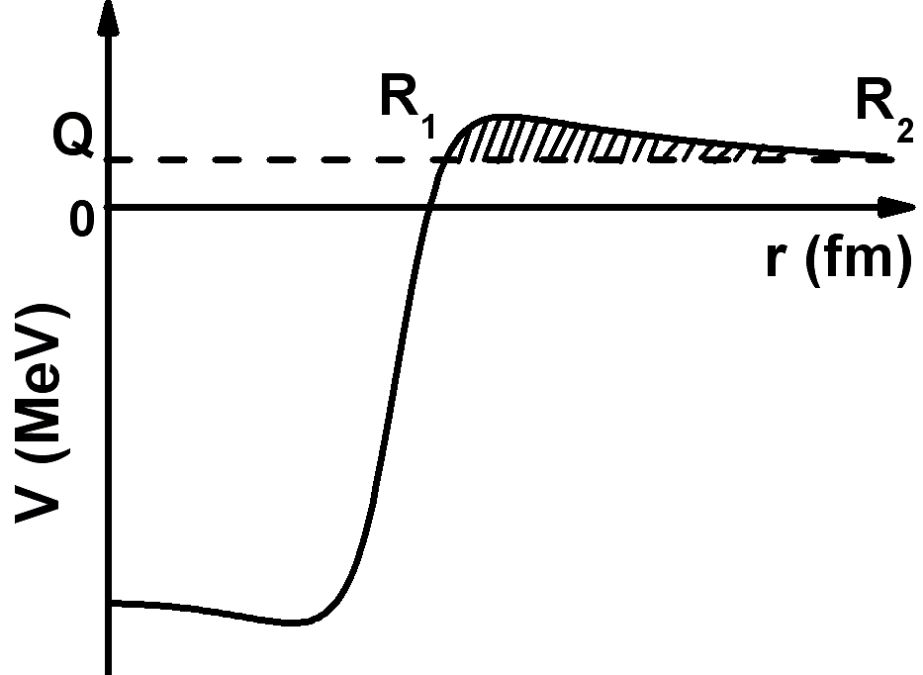
Introduction
α decay: “two-step” process (Gamow’s picture)
Preformation of an α cluster.
Penetration through the barrier.
α-preformation factor
assault frequency
penetrability

Slide 5
Introduction
In principle, the α-preformation factor can be evaluated by the overlap of the wave function of parent nucleus and α particle.
It’s difﬁcult to pin down the exact α-preformation factor microscopically due to the complexity of both nuclear potential and nuclear many-body problem.
Microscopic Methods VS Semi-empirical Methods

Slide 6
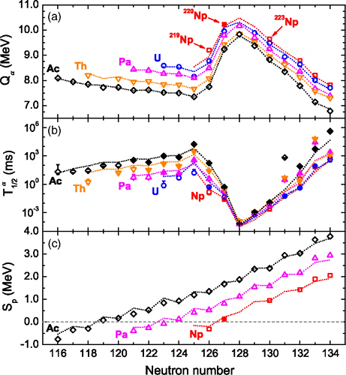
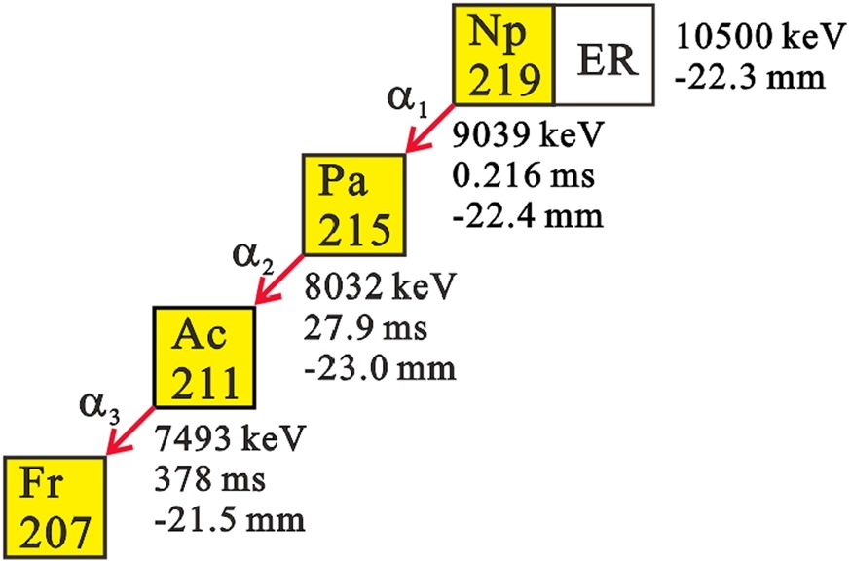
Introduction
[H. B. Yang, et al., Phys. Lett. B 777, 212(2018)]
[Z. Y. Zhang, et al., Phys. Rev. Lett. 122, 192503(2019)]

Slide 7
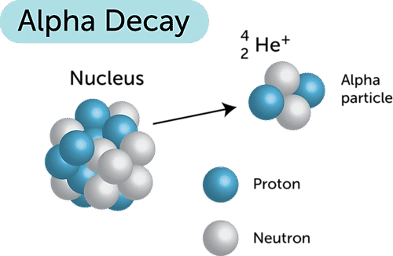
Buck-Merchant-Perez Cluster Model
It is assumed that the ground state of parent nucleus is an 𝛼 particle orbiting the daughter nucleus in the Buck-Merchant-Perez cluster model.
[Buck, et al., Phys. Rev. C 45, 2247(1992)]

Slide 8
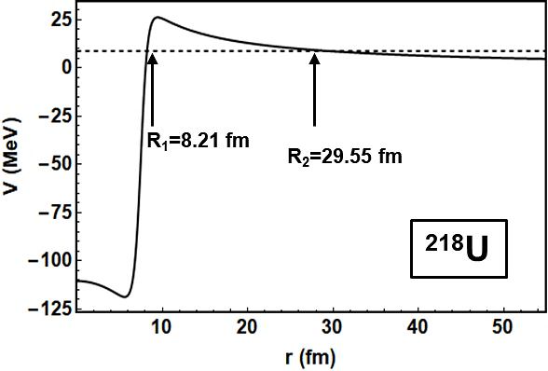
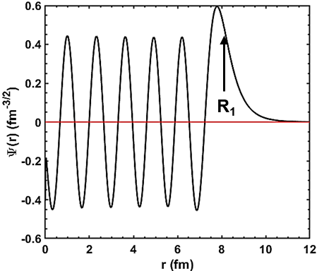
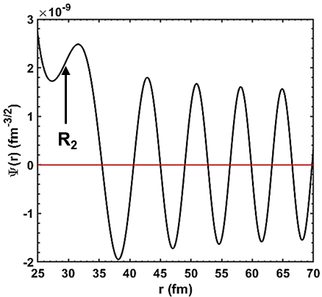
Buck-Merchant-Perez Cluster Model
The Effect Core-cluster Interaction Potential
Radial Wave Function

Slide 9
Buck-Merchant-Perez Cluster Model
The Wildermuth Condition
Bohr-Sommerfeld Quantization Condition
α-Decay Width and Half-Life

Slide 10
Buck-Merchant-Perez Cluster Model
Parameters
Note:
Changed Parity
l -- odd
G=2n+l -- odd

Slide 11
α-Preformation Factor
Constant α-Preformation Factor
The Cluster-Formation Model (CFM)
Z-dependent α-Preformation Factor

Slide 12
The Cluster-Formation Model
Clusterization State
Orthogonality Condition
Total Wavefunction
i_{th} Clusterization Hamiltonian
Total Hamiltonian
[Ahmed et al., J. Phys. G: Nucl. Part. Phys. 40, (2013)065105]

Slide 13
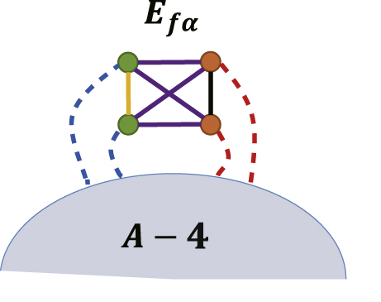
The Cluster-Formation Model
(Neutron)
(Proton)
even-even

Slide 14
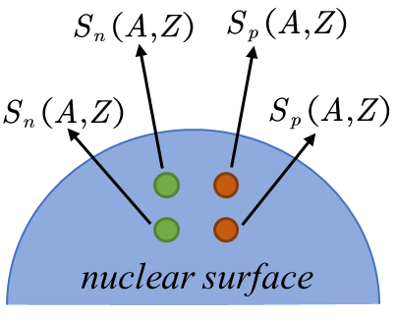
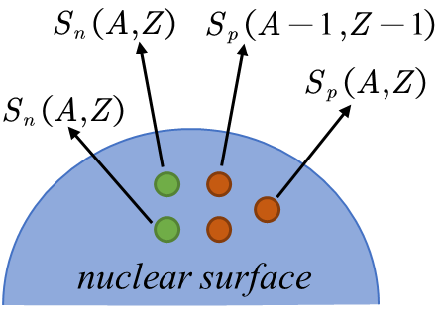
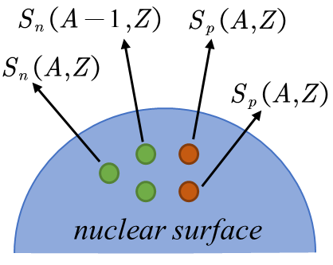
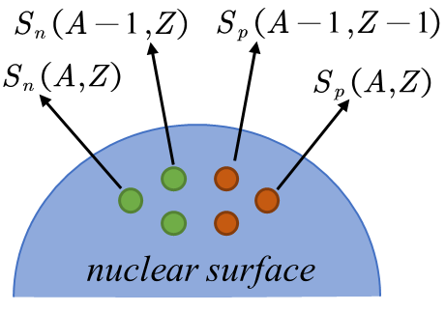
The Cluster-Formation Model
even-even
old-even
even-old
old-old
[Daming Deng et al., J. Phys. G: Nucl. Part. Phys. 42, 075106]

Slide 15
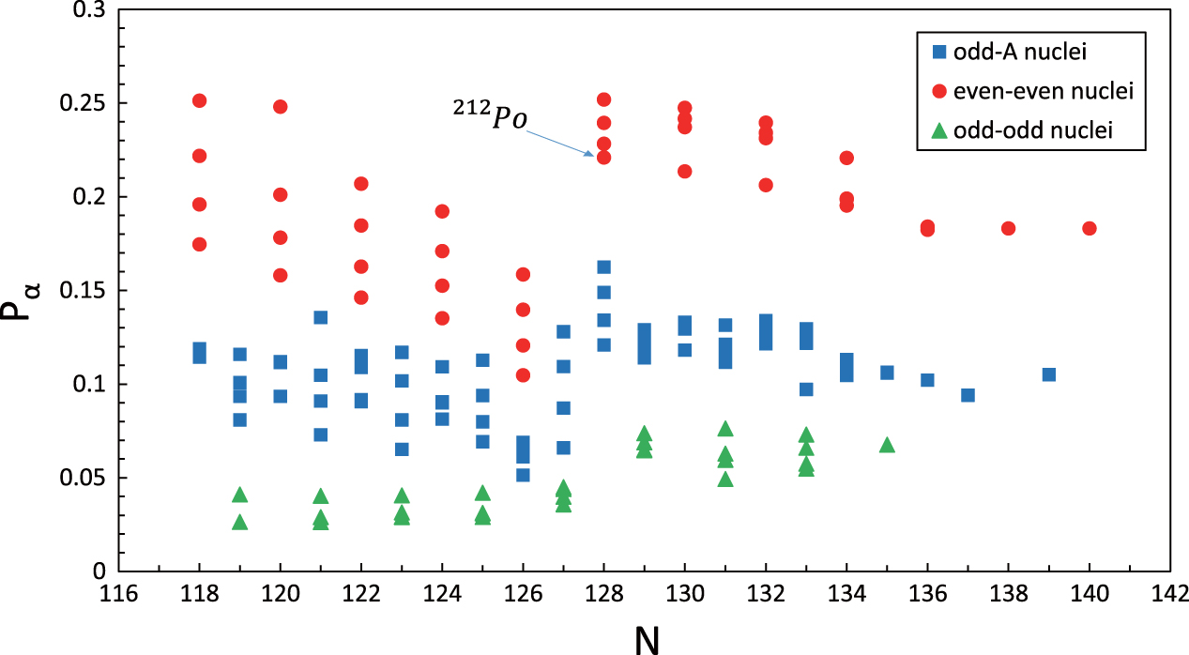
The Cluster-Formation Model

Slide 16
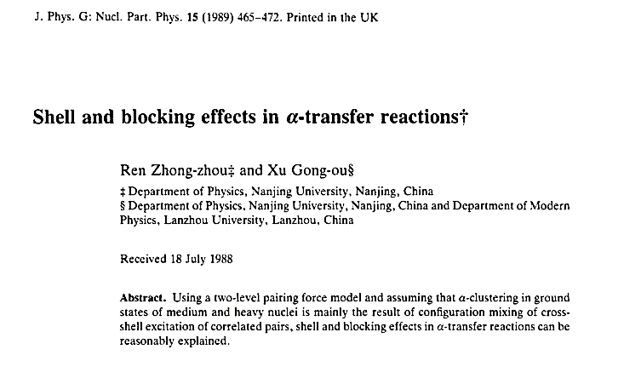
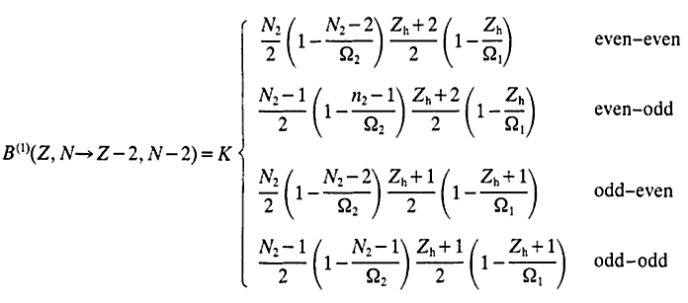
Z-dependent α-Preformation Factor
The Maximum Proton Number in a Major Shell
Valence Proton
[Z. Ren, et al., J. Phys. G: Nucl. Part. Phys. 15, 465]

Slide 17
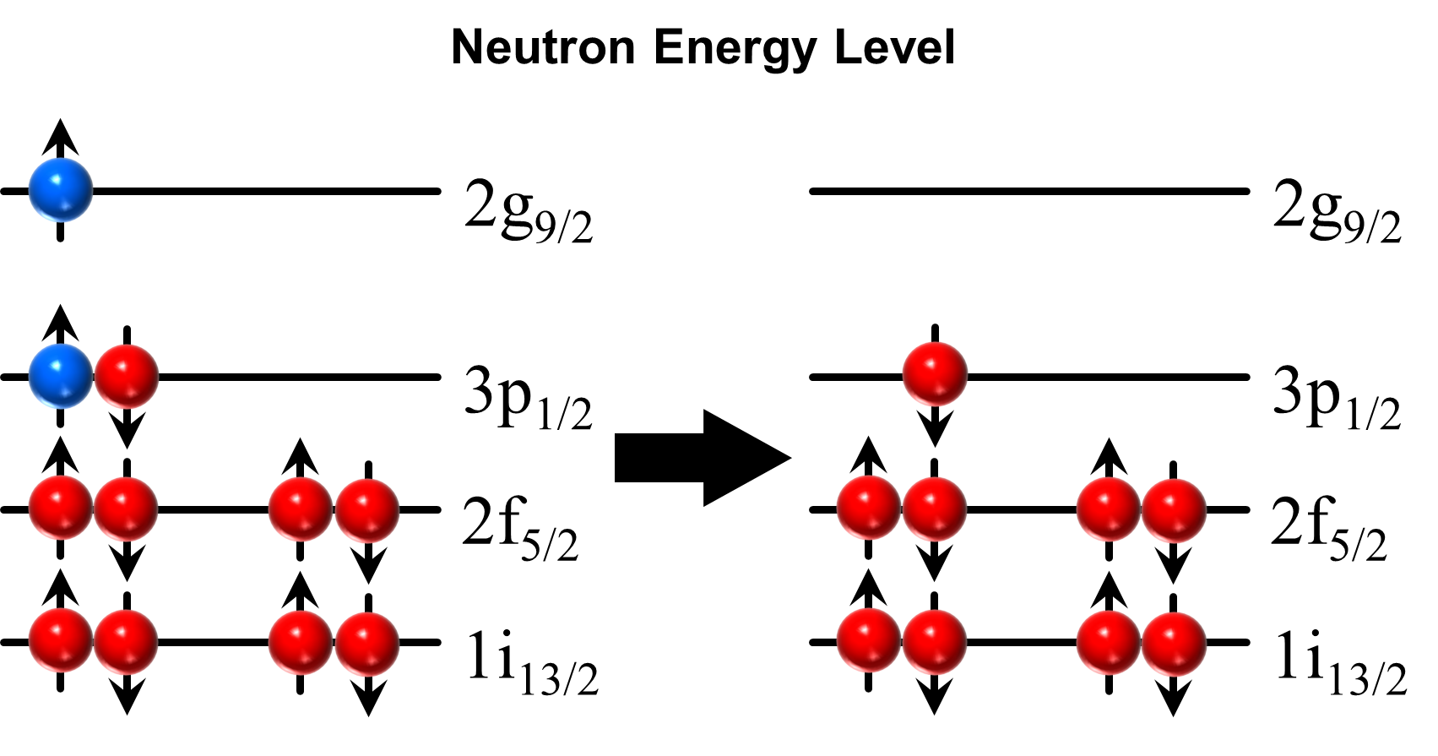
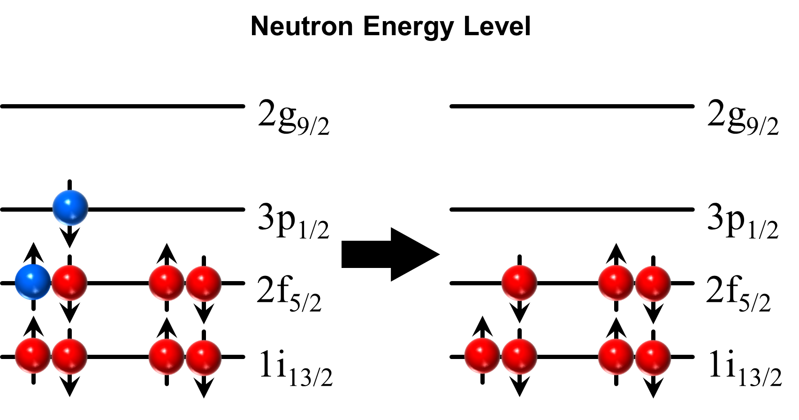
Z-dependent α-Preformation Factor
Centrifugal Barrier
Unpaired Nucleons
N=127
Shell Effect
N=125

Slide 18
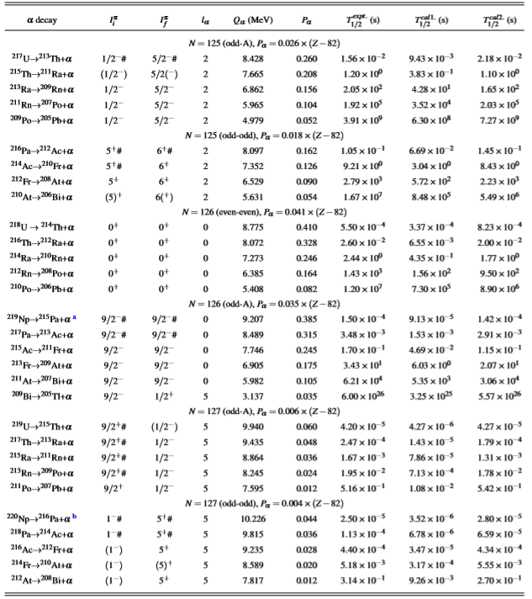
Z-dependent α-Preformation Factor

Slide 19
Constant α-Preformation Factor

Slide 20
The Cluster-Formation Model

Slide 21
Z-dependent α-Preformation Factor

Slide 22
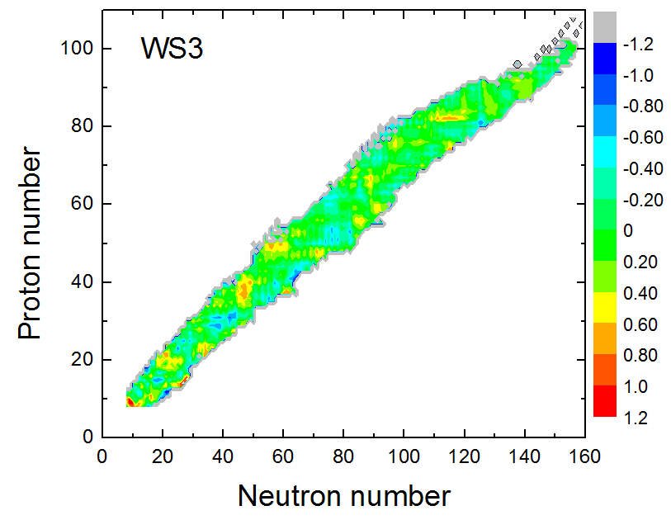
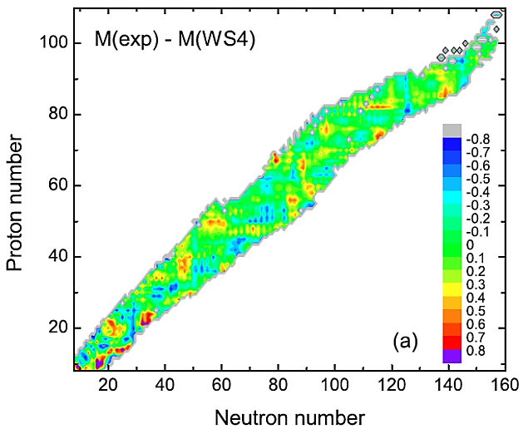
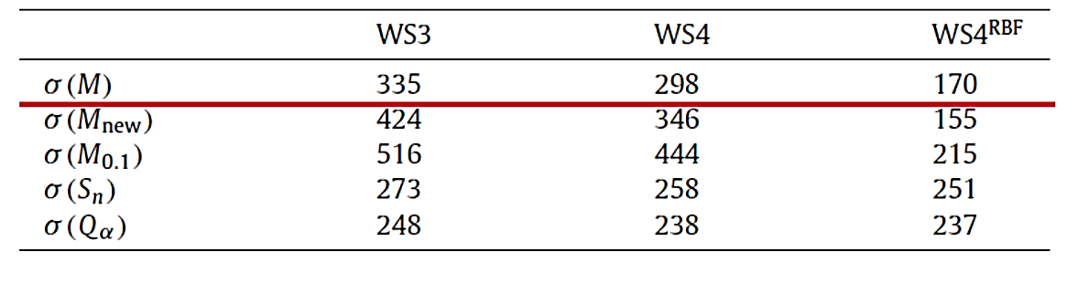
Weizsäcker-Skyrme (WS) Model

Slide 23
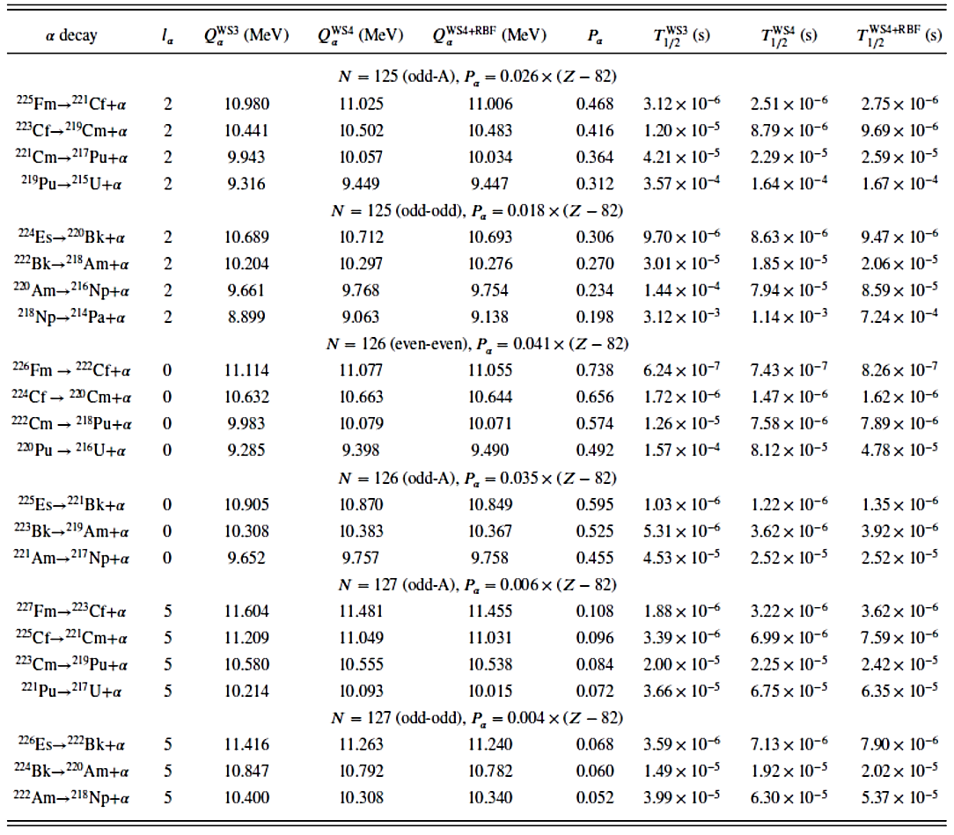
Weizsäcker-Skyrme (WS) Model

Slide 24
Summary
α decay process has been described as a two-step process, involving the preformation of the α particle and the following penetration through the central potential barrier, in Gamow’s picture.
The semi-empirical methods to extract the α-preformation factor: CFM, Constant / Z-dependent α-Preformation Factor.
The theoretical studies on alpha-decay half-lives of N = 125-127 isotones by combining the Buck-Merchant-Perez cluster model with the Z-dependent α-preformation factor, etc.
Predictions on α -decay half-lives of the N=125, 126 and 127 isotones with 94≤Z≤100 by combining the WS model.

Slide 25
Thanks for your attentions !

