Slide 1
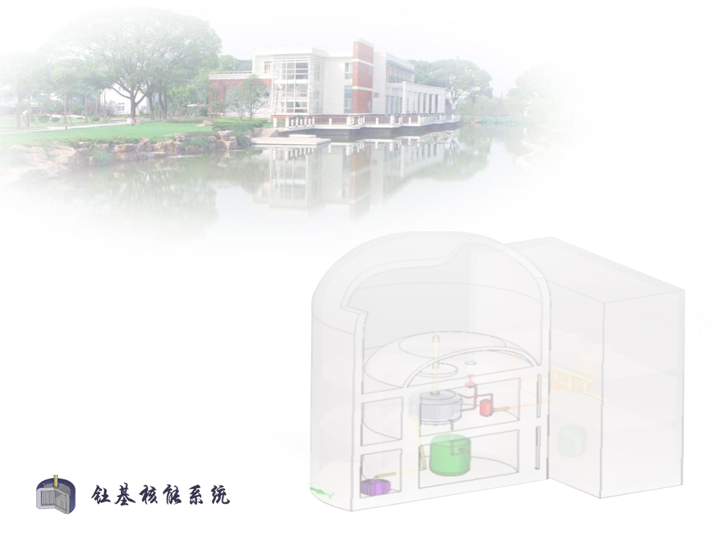
低本底探测用高纯材料成分分析
唐晓星
中国科学院上海应用物理研究所
2023.12.17

Slide 2
报 告 内 容
IPC ¹⁰⁰MoO₃ 分析
Li₂CO₃分析
Th U分离富集

Slide 3
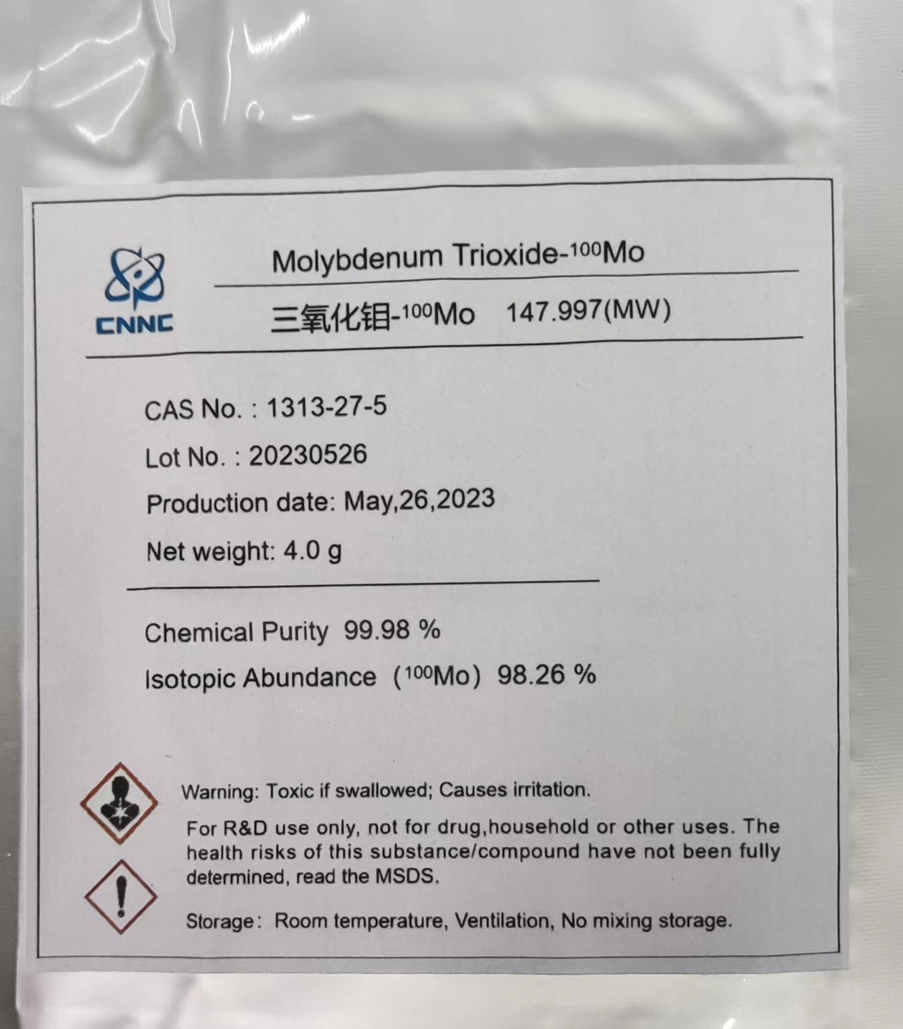
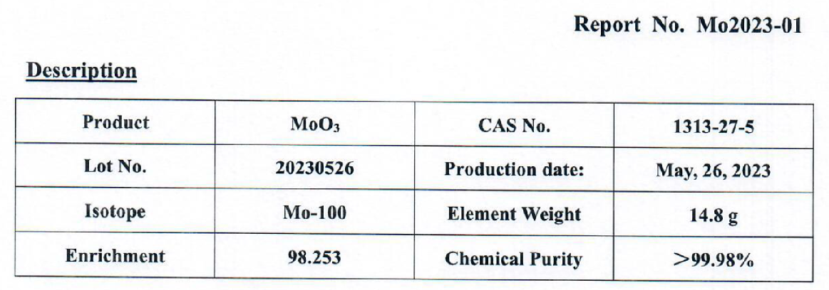
IPC ¹⁰⁰MoO₃ 样品

Slide 4
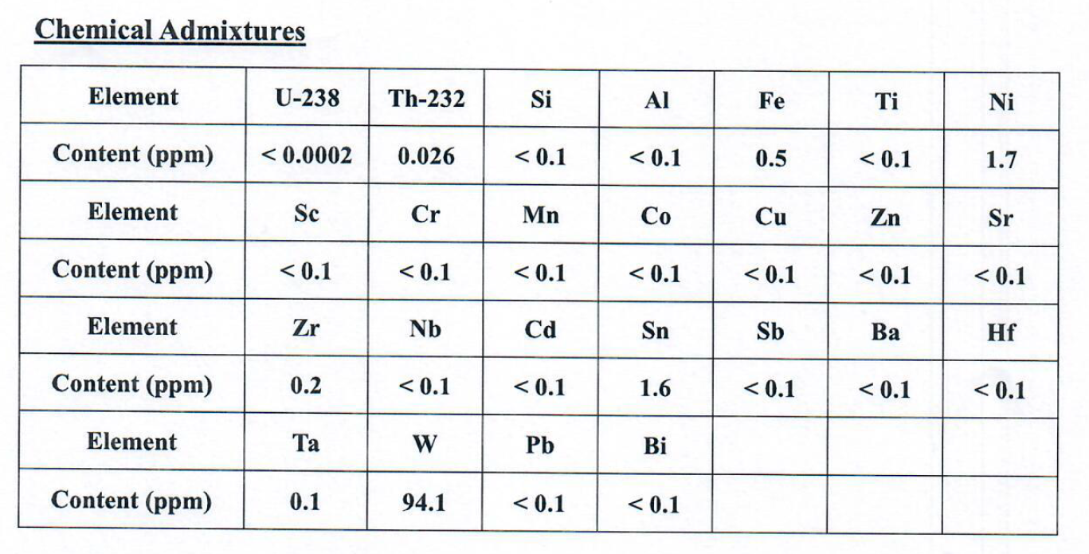
IPC ¹⁰⁰MoO₃ 样品
✦ ²³⁸U: < 200 ppt
✦ ²³²Th: 26 ppb
✦ no info about K

Slide 5
IPC ¹⁰⁰MoO₃ 分析结果比对
Abundance | Requirement，% | IPC | SINAP | LNGS
¹⁰⁰Mo | 98 | 98.253 | 98.34 | 98.4±0.5
Element | Requirement,ppm
U-238 | ＜0.01 | 110 ppt | 162 ppt | 16±3 ppt
Th-232 | ＜0.01 | 1200 ppt | 1449 ppt | 50±10 ppt
K | — | 3.12 | 26.6 | 16±3.2
W | ＜1000 | 192 | 626 | —
Si | ＜50 | 0.1 | — | —
Al | ＜30 | 0.1 | 1.11 | —
Fe | ＜30 | 0.5 | 6.74 | —
Ti | ＜30 | 0.1 | 1.09 | —
Ni | ＜30 | 1.7 | 0.35 | —
Sc | ＜30 | 0.1 | 0.38 | —
Cr | ＜30 | 0.1 | 0.72 | —
Mn | ＜30 | 0.1 | 0.04 | —

Slide 6
IPC ¹⁰⁰MoO₃ 分析结果比对
Element | Requirement,ppm | IPC | SINAP | LNGS
Co | ＜30 | 0.1 | nd | —
Zn | ＜30 | 0.1 | 0.39 | —
Sr | ＜30 | 0.1 | nd | —
Zr | ＜30 | 0.2 | nd | —
Nb | ＜30 | 0.1 | nd | —
Cd | ＜30 | 0.1 | 0.96 | —
Sn | ＜30 | 1.6 | 3.22 | —
Sb | ＜30 | 0.1 | - | —
Ba | ＜30 | 0.1 | 0.05 | —
Hf | ＜30 | 0.1 | nd | —
Ta | ＜30 | 0.1 | nd | —
Pb | ＜30 | 0.1 | nd | —
Bi | ＜30 | 0.1 | nd | —
Cu | ＜30 | 0.1 | nd | —

Slide 7
IPC ¹⁰⁰MoO₃ 分析方法比对
Name of laboratory | Analytical instruments | Sample pretreatment procedure
IPC | Thermo Fisher ELEMENT 2 HR-ICP-MS | 0.5ml氨水溶解10mg三氧化钼，蒸发浓缩后用2%硝酸定容至10ml。稀释1000倍。
SINAP | Thermo Fisher X2 ICP-MS | 50mg三氧化钼，加3ml H₂O, 2ml NH₃·H₂O, 80℃溶解，2%硝酸定容至50ml。稀释1000倍。
LNGS | HR-ICP-MS | 1 g NaOH in 10 ml. 2 aliquote da 5 mL sono state acidificate con 3 mL HNO3; alla seconda è stato aggiunto uno spike di Th ed U poi sono state portate a 10 ml. The measurements of Th and U content were performed after matrix separation and pre-concentration by mean chromatographic resins (TRU by Triskem). Differently, regard K content measurements were carried out by dilution after mineralization with same procedure adopted for previous analysis. 0.958 gMoO3,dilution factor 20.88。

Slide 8
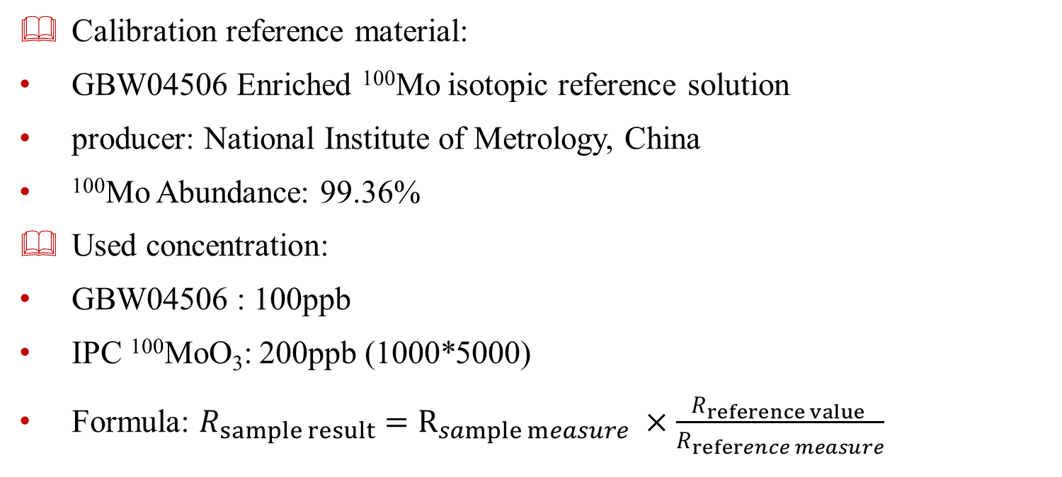
¹⁰⁰Mo isotope abundance
IPC ¹⁰⁰MoO₃ sample testing
Calibration reference material:
GBW04506 Enriched ¹⁰⁰Mo isotopic reference solution
producer: National Institute of Metrology, China
¹⁰⁰Mo Abundance: 99.36%
Used concentration:
GBW04506 : 100ppb
IPC ¹⁰⁰MoO₃: 200ppb (1000*5000)
Formula: $R_{sample result}=R_{sample measure} ×$ $\frac{R_{reference value }}{R_{reference measure}}$
Abundance | ⁹²Mo | ⁹⁴Mo | ⁹⁵Mo | ⁹⁶Mo | ⁹⁷Mo | ⁹⁸Mo | ¹⁰⁰Mo
GBW04506 | 0.0003200 | 0.0002161 | 0.0003881 | 0.0004770 | 0.0003994 | 0.0045568 | 0.9936425
Notes:
Follow introduce Mo-100 isotope abundance testing.
We used Mo isotope standard solution to correction.
The standard solution is GBW04506 Enriched Mo-100
Produced by national institute of metrology, china
And Mo-100 abundance is 99.36 percent.
In experiment, the standard concentration is about 100ppb and IPC sample is about 200ppb. Mentioned 1000 dilution and continue dilute five thousand.
The sample result according sample measure multiply reference correction factor.

Slide 9
Experimentation and Result
IPC ¹⁰⁰MoO₃ sample testing
Sample | 92Mo | 94Mo | 95Mo | 96Mo | 97Mo | 98Mo | 100Mo | Total intensity | 100Mo/Total | correction factor | Result
 | cps | cps | cps | cps | cps | cps | cps | cps
blank | 9 | 8 | 12 | 13 | 6 | 28 | 466
GBW04506 -1 | 299 | 207 | 393 | 455 | 388 | 4709 | 1098761
GBW04506 -2 | 277 | 203 | 370 | 488 | 386 | 4572 | 1082551
subtract blank
GBW04506 -1 | 290 | 199 | 381 | 442 | 382 | 4681 | 1098295 | 1104669 | 0.9942298 | 0.9994093
GBW04506 -2 | 268 | 195 | 358 | 475 | 379 | 4544 | 1082085 | 1088305 | 0.9942850 | 0.9993538
Average |  |  |  |  |  |  |  |  |  | 0.9993815
blank | 13 | 8 | 10 | 11 | 6 | 28 | 403
MoO₃-1 | 177 | 115 | 213 | 250 | 280 | 16867 | 1103253
MoO₃-2 | 186 | 120 | 226 | 254 | 301 | 17306 | 1128466
subtract blank
MoO₃-1 | 164 | 107 | 203 | 239 | 275 | 16838 | 1102849 | 1120675 | 0.9840938 |  | 0.9834852
MoO₃-2 | 173 | 112 | 216 | 243 | 295 | 17278 | 1128062 | 1146379 | 0.9840221 |  | 0.9834135
Average |  |  |  |  |  |  |  |  |  |  | 0.9834493
blank | 11 | 8 | 11 | 12 | 7 | 22 | 401
GBW04506 -1 | 270 | 188 | 327 | 436 | 368 | 4340 | 1016717
GBW04506 -2 | 292 | 213 | 338 | 439 | 362 | 4380 | 1033455
subtract blank
GBW04506 -1 | 259 | 180 | 315 | 424 | 361 | 4317 | 1016316 | 1022172 | 0.9942711 | 0.9993678
GBW04506 -2 | 281 | 204 | 327 | 428 | 355 | 4358 | 1033054 | 1039007 | 0.9942708 | 0.9993680
Average |  |  |  |  |  |  |  |  |  | 0.9993679
blank | 10 | 6 | 11 | 9 | 5 | 24 | 355
MoO₃-1 | 173 | 125 | 222 | 251 | 302 | 17338 | 1128731
MoO₃-2 | 190 | 123 | 216 | 271 | 309 | 17831 | 1166469
subtract blank
MoO₃-1 | 164 | 119 | 210 | 242 | 297 | 17313 | 1128377 | 1146721.931 | 0.9840019 |  | 0.9833798
MoO₃-2 | 180 | 117 | 205 | 262 | 304 | 17806 | 1166114 | 1184988.237 | 0.9840725 |  | 0.9834506
Average |  |  |  |  |  |  |  |  |  |  | 0.9834152
Notes:
This is instrument testing and result
First do the blank 2percent nitric acid. Then do standard solution, blank, sample solution.
We do two cycles.
Data processing, we use standard or sample intensity subtract blank, then count the total intensity、 Mo-100 percent . According standard reference value give correction factor.
Final count IPC sample Mo isotope abundance.

Slide 10
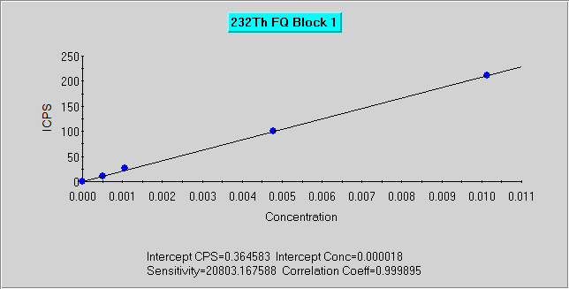
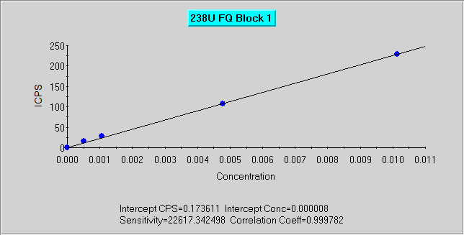
Th&U content
IPC ¹⁰⁰MoO₃ sample testing
Preparation: mentioned before
Dilution factor: 1000
Calibration solution concentration:
zero, 0.508ppt, 1.073ppt, 4.776ppt, 10.13ppt.
Experimentation and Result
Sample |  | Th/ppt | U/ppt
Measurement value
Blank |  | 0.003 | 0.002
MoO₃ | 1 | 1.289 | 0.190
 | 2 | 1.645 | 0.140
Subtract blank |  |  |  | Dilution factor
MoO₃ | 1 | 1.286 | 0.188 | 999.4
 | 2 | 1.642 | 0.138 | 982.6
Multiply dilution factor
MoO₃ | 1 | 1285 | 188
 | 2 | 1614 | 136
average |  | 1449 | 162
Notes:
Next introduce Thorium and uranium content testing method.
Sample preparation mentioned before. Dilution 1000 and no need continue dilute.
Calibration solution concentration is zero, about point five ppt, one ppt, five ppt and ten ppt.
These are calibration curve, correlation coefficient all above 0.999, but in the uranium, point five and one ppt a little high, the blank is too low.
This is the result: thorium content is high, uranium is nearly detection limit.

Slide 11
Instrument operation data-concentration
Run | Time | 232Th | 238U | Run | Time | 232Th | 238U | Run | Time | 232Th | 238U
 |  | ppt | ppt |  |  | ppt | ppt |  |  | ppt | ppt
BK –standard solution |  |  |  | 2%HNO3 wash system
1 | 10:19:37 | -0.018 | -0.008 | 1 | 10:30:57 | 0.043 | 0.057
2 | 10:19:48 | 0.013 | 0.011 | 2 | 10:31:09 | 0.043 | -0.008
3 | 10:20:00 | 0.013 | -0.008 | x |  | 0.043 | 0.025
x |  | 0.003 | -0.002 | s |  | 0 | 0.046
s |  | 0.017 | 0.011 | %RSD |  | 0 | 185.6
%RSD |  | 692.8 | 692.8
BK –standard solution |  |  |  | 2% HNO3 wash system |  |  |  | 2%HNO3 wash system
1 | 10:21:32 | 0.003 | 0.011 | 1 | 10:32:29 | 0.043 | 0.020 | 1 | 10:42:00 | 0.073 | 0.011
2 | 10:21:44 | -0.008 | -0.008 | 2 | 10:32:41 | 0.013 | -0.008 | 2 | 10:42:12 | 0.033 | -0.008
x |  | -0.003 | 0.002 | x |  | 0.028 | 0.006 | x |  | 0.053 | 0.002
s |  | 0.007 | 0.013 | s |  | 0.021 | 0.02 | s |  | 0.028 | 0.013
%RSD |  | 282.8 | 848.5 | %RSD |  | 77.14 | 318.2 | %RSD |  | 53.87 | 848.5
Th u 0.5PPt |  |  |  | bk -sample |  |  |  | Th u 0.5PPt
1 | 10:23:53 | 0.663 | 0.748 | 1 | 10:34:15 | 0.043 | 0.011 | 1 | 10:44:05 | 0.563 | 0.665
2 | 10:24:05 | 0.363 | 0.600 | 2 | 10:34:27 | -0.008 | 0.002 | 2 | 10:44:17 | 0.573 | 0.527
x |  | 0.513 | 0.674 | x |  | 0.018 | 0.006 | x |  | 0.568 | 0.596
s |  | 0.212 | 0.104 | s |  | 0.035 | 0.007 | s |  | 0.007 | 0.098
%RSD |  | 41.39 | 15.46 | %RSD |  | 202 | 106.1 | %RSD |  | 1.246 | 16.4
Th u 1PPt |  |  |  | bk -sample |  |  |  | Th u 1ppt
1 | 10:25:32 | 1.184 | 1.052 | 1 | 10:35:50 | 0.003 | 0.011 | 1 | 10:45:47 | 1.304 | 1.162
2 | 10:25:44 | 1.254 | 1.411 | 2 | 10:36:02 | 0.003 | -0.008 | 2 | 10:45:59 | 1.164 | 1.162
x |  | 1.219 | 1.231 | x |  | 0.003 | 0.002 | x |  | 1.234 | 1.162
s |  | 0.05 | 0.254 | s |  | 0 | 0.013 | s |  | 0.099 | 0
%RSD |  | 4.066 | 20.63 | %RSD |  | 0 | 848.5 | %RSD |  | 8.032 | 0
Th u 5PPt |  |  |  | 1 MoO3
1 | 10:27:32 | 4.900 | 4.893 | 1 | 10:37:53 | 1.294 | 0.140
2 | 10:27:44 | 4.669 | 4.543 | 2 | 10:38:05 | 1.284 | 0.241
x |  | 4.784 | 4.718 | x |  | 1.289 | 0.190
s |  | 0.163 | 0.248 | s |  | 0.007 | 0.072
%RSD |  | 3.404 | 5.246 | %RSD |  | 0.549 | 37.64
Th u 10PPt |  |  |  | 2 MoO3
1 | 10:29:17 | 9.787 | 10.12 | 1 | 10:39:42 | 1.455 | 0.121
2 | 10:29:28 | 10.43 | 10.13 | 2 | 10:39:54 | 1.835 | 0.158
x |  | 10.11 | 10.13 | x |  | 1.645 | 0.140
s |  | 0.453 | 0.007 | s |  | 0.269 | 0.026
%RSD |  | 4.484 | 0.064 | %RSD |  | 16.36 | 18.65
Notes:
This is instrument operation data:
First we do standard solution, then wash system by 2 percent nitric acid, then do two sample blank, ensure system have no residual from standard ,then do ICP Mo-100 sample.
For confirm Mo affect and ICP-MS system stability, we do blank and standard again.
Retest results are almost the same as the first results

Slide 12
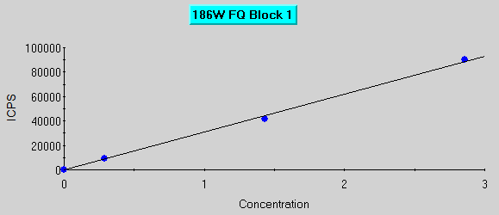
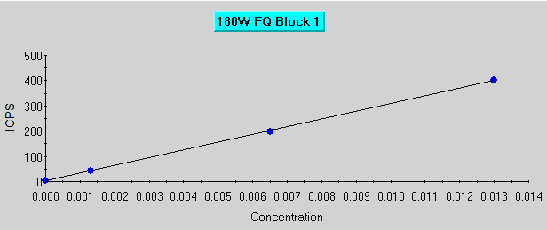
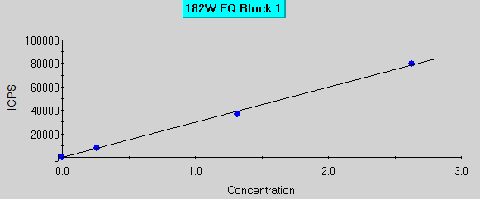
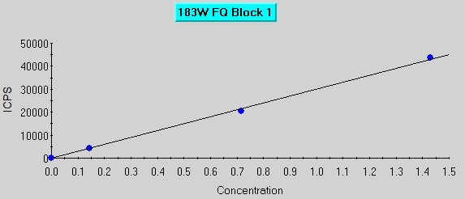
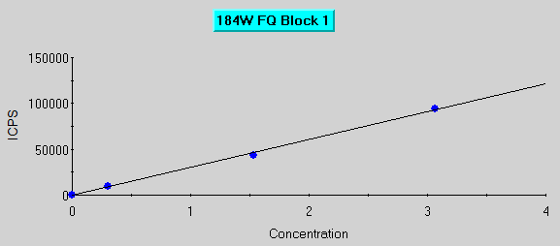
W content
IPC ¹⁰⁰MoO₃ sample testing
Used concentration:
IPC ¹⁰⁰MoO₃: 10ppm (1000*100)
Calibration solution : zero, 1ppb, 5ppb, 10ppb
Calibration solution | 180W | 182W | 183W | 184W | 186W
 | ppb | ppb | ppb | ppb | ppb
W 1PPB | 0.001 | 0.263 | 0.143 | 0.307 | 0.286
W 5PPB | 0.006 | 1.315 | 0.715 | 1.534 | 1.43
W 10PPB | 0.013 | 2.63 | 1.43 | 3.067 | 2.86
Notes:
Nest introduce the tungsten content testing
In this experiment, IPC Mo-100 sample concentration is about 10 ppm, Mentioned 1000 dilution and continue dilute 100.
We chose all stable isotopes and every isotope concentration count from nature abundance. Such as in 1ppb tungsten calibration solution, tungsten 180 concentration is point 001.
These are tungsten isotopes calibration curve, each isotope is basically satisfied.

Slide 13
Result
IPC ¹⁰⁰MoO₃ sample testing
Sample result:
Run | 180W | 182W | 183W | 184W | 186W
measurement value | ppb | ppb | ppb | ppb | ppb | Dilution factor
blank | 0 | 0 | 0 | 0 | 0 | 1 step | 2 step
1 MoO3 | 0.002 | 0.368 | 0.206 | 0.613 | 5.531 | 999 | 100
2 MoO3 | 0.001 | 0.301 | 0.168 | 0.509 | 4.614 | 983 | 105
multiply dilution factor |  |  |  |  |  | sum | average
1 MoO3 | 200 | 36857 | 20632 | 61395 | 553960 | 673044
2 MoO3 | 104 | 31156 | 17390 | 52686 | 477590 | 578926 | 625985
Accuracy assessment:
add preparation | MoO3 1*1000/g | dilute by 2%HNO3/g | add 100ppb W solution/g | add W content/ng
MoO3 1 | 0.1 | 10.267
MoO3 1 1PPB addition | 0.1 | 10.11 | 0.101 | 10.1
MoO3 1 5PPB addition | 0.1 | 11.32 | 0.505 | 50.5
MoO3 1 10PPB addition | 0.1 | 11.19 | 1.018 | 101.8
Notes:
Nest we see the results:
Instrument measurement value, sample blank concentration is zero,
IPC Mo 100 results: each isotope multiply dilution factor, then sum each isotope result and give the tungsten concentration.
This is accuracy assessment sample making process:
We use Mo sample one, point one gram from sample, 0.1, 0.5, 1gram from 100ppb tungsten solution, then dilute to about ten gram. Count tungsten content is 10 50 100 Nano gram.

Slide 14
Accuracy assessment result
 | 180W | 182W | 183W | 184W | 186W
measurement value/ppt
MoO3 1 | 0.001 | 0.323 | 0.183 | 0.545 | 4.881
MoO3 1 1PPB addition | 0.002 | 0.563 | 0.311 | 0.831 | 5.305
MoO3 1 5PPB addition | 0.006 | 1.32 | 0.718 | 1.699 | 5.571
MoO3 1 10PPB addition | 0.012 | 2.408 | 1.323 | 2.977 | 6.827
W content/ng
MoO3 1 | 0.010 | 3.316 | 1.879 | 5.596 | 50.113
MoO3 1 1PPB addition | 0.020 | 5.692 | 3.144 | 8.401 | 53.634
MoO3 1 5PPB addition | 0.068 | 14.942 | 8.128 | 19.233 | 63.064
MoO3 1 10PPB addition | 0.134 | 26.946 | 14.804 | 33.313 | 76.394
W content/ng-Subtract blank
MoO3 1 1PPB addition | 0.010 | 2.376 | 1.265 | 2.806 | 3.520
MoO3 1 5PPB addition | 0.058 | 11.626 | 6.249 | 13.637 | 12.950
MoO3 1 10PPB addition | 0.124 | 23.629 | 12.926 | 27.717 | 26.281
W content/ng-theroy(according to add 100ppb W solution)
MoO3 1 1PPB addition | 0.010 | 2.656 | 1.444 | 3.101 | 2.889
MoO3 1 5PPB addition | 0.051 | 13.282 | 7.222 | 15.504 | 14.443
MoO3 1 10PPB addition | 0.102 | 26.773 | 14.557 | 31.253 | 29.115
Recovery/%
MoO3 1 1PPB addition | 98.5 | 89.4 | 87.6 | 90.5 | 121.9
MoO3 1 5PPB addition | 114.2 | 87.5 | 86.5 | 88.0 | 89.7
MoO3 1 10PPB addition | 121.8 | 88.3 | 88.8 | 88.7 | 90.3
Notes:
Then we see results:
The recovery is from 86.5%-121.9%, basically satisfied in ICP-MS.

Slide 15
Other elements content
IPC ¹⁰⁰MoO₃ sample testing
Preparation: mentioned before
Dilution factor: 1000
Calibration solution :
SPEX: CLMS-1, CLMS-2, CLMS-3, CLMS-4
CLMS-1 :Ce, Dy, Er, Eu, Gd, Ho, La, Lu, Nd, Pr, Sc, Sm, Tb, Th, Tm, Y, Yb
CLMS-2: Ag, Al, As, Ba, Be, Bi, Ca, Cd, Co, Cr, Cs, Cu, Fe, Ga, K, Li, Mg, Mn, Na, Ni, Pb, Rb, Se, Sr, Tl, U, V, Zn
CLMS-3 :Au, Hf, Ir, Pd, Pt, Rh, Ru, Sb, Sn, Te
CLMS-4: B, Ge, Mo, Nb, P, Re, S, Si, Ta, Ti, W, Zr
Measurement method: survey (all spectrum scan) and main peak jump
Result:
according calibration solution give each element content
Some elements comparison between survey and main peak jump
Notes:
Nest introduce other elements contents testing:
Sample preparation mentioned before. Dilution 1000 and no need continue dilute.
Calibration solution we used American spex producer series standard solution.
Instrument testing method we use survey and main peak jump.

Slide 16
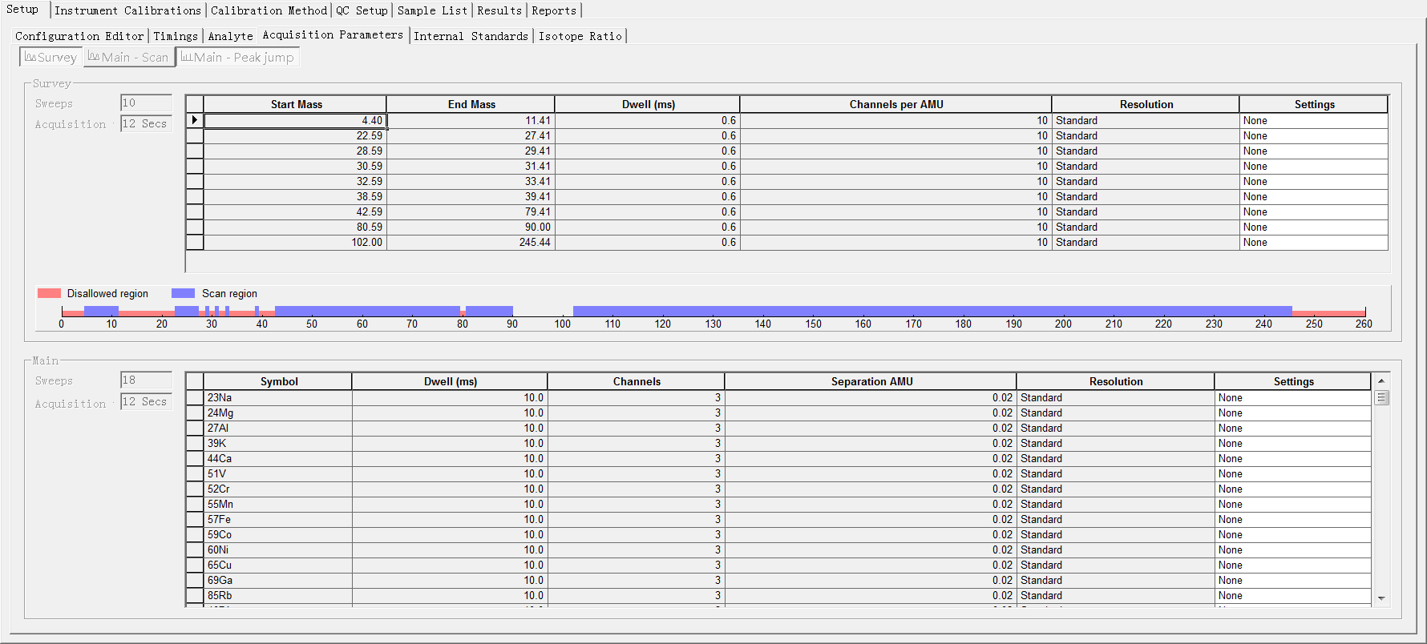
Other elements content
IPC ¹⁰⁰MoO₃ sample testing
Survey and main peak jump:
Notes:
This is instrument interface:
Survey method :scan mass from 4 to 245.
Main peak jump is testing chosed elements.

Slide 17
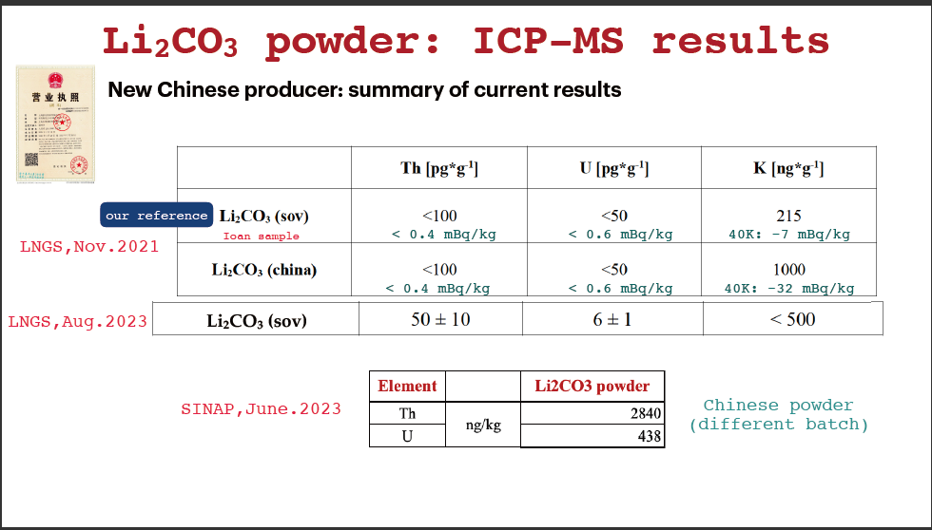
Li₂CO₃分析

Slide 18
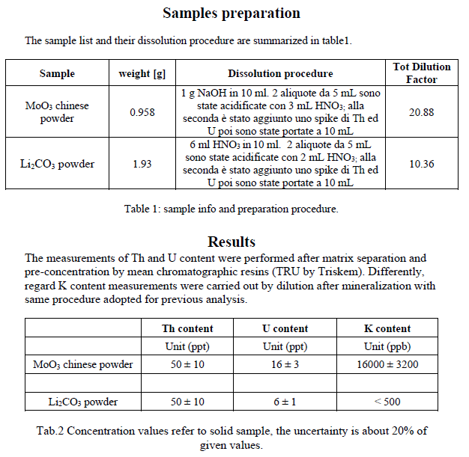
LNGS testing

Slide 19
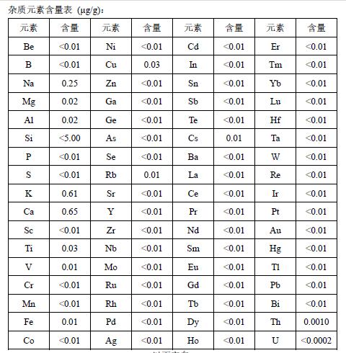
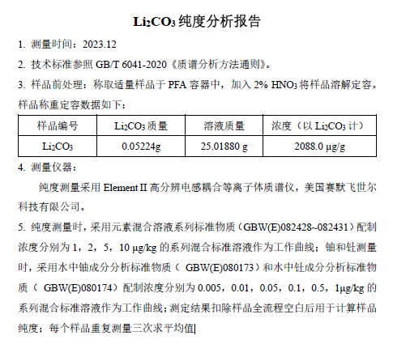
Li₂CO₃分析
ppm
IPC testing
Th: 1000ppt
U :<200ppt

Slide 20
Samples preparation:
Samples preparation:
Samples preparation:
Samples preparation:
Li₂CO₃分析
元素 | 单位 | Li2CO3 意大利 | Li2CO3-1 | Li2CO3-2
W | ug/kg | nd | nd | 817
Mg | ug/kg | 1855 | 3045 | 2339
Cr | ug/kg | 1150 | 1430 | 1263
Ba | ug/kg | nd | 2573 | 549
Sc | ug/kg | nd | 106 | 197
Nd | ug/kg | nd | 31 | 1252
Cs | ug/kg | nd | nd | 31
Sn | ug/kg | nd | nd | 29
Te | ug/kg | nd | nd | 193
Ce | ug/kg | nd | 14 | 10339
Gd | ug/kg | nd | nd | 53
Er | ug/kg | nd | 10 | nd
Ga | ug/kg | nd | 83 | 16
Rb | ug/kg | nd | nd | 33
Y | ug/kg | nd | 15 | nd
La | ug/kg | nd | nd | 95
Sr | ug/kg | nd | 3921 | 59
Pr | ug/kg | nd | nd | 4
Zr | ug/kg | nd | nd | 948
Mn | ug/kg | nd | nd | 95
Ge | ug/kg | nd | nd | 40
Al | ug/kg | nd | nd | 18243
Pb | ppb | nd | 65 | 1369
Hf | ug/kg | nd | nd | 32
Ta | ug/kg | nd | nd | 17
SINAP testing
⁷Li-¹⁷OH/¹⁸O/¹⁹OH
Sample preparation
³⁵Cl-¹⁷OH/³⁷Cl-¹⁷OH/¹⁶O
Sample | Weight / g | Dissolution procedure | Dilution factor
Li₂CO₃ power | 0.05 | Dissolution: 5ml 5%HNO₃. Dilution: 2%HNO₃ | 1000
元素 | 单位 | Li₂CO₃ 意大利 | Li₂CO₃-1 | Li₂CO₃-2
Th | ppb | nd | 122 | 11.6
U | ppb | nd | nd | 0.05

Slide 21
Th U分离富集
固相萃取树脂
树脂 | 用途 | 萃取功能基团
TEVA® Resin | Tc, Th, Np, Pu, Am/lanthanides | aliphatic quaternary amine
UTEVA® Resin | Th, U, Np, Pu | diamyl, amylphosphonate (DAAP)
TRU Resin | Fe, Th, Pa, U, Np, Pu, Am, Cm | octylphenyl-N,N-diisobutyl carbamoylphosphine oxide (CMPO)
Produced by Triskem

Slide 22
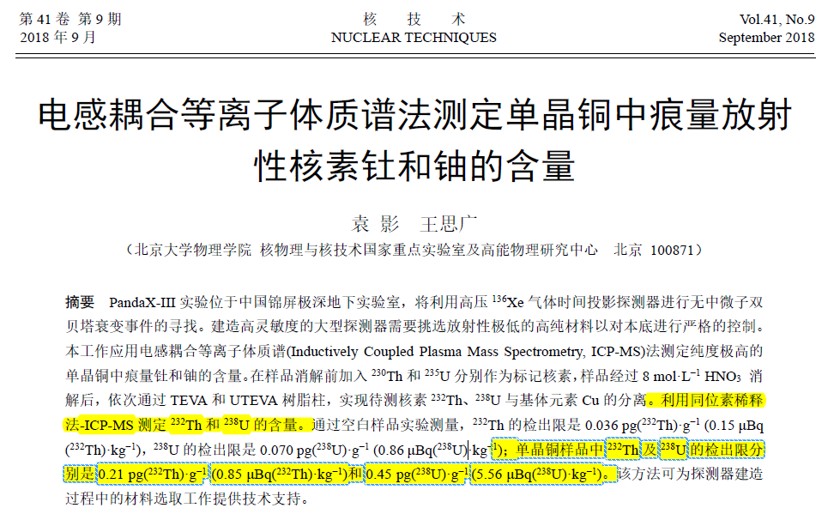
Th U分离富集
采购：
TEVA /UTEVA
采购标记核素：
Th-230/U-236
中国同福签订采购合同，因核管制对中国禁售，最终退款
LOD:
Th-232: 0.21ppt
U-238: 0.45ppt

Slide 23
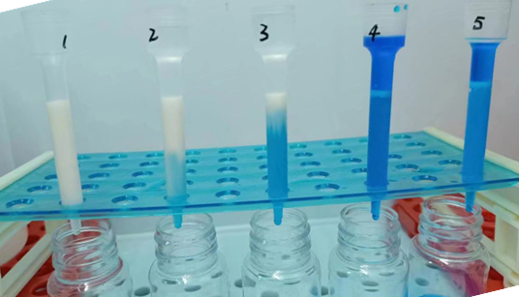
UTEVA-TEVA联合树脂实验
回收率评估：天然的Th-232和U-238/235标准溶液
 |  | 测量值/pg |  | 回收率/%
样品 | 加标量/pg | Th | U | Th | U
硝酸空白样品 | 30 | 19.9 | 28.1 | 66.4 | 93.7
硝酸空白样品 | 30 | 19.3 | 29.8 | 64.4 | 99.3
硝酸空白样品 | 30 | 17.2 | 29.0 | 57.4 | 96.6

Slide 24
UTEVA-TEVA联合树脂实验
样品名称 | 样品编号 |  | 测试结果 ng/kg
 |  |  | 232Th | 238U
Cu | Cu 空白 | 平行样1 | 1.50 | 2.78
 |  | 平行样2 | 1.38 | 2.40
 |  | 平行样3 | 1.24 | 3.49
 |  | 平均值 | 1.37 | 2.89
 | Cu 4# | 平行样1 | 1.82 | 2.99
 |  | 平行样2 | 2.24 | 2.97
 |  | 平行样3 | 3.27 | 4.33
 |  | 平均值 | 2.44 | 3.43
样品名称 | 样品编号 |  | 测试结果 ng/kg
 |  |  | 232Th | 238U
Cu | Cu 空白 | 平行样1 | 1.06 | 2.79
 |  | 平行样2 | 0.70 | 3.17
 |  | 平均值 | 0.88 | 2.98
 | Cu 5# | 平行样1 | 0.84 | 3.21
 |  | 平行样2 | 1.09 | 2.40
 |  | 平均值 | 0.96 | 2.80
样品名称 | 样品编号 |  | 测试结果 ng/kg
 |  |  | 232Th | 238U
Cu | Cu 空白 | 平行样1 | 0.95 | 2.13
 |  | 平行样2 | 0.51 | 1.89
 |  | 平行样3 | 1.08 | 2.10
 |  | 平均值 | 0.85 | 2.04
 | 桶部Cu | 平行样1 | 3.59 | 3.78
 |  | 平行样2 | 2.04 | 4.36
 |  | 平行样3 | 4.97 | 2.57
 |  | 平均值 | 3.53 | 3.57
样品名称 | 样品编号 |  | 测试结果 ng/kg
 |  |  | 232Th | 238U
Cu | Cu 空白 | 平行样1 | 4.87 | 1.09
 |  | 平行样2 | 4.29 | 1.51
 |  | 平行样3 | 3.79 | 1.34
 |  | 平均值 | 4.32 | 1.31
 | 桶部Cu | 平行样1 | 3.84 | 1.93
 |  | 平行样2 | 3.62 | 1.60
 |  | 平行样3 | 3.14 | 1.74
 |  | 平均值 | 3.53 | 1.76

Slide 25
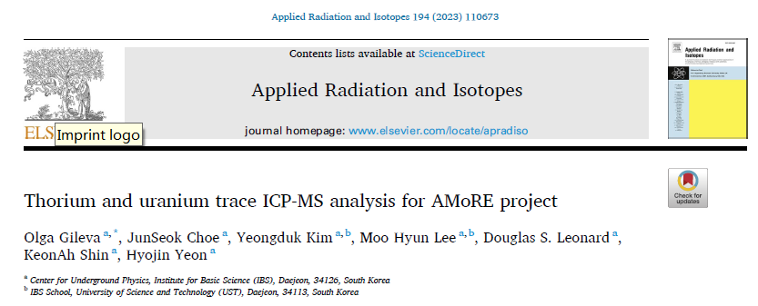
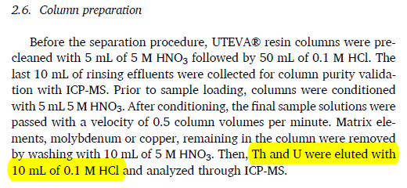
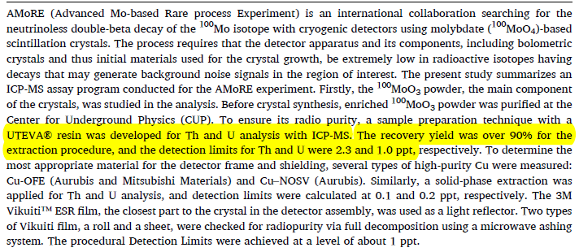
UTEVA树脂实验
SINAP-UTEVA实验
样品 |  | 测量值 |  | 扣空白 |  | 回收率/%
 | 加标量/pg | Th/pg | U/pg | Th/pg | U/pg | Th/pg | U/pg
空白 | 0 | 47.8 | 6.65
空白 | 0 | 42.7 | 6.11
空白 | 0 | 42.5 | 7.14
空白加标 | 30.9 | 28.2 | 38.4 | 负值 | 31.75 | / | 103
空白加标 | 30.4 | 26.0 | 35.8 | 负值 | 29.14 | / | 96
空白加标 | 91.2 | 21.0 | 100 | 负值 | 93.37 | / | 102
空白加标 | 90.9 | 20.2 | 100 | 负值 | 93.56 | / | 103

Slide 26
总结
原料及晶体纯度越来越高，Th U的直接测量基本达到了ICP-MS的测定下限
进一步压低Th U测定下限，需对Th U进行富集
富集过程步骤复杂，加天然核素评估过程损失，会污染环境、样品
希望合作组能够帮忙解决标记核素Th-230、U-236 或 高丰度U-235.

Slide 27
谢谢！

Slide 28
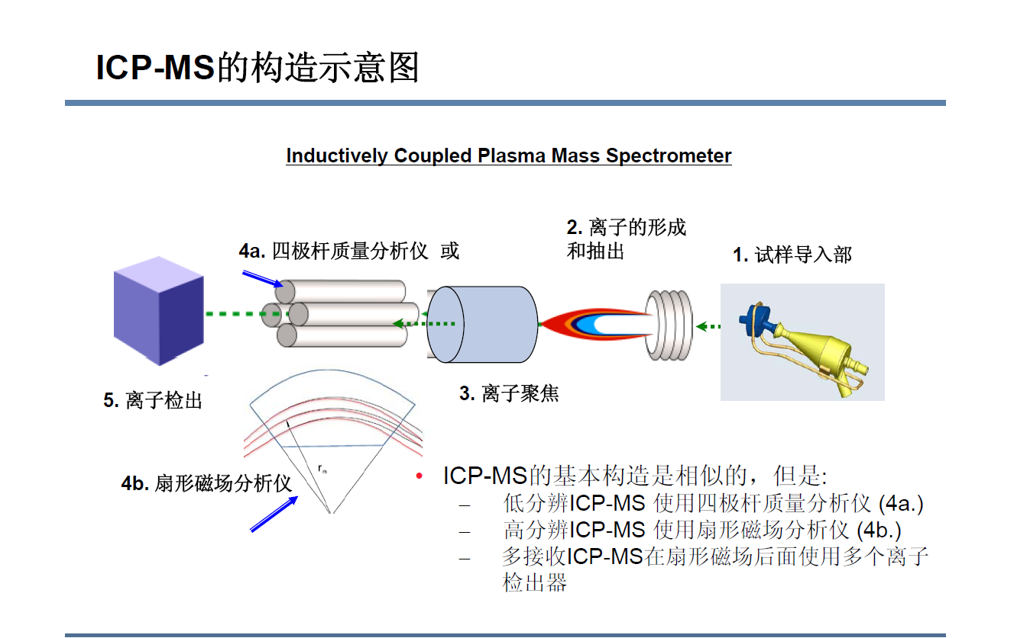
ICP-MS简介

Slide 29
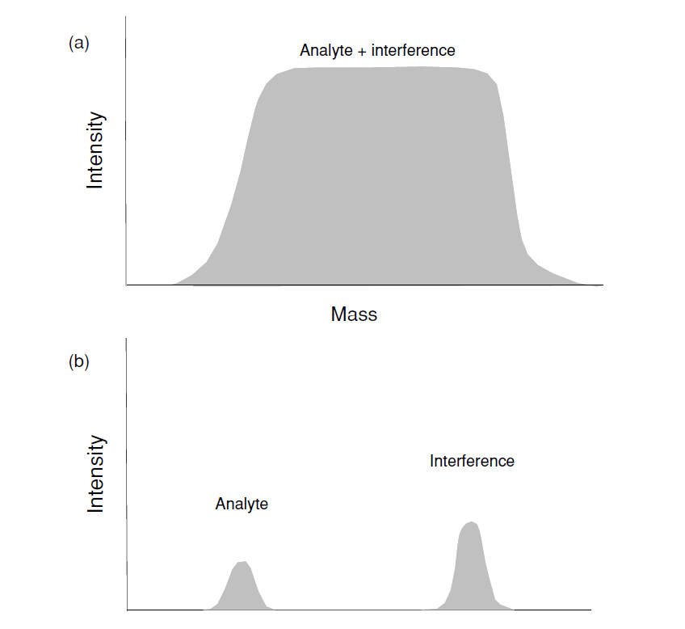
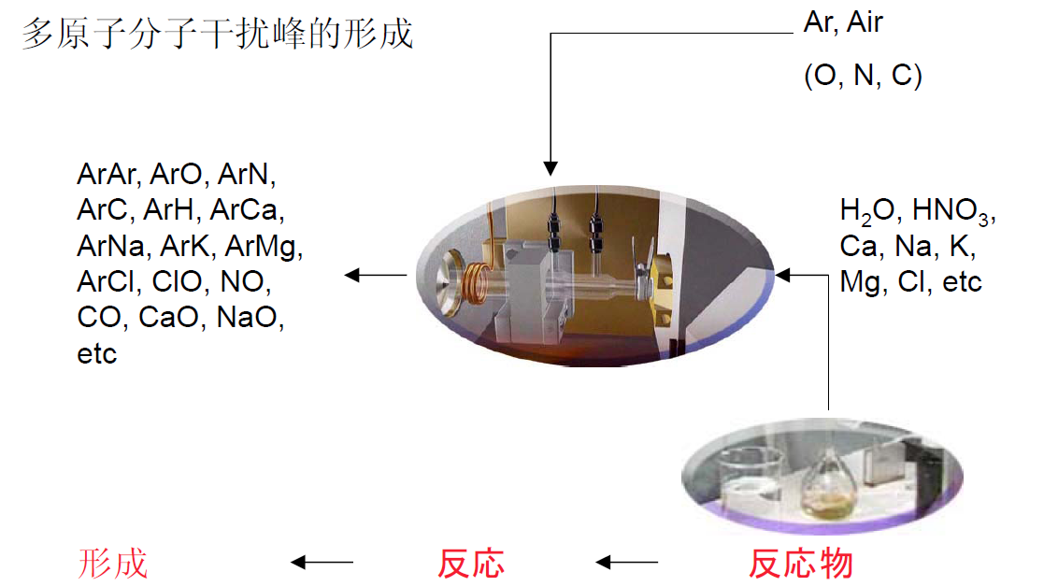
HR-ICP-MS优点
克服多原子分子干扰峰

Slide 30
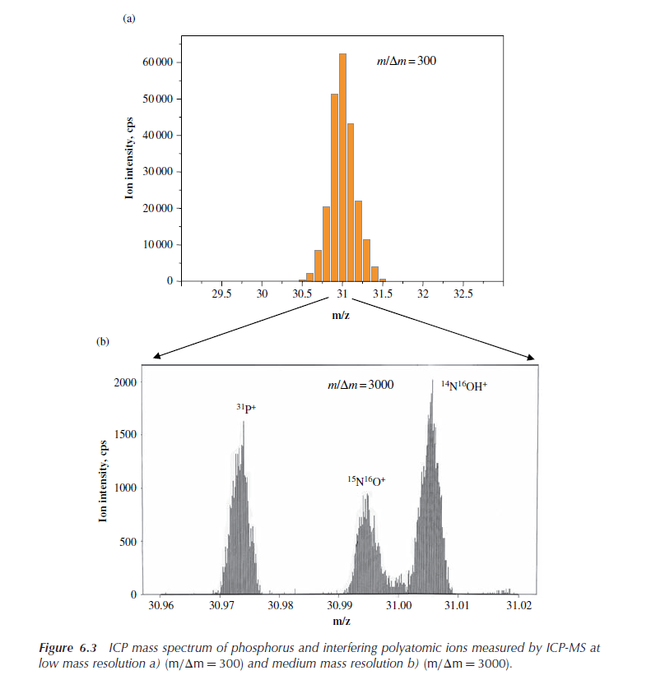
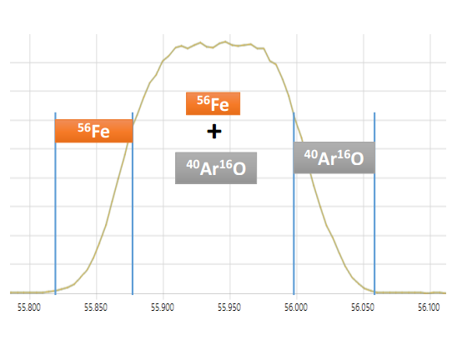
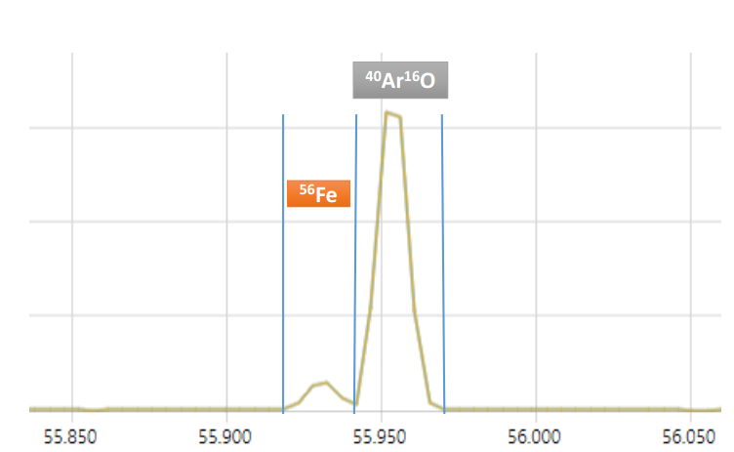
¹⁴N¹⁶OH、¹⁵N¹⁶O对³¹P的干扰和⁴⁰Ar¹⁶O对⁵⁶Fe的干扰

Slide 31
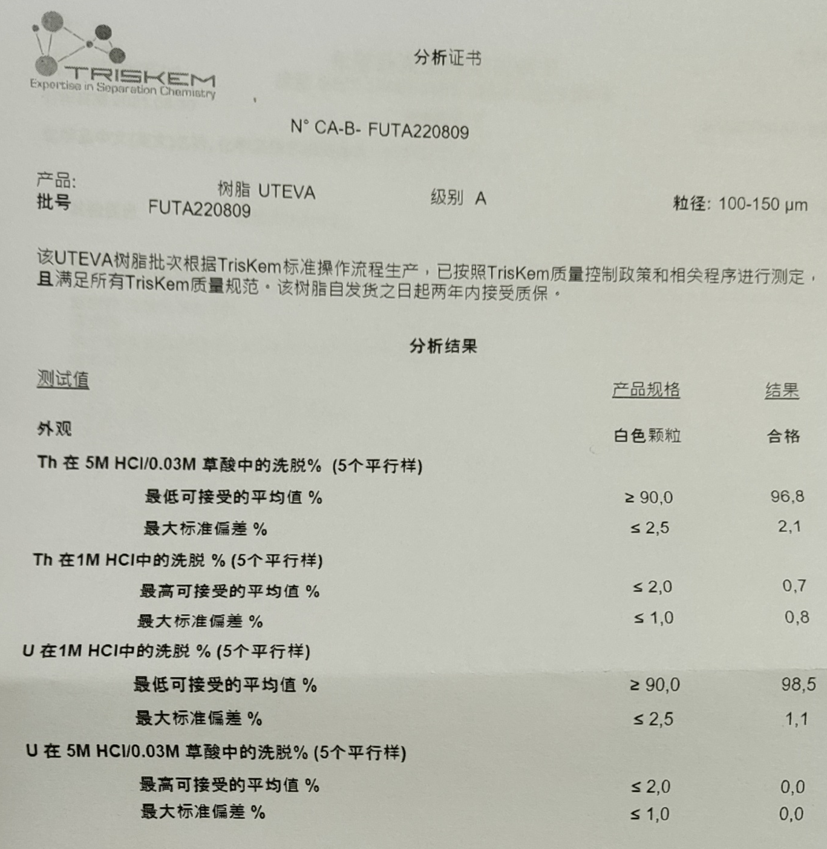
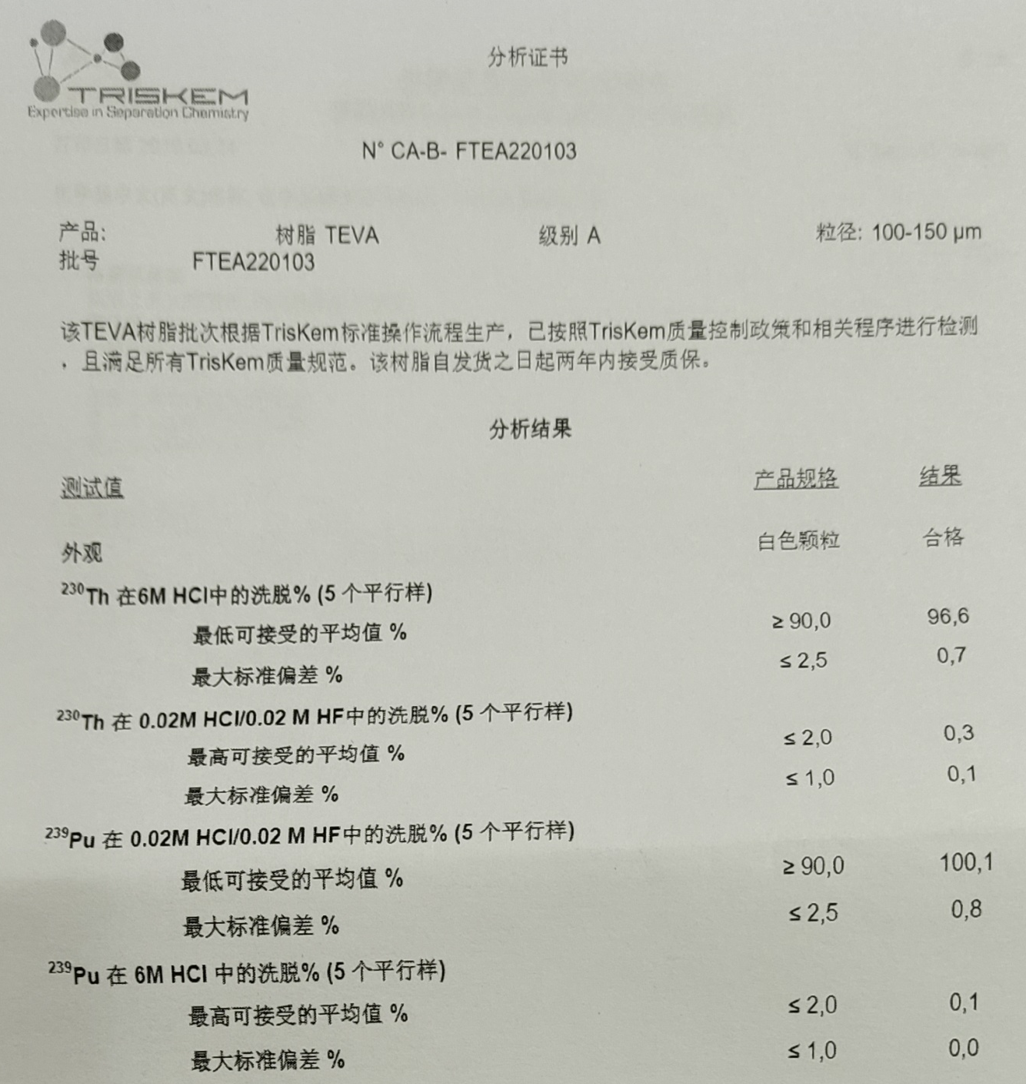
Th U分离富集

