Slide 1
Data Process & Noise Subtraction
谢芳

Slide 2
Data Process Work Flow
DAQ
Convert Data Format
Derivative Trigger
Noise Subtraction Module
Pulse Shape Cut
Optimal Filter
Extract Amplitude
Spectrum,
etc.

Slide 3
Derivative Trigger (DT)
Set DT flag, record the event within 10s window
Continues Derivative > 0
Threshold > 3 times RMS
Baseline slope projected to X-axis
Use 3s before trigger to calculate baseline RMS.

Slide 4
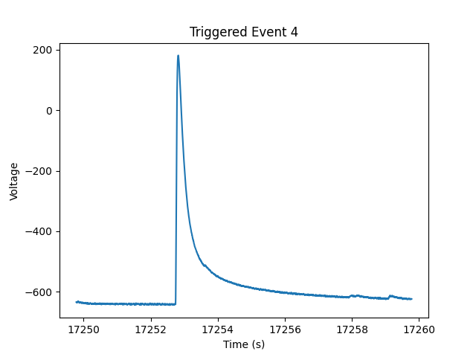
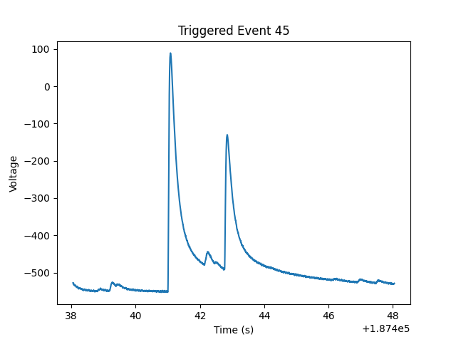
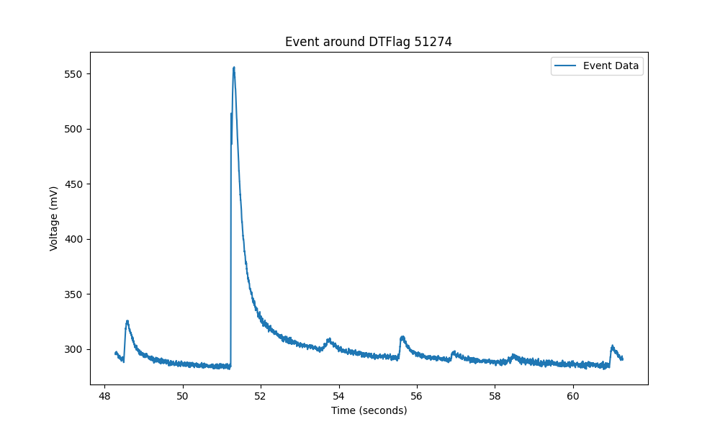
Triggered Examples

Slide 5
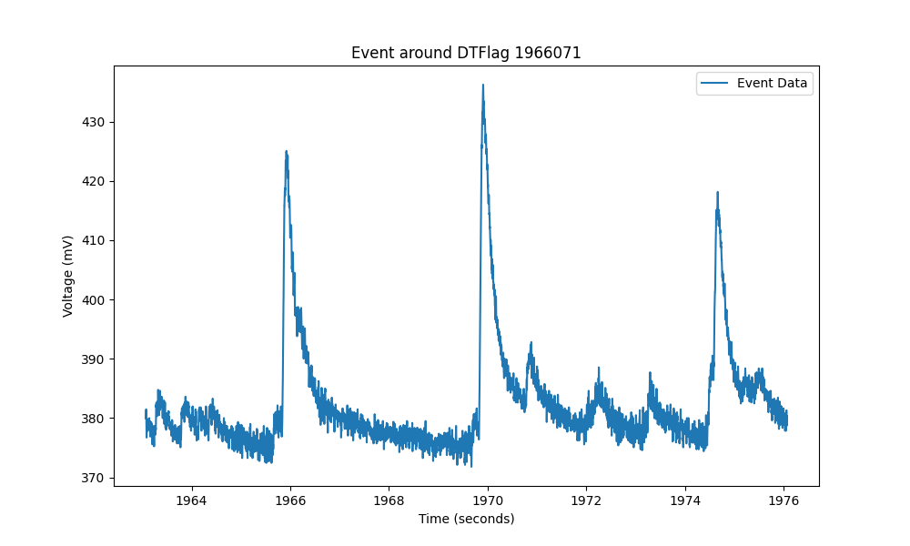
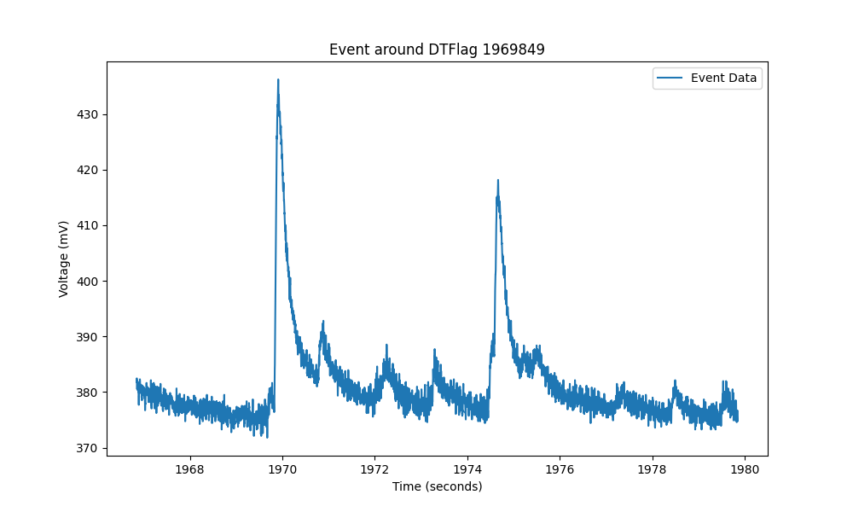
Triggered Examples
Trigger algorithm developed using python3
Project to the X-axis and calculate baseline RMS

Slide 6
Noise Subtraction Principle
Δt=0
Δt=t’
reference
Δt=t_{best}
shift baseline
C++ based algorithm developed by Shihong Fu
re-written as plug-in module based on python3 by Fang

Slide 7
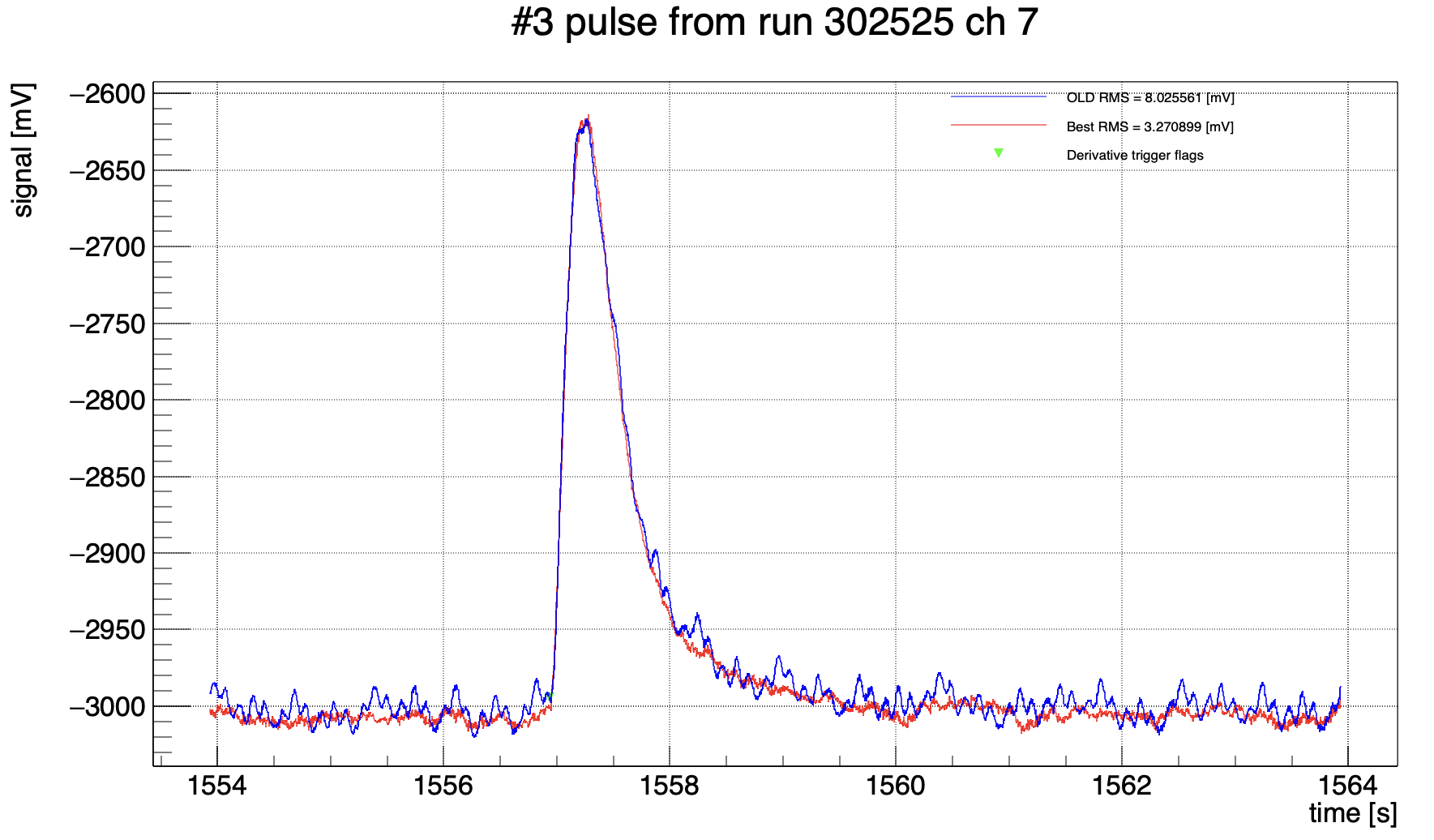
Noise Subtraction
An example implemented on CUORE data
V′ (t₀) = V(t₀) − V(t₀ − Δt)
Unfortunately, due to high background event frequency and less stable baseline during the test runs at USTC and Fudan, it is hard to implement this method at the moment.

Slide 8
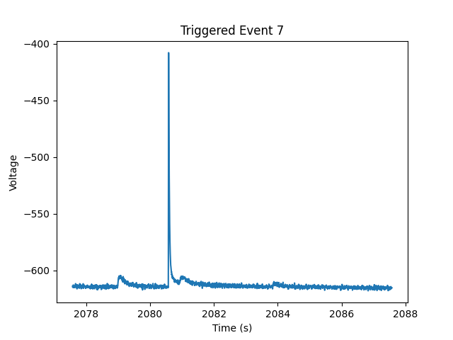
Pulse Shape Cut
preliminary scheme: cut on the pulse width
Consider to add more precise parameters: raise time, decay time, etc

Slide 9
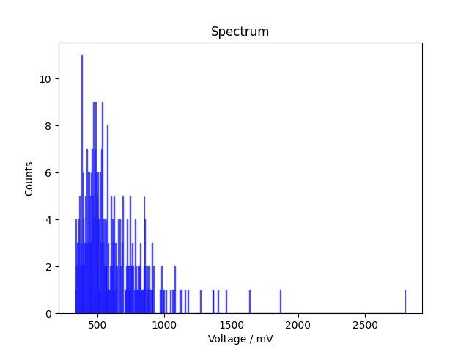
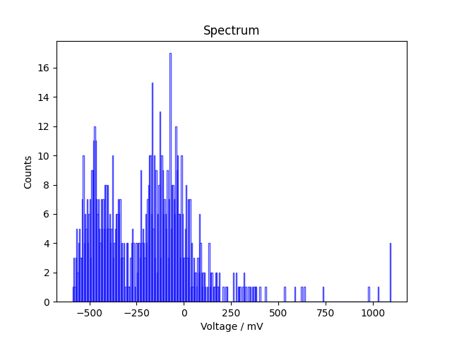
Obtain the Spectrum
Data from USTC LMO test run13 with water shielding,
sample rate 0.001s, ~4 day run each, with & without ²²Na
Preliminary result
Preliminary result
Without calibration source ²²Na
With calibration source ²²Na
Need to understand the the second major peak, it is too wide.

Slide 10
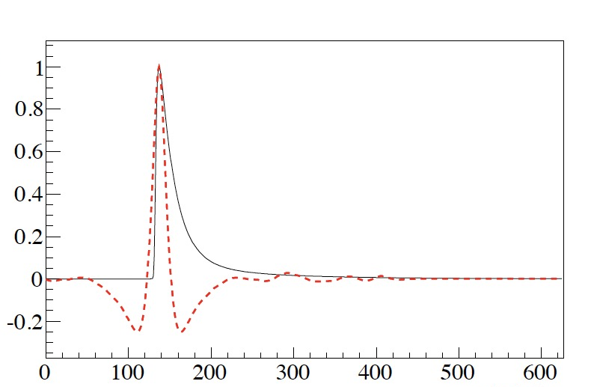
To Do: Optional Modules & Denoise
Upgrade the pulse cut
Optimal Filter Module
Re-trigger Module: optimize the trigger algorithm. For example, for the baseline slope, do liner fit to find the $\text{χ}\text{²}$
kx+b

