Slide 1
012-文献讨论会
---A portable and monoenergetic 24 keV neutron
source based on ¹²⁴Sb-⁹Be photoneutrons and an
iron filter（2023 JINST 18 P07018）
陈昊

Slide 2
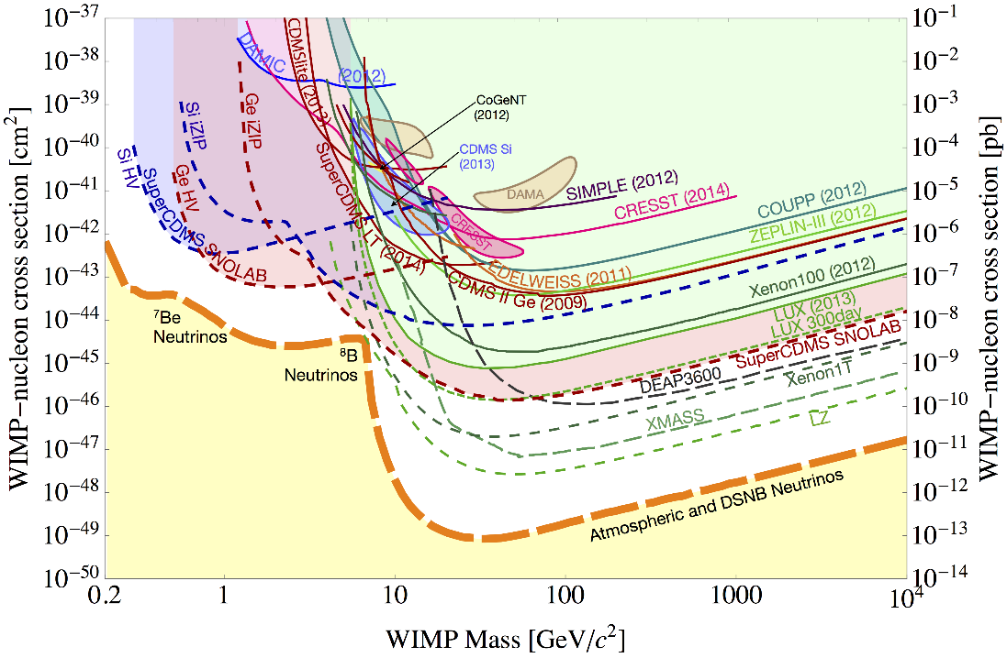
研究背景和意义
CUPID pre-CDR: “A low energy threshold and a large mass are the most appealing features for experiments hoping to observe these effects. With the possibility of separating nuclear recoils (characterized by a lower light yield) from the dominant electron-based background, CUPID’s technology is particularly well-suited for searches of this kind.”
Opportunity!
探测器在低能区的响应需要低能中子源

Slide 3
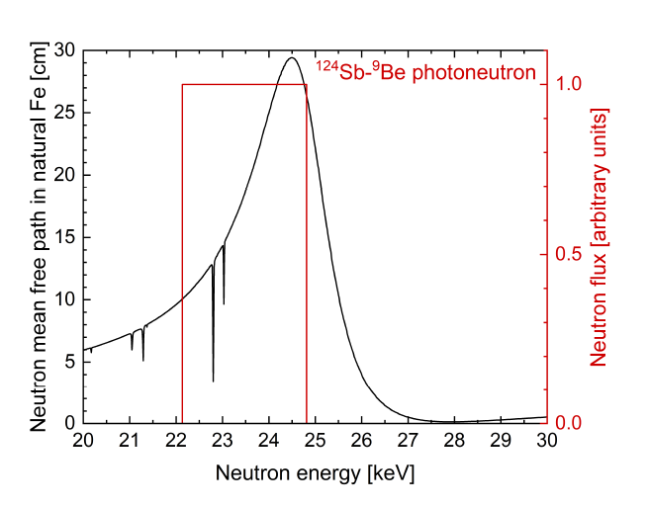
几种中子源
单能源是更好的刻度源！
可移动
高rate
低本底 （gamma)
单能：
DD：~2.5 MeV
D-reflector: ~272 keV low flux
D-T: 14.1 MeV
加速器打靶：可调，不可移动
iron filter→ 24 keV
photo-neutron: ⁸⁸Y-⁹Be (154 keV)
¹²⁴Se-⁹Be (24 keV)
连续能量：
AmLi: 0.5 MeV (能谱峰值）
AmBe: 4 MeV (能谱峰值）
²⁵²Cf: 2 MeV (能谱峰值）

Slide 4
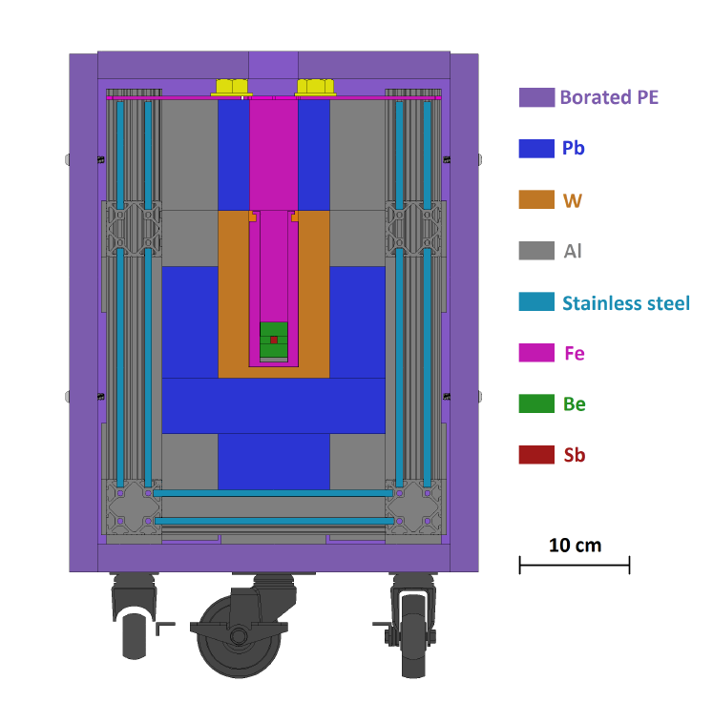
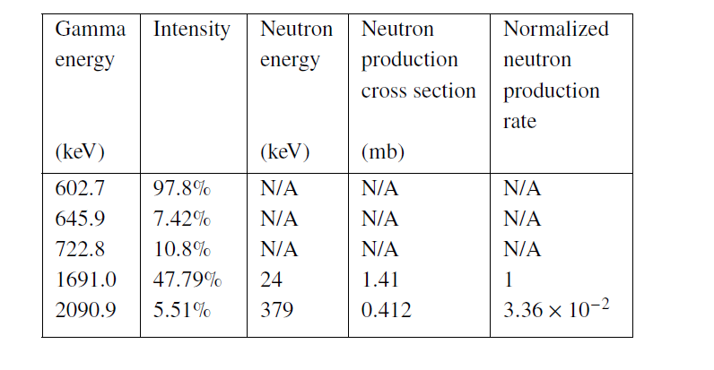
Setup
中子
The gamma energy threshold for photoneutron production in ⁹Be is
1666 keV
One 24keV neutron per 10000 ¹²⁴Se decay

Slide 5
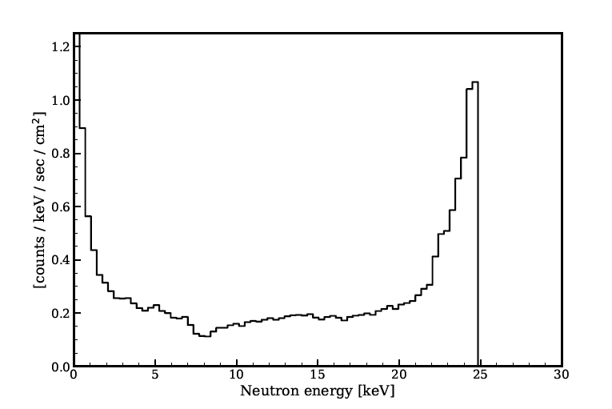
模拟结果

Slide 6
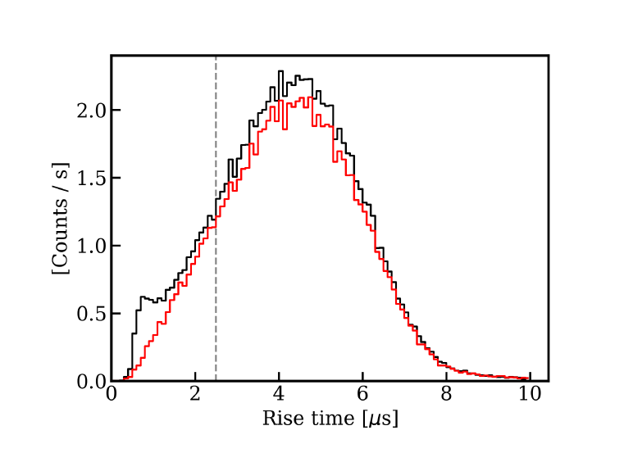
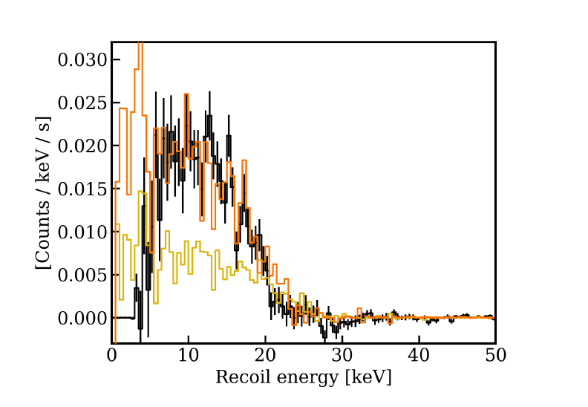
测试
中子测量：hydrogen gas proportional counter (HGPC)
Background subtracted neutron energy
data vs simulation
用pulse shape鉴别中子和gamma

Slide 7
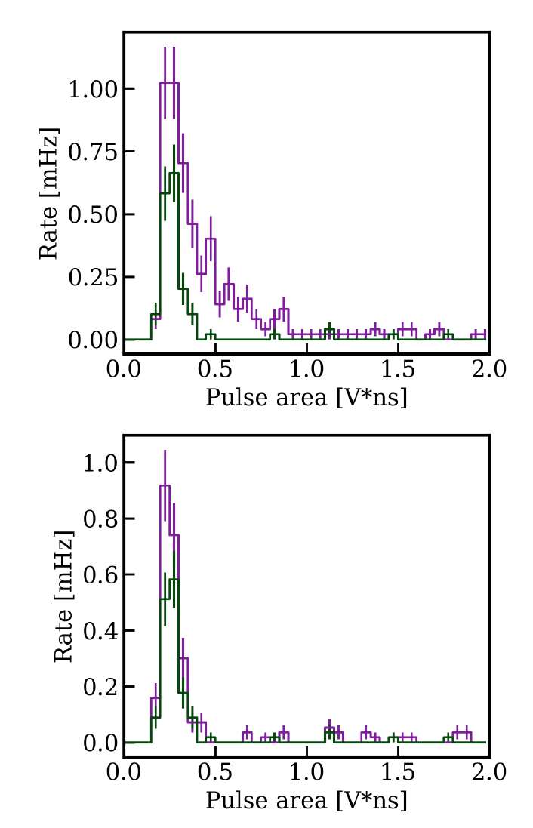
Neutron tagging 液闪
theta

